Slide 1
HL7 Gender Harmony project
Representing sex and gender identity in clinical models
Rob McClure (he, him)
Project Lead, Vocabulary Co-chair
October 2021
Rob Horn (he, him)
SME, DICOM rep
October 2021

Slide 2
Background
Vocabulary Working Group Project begun Spring 2019
Informative HL7 Specification (Jan 2021) Ballot, Published Aug 201
Describes logical model for sex and gender data representation
Weekly (Monday 4p ET) web calls and HL7 Confluence content site (http://hl7.me/GHP)
Good participation from external SDO (DICOM, IEEE, some NCPDP), US gov, Canadian, Australian, LGBTQ+, EHR (Epic, Allscripts), AMA, ACP
JAMIA publication. Early open-access but look for corrigendum
The time has come! (EG: USPSTF Approach to Addressing Sex and Gender When Making Recommendations for Clinical Preventive Services. JAMA. Oct 25, 2021. doi:10.1001/jama.2021.15731

Slide 3
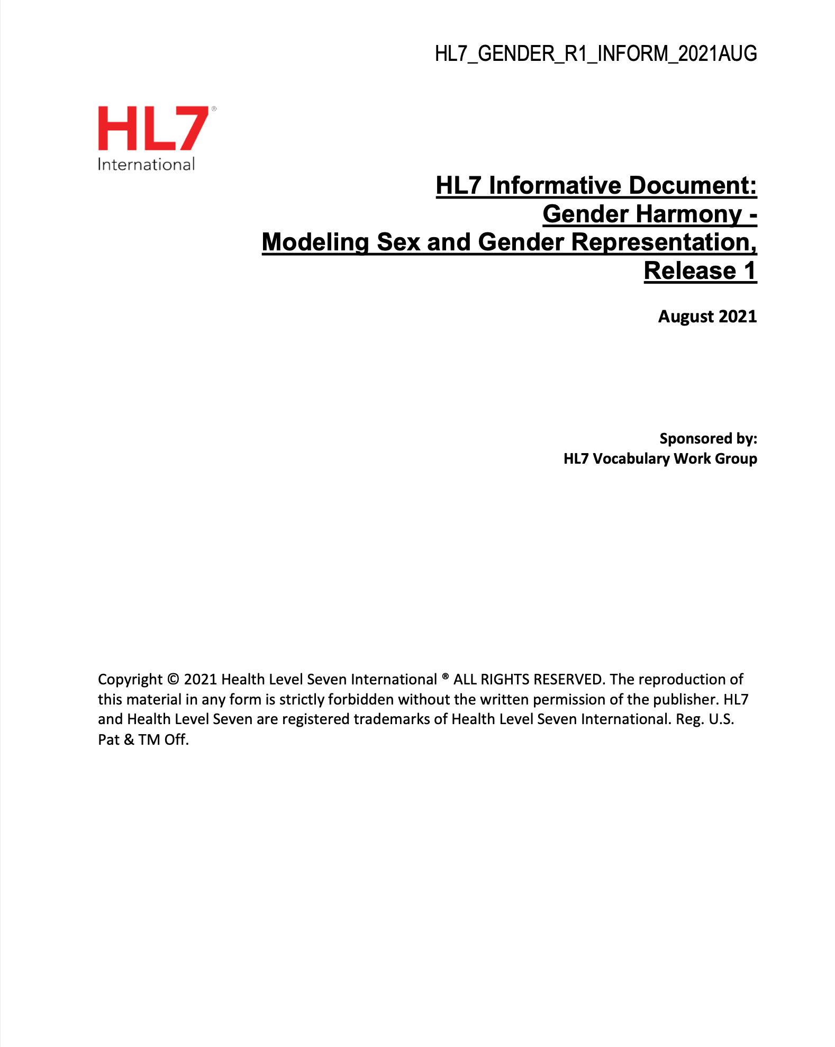
Contents
Background
Current State overview
Impact on clinical care
Sex and Gender in:
Quality measurement
Reporting in Payment for Care
Data Analysis
Model
Implementation Guidance
Appendices

Slide 4
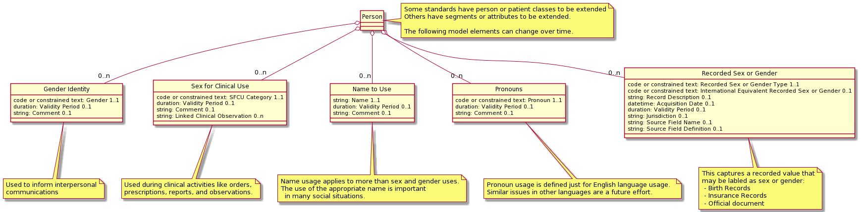
Gender Harmony
Logical Model
This is an abstract class model that each standard will need to map into the specific concrete classes used

Slide 5
GH Element Specifics
Gender Identity (GI)
Source:
Patient only
Is always Patient level datum
Use:
Appropriate clinical interactions
Not intended for clinical assessments or payment functions
May, or may not, be aligned with the proper value for a clinical, administrative or legal based decision
IE: this is not administrative, legal, or clinical
Sex For Clinical Use (SFCU)
Source:
Clinician
Clinical rules system
Clinical observations
Can be “Patient level datum” but often specific to a particular use
Use when patient physiology determines appropriate:
Tests, drugs, procedures
Reference ranges, methods, algorithms, pathways
Analysis and diagnostic methods
selecting and describing subjects for clinical trial and other research activities

Slide 6
GH Element Specifics-2
Recorded Sex or Gender (RSG)
Sources:
Medical Records
Identity documents (e.g., passport)
Insurance and other administrative documents
Other relevant sources
Are Patient level data
Essentially tagging as not GI or SFCU
Uses:
Administrative Processes like ordering and billing
Understanding patient history
Legal and regulatory requirements (e.g., insurance cards)
Patient identity determination (e.g., passport information)
Sex assigned at birth is an RSG

Slide 7
GH Element Specifics-3
Name to Use (NtU)
Source:
Patient
Is always Patient level datum
Use:
All clinical interactions
Establish therapeutic relationship
Use in reports, instructions, guidance, etc.
If “legal” name needed, send NtU in addition
Pronouns
Source:
Patient
Is always Patient level datum
Use:
Where appropriate in clinical interactions
Establish therapeutic relationship
Use in reports, instructions, guidance, etc.

Slide 8
Proposed Minimum Value Sets
Gender Identity
Sex for Clinical Use (SFCU)
Term | Definition
Female | A person's self-identification as a woman, as female, or as a girl.
Male | A person's self-identification as a man, as male, or as a boy.
Nonbinary | Having a specific identity which is nonbinary (not within a binary construct of male or female) or having an identity which falls under the nonbinary umbrella (i.e., any or all gender identities which are not female or male).
Unknown | The person’s gender identity is not known at this time, for any of a variety of reasons. (e.g., “was not able to ask” or “person does not want to answer”.)
Term | Definition
Female SFCU | The “female” values apply to this patient, in the case of a given procedure or process in a given context, for instance for a procedure, algorithm, hormone level, organ inventory, etc.
Male SFCU | The “male” values apply to this patient, in the case of a given procedure or process in a given context, for instance for a procedure, algorithm, hormone level, organ inventory, etc.
Specified SFCU | This patient has specific documented characteristics that do not fully match either male or female in a given context, for instance for a procedure, algorithm, hormone level, organ inventory, etc.
Unknown SFCU | The SFCU can not be determined because there are no observations or the observations are not sufficient to determine a value. For example, an emergency trauma case may require treatment before SFCU can be established.
Gender Identity should allow many other phrases but these are the minimum required that any other could be mapped to
SFCU should be Required binding. This is intended to be a categorization of the linked observations

Slide 9
Proposed Minimum Value Sets
Recorded Sex or Gender
Pronouns
Term | Definition
He, Him, His, Himself | English personal pronouns, typically associated with masculinity, that are requested by a person to be used by them.
She, Her, Hers, Herself | English personal pronouns, typically associated with femininity, that are requested by a person to be used by them.
They, Them, Their, Theirs, Themself | English personal pronouns, typically not associated with masculinity or femininity, that are requested by a person to be used by them.
Uses Other Pronouns | Person indicates that they use other pronouns than he/him, she/her, or they/them pronouns.
Unknown Pronouns | Unknown; used in situations wherein no pronouns can be asked for (young children, infants, neonates, etc.).
Term | Definition
F | A value which corresponds to female (‘F’) has been recorded in some context.
M | A value which corresponds to male (‘M’) has been recorded in some context.
X | A value which corresponds to ‘X’ (nonbinary, intersex, etc.) has been recorded or the value is unspecified.
< | A value has not been recorded or a value cannot be ascertained for any reason.
This value set is intended to be an “International Equivalent,” that is based on the set noted in Doc 9303: Machine Readable Travel Documents, Seventh Edition (2015), Part 7: Machine Readable Visas published by the International Civil Aviation Organization (ICAO)
Based on LOINC answer list for Personal Pronouns - Reported, LL5144-2 Personal pronouns / Answers: 10; Scale: Nom; Code: -; Score: -.

Slide 10
FHIR, V2.?, CDA/C-CDA Enhancements
Changes need to be aligned
We are currently working on Phase 2 of this project
Crafting specific changes in each HL7 product to clarify how to represent the 5 elements
Also working with DICOM, ISO, NCPDP
Plan to publish a “cross-paradigm” FHIR IG ballot (please review!) in May 2022 that identifies changes for each product.
V2 DRAFT example:
PID-8 will be unchanged but is not any of these elements
GI – either:
PD1 new field
Guidance on use of OBX
Entirely new segment for all GH (and SO?)
SFCU
Patient level same as GI?
OBX for others

Slide 11
We need your help!
Join us http://hl7.me/GHP Mondays 4-5:30p ET
We need person-power to create the IG
Bring use cases to demonstrate common use across all standards protocols

