Slide 1
Public Health Surveillance Community
April 3rd, 2025
Myriam Talantikit
Specialist, Standards
Notes:
The logo can be changed in the master slides. Please use the following instructions
Select view > slide master.
Right click on the logo and select change picture.
Select the image you want to use. You may need to scale the image accordingly
When you're done, select close master view.

Slide 2
Agenda
Welcome and Introduction
Picklists Updates
Antigen and Immunoglobulin subsets content modification
Subsets Merging
Questions and wrap up
Notes:
The logo can be changed in the master slides. Please use the following instructions
Select view > slide master.
Right click on the logo and select change picture.
Select the image you want to use you may need to scale the image accordingly
When you're done, select close master view.

Slide 3
2. Picklists updates

Slide 4
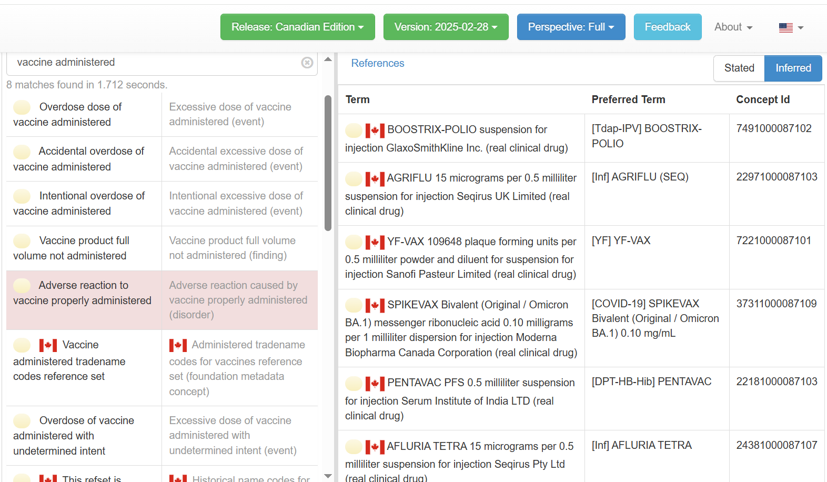
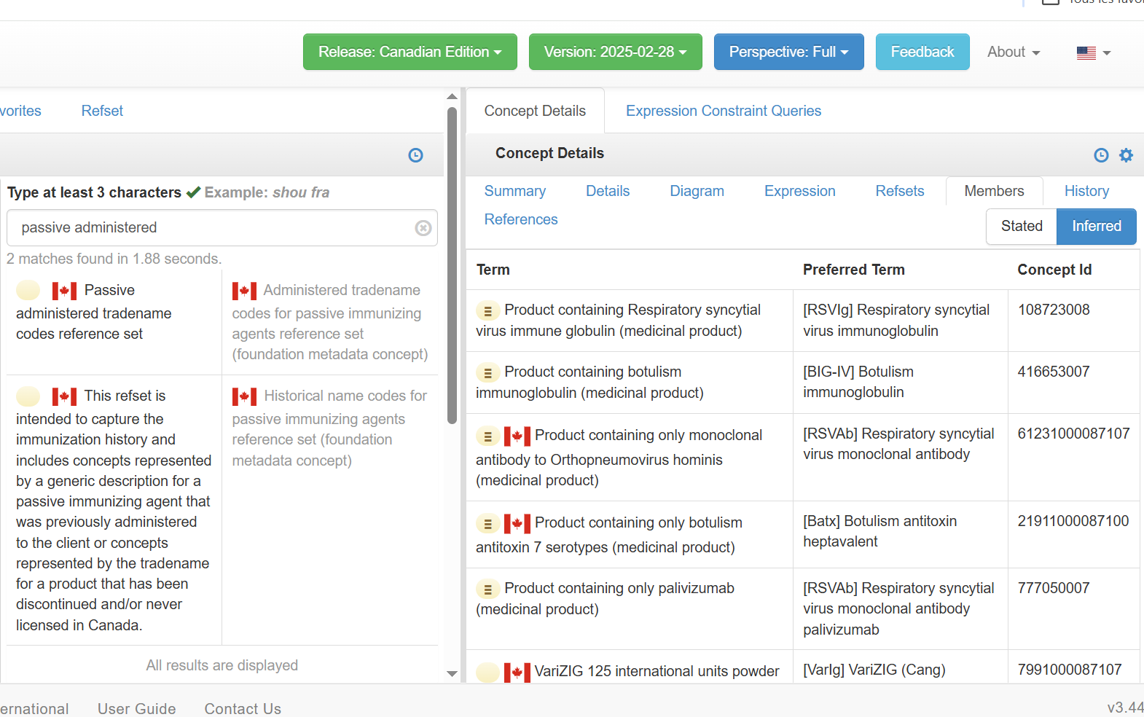
Clinician Picklists
Integrated into the February Release
Picklists Editorial guideline
As concepts’ PT

Slide 5
Patients Friendly Picklists
Will be integrated into the May Release
Publication format
Language reference set
Displayed as the current Canada English Language Reference Set and Canada French Language Reference Set
Two new Language reference Sets
Canada English Patients Picklist Language Reference Set
Canada French Patients Picklist Language Reference Set

Slide 6
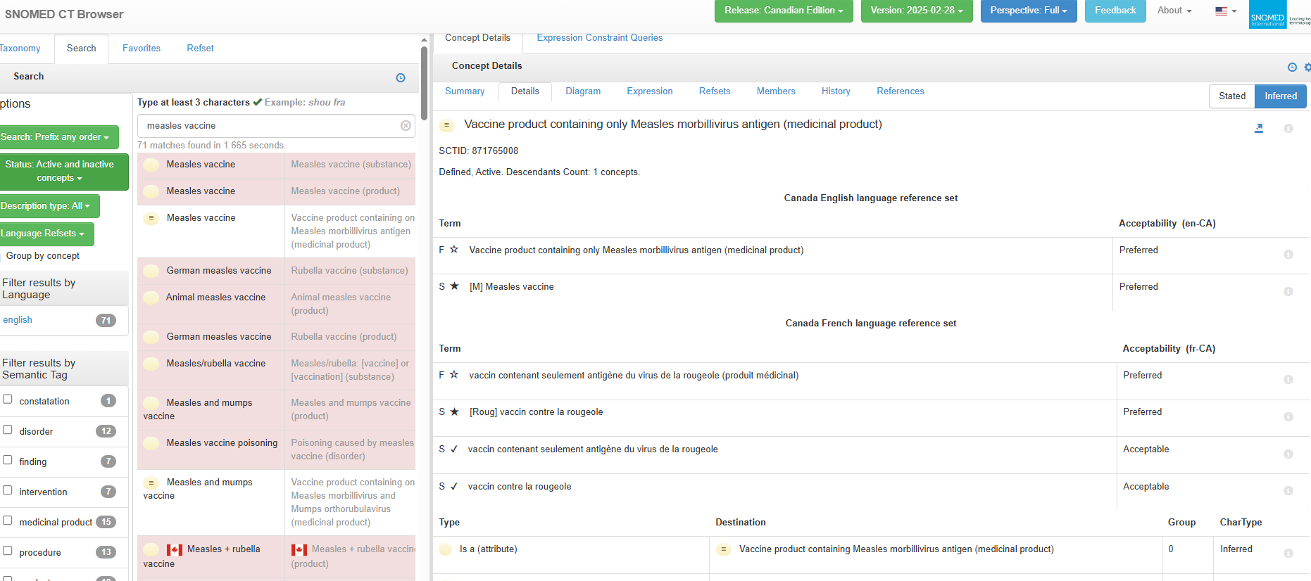
Patients Friendly Picklists
Notes:
You will be able to see the acceptable preferred term for the Patients-Friendly Picklists

Slide 7
Patients Friendly Picklists
Next step
Create RFCs for the two new language reference sets
Create RFCs for all Patients-Friendly terms

Slide 8
3. Antigen subset and Immunoglobulin subset content modification

Slide 9
AntigenCode susbset Current scope
The scope of this subset is antigens contained within the vaccines (based on VaccineHistoricalNameCode subset) that may be administered to or have been received by a patient. In some cases, more than one antigen per disease or pathogen may be included when the sub-type, serotype or formulation (adjuvant) is relevant (e.g. pneumococcal conjugate and pneumococcal polysaccharide). This is to facilitate population of a comprehensive immunization history, forecasting and inventory management.

Slide 10
NVC requirements
For mapping purposes (antigen → disease)
antigens in the NVC are mapped to diseases.
The P/Ts require an agent-to-antigen-to-disease mapping for their immunization registry forecaster tool. If an antigen is missing, a disease cannot be assigned.
Notes:
The logo can be changed in the master slides. Please use the following instructions
Select view > slide master.
Right click on the logo and select change picture.
Select the image you want to use you may need to scale the image accordingly
When you're done, select close master view.

Slide 11
Use case
Varicella and Shingles (zoster) diseases are caused by the same virus
Varicellovirus humanalpha3 (current scientific name)
Human alphaherpesvirus 3, varicella-zoster virus (alternative names)
Vaccines authorized for varicella disease prevention
VARILRIX, VARIVAX, and the MMR-Var vaccines.
These vaccines contain Antigen of live attenuated Varicellovirus humanalpha3
Vaccines authorized for shingles (zoster) disease prevention
ZOSTAVAX and SHINGRIX.
ZOSTAVAX contains Antigen of live attenuated Varicellovirus humanalpha3
SHINGRIX contains Antigen Varicellovirus humanalpha3 recombinant surface glycoprotein E

Slide 12
Use case
Panorama (for vaccine evaluation and forecasting) required:
A code for Varilrix or Varivax
A code for Zostavax or Shingrix
A code for MMR vaccines
This requirement cannot be achieved using the active ingredient substance(s). The proposal was to retire the antigen substances from the Ag subset and replace them with generic vaccine codes:
28441000087100 |Vaccine product containing only Human alphaherpesvirus 3 antigen for varicella prevention (medicinal product)|
28451000087102 |Vaccine product containing only Human alphaherpesvirus 3 antigen for herpes zoster prevention (medicinal product)|

Slide 13
NVC requirements
In order to answer the request, we had to re-integrate
260214004 |Antigen of Varicellovirus humanalpha3 (substance)|. This is the active ingredient of generic vaccines 871908002, 28441000087100, 28451000087102)
561000221108 |Antigen of live attenuated Varicellovirus humanalpha3 (substance)|
23021000087106 |Antigen of Varicellovirus humanalpha3 recombinant surface glycoprotein E (substance)|
What is necessary for your needs?
Is it only for forecasting? Or will it be used for other purposes?
Who will be using this subset?
Notes:
The logo can be changed in the master slides. Please use the following instructions
Select view > slide master.
Right click on the logo and select change picture.
Select the image you want to use you may need to scale the image accordingly
When you're done, select close master view.

Slide 14
Notes
No need for new subset
Requirements for mapping
Missing
Unique antigen
Notes:
The logo can be changed in the master slides. Please use the following instructions
Select view > slide master.
Right click on the logo and select change picture.
Select the image you want to use you may need to scale the image accordingly
When you're done, select close master view.

Slide 15
4. Subsets merging

Slide 16
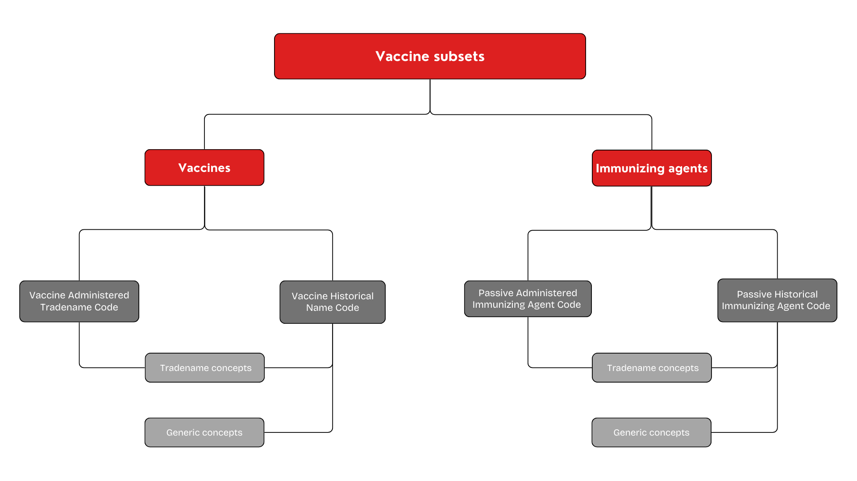
Current subsets representation

Slide 17
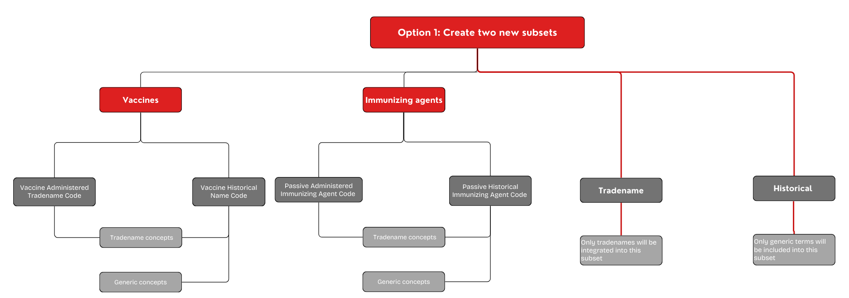
Option 1: Create two new subsets
Notes:
PROS:
Combined content as CVC had in their solution
All tradename immunizing agents would stay in the Tradename subset
CONS:
- Increased number of subsets: The current individual subsets and the new ones will need to be maintained concurrently
- Diffrrentiation of the active from the passive agents difficult (although this may be done by the immunizing agents abbreviation)
May cause confusion for implementers as to which subsets need to be implemented

Slide 18
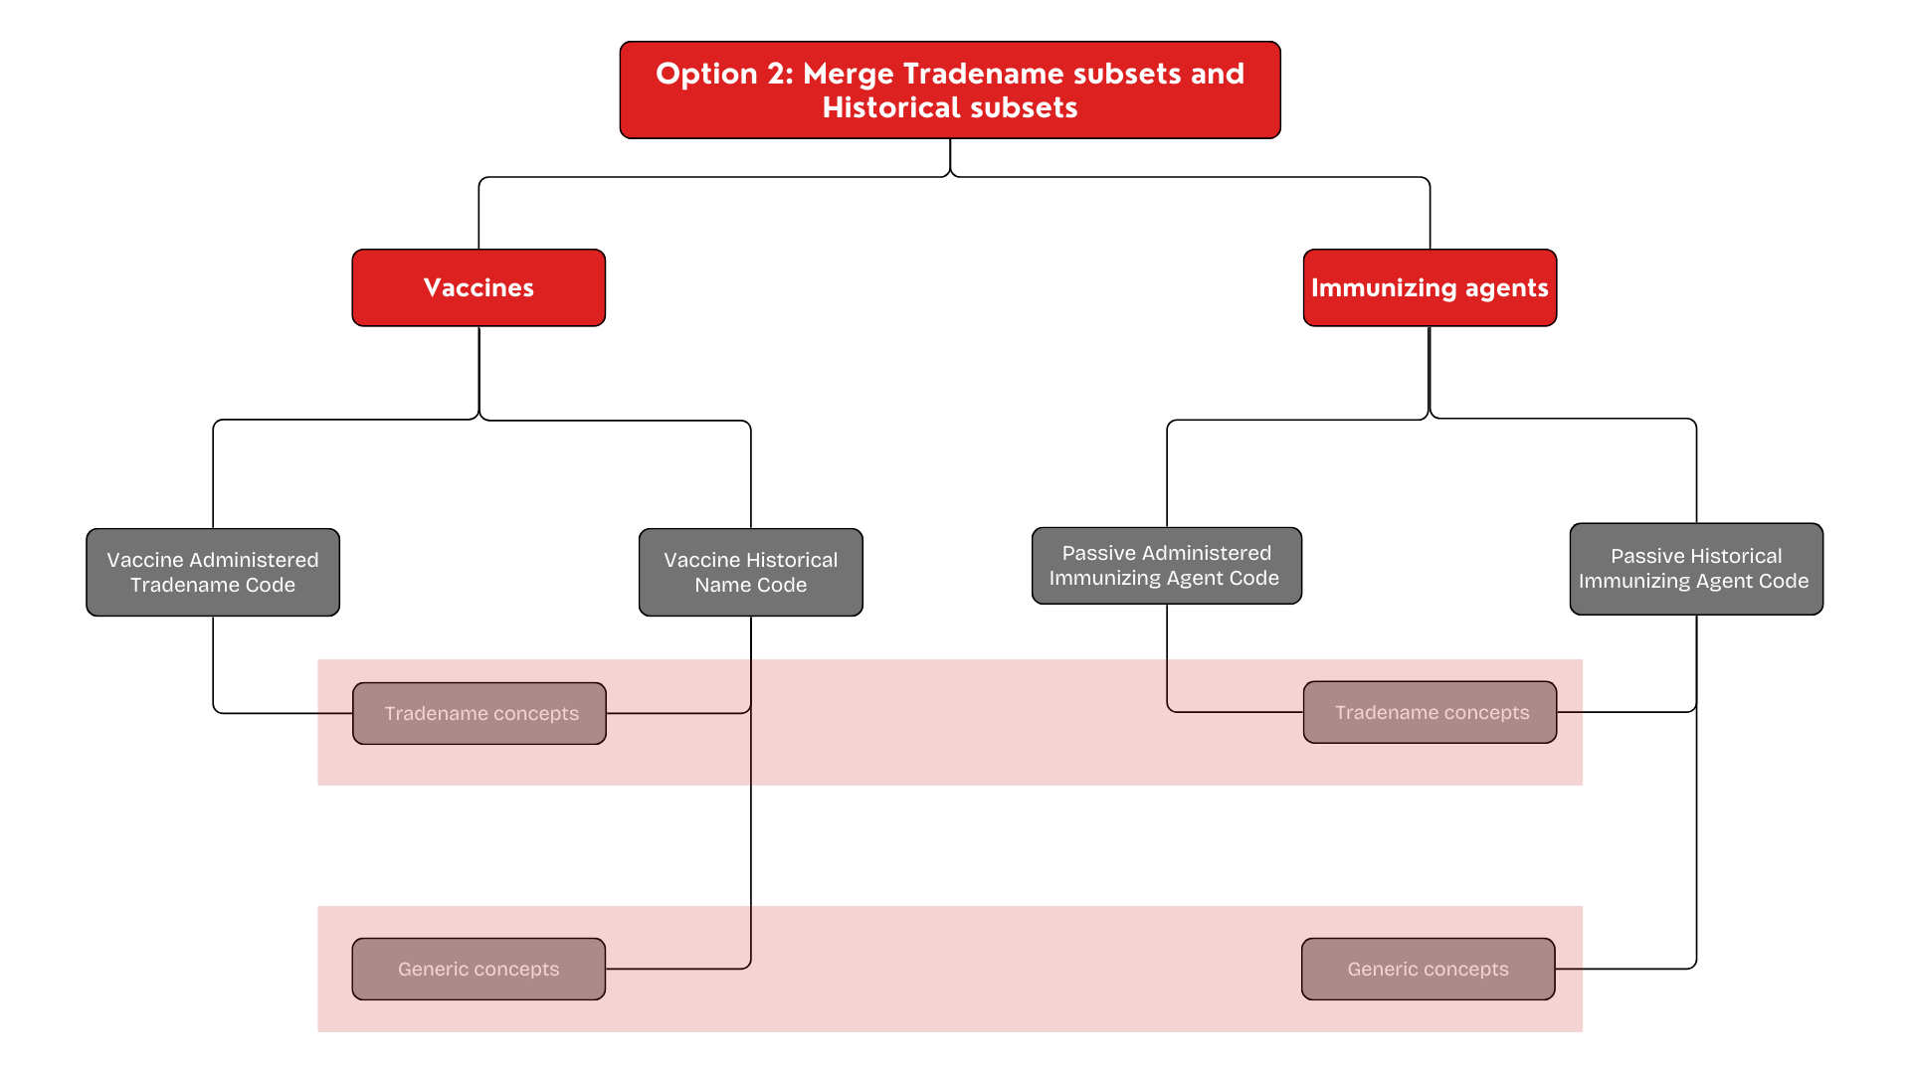
Option 2: Merge current subsets
Notes:
PROS:
- Combined content as CVC had in their solution
- All tradename immunizing agents would stay in the Tradename subset
- Decrease the number of subsets to maintain (two instead of four)
CONS:
- Differentiation of the active from the passive agents difficult (although this may be done by the immunizing agents abbreviation)
- Change in subsets scope and membership may cause confusion for the implementers

Slide 19
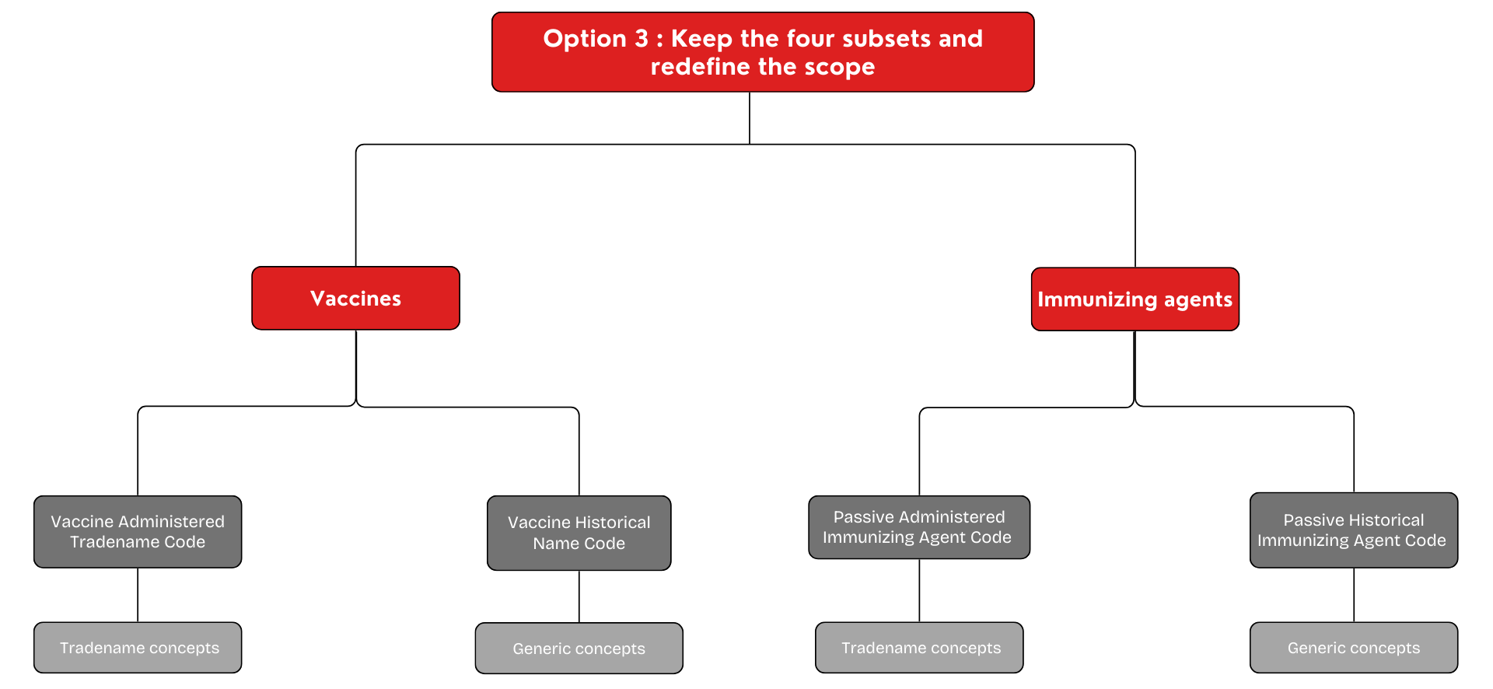
Option 3: Keep current subsets and redefine scope
Notes:
PROS:
- No issue to differentiate the active from the passive
- All tradename immunizing agents would stay in the Tradename subsets
- No additional maintenance burden for anyone
CONS:
- Not combined as CVC had them in their solution, but NVC can join them in the online tool
- Change in subsets scope and membership may cause confusion for the implementers

Slide 20
Infoway recommendation
Option 2
What are your needs? What is your opinion on that matter?
Notes: NVC: Option 3 preferred – opinion gathered during EUDP
Align with CVC has in their solution
Allow the differentiation passive from active
Option 2 would require changing things significantly

Slide 21
6. Questions/Wrap up
Next meeting Thursday, May 1, 2024, 2:00-3:00 pm ET

Slide 22
Thank you!
Contact Information
standards@infoway-inforoute.ca

