Slide 1




Michael Smith Foundation for Health Research (MSFHR)
REACH Grant Knowledge Translation Topics: Review of Gender, Sex and Sexual Orientation (GSSO)
In Digital Health Systems – Part 2
Aug 10, 2021
Karen Courtney, Francis Lau, Aaron Devor, Marcy Antonio, Kelly Davison, Roz Queen
University of Victoria
Jody Jollimore, Michael Kwag, Anu Radha Verma
Community-Based Research Centre
Canada Health Infoway, Canadian Institute for Health Information, Canadian Health Information Management Association

Slide 2
… acknowledge with respect the Lekwungen-speaking peoples on whose traditional territories the University of Victoria stands; the Songhees, Esquimalt and the W_SÁNEC (“w’Saanich”) peoples, whose historical relationship with the land continues to this day
… each of you will join me and acknowledge the privilege we have of coming together in the spirit of respectful dialogue from the traditional territories of indigenous peoples from across this land known as Canada

Slide 3
Agenda
Meeting Schedule
GSSO Action Plan
Digital Health Systems
Implications
Next Steps

Slide 4
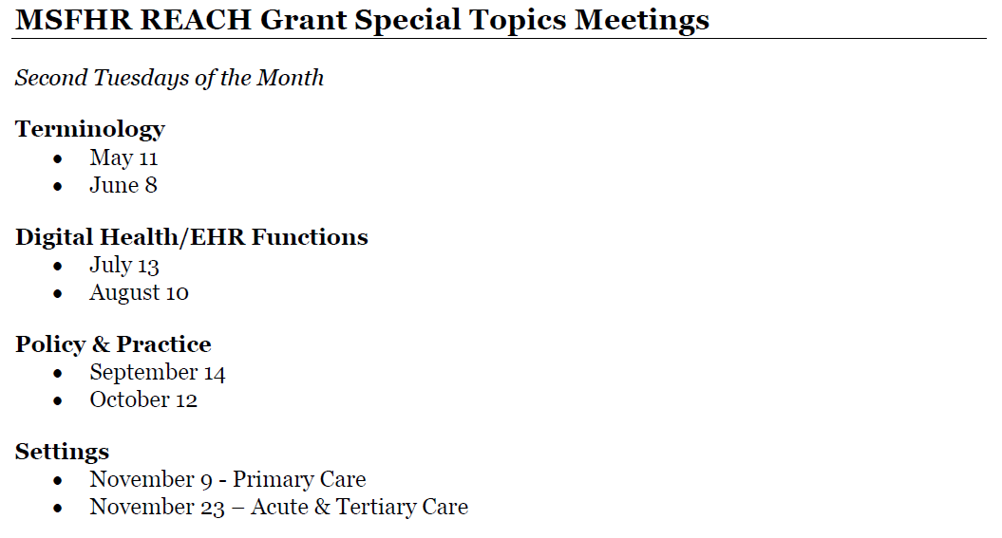
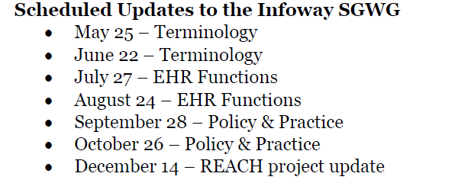
1. Meeting Schedule
Second Tuesdays of the Month
Fourth Tuesdays of the Month

Slide 5
2. GSSO Action Plan
Envisage an equity- and SGM-oriented health system vision and goal
Engage and partner with organizations and communities to modernize GSSO information practices to meet SGM needs
Establish GSSO terminology for patient care, health system use and research
Enable EHRs +digital health to collect, use, exchange and reuse standardized GSSO data
Integrate and tailor GSSO data collection with organizational structures, policies, use cases and workflow processes
Educate & train staff to provide culturally competent and safe care, and educate patients to understand need
Establish a central hub to coordinate this action plan over time and continue national conversation as next step
This plan focuses on what actions are needed, with details on who, how and when to be discussed and established later

Slide 6
3. Digital Health Systems
Action-4: Enable EHRs +digital health to collect, use, exchange and reuse standardized GSSO data
Databases – dictionary, codes, mapping, quality, access, usage
Interfaces – input forms, searches, displays, help
Outputs – lists, reports, letters, labels, wrist bands
Security/Privacy – access, masking, help, exchange, audit
Decision support
Analytics
IT support
What are the specific implementation issues for YOUR organization to incorporate GSSO into your digital health systems?

Slide 7
3. Digital Health Systems
Databases – dictionary, codes, mapping, quality, access, usage
Interfaces – input forms, searches, displays, help
Outputs – lists, reports, letters, labels, wrist bands
Security/Privacy – access, masking, help, exchange, audit
Decision support – decision rules, data fields, evidence base, best practices
Rules – e.g. ID, labels, bed, flag, ref ranges, alerts, preventive care, documents?
Data fields- e.g. sex at birth, gender identity, sexual orientation, organ inventory, recorded sex/gender, name used, legal name, pronouns?
Evidence for rules - e.g. reference ranges, preventive care, alerts, blood donation?
Best practices – e.g. governance, accuracy, usage, audit logs?

Slide 8
3. Digital Health Systems
Databases – dictionary, codes, mapping, quality, access, usage
Interfaces – input forms, searches, displays, help
Outputs – lists, reports, letters, labels, wrist bands
Security/Privacy – access, masking, help, exchange, audit
Decision support - decision rules, data fields, evidence base, best practices
Analytics – coding categories, population health, text-mining
Categories- aggregation, e.g. nonbinary, man, woman, not disclosed, other gender?
Categories - derived, e.g. if sex at birth ≠ gender identity => transgender person?
Population health – indicators, metrics, access, quality, outcomes?
Text mining - free-text analysis to identify new terms, trends, misuse?

Slide 9
3. Digital Health Systems
Databases – dictionary, codes, mapping, quality, access, usage
Interfaces – input forms, searches, displays, help
Outputs – lists, reports, letters, labels, wrist bands
Security/Privacy – access, masking, help, exchange, audit
Decision support - decision rules, data fields, evidence base, best practices
Analytics - categories: aggregated & derived, population health, text-mining
IT support – system & terminology implementation, best practices
System – e.g. update, deployment & maintenance logistics & issues?
Terminology – e.g. update, deployment & maintenance logistics & issues?
Best practices - leading organizations, communities, vendors?
What other implementation issues should be considered?

Slide 10
4. Implications
Databases – dictionary, codes, mapping, quality, access, usage
Interfaces – input forms, searches, displays, help
Outputs – lists, reports, letters, labels, wrist bands
Security/Privacy – access, masking, help, audit
Decision support - decision rules, data fields, evidence base, best practices
Analytics - categories: aggregated & derived, population health, text-mining
IT support - system & terminology implementation, best practices
What are the implications for YOUR organization wishing to implement GSSO in your digital health systems?

Slide 11
Agenda
Meeting Schedule
GSSO Action Plan
Digital Health Systems
Implications
Next Steps

Slide 12
4. Next Steps
Second Tuesdays of the Month
Fourth Tuesdays of the Month
√
GSSO Practice/Research Presentations
Aug 24 – Tehmina Ahmad, University of Toronto: The Case for a Canadian Standard for 2SLGBTQIA+ Medical Education

Slide 13


