Slide 1

CA-Baseline
A Starting Point for Canadian FHIR Implementation Guides
Jurisdictional Working Group Endorsement Request

Slide 2
Who Are We?
FHIR Implementers Community
eReferral
InfoCentral Community
Community Streams
Canadian FHIR Baseline
SMART on FHIR CoP
~250 members to date
~100 distinct organizations from across the country
Representation across primarily Ontario, Alberta, Saskatchewan, British Columbia, Quebec, New Brunswick, Newfoundland, as well as Pan-Canadian groups

Slide 3
The Canadian FHIR Baseline Working Group
75+ Participants
40+ Organizations
Multi-jurisdictional Representation
Profiling Streams
Nova Scotia
Alberta
British Columbia
First Nations
Manitoba
Newfoundland
Ontario
Quebec
Pan-Canadian
International
Due Diligence Review Stream
Governance Stream
Clinical Organizations
Jurisdictional & Regional Organizations (Operational Level)
Strategic Federal Organizations
Solution Vendors
Standards Organizations
Health Systems

Slide 4









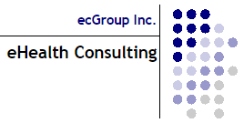

Who Participates?
Argentix Informatics

Slide 5
What are the Limitations of the FHIR Base Specification?
FHIR Base Specification = “building blocks”, whose defined data elements are expected to be encountered in 80% of systems around the world
FHIR Base Specification intentionally avoids region-specific code systems & business rules (based on policy)
Expects implementations to constrain and extend the building blocks to meet their specific needs
Each implementor builds an Implementation Guides (IG) that uses those blocks to meet their needs
Starting from base specification is like starting from scratch each time
Lack of alignment between IGs operating in same countries and domains
We all need customization, but we aren’t leveraging each other’s efforts
FHIR Base Specification
IG
IG
IG
IG
IG
IG
IG
IG
IG
IG
IG

Slide 6
What Are We Doing And Why?
Realm-specific guidance (i.e. Canadian Baseline)
Completed effort upfront to identify the basic constraints and extensions that any FHIR implementation operating in Canada can expect to include
Intended as a common starting point, not an out-of-the-box implementation
Convened Canadian implementers and Implementation Guide authors to develop initial draft over 18 month period
Due diligence reviews against existing Canadian FHIR Implementation Guides to ensure alignment and appropriate scope maintained
Ready for the larger community to review & use it (which helps us refine the content to support the breadth of use cases in the Canadian realm)
FHIR Base Specification
Canadian Realm
IG
IG
IG
IG
IG
IG
US
Realm
IG
IG
IG

Slide 7
What Are We Doing And Why?
HL7 FHIR
Canadian FHIR Baseline Profiles
Canadian FHIR Implementation Guide 1
Canadian FHIR Implementation Guide 2
Canadian FHIR Implementation Guide 3
Etc.
Canadian Baseline:
27 Profiles
(resources from the base specification constrained/extended for Canadian use)
Start Here
First step in reducing burdens on IGuide authors and unnecessary system customization across jurisdictions and healthcare domains

Slide 8
What is Our Vision Statement?
The vision for the Canadian FHIR Baseline initiative is a Canadian digital health landscape wherein all implementations of the FHIR standard share a common set of concepts & constraints. This ensures that fundamental health information concepts are defined and expressed consistently across use cases and jurisdictions, increasing data interoperability and making it quicker and more cost effective for FHIR solutions to be implemented.

Slide 9
Who Are We Targeting And Why?
Federal, Provincial, Territorial (Strategic Level)
Broadly incorporate published standards in the tools/solutions
Standards Organization
Define policy and fund initiatives to improve data quality, reporting, and interoperable exchange
Clinical Organizations
FHIR Community Affiliates
Support health systems in meeting requirements
Contribute expertise to the refinement of standard
Use and extend standards to write IGuides
Enforce and support (fund) the implementation of programs/tools that meet requirements
Jurisdictional and Regional (Operational Level)
Health Systems
Solution Vendors
Implement tools/changes that meet requirements for program
Utilize IGuides to inform specific changes/development of tools
FHIR iGuide Authors/SMEs
Define requirements that are operationalized through implementation guides
Canadian Health Information Standards Ecosystem

Slide 10
Benefits – What’s In It For You?
Solution Vendors
Federal, Provincial, Territorial (Strategic Level)
Jurisdictional and Regional (Operational Level)
Health Systems
Clinical Organizations
FHIR Community Affiliates
FHIR iGuide Authors / SMEs
Standards Organization
Incorporation of the Baseline into our Canadian Ecosystem results in the following benefits for jurisdictional stakeholders:
Business Lens
Technical Lens
Canadian
Health Information
Standards
Ecosystem
Increased reliability / quality of data & patient safety
Achieving front end & backend interoperability across vendors & jurisdictions more feasible
Reduced effort/time for jurisdictional resources to generate Implementation Guides
Decreased need to customize vendor products for jurisdictional needs
Increased power & choice in procurement of vendors that support Canadian concepts
Helps alleviate discrepancies between jurisdictional data exchange workflows
Increased business opportunities and partnerships
Creation of conformance tools to support testing and compliance

Slide 11
What’s Our Ask of You?
Solution Vendors
Federal, Provincial, Territorial (Strategic Level)
Jurisdictional and Regional (Operational Level)
Health Systems
Clinical Organizations
FHIR Community Affiliates
FHIR iGuide Authors / SMEs
Standards Organization
We are asking you to endorse the CA Baseline.
Statement of Endorsement:
We agree with the vision and benefits of the CA Baseline
You are part of the diverse Pan-Canadian community that informs, drives, and enforces FHIR implementations in Canada
We require iGuide authors under our purview to use the CA Baseline as a starting point for their profiles
We promote awareness of & participate in the refinement of the CA Baseline
We will contribute to the creation of a shared governance model for this work, that is co-owned across jurisdictions and chaired by a Pan-Canadian body

Slide 12
How Has It Been Vetted for Canadian Use?
Due Diligence Reviews Conducted On:
Ontario eReferral Specification
International Patient Summary
PHI Access
Ontario DHIR Specification
Ontario Provincial Provider Registry Specification
Ontario Provincial Client Registry Specification
PrescribeIT Specification
Ontario Lab Information System Specification

Slide 13
Who is Using It?
Projects and Guides already using the CA Baseline:
Informal Alignment
OMD Core Data Set Standard
[Your guide here]
Endorsement / Dependencies on CA Baseline iGuide
Patient Summary (Pan-Canadian)
Patient Summary (Ontario)
BC Standards Catalogue
PHI Access

Slide 14
What’s Next?
Immediate Next Steps:
Your group provides the attached CA Baseline materials with subcommittee/ technical team
Gain confirmation that your group endorses the CA Baseline and will support the asks identified in this proposal
Post endorsement statement on your Jurisdictional standards site (see Alignment Package)
Include an alignment statement in jurisdictional implementation guides (see Alignment Package)
CA Baseline workstream will collect additional endorsements from the other stakeholders identified in the presentation
After Endorsements Collected:
Jurisdictional operational working group endorsements input into proposal for Federal Strategic Level organizations (e.g., Canada Institute for Health Information, Canada Health Infoway, etc.) to ask for:
  Support in the establishment of a formal governance model that is co-owned by jurisdictions and chaired by a Pan-Canadian body, to ensure the CA Baseline is adopted and maintained unilaterally
  Harmonization between the CA Baseline and strategic initiatives
  Acceptance of the CA Baseline as a foundation for a future more prescriptive / constraining specification (Core)
  Tooling to support conformance testing and adherence to the CA Baseline Profiles (profile validators, sandbox environment, etc.)

Slide 15
For Authors and Implementers
CA Baseline iGuide: http://build.fhir.org/ig/HL7-Canada/ca-baseline/branches/master/index.html
FHIR Implementers Community on InfoCentral: https://infocentral.infoway-inforoute.ca/en/collaboration/wg/fhir-implementations
Contact Info for CA Baseline Co-Leads:
  Sheridan Cook: sheridan.cook@accenture.com
  Mike Savage: michael.savage@sunlife.com
  HL7Canada@infoway-inforoute.ca

Slide 16
CA-Baseline
A Starting Point for Canadian FHIR Implementation Guides
Alignment Package

Slide 17
What does the Alignment Package Include?
Endorsement Statement Boilerplate Language
Alignment Statement Boilerplate Language
Description of Alignment Options
Technical Instructions to Incorporate Alignment Options into your standards

Slide 18
Endorsement Statement Boilerplate Language
Please consider the following ‘boiler-plate’ wording when referencing your Jurisdiction’s / your FHIR Implementation Guides’ alignment to the FHIR Canadian Baseline Profiles:
General Statement on Jurisdiction’s Standards Website
“Our Digital Health Standards and their constituent FHIR Implementation Guides are based on the FHIR Canadian Baseline Profiles, in order to reduce variations in data exchange standard use across jurisdictions and use cases. For more information on the FHIR Canadian Baseline Profiles, please refer to the Specification here [link]. To participate in the ongoing maturity of the Profiles and to provide feedback, please visit the InfoCentral Working Group here [link].”

Slide 19
Alignment Statement Boilerplate Language
Please consider the following ‘boiler-plate’ wording when referencing your Jurisdiction’s / your FHIR Implementation Guides’ alignment to the FHIR Canadian Baseline Profiles:
Specific Jurisdictional FHIR Implementation Guide Intro Section
“The FHIR Profiles defined in the [insert jurisdictional standard], [optional: with the exception of _____] are aligned to the FHIR Canadian Baseline Profiles, version [insert version]. The FHIR Canadian Baseline profiles have been developed to help improve interoperability among healthcare IT solutions across Canada.
This [jurisdictional standard] makes use of the CA Baseline in the following ways [choose from the list below]
informally aligns to the constraints of the CA Baseline profiles
claims a dependency on CA Baseline Implementation Guide to make use of its artefacts (e.g., extensions, value sets, etc),
declares conformance to the CA Baseline through the validation of examples against the CA Baseline constraints
uses the CA Baseline as the BaseDefinition for the following profiles [insert here],
[Other: please describe]
To learn more about the Baseline and its benefits, or to contribute to advancing the maturity of the FHIR Canadian Baseline Profiles, please visit Canada Health Infoway’s InfoCentral Working Group here [link].”

Slide 20
What are the Options for Adopting the Canadian FHIR Baseline Profiles?
Flexible
End Goal: Pan-Canadian Collaborative enforcement of CA Baseline profiles as the starting point for prospective Canadian FHIR profiles, while offering alternative mechanisms for showing harmonization for previously published guides & profiles where re-profiling isn’t appropriate
This adoption approach is heavily impacted by profile maturity & stability
FHIR offers a variety of mechanisms that can be used in meantime to assist early implementors in alignment and testing against the CA Baseline Profiles
Informal Alignment
IGuide Dependencies
Instance Validation
Re-profiling
Dynamic
Stable
Rigid
Notes:
(1:15) Thanks Mike, one of the most important things to understand about the Canadian Baseline is that it operates in a uniquely challenging space- it’s been developed through grassroots volunteer efforts which means were not starting from a place of a formal policy or program stating that the baseline will be adopted these ways – which means we also don’t have formal incentives or disincentives tied to adoption.
So we’ve done considerable work in our governance stream to identify a path forward to connect with federal and jurisdictional working groups in asking them to be part of a collaborative enforcement body that will enforce the use of the CA Baseline in their jurisdictions for any prospective guides. We know jurisdictions like BC have already started to include the Baseline in their standards catalogue but we’ve also heard that they are looking for some assurance to the maturity and stability in the content before enforcing that their implementation guide authors start using the CA Baseline.
So in the meantime we’ve outlined a number of mechanisms that implementors can use to adopt and test the profiles for the improvement of their content as well as the improvement and further maturity of ours.
So I’m Going to talk about four of these mechanisms today and the conditions in which theyre most helpful to implementors.

Slide 21
What are the Approaches to Adopt the Canadian FHIR Baseline Profiles?
Flexible
Informal Alignment Approach
What is it: Reviewing the StructureDefinition of the CA Baseline CI Build profile, inputting its constraints manually into your profile, and surfacing any constraints that need to be relaxed to CA Baseline issue log
Informal Alignment
IGuide Dependencies
Instance Validation
Re-profiling
Pros:
Ensures harmonization
Flexibility for those falling outside of the 80/20 rule
Cons:
Effort intensive: No easy way to computably compare
Lack of transparency
Complex profiling (slices, invariants, etc.) can be misunderstood
Dynamic
Stable
When should I use this approach?
Early production implementors using CA Baseline before maturity level 2
When performing DDR against your existing specification
Profiles where re-profiling is expected
Rigid
Notes:
(1:36) We’re going to start from the most flexible approach that implementors can begin adopting immediately while the Baseline is still considered an evolving draft.
So Informal alignment is not a mechanism per se, but it’s the approach that the Canadian standards community has been using for the last 18 months to align their guides and profiles to the earliest drafts of the baseline.
The process is manual visual comparison of the profile differential to note what cardinality, MS flag constraints and terminology recommendations are in place and then carrying that over into their profiles.
The biggest benefit of this approach that doesn’t force you to inherit all constraints – making it a good choice for implementors developing production level systems that are more averse to changes in the baseline. This approach also allows deviation from the CA Baseline when it’s appropriate, say you have a fringe use case that falls south of the 80/20 rule.
The downside of this is approach is that we don’t have transparency on who is using it. Because of this, it increases the risk of missing places where CA Baseline that overly restrictive.
It’s critical that if you are using this approach – you communicate back to the CA Baseline team when you’ve identified a constraint that you can’t reasonably carry over into your guide– and you do so using our simplifier issue log.
As the baseline profiles become more mature & stable – this remains a good approach for Iguide authors who have other reasons for not inheriting the constraints directly – one example might br for those anticipating an already nested structure in their profile (e.g., like we see around some types of observations ).

Slide 22
What are the Approaches to Adopt the Canadian FHIR Baseline Profiles?
Flexible
Instance Validation Approach
What is it: Adding CA Baseline Profile to meta.profile element in example messages, running through validator (e.g., FHIR Validator, Simplifier validation button, etc.)
Informal Alignment
IGuide Dependencies
Instance Validation
Re-profiling
Pros:
Lightweight, performed at testing
Can be performed on historical specifications
Can validate against multiple profiles at once
Cons:
Doesn’t validate against Must Support
Requires profile to be resolvable locally or canonically
Dynamic
Stable
When should I use this approach?
Validating non-MS constraints against existing specifications
Connectathon testing
Rigid
Notes:
(1:40) We consider the next approach to be less flexible and narrowly scoped in how an implementor can use this mechanism. When we say instance, we’re typically talking about examples that model the constraints outlined in the specification. Just because I develop examples for a PrescribeIT implementation guide doesnt mean I can’t also validate those examples against the rules set out in non-prescribeit profiles.
And I do so by editing my example file to call out the profile or profiles I’d like to validate the instance against. I’d run that through one of the validator tools and receive information back from the tool indicating if there are any warnings or errors related to breaking profile rules.
So lets say, my guide only requires patient name text, but the CA Baseline has a rule that requires either given, family, or both names be present …if my example only includes name text and I run it up against my profile AND the Baseline profile– this approach would tell my I failed a rule in the CA baseline. And ultimately tell me there is a gap between my content and the Baseline that needs to be resolved.
So it works really well on cardinality and invariant constraints. However, it doesn’t cover validation of Must Support flags which actually tend to be one of the trickier areas to assess alignment.
So while we widely encourage everyone to use this approach in their arsenal – particularly those who want to prove that published specifications don’t inhibit conformance the Baseline) … it still need to be combined with other approaches to confidently guarantee alignment to the CA Baseline

Slide 23
What are the Approaches to Adopt the Canadian FHIR Baseline Profiles?
Flexible
Implementation Guide Dependencies
What is it: Adding CA Baseline Guide into ImplementationGuide.dependsOn to allow your guide to point to CA Baseline profiles, terminology, extensions, etc.
Informal Alignment
IGuide Dependencies
Instance Validation
Re-profiling
Pros:
Allows pointing to external constraints without duplicating in your guide
Packaging allows version specific stability
Cons:
Requires IGuide & contents to be resolvable and/or published in a package
Dynamic
Stable
When should I use this approach?
When reusing national and implementation specific extensions or terminology
Rigid
Notes:
(1:06) The Iguide Dependency approach on the other hand allows you to reference other Iguide content – like extensions and profiles and value sets without having to rebuild those within your own implementation guide packages. So uf you’re in BC and you want to leverage the aboriginal identity group extension that weve socialized within the baseline - you’d be able to include the CA Baseline as one your guide dependencies and then youre not stuck maintaining or changing this extension over time.
Including an implementation guide dependency to the baseline doesn’t force you to use any specific content in the baseline – but it’s a particularly helpful approach for folks who are expecting to develop profiles that will rely on nationally standardized extensions and terminologies – a lot of the extensions we’ve surfaced to date are patient and practiotioner focused. So folks who are working on client and provider registries – this is a great approach for you to start implementing as soon as you can.
Now the downside of this approach is that it works best when you have a stable versioned package that you can point to. Which from the Baseline perspective is coming very soon but isn’t available this week (next)

Slide 24
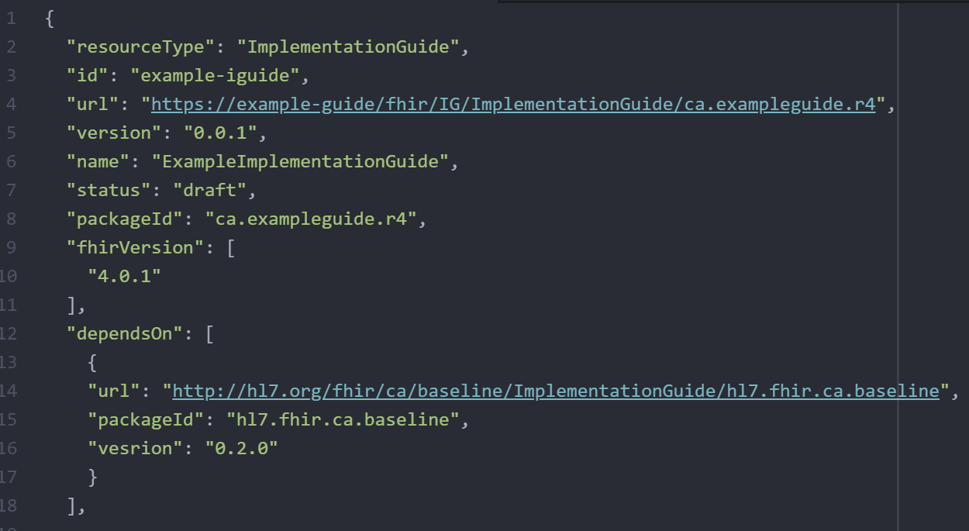
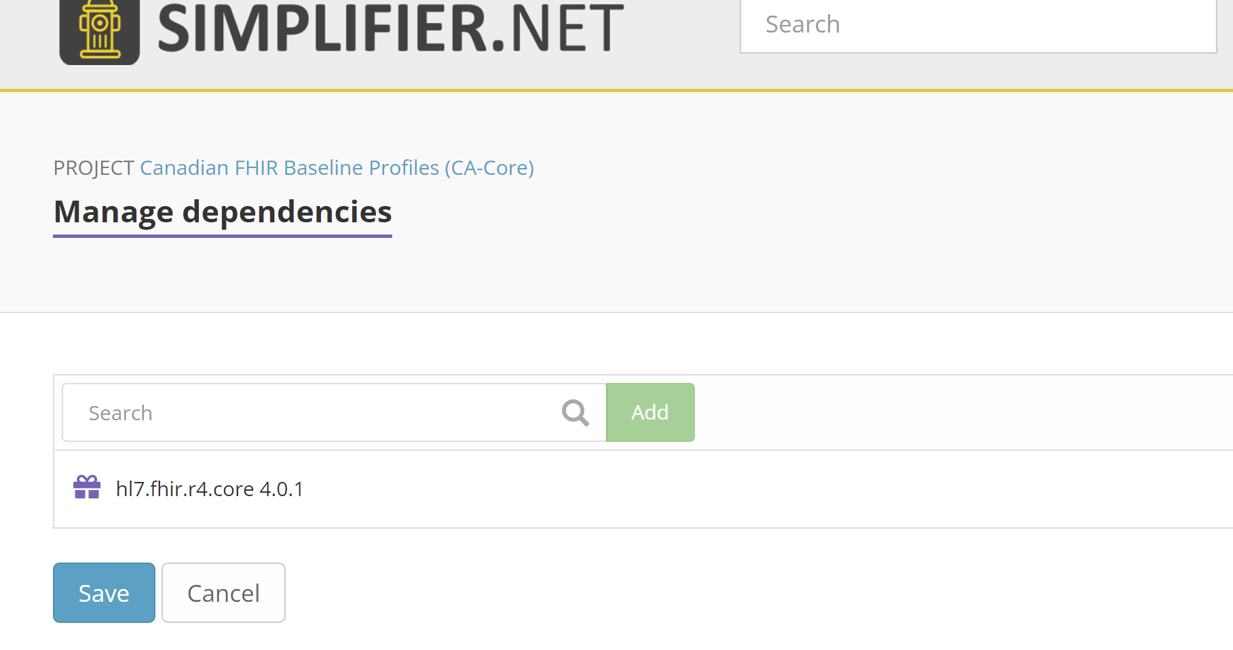
What are the Approaches to Adopt the Canadian FHIR Baseline Profiles?
CA Baseline will release package after reaching Maturity Level 1
Added in ImplementationGuide resource directly, or through Simplifier
https://docs.fire.ly/projects/Simplifier/simplifierPackages.html#add-dependencies
Notes:
(45 seconds) Mike will talk to this in a few minutes, but we’d like to align a package release around our movement into Maturity Level 1. Which we’re expecting within the next few weeks. We’ll make an announcement on the Infocentral forum when we’ve released the package. You can also subscribe for updates using the subscribe button on the CA baseline simplifier project or reach out to Mike and I in our ask the speaker session if you’re particulary interested in getting your hands on it immediately when its fresh off the presses.
I’ve included screenshots showing the different mechanisms your teams are able to use to add Iguide dependencies into your projects. Firely the team behind simplifier has some great documentation and a few presentations of their own on adding in dependencies into your simplifier projects – I’ve dropped the link in the slide for folks who are interested.

Slide 25
What are the Approaches to Adopt the Canadian FHIR Baseline Profiles?
Flexible
Re-Profiling
What is it: Adding CA Baseline profile into StructureDefinition.basedOn to allow your profile to inherit constraints directly from CA Baseline w/o needing to include in differential
Informal Alignment
IGuide Dependencies
Instance Validation
Re-profiling
Pros:
Efficient: Carry over constraints and only apply effort profiling the new
Guarantees alignment
Fastest way to prove conformance
Cons:
Requires stability of parent profile to use in production
Re-work if you decide to switch back
Challenges viewing delta (depending on tools used)
Dynamic
Stable
When should I use this approach?
Connectathon testing
Specification maturity level validation
Profiles that are direct implementations that are not expecting to re-profile further
Rigid
Notes:
(1:55) Last but certainly not least is Re-profiling. You might’ve heard us say in the past – profiles should derive or inherit constraints from the baseline. They do so through a process called Re-profiling.
Its the most rigid mechanism for adopting the baseline, but it also carries with it the most benefits. By indicating your profile is based on the CA Basline– you’re essentially copy/pasting all the work that’s been done already and only have to write code for the things you care about that weren’t originally in the baseline.
So, say your in Manitoba you have a pharmacy service youre developing a medication request profile for– and the constraints in the Baseline already covers 2/3 of your requirements but maybe you want to tighten up a few things. Re-profiling lets you do that while cutting down the time and effort to author your profile with the added benefit of reinforcing a minimum set of requirements that are shared across Canadian FHIR Prescription profiles regardless of jurisdiction or vendor.
Standards might be one of the only industries where plagiarism isn’t just accepted…its heavily encouraged because it advances the greater good.
This is why this is the approach we are recommending to jurisdictional governance bodies and working groups to employ for forthcoming FHIR content. We understand that this is going to take some trust and assurance that the baseline profiles are ready for trial use, changes will be controlled, and that there will be mechanisms for implementors to surface true blockers to their ability to fully re-profile.
We’re asking early adopters to begin trialing this approach against their own use cases and to surface areas they get hung up on through the simplifier issue log. To be clear…we’re not asking for this to be in production implementations right off the bat- but we do need early testers to try this out to catch blind spots and advance the maturity level of the content so production systems can eventually begin using this.

Slide 26
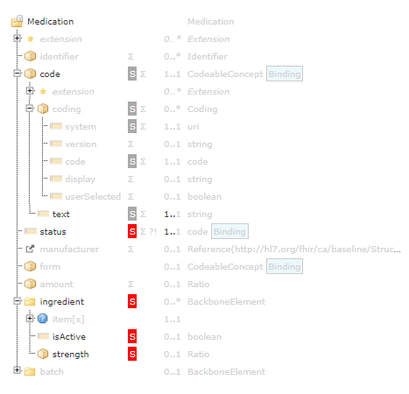
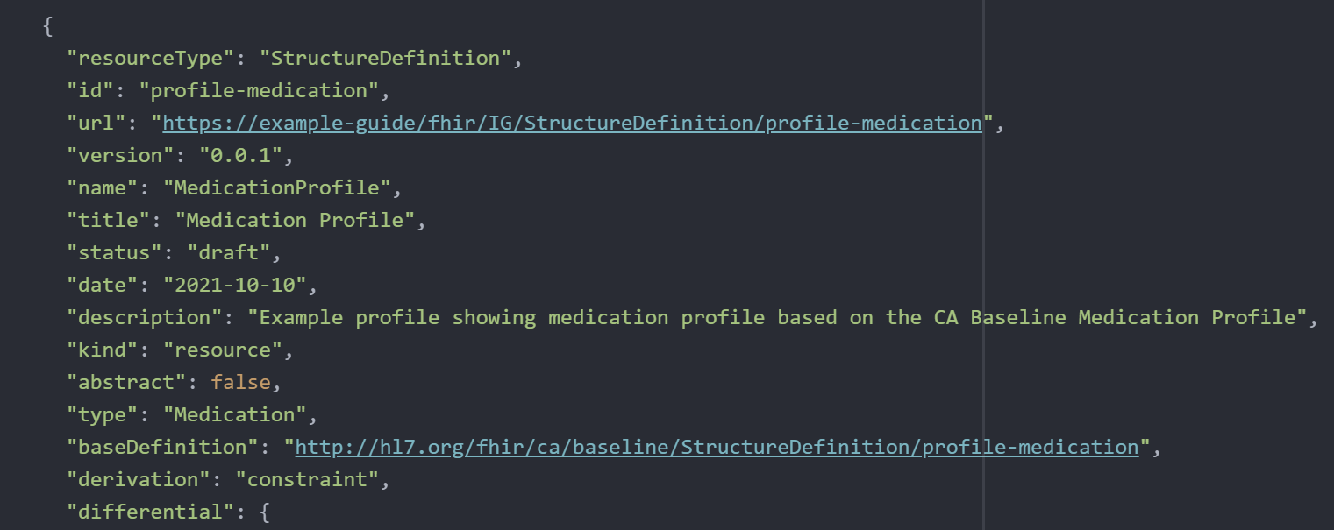
What are the Approaches to Adopt the Canadian FHIR Baseline Profiles?
Profiles available to test any time, but more stable to begin re-profiling starting after CA Baseline Maturity Level 1
Added directly into StructureDefinition
Notes:
(45 seconds )You can begin re-profiling to test out this approach – but we are just finishing up some light housekeeping on the profiles this month – so there may be a few constraints you might see relaxed in the next two weeks that are actions that arose out of our due diligence process that Mike will speak to.
I wanted to show a few images showing how easy it is to implement this approach. If you’re nervous or haven’t done this before or want to talk about things that are keeping you from re-profiling – reach out to Mike or I at the Ask the speaker session. If it means getting folks to trial this out and advance the standard we will find a way to meet with your team and walk them through this.
Now over to Mike who is going to tell you all the work we’ve done to date to get the profiles to a place you can confidently start using them.

