Slide 1
September 2021 HL7 Report Connectathon and WGM
Joanie Harper, Specialist, Standards
Joel Francis
Ron Parker, HL7 Canada Chair
Notes:
The logo can be changed in the master slides. Please use the following instructions
Select view > slide master.
Right click on the logo and select change picture.
Select the image you want to use. You may need to scale the image accordingly
When you're done, select close master view.

Slide 2
Table of Contents
HL7 Sept 2021 Connectathon
  International Patient Summary
  Smart Cards
HL7 Plenary and Work Group Meeting
  Plenary Sessions
  Noteworthy Announcements
  FHIR Management Group and Infrastructure
  Vocabulary
  Terminology Services Group
  Upcoming Education Opportunities

Slide 3
HL7 Connectathon (Virtual)
553 Participants
44 Tracks
49 Implementation guides being tested
140 people registered in ConMan
18 Clients / 77 Servers

Slide 4
International Patient Summary (IPS)
Overview: Test the creation and exchange of patient summary data across jurisdictions and usage contexts using the FHIR International Patient Summary (IPS) Implementation Guide specification. The track will focus on the primary theme of cross-border IPS document bundle data exchange, with additional sub-themes. See the Confluence page for more details.
Confluence Page: https://confluence.hl7.org/pages/viewpage.action?pageId=120750114
Specifications tested
  connectathon-2 branch build: http://build.fhir.org/ig/HL7/fhir-ips/branches/connectathon-2/index.html
  connectathon branch build: http://build.fhir.org/ig/HL7/fhir-ips/branches/connectathon/index.html
  CI build: http://build.fhir.org/ig/HL7/fhir-ips
  1.0.0 STU1 build: http://hl7.org/fhir/uv/ips/
Notes:
The logo can be changed in the master slides. Please use the following instructions
Select view > slide master.
Right click on the logo and select change picture.
Select the image you want to use you may need to scale the image accordingly
When you're done, select close master view.

Slide 5
International Patient Summary (IPS)
The $summary operation was tested on two servers resulting in an IPS bundle. Resulting bundle was loaded into www.ipsviewer.com for viewing
  Confluence Page: https://confluence.hl7.org/pages/viewpage.action?pageId=120750114
The IPS viewer (www.ipsviewer.com) was demonstrated and tested. You can paste an IPS bundle into the box and view the IPS that it represents. (This was originally built by Diego Kaminker and Fernando Campos. It was modified in 2021 by John D’Amore)
IPS samples are being collected into a github repository - https://github.com/jddamore/IPSviewer/tree/main/samples
Two sessions were held looking at the WHO’s Digital Documentation of COVID Certificates (DDCC). https://worldhealthorganization.github.io/ddcc/
  One educational session and one technical session.
There were sessions with the SMART Health Cards (SHC) track
  Grahame Grieve did a test implementation on the translation of IPS to SHC https://chat.fhir.org/#narrow/stream/284830-smart.2Fhealth-cards/topic/IPS/near/253167603
Notes:
The logo can be changed in the master slides. Please use the following instructions
Select view > slide master.
Right click on the logo and select change picture.
Select the image you want to use you may need to scale the image accordingly
When you're done, select close master view.

Slide 6
International Patient Summary (IPS)
Feedback and planned next steps
  Get Bundle from branch into continuous integration build of IPS standard planned for implementation the week of Sept 20-25.
  Include additional guidance (not conformance) around language/translations. Planned for implementation the week of Sept 20-25.
    Edit section 3.5 (Design Considerations) with this preliminary text: While the IPS standard allows for language translations to be included, both in coded display and narrative, there should be no expectation by downstream consumers (e.g. another nation in cross-border sharing) that local language translations will be present.
  Resolve validation errors related to terminology
    Three participants confirmed ATC/FDA terminology errors
Notes:
The logo can be changed in the master slides. Please use the following instructions
Select view > slide master.
Right click on the logo and select change picture.
Select the image you want to use you may need to scale the image accordingly
When you're done, select close master view.

Slide 7
International Patient Summary (IPS)
Feedback for Consideration
  Discussion of “Must Support” among slices of “base” vs. “cross-border” profiles
  Terminology around vaccine specificity
    Request addition of CVX option (current immunization terminologies are SNOMED BPS and WHO ATC) to provide greater level of vaccine specificity
  Discussion about relaxation of mandatory sections and text narrative
    No plans to relax mandatory sections however, all mandatory sections can be empty using
  Discussion on credentials for IPS vs. SMART Health Cards (SHC)
    Link to verifiable credential types
  Discussion around elements that have variation between IPS and SHC
Notes:
The logo can be changed in the master slides. Please use the following instructions
Select view > slide master.
Right click on the logo and select change picture.
Select the image you want to use you may need to scale the image accordingly
When you're done, select close master view.

Slide 8
Smart Health Cards (SHC)
Overview: The SMART Health Cards framework and associated Vaccination and Testing IG are in the process of being submitted for ballot and this Connectathon provides an opportunity for participants to test development against the spec and become familiar with tooling that has been built to support the standard.
  Smart Heath Cards Vaccination and Testing
  Smart Health Cards Framework
Confluence Page: https://confluence.hl7.org/display/FHIR/2021-09+SMART+Health+Cards+for+Vaccination+and+Testing
Specifications tested:
  SMART Health Cards - Vaccination and Testing IG
  SMART Health Cards Framework
Notes:
The logo can be changed in the master slides. Please use the following instructions
Select view > slide master.
Right click on the logo and select change picture.
Select the image you want to use you may need to scale the image accordingly
When you're done, select close master view.

Slide 9
Smart Health Cards (SHC)
Grahame Grieve is working on a general purpose client that can connect to any server. You can download Health Cards, extract the bundle, and see the contents. It supports validating and re-signing Health Cards. Does not yet accept images but planning on adding a QR code recognition library. It will be released to community when it is stable.
  Discussion around translation of IPS to SHC. https://chat.fhir.org/#narrow/stream/284830-smart.2Fhealth-cards/topic/IPS/near/253167603
  There were issues around QR code generation as part of the $issue operation
Connectathon.vci.org – supports issuing or scanning QR codes. Currently not supporting outgoing requests which is causing issues with resolving public keys.
Notes:
The logo can be changed in the master slides. Please use the following instructions
Select view > slide master.
Right click on the logo and select change picture.
Select the image you want to use you may need to scale the image accordingly
When you're done, select close master view.

Slide 10
Smart Health Cards (SHC)
Breakout with IPS - recap
Creation of SHCs from an IPS
  Can an immunization SHC be created from IPS and digitally signed?
  Is there a benefit to taking a whole IPS and creating a SHC from that?
    IPS bundle would create a huge QR code
    Health Cards for public events and pubs etc. is seen as transient but Health Cards for other parts of the healthcare system will likely be ongoing
      This is why they transitioned to a 2 specification approach. One specification for the foundational infrastructure and one specification for the vaccination and testing use case.
Notes:
The logo can be changed in the master slides. Please use the following instructions
Select view > slide master.
Right click on the logo and select change picture.
Select the image you want to use you may need to scale the image accordingly
When you're done, select close master view.

Slide 11
HL7 Plenary and Work Group Meeting
419 Participants
292 Sessions

Slide 12
CEO Plenary Presentation
Announcement of the creation of a Public Health FHIR Accelerator program to explore and enable the equitable use of data for public health.
The FHIR at Scale Taskforce (FAST) will transition to a FHIR Accelerator in 1Q22.
  Works to replace core infrastructure barriers with consensus based scalable solutions.
HL7 and HIMSS Accelerate have entered into a collaborative, non-exclusive partnership to distribute HL7 education resources.
HL7 and Health Data Management have entered into a collaborative, non-exclusive partnership providing HL7 with a dedicated publication channel hosted within HealthDataManagement.com.
HL7 has been approached by RAND with opportunities for collaboration across the realm of standards implementation
HL7 has created the HL7 Implementation Division to collaborate with the implementer community to create and manage a standards ecosystem to support testing and to develop program management services to support Accelerators and other global collaborative groups.
Notes:
The logo can be changed in the master slides. Please use the following instructions
Select view > slide master.
Right click on the logo and select change picture.
Select the image you want to use you may need to scale the image accordingly
When you're done, select close master view.

Slide 13
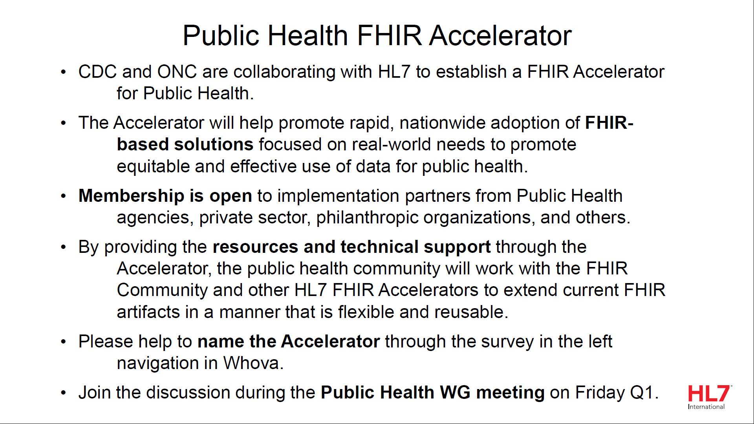
CEO Plenary Presentation
Notes:
The logo can be changed in the master slides. Please use the following instructions
Select view > slide master.
Right click on the logo and select change picture.
Select the image you want to use you may need to scale the image accordingly
When you're done, select close master view.

Slide 14
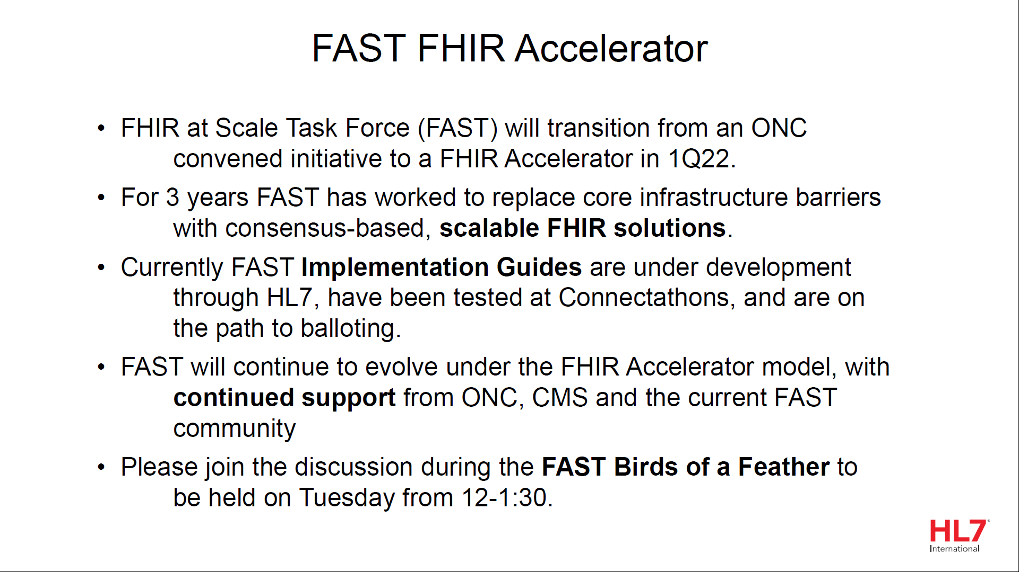
CEO Plenary Presentation
Notes:
The logo can be changed in the master slides. Please use the following instructions
Select view > slide master.
Right click on the logo and select change picture.
Select the image you want to use you may need to scale the image accordingly
When you're done, select close master view.

Slide 15
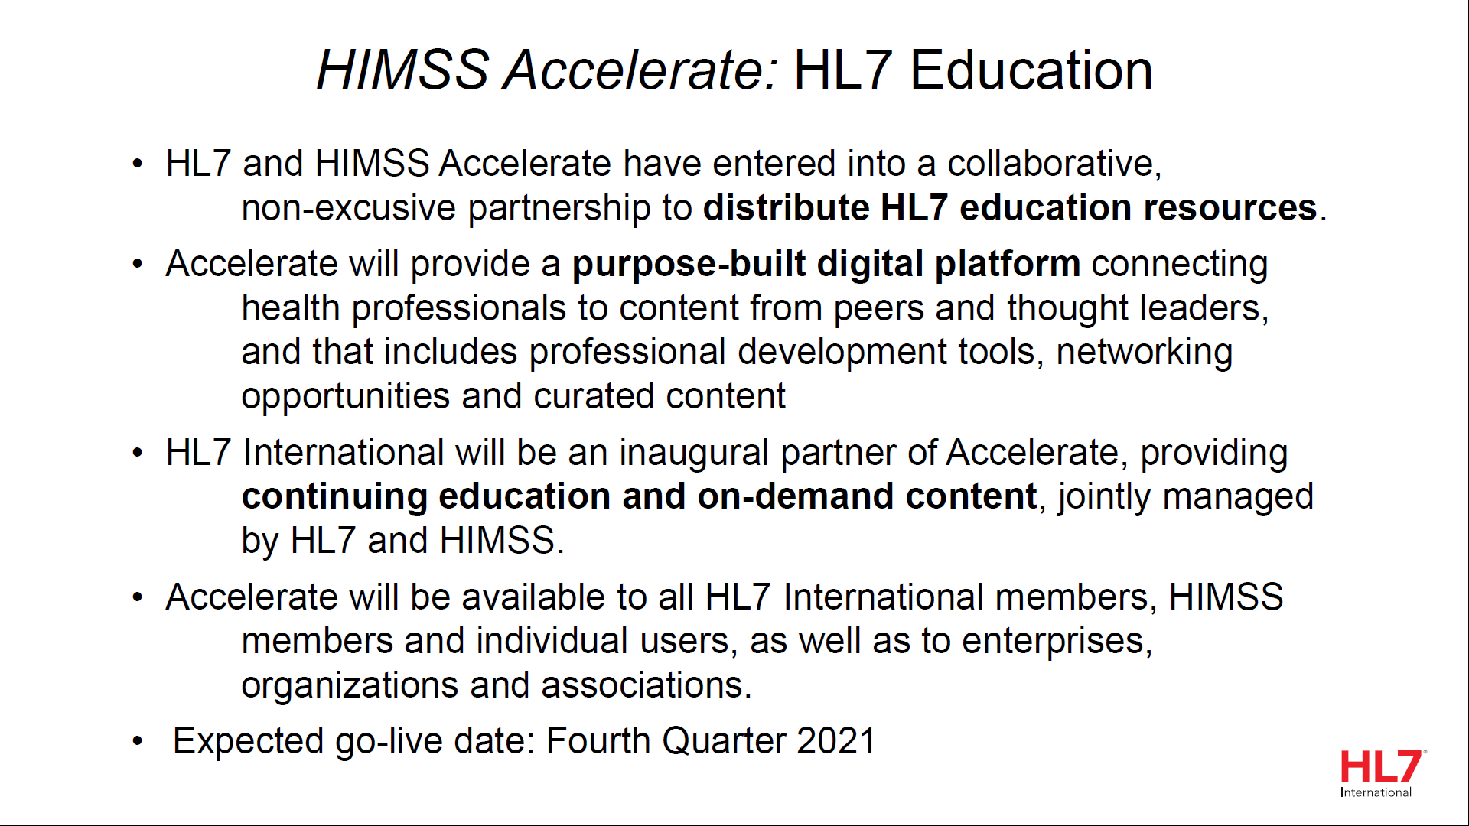
CEO Plenary Presentation
Notes:
The logo can be changed in the master slides. Please use the following instructions
Select view > slide master.
Right click on the logo and select change picture.
Select the image you want to use you may need to scale the image accordingly
When you're done, select close master view.

Slide 16
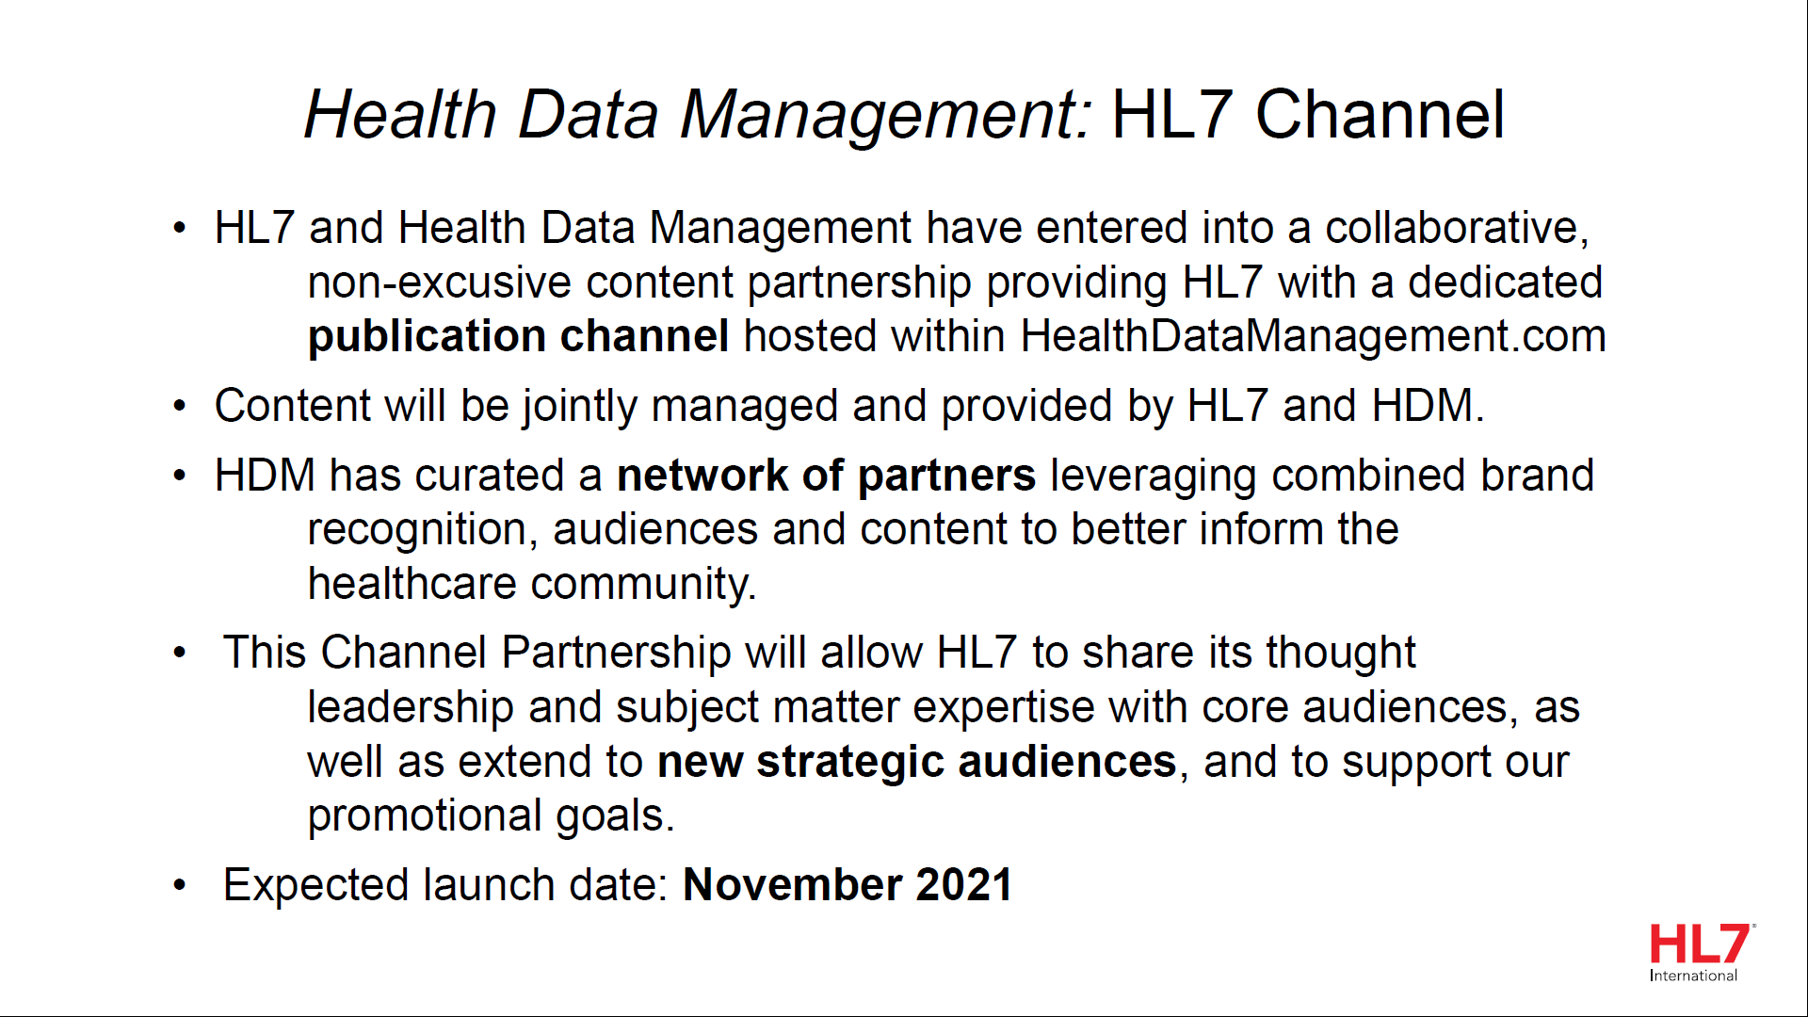
CEO Plenary Presentation
Notes:
The logo can be changed in the master slides. Please use the following instructions
Select view > slide master.
Right click on the logo and select change picture.
Select the image you want to use you may need to scale the image accordingly
When you're done, select close master view.

Slide 17
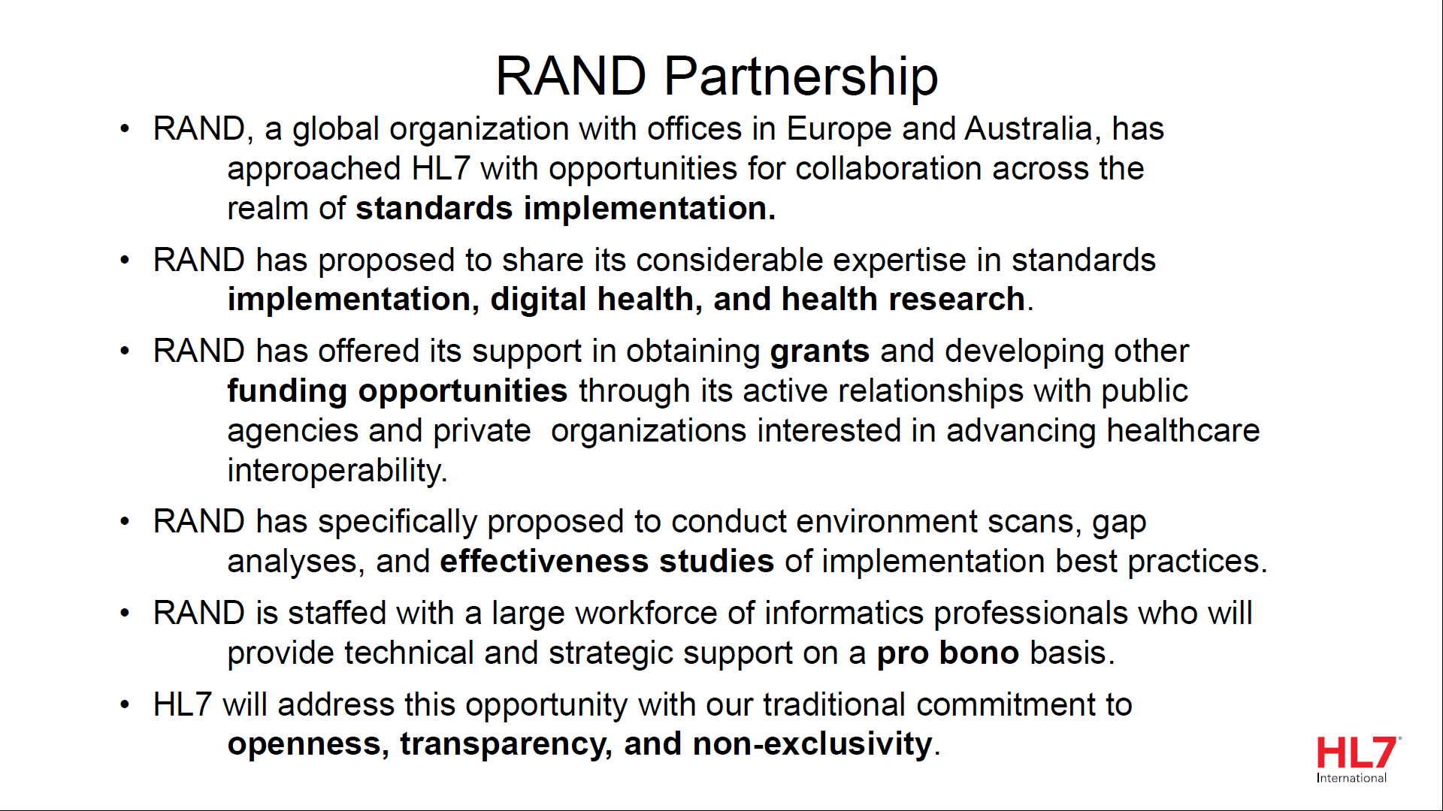
CEO Plenary Presentation
Notes:
The logo can be changed in the master slides. Please use the following instructions
Select view > slide master.
Right click on the logo and select change picture.
Select the image you want to use you may need to scale the image accordingly
When you're done, select close master view.

Slide 18
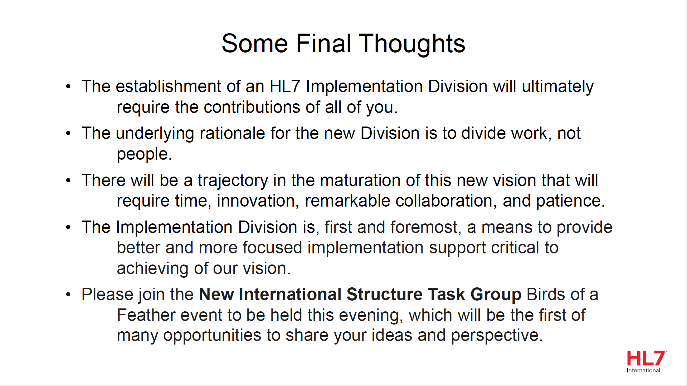
CEO Plenary Presentation
Notes:
The logo can be changed in the master slides. Please use the following instructions
Select view > slide master.
Right click on the logo and select change picture.
Select the image you want to use you may need to scale the image accordingly
When you're done, select close master view.

Slide 19
Plenary Session 1
The Future of Digital Health Innovation

Slide 20
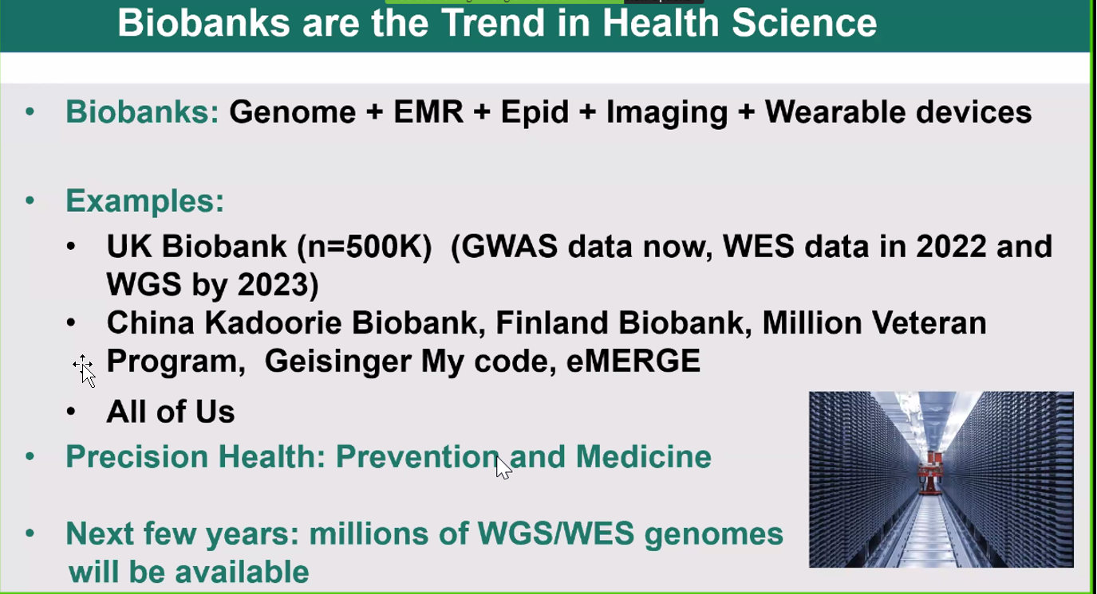
Plenary Session 1 – The Future of Digital Health Innovation
Panel: The use of Artificial Intelligence in Healthcare
Presentation 1 Xihong Lin – Department of Biostatistics and Department of Statistics, Harvard University and Broad Institute.
  Data Science and AI in Genomic Population Science and Medicine
Notes:
The logo can be changed in the master slides. Please use the following instructions
Select view > slide master.
Right click on the logo and select change picture.
Select the image you want to use you may need to scale the image accordingly
When you're done, select close master view.

Slide 21
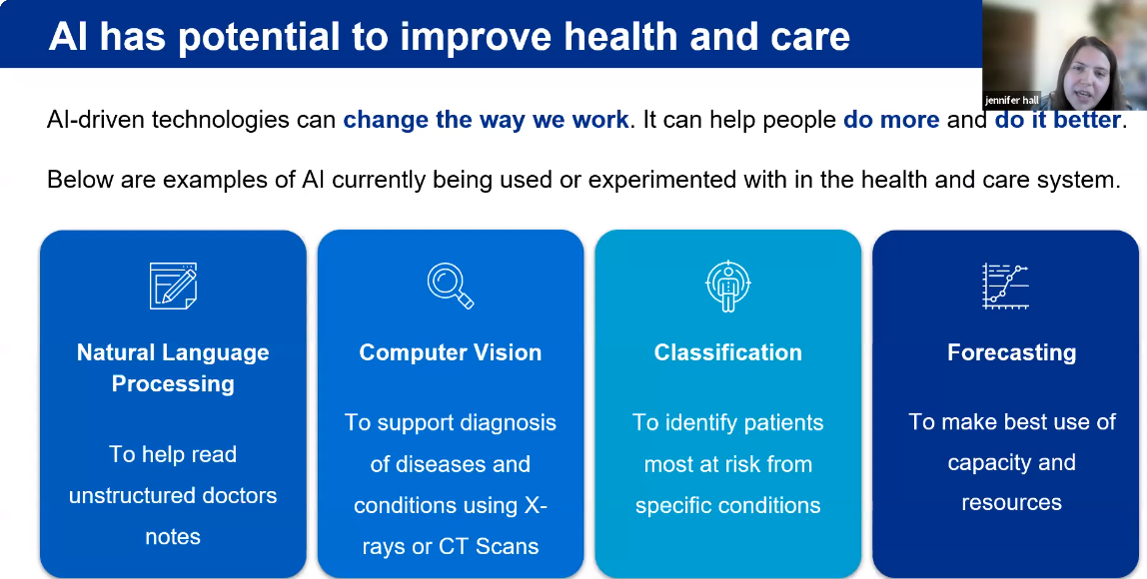
Plenary Session 1 – The Future of Digital Health Innovation
Presentation 2
  Jennifer Hall – AI Senior Data Scientist, NHSX, London, England
  Overview of AI Lab, Ethics, Skunkworks & Developments in Clinical Care
Notes:
The logo can be changed in the master slides. Please use the following instructions
Select view > slide master.
Right click on the logo and select change picture.
Select the image you want to use you may need to scale the image accordingly
When you're done, select close master view.

Slide 22
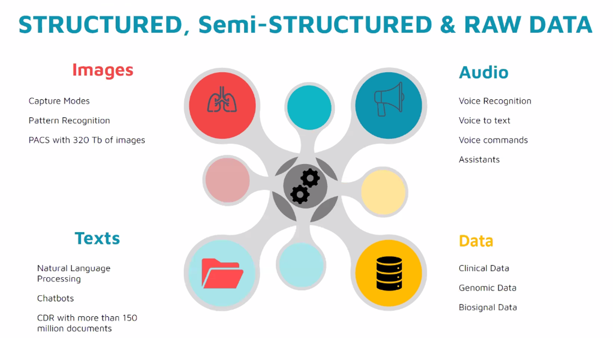
Plenary Session 1 – The Future of Digital Health Innovation
Presentation 3 Sonia Benitez MD, MSc – Internal Medicine Specialist, Hospital Italiano, Buenos Aires, Argentina
  AI in Argentina – Lessons Learned at Hospital Italiano de Buenos Aires
Notes:
The logo can be changed in the master slides. Please use the following instructions
Select view > slide master.
Right click on the logo and select change picture.
Select the image you want to use you may need to scale the image accordingly
When you're done, select close master view.

Slide 23
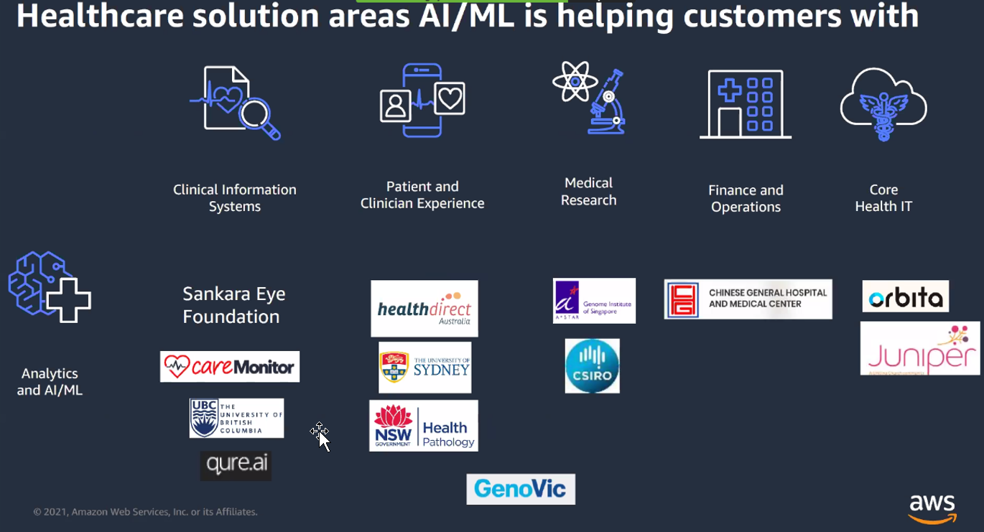
Plenary Session 1 – The Future of Digital Health Innovation
Presentation 4 Julian Sham, MD – Healthcare Lead, Asia Pacific & Japan, Amazon Web Services, Singapore
  AI: Its Positive Impact on Health Outcomes in Asia Pacific, Japan and Beyond
Notes:
The logo can be changed in the master slides. Please use the following instructions
Select view > slide master.
Right click on the logo and select change picture.
Select the image you want to use you may need to scale the image accordingly
When you're done, select close master view.

Slide 24
Plenary Session 2
The Future of Interoperability

Slide 25
Plenary Session 2 – The future of Interoperability from National Coordinators
Micky Tripathi, PhD, MPP National Coordinator for Health Information Technology
Karen DeSalvo, MD, MPH – Chief Health Officer Google, former ONC National Coordinator
Don Rucker, MD, MBA – Former National Coordinator at ONC
This Panel was very US Centric however, the section on where they hope to be in 5 years had more global relevance:
  EMRs will be fully able to emit data
  More use of Big Data to help build a “learning health system”
  Apps that empower patients with all encompassing integration of medical record, medical data, and other life data
  Better digital privacy – authentication, authorization, and consent so patients have seamless control of their information
  Better connection between medical, public health, and social care infrastructures
Notes:
The logo can be changed in the master slides. Please use the following instructions
Select view > slide master.
Right click on the logo and select change picture.
Select the image you want to use you may need to scale the image accordingly
When you're done, select close master view.

Slide 26
HL7 Board Chair’s Comments
Walter Suarez MD, MPH, FHIMSS – Chair, HL7 Board of Directors
Pleased to see that we are moving beyond clinical care, administrative and financial operations, and into public health and integrating the rest of the care continuum including social determinants of health.
The pandemic accelerated the need to reconsider what we do and how we do it. This sparked the need for the re-envisioning strategy (https://confluence.hl7.org/display/RH/Re-Envisioning+HL7+Home).
  Five bold principles: Focus, Agility, Global Relevance, Sustainability, and Community
  Changes to the TSC and consolidating leadership groups
  Improving the efficiency of internal processes
  Formation of the new Implementation Division
  Working on a new strategy to strengthen and expand affiliates and HL7 presence around the world
  Looking at implementing accrediting and credentialing education program
  Building new partnerships and expanding existing partnerships
Notes:
The logo can be changed in the master slides. Please use the following instructions
Select view > slide master.
Right click on the logo and select change picture.
Select the image you want to use you may need to scale the image accordingly
When you're done, select close master view.

Slide 27
Noteworthy Announcements
Several Canadian accepted as HL7 Fellows:
  Paul Knapp
  Lorraine Constable
  Melva Peters
  Jean Duteau
  Ron Parker
The new TSC Chair-elect is Jean Duteau!
  He will work in this capacity alongside the current chair for 2022 and then take on the full role after that.
JIRA Balloting will be available to Intl Affiliates May 2022

Slide 28
FHIR Management Group
Publisher impacting change process
  R4B and R5 not able to work with current build – right now there is a bug that breaks the build.
  There is a new project approved by FHIR-I to manage changes to the IG publisher/process
  More details: https://confluence.hl7.org/display/FHIRI/Publisher-impacting+Change+Process
R5 planning - CapabilityStatement2 is a draft resource – How important is it? How are we going to test it at the Connectathon?
Notes:
The logo can be changed in the master slides. Please use the following instructions
Select view > slide master.
Right click on the logo and select change picture.
Select the image you want to use you may need to scale the image accordingly
When you're done, select close master view.

Slide 29
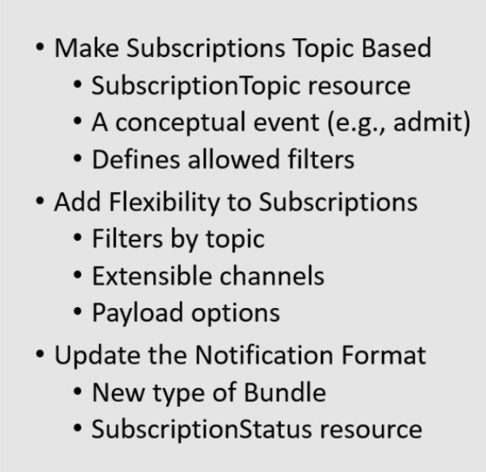
FHIR Infrastructure
https://confluence.hl7.org/display/FHIRI/FHIR+Infrastructure+Agenda+WGM+202109
  R5 Redesign
Notes:
The logo can be changed in the master slides. Please use the following instructions
Select view > slide master.
Right click on the logo and select change picture.
Select the image you want to use you may need to scale the image accordingly
When you're done, select close master view.

Slide 30
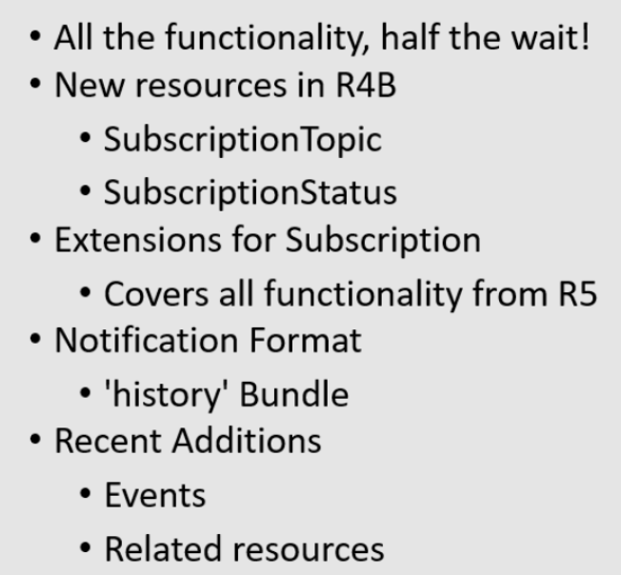
FHIR Infrastructure
  R4(B) Backport IG
  https://confluence.hl7.org/pages/viewpage.action?pageId=79499153
Notes:
The logo can be changed in the master slides. Please use the following instructions
Select view > slide master.
Right click on the logo and select change picture.
Select the image you want to use you may need to scale the image accordingly
When you're done, select close master view.

Slide 31
Vocabulary
Agenda for the week: https://confluence.hl7.org/display/VOC/Sept+2021+-+HL7+Virtual+WGM+Meeting+Agenda+for+Vocabulary
The last column on this page has links to the minutes for every Vocabulary session.
Notes:
The logo can be changed in the master slides. Please use the following instructions
Select view > slide master.
Right click on the logo and select change picture.
Select the image you want to use you may need to scale the image accordingly
When you're done, select close master view.

Slide 32
Vocabulary – Gender Harmony
Informative specification published in August 2021 and it is a logical model for sex and gender data representations: http://www.hl7.org/implement/standards/product_brief.cfm?product_id=564
JAMIA publication accepted for November publication.
The logical model describes Gender Identity, Sex for Clinical Use, Name to Use, Pronouns, and Recorded Sex or Gender (RSG).
Also proposed several value sets for Gender Identity and Sex for Clinical Use (SFCU).
Recorded Sex or Gender has a '<' value that aligns with machine readable travel documents that has broad applicability. Another value set for pronouns that is straightforward.
This goal has been accomplished and now working on enhancing in the HL7 space to align with the outcome of Gender Harmony.
  How should this be accomplished in each product family and across product families so that it is easily translatable?
Notes:
The logo can be changed in the master slides. Please use the following instructions
Select view > slide master.
Right click on the logo and select change picture.
Select the image you want to use you may need to scale the image accordingly
When you're done, select close master view.

Slide 33
Vocabulary – Gender Harmony
Looking at use cases that exercise the elements in Gender Harmony product. Intent is to describe how to communicate a use case.
  Will build a single cross-paradigm IG to describe templates for CDA, describe a profile on patient for FHIR, and describe part of a chapter that could be in the next version of V2
These changes are not seen as US Realm specific.
The Gender Harmony group is looking into getting some dedicated resources to help with the creation of the IGs. Without help, it will be making use cases, but it will be tough to make progress.
There is a page and process for creating and documenting Cross Paradigm Use Cases.
  Please add use cases if you have them! They will be used in discussion with the product families and used as a starting point to determine what changes need to be made.
  The intent is to capture information necessary to fill out a record for the product families. We need to profile each of the specifications where this would impact them (V2 and C-CDA) and we need help from those with expertise in these areas.
Discussion of requested clinical LOINC observations for RSG and SFCU. See the minutes for more details.
Discussion of implementation of Gender Harmony (Tuesday minutes)
  Much of the discussion was around HL7v2 implementation
Notes:
The logo can be changed in the master slides. Please use the following instructions
Select view > slide master.
Right click on the logo and select change picture.
Select the image you want to use you may need to scale the image accordingly
When you're done, select close master view.

Slide 34

Vocabulary – UTG / THO
HL7 is moving towards THO (terminology.hl7.org) being the single source of truth for all terminology artifacts
THO 3.0.0 release upcoming. THO will soon have a new layout:
The Code Systems tab has been split into separate tabs
  HL7 Code Systems which contains:
    CDA, FHIR, V2, V3, Unified, and retired content
  External Terminologies which contains
    Metadata records, technical identifiers (Naming Systems), code system fragments, complete code systems, retired content
    These are further split by those that are curated by HTA
New tab for Identifier Systems, Pending (reserves a URI for the code system)
Notes:
The logo can be changed in the master slides. Please use the following instructions
Select view > slide master.
Right click on the logo and select change picture.
Select the image you want to use you may need to scale the image accordingly
When you're done, select close master view.

Slide 35
Vocabulary – UTG / THO
There will be a cleanup of External Terminologies, those not curated by HTA
  For those Code Systems, there will be a period during which the Code System owners can bring them into HTA. After that time, those not registered with HTA will be moved to retired content.
Notes:
The logo can be changed in the master slides. Please use the following instructions
Select view > slide master.
Right click on the logo and select change picture.
Select the image you want to use you may need to scale the image accordingly
When you're done, select close master view.

Slide 36
Vocabulary – Artifact Deprecation
Policy Task Force is meeting every Thursday – current focus is deprecation policy
  Deprecation still needs to be defined
    LOINC definition could be a good starting point
  Then the scope of the deprecation policy needs to be defined
    Generally, want to stick to code systems, value sets, and their identifiers
  Deprecation is not a status – it is a usage note or guidance or a workflow state
  Deprecated is still active
  Jess Bota to put together a terminology lifecycle document
Notes:
The logo can be changed in the master slides. Please use the following instructions
Select view > slide master.
Right click on the logo and select change picture.
Select the image you want to use you may need to scale the image accordingly
When you're done, select close master view.

Slide 37
Terminology Services Management Group (TSMG)
Confluence page: https://confluence.hl7.org/display/VOC/Terminology+Services+Management+Group
Zulip channel: https://chat.fhir.org/#narrow/stream/301245-TSMG
Weekly calls: Tuesdays 5-6:30pm Eastern time. This meeting is an open meeting with only members having votes.
The newly formed TSMG had their first meeting in Tuesday Sept 21st at the WG meeting with the following topics:
Administrative topics around election of co-chairs, TSC representative, and term duration
A review of the Problem statement
Initial review of the Mission and Charter. Discussion to continue in Zulip.
Overview of items in scope
  Terminology Services functions
  Process improvements around terminology improvements and use
  Education, Implementation, and Outreach (Connectathons)
Notes:
The logo can be changed in the master slides. Please use the following instructions
Select view > slide master.
Right click on the logo and select change picture.
Select the image you want to use you may need to scale the image accordingly
When you're done, select close master view.

Slide 38
General Session – Education & Meetings
HL7 Certified Educator Program to begin in January 2022
Train the Trainer course to be offered starting in November 30
HL7 Educational offerings can be found at https://www.hl7.org/training/calendar.cfm?ref=nav
First course to be offered by HIMSS Accelerate will be “Understanding the HL7 Organization – From Process to Governance”
Notes:
The logo can be changed in the master slides. Please use the following instructions
Select view > slide master.
Right click on the logo and select change picture.
Select the image you want to use you may need to scale the image accordingly
When you're done, select close master view.

Slide 39
General Session – Education & Meetings
Jan 2022 Connectathon (Jan 10-12) and WGM (Jan 18-21) – Virtual
May 2022 Connectathon (May 7-8) and WGM (May 9-13) – In-person Dallas
Sep 2022 Connectathon (Sep 17-18) and WGM (Sep 19-23) –
in-person Baltimore
HL7 FHIR DevDays – June 6-9, 2022 – Hybrid event – Cleveland and virtual
Notes:
The logo can be changed in the master slides. Please use the following instructions
Select view > slide master.
Right click on the logo and select change picture.
Select the image you want to use you may need to scale the image accordingly
When you're done, select close master view.

Slide 40
Thank You
Fun fact: 419 attendees spent 211 days and 4 hours in Zoom, and between them, attended 6803 meetings

