Slide 1

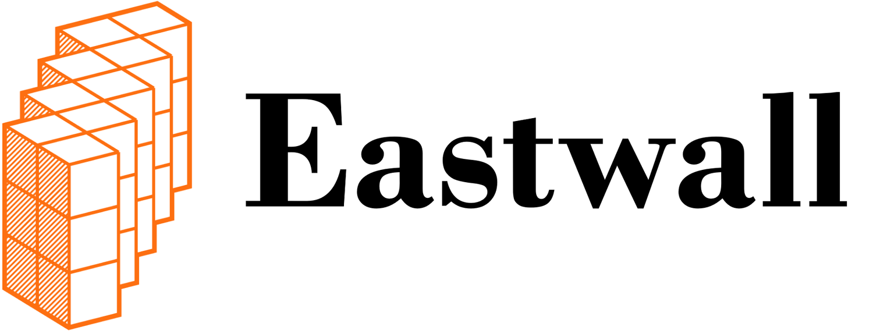

Cloud Based Medical Imaging
Moving your Images/PACS to the Cloud
Chuck Martin, Jason Klotzer
03/24/2023

Slide 2


Speakers
Chuck Martin
Jason Klotzer
chuck.martin@eastwall.com
Founder, Principal, Eastwall
jklotzer@google.com
Medical Imaging Lead, Google Cloud
Chuck is a cloud technologist based out of St. Louis, MO with over 20 years experience in developing and managing enterprise systems and cloud solutions for the highly regulated medical industry. He has led global teams across various disciplines, including technical sales, product management, cyber security, DevOps, CI/CD, managed services, and business development in the Oncology industry. Chuck co-founded Eastwall, a Cloud Consulting & Engineering company, in 2022 to help healthcare organizations better leverage cloud technologies.
Jason is a customer engineer based out of Austin, TX who works in the HCLS vertical of Google Cloud, and has been in the medical imaging space for more than 15 years. He has architected several PACS and VNA systems and specializes in the visualization of medical images for diagnostic reading. He has spent the last few years focused on the applicability of AI and analytics in medical imaging.

Slide 3
Table of Contents
Initial considerations
Readiness
Secondary use
Gotchas / Other considerations
01
02
03
04

Slide 4

Initial considerations
Integration patterns
Why consider it?
Non-functional requirements
Business motivations
AI driving adoption?
Notes:
o How can people get data to the cloud? JASON
· Typically the connections are:
o PACS or DIMSE Cloud (less efficient) - usually needs high bandwidth/low latency expensive connections
o DICOMWeb to Cloud - more efficient than DIMSE for single study transfers as data is transferred in parallel chunks via HTTPS with efficient compression algorithms
o DIMSE to 3rd Party to DICOMweb to Cloud, many "broker gateways" available
o Combination of hardware based storage migration with software “catch-up”
· And of course a lot of this will need to be aligned with the particular vendor you choose.
o Why are they considering it? What would be the Non-functional requirements? JASON
Healthcare providers are considering cloud-based medical imaging services for several reasons, including cost-effectiveness, scalability, accessibility, and security. Some of the non-functional requirements for cloud-based medical imaging services include:
· Availability: The system should be available 24/7 and provide uninterrupted access to medical images and related data.
· Performance: The system should provide fast and reliable access to medical images and related data, even during peak usage.
· Security: The system should ensure the confidentiality, integrity, and availability of medical images and related data, following regulatory standards such as HIPAA.
· Scalability: The system should be able to handle increasing volumes of medical images and related data as the organization grows.
· Interoperability: The system should be able to integrate with existing healthcare systems and applications.
o What are the business motivations? Why are they considering this? CHUCK
· Cost savings: Cloud-based services eliminate the need for costly on-premises hardware, software, and maintenance, reducing the overall cost of medical imaging services.
· Accessibility: Cloud-based services enable healthcare providers to access medical images and related data from any location using any device with an internet connection, improving collaboration and patient care.
· Scalability: Cloud-based services allow healthcare providers to scale up or down their medical imaging services based on their needs, without the need for additional hardware or software investment.
· Security: Cloud-based services provide advanced security features, such as data encryption, access controls, and auditing, ensuring the confidentiality, integrity, and availability of medical images and related data.
NEW? – How is AI driving cloud adoption for medical imaging? Obviously it is best if the data set is in the same proximity to the AI models being used to keep latency down/increase usability. JASON

Slide 5

Readiness
Readiness assessment using a Cloud adoption framework
Identifying the organization's business requirements and objectives for cloud adoption.
Assessing the organization's current IT infrastructure, including hardware, software, and network, to determine its compatibility with cloud-based services.
Identifying the organization's data and security requirements and ensuring compliance with regulatory standards such as HIPAA.
Evaluating the organization's staff skills and resources to determine their readiness to adopt and manage cloud-based services.
Developing a cloud adoption strategy and roadmap that aligns with the organization's business objectives and requirements
Notes:
o What is involved with a readiness assessment using a Cloud adoption framework? CHUCK
· Identifying the organization's business requirements and objectives for cloud adoption.
· Assessing the organization's current IT infrastructure, including hardware, software, and network, to determine its compatibility with cloud-based services.
· Identifying the organization's data and security requirements and ensuring compliance with regulatory standards such as HIPAA.
· Evaluating the organization's staff skills and resources to determine their readiness to adopt and manage cloud-based services.
· Developing a cloud adoption strategy and roadmap that aligns with the organization's business objectives and requirements

Slide 6
Secondary use
Internal Research
External Research
Data availability for internal research, with separation from clinical care. Availability of resources, such as ML, analysis, and other tools, for researchers to leverage data at scale.
Initial requirements are similar to internal, but also likely includes de-identification, multi-tenant data segmentation, and API management.
Notes:
JASON

Slide 7
Gotchas / Other Considerations
Advisory is key. Make sure to engage experts as you embark on this journey.
EHR to the cloud
PACS consolidation
Image lifecycle management
Rendering performance
Long term ROI for different options?
Seek out cloud systems and services who prioritize standards
Notes:
o Need to engage experts: CHUCK
· Where do they want to go? Advisory is key. EHR to the cloud too? PACS Consolidation? Long term ROI for different options?
o Long Term Software Lifecycle Management: JASON
· Cloud systems and services use standards. Not to say other vendors are not, but the consistency is certainly there in the cloud

Slide 8
Thank you.

