Slide 1

CA-Baseline
March 2023 Governance Call

Slide 2
Agenda
Continuation of community discussion on Base/Baseline/Core – mutual exclusivity, impacts goals and outcomes, use case agnosticism

Slide 3
Community Discussion – Where Does Baseline Fit?
Continuation of community discussion on Base/Baseline/Core to help contribute our thoughts as implementers back into the national IG discussions in May
Do a Base or a Baseline have to be a formal derivation point for Cores & Mores – what are the benefits vs risks?
  Benefits:
  Risks:
Are there specific risks to consider with the Baseline given our approach (application of MS), maturity (1.0.0 Trial Use) and process (grassroots)?
Does the amount of IGuide layers expected in the ecosystem change the approach?
  Universal Realm-Use Case/Domain, National Base, National Core, National Use Case, Regional Use Case, Direct Implementations
Do the types of profiles in the guide (e.g., only Entities) make a difference in the risks/benefits?
Is there a future where a Base or Baseline no longer is needed to achieve our goals:
  “exposing the implementation guide and vendor community to what concepts can be expected to be supported across jurisdictions today.”
  “concepts that were common across existing implementations become ubiquitous in future implementations.”
Why would endorsement of a Baseline and other national specifications being mutually exclusive? How can we avoid the conditions in which they would be?

Slide 4
Community Discussion – Where Does Baseline Fit?
Do a Base or a Baseline have to be a formal derivation point for Cores & Mores – what are the benefits vs risks?
  Benefits:
    Ensures consistency to make it easier for vendors to implement against our collective guides
    Sets the core fundamental common concepts we need without a specific use case – allows implementations who are not covered by the use cases (temporarily or in the future) in other guides to have common starting point
    Use case agnosticism helps to reduce risks that occur when implementers review each others use case driven guides
    Allows for faster comparison between guides by removing need to assess functionally claimed commonalities
  Risks:
    If using the most current – any issues around instability / bugs are inherited downstream, and necessary continued review to determine if changes bring your implementation out of conformance (e.g., required concept that a child guide does not require)
    If using stable versions: still require continued review
    As layers are added – software dependency management risks are incurred (compounded?) – particularly if the various layers have different governing bodies/processes that the most downstream guide doesn’t have control over
    If the artefact that necessitates inheritance doesn’t have the input from the various guides (that would have to inherit its rules) creates issues that organically result in variances
      Efforts related to assessing right scope of
Are there specific risks to consider with the Baseline given our approach- constraints that are common but not Canadian (application of MS, conditional constraints) maturity (1.0.0 Trial Use) and process (grassroots)?
Particularly if the various layers have different governing bodies/processes that the most downstream guide doesn’t have control over/there may not be commonality in ideas and approach if baseline and national guides are not governed under same groups and principles
  Some processes in place that have addressed the concerns through process and transparency – but
Credibility issues that are bidirectional (acceptance of a Baseline before a Core or vice versa if the participants and auspices are different between the two)
Some consideration that formal relationship requirements may change variables in this (e.g., grassroots) and therefore impact benefits/risks

Slide 5
Community Discussion – Where Does Baseline Fit?
Does the amount of IGuide layers expected in the ecosystem change the approach?
  Universal Realm-Use Case/Domain, National Base, National Core, National Use Case, Regional Use Case, Direct Implementations
  Multiple layers that an implementation guide has to adhere to, verify, and document creates additional burdens for implementer the more distributed the layers of guides are in terms of governance and process
  May depend on the process or “safety valve” that is supported for deviations and documentations of deviations (e.g., what is done in the US Core)

Slide 6
Community Discussion – Where Does Baseline Fit?
Is there a future where a Base or Baseline no longer is needed to achieve our goal of “exposing the implementation guide and vendor community to what concepts can be expected to be supported across jurisdictions today.” and the outcome of “concepts that were common across existing implementations become ubiquitous in future implementations.”
Does our ability to fulfill our goals and achieve outcomes change based on the presence of other national/domain guides in our community?
  Will depend on positioning of other guides
    Redundancy/duplication of profiles should be avoided
    There are many target levels for where constraints can be applied – and even levels that look similar may not be
    If Baseline profile is used to establish a set of requirements under scope X– and Core is a set of requirements under scope X – then not as concerning to our end goals? But if Baseline scope is X and Core is X,U then what?
      In inheritance hierarchy you don’t replace
      True use case agnosticism might not be where we are at with the baseline if we have constraints - if we are not right people will ignore the work we’re doing
      Our process (DDR) has been the right one to date for our current scope
    The process in which the Core/replacement would take would have to have trust in the community (that needs to implement against it)

Slide 7
Community Discussion – Use Case Agnosticism
Two Statement made last meeting that we may not actually be use case agnostic + that in inheritance hierarchy you don’t duplicate
  True use case agnosticism might not be where we are at with the baseline if we have constraints - if we are not right, people will ignore the work we’re doing
    Our process (DDR) has been the right one to date for our current scope
  Only use case we should be considering is “use in Canada” – some aspects of a patient, provider, service we could generalize well enough but should be continuing to ask the question of whether we’re maintaining that use case agnosticism
  Not immutable – but there needs to be a foundational process to ensure that requests for changes are handled in a transparent manner
Not being use case agnostic poses a challenge for asking the CA Core / other national domain guides to derive from us
Two Paths in front of us: 1) Continue with current process of “relax as identified” or relax upfront – both require some degree of governance/process to deal with requests for change since even with upfront relaxation things can still slip through
  Concern that if we relax considerably – then we may erode some of the current value that implementers have from using the FHIR base – but need to examine if that’s still true if another guide takes on those constraints
  One important constraint to maintain is our approach to surfacing terminology
  Need to differentiate between constraints that are use case specific – domain guides may slim terminology for use
  There are some benefits beyond profile consistency that the CA Baseline provides (e.g., business & technical coordination of folks that are all eating different pieces of the same elephant) – these need to be explored
Thought Exercise: If Baseline profile is used to establish a set of requirements under scope X– and Core is a set of requirements under scope X – then not as concerning to our end goals? But if Baseline scope is X and Core is X,U then what?
  Biggest concern is that the Baseline & Core will be on divergent path
  If the Core consumed constraints in the CA Baseline (X) and was use case agnostic (X) then….
    If consumed and a mechanism for community input & trusted processes – no concerns with the Baseline retiring (other than losing some of our passive benefits being on calls together)? Would have to feel confident in the process and that input of community authors concerns are considered and addressed.
  If the Core consumed constraints in the CA Baseline (X) and was use case agnostic plus additional desired constraints (X+) then….
    If goes by principles we’ve talked about for use case agnosticism (and same constant of trusted & agreed process) – no concerns with the Baseline retiring (other than other passive benefits)?
  If the Core consumed constraints in the CA Baseline and wasn’t use case agnostic (X, Y) then…
If the constraints of the CA Baseline were fully consumed – are there passive/non-passive benefits to us continuing the work?
As we examine use case agnosticism (putting a discerning eye towards constraints beyond what we’ve done in the DDR) also use it as an opportunity to identify extensions in use not previously socialized (and our stance given use case agnosticism)

Slide 8
Community Discussion – Outstanding Questions
Finish last scenario on thought exercise (if the CA Core was X scope plus Y scope – then what)
If the constraints of the CA Baseline were fully consumed – are there passive/non-passive benefits to us continuing the work?
Why would endorsement of a Baseline and other national specifications being mutually exclusive? How can we avoid the conditions in which they would be?
What do we communicate/ recommend that authors who have already begun deriving from CA Baseline?
  Some already using as a consistency anchor w/in jurisdictions – already being used to compare differences in BC guides
Has our approach (allowing multiple methods of alignment) changed? Does it need to change?
Do the types of profiles in the guide (e.g., only Entities) make a difference in the risks/benefits?

Slide 9
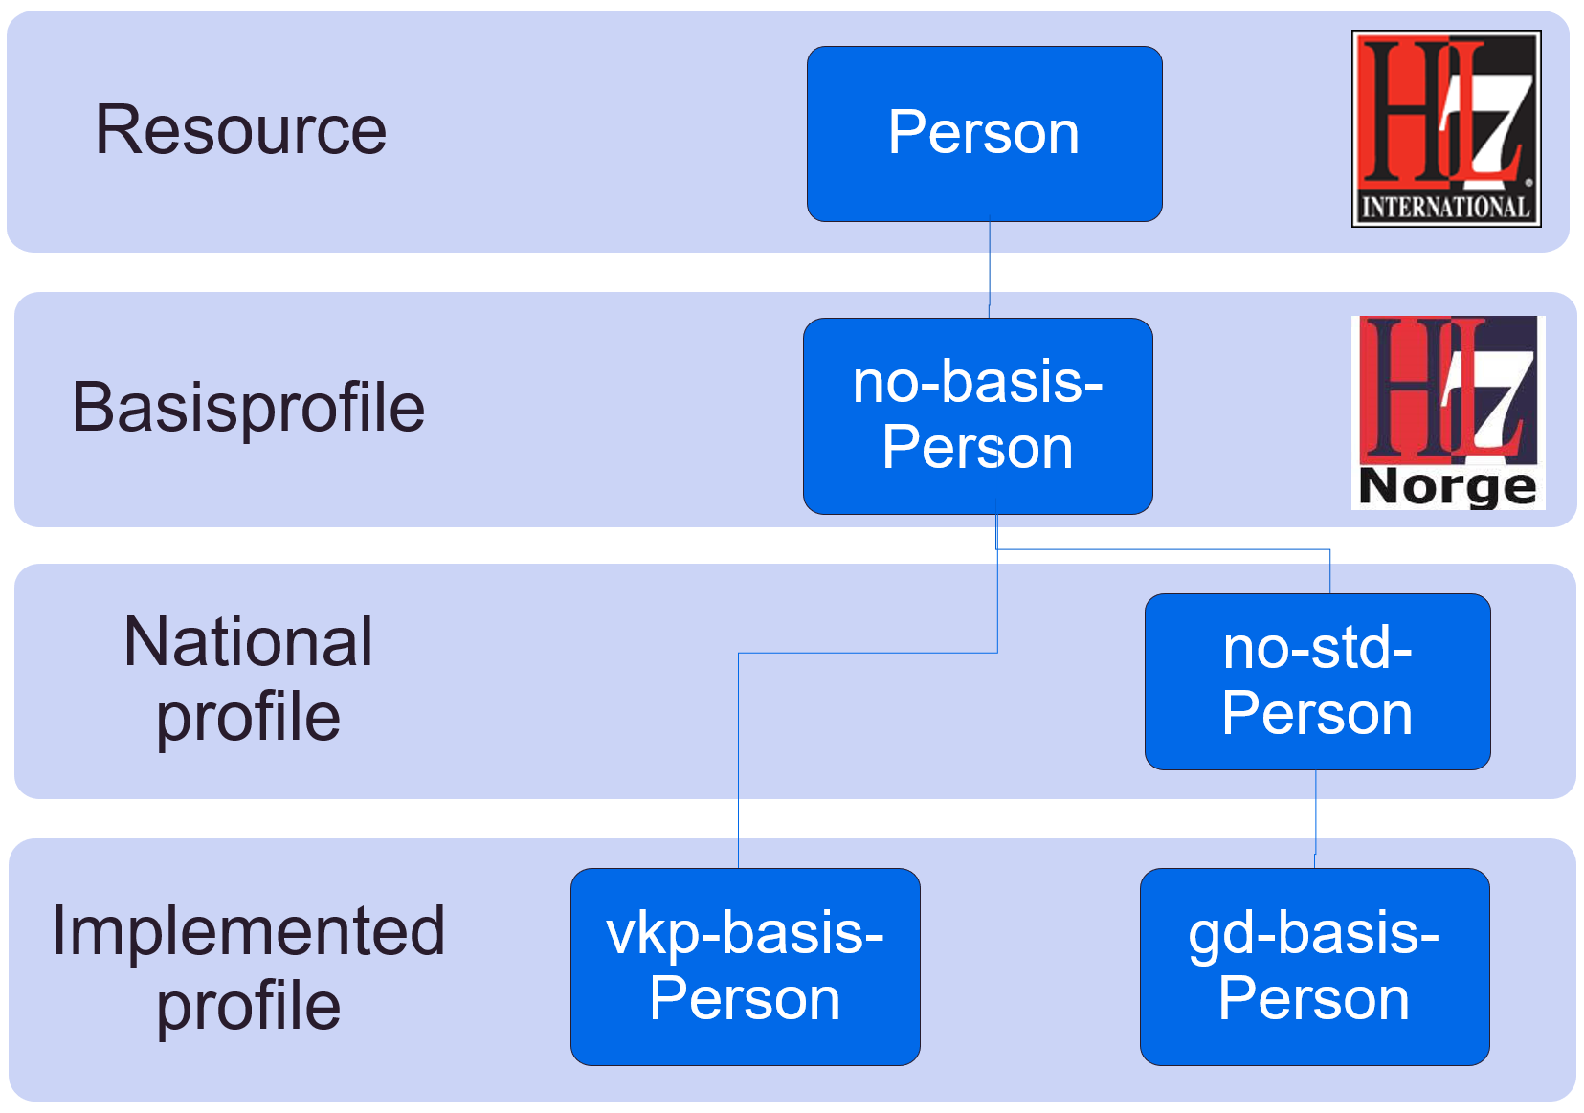
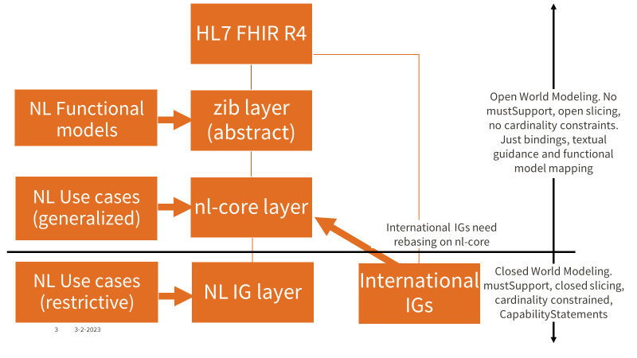
National Examples of Relationships between FHIR Profiles
Norway Relationships Between Profiles
Netherlands Relationships Between Profiles

Slide 10
MustSupport Replacement Proposal
Continuation of discussion on MustSupport replacement proposal posed in the forum:
  https://confluence.hl7.org/display/FHIR/Must+Support+replacement+proposal

Slide 11
Agenda
Housekeeping:
  Reminder: 1/27 call being used to continue our review & conversation around our responses to the Canadian Common Data Standards for Interoperability - Nov 18, 2022 FAQ
Confirm whether we are comfortable moving forward with using the Bake Process for our project
Review the Canadian Common Data Standards for Interoperability - Nov 18, 2022 FAQ and compile a list of questions/asks for clarity to provide back to the initiative email
  Consider the efforts occurring w/ the HL7 affiliates (and their constituent communities) in developing and refining the definitions
  Acknowledge the existing context & history with affiliate use of Core & Base (e.g., US Core being clinical domain focused and influenced by funding mechanisms & priorities)
    US has considered a Baseline and employed a ticket process on top of the US Core but has not formally engaged in that work
Begin activities discussed in November 25th Governance session
  Clean-up of project and guide remove confusion around use of core in project name and in some project pages
  Begin activity of Compiling anything noted as a ‘core candidate’ consideration/flag and determine where these are helpful for further consideration in light of the above possible Canadian Core development
  Next Governance Session: Next Governance Session is during the HL7 WGM, we’ll use it to go over the activities discussed Nov 25th and use our profiling call the following Friday (Jan 27th) to resume the FAQ/review any answers that come through in the meantime.

Slide 12
Discussion
Questions:
Data dictionary definition Question: How will we be able to see/receive updates on the data definitions (and other materials) (both indirectly as implementers and as the CA Baseline group to inform our understanding of the impact on our own profiles)
Comments:
On getting updates on Pan-Canadian projects in the CA Baseline – it may make sense to get high level updates on things that are scoped nationally (like CA:FeX and this new initiative)– but we have to be conscious of capacity & use of our meeting times to socialize this information
  Asks for clarity:
On the question related to the HLF & PCLF – can you provide more clarity on where CA Core discussions are happening based on this response (either now or post-planning stage)?
We would request clearer statement on where you are at in point in process as well as details on how to learn more about participating in some of these groups (asked as both individual implementers and how/if the CA Baseline working group would contribute)

Slide 13
Discussion
Concerns:
Baseline & Core Relationship: The update of the FAQs to assert that over time the CA-Baseline will be retired/replaced is not in alignment with what we have heard and has clear implications in short/mid term to existing implementers that have re-profiled from the CA Baseline as well as those that are considering the endorsement of the Baseline w/ their jurisdictional governance structures
  We need more context on depth & scale in what their expectation is for replacing the CA Baseline
  We would assert that the CA Baseline is meaningful to maintain in the short & long-term but the exact nature /relationship with the core or similar program (domain based – like DaVinci) is still to be defined based on the target of this new work
  Having this relationship ambiguous is a challenge for implementations/endorsement (e.g., jurisdictions that have been asked to endorse the CA Baseline expressing confusion/hesitance with how to move forward with the CA Baseline without more clarity)
  ----
  If a jurisdiction wants to get involved or monitor what is occurring – how do they engage? How do they hear about the work?

Slide 14
Update on HL7 International Council Discussion on Base & Core Definitions
Summarized Minutes & NL approach slides can be found (still awaiting final slides that were presented): https://confluence.hl7.org/display/IC/2023+January+WGM+-+Las+Vegas+Minutes
Presentation from Ron Parker about the implications on this issue in Canada. Focus was on challenge of language regarding baseline vs. core, while acknowledging the meetings [with the national IG authors] had earlier in the week.
Didn’t really want to talk about the labels, as they had loaded meaning depending on the reader’s or listener’s context, but rather focus on the [enterprise architecture approach of] separation of concerns between a national consensus-based foundation for FHIR profiles and IG’s versus IG’s that were build for a specific purpose within a particular context.
Both are a form of standardization
  Baseline at concept representation level
  Core is within a particular use context
Baseline
  Normative at the concept representation level
  This is where profiling of FHIR Resources is done to be aligned with a realm's health informatics concepts.
  Baseline is implementation guidance that is the starting point from witch to derive standards for a wide range of use cases.
Lots of discussion ensued - Alexander from the Netherlands says they use the term “Core”, however they have a methodology that maps back to a “conceptual” version of core, a “logical” version of core for design purposes, and then a “physical” version suitable for a actual implementation. This maps well to both TOGAF and OMG’s model-driven architecture RMODP concepts of Computation Independent Model, Platform Independent Model, and Platform Specific Model (CIM, PIM, and PSM).
Brett Marquard, Chair of US Realm Committee was sitting in and suddenly totally got the value of the separation of concerns and related that to their challenges in meeting ONC timelines for USCDI. I was very empathic to the challenges of his mandate, and he acknowledged that they were having exactly this problem with U.S. Core, and that this was coming up more and more often in meetings (as I have seen).
No conclusion was made, but good discussion around the room gave Ron a lot of input to this issue. In the meantime, IC has agreed to watch the cataloguing posted on the International Council Website and see what develops before any new language is introduced. Also, this really would benefit from a conversation with Graham.

Slide 15
FHIR – Baseline vs Core
Both are a form of standardization
  Baseline at concept representation level
  Core is within a particular use context
“Baseline”
  Normative at the concept representation level
  This is where profiling of FHIR Resources is done to be aligned with a realm’s health informatics concepts (e.g. how are “patient” or “encounter” represented?)
  Baseline is implementation guidance that is the starting point from which to derive standards for a wide range of use cases.
“Core”
  Derived from a Baseline
  Implementation guidance for a range of commonly-used use cases intended to be consistently implemented (normative) within a given governance jurisdiction
  Core may begin with a limited scope, that will grow over time based
  A particular Core standard that is appropriate for a certain use case may not be sufficient for other use cases and should not be considered reusable outside of the specific use case

Slide 16
US Baseline vs CA Baseline
US Baseline
  Doesn’t exist
  US Realm has agreed that a more general baseline would be useful, but no one has put effort into it other than to log when initiatives have a business need to “break” US Core.
CA Baseline
  Has begun, but is not comprehensive (yet)
  Grass roots evolution based on consolidation of existing initiatives, harmonizing concept representation
  Informed by other international work
  IMHO: This is where CA data model mapping to FHIR needs to be done

Slide 17
US Core vs CA Core
US Core
  US Core (which grew out of Argonaut) is focused on implementing USCDI, and that is its (narrower) scope.
  The FHIR US core was designed to consider just clinical needs not administrative, financial or other domains, so it isn't the right starting point for a hierarchy of derived IGs.
CA Core
  Based on business priorities that bring focus to standardization for a particular use case
  The CA baseline team did look at US Core when doing the initial baseline analysis.
  There is a recently published AU Core that Canada should look at closely.
  For CA Core, it is important to know what is defining the scope.

Slide 18
Standardizing on “Baseline” and “Core” Definitions
Discussion:
  It does not appear there are definitions for these two terms in HL7, and when used interchangeably, create confusion
Proposed approach for clarification (not necessarily in sequence):
  HL7 Canada will propose the definitions provided here and will post them to chat.FHIR.org for discussion
  These definitions will also be reviewed with
  At the Jan 2023 meeting, HL7 International Council members will be asked to review the definitions and relate their own understanding
  HL7 Canada and / or HL7 Intl Council will ask TSC to define these concepts formally

Slide 19
Current Maturity Activity Roadmap
We’re Here
QA Period
Prep for FMM0
FMM0
QA Period
FMM1
FMM2
Complete Remaining Clinical Profiles
Clean-up of IG Profile Content for QA/Due Diligence Review
Prep for IGuide draft to be published as a whole for broad community awareness: Maturity Model Stage 0 (FMM0)
IGuide is published as first draft (FMM0) for community exposure
Community engaged in external due diligence review: Existing projects providing feedback & comparison against domains
Mechanism/tool* is used to collect broader community & implementor feedback (i.e. Peer reviews, connectathons, and/or ballot for comment) to confirm that it meets needs of early implementors
Improvements made to IGuide based on initial round of feedback
IGuide changes are reconciled to ensure additional Validator warnings are resolved
IGuide made available for use by implementors
Require 3+ implementors before IGuide can be progressed to FMM2.
Physical presence limitations may require us to find alternative means of surfacing IGuide via connectathon
Implementation feedback and results gathered for submission to HL7 Canada
Prep for formal balloting
Framework for completing internal due diligence review (purpose, scope, depth, success criteria, review process)
Principles developed for this internal and external due diligence review
1st level due diligence review against existing CA FHIR IGuides
Reconciliation of changes driven by DDRs
Processes and tools for collecting community feedback identified and confirmed
We’re Here
Align approach with Infoway Governance Report Findings & Recommendations
Jurisdictions and Implementor Community is engaged to help validate approach, are engaged as we progress through the approach.
Identification and call for endorsement & creation of governance collaborative
Pan-Canadian Baseline Governance Collaborative - promotes roll out of the Baseline in jurisdictional FHIR projects– formalizes decision making about a CA Core and requirements related to procurement
Documentation of governance, representation, and decision making process for inclusion in section(s) IGuide
CA Baseline Workstream supports PCBGC with recommendations, maintenance & enhancement of the CA Baseline
Any updates being run through FHIR Validator to find and correct errors and warnings
Notes:
Due Diligence Review:
Handful (2-3) National/International IGuides used as comparison points during Friday Calls
*First level definition needed (what’s the depth we want to get to before building to a 2nd level review with larger community
Need to have some recognition of the step that is required at a national level to align the provinces (not just align the implementors w/in provinces) – gap that needs to be filled and this process will need to align to that.
Identify enablers needed to accomplish these milestones

Slide 20
Governance Workstream & Collaborative: Plan & Boundaries
Draft Endorsement Deck
Identify Key Endorsers
Create supportive materials to prep Collaborative for ToR
Endorsement Presentations to Working Groups
Confirm endorsements
Supply SME recommendations for profile reconciliation, tooling, maintenance, & evolution
Re-engage SMEs around CA Core – resurface recommendations for more prescriptive constraints
Confirm commitments to join collaborative
Manage tool/reconciliation for feedback from any implementors
Collaborative initiated
Creation of ToR & Adoption Milestones
Drive Baseline profile adoption (websites, materials for IGuide Authors)
Decisions around tooling/enforcement
Decision on CA Core & Enforcement

