Slide 1

CA-Baseline May 2023 Governance Call

Slide 2
Agenda
Housekeeping:
OwnCloud: https://storage.infoway-inforoute.ca/index.php/s/r2fgjIKoaNMXpVT
Re-assess interest in secretariat role – ask for volunteers
Recap from last Governance call to anchor our work moving forward
Discuss what processes we can incorporate to bring about more use case agnosticism
Review what other more agnostic approaches look like in other bases
Discuss what processes we can incorporate to bring about more use case agnosticism
Discuss where we may be missing the mark for use case agnosticism
Discuss what is and isn’t working about our current DDR and community issue process to determine if anything needs to change with those to drive the work
Future agenda item:
Profiling – MustSupport Removal / Modeling Change – June 2nd
Review of feedback from MustSupport modeling change – June 9th
Org Chart – Roadmap Activities at Large – Where do we fit in? How do we see ourselves? So we can provide feedback or commentary – initial reaction w/ collected feedback at governance call - June 9th
Principles behind participation in SDO (e.g., ANSI due diligence requirements and essentials for building and localizing) – Informative presentation by Ron - June 23rd potentially
Discussion on Shift to using private youtube channel/shifting approach for recordings in the future

Slide 3
Refining for more Use Case Agnosticism
From a past governance call:
True use case agnosticism might not be where we are at with the baseline if we have constraints - Other National Bases have much less constraints”
If we continue as a set of artifacts that is useful to Core/Mores we need to continue actively vetting whether we’re maintaining use case agnosticism – needs to be a foundational process to ensure that requests for changes are handled in a transparent manner
Review what other more agnostic approaches look like in other bases
http://build.fhir.org/ig/hl7au/au-fhir-base/StructureDefinition-au-condition.html
https://build.fhir.org/ig/HL7NZ/nzbase/StructureDefinition-NzCondition.html
https://simplifier.net/guide/uk-core-implementation-guide-stu3-sequence/Home/ProfilesandExtensions/Profile-UKCore-Condition?version=1.6.0
https://hl7.dk/fhir/core/StructureDefinition-dk-core-condition.html
http://build.fhir.org/ig/HL7-Canada/ca-baseline/branches/master/StructureDefinition-profile-condition.html

Slide 4
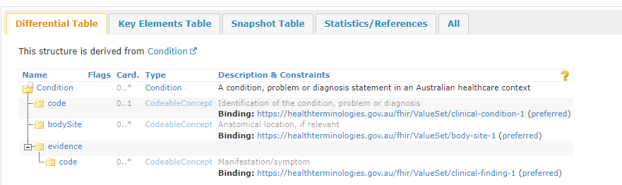
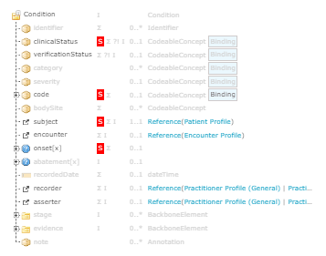
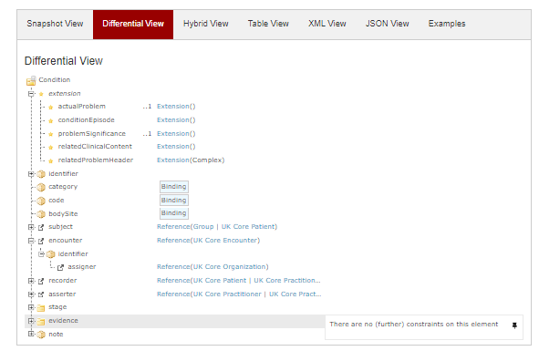
Comparison with other Base Practices
AU Base Condition
UK Core Condition
CA Baseline Patient

Slide 5
Refining for more Use Case Agnosticism
Where we may be missing the mark for use case agnosticism?
Prior to use cases the IGuide provides consistent representation of concepts
Are there things that we can comfortably apply cardinality or MustSupport rules that will never be challenged by use cases (paramedical services, consumer apps, emergency treatment) (what about CDS hooks?)
Are CA Baseline requirements different from the FHIR Base? When do we need to be different due to our locale…and whether it is necessary to represent in the StructureDefinition?
If we really mean for something to be applied consistently– computable constraints are necessary
MustSupport?
Practitioner and PractitionerRole examples where MS was too strong raised by BC
Considerations for mustSupport as a section in guide (without applying the MS flags themselves?)
Do we want to change or delay change because of what is coming forward in the replacement of MustSupport and the work occurring with pan-Canadian data models?
Process for how we make this decision: Send note to the forums on the decision (remove or not remove MustSupport flags w/ addition of noting any in a section), decision will be made by community by date X, will be discussed on X call, feedback provided before date X via forums and/or calls, posting the decision that was made on forum and reiterated on call
Two weeks notice ahead of last feedback call - Feedback before the 9th, discussion on the 2nd, discussion on how to handle on the 9th, decision after the 9th communicated as above
Right level for a major change like position on mustSupport
Following similar process for other types of decisions (with potential for grouping)
Cardinality?
Terminology?
Clinical terminology: can cause creep of use cases (e.g., different billing codes vs clinical codes)
Data Types?
Reference Targets?
Extensions?
Do we set a target? And if so how do we get there? Is it different from our current DDR process?

Slide 6
Refining for more Use Case Agnosticism
Will there be impact to users that is different if we preempt these revisions vs wait for them to come up organically in the community?
Does it erode some of the value for our users to remove some of these items? How do we prioritize our users?
Does this concern only exist for some types of revisions (e.g., Must Support) what about data type rules)?
What is and isn’t working about our current DDR and community issue process to determine if anything needs to change with those to drive the work?

