Slide 1

The CPUC’s $24.15 flat fee
The Good, The Bad and The Ugly
Ahmad Faruqui, Ph. D.

Slide 2
Electrification is a high priority for California
California, home to nearly 40 million people, is the largest state in the US.
Electrification is a top priority. Two technologies figure prominently: heat pumps and electric vehicles.
To accelerate electrification, the state needs to make electricity competitive with natural gas for domestic use and with gasoline for transportation. That means lowering the capital cost of electric equipment and lowering the cost of electricity to the consumer.
The state, along with the federal government, is providing various financial incentives that would lower the purchase and installation cost of heat pumps and EVs.
But it is also doing something that makes electrification unaffordable: repeatedly raising electric rates and pushing up electric bills to the breaking point.

Slide 3
Let’s consider the case of Pacific Gas & Electric (PG&E)
PG&E serves 5.5 million electric customers and 4.5 million gas customers in northern California. With the consent of the California Public Utilities Commission (CPUC), PG&E has more than doubled its electric rates over the past 10 years. For EV charging, the off-peak rate has doubled in just 5 years.
An EV that gets 4 miles/kWh is not going to save much in driving costs compared to an ICEV that gets 45 mpg.
To put things in perspective, it’s useful to compare PG&E’s electric bills with those of the Sacramento Municipal Utilities District (SMUD).

Slide 4
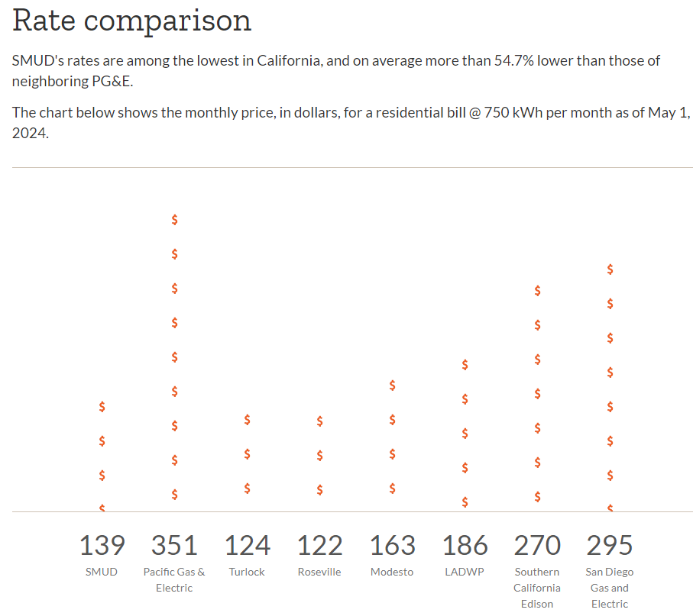
A PG&E customer would pay 2.61 times as much as a SMUD customer using 750 kWh a month

Slide 5
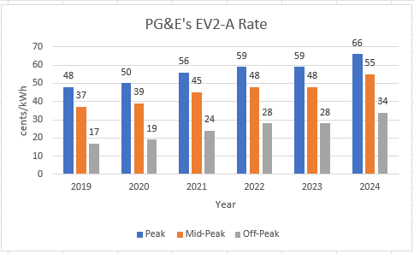
PG&E’s rates have been accelerating rapidly during the past 5 years

Slide 6
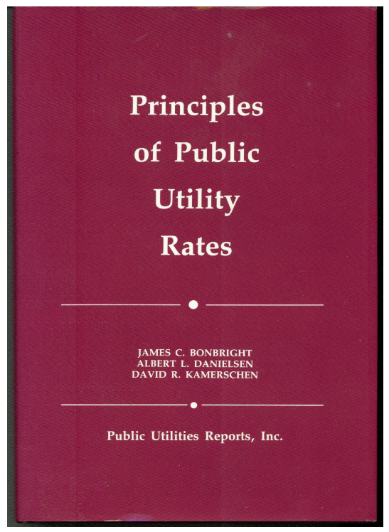
What are the principles that govern rate design?
To promote economic efficiency an equity, rates should be based on cost of service
Rates should be changed gradually
Rates should minimize adverse impact on customers

Slide 7
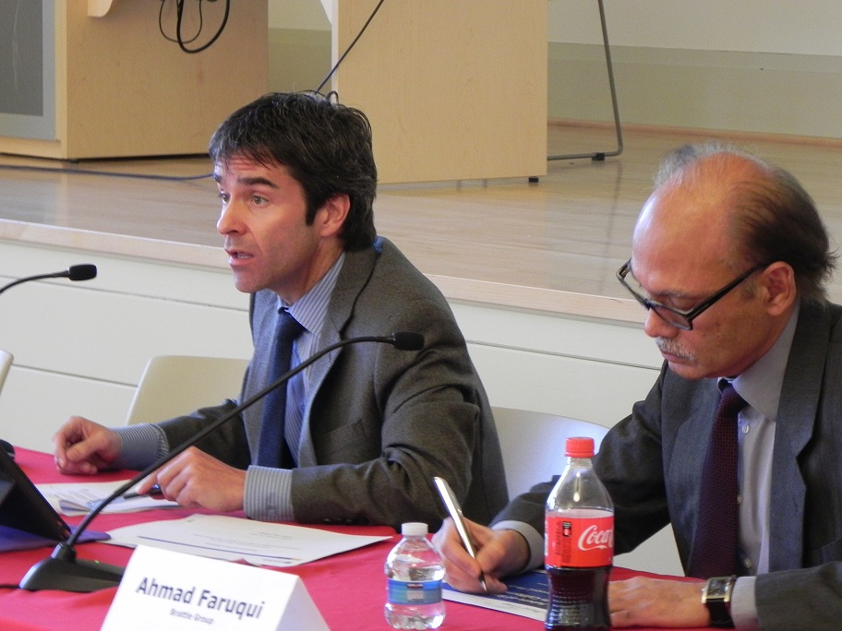
Fixed charges should be included in residential rates to recover the costs of metering, billing and customer care
On behalf of the 3 large investor-owned utilities in California, I testified on the topic before the California Public Utilities Commission (CPUC) during the 2010’s
At one point, the CPUC was close to approving a $3 a month fixed charge but was told by the GC of the commission that it would violate the constitution
A caucus of the state assembly was held in Fresno a few years later; I spoke at that session in support of a fixed charge
A law was passed allowing a fixed charge of up to $10 a month, yet the CPUC refused to approve it
Today, two of the three IOUs have a fixed charge of $0 and the third of just under a dollar

Slide 8
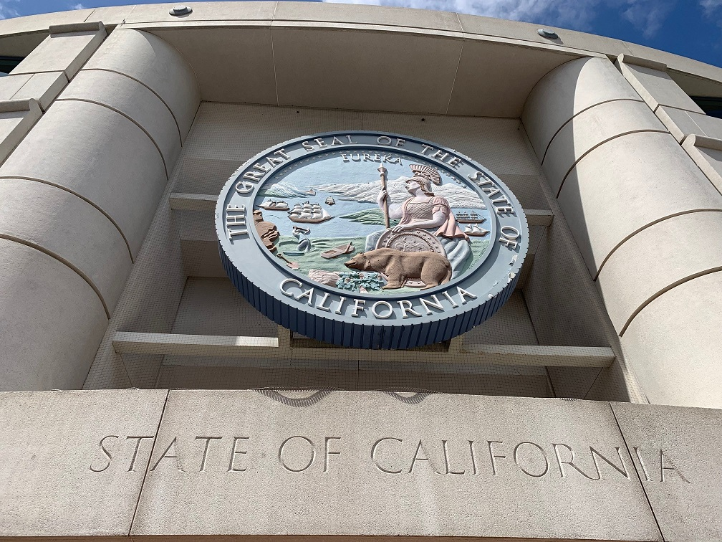
In December 2017, the CPUC held a workshop on rate design
A suggestion was made to drop energy prices down to the marginal cost of energy
Since that would create a revenue deficiency, a suggestion was made to recover the deficiency through a fixed charge
I was on a panel where the suggestion was debated
I objected to it, saying such a fixed charge would be very high

Slide 9
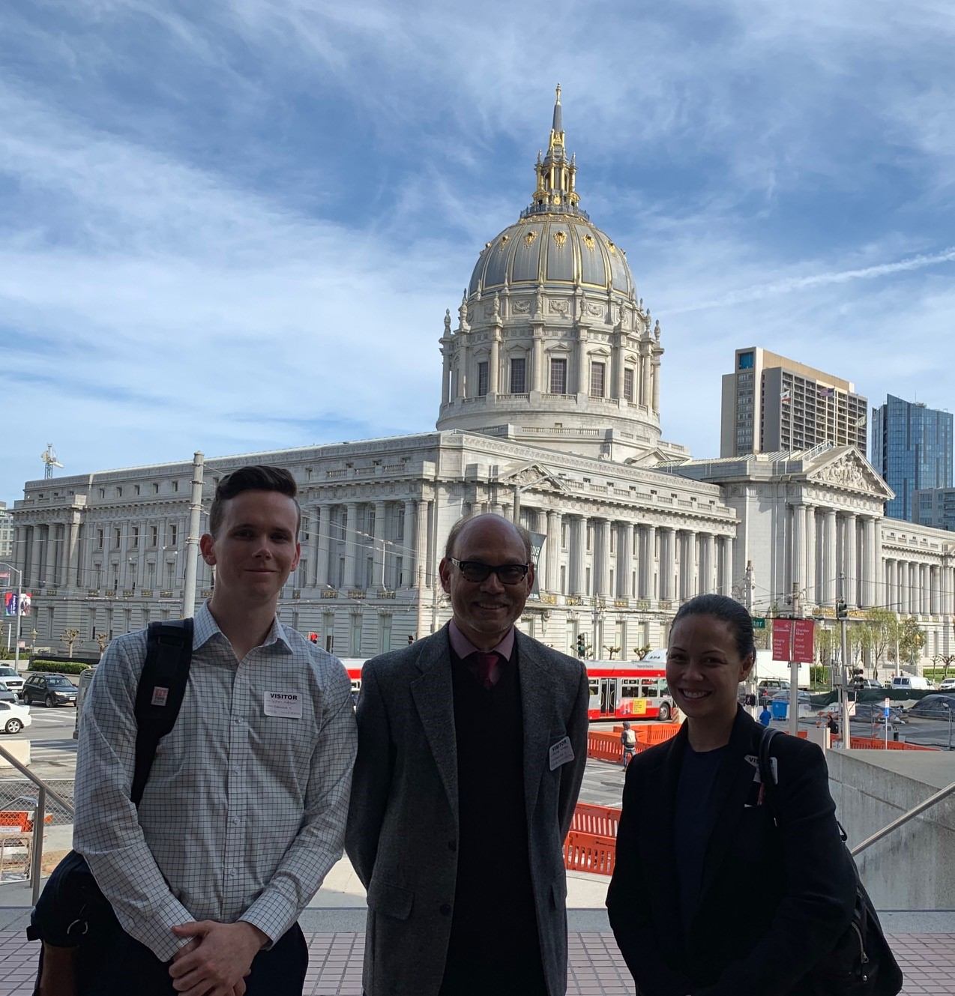
In 2019, the CPUC staff invited me to an informal discussion about rate design
They asked me: what is the biggest barrier?
I said high electric rates compared to natural gas rates
What can be done to promote heat pumps?
I listed the following: lower electric rates, raise gas rates, provide rebates on heat pumps, put a tax on gas water heaters and gas furnaces, ban the installation of gas equipment, fine and arrest contractors who install gas equipment
They said we can’t do most of what you just described

Slide 10
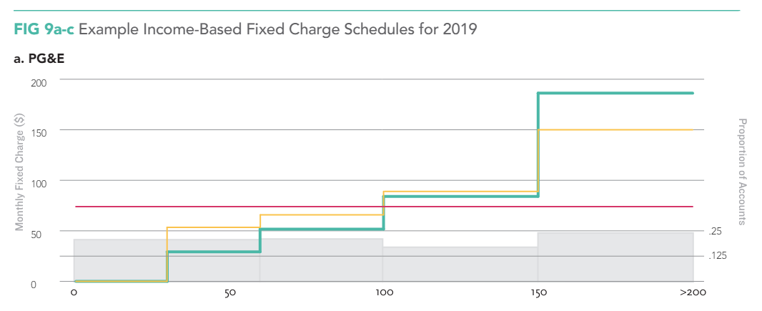
In 2021, a group called Next10 published a paper by Borenstein et al. which introduced income graduation in the fixed charge
It said the best way to promote “affordable electrification” was to set energy prices equal to marginal costs and to recover the lost revenue through a fixed charge
However, the fixed charge would vary by income
The paper created 5 income tiers across which the fixed charge rose
For PG&E customers, the paper proposed a top tier charge of ~$185 (average of ~$75)

Slide 11
In June 2022, Governor Newsom signed AB 205 – a trailer bill which had passed with no discussion or debate. It included a short clause about IGFC.
"The commission may authorize fixed charges for any rate schedule applicable to a residential customer account. The fixed charge shall be established on an income-graduated basis with no fewer than three income thresholds so that a low-income ratepayer in each baseline territory would realize a lower average monthly bill without making any changes in usage. The commission shall, no later than July 1, 2024, authorize a fixed charge for default residential rates."

Slide 12
The CPUC forced the IGFC into an ongoing proceeding on demand flexibility – its antithesis
Several parties submitted their IGFC proposals on April 7, 2023
TURN, which had always opposed a fixed charge, came out in support of IGFC
It teamed up with NRDC, which had also opposed fixed charges
The IOUs submitted a joint testimony showing fixed charges by four income tiers and discussing how they would get income data
  The appendix showed that customers were opposed to the very idea!

Slide 13
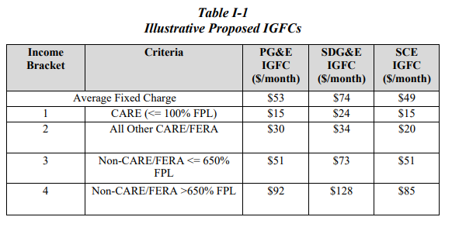
The three IOUs proposed sky high values for fixed charges in the fourth tier – values that did not exist anywhere in the US

Slide 14
The IGFC is a case of designing rates without data --- it will promote “affordable electrification,” as stated
Discounting energy charges and moving the “lost revenue” into fixed charges is just a shell game
Low-income customers who save money under IGFC will prioritize food, clothing and shelter over buying heat pumps or electric vehicles
  Their bill savings won’t make for affordable electrification
  Many of them are renters
  Many don’t own cars

Slide 15
IGFC will penalize efficiency and reward gluttony, in a deviation from common rate design practice
Middle income customers with low bills will see them go up
  Single individuals
  Couples living in apartments
  Families living in energy efficient homes
  Homes with solar panels
Those who use a lot of energy will see their bills go down
  The proposal will encourage the wasting of energy
This proposal is contrary to the state’s long-standing tradition of promoting energy efficiency

Slide 16
Faced with unprecedented public opposition, the CPUC asked utilities to submit a “first version” of IGFC
PG&E dropped the average fixed charge from $53 to $42, still 3.5X the US average
It dropped the upper tier fixed charge from $92 to $51, which is 4.3X the US average
The fixed charges in the “final version” were unchanged
The “first version” was meant to get the IGFC legitimized, and to open the door for implementing the original numbers in the “final version”

Slide 17
A Proposed Decision was released on March 24 and slightly revised on May 7, but the values for the fixed charges remained unchanged
The Tier 1 fixed charge was set at $6.00
The Tier 2 fixed charge was set at $12.08, which is the US median across 173 IOUs
The Tier 3 fixed charge was set at $24.15, and simply based on SMUD’s fixed charge, despite the many differences in SMUD’s cost structure and rate level
The CPUC has left the door open to raising the fixed charge in subsequent rate cases and to introducing more income tiers, requiring income verification

Slide 18
On May 9, the CPUC approved the IGFC values in the Proposed Decision without any discussion or debate
The vote was 4-0, with one commissioner recusing himself
The unanimous vote came despite several cautionary editorials and opinion pieces in the Los Angeles Times, San Francisco Chronicle and the Sacramento Bee
It came despite cautionary letters from several state assembly members and senators to the CPUC president

Slide 19
The CPUC’s flat fee of $24.15 will be the second highest in the country and is a huge jump from today’s flat fee

Slide 20
What will happen next is anyone’s guess
AB 1999 is being revised and will be voted upon by the utilities and energy committee of the assembly on May 15
If it passes, it will be voted upon in the assembly, and, if it passes, in the senate
Many Democratic legislators and most Republican legislators are opposed to IGFC
If AB 1999 passes and makes it to the governor’s desk, Gavin Newsom, who has his eyes on the White House, will have a tough decision to make
A class action lawsuit cannot be ruled out, nor a proposition on the ballot

Slide 21
There is a better way to make electrification affordable
Cap the growth in electric rates by the rate of inflation (~3%)
Find ways to lower cost and thus the rate level – PG&E’s rates are 3X the US average and 2.6X SMUD’s rates
Offer low-income customers additional rebates to offset the capital and installation costs of electrification technologies
Replace the IGFC with a better rate design, such as that outlined in the next slide

Slide 22
Here is a more efficient and equitable rate design for promoting electrification
First, include a modest fixed charge (~$10-15) and set the energy price equal to marginal cost. Let it vary by time of use. This rate design will help promote demand flexibility, which is the title of the proceedings in which the CPUC is discussing IGFC.
Second, only apply the new rate design to customers who are (a) in the market for replacing their HVAC system, water heater, stove, clothes dryer or gasoline car or (b) building a new house.
Third, even for customers who are in the market for new electric technologies, only apply the new rate design to the incremental use of electricity which will occur via electrification. In other words, don’t incentivize wasteful use of energy from existing technologies.

Slide 23
The $24.15 flat fee has good, bad and ugly features
The Good | The Bad | The Ugly
The climb down was dramatic | There is no upper limit to the fixed charge | Public comments were not taken, evidentiary hearings were not held
The fixed charge dropped from $185 to $92 to $24 for PG&E | More income tiers might be introduced, requiring income verification | It evoked the sordid manner in which AB 205 was passed

Slide 24
Selected commentaries on the flat fee
https://www.sfchronicle.com/opinion/editorials/article/pge-fixed-bill-california-19436421.php
https://www.latimes.com/environment/story/2024-05-07/california-utilities-seek-higher-fixed-monthly-fees
https://www.sacbee.com/opinion/op-ed/article287331975.html
https://www.canarymedia.com/articles/utilities/can-californias-new-cpuc-fixed-rates-really-help-the-energy-transition
https://www.sfchronicle.com/opinion/openforum/article/california-electric-bills-news-puc-19410274.php
https://www.sfchronicle.com/opinion/letterstotheeditor/article/pge-rates-climate-change-gaza-protests-19416842.php
https://www.latimes.com/opinion/letters-to-the-editor/story/2024-04-21/adding-flat-fee-added-to-electric-bills-wont-help-californians

Slide 25
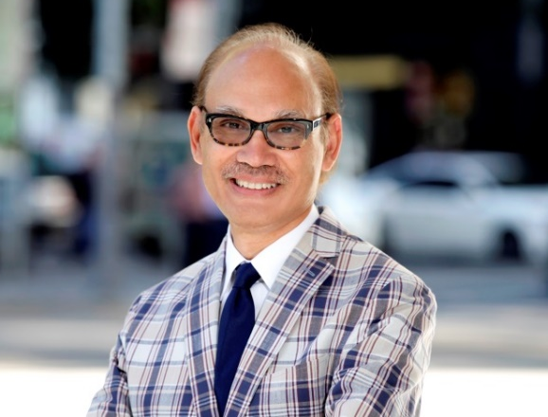
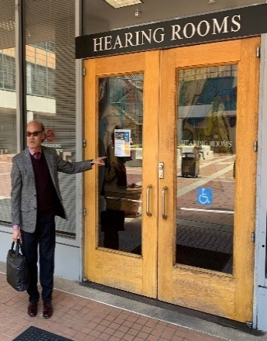
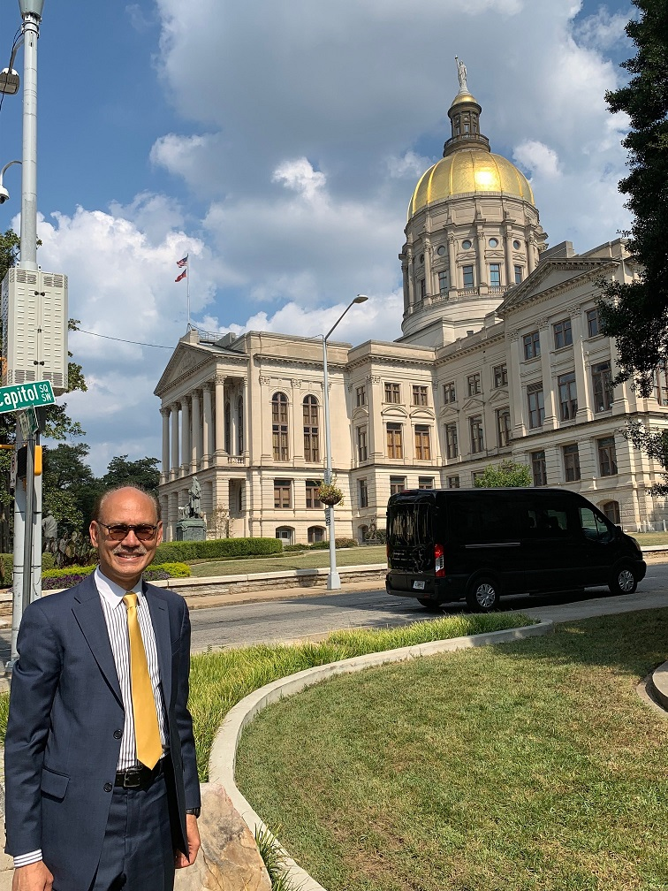
Biography
Ahmad faruqui, ph.d.
Economist-at-Large
San Francisco, California
Ahmadfaruqui@gmail.com
+1.925.408.0149
Dr. Faruqui has 45 years of consulting, teaching and research experience in rate design, load flexibility, energy efficiency, demand response, distributed energy resources, demand forecasting, decarbonization, and electrification. He has worked for over 150 clients on 5 continents and testified or appeared nearly 100 times before regulatory bodies, governments, and legislative councils on 6 continents.
He has authored or coauthored more than 100 papers in peer-reviewed and trade journals and co-edited books on industrial structural change, customer choice, and electricity pricing. His work has been cited in Bloomberg, Business Week, The Economist, and Forbes, and in Los Angeles Times, Mercury News, San Francisco Chronicle, New York Times, San Diego Union-Tribune, Sacramento Bee and the Washington Post. He has appeared on NPR and Fox Business News.
Dr. Faruqui has taught economics at San Jose State, UC Davis and the University of Karachi and delivered guest lectures at Carnegie Mellon, Harvard, Idaho, MIT, New York, Northwestern, Rutgers, San Francisco, Stanford, and UC Berkeley. He holds an MA in Agriculture Economics and a PhD in Economics from UC Davis, and a BA and an MA in Economics from the University of Karachi, Pakistan.

