Slide 1

The Canadian Clinical Drug Data Set (CCDD) Special Groupings and Coded Attributes Change November 28th, 2023

Slide 2
Agenda
Why is a change needed to the Canadian Clinical Drug Data Set (CCDD) Special Groupings and Coded Attributes files?
Brief overview of the Alberta Tracked Prescription Program (TPP)
What will this change look like?

Slide 3
Why is a Change Needed? The Use Case
The Alberta Tracked Prescription Program (TPP) will leverage the CCDD ‘Special Groupings’ and ‘Coded Attributes’ files to identify monitored medications that have specific prescribing requirements under their policy
The CCDD will be leveraged to support safe prescribing of controlled substances
Will help reduce the need for paper forms, and allow a greater adoption of e-prescribing for these medications

Slide 4
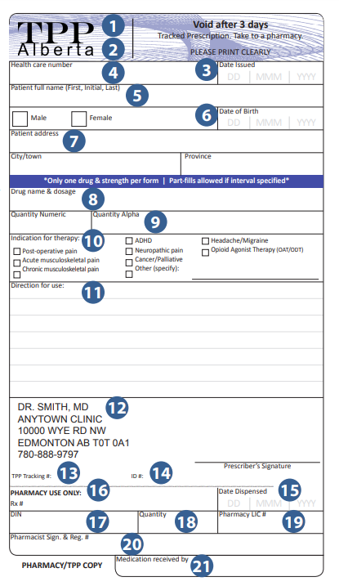
The Tracked Prescription Program (TPP)
The TPP Program was established in Alberta to monitor certain drugs prone to misuse (e.g., morphine, fentanyl)
Clinicians prefer e-prescribing for the security and subsequent reduced need for the paper TPP form
There is a set of ‘Indications for Use’ that are mandatory for the TPP program
Currently, with the EMR tools available, it is challenging for prescribers to easily provide an indication that is aligned with the TPP’s standard list when prescribing monitored medications
To meet the requirements of the program, e-prescribing solutions need to capture indication for use and the CCDD changes will support this
Notes:
Driver to look at mandatory capturing of Indication for Use in Alberta
Discuss paper vs electronic changes
If we were to develop functionality, to make Indication mandatory for some medications, want their feedback as it may have implications more broadly than AB; thoughtful in how implement and clinician implications

Slide 5
What Will the Change Look Like?
An additional policy (i.e., Alberta TPP Type 1) in the ‘Coded Attributes’ file
Those concepts that fall under the new policy, will be added to the ‘Special Groupings’ file and identified with the new Coded Attribute
There will be no structural changes to the existing files
Distribution will follow the existing CCDD publishing process
The Alberta TPP Type 1 coded medication list will be available publicly; however, the TPP program will own and update the list as the program evolves
Target for this change is early next year, and there will be an announcement on the InfoCentral Medication Management community ahead of time

Slide 6
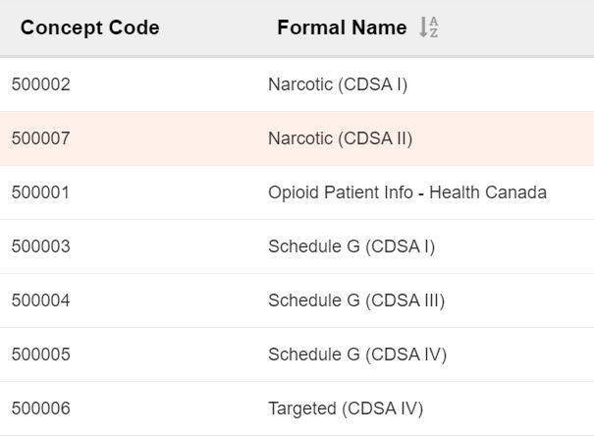
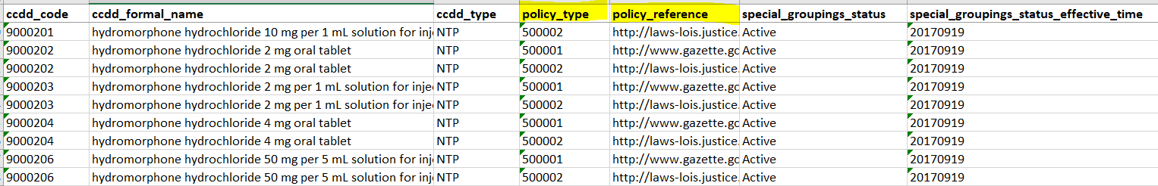

Slide 7

Comments / Questions?

