Slide 1
Public Health Surveillance (PHS) Community
Agenda and Notes
June 6, 2024, 2:00–3:00 pm ET

Slide 2
PHS Community Agenda
Welcome and Introductions (5 min)
Infoway Is Recruiting (5 min)
Terms of References – Final (5 min)
New Requests Since Last Meeting And May Release Of The SNOMED CT CA Edition (5 min)
Merging Options For The Tradename And Generic/Historical Subsets (15 min)
Follow-up On Who Uses The Antigen And Immunoglobulin Joint Subset And The Objective? (10 min)
Follow-up On The Picklist (clinician/public) subsets (5 min)
Questions/Wrap Up (5 min)

Slide 3
Welcome and Introductions (5 min)
Linda Parisien, Canada Health Infoway

Slide 4
2. Infoway Is Recruiting (5 min)
Resources update
Rita Pyle last day was May 29
Tara Mawhinney last PHSC meeting
2 positions open:
Public Health Surveillance Advisor, part time
PHS-Standards SME, full time
https://www.linkedin.com/jobs/view/3932577140
Linda Parisien, Canada Health Infoway

Slide 5
3. Updated Terms of Reference – Final version (5 min)
Highlights of changes-
References NVC scope
Table describes NVC and PHSC roles
Any comments, concerns, suggestions?
RESULT: NO OBJECTIONS. APPROVED AS FINAL
ACTION: Tara will post the final TOR version on the PHSC Forum
Tara Mawhinney, Canada Health Infoway

Slide 6
ToR Addition:
EUDP Terms of Reference | PHSC Scope
Identify and define changes or updates (e.g., new data elements or subsets), related to NVC data sources, to prepare change requests for submission to data providers. | Provide input on existing or future SNOMED CT CA subset requirements. Ensure new content created meets pan-Canadian requirements.
CHI PHSC forum will subsequently deliberate on the specifics of the request for development, which then will be seamlessly integrated into the NVC when ready. Therefore, EUDP members are encouraged to join CHI PHSC to actively engage and further shape these requests brought forward by the group. | Seek out expert advice on complex issues that may arise in the creation or updates to vaccine concepts. Incorporate recommendations into new / updated content.
Data providers will provide input and insight into source data, identify potential data opportunities aligned with user needs, and assess the feasibility of discussed requirements. Additionally, they will facilitate integration with the NVC and ensure data integrity. | Work closely with NVC / EUDP to ensure alignment of “sources of truth” and timing of priorities for new SNOMED CT CA content development.

Slide 7
4. New Requests Since last Meeting and May SNOMED CT CA Edition Release (5 min)
Linda Parisien, Canada Health Infoway

Slide 8
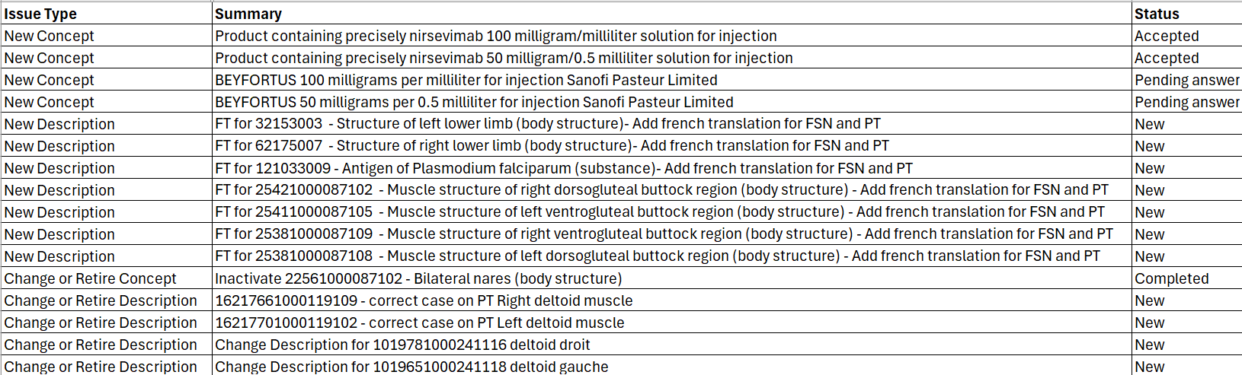
New Requests Since Last PHSC Meeting
Target publication: August 2024

Slide 9
May 31, 2024 SNOMED CT CA Edition Publication
Now available on the Terminology Gateway, in addition of the maintained Immunization subsets:
The ImmunizationMarketAuthorizationHolderCode subset identifies the Market Authorization Holder authorized by Health Canada for distributing the immunizing agent in Canada.
The ImmunizationReportingSourceCode subset identifies the source of the immunization record.
The ImmunizationAdministrationAnatomicalSiteCode subset identifies the anatomical site where the immunizing agent was administered.
The ImmunizationRouteOfAdministrationCode identifies the path the administered immunization takes to get into the body. The subset has been curated specifically to capture only routes of administration relevant to immunization
The ImmunizationPractitionerOccupationCode identifies the occupation of healthcare practitioner that administer immunization. The subset has been curated specifically to capture only relevant healthcare practitioner occupations.

Slide 10
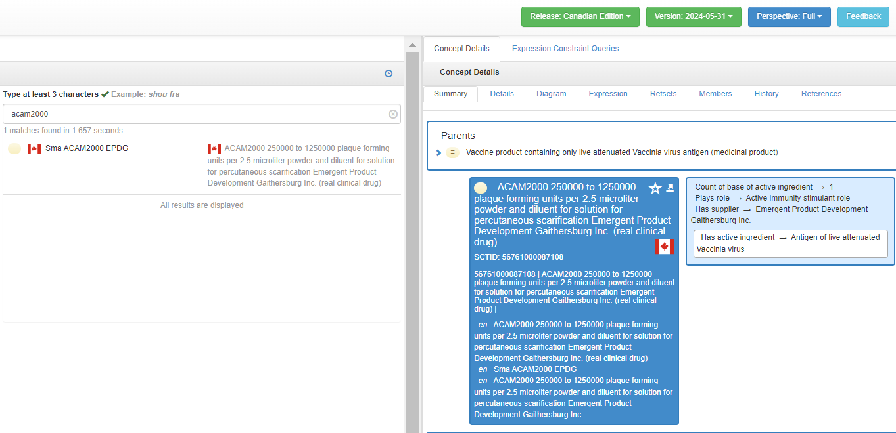
May 31, 2024 SNOMED CT CA Edition Publication
All Canadian specific content also available in the SNOMED International Browser:

Slide 11
5. Merging Options For The Tradename And Generic/Historical Subsets (15 min)
Linda Parisien, Canada Health Infoway
Group discussion

Slide 12
Option #1
Create 2 new subsets
  A new Tradename subset that would combine all active and passive tradename immunizing agents
  A new Generic subset that would combine all active and passive generic immunizing agents
  PROS:
    Combined content as CVC had in their solution
    All tradename immunizing agents would stay in the Tradename subset
    Decrease the number of subsets
  CONS:
    The current individual subsets and the new ones will need to be maintained concurrently
    Différentiation of the active from the passive agents difficult (although this may be done by the immunizing agents abbreviation)
    May cause confusion for implementers as to which subsets need to be implemented

Slide 13
Option #2
Merge the current tradenames subsets and the historical subsets
  The current Tradename subset would combine all active and passive tradename immunizing agents
    The current Tradename subset scope would need to be adjusted to only contain Tradename immunizing agents
  The current Historical subset that would combine all active and passive generic immunizing agents
    The current Historical subset would need to be renamed and scope changed to only contain generic concepts
  PROS:
    Combined content as CVC had in their solution
    All tradename immunizing agents would stay in the Tradename subset
    Decrease the number of subsets to maintain (two instead of four)
  CONS:
    Différentiation of the active from the passive agents difficult (although this may be done by the immunizing agents abbreviation)
    Change in subsets scope and membership may cause confusion for the implementers

Slide 14
Option #3
Keep the four current Tradename and Historical subsets and redefine their scope (and membership)
  Redefine the scope of each subsets to only have the Tradename in the Tradename subsets and only ‘generic’ concepts in the Historical subsets
    VaccineAdministeredTradeNameCode
    PassiveAdministeredImmunizingAgentCode
    VaccineHistoricalNameCode
    PassiveHistoricalImmunizingAgentCode

Slide 15
Option #3
Keep the four Tradename and Historical subsets and redefine their scope (and membership)
  PROS:
    No issue to differentiate the active from the passive
    All tradename immunizing agents would stay in the Tradename subsets
    No additional maintenance burden for anyone
  CONS:
    Not combined as CVC had them in their solution, but NVC can join them in the online tool
    Change in subsets scope and membership may cause confusion for the implementers

Slide 16
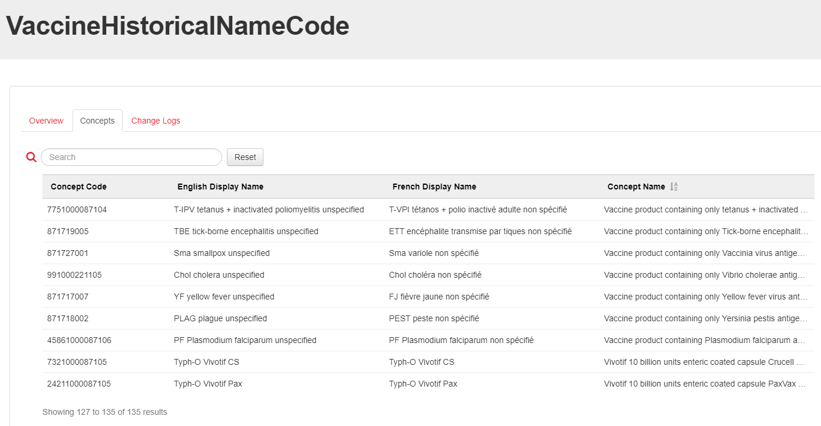
Option #3
What does this mean:

Slide 17
Option #3
New proposal Subsets definition
Vaccineadministeredtradenamecode
CURRENT:
The scope of this subset is vaccines that are currently licensed for use in Canada and those obtained through special access programs for use in Canada. The subset includes concepts represented by the trade name (brand name) of the vaccine administered to the client. This content is intended to be used when populating a record at the point of immunization.
PROPOSE CHANGE:
The subset includes concepts represented by the trade name (brand name) of the vaccine administered to the client. The scope of this subset is all vaccines that have been are currently licensed for use in Canada, and those obtained through special access programs for use in Canada, and those that were never licensed in Canada (i.e., administered in other countries).

Slide 18
Option #3
New proposal Subsets definition
Vaccinehistoricalnamecode
CURRENT:
The scope of this subset is vaccines that are currently licensed for use in Canada (generic description, i.e. no trade name), those obtained through special access programs (generic description), and vaccines that have been discontinued and/or never licensed in Canada (with trade name). This content is intended to be used when populating an immunization history when the client and /or provider does not have the detail of the trade name (brand name) of the vaccine administered OR the product has been discontinued and/or never licensed in Canada. This subset will include concepts represented by a generic description for a vaccine that was previously administered to the client as may be expressed by the client or provider for an immunization history and concepts represented by the trade name for products that have been discontinued and/or never licensed in Canada.
PROPOSE CHANGE:
The scope of this subset is generic vaccines that have been are currently licensed for use in Canada (generic description, i.e. no trade name), those obtained through special access programs (generic description), and for vaccines that have been discontinued and/or were never licensed in Canada. (with trade name). This content is intended to be used when populating an immunization history when the client and /or provider does not have the detail of the trade name (brand name) of the vaccine administered or OR the product has been discontinued and/or never been licensed in Canada. This subset will include concepts represented by a generic description for a vaccine that was previously administered to the client as may be expressed by the client or provider for an immunization history and concepts represented by the trade name for products. that have been discontinued and/or never licensed in Canada.

Slide 19
Option #3
New proposal Subsets definition
PassiveAdministeredImmunizingAgentCode
CURRENT:
The scope of this subset is passive immunizing agents that are currently licensed for use in Canada and those obtained through special access programs. The subset includes concepts represented by the trade name (brand name) of the passive immunizing agent (immune globulin or antitoxin) that was administered to the client. Passive immunizing agents are used to facilitate protection against vaccine preventable infections, when vaccines are not available or are contraindicated or when vaccines have not been used before exposure to the infective agent. This content is intended to be used when populating a record at the point of administration.
PROPOSE CHANGE:
The subset includes concepts represented by the trade name (brand name) of the passive immunizing agent (immune globulin or antitoxin) that was administered to the client. The scope of this subset is all passive immunizing agents that that have been are currently licensed for use in Canada, and those obtained through special access programs for use in Canada, and those that were never licensed in Canada (i.e., administered in other countries). Passive immunizing agents are used to facilitate protection against vaccine preventable infections, when vaccines are not available or are contraindicated or when vaccines have not been used before exposure to the infective agent.

Slide 20
Option #3
New proposal Subsets definition
PassiveHistoricalImmunizingAgentCode
CURRENT:
The scope of this subset is passive immunizing agents used in Canada (generically described, i.e. without trade name), those obtained through special access programs (generically described), and agents that have been discontinued and/or never licensed in Canada (with trade name). This content is intended to be used when populating an immunization history when the client and/or provider does not have the detail of the trade name of the agent administered OR the product has been discontinued and/or never licensed in Canada. Passive immunizing agents are used to facilitate protection against vaccine preventable infections, when vaccines are not available or are countraindicated or when vaccines have not been used before exposure to the infective agent. This subset will include concepts represented by a generic description for an agent that was previously administered to the client as may be expressed by the client or provider for an immunization history and concepts represented by the trade name for products that have been discontinued and/or never licensed in Canada.
PROPOSE CHANGE:
The scope of this subset is generic passive immunizing agents used in Canada (generically described, i.e. without trade name), those obtained through special access programs (generically described), and passive agents that have been discontinued and/or were never licensed in Canada. (with trade name). This content is intended to be used when populating an immunization history when the client and/or provider does not have the detail of the trade name of the agent administered or OR the product has been discontinued and/or never been licensed in Canada. Passive immunizing agents are used to facilitate protection against vaccine preventable infections, when vaccines are not available or are countraindicated or when vaccines have not been used before exposure to the infective agent. This subset will include concepts represented by a generic description for an a passive agent that was previously administered to the client as may be expressed by the client or provider for an immunization history and concepts represented by the trade name for products. that have been discontinued and/or never licensed in Canada..

Slide 21
Merging Options For The Tradename And Generic/Historical Subsets
Comments received from the audience:
  The Infoway subsets should align with the NVC subsets
  Option #2 was preferred by one jurisdiction
  REQUEST FOR ACTION FROM THE PHSC:
  Please provide feedback and comments on this topic on the PHSC Forum at any moment between now and September, so the changes can be effective in the November 2024 CA Edition release

Slide 22
6. Follow-up On Who Uses The Antigen And Immunoglobulin Joint Subset And For What? (10 min)
Was not discussed – Postponed to September meeting
Linda Parisien, Canada Health Infoway
Group discussion

Slide 23
Antigen/Immunoglobulin Subsets
Who uses the joint subset?
How is the subset used?
Why is the subset used?
  Are you using them for forecasting?
  If so, are you experiencing any challenges?
If you are not using the joint subset, are you using the individual antigen subset and or the immunoglobulin subset published on the Infoway Terminology Gateway?
Notes:
The logo can be changed in the master slides. Please use the following instructions
Select view > slide master.
Right click on the logo and select change picture.
Select the image you want to use you may need to scale the image accordingly
When you're done, select close master view.

Slide 24
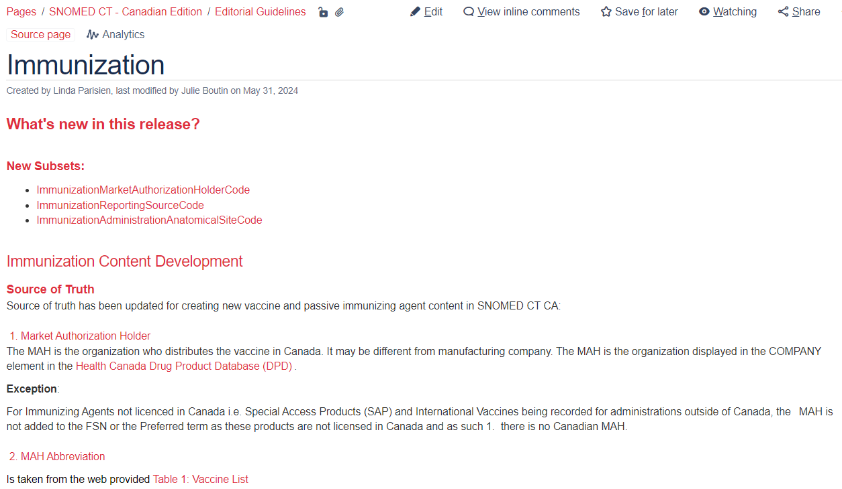
Antigen/Immunoglobulin Subsets
Immunization Editorial Guidelines
Notes:
The logo can be changed in the master slides. Please use the following instructions
Select view > slide master.
Right click on the logo and select change picture.
Select the image you want to use you may need to scale the image accordingly
When you're done, select close master view.

Slide 25
Antigen/Immunoglobulin Subsets
Excerpt from the Immunization Editorial Guidelines (AntigenCode Subset)
For some categories of antigens the granularity level has been driven by the forecasting schedule.
  For example, pneumococcal polysaccharide has the same forecast regardless of whether the patient received a single or multi-valent product. Therefore only one higher parent is created as pneumococcal polysaccharide antigen to accommodate for all pneumo-p. The same has been done for the pneumococcal conjugate formulation: only one higher parent is created as pneumococcal conjugate antigen to accommodate for all pneumo-c.
Specific strains are not always needed for forecasting; therefore where multiple strains exist, the antigens were identified along with terms such as conjugate. Examples where this has been used include: pneumococcal conjugate and pneumococcal polysaccharide (no requirement for specifying to 23 valency).
For HPV, the clinical requirement for forecasting is to identify whether the product is HPV-2 or HPV-4, therefore the HPV antigens were identified including HPV bivalent (i.e. HPV 2), HPV quadrivalent (i.e. HPV 4), but also the individual antigens were included HPV types 6, 11, 16, 18.
Notes:
The logo can be changed in the master slides. Please use the following instructions
Select view > slide master.
Right click on the logo and select change picture.
Select the image you want to use you may need to scale the image accordingly
When you're done, select close master view.

Slide 26
Antigen/Immunoglobulin Subsets
Excerpt from the Immunization Editorial Guidelines (AntigenCode Subset)
The rationale for creation of ‘buckets’ is to combine similar antigens together in the groups required to support the immunization schedule forecast logic.
Buckets created: Pneu-C-7, Pneu-C-10, Pneu-C-13, Pneu-P-23, Rota, HPV-2-4 and Men
  The bucket will carry a (medicinal product) semantic tag, because the concept represented by this code is not an ‘atomic’ concept
  There are multiple exceptions to this rule. Refer to the editorial page.
Notes:
The logo can be changed in the master slides. Please use the following instructions
Select view > slide master.
Right click on the logo and select change picture.
Select the image you want to use you may need to scale the image accordingly
When you're done, select close master view.

Slide 27
7. Follow-up On The Picklists (Clinician/Public) Subsets (5 min)
Was not discussed – Post-poned to September meeting
Linda Parisien, Canada Health Infoway

Slide 28
8. Questions/Wrap up
Next meeting
Thursday, September 5, 2024, 2:00-3:00 pm ET
HAVE A GREAT SUMMER!

Slide 29
Thank you!
Contact Information:
standards@infoway-inforoute.ca

