Slide 1
The Centre for Gender, Diversity and Inclusion Statistics The Centre for Demography Statistics Canada
Sexual Orientation and Gender in Canada’s Statistical System
Infoway Sex and Gender Working Group, February 23, 2021

Slide 2


The Centre for Gender, Diversity, and Inclusion Statistics
The Centre identifies and addresses gaps in the availability of disaggregated data on sex, gender, and other intersecting identity characteristics to enrich our understanding of social, economic, and environmental issues.
Goals and objectives
Report to Canadians about the state and progress of gender, diversity, and inclusion in Canada
Generate new information to increase knowledge, develop new concepts and measures to address intersecting characteristics
Build statistical capacity to increase knowledge of gender, diversity, inclusion, and Gender-based Analysis Plus (GBA+)

Slide 3
National Statistical Standards Tested and Trusted

Slide 4
National statistical standards Tested and trusted
For Statistics Canada to provide more disaggregated information for population groups, the data must be collected in a standardized way to allow for meaningful comparisons and a sufficient volume of data must also be collected to enable these comparisons.
Statistics Canada plays a leading role in ensuring that strong standards are developed and adopted as part of the national statistical system. This includes making available statistical standards for collecting disaggregated data.
“Tested and trusted statistical standards” explores how statistical standards are used to provide data insights on a particular topic to help individuals understand and interpret those data.
Link: https://www150.statcan.gc.ca/n1/pub/11-627-m/11-627-m2020051-eng.htm

Slide 5

Statistics Canada’s Policy on Standards
Each standard should have the following characteristics:
describe the concept that the standard addresses when appropriate;
identify the statistical unit(s) to which it applies;
provide a name and definition of each variable included in the standard;
provide the classification(s) to be used in the compilation and dissemination of data on each variable
E.g. Gender and sex variables
Classification: A classification is a systematic grouping of the values that a variable can take comprising mutually exclusive classes, covering the full set of values, and often providing a hierarchical structure for aggregating data. More than one classification can be used to represent data for a given variable.

Slide 6
Measuring sexual orientation and gender

Slide 7
Measuring sexual orientation In surveys
2003
Do you consider yourself to be:
INTERVIEWER: Read categories to respondent.
… heterosexual? (sexual relations with people of the opposite sex)
… homosexual, that is lesbian or gay? (sexual relations with people of your own sex)
… bisexual? (sexual relations with people of both sexes)
Present
What is your sexual orientation?
Would you say you are:
Heterosexual
Lesbian or gay
Bisexual
Or please specify:

Slide 8

Measuring sexual orientation Adapting Statistics Canada’s standards and measures - Consultation process
Formed internal working group on sexual orientation with a four phased approach:
Expert consultations (Spring/Summer 2020)
Focus groups with LGBTQ2+ non-LGBTQ2+ Canadians (June-July 2020)
Public consultation through the Statistics Canada website (February 2021)
One-on-one interviews with LGBTQ2+ non-LGBTQ2+ Canadians on updated questions to measure sexual orientation (March 2021)
Outcomes:
Statistical metadata (definitions and categories) related to sexual orientation
Updated questions to measure sexual identity, attraction and behaviour

Slide 9

Measuring sexual orientation Adapting Statistics Canada’s standards and measures Consultation process continued
Current Phase: Public consultation through the Statistics Canada website
To better respond to the growing information needs of diverse communities in Canada, a public consultation was launched on Feb 2, 2021 on gender and sexual diversity statistical metadata standards.
https://www.statcan.gc.ca/eng/consultation/2021/gender

Slide 10
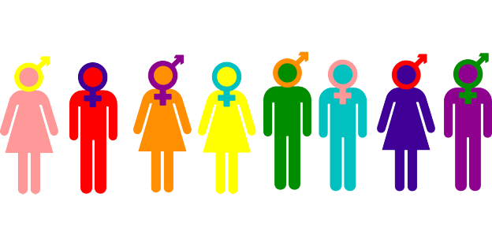
Sexual orientation of person
Proposed definition:
Sexual orientation refers to an umbrella term that includes a person's sexual identity, sexual attraction and sexual behaviour. Sexual identity refers to how a person perceives their sexuality (e.g., lesbian, straight, bisexual), sexual attraction refers to whom a person finds sexually appealing, and sexual behaviour refers to with whom a person engages in sexual activity. A person's sexual orientation may change over time.

Slide 11
Proposed new standard classification (list) of sexual identity
Code | Category
1 | Heterosexual or straight
2 | Minority sexual identity
2.1 | Gay or lesbian
2.2 | Bisexual
2.3 | Pansexual; asexual; queer, n.o.s¹.; Two-Spirit, n.o.s.; or sexual identity, n.e.c.²
2.3.1 | Pansexual
2.3.2 | Asexual
2.3.3 | Queer, n.o.s.
2.3.4 | Two-Spirit, n.o.s.
2.3.5 | Sexual identity, n.e.c.
1. Not otherwise stated
2. Not elsewhere classified

Slide 12
LGBTQ2+ Status of person
LGBTQ2+ status refers to whether or not a person is lesbian, gay, bisexual, transgender, queer, Two-Spirit, or another non-binary gender or minority sexual identity.
Derivation
'LGBTQ2+ status' is derived from information on 'Transgender status' and 'Sexual orientation- sexual identity'. The 'Transgender status' classification identifies persons whose current gender is not the same as their sex at birth (which includes the non-binary population). Together with persons reporting a minority sexual identity, they constitute the LGBTQ2+ population.

Slide 13

Sexual orientation of person
Attraction and behaviour
Separate components from sexual identity to fit different purposes
Attraction – recommended to measure sexual minority youth
Behaviour – collected to inform public health indicators
Each classification has two versions – one depends on respondent’s own sex/gender

Slide 14
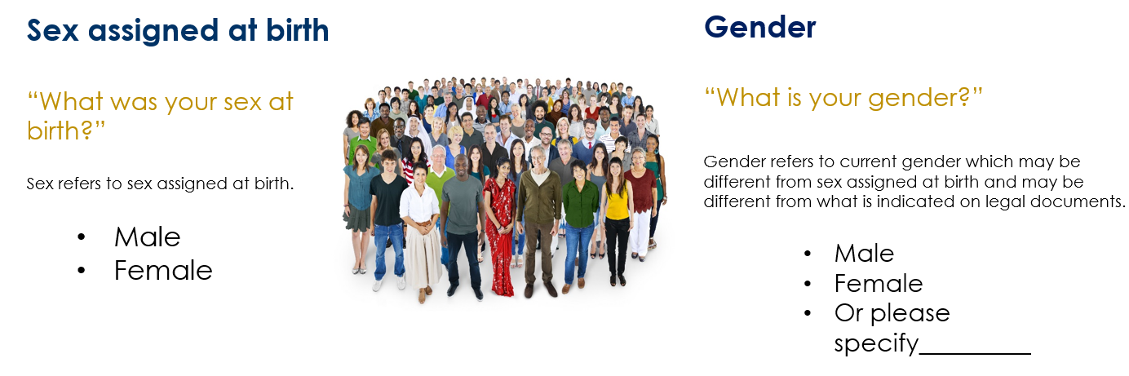
2021 Census of Population questionnaire

Slide 15
Gender definition (current)
Gender refers to the gender that a person internally feels ('gender identity' along the gender spectrum) and/or the gender a person publicly expresses ('gender expression') in their daily life, including at work, while shopping or accessing other services, in their housing environment or in the broader community. A person's current gender may differ from the sex a person was assigned at birth (male or female) and may differ from what is indicated on their current legal documents. A person's gender may change over time.

Slide 16
Gender definition (proposed update)
Gender refers to a person’s social or personal identity as a man, woman or non-binary person (a person who is not exclusively male or female). Conceptions of gender are influenced by several factors, including biological characteristics, cultural and behavioural norms, and self-identity.
Gender includes the concepts of
gender identity (felt gender), which is the gender that a person feels internally
gender expression (lived gender), which is the gender a person expresses publicly in their daily life, including at work, at home or in the broader community.
A person’s current gender may differ from the sex they were assigned at birth (male or female), and may differ from what is indicated on their current legal documents. A person’s gender may change over time. Some people may not identify with a specific gender or with the concept of gender as a whole.

Slide 17
Classification of cisgender and transgender (current)
Transgender This category includes persons whose sex assigned at birth was reported as female and whose current gender was reported as other than female; or persons whose sex assigned at birth was reported as male and whose current gender was reported as other than male. It also includes persons who were reported as being unsure of their gender or persons who were reported as both male and female, bi-gender, or neither male nor female.

Slide 18
Classification of transgender status (proposed update)
Transgender person This category refers to persons whose reported sex assigned at birth differs from their current gender. It includes persons who are non-binary, that is, whose current gender was not reported exclusively as male or female.
Concepts related to sex at birth, gender and transgender status
Transgender status
Gender/Sex at birth | Male sex persons | Female sex persons
Male gender persons | Cisgender men | Transgender men
Female gender persons | Transgender women | Cisgender women
Non-binary persons | Transgender non-binary persons

Slide 19
Classification of gender (current)
Gender diverse This category includes persons whose current gender was not reported exclusively as male or female. It includes persons who were reported as being unsure of their gender, persons who were reported as both male and female, or neither male nor female.

Slide 20
Classification of gender (proposed update)
Non-binary gender This category includes persons whose current gender was not reported exclusively as male or female.
It includes persons who were reported as both male and female, neither male nor female, or either male or female in addition to another gender, or persons who were reported as being unsure of their gender.
It includes persons whose current gender was indicated, for example, as agender, pangender, genderqueer, genderfluid, gender non-conforming, or Two-Spirit, a term specific to Indigenous people from North America.

Slide 21
Work leading up to the 2021 Census
Publication of the new gender standard (spring 2021)
Dissemination strategy
Analytical plan for the 2021 Census
Release of initial results on gender diversity in Canada (spring 2022)
Results on sociodemographic characteristics of the transgender and non-binary population in Canada (winter 2023)
Guidance on disseminating gender for surveys and the Census (spring 2021)
Gender by default
2-category gender variable in most data and analytical products

Slide 22
Highlights of Recent Publications

Slide 23
Selection of publications on diverse population groups Gender and sexual orientation
Vulnerabilities related to COVID-19 among LGBTQ2+ Canadians
https://www150.statcan.gc.ca/n1/pub/45-28-0001/2020001/article/00075-eng.htm
Impact of COVID-19 on businesses majority-owned by women
https://www150.statcan.gc.ca/n1/pub/45-28-0001/2020001/article/00056-eng.htm
Gender differences in mental health during the COVID-19 pandemic
https://www150.statcan.gc.ca/n1/pub/45-28-0001/2020001/article/00047-eng.htm
Labour Market Experience, Gender Diversity and the Success of Women-owned Enterprises
https://www150.statcan.gc.ca/n1/pub/11f0019m/11f0019m2020010-eng.htm
Representation of women on boards of directors
https://www150.statcan.gc.ca/n1/daily-quotidien/200128/dq200128b-eng.htm
Perceptions related to gender-based violence, gender equality, and gender expression
https://www150.statcan.gc.ca/n1/pub/85-005-x/2019001/article/00001-eng.htm
Measuring and Analyzing the Gender Pay Gap: A Conceptual and Methodological Overview
https://www150.statcan.gc.ca/n1/pub/45-20-0002/452000022019001-eng.htm

Slide 24
New Releases from Statistics Canada Social media
For updates on current social, economic and environmental conditions please follow us at:
@statcan_eng
@statcan_eng
Statistics Canada
Statistics Canada
Statistics Canada
u/StatCanada

Slide 25
Contact Information Can’t find what you want?
Contact us at Statistics Canada.
Centre for Gender, Diversity and Inclusion Statistics
Email: statcan.cgdis-csgdi.statcan@canada.ca
The Statistical Information Service offers a complete range of services to data users.
They can be reached at:
Phone number: 1-800-263-1136
E-mail: infostats@canada.ca or statcan.infostats-infostats.statcan@canada.ca

Slide 26
Annex: category definitions, sexual identity:
Heterosexual or straight | This category includes persons whose current sexual identity was reported as heterosexual or straight. It includes persons who have physically and/or emotionally intimate feelings only towards persons of a different sex or gender than their own.
Minority sexual identity | This category includes persons whose current sexual identity was reported as gay, lesbian, bisexual, pansexual, asexual, queer, Two-Spirit, or another sexual identity that is not heterosexual or straight.
Gay or lesbian | This category includes persons whose current sexual identity was reported as gay or lesbian. It includes persons who have physically and/or emotionally intimate feelings only towards persons of the same sex or gender as their own.
Bisexual | This category includes persons whose current sexual identity was reported as bisexual. It includes persons who have physically and/or emotionally intimate feelings both towards persons of their own sex or gender and persons of a different sex or gender.
Pansexual; asexual; queer, n.o.s.; Two-Spirit, n.o.s.; or sexual identity, n.e.c. | This category includes persons whose current sexual identity was reported as pansexual, asexual, queer, Two-Spirit, or another sexual identity that is not heterosexual or straight, gay, lesbian or bisexual.
Pansexual | This category includes persons whose current sexual identity was reported as pansexual. It includes persons who have physically and/or emotionally intimate feelings towards persons of any sex or gender.
Asexual | This category includes persons whose current sexual identity was reported as asexual. It includes persons who have little or no interest in sex. It also includes persons who reported not having a sexual orientation.
Queer, n.o.s. | This category includes persons whose current sexual identity was reported as queer. Some people use this term to denote any sexuality other than heterosexual or straight; for others, the term carries strong political connotations and a reclamation of a derogatory term; while there remain those for whom the term carries stigma.
Two-Spirit, n.o.s. | This category includes Indigenous people from North America whose current sexual identity was reported as Two-Spirit. It includes Indigenous people whose cultural role embodies both female and male spirits. Indigenous people may understand Two-Spirit to be an umbrella term that includes those who embrace various sexual identities, gender identities and expressions. Some Indigenous people may not identify with the term 'Two-Spirit', instead preferring to use a different term specific to their culture.
Sexual identity, n.e.c. | This category includes persons who reported a current sexual identity that is not heterosexual or straight, gay, lesbian, bisexual, pansexual, asexual, queer or Two-Spirit.

