Slide 1
Canadian FHIR Exchange
(CA:FeX) Release 2
Pan-Canadian Projectathon
March 2023
Attila Farkas, Senior Director, Infoway Interoperability Program
Sheridan Cook, Standards Lead

Slide 2
The Journey to CA:FeX
Notes:
Attila

Slide 3


Patient Summary: An Interoperability Priority Area
Extensive consultations with jurisdictions, clinicians, patients and industry identified patient summaries as an interoperability priority area to solve several key challenges.
Patient Summaries can help improve:
Clinical uses of
Patient Summaries may include:
Coordination of care and clinical workflow efficiencies
Health outcomes and patient safety
Patient and provider experiences
Cross-jurisdictional patient flows
Medical emergencies
Unfamiliar provider at point of care (e.g., unattached patient)
Coordination/Transitions of care
Notes:
Attila

Slide 4
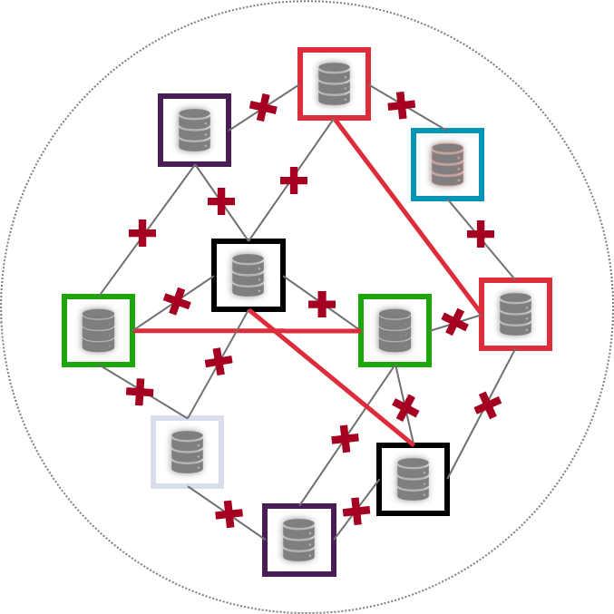
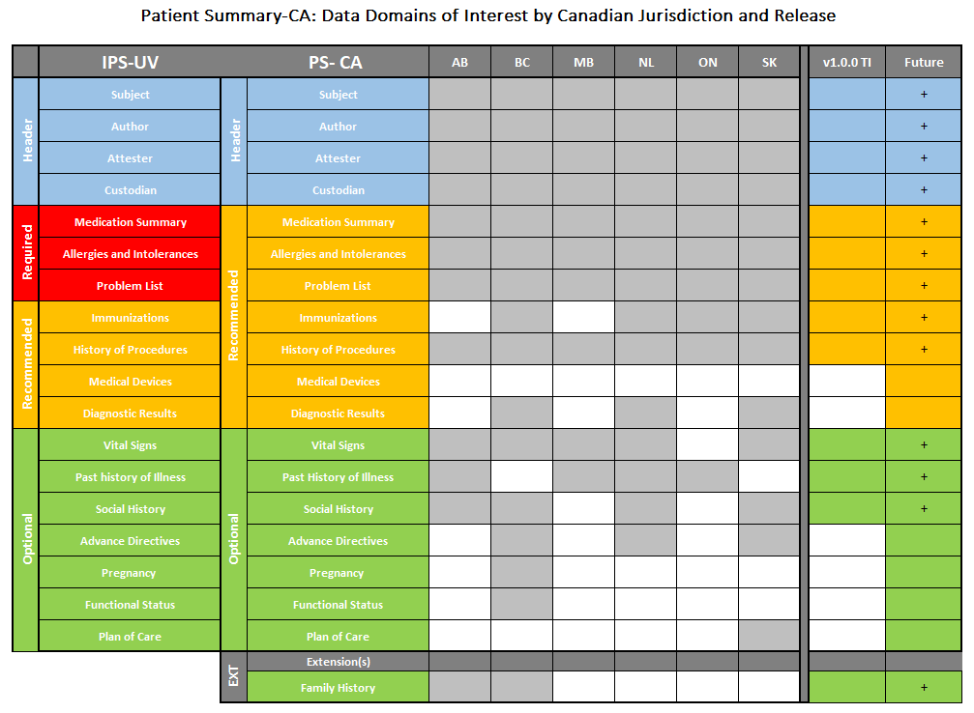
The Need to Exchange and Share the Patient Summary At Scale
PS-CA is primarily a content specification that sets the minimum expectation with respect to data requirements. Without a widely accepted mechanism for making the Patient Summary available, the utility of the content as a standalone is limited.
PS-CA Guidance on Minimum Data Set
Without some guidance and standardization in the exchange ecosystem, vendors must customize their solution to meet the many requirements of each trading partner

Slide 5
The Need to Exchange and Share the Patient Summary At Scale
PS-CA is primarily a content specification that sets the minimum expectation with respect to data requirements. Without a widely accepted mechanism for making the Patient Summary available, the utility of the content as a standalone is limited.
Canadian Specification
PS-CA Guidance on Minimum Data Set
Market interest to assemble a core FHIR document with resources at the source drove the creation of CA:FeX v1.0
CA:FeX
FHIR
supports APIs for documents or DISCRETE DATA access
Existing International Exchange Patterns
PS-CA Guidance on data exchange mechanisms
PS-CA points to MHD as an established exchange pattern (IHE interoperability standard). However, the FHIR-based standard at the time required submission of Binary and use of List, limiting representation of the document to other formats in the future and requiring additional steps in retrieval.
The market indicated the need for an alternative.
MHD
FHIR
aligned with IHE document exchange actors
XDS on FHIR
FHIR front end to IHE XDS legacy
Notes:
Attila

Slide 6


Scope of CA:FeX v1.0.0 TI
Patient Summaries, a new document type (unburdened by legacy formats) were the right starting point for CA:FeX guidance.
The CA:FeX specification started with FHIR-based multi-resource (document) exchange.
FHIR supports multiple representations of documents, including FHIR-assembled documents (e.g., bundle with composition) and FHIR-enabled documents (e.g., binary) and references (e.g., DocumentReference). These are FHIR formats that allow for RESTful exchange.
The inception of CA:FeX v1.0.0 TI only aimed to cover the gap of MHD (e.g., did not support Bundle/Composition). Therefore, the first release of the specification focused on providing guidance for the exchange of FHIR-Assembled Documents.
CA:FeX v1.0.0 TI Interactions
Submit a Document (CA:FeX 1)
Search for a Document
(CA:FeX 2A)
FHIR Server
Retrieve a Document
(CA:FeX 2A)
Exchange of FHIR-Assembled Documents is just one expression of how data is expected to be exchanged in Canada.
CA:FeX has the opportunity to introduce guidance on a more comprehensive set of capabilities that FHIR clients and servers in Canada could be expected to support.
FHIR-Assembled
Documents
Repository
6

Slide 7
CA:FeX Evolution

Slide 8



A Vision for Canadian FHIR Exchange
CA:FeX intends to standardize the adoption of FHIR based health information exchange patterns across Canada through the development of a pan-Canadian FHIR API guide. It intends to do this by providing a minimum set of capability expectations for any actors participating in the exchange of health information (single or multi resource).
These core capabilities will become predictable building blocks for Canadian implementers to meet their implementation needs. By building on this standard, Canadian implementers and vendors can be confident that their investments in FHIR capabilities will be reusable and support cross-system interoperability by-design.
Notes:
Went from a young standard born of necessity -> confident standard that expresses and most importantly executes on the vision for Canadian FHIR Exchange

Slide 9
CA:FeX R2 – Placing Canada at the Intersection of International Standards
The Canadian market is well positioned to incorporate the learnings (and influence) of International FHIR Standards
International specifications are attempting to standardize minimum expectations for exchanging FHIR resources
Generalized guidance exists in international standards (e.g., IHE QEDm) for exchanging FHIR resources with the explicit purpose of sharing clinical information
International API standards (e.g., IPA) are also evolving to define a predictable experiences for clinical data integrators & consumers
International information standards are defining minimum content expectations under certain exchange contexts (e.g., IPS)
CA:FeX addresses these realities by designing around the following principles:
Prioritize a consistent predictable experience for FHIR Integrators & Data Consumers
Reduce rework and unnecessary customization for implementers by pursuing alignment and contribution to International Standards (e.g., QEDm, IPA, IPS)
Scope each release to include minimum capabilities that are reachable for innovators in the market at the point in time
Notes:
The gap that we fill is:
A commonly shared set of rules & expectations that all FHIR interfaces in Canada agree to share and uphold for RESTful exchange of the types of information named in the product definition.
These rules & expectations provide integrators (e.g., apps and ingesting systems the ability to anticipate the default code they have to write to interact with any of these interfaces, regardless of jurisdiction.)

Slide 10
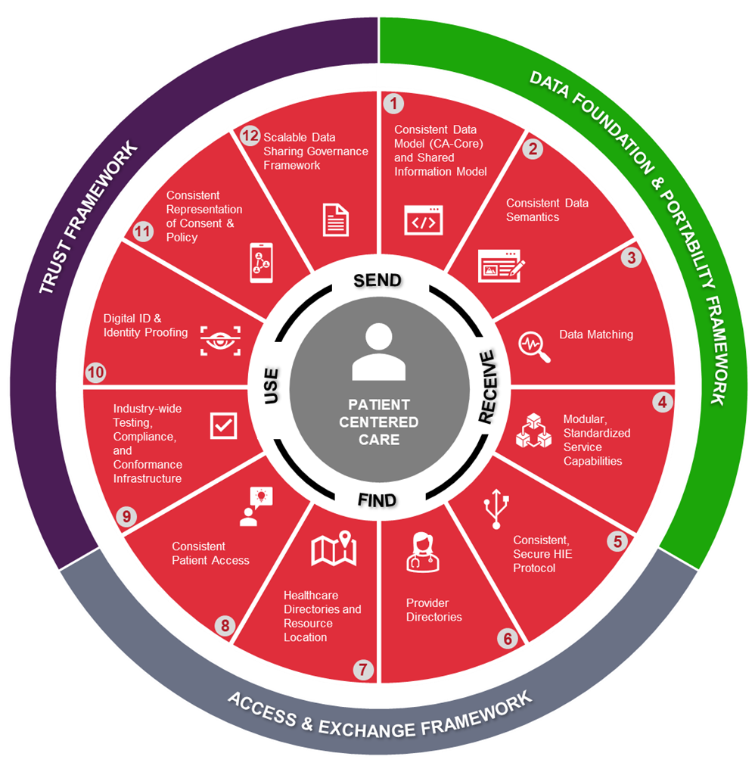



CA:FeX R2 – Place within the pan-Canadian Interoperability Roadmap
CA:FeX is one piece of the larger set of building blocks that implementers will need to incorporate into their systems to facilitate the exchange of Personal Health Information across providers.
Interoperability Roadmap Building Blocks
4
Modular, Standardized
Service Capabilities
5
Consistent, Secure
HIE protocol
Notes:
One component of a larger interoperability agenda (roadmap) - alignment and controlled growth that is congruous with the work in the roadmap

Slide 11
Scope of CA:FeX R2: A Foundation for FHIR Servers and Applications
The CA:FeX 2.0.0 DFT specification has expanded its scope to cover the set of exchange paradigms that are expected to be used by early FHIR Implementers:
Single Resource Exchange, e.g., search for a patient’s allergies: RESTful exchange behaviors and identification of the interaction support capabilities (read, search, create, update, and delete) and a reference to a subset of FHIR resource types that systems must support to enable single resource exchanges.
Multi-Resource Exchange, e.g., retrieve a Patient Summary document: Approaches for exchanging multiple resources together in the form of documents, and identification of standardized search parameters and practices for document implementers to incorporate into guides and systems.
Extending APIs with FHIR Operations: e.g., $summary:
Identification of functional FHIR operations that allow implementers to abstract complexity away from requesting applications, by offering a single API call that can trigger multi-step processes to execute.
Server Capability Statement
Client Capability Statement
FHIR Extended Operations
Search Parameters
Conformance Requirements
Guidance on Minimum RESTful operations – Single Resource
Guidance on Minimum RESTful operations – Multiple Resource (document)
Guidance on Applicable RA Security & Authentication Modules
CA:FeX – FHIR Implementation Guide
11
Notes:
Published expectations for what the minimal viable resources and interactions that any FHIR server in Canada should include. This means that future versions of CA:FeX will drive more sophisticated exchange that references and builds upon a pan-Canadian data model, such as CA-Core, and its resources.
• At a more granular level, CA:FeX v2.0.0 DFT will include interaction guidance for single resource exchange, search parameters, and capability statements that can be directly tested against. This growth will enable the exchange of information that goes far beyond the exchange of a document, expanding the use cases that CA:FeX applies to and the clinical workflows that it can empower.

Slide 12
CA:FeX R2 Building Blocks (Illustrative)
Below is a simple illustration, highlighting the scope and potential building blocks of CA:FeX v2.0.0. Based on the implementation patterns selected, CA:FeX v2.0.0 may provide the applicable guidance for specific RA components.
Server Capability Statement
Client Capability Statement
Computable constraints informed by the Pan-Canadian Data Model
FHIR Extended Operations
Search Parameters
Conformance Requirements
National FHIR Profiles
(e.g., CA Core)
Guidance on Minimum RESTful operations – Single Resource
Guidance on Minimum RESTful operations – Multiple Resource (document)
Guidance on Applicable RA Security & Authentication Modules
Authentication Requirements
Authorization Requirements
Audit Requirements
CA:FeX – FHIR Implementation Guide
Reference Architecture
Note: Building blocks within RA are not exhaustive; this illustration only highlights the components that CA:FeX currently points to.

Slide 13
Illustrative Example of CA:FeX R2 in the Real World
Scenario: Retrieve a patient’s Condition (single resource) & Patient Summaries (multi resources) from past treatment locations to inform a diagnosis from a specialist.
EHR FHIR Server
CA:FeX
EHR Server Capability Statement
Server Capability Statement
FHIR Extended Operations
Conformance Requirements
Search Parameters
MedicationStatement
GET/Bundle_search{?[parameters]}
GET/Condition_search{?[parameters]}}
Condition
National Profile Requirements (e.g., CA Core)
Patient Summary
SMART on FHIR considerations
EHR Authorization Server
Alignment to the International Patient Access Standard
Implemented Authentication & Authorization Patterns
Reference Architecture
Server Capability Statement
FHIR Extended Operations
Note: Building blocks within RA are not exhaustive; this illustration only highlights the components that CA:FeX currently points to.

Slide 14



How does CA:FeX R2 Position Us for Real World Challenges
The shift towards FHIR-enabled RESTful exchange in Canada will naturally uncover a variety of methods and workflows available for ecosystems to implement against a given use case (e.g., push to central repositories, intermediate retrieval)
As CA:FeX evolves to accommodate and address these realities – FHIR Extended Operations provide a promising backdrop for abstracting this complexity away from data consumers & integrators.
Example: Some data sources expect Patient Summaries to be submitted directly by primary care physicians, others allow for data elements to be contributed so that a Patient Summary can be generated automatically at the time of request.
It’s challenging and costly for applications to anticipate and build for each environment.
$summary operation: This operation asks for the latest appropriate summary for a patient (whether it already exists or must be newly generated) and returns the latest summary in the form of a FHIR Document.
Operations are not a silver bullet for every implementation
Need to be validated and refined collaboratively to ensure they hold up in the Canadian market
Requires infrastructure & governance to grow to support the adoption of capabilities that help us align

Slide 15

Latest News on IPS generation from HL7 International WG
HL7 Technical Steering Committee member for the 2023-2024 term
Implementation Representative:
James Agnew – CTO, Smile DH
Updates from the January 2023 Connectathon, Henderson, Nevada

Slide 16
Engaging with CA:FeX 2.0.0
CA:FeX 2.0.0 DFT Implementation Guide – Published on Simplifier​
Collaborative interoperability projects (aligned with the roadmap) forthcoming to validate and refine CA:FeX capabilities & adoption
Canadian FHIR Exchange White Paper – Circulated After the Projectathon

Slide 17
Thank you

Slide 18
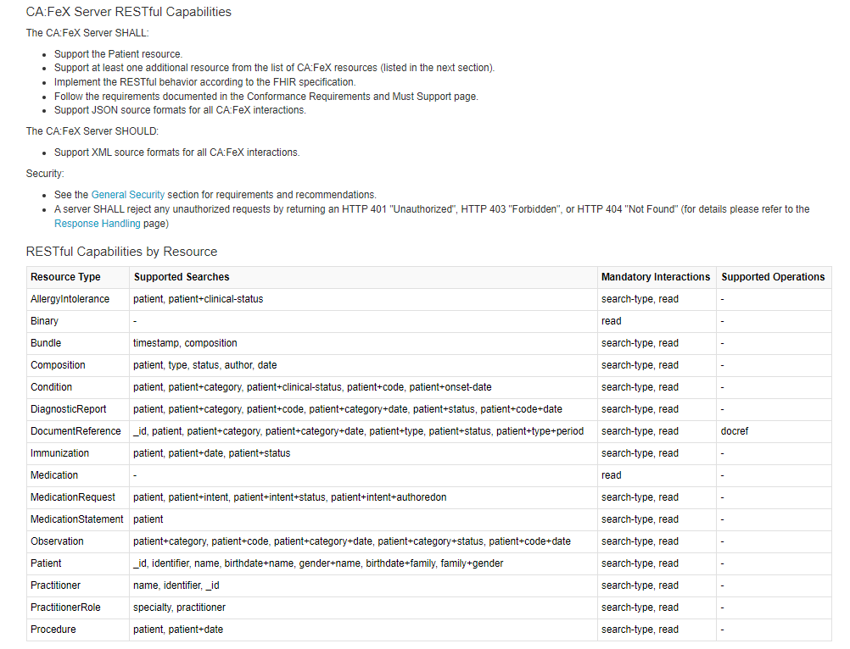
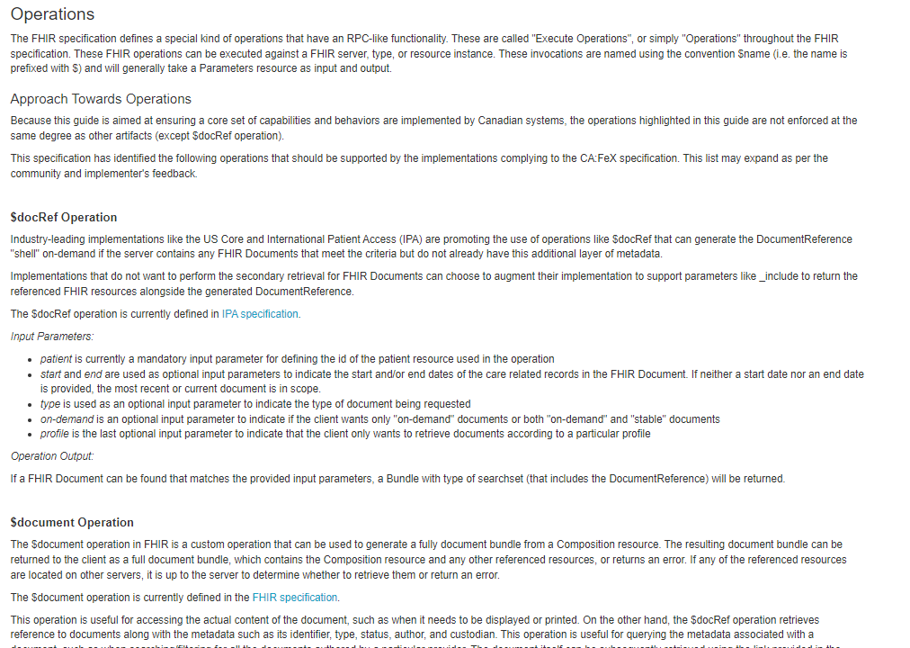
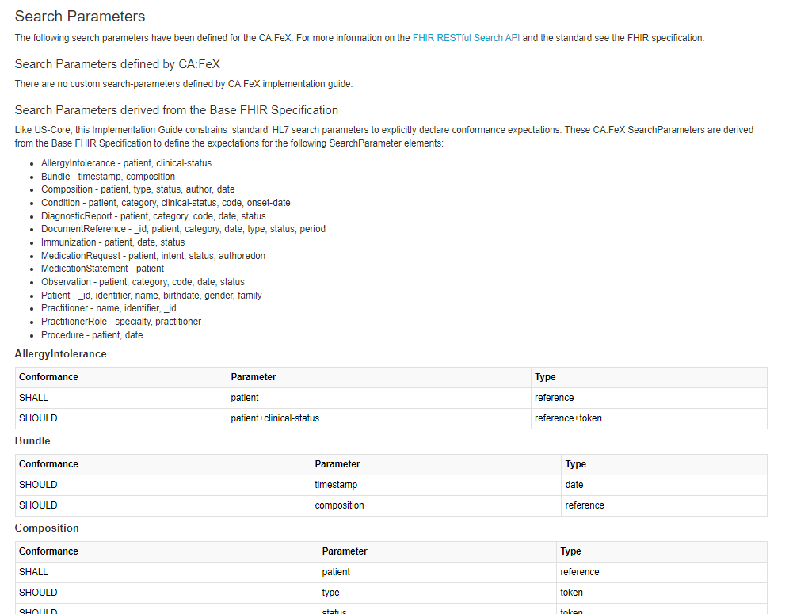
CA:FeX 2.0.0 – Glimpse into the Constraints in the Most Recent Release
Computable Expectations on Servers
Guidance on Conditional
Operations & Search Parameters

