Slide 1

CA-Baseline
Pan Canadian Baseline Governance Collaborative Content

Slide 2
Where are we in our Baseline Maturity Roadmap?
Profiles are Here
QA Period
Prep for FMM0
FMM0
QA Period
FMM1
FMM2
Complete Remaining Clinical Profiles
Clean-up of IG Profile Content for QA/Due Diligence Review
Prep for IGuide draft to be published as a whole for broad community awareness: Maturity Model Stage 0 (FMM0)
IGuide is published as first draft (FMM0) for community exposure
Community engaged in external due diligence review: Existing projects providing feedback & comparison against domains
Mechanism/tool* is used to collect broader community & implementor feedback (i.e. Peer reviews, connectathons, and/or ballot for comment) to confirm that it meets needs of early implementors
Improvements made to IGuide based on initial round of feedback
IGuide changes are reconciled to ensure additional Validator warnings are resolved
IGuide made available for use by implementors
Require 3+ implementors before IGuide can be progressed to FMM2.
Physical presence limitations may require us to find alternative means of surfacing IGuide via connectathon
Implementation feedback and results gathered for submission to HL7 Canada
Prep for formal balloting
Framework for completing internal due diligence review (purpose, scope, depth, success criteria, review process)
Principles developed for this internal and external due diligence review
1st level due diligence review against existing CA FHIR IGuides
Reconciliation of changes driven by DDRs
Governance is Here
Processes and tools for collecting community feedback identified and confirmed
Align approach with Infoway Governance Report Findings & Recommendations
Jurisdictions and Implementor Community is engaged to help validate approach, are engaged as we progress through the approach.
Identification and call for endorsement & creation of governance collaborative
Pan-Canadian Baseline Governance Collaborative - promotes roll out of the Baseline in jurisdictional FHIR projects– formalizes decision making about a CA Core and requirements related to procurement
Documentation of governance, representation, and decision making process for inclusion in section(s) IGuide
CA Baseline Workstream supports PCBGC with recommendations, maintenance & enhancement of the CA Baseline
Any updates being run through FHIR Validator to find and correct errors and warnings
Notes:
Due Diligence Review:
Handful (2-3) National/International IGuides used as comparison points during Friday Calls
*First level definition needed (what’s the depth we want to get to before building to a 2nd level review with larger community
Need to have some recognition of the step that is required at a national level to align the provinces (not just align the implementors w/in provinces) – gap that needs to be filled and this process will need to align to that.
Identify enablers needed to accomplish these milestones

Slide 3
Maturity Level Progress
Maturity Level | Profile | Substream Review Status | Due Diligence Review Status
1 | Patient Profile | Complete | PCR, DHIR, Ontario eReferral
1 | Practitioner Profile (General) | Complete | PPR, DHIR, Ontario eReferral, PrescribeIT
1 | Practitioner Profile (Provider Registry) | Complete | PPR
1 | PractitionerRole Profile (General) | Complete | PPR
1 | PractitionerRole Profile (Provider Registry) | Complete | PPR
1 | Organization Profile | Complete | DHIR, PrescribeIT
1 | Location Profile | Complete | PPR, Ontario eRefferal
1 | Immunization Profile | Complete | DHIR, IPS, PHI Access, PS-CA
1 | AllergyIntolerance Profile | Complete | Ontario eReferral, IPS, PS-CA
1 | Condition Profile | Complete | Ontario eReferral, IPS, PS-CA
1 | Procedure Profile | Complete | IPS, PS-CA
1 | Medication Profile | Complete | PrescribeIT, IPS, PS-CA
1 | MedicationDispense Profile | Complete | PrescribeIT, PHI Access, PS-CA
1 | MedicationRequest Profile | Complete | PrescribeIT, PS-CA
1 | MedicationStatement Profile | Complete | IPS
1 | Observation Profile (General) | Complete | IPS
0.5 | Observation Profile (Laboratory Results) | Resuming | OLIS R4 (started)
0.5 | DiagnosticReport Profile (Laboratory) | Resuming | PHI Access, OLIS R4 (started)
0 | Observation (Tobacco SmokingStatus) | Complete | IPS
0 | ImmunizationRecommendation Profile | Complete | DHIR
0 | MedicationAdministration Profile | Complete | Not Complete
0 | Encounter Profile | Complete | Not Complete
0 | Goal Profile | Complete | Not Complete
0 | DiagnosticReport for Report and Note | Complete | Not Complete
0 | Document Reference Profile | Complete | Not Complete
0 | Device Profile (Medical and Non-medical) | Partial - Paused until SME available | Not Complete
0 | Device Profile (Implantable) | Partial - Paused until SME available | Not Complete
http://build.fhir.org/ig/HL7-Canada/ca-baseline/branches/master/allartifacts.html

Slide 4
Projects and Guides already using the CA Baseline
Informal Alignment
OMD Core Data Set Standard
[Your guide here]
Endorsement / Dependencies on CA Baseline iGuide
Patient Summary (Pan-Canadian)
Patient Summary (Ontario)
BC Standards Catalogue
PHI Access

Slide 5
Dealing with Profile Maturity Differences
Do we want to apply maturity levels to the profiles, the guide, or both?
Likely both
Maturity levels reflected for both profiles & guides following traditional FMM progression
Want to shoot for IGuide maturity level that is closer to trial use to alert implementors they are stable enough to try out
Until we get out of Draft level for whole guide - marking resources/elements as lower maturity may not be helpful - because the assumption is that entirety of it is low maturity
What do we do with the profiles that are lower level in maturity than the others? Keep them out of the guide, segment them somewhere else?
Don't leave them out of the IGuide, clearly differentiate them at resource level (and maybe even element level - for example observation.focus)
Does it make sense to vary from the FHIR FMM implementation-driven definition given that we’re a baseline?
May have to vary somewhat given baseline scope is different than a traditional implementation guide scope/different than the international spec use of maturity (i.e. used in multiple countries)
Need to define a logic for understanding our maturity level that is communicated in the guide.
# of comparison specifications included as parameters in the definition for maturity (differentiate specs that have been implemented vs those that are also still in draft form)
#of times the baseline/profiles based off the baseline are used as another indicator for later levels of maturity
Does it make sense to ask for a different expectations for less mature profiles?
Not appropriate for the workstream to define the expectations- we can make recommendations but decision on what jurisdictions are expected to do with each comes from the collaborative
Does it make sense for us to ask for different types of support from our governance group for less mature profiles
- i.e. agreeing to use the level X for implementation and to provide support getting community feedback for level Y)

Slide 6
Baseline Profile Maturity Level Definitions
# | Current FHIR Maturity Level Definition | CA Baseline Maturity Level Definition
0 (draft) | FHIR Base Definition: the artifact has been published on the current build. This level is synonymous with Draft. UK Core: The Profile has been published on the current build. This Profile has had no formal review and therefore may have quality issues. It is published only to allow the review process to start AU Core: Same as FHIR Base Definition | The artifact has been published on the current build. This level is synonymous with Draft. Implementors should be aware that artifacts at this maturity level are subject to community review and refinement.
1 | FHIR Base Definition: FMM0 + the artifact produces no warnings during the build process and the responsible WG has indicated that they consider the artifact substantially complete and ready for implementation. For resources, profiles and implementation guides, the FHIR Management Group has approved the underlying resource/profile/IG proposal. UK Core: The Profile produces no warnings during the build process and has had a formal internal review by the UK Core development team AU Core: Same as FHIR Base Definition | The artifact produces no warnings during the build process and has had a formal internal review by the CA Baseline Working Stream. The artifact is considered substantially complete and ready for trial use. Profiles at this level are available for the community to experiment with, in developing their own profiles, in order to solicit implementor feedback. Implementors should be aware that artifacts at this maturity level are still subject to community review and refinement.
2 | FHIR Base Definition: FMM1 + the artifact has been tested and successfully supports interoperability among at least three independently developed systems leveraging most of the scope (e.g. at least 80% of the core data elements) using semi-realistic data and scenarios based on at least one of the declared scopes of the artifact (e.g. at a connectathon). These interoperability results must have been reported to and accepted by the FMG UK Core: The Profile has been released for review to the UK FHIR community, any feedback received has been addressed as far as possible AU Core: Same as FHIR Base Definition | The artifact has been released for review to the CA FHIR community, and is being used and/or demonstrated by at least three implementations (e.g., pan-Canadian, jurisdictional, vendor, etc.) from at least two different jurisdictions. Implementor feedback has been addressed as far as possible and is socialized through the Canadian Governance Collaborative. Implementors should be aware that artifacts at this maturity level are still subject to community review and refinement.
For the Purposes of the Canadian Baseline Implementation Guide, current build means it is published on the publicly available CI Build(http://build.fhir.org/ig/HL7-Canada/ca-baseline/branches/master/index.html) and Simplifier Project (https://simplifier.net/CanadianFHIRBaselineProfilesCA-Core)
For our purposes, ready for use means ready for Canadian profiles to begin attempting to derive from the Baseline profiles, it is understood that artifacts can be ready for use but are still expected to undergo revisions
*demonstrated could mean 1) profiles formally derive from the baseline using the baseDefinition and show no conformance errors , OR 2) profiles can be validated against the {BaselineProfileURL] and is conformant (produces no errors)
Notes:
https://confluence.hl7.org/display/FHIR/FHIR+Maturity+Model#:~:text=This%20page%20describes%20the%205,it%20has%20been%20subject%20to.
https://simplifier.net/guide/UKCoreDevelopment2/Profiles
# of comparison specifications included as parameters in the definition for maturity (differentiate specs that have been implemented vs those that are also still in draft form)
#of times the baseline/profiles based off the baseline are used as another indicator for later levels of maturity

Slide 7
Baseline Profile Maturity Level Definitions
# | Current FHIR Maturity Level Definition | CA Baseline Maturity Level Definition
3 | FHIR Base Definition: FMM2 + the artifact has been verified by the work group as meeting the Conformance Resource Quality Guidelines; has been subject to a round of formal balloting; has at least 10 distinct implementer comments recorded in the tracker drawn from at least 3 organizations resulting in at least one substantive change UK Core: The Profile has been presented for inclusion in the Technical and Clinical Assurance process AU Core: Same as FHIR Base Definition | The artifact has been verified by the work group as meeting the CA Baseline Quality Guidelines; has been subject to a round of formal balloting; Implementation guides at this maturity: have at least 10 distinct implementer comments submitted to [location tbd], provided by at least 3 organizations across three jurisdictions resulting in at least one substantive change Resources at this level of maturity: have at least 3 distinct implementer comments submitted to [location tbd] across at least three jurisdictions Requests for changes from this level onwards are expected to follow an evaluation & consultation process with the Canadian Governance Collaborative.
4 | FHIR Base Definition: FMM3 + the artifact has been tested across its scope (see below), published in a formal publication (e.g. STU), and implemented in multiple prototype projects. As well, the responsible work group agrees the artifact is sufficiently stable to require implementer consultation for subsequent non-backward compatible changes. UK Core: The Profile has completed the Technical and Clinical Assurance process and the status has been changed to active AU Core: Same as FHIR Base Definition | FMM3 + the artifact has been tested across its scope (see below), published in a formal publication (e.g. STU) that FHIR projects have referenced/utilized across multiple prototype projects across at least three jurisdictions As well, the FHIR Implementors work group agrees the artifact is sufficiently stable, and that any future non-backward compatible [breaking] changes will go to the Canadian FHIR community for consultation.
Notes:
https://confluence.hl7.org/display/FHIR/FHIR+Maturity+Model#:~:text=This%20page%20describes%20the%205,it%20has%20been%20subject%20to.
https://simplifier.net/guide/UKCoreDevelopment2/Profiles
From the HL7 Confluence Site – Footnotes: Any of the criteria can be waived provided the sponsoring WG can convince the FMG that that criteria should not apply in the case of a specific artifact.
Tested across scope means:
- The FMG has signed off on the list of "example contexts" defined for the artifact- For each example context, the artifact has either been: reviewed and approved by a domain expert for that scope area, mapped to an existing implemented scope-area-specific standard or tested in an implementation
In most cases, if an artifact is derived from or otherwise depends on another artifact, the derived artifact cannot be more mature than the artifact referenced. However, FMG may make general or specific exceptions to this rule.
In some cases, an artifact may have components or dependencies that are a lower level than the resource overall. For example, a resource may have been well tested, with the exception of one or two data elements which are "new" or that have limited production use due to the distribution of early adopters. In these cases, a "maturity note" will be provided that highlights areas of the resource that are considered "less mature" than the resource as a whole.
# of comparison specifications included as parameters in the definition for maturity (differentiate specs that have been implemented vs those that are also still in draft form)
#of times the baseline/profiles based off the baseline are used as another indicator for later levels of maturity

Slide 8
Baseline Profile Maturity Level Definitions
# | Current FHIR Maturity Level Definition | CA Baseline Maturity Level Definition
5 | FHIR Base Definition: FMM4 + the artifact has been published in two formal publication release cycles at FMM1+ (i.e. STU level) and has been implemented in at least 5 independent production systems in more than one country UK Core: The Profile has been presented for inclusion in the HL7 UK Ballot Process AU Core: FMM 5 PLUS the artifact has been published in two formal publication release cycles at FMM1+ (i.e. Trial Use level) and has been implemented in at least 5 independent production systems. | Draft wording as of July 21st: Artifact is ready for inclusion in normative ballot in the HL7 Canada Ballot Process. At least 5 independent production systems, across 3 jurisdictions, have demonstrated* conformance to the CA Baseline Profile as a starting point. “Independent production systems” should be inclusive of the following implementor types: Health Vendors (e.g., EHR, HIT, Consumer Health) Jurisdictional Health Assets Pan-Canadian/Federal Health Assets
6 (normative) | FHIR Base Definition: FMM5 + the responsible work group and the FMG agree the material is ready to lock down and the artifact has passed HL7 normative ballot UK Core: The Profile has completed the HL7 UK Ballot process and is now deemed to be Normative AU Core: The Artifact is now considered stable | The FHIR Implementors Group and the Canadian Governance Collaborative agree the material is ready to lock down and the artifact has passed HL7 Canada normative ballot
*demonstrated could mean 1) profiles formally derive from the baseline using the baseDefinition and show no conformance errors , OR 2) profiles can be validated against the {BaselineProfileURL] and is conformant (produces no errors)
Demonstration process may differ for conformance activities outside of the CA Baseline Artifact Maturity process. Some instances may want to prove conformance for other purposes outside of maturing the CA Baseline (e.g., proving conformance of tool for procurement criteria)
Notes:
https://confluence.hl7.org/display/FHIR/FHIR+Maturity+Model#:~:text=This%20page%20describes%20the%205,it%20has%20been%20subject%20to.
https://simplifier.net/guide/UKCoreDevelopment2/Profiles
From the HL7 Confluence Site – Footnotes: Any of the criteria can be waived provided the sponsoring WG can convince the FMG that that criteria should not apply in the case of a specific artifact.
Tested across scope means:
- The FMG has signed off on the list of "example contexts" defined for the artifact- For each example context, the artifact has either been: reviewed and approved by a domain expert for that scope area, mapped to an existing implemented scope-area-specific standard or tested in an implementation
In most cases, if an artifact is derived from or otherwise depends on another artifact, the derived artifact cannot be more mature than the artifact referenced. However, FMG may make general or specific exceptions to this rule.
In some cases, an artifact may have components or dependencies that are a lower level than the resource overall. For example, a resource may have been well tested, with the exception of one or two data elements which are "new" or that have limited production use due to the distribution of early adopters. In these cases, a "maturity note" will be provided that highlights areas of the resource that are considered "less mature" than the resource as a whole.
# of comparison specifications included as parameters in the definition for maturity (differentiate specs that have been implemented vs those that are also still in draft form)
#of times the baseline/profiles based off the baseline are used as another indicator for later levels of maturity
June 25: For Continued Discussion:
-inclusion of some interoperability milestone - e.g., between at least one pairing of implementors
-do we need to define what combinations and numbers would be necessary for meeting this bar (e.g., implemented in at least 5 independent production instances deployed across at least X jurisdictions representing X implementor types (e.g., EHR vendors, jurisdictional health assets, mobile applications, etc.)?
July 9 2021 Discussion:
Emphasize maturation
5 production instances seems good to inherit
Call out the implementor types explicitly; adds to the authority of the maturation process
EHR Vendors
Jurisdictional Health Assets
(to continue to fill this out)
Given it’s a baseline profile, what does ‘implementation’ look like?
CA Baseline Profiles are meant to be used as the starting point for Canadian fhir profiles > expectation at Level 5 is that these derived profiles have been ‘implemented’ in whichever project they’re of
Perhaps revise wording of “implementation” and focus more on CA Baseline’s role as a “starting point” for other profiles
“at least 5 independent production systems have used (derived from) the CA Baseline Profile as a starting point”
Difficult to require every jurisdiction to have ‘derived’ a profile off of it
3 has been the # jurisdictions used thus far
Connecting the two metrics: 5 ind prod sys’s, across 3 jurisdictions
(a project which is implemented across jurisdictions [e.g. RxIT] would cover all 3 jurisdictions with 1 project; thus, a CA Profile derived off of by this project would qualify across those jurisdictions)

Slide 9
Change Management Process
Activities: Submission, Discussion, Consensus, Triage, Change Tracking, Resolution*
Potential Tools: Infocentral Forum, Simplifier Issue Log, Github Issue Log, Jira platform
Existing Process:
Simplifier Issue Log is used to track changes submitted by the community, profiling meetings will be used to review requests and agree on changes
Desired Process:
The community member submits a request on Infocentral Forum thread (x) for a change to the Baseline, requests have a minimum set of information
  Other community members that subscribe to the thread are notified of the new post
  Discussion ensues in that thread if appropriate
  Moderator manages discussion, closes 10 days after discussion ends and synthesizes results into a issue log ticket
    Moderator(s) in immediate term
    Distributed responsibility tied to participation in governance collab in long term
  Ticket includes a minimum set of information (requestor, date, profile, type of change, etc.)
  Baseline editors review issues – claim responsibility, if unclear pause & post back to forum thread - and update as the request is being worked on/resolved – eventually closing the issue
  The original requestor is notified – on Infoway forum
Decision: Uptake of the desired process will depend on having confirmation of individual(s) that will support moderator role on Infocentral forum
Additional considerations:
whether Infoway Interoperability Standards Governance doesn’t/doesn’t have another recommended process or tools (Randy reaching out to confirm)
whether customization could be complete to improve the integration between Simplifier and Github for issues
*Future levels may include targeted discussion with submitter as part of the evaluation process

Slide 10
Terminology Expectations
Challenge
Can’t progress to Level 1 maturity until the artifact(s) produce no warnings during build process.
356/411 of our current errors and warnings are due to unresolvable terminology – this # will expand as we start to include examples (values that can’t be validated produce additional warnings)
Most value sets that the CA Baseline points to are authored by other organizations that may change the value sets over time
Approaches:
Point to URLs socialized in other guides
  may/may not resolve – build warnings continue
Create value sets in our IGuide
  Shells that Point to URLs socialized in other guides (may/may not resolve)
  Inclusion of sample values
  Inclusion of all values
Terminology Server to host value sets with validation capabilities
  Value sets are published on our own terminology server?
  Each value set publishing organization (Infoway, CanImmunize, PrescribeIt, etc.) publishes their own resolvable value sets?
  Canadian realm terminology server ?
  Canadian value sets published on the global terminology server (tx.fhir.org)?
Next Steps:
  Develop “scorecard” for terminology warnings (which value sets/guides/publishing organizations are driving most of our warnings)
  Decide on approach for resolving these warnings with respective publishers
Notes:
The artifact produces no warnings during the build process and has had a formal internal review by the CA Baseline Working Stream. The artifact is considered substantially complete and ready for trial use.

Slide 11
Terminology Resolution Scorecard
Technical Challenge: Value sets aren’t actively hosted today at their canonical urls which doesn’t allow for the IGPublisher to resolve the value set
IGPublisher can’t hit other servers other than tx.fhir.org (currently being worked on in HL7 intl)
Can’t submit username/password or API key to allow for access to closed sites (like Terminology Gateway)
Identified Approaches:
Recommend hosting at canonical url or in tx.fhir.org
Recommend publishing an Implementation Guide FHIR Resource we can point to (alternatively can publish a ‘shell’ iGuide just for the valuesets)
Include as a suppressed warning (if we can limit warnings to only the valuesets or hosts we know are accepted)
Allow the non-resolved links to not resolve, but include an explicit note for implementers that this is the intended valueset but valueset owner doesn’t have it set up for us to point to it properly
Source | Error & Warning Count | Unique Value Sets Generating Errors / Warnings | Example Warnings / Errors | How should we approach?
Infoway Terminology Gateway | 51 | 15 | (Warning) The valueSet reference https://fhir.infoway-inforoute.ca/ValueSet/allergyintolerancestatuscode on element AllergyIntolerance.verificationStatus.coding could not be resolved | Value sets aren’t actively hosted today at their canonical urls which doesn’t allow for the IGPublisher to resolve the value set – Decision: Attempt Suppression – isolating just the value set/domain
CanImmunize | 18 | 7 | (Warning) The valueSet reference https://cvc.canimmunize.ca/v3/ValueSet/Generic on element Immunization.vaccineCode.coding could not be resolved | CanImmunize publishes guidance and API but not a FHIR implementation guide resource. Which Approach should we recommend to CanImmunize?

Slide 12
Terminology Resolution Scorecard
Technical Challenge: Value sets aren’t actively hosted today at their canonical urls which doesn’t allow for the IGPublisher to resolve the value set
IGPublisher can’t hit other servers other than tx.fhir.org (currently being worked on in HL7 intl)
Can’t submit username/password or API key to allow for access to closed sites (like Terminology Gateway)
Identified Approaches:
Recommend hosting at canonical url or in tx.fhir.org
Recommend publishing an Implementation Guide FHIR Resource we can point to
Include as a suppressed warning (if we can limit warnings to only the valuesets or hosts we know are accepted)
Source | Error & Warning Count | Unique Value Sets Generating Errors / Warnings | Example Warnings / Errors | How should we approach?
PrescribeIT | 14 | 2 | (Warning) The type of profile http://prescribeit.ca/fhir/StructureDefinition/ext-medication-strength-description cannot be checked as the profile is not known | Extensions are published on web page not FHIR implementation guide, Some value sets flagged under Terminology Gateway are actually PrescribeIT Which Approach should we recommend to PrescribeIT?
SNOMED-CT | 12 | 3 | (Error) The valueSet reference http://snomed.info/sct on element AllergyIntolerance.code.coding points to something that is not a value set (CodeSystem) | Which Approach should we recommend for SNOMED errors?

Slide 13
Use/Derivation Expectations
Terms Used So Far:
used=direct implementation (using CA Baseline for exchanging data)
demonstrated could mean
  1) profiles formally derive from the baseline using the baseDefinition and show no conformance errors , OR
  2) profiles can be validated against the {BaselineProfileURL] and is conformant (produces no errors)
Demonstration process may differ for conformance activities outside of the CA Baseline Artifact Maturity process. Some instances may want to prove conformance for other purposes outside of maturing the CA Baseline (e.g., proving conformance of tool for procurement criteria)
What our expectations for use or demonstration (beyond indicating you are informed by CA Baseline) and why?

Slide 14
Use/Derivation Expectations - Discussion
Is there a definable ‘sequence’ of derivation approaches that we recommend implementers to follow?
  Will be helpful to spotlight existing cases where implementations have looked to the CA Baseline Profiles as a starting point already (e.g. Patient Summary work, BC, OMD Core Data Set on FHIR, etc.)
  Graduated approach – aligns with our Maturity Model
  Re-profiling – can be tricky in earlier stages of building an implementation; may be deriving constraints from multiple sources, decisions on implementer side may still be up in the air
  Informal & Instance – can be done in parallel
Can / should we be attaching ‘timelines’ to ‘users’ of the CA Baseline, to ensure their usage of the profiles matures?
  Feels dependent on the Baseline Profiles being in enough of a stable state
  Also to be in place first would be the governance structure which can handle changes etc (aka the CA Baseline Governance Group that we’re proposing to establish with cross-jurisdictional representation)
  Will be at Level 1 of our Maturity Model within a week or 2
  Need to have the jurisdictions prepared to contribute resourcing to participate in their own ‘derivation’ efforts for their jurisdictional iGuides
Where will Guidance on these approaches (and rules for the approaches) live? In the iGuide? Elsewhere?
  Good to look to put page(s) in the iGuide that we can point folks to

Slide 15
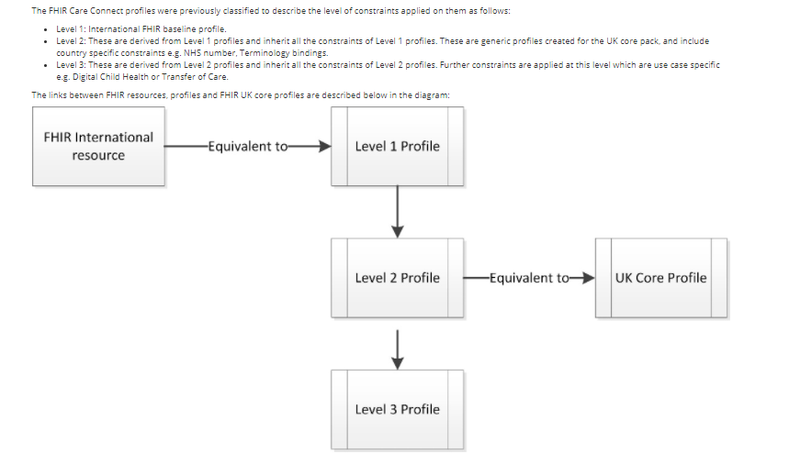
How Other National Bases are Handling Derivation: UK Core
https://simplifier.net/guide/UKCoreDevelopmentGuidance/CTAssurance

Slide 16
How Other National Bases are Handling Derivation: Netherlands National Profiles
https://www.hl7.nl/component/zoo/item/hl7-nederland-valideert-en-publiceert-nationale-hl7-fhir-nl-profielen.html
They have a formal governance structure and centrally validate all profiles in HL7 Netherlands as a means to avoid duplication and overlap and assure that the Health Information Building Block specifications are being met
Have a full nomination -> validation-> publish process that requires their review and approval of all generic national profiles
This validation is performed by the HL7 FHIR®-NL Validation Team. This team consists of approximately 15 experienced technical and functional HL7 FHIR® experts. They jointly validate the profiles offered. The validation procedure and further preconditions are monitored by the HL7 FHIR®-NL Council, in which various important national organizations, umbrella organizations and supplier organizations are represented.
Most profiles in the Nictiz STU3 project point to the base definition (though some like GP Lab Result point to HCIM Lab Test Result Observation)

Slide 17
Governance Workstream & Collaborative: Plan & Boundaries
Draft Endorsement Deck
Identify Key Endorsers
Create supportive materials to prep Collaborative for ToR
Endorsement Presentations to Working Groups
Confirm endorsements
Supply SME recommendations for profile reconciliation, tooling, maintenance, & evolution
Re-engage SMEs around CA Core – resurface recommendations for more prescriptive constraints
Confirm commitments to join collaborative
Manage tool/reconciliation for feedback from any implementors
Collaborative initiated
Creation of ToR & Adoption Milestones
Drive Baseline profile adoption (websites, materials for IGuide Authors)
Decisions around tooling/enforcement
Decision on CA Core & Enforcement

Slide 18
Key Endorsers Identifier
Alberta HISCA – HL7 Sub Committee
  Workstream members from Alberta attempting to get on agenda
Ontario Health - Strategic Committee (SC) & Business & Technical Committee (BTC)
  Preliminary conversation before getting on agenda
  Informed of federal requirements in preliminary discussion
British Columbia HISWG & HISSC – BC FHIR Working Group
  BC FHIR WG have previously reviewed guide but have outstanding changes they’d like to see
  Awaiting to get on agenda given current priorities
Manitoba – Shared Health Manitoba
Digital Health Canada Atlantic Chapter
  Can reach out to potentially do a presentation (pitch deck) to the Atlantic Chapter
CHI & CIHI
HL7 Canada, IHE Canada
Should every endorser be a target for the Baseline Collaborative – or just jurisdictional & federal orgs?
  What about vendors?

Slide 19
Boundaries with CA Baseline Governance Collaborative
What is the CA Baseline Workstream Responsible for? Where do our boundaries begin and end with the governance group?
Governance Collaborative needs to be the group making decisions to be valid, but the workstream can support them in getting the governance collaborative running (operational support) and supporting the collaborative by offering up recommendations and subject matter expertise
Responsibilities for the Governance Group
  Workstream might suggest options to consider
    Some higher-level responsibilities may already be defined through the work we’re doing now
  Governance Collaborative needs to edit and confirm responsibilities and goals of the group as part of the ToR
Process for Decision Making & Resolving Conflicting Opinions across Jurisdictions
  Workstream might provide template example of terms of reference and point to supportive materials
  Governance Collaborative needs to come to agreement and define process in ToR
Time/resource commitment
  Workstream can provide examples of what previous types of engagements have for engagement, but ToR would be where commitment decided
  Governance Collaborative needs to decide on time commitment and meeting cadence as part of ToR
Preparing additional supportive materials for implementors
  Workstream can provide examples (workflow scenarios?) to assist implementors in using the baseline
  Governance Collaborative supports workstream by connecting to realistic data that would assist with this type of modeling of test data and scenarios
Enforcement/Adoption Decisions/Maturity
  Governance Collaborative will decide readiness & timelines for having prospective guides derive from the CA Baseline
  Workstream can provide insight into level of stability/make recommendations for how reconciliation and versioning is handled
  Workstream can provide guidance on maturity levels & interpreting them but the expectations for what each maturity level will
  Workstream can provide language in Guide around encouraging harmonization of previous guides and which CA guide/versions were considered harmonized during the DDR
Tooling Decisions
  Workstream can provide recommendations for tools for viewing profiles, submitting/reconciling feedback, and other kinds of tools (FHIR servers, conformance tools, etc.) depending on the scope decided by the Collaborative
  Governance Collaborative will decide what kinds of tools are required and will determine how tools will be supported if they are not open-source
Maintaining the Baseline: profiling versions, feedback process,
  Workstream will be responsible for committing any changes to the Baseline to prepare for the Governance Collaborative
  Workstream will provide intermittent support committing any agreed upon changes to the Baseline that result out of Collaborative/Implementor Adoption Feedback
CA Core Decisions
  Workstream can provide insight into past recommendations for prescriptive constraints for CA Core
  Governance Collaborative will have to decide how and when to pursue CA Core and develop plan to tie to incentives/disincentives (i.e. procurement)
Notes:
Sketch in profile and guidance versioning policy recommendation (ex: “a change to value sets could be done as a future non-breaking change, guides that use previous value sets are still valid”)

Slide 20
CA-Baseline
A Starting Point for Canadian FHIR Implementation Guides
Jurisdictional Working Group Endorsement Request

Slide 21
Who Are We?
FHIR Implementers Community
eReferral
InfoCentral Community
Community Streams
Canadian FHIR Baseline Profiles
~250 members to date
~100 distinct organizations from across the country
Representation across primarily Ontario, Alberta, Saskatchewan, British Columbia, Quebec, New Brunswick, Newfoundland, as well as Pan-Canadian groups
Notes:
We represent the Canadian FHIR Implementers Community, a grass-roots group of FHIR implementers and enthusiasts from across Canada
The FHIR Implementers Community has maintained several sub-working groups during its existence. Currently, the two prominent groups in operation are the eReferral Working Group and the Canadian FHIR Baseline Profiles Working Group

Slide 22
The Canadian FHIR Baseline Profiles Stream
75 Participants
41 Organizations
Multi-jurisdictional Representation
Profiling Streams
Nova Scotia
Alberta
British Columbia
First Nations
Manitoba
Newfoundland
Ontario
Quebec
Pan-Canadian
International
Due Diligence Review Stream
Governance Stream
Clinical Organizations
Jurisdictional & Regional Organizations (Operational Level)
Strategic Federal Organizations
Solution Vendors
Standards Organizations
Health Systems

Slide 23









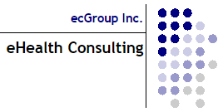

Who Participates?

Slide 24
What are the Limitations of the FHIR Base Specification?
FHIR Base Specification = “building blocks”, whose defined data elements are expected to be encountered in 80% of systems around the world
FHIR Base Specification intentionally avoids region-specific code systems & business rules (based on policy)
Expects implementations to constrain and extend the building blocks to meet their specific needs
Each implementor builds an Implementation Guides (IG) that uses those blocks to meet their needs
Starting from base specification is like starting from scratch each time
Lack of alignment between IGs operating in same countries and domains
We all need customization, but we aren’t leveraging each other’s efforts
FHIR Base Specification
IG
IG
IG
IG
IG
IG
IG
IG
IG
IG
IG
Notes:
The Canadian FHIR Baseline Profiles (CA Baseline for short) group is working on building and socializing its namesake: a set of FHIR Profiles which will serve as the starting point for all Canadian FHIR Implementation Guides going forward.
These FHIR Profiles possess constraints which are deemed to be common across the majority of Canadian FHIR-based workflows, and across jurisdictional boundaries.
The data elements which are included in a 'base' FHIR Resource are those which are considered relevant / useful to at least 80% of implementing systems; the 80-20 rule is the 'rule of thumb' for deciding 'what's in & what's out' of a FHIR Resource base list of elements (those that aren't relevant to at least 80% of systems are what have to be defined at the specific implementation level as 'extensions’
Reuse and Composability – FHIR resources are designed with the 80/20 rule in mind – focus on the 20% of requirements that satisfy 80% of the interoperability needs. To this end, resources are designed to meet the general or common data requirements of many use cases to avoid the proliferation of numerous, overlapping and redundant resources. Extension and customizations exist (see FHIR Profiles) to allow common, somewhat generic resources to be adopted and adapted as needed for specific use case requirements. In addition, FHIR resources are highly composable in that resources commonly refer to other resources. This further promotes reuse and allows for complex structures to be built from more atomic resources.
data elements are in the 80%: i.e. something that 80% of implementers will encounter and/or need - not 80% of the cases that occur to all implementers (this is about preventing work flow variations from complicating the model) -https://wiki.hl7.org/Authoring_FHIR_Resources#DesignConsiderations

Slide 25
What Are We Doing And Why?
Realm-specific guidance (i.e. Canadian Baseline)
Completed effort upfront to identify the basic constraints and extensions that any FHIR implementation operating in Canada can expect to include
Intended as a common starting point, not an out-of-the-box implementation
Convened Canadian implementers and Implementation Guide authors to develop initial draft over the last 18 months
Due diligence reviews against existing Canadian FHIR Implementation Guides to ensure alignment and appropriate scope maintained
Ready for the larger community to review it (which helps us refine the content to support the breadth of use cases in the Canadian realm)
FHIR Base Specification
Canadian Realm
IG
IG
IG
IG
IG
IG
US
Realm
IG
IG
IG
Notes:
The Canadian FHIR Baseline Profiles (CA Baseline for short) group is working on building and socializing its namesake: a set of FHIR Profiles which will serve as the starting point for all Canadian FHIR Implementation Guides going forward.
These FHIR Profiles possess constraints which are deemed to be common across the majority of Canadian FHIR-based workflows, and across jurisdictional boundaries.

Slide 26
What Are We Doing And Why?
HL7 FHIR
Canadian FHIR Baseline Profiles
Canadian FHIR Implementation Guide 1
Canadian FHIR Implementation Guide 2
Canadian FHIR Implementation Guide 3
Etc.
Canadian Baseline:
27 Profiles
(resources from the base specification constrained/extended for Canadian use)
Start Here
First step in reducing burdens on IGuide authors and unnecessary system customization across jurisdictions and healthcare domains
Notes:
The Canadian FHIR Baseline Profiles (CA Baseline for short) group is working on building and socializing its namesake: a set of FHIR Profiles which will serve as the starting point for all Canadian FHIR Implementation Guides going forward.
These FHIR Profiles possess constraints which are deemed to be common across the majority of Canadian FHIR-based workflows, and across jurisdictional boundaries.

Slide 27
Who are we Targeting and Why?
Federal, Provincial, Territorial (Strategic Level)
Broadly incorporate published standards in the tools/solutions
Standards Organization
Define policy and fund initiatives to improve data quality, reporting, and interoperable exchange
Clinical Organizations
FHIR Community Affiliates
Support health systems in meeting requirements
Contribute expertise to the refinement of standard
Use and extend standards to write IGuides
Enforce and support (fund) the implementation of programs/tools that meet requirements
Jurisdictional and Regional (Operational Level)
Health Systems
Solution Vendors
Implement tools/changes that meet requirements for program
Utilize IGuides to inform specific changes/development of tools
FHIR iGuide Authors/SMEs
Define requirements that are operationalized through implementation guides
Canadian Health Information Standards Ecosystem
Notes:
You are part of the diverse Pan-Canadian community that informs, drives, and enforces FHIR implementations in Canada
Complex levers/motivation, each member of the ecosystem contributes something that drives the adoption of FHIR
Community affiliates largely made up of organizations in this ecosystem contributing members to the community

Slide 28
What’s Our Ask Of You?
Solution Vendors
Federal, Provincial, Territorial (Strategic Level)
Jurisdictional and Regional (Operational Level)
Health Systems
Clinical Organizations
FHIR Community Affiliates
FHIR iGuide Authors / SMEs
Standards Organization
We are asking [Insert group name] to endorse the CA Baseline.
Statement of Endorsement:
We agree with the vision and benefits of the CA Baseline
You are part of the diverse Pan-Canadian community that informs, drives, and enforces FHIR implementations in Canada
We require iGuide authors under our purview to use the CA Baseline as a starting point for their profiles
We promote awareness of & participate in the refinement of the CA Baseline
We will contribute to the creation of a shared governance model for this work, that is co-owned across jurisdictions and chaired by a Pan-Canadian body
Notes:
Fundamentally, we are asking for you to declare that you agree with the vision and benefits of establishing a set of Canadian FHIR Baseline Profiles
As a Jurisdictional and Regional Group, our ask of you is as follows:

Slide 29
What’s In It For You?
Solution Vendors
Federal, Provincial, Territorial (Strategic Level)
Jurisdictional and Regional (Operational Level)
Health Systems
Clinical Organizations
FHIR Community Affiliates
FHIR iGuide Authors / SMEs
Standards Organization
Incorporation of the Baseline into our Canadian Ecosystem results in the following benefits for jurisdictional stakeholders:
Business Lens
Technical Lens
Increased reliability / quality of data & patient safety
Achieving front end & backend interoperability across vendors & jurisdictions more feasible
Canadian
Health Information
Standards
Ecosystem
Reduced effort/time for jurisdictional resources to generate Implementation Guides
Decreased need to customize vendor products for jurisdictional needs
Increased power & choice in procurement of vendors that support Canadian concepts
Helps alleviate discrepancies between jurisdictional data exchange workflows
Increased business opportunities and partnerships
Creation of conformance tools to support testing and compliance
Notes:
As a Jurisdictional and Regional Group, beyond the stakeholder-agnostic benefits of the CA Baseline here is what we feel you stand to gain by declaring yourself as an advocate of our work with the CA Baseline:
Publishing iGuides with a minimum set of common constraints reduces time taken to author net-new Guides & also primes participating iGuide Implementers for future Jurisdictional initiatives

Slide 30
Due Diligence Review
Ontario eReferral Specification
International Patient Summary
PHI Access
Ontario DHIR Specification
Ontario Provincial Provider Registry Specification
Ontario Provincial Client Registry Specification
PrescribeIT Specification

Slide 31
Projects and Guides already using the CA Baseline
Informal Alignment
OMD Core Data Set Standard
[Your guide here]
Endorsement / Dependencies on CA Baseline iGuide
Patient Summary (Pan-Canadian)
Patient Summary (Ontario)
BC Standards Catalogue
PHI Access

Slide 32
What’s Next?
Immediate Next Steps:
Walkthrough of the attached CA Baseline materials with subcommittee/ technical team
Gain confirmation that [insert name here] endorses the CA Baseline and will support the asks identified in this proposal.
Post endorsement statement on your Jurisdictional standards site (see Alignment Package)
Include an alignment statement in jurisdictional implementation guides (see Alignment Package)
CA Baseline workstream will collect additional endorsements from the other stakeholders identified in the presentation
After Endorsements Collected:
Jurisdictional operational working group endorsements input into proposal for Federal Strategic Level organizations (e.g., Canada Institute for Health Information, Canada Health Infoway, etc.) to ask for:
  Support in the establishment of a formal governance model that is co-owned by jurisdictions and chaired by a Pan-Canadian body, to ensure the CA Baseline is adopted and maintained unilaterally
  Harmonization between the CA Baseline and strategic initiatives
  Acceptance of the CA Baseline as a foundation for a future more prescriptive / constraining specification (Core)
  Tooling to support conformance testing and adherence to the CA Baseline Profiles (profile validators, sandbox environment, etc.)
Notes:
We are hoping the prospect of a pan-Canadian set of FHIR Baseline Profiles resonates with you. As we continue to seek pan-Canadian sponsorship, we would like to be able to include your organization name and logo in our growing list of CA Baseline advocates.

Slide 33
For Authors and Implementers
CA Baseline iGuide: http://build.fhir.org/ig/HL7-Canada/ca-baseline/branches/master/index.html
FHIR Implementers Community on InfoCentral: https://infocentral.infoway-inforoute.ca/en/collaboration/wg/fhir-implementations
Contact Info for CA Baseline Co-Leads:
  Sheridan Cook: sheridan.cook@accenture.com
  Mike Savage: michael.savage@sunlife.com

Slide 34
CA-Baseline
A Starting Point for Canadian FHIR Implementation Guides
Alignment Package

Slide 35
What does the Alignment Package Include?
Endorsement Statement Boilerplate Language
Alignment Statement Boilerplate Language
Description of Alignment Options
Technical Instructions to Incorporate Alignment Options into your standards

Slide 36
Endorsement Statement Boilerplate Language
Please consider the following ‘boiler-plate’ wording when referencing your Jurisdiction’s / your FHIR Implementation Guides’ alignment to the FHIR Canadian Baseline Profiles:
General Statement on Jurisdiction’s Standards Website
“Our Digital Health Standards and their constituent FHIR Implementation Guides are based on the FHIR Canadian Baseline Profiles, in order to reduce variations in data exchange standard use across jurisdictions and use cases. For more information on the FHIR Canadian Baseline Profiles, please refer to the Specification here [link]. To participate in the ongoing maturity of the Profiles and to provide feedback, please visit the InfoCentral Working Group here [link].”

Slide 37
Alignment Statement Boilerplate Language
Please consider the following ‘boiler-plate’ wording when referencing your Jurisdiction’s / your FHIR Implementation Guides’ alignment to the FHIR Canadian Baseline Profiles:
Specific Jurisdictional FHIR Implementation Guide Intro Section
“The FHIR Profiles defined in the [insert jurisdictional standard], [optional: with the exception of _____] are aligned to the FHIR Canadian Baseline Profiles, version [insert version]. The FHIR Canadian Baseline profiles have been developed to help improve interoperability among healthcare IT solutions across Canada.
This [jurisdictional standard] makes use of the CA Baseline in the following ways [choose from the list below]
informally aligns to the constraints of the CA Baseline profiles
claims a dependency on CA Baseline Implementation Guide to make use of its artefacts (e.g., extensions, value sets, etc),
declares conformance to the CA Baseline through the validation of examples against the CA Baseline constraints
uses the CA Baseline as the BaseDefinition for the following profiles [insert here],
[Other: please describe]
To learn more about the Baseline and its benefits, or to contribute to advancing the maturity of the FHIR Canadian Baseline Profiles, please visit Canada Health Infoway’s InfoCentral Working Group here [link].”

Slide 38
What are the Options for Adopting the Canadian FHIR Baseline Profiles?
Flexible
End Goal: Pan-Canadian Collaborative enforcement of CA Baseline profiles as the starting point for prospective Canadian FHIR profiles, while offering alternative mechanisms for showing harmonization for previously published guides & profiles where re-profiling isn’t appropriate
This adoption approach is heavily impacted by profile maturity & stability
FHIR offers a variety of mechanisms that can be used in meantime to assist early implementors in alignment and testing against the CA Baseline Profiles
Informal Alignment
IGuide Dependencies
Instance Validation
Re-profiling
Dynamic
Stable
Rigid
Notes:
(1:15) Thanks Mike, one of the most important things to understand about the Canadian Baseline is that it operates in a uniquely challenging space- it’s been developed through grassroots volunteer efforts which means were not starting from a place of a formal policy or program stating that the baseline will be adopted these ways – which means we also don’t have formal incentives or disincentives tied to adoption.
So we’ve done considerable work in our governance stream to identify a path forward to connect with federal and jurisdictional working groups in asking them to be part of a collaborative enforcement body that will enforce the use of the CA Baseline in their jurisdictions for any prospective guides. We know jurisdictions like BC have already started to include the Baseline in their standards catalogue but we’ve also heard that they are looking for some assurance to the maturity and stability in the content before enforcing that their implementation guide authors start using the CA Baseline.
So in the meantime we’ve outlined a number of mechanisms that implementors can use to adopt and test the profiles for the improvement of their content as well as the improvement and further maturity of ours.
So I’m Going to talk about four of these mechanisms today and the conditions in which theyre most helpful to implementors.

Slide 39
What are the Approaches to Adopt the Canadian FHIR Baseline Profiles?
Flexible
Informal Alignment Approach
What is it: Reviewing the StructureDefinition of the CA Baseline CI Build profile, inputting its constraints manually into your profile, and surfacing any constraints that need to be relaxed to CA Baseline issue log
Informal Alignment
IGuide Dependencies
Instance Validation
Re-profiling
Pros:
Ensures harmonization
Flexibility for those falling outside of the 80/20 rule
Cons:
Effort intensive: No easy way to computably compare
Lack of transparency
Complex profiling (slices, invariants, etc.) can be misunderstood
Dynamic
Stable
When should I use this approach?
Early production implementors using CA Baseline before maturity level 2
When performing DDR against your existing specification
Profiles where re-profiling is expected
Rigid
Notes:
(1:36) We’re going to start from the most flexible approach that implementors can begin adopting immediately while the Baseline is still considered an evolving draft.
So Informal alignment is not a mechanism per se, but it’s the approach that the Canadian standards community has been using for the last 18 months to align their guides and profiles to the earliest drafts of the baseline.
The process is manual visual comparison of the profile differential to note what cardinality, MS flag constraints and terminology recommendations are in place and then carrying that over into their profiles.
The biggest benefit of this approach that doesn’t force you to inherit all constraints – making it a good choice for implementors developing production level systems that are more averse to changes in the baseline. This approach also allows deviation from the CA Baseline when it’s appropriate, say you have a fringe use case that falls south of the 80/20 rule.
The downside of this is approach is that we don’t have transparency on who is using it. Because of this, it increases the risk of missing places where CA Baseline that overly restrictive.
It’s critical that if you are using this approach – you communicate back to the CA Baseline team when you’ve identified a constraint that you can’t reasonably carry over into your guide– and you do so using our simplifier issue log.
As the baseline profiles become more mature & stable – this remains a good approach for Iguide authors who have other reasons for not inheriting the constraints directly – one example might br for those anticipating an already nested structure in their profile (e.g., like we see around some types of observations ).

Slide 40
What are the Approaches to Adopt the Canadian FHIR Baseline Profiles?
Flexible
Instance Validation Approach
What is it: Adding CA Baseline Profile to meta.profile element in example messages, running through validator (e.g., FHIR Validator, Simplifier validation button, etc.)
Informal Alignment
IGuide Dependencies
Instance Validation
Re-profiling
Pros:
Lightweight, performed at testing
Can be performed on historical specifications
Can validate against multiple profiles at once
Cons:
Doesn’t validate against Must Support
Requires profile to be resolvable locally or canonically
Dynamic
Stable
When should I use this approach?
Validating non-MS constraints against existing specifications
Connectathon testing
Rigid
Notes:
(1:40) We consider the next approach to be less flexible and narrowly scoped in how an implementor can use this mechanism. When we say instance, we’re typically talking about examples that model the constraints outlined in the specification. Just because I develop examples for a PrescribeIT implementation guide doesnt mean I can’t also validate those examples against the rules set out in non-prescribeit profiles.
And I do so by editing my example file to call out the profile or profiles I’d like to validate the instance against. I’d run that through one of the validator tools and receive information back from the tool indicating if there are any warnings or errors related to breaking profile rules.
So lets say, my guide only requires patient name text, but the CA Baseline has a rule that requires either given, family, or both names be present …if my example only includes name text and I run it up against my profile AND the Baseline profile– this approach would tell my I failed a rule in the CA baseline. And ultimately tell me there is a gap between my content and the Baseline that needs to be resolved.
So it works really well on cardinality and invariant constraints. However, it doesn’t cover validation of Must Support flags which actually tend to be one of the trickier areas to assess alignment.
So while we widely encourage everyone to use this approach in their arsenal – particularly those who want to prove that published specifications don’t inhibit conformance the Baseline) … it still need to be combined with other approaches to confidently guarantee alignment to the CA Baseline

Slide 41
What are the Approaches to Adopt the Canadian FHIR Baseline Profiles?
Flexible
Implementation Guide Dependencies
What is it: Adding CA Baseline Guide into ImplementationGuide.dependsOn to allow your guide to point to CA Baseline profiles, terminology, extensions, etc.
Informal Alignment
IGuide Dependencies
Instance Validation
Re-profiling
Pros:
Allows pointing to external constraints without duplicating in your guide
Packaging allows version specific stability
Cons:
Requires IGuide & contents to be resolvable and/or published in a package
Dynamic
Stable
When should I use this approach?
When reusing national and implementation specific extensions or terminology
Rigid
Notes:
(1:06) The Iguide Dependency approach on the other hand allows you to reference other Iguide content – like extensions and profiles and value sets without having to rebuild those within your own implementation guide packages. So uf you’re in BC and you want to leverage the aboriginal identity group extension that weve socialized within the baseline - you’d be able to include the CA Baseline as one your guide dependencies and then youre not stuck maintaining or changing this extension over time.
Including an implementation guide dependency to the baseline doesn’t force you to use any specific content in the baseline – but it’s a particularly helpful approach for folks who are expecting to develop profiles that will rely on nationally standardized extensions and terminologies – a lot of the extensions we’ve surfaced to date are patient and practiotioner focused. So folks who are working on client and provider registries – this is a great approach for you to start implementing as soon as you can.
Now the downside of this approach is that it works best when you have a stable versioned package that you can point to. Which from the Baseline perspective is coming very soon but isn’t available this week (next)

Slide 42
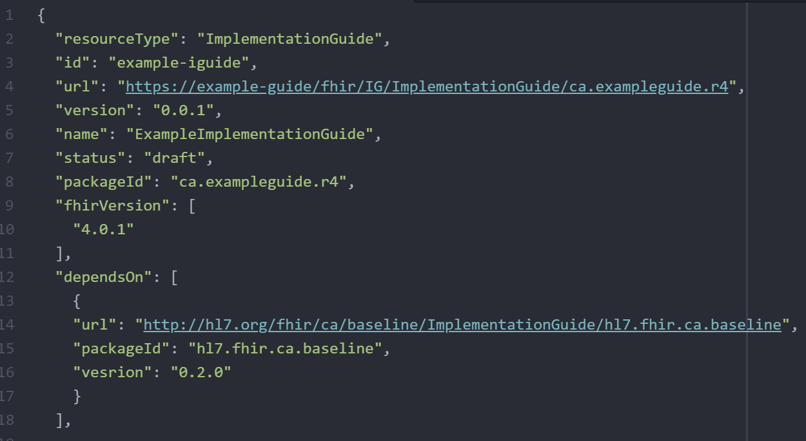
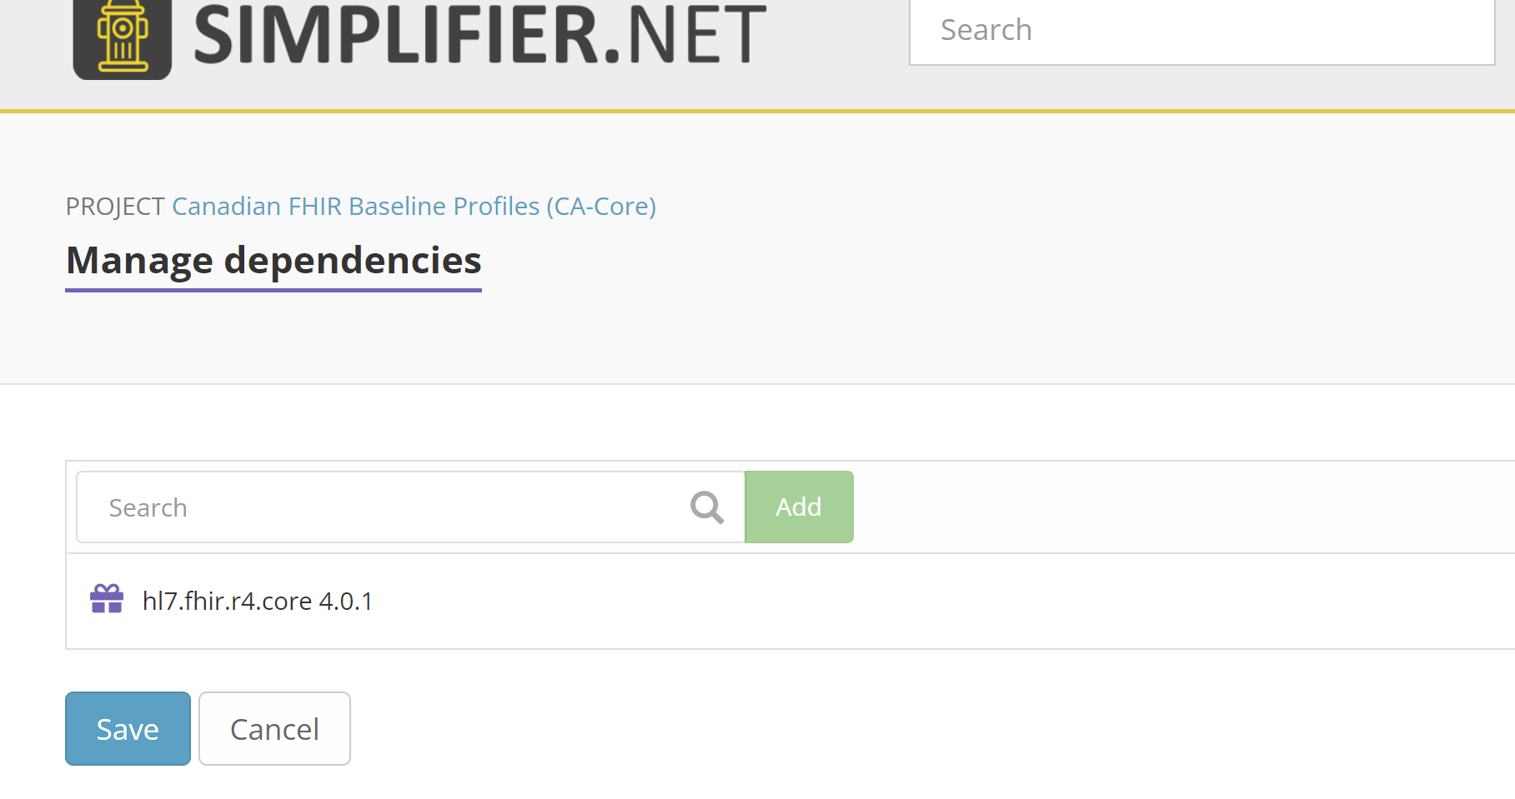
What are the Approaches to Adopt the Canadian FHIR Baseline Profiles?
CA Baseline will release package after reaching Maturity Level 1
Added in ImplementationGuide resource directly, or through Simplifier
https://docs.fire.ly/projects/Simplifier/simplifierPackages.html#add-dependencies
Notes:
(45 seconds) Mike will talk to this in a few minutes, but we’d like to align a package release around our movement into Maturity Level 1. Which we’re expecting within the next few weeks. We’ll make an announcement on the Infocentral forum when we’ve released the package. You can also subscribe for updates using the subscribe button on the CA baseline simplifier project or reach out to Mike and I in our ask the speaker session if you’re particulary interested in getting your hands on it immediately when its fresh off the presses.
I’ve included screenshots showing the different mechanisms your teams are able to use to add Iguide dependencies into your projects. Firely the team behind simplifier has some great documentation and a few presentations of their own on adding in dependencies into your simplifier projects – I’ve dropped the link in the slide for folks who are interested.

Slide 43
What are the Approaches to Adopt the Canadian FHIR Baseline Profiles?
Flexible
Re-Profiling
What is it: Adding CA Baseline profile into StructureDefinition.basedOn to allow your profile to inherit constraints directly from CA Baseline w/o needing to include in differential
Informal Alignment
IGuide Dependencies
Instance Validation
Re-profiling
Pros:
Efficient: Carry over constraints and only apply effort profiling the new
Guarantees alignment
Fastest way to prove conformance
Cons:
Requires stability of parent profile to use in production
Re-work if you decide to switch back
Challenges viewing delta (depending on tools used)
Dynamic
Stable
When should I use this approach?
Connectathon testing
Specification maturity level validation
Profiles that are direct implementations that are not expecting to re-profile further
Rigid
Notes:
(1:55) Last but certainly not least is Re-profiling. You might’ve heard us say in the past – profiles should derive or inherit constraints from the baseline. They do so through a process called Re-profiling.
Its the most rigid mechanism for adopting the baseline, but it also carries with it the most benefits. By indicating your profile is based on the CA Basline– you’re essentially copy/pasting all the work that’s been done already and only have to write code for the things you care about that weren’t originally in the baseline.
So, say your in Manitoba you have a pharmacy service youre developing a medication request profile for– and the constraints in the Baseline already covers 2/3 of your requirements but maybe you want to tighten up a few things. Re-profiling lets you do that while cutting down the time and effort to author your profile with the added benefit of reinforcing a minimum set of requirements that are shared across Canadian FHIR Prescription profiles regardless of jurisdiction or vendor.
Standards might be one of the only industries where plagiarism isn’t just accepted…its heavily encouraged because it advances the greater good.
This is why this is the approach we are recommending to jurisdictional governance bodies and working groups to employ for forthcoming FHIR content. We understand that this is going to take some trust and assurance that the baseline profiles are ready for trial use, changes will be controlled, and that there will be mechanisms for implementors to surface true blockers to their ability to fully re-profile.
We’re asking early adopters to begin trialing this approach against their own use cases and to surface areas they get hung up on through the simplifier issue log. To be clear…we’re not asking for this to be in production implementations right off the bat- but we do need early testers to try this out to catch blind spots and advance the maturity level of the content so production systems can eventually begin using this.

Slide 44
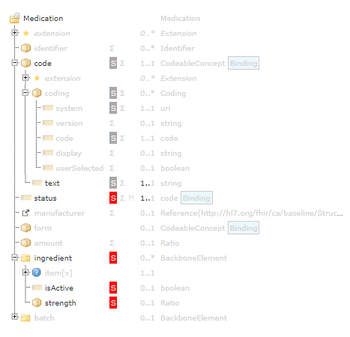
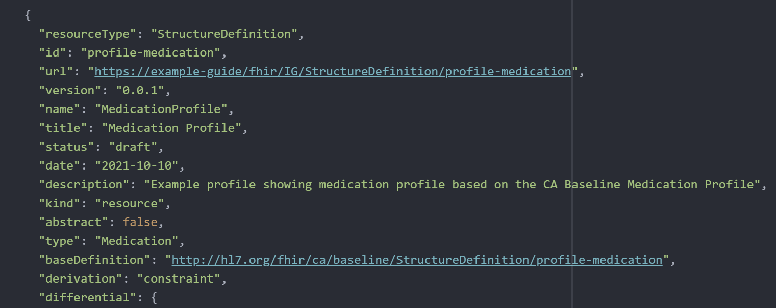
What are the Approaches to Adopt the Canadian FHIR Baseline Profiles?
Profiles available to test any time, but more stable to begin re-profiling starting after CA Baseline Maturity Level 1
Added directly into StructureDefinition
Notes:
(45 seconds )You can begin re-profiling to test out this approach – but we are just finishing up some light housekeeping on the profiles this month – so there may be a few constraints you might see relaxed in the next two weeks that are actions that arose out of our due diligence process that Mike will speak to.
I wanted to show a few images showing how easy it is to implement this approach. If you’re nervous or haven’t done this before or want to talk about things that are keeping you from re-profiling – reach out to Mike or I at the Ask the speaker session. If it means getting folks to trial this out and advance the standard we will find a way to meet with your team and walk them through this.
Now over to Mike who is going to tell you all the work we’ve done to date to get the profiles to a place you can confidently start using them.

