Slide 1
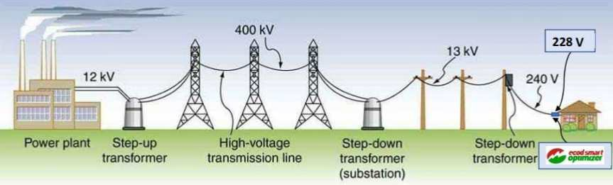
Benefits of voltage regulation in electrical lines
Higher current transmission voltage means lower losses in transmission lines.
(Benefits for energy distributors)
Lower voltage (within tolerance) means lower bills for consumers and extended operation time of devices.
(Benefits for energy consumers)

Slide 2
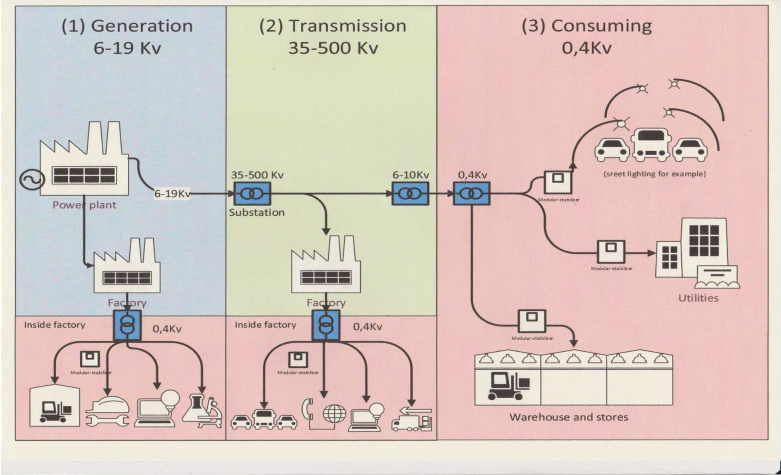
Reducing electricity consumption, reducing losses in transmission lines, increasing efficiency and stability of energy system overall
(3) Maximum reduction of voltage on the level of ultimate consumers, allowed by the Standard, at 0,4 kV will lead (2) to the reduction of current values in feed lines up to (1) the sources producing electric energy – generators at power stations. The reduction of currents will lead to the reduction of losses.
The level of losses will decrease, first of all, at stage (2) of energy transfer. The physical manifestation of it will be the decrease in energy deficit value. This factor will dramatically influence the performance stability of the generating segment (1) of electric energy networks: will increase the reliability of its parameters, the operational stability of generators.

