Slide 1

CA-Baseline A Starting Point for Canadian FHIR Implementation Guides Technical Walkthrough & Alignment Package

Slide 2
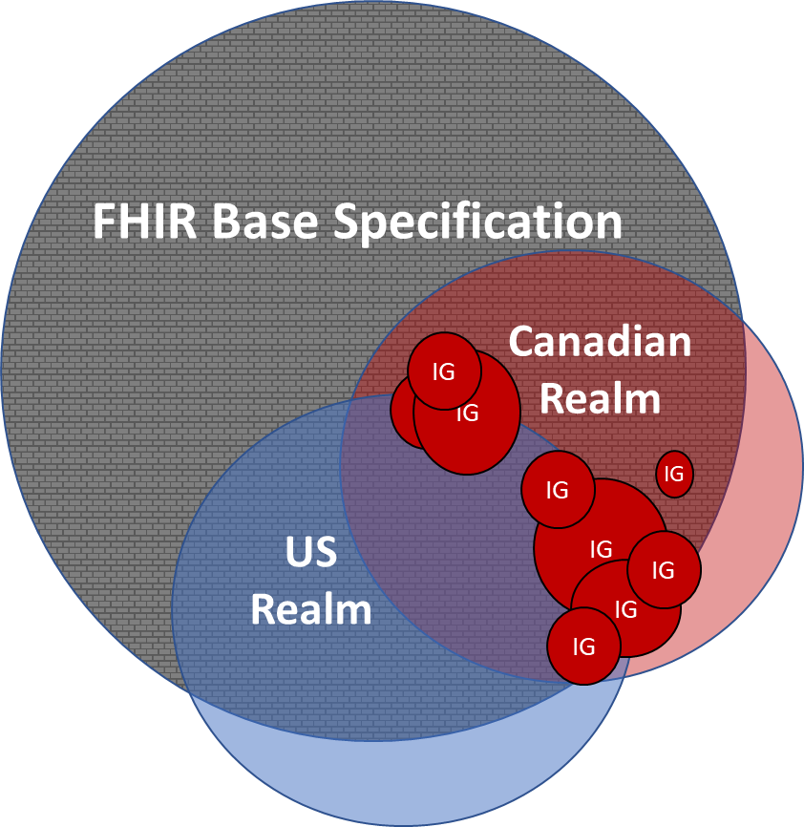
What is the CA Baseline?
Effectively a slightly more constrained starting point for creating use-case specific FHIR Profiles
Constraints have been made that are found to occur in ~80% of the use cases where the FHIR Resource is Profiled
Intended as a common starting point, not an out-of-the-box implementation

Slide 3
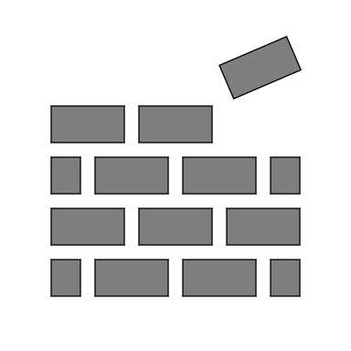

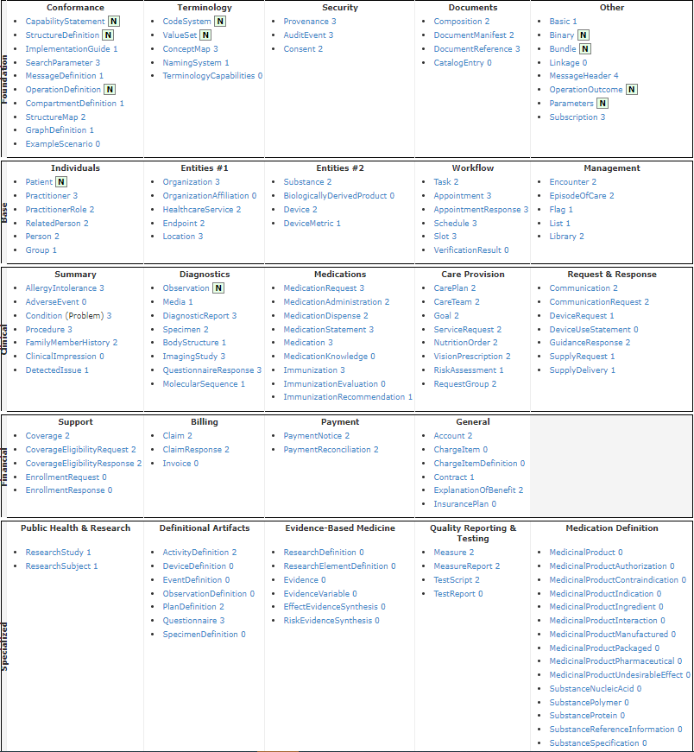
FHIR as a Platform Specification
FHIR Base Specification = “building blocks”, whose defined data elements are expected to be encountered in 80% of systems around the world
Resources that are intended to support broad range of activities: Clinical Care, Patient Access, Pharmacy, Transitions of Care, Administrative Workflows, Insurance & Billing, Public Health, Research Trials, etc.
FHIR Base Specification
(All Resources – Minimal Constraints)
FHIR Base Specification is international - intentionally avoids region-specific code systems & business rules (based on policy)
Expects implementations to constrain and extend the building blocks to meet their specific needs
Notes:
HL7.org/FHIR

Slide 4
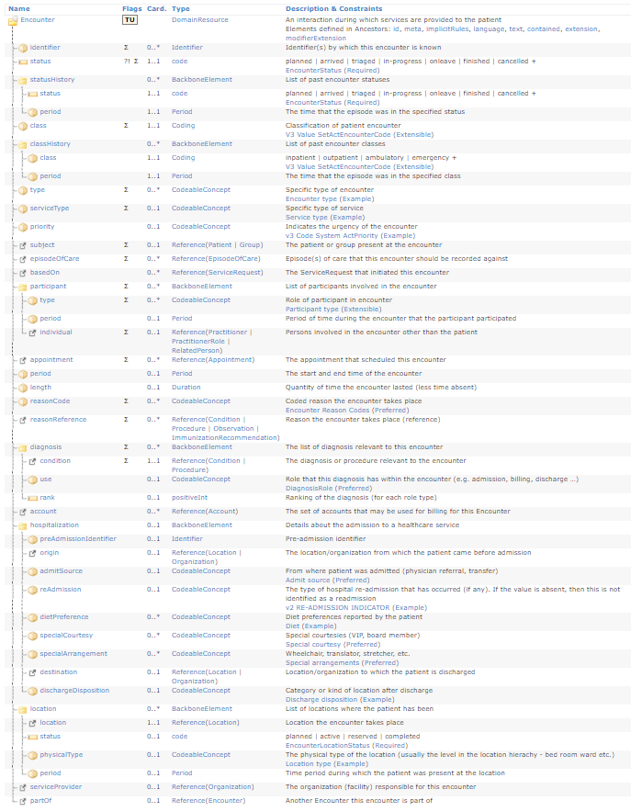
Making use of a Platform Specification
In FHIR base specification – most elements are considered optional – it’s a guide to how concepts can be modeled but not intended to be implemented out of the box
Profiling – allows implementors to further restrict and extend the base specification to meet and enforce their specific needs. Examples include:
Rules about which resource elements are or are not used, and what additional elements are added that are not part of the base specification
Rules about which API features are used, and how
Rules about which terminologies are used in particular elements
Descriptions of how the Resource elements and API features map to local requirements and/or implementations
Note that because of the nature of the healthcare ecosystem, there may be multiple overlapping sets of adaptations - by healthcare domain, by country, by institution, and/or by vendor/implementation.
https://www.hl7.org/fhir/profiling.html#5.1.0
Notes:
Profiles are the computable representation of the needs of a specific implementation. They are in themselves resources (StructureDefinition) which means that profiles can be queried, passed in documents, etc – the same as any clinical piece of data in the FHIR model
In FHIR base specification – most elements are considered optional – it’s a guide to how concepts can be modeled but not something you can implement out of the box
- In a care team look up service– practitioner is one of the resources you’d expect to be used.

Slide 5
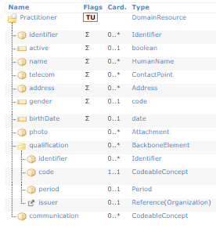
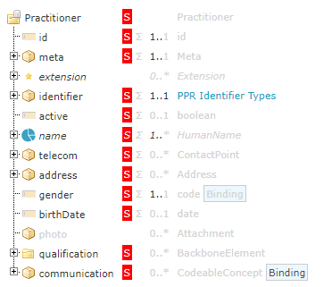
Profiles Defining Implementation Expectations: Practitioner Registry Example
FHIR R4 Base Resource
Purpose: Define a set of elements that systems around the world may use when capturing information about practitioner
Ontario PPR Practitioner Response Profile
Purpose: Define expectations for what will be returned in a response when querying the Ontario PPR service for a provider
Notes:
Value of profile is that it allows us to communicate specific implementation expectations in a way that is computably enforceable
Example on the left , Example on the right we see a profile differential (essentially what has changed with profile) – and the constraints they’ve applied for this specific to a jurisdiction, and its communicating expectations for what will always come back in the response to a query for practitioner info from this particular service
Scope is tight, constraints very defined

Slide 6
What are the Limitations of the FHIR Base Specification?
Each implementor builds an Implementation Guides (IG) that uses those blocks to meet their needs
Starting from base specification is like starting from scratch each time
Lack of alignment between IGs operating in same countries and domains
We all need customization, but we aren’t leveraging each other’s efforts
FHIR Base Specification
(All Resources – Minimal Constraints)
IG
IG
IG
IG
IG
IG
IG
IG
IG
IG
IG
Notes:
Now up until now – most implementations went straight to the base specification to begin their profiling… but the challenge there was that there are national and region specific concepts that we could expect in almost every implementation guide in Canada – that those Iguide Authors were having to define each and every time they wrote a profile
That process lends itself well to Iguides across our jurisdictions becoming misaligned and for the vendors to interpret this as custom configuration for each org or jurisdictions – a kind of every man for himself model – costing us time and money and downstream problems trying to harmonize

Slide 7
What Are We Doing in the CA Baseline And Why?
Realm-specific guidance (i.e. Canadian Baseline)
Completed effort upfront to identify the basic constraints and extensions that any FHIR implementation operating in Canada can expect to include
Intended as a common starting point, not an out-of-the-box implementation
Convened Canadian implementers and Implementation Guide authors to develop initial draft over the last 18 months
Due diligence reviews against existing Canadian FHIR Implementation Guides to ensure alignment and appropriate scope maintained
Ready for the larger community to review it (which helps us refine the content to support the breadth of use cases in the Canadian realm)
FHIR Base Specification
Canadian Realm
IG
IG
IG
IG
IG
IG
US
Realm
IG
IG
IG
Notes:
Set out to test that theory and see if we could develop realm specific guidance that could be a starting point for all Canadian fhir implementation guides in the form of what we now know as the Canadian Baseline
Group of volunteer iguide authors, implementors, and handful of clinicians developed a set of profiles with the minimum constraints and extensions we’d expect to see here in Canada in a process that occurred over the last year and a half
Now finishing up our quality assurance process dubbed Due Diligence Reviews to compare our profiling decisions against existing Canadian FHIR implementation guides and identify and correct areas of misalignment

Slide 8




CA Baseline Approach to Profiling
Realm-specific Baseline constraints that Canadian profiles will include– needs to be use case & implementation agnostic
Expose implementation guide and vendor community to what concepts can be expected to be supported across jurisdictions today
Drive consistency and harmonization through socialization and profile derivation
Concepts that were common across existing implementations become ubiquitous in future implementations.
Avoid overly prescriptive constraints before an incentive/governance structure is in place
Absence of united front with vendors = configuration costs passed down to implementing systems to ensure presence of concepts & use of prescribed coding systems
Notes:
Drive harmonization through socialization and profile derivation - Concepts that were common across existing implementations become ubiquitous in future implementations.

Slide 9
CA Baseline Approach to Profiling
Similar to implementation-specific profiles, our CA Baseline profiles are a resource definition that applies constraints and extensions (to a base resource) for the purposes of mechanically enforcing rules about what is expected
Changes we apply in CA Baseline Profiles:
Must Support Flags
Cardinality
Extensions
Invariants
Slices
Terminology & Binding Strength
Notes:
Going to talk about how those principles are operationalized through profiling.
We make the same types of changes that more specific implementors make – apply must support flags, change cardinality, add extensions – but we it at more of a mezzo level – because we know that the changes we make will be inherited into everything that will derive from the Baseline

Slide 10

Must Support Flags
Must Support (MS) Flags - property that can be applied within a profile that, if true, means the system claiming to conform to the profile must support the element
Every guide defines the meaning of must support
MS flags are inherited into derived profiles, but those profiles can further constrain the meaning of must support
CA Baseline
Must Support Approach
MS
Query Scenario:
Queried server shall send/relay the element (if available and permitted)
The querying client can assume it will be received if available
Create/Update Scenario:
Client creating resourced shall be capable of sending/relaying element
Server shall be capable of receiving/relaying/storing the data element
Business rules, data regulations, additional implementation guides should determine what the server and/or querying client will do with the data it receives (i.e., store, persist, display, etc.)
https://www.hl7.org/fhir/profiling.html#mustsupport
http://build.fhir.org/ig/HL7-Canada/ca-baseline/branches/master/general-guidance.html
Notes:
For those not familiar – ms flags
Ambiguous – that’s because FHIR expects each guide to define their own meaning of MS
We’ve developed a simple definition to provide clarity to clients and servers in both query and creation scenarios – that focuses on ability to send/relay/and receive but don’t make statements about business rules or expectations for what you’ll do with the data – because we want to leave that up to the derivative profile to decide
So even if we think something would be clinically nice to have – we need to be careful – since we expect some practical implementations will have strong MS definitions like “MS elements need to be displayed to the clinical user” – we don’t want to force them to put rigid rules on something that doesn’t matter to that specific implementation AND we don’t want to make them maintain and explain to different definitions for must support in the same guide

Slide 11
Cardinality
A profile inherits cardinality and can restrict the cardinality of an element within the limits of the structure it is constraining
 |  | Derived Cardinality
 |  | 0..0 | 0..1 | 0..* | 1..1 | 1..*
Base Cardinality | 0..1 | yes | yes | no | yes | no
 | 0..* | yes | yes | yes | yes | yes
 | 1..1 | no | no | no | yes | no
 | 1..* | no | no | no | yes | yes
Cardinality inheritance can have significant impact to downstream implementors
CA Baseline keeps cardinality changes minimal – mostly occur in child elements (like requiring system and code be present if CodeableConcept supplied)
https://www.hl7.org/fhir/profiling.html#cardinality
Notes:
Cardinality has similar challenges for a mezzo level profile like ours – because its inherited and derived profiles aren’t allowed to loosen or extend it
So we have to be very careful about where and when we make cardinality changes – if you see it in the Baseline its almost always going to be happening at the child elements on things like coding – if you say youre sending me a code – then you have to send a code and system

Slide 12
Terminology
Binding Strength | Definition | Can Profile Change Terminology? | Can Profile Change Binding Strength?
required | The concept in this element SHALL be from the specified value set. | No, bound terminology is required to be the same | No, must remain required.
extensible | The concept in this element SHALL be from the specified value set if any of the codes within the value set can apply. If the value set does not cover the concept (based on human review), alternate codings may be included instead. | Derived profiles may state rules on which codes can be used, but cannot select new or additional codes for these elements (unless no codes with appropriate meanings are found) | Can remain extensible, or tighten to required.
preferred | Instances are encouraged to draw from the specified codes for interoperability purposes but are not required to do so to be considered conformant. | Implementors should consider adopting the preferred value set wherever possible, but derived profiles may bind the element to any value set they choose | Can remain preferred, or tighten to extensible or required.
example | Instances are not expected or even encouraged to draw from the specified value set. The value set merely provides examples of the types of concepts intended to be included. | Derived profiles may bind the element to any value set they choose | Can remain example, or tighten to preferred, extensible, or required.
A profile inherits terminology & binding strength from the structure it’s constraining
Looser binding strength = greater flexibility for derived profile to make implementation-driven changes to terminology or strength
Notes:
Now for the profiling changes this crew is probably more interested in – terminology changes
If you see a value set that has required binding strength- it means your profile cant change the value set and cant change the strength
If its extensible – it means you can constrain the codes in the set – but its much more difficult to add additional codes unless you can prove there aren’t semantic mappings to your new codes in the original value set. You can only tighten to required or keep at extensible.
With preferred – greater mechanical flexibility to change the value set but still recommended to use the value set if at all possible –
With example – the author is saying (we really don’t care use what you want heres an example of one potential coding system)

Slide 13
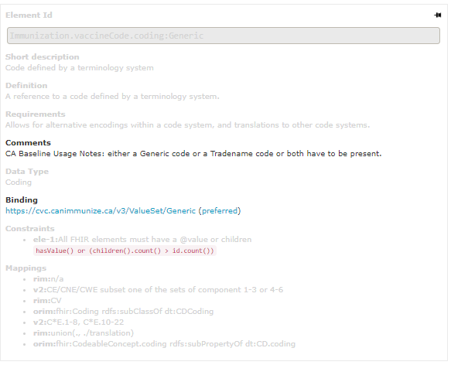
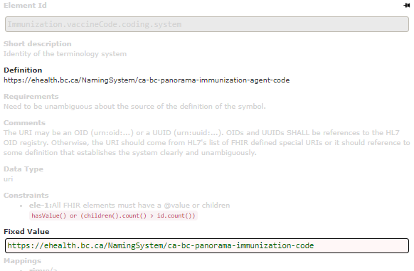
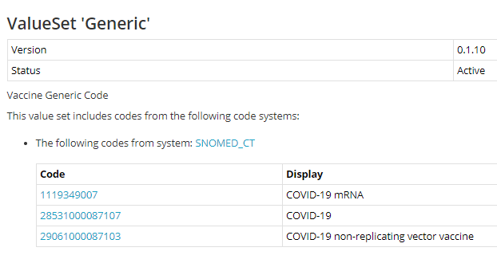
Impacts of Terminology Binding
Preferred Value Set in Baseline– Different Value Sets in Potential Derived Profiles
CA Baseline Immunization.vaccineCode Generic Value Set
BCY Imms Citizen Access Immunization.vaccineCode
COVaxON Immunization.vaccineCode
Generic Value Set
SNOMED CT Pharma/Biologic Codes
These codes can also be found in value set on the left
Panorama codes map to SNOMED CT & CVC codes but also typically include Jurisdictionally Local Codes “JIBC_DILT_MMR” for things not in CVC yet
Notes:
In the baseline we try wherever possible to use preferred – because we know there are downstream implications to going stronger than that
Middle – codes here are actually a subset of snomed codes specifically for covid vaccines. So they can be found in the value set on the left even though they are being defined here in their own value set
On the right – Profile for citizen access of immunization information from panorama
(e.g., diluent, sterile water injections, new codes, etc.)
If we had set the binding strength to required – some gaps are expected (even for systems like panorama that we think of as highly standardized).

Slide 14
What are the Options for Adopting the Canadian FHIR Baseline Profiles?
Flexible
End Goal: Pan-Canadian Collaborative enforcement of CA Baseline profiles as the starting point for prospective Canadian FHIR profiles, while offering alternative mechanisms for showing harmonization for previously published guides & profiles where re-profiling isn’t appropriate
This adoption approach is heavily impacted by profile maturity & stability
FHIR offers a variety of mechanisms that can be used in meantime to assist early implementors in alignment and testing against the CA Baseline Profiles
Informal Alignment
IGuide Dependencies
Instance Validation
Re-profiling
Dynamic
Stable
Rigid
Notes:
(1:15) Thanks Mike, one of the most important things to understand about the Canadian Baseline is that it operates in a uniquely challenging space- it’s been developed through grassroots volunteer efforts which means were not starting from a place of a formal policy or program stating that the baseline will be adopted these ways – which means we also don’t have formal incentives or disincentives tied to adoption.
So we’ve done considerable work in our governance stream to identify a path forward to connect with federal and jurisdictional working groups in asking them to be part of a collaborative enforcement body that will enforce the use of the CA Baseline in their jurisdictions for any prospective guides. We know jurisdictions like BC have already started to include the Baseline in their standards catalogue but we’ve also heard that they are looking for some assurance to the maturity and stability in the content before enforcing that their implementation guide authors start using the CA Baseline.
So in the meantime we’ve outlined a number of mechanisms that implementors can use to adopt and test the profiles for the improvement of their content as well as the improvement and further maturity of ours.
So I’m Going to talk about four of these mechanisms today and the conditions in which theyre most helpful to implementors.

Slide 15
What are the Approaches to Adopt the Canadian FHIR Baseline Profiles?
Flexible
Informal Alignment Approach
What is it: Reviewing the StructureDefinition of the CA Baseline CI Build profile, inputting its constraints manually into your profile, and surfacing any constraints that need to be relaxed to CA Baseline issue log
Informal Alignment
IGuide Dependencies
Instance Validation
Re-profiling
Pros:
Ensures harmonization
Flexibility for those falling outside of the 80/20 rule
Cons:
Effort intensive: No easy way to computably compare
Lack of transparency
Complex profiling (slices, invariants, etc.) can be misunderstood
Dynamic
Stable
When should I use this approach?
Early production implementors using CA Baseline before maturity level 2
When performing DDR against your existing specification
Profiles where re-profiling is expected
Rigid
Notes:
(1:36) We’re going to start from the most flexible approach that implementors can begin adopting immediately while the Baseline is still considered an evolving draft.
So Informal alignment is not a mechanism per se, but it’s the approach that the Canadian standards community has been using for the last 18 months to align their guides and profiles to the earliest drafts of the baseline.
The process is manual visual comparison of the profile differential to note what cardinality, MS flag constraints and terminology recommendations are in place and then carrying that over into their profiles.
The biggest benefit of this approach that doesn’t force you to inherit all constraints – making it a good choice for implementors developing production level systems that are more averse to changes in the baseline. This approach also allows deviation from the CA Baseline when it’s appropriate, say you have a fringe use case that falls south of the 80/20 rule.
The downside of this is approach is that we don’t have transparency on who is using it. Because of this, it increases the risk of missing places where CA Baseline that overly restrictive.
It’s critical that if you are using this approach – you communicate back to the CA Baseline team when you’ve identified a constraint that you can’t reasonably carry over into your guide– and you do so using our simplifier issue log.
As the baseline profiles become more mature & stable – this remains a good approach for Iguide authors who have other reasons for not inheriting the constraints directly – one example might br for those anticipating an already nested structure in their profile (e.g., like we see around some types of observations ).

Slide 16
What are the Approaches to Adopt the Canadian FHIR Baseline Profiles?
Flexible
Instance Validation Approach
What is it: Adding CA Baseline Profile to meta.profile element in example messages, running through validator (e.g., FHIR Validator, Simplifier validation button, etc.)
Informal Alignment
IGuide Dependencies
Instance Validation
Re-profiling
Pros:
Lightweight, performed at testing
Can be performed on historical specifications
Can validate against multiple profiles at once
Cons:
Doesn’t validate against Must Support
Requires profile to be resolvable locally or canonically
Dynamic
Stable
When should I use this approach?
Validating non-MS constraints against existing specifications
Connectathon testing
Rigid
Notes:
(1:40) We consider the next approach to be less flexible and narrowly scoped in how an implementor can use this mechanism. When we say instance, we’re typically talking about examples that model the constraints outlined in the specification. Just because I develop examples for a PrescribeIT implementation guide doesnt mean I can’t also validate those examples against the rules set out in non-prescribeit profiles.
And I do so by editing my example file to call out the profile or profiles I’d like to validate the instance against. I’d run that through one of the validator tools and receive information back from the tool indicating if there are any warnings or errors related to breaking profile rules.
So lets say, my guide only requires patient name text, but the CA Baseline has a rule that requires either given, family, or both names be present …if my example only includes name text and I run it up against my profile AND the Baseline profile– this approach would tell my I failed a rule in the CA baseline. And ultimately tell me there is a gap between my content and the Baseline that needs to be resolved.
So it works really well on cardinality and invariant constraints. However, it doesn’t cover validation of Must Support flags which actually tend to be one of the trickier areas to assess alignment.
So while we widely encourage everyone to use this approach in their arsenal – particularly those who want to prove that published specifications don’t inhibit conformance the Baseline) … it still need to be combined with other approaches to confidently guarantee alignment to the CA Baseline

Slide 17
What are the Approaches to Adopt the Canadian FHIR Baseline Profiles?
Flexible
Implementation Guide Dependencies
What is it: Adding CA Baseline Guide into ImplementationGuide.dependsOn to allow your guide to point to CA Baseline profiles, terminology, extensions, etc.
Informal Alignment
IGuide Dependencies
Instance Validation
Re-profiling
Pros:
Allows pointing to external constraints without duplicating in your guide
Packaging allows version specific stability
Cons:
Requires IGuide & contents to be resolvable and/or published in a package
Dynamic
Stable
When should I use this approach?
When reusing national and implementation specific extensions or terminology
Rigid
Notes:
(1:06) The Iguide Dependency approach on the other hand allows you to reference other Iguide content – like extensions and profiles and value sets without having to rebuild those within your own implementation guide packages. So uf you’re in BC and you want to leverage the aboriginal identity group extension that weve socialized within the baseline - you’d be able to include the CA Baseline as one your guide dependencies and then youre not stuck maintaining or changing this extension over time.
Including an implementation guide dependency to the baseline doesn’t force you to use any specific content in the baseline – but it’s a particularly helpful approach for folks who are expecting to develop profiles that will rely on nationally standardized extensions and terminologies – a lot of the extensions we’ve surfaced to date are patient and practiotioner focused. So folks who are working on client and provider registries – this is a great approach for you to start implementing as soon as you can.
Now the downside of this approach is that it works best when you have a stable versioned package that you can point to. Which from the Baseline perspective is coming very soon but isn’t available this week (next)

Slide 18
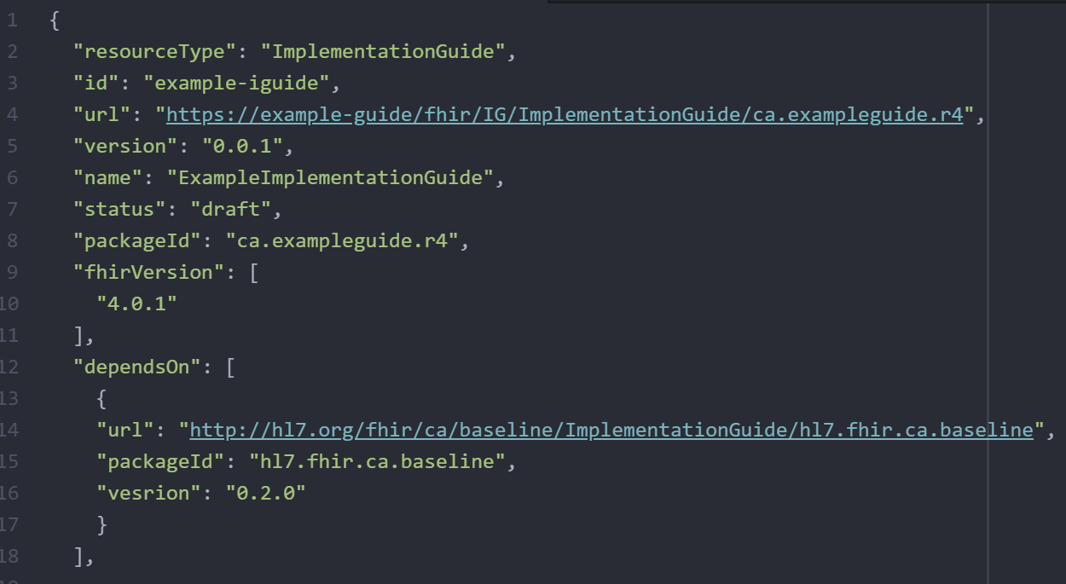
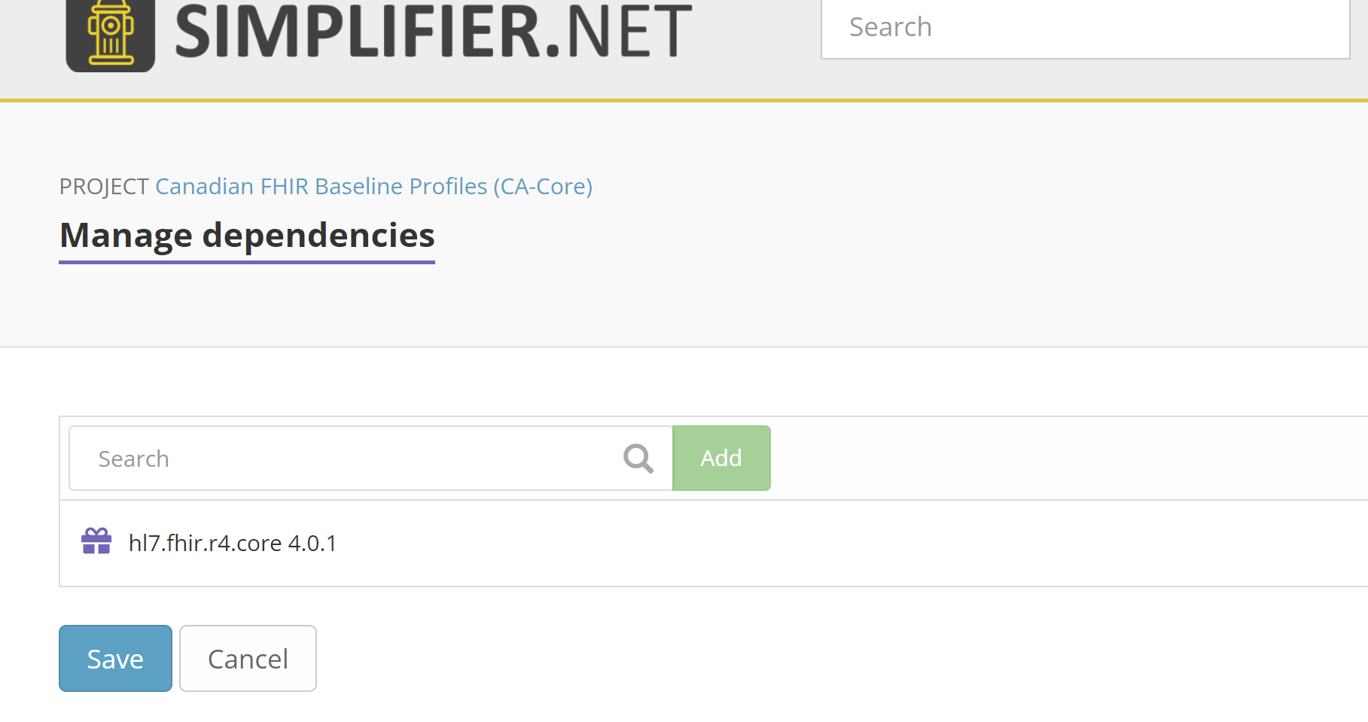
What are the Approaches to Adopt the Canadian FHIR Baseline Profiles?
CA Baseline will release package after reaching Maturity Level 1
Added in ImplementationGuide resource directly, or through Simplifier
https://docs.fire.ly/projects/Simplifier/simplifierPackages.html#add-dependencies
Notes:
(45 seconds) Mike will talk to this in a few minutes, but we’d like to align a package release around our movement into Maturity Level 1. Which we’re expecting within the next few weeks. We’ll make an announcement on the Infocentral forum when we’ve released the package. You can also subscribe for updates using the subscribe button on the CA baseline simplifier project or reach out to Mike and I in our ask the speaker session if you’re particulary interested in getting your hands on it immediately when its fresh off the presses.
I’ve included screenshots showing the different mechanisms your teams are able to use to add Iguide dependencies into your projects. Firely the team behind simplifier has some great documentation and a few presentations of their own on adding in dependencies into your simplifier projects – I’ve dropped the link in the slide for folks who are interested.

Slide 19
What are the Approaches to Adopt the Canadian FHIR Baseline Profiles?
Flexible
Re-Profiling
What is it: Adding CA Baseline profile into StructureDefinition.basedOn to allow your profile to inherit constraints directly from CA Baseline w/o needing to include in differential
Informal Alignment
IGuide Dependencies
Instance Validation
Re-profiling
Pros:
Efficient: Carry over constraints and only apply effort profiling the new
Guarantees alignment
Fastest way to prove conformance
Cons:
Requires stability of parent profile to use in production
Re-work if you decide to switch back
Challenges viewing delta (depending on tools used)
Dynamic
Stable
When should I use this approach?
Connectathon testing
Specification maturity level validation
Profiles that are direct implementations that are not expecting to re-profile further
Rigid
Notes:
(1:55) Last but certainly not least is Re-profiling. You might’ve heard us say in the past – profiles should derive or inherit constraints from the baseline. They do so through a process called Re-profiling.
Its the most rigid mechanism for adopting the baseline, but it also carries with it the most benefits. By indicating your profile is based on the CA Basline– you’re essentially copy/pasting all the work that’s been done already and only have to write code for the things you care about that weren’t originally in the baseline.
So, say your in Manitoba you have a pharmacy service youre developing a medication request profile for– and the constraints in the Baseline already covers 2/3 of your requirements but maybe you want to tighten up a few things. Re-profiling lets you do that while cutting down the time and effort to author your profile with the added benefit of reinforcing a minimum set of requirements that are shared across Canadian FHIR Prescription profiles regardless of jurisdiction or vendor.
Standards might be one of the only industries where plagiarism isn’t just accepted…its heavily encouraged because it advances the greater good.
This is why this is the approach we are recommending to jurisdictional governance bodies and working groups to employ for forthcoming FHIR content. We understand that this is going to take some trust and assurance that the baseline profiles are ready for trial use, changes will be controlled, and that there will be mechanisms for implementors to surface true blockers to their ability to fully re-profile.
We’re asking early adopters to begin trialing this approach against their own use cases and to surface areas they get hung up on through the simplifier issue log. To be clear…we’re not asking for this to be in production implementations right off the bat- but we do need early testers to try this out to catch blind spots and advance the maturity level of the content so production systems can eventually begin using this.

Slide 20
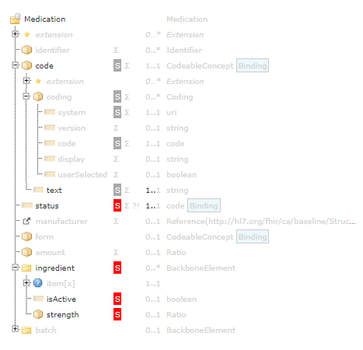
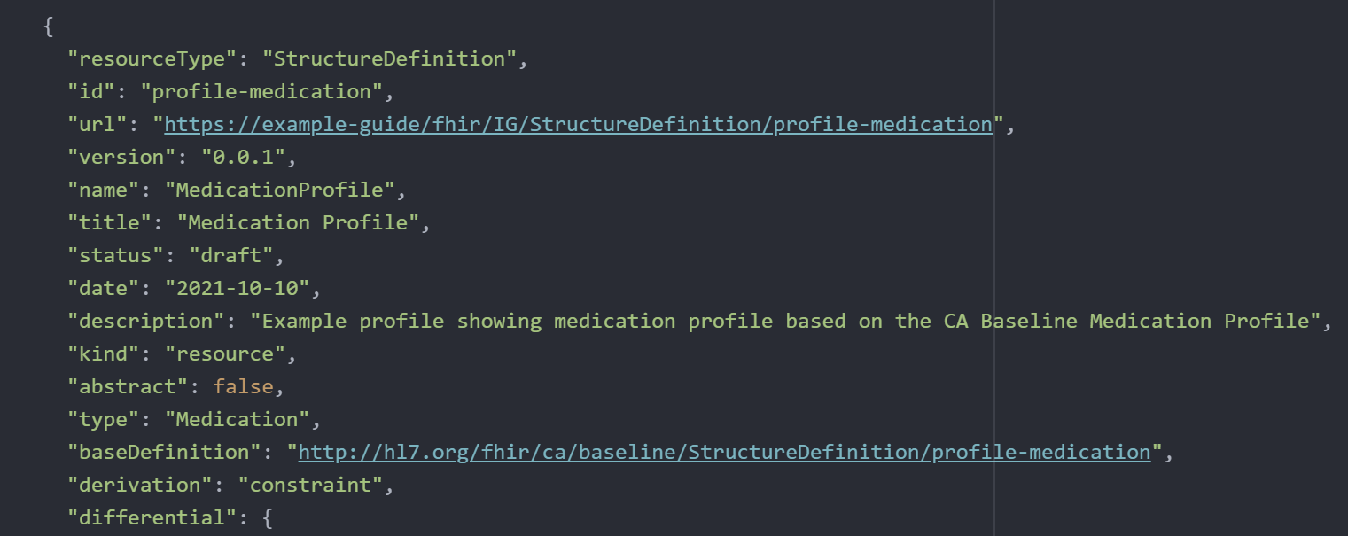
What are the Approaches to Adopt the Canadian FHIR Baseline Profiles?
Profiles available to test any time, but more stable to begin re-profiling starting after CA Baseline Maturity Level 1
Added directly into StructureDefinition
Notes:
(45 seconds )You can begin re-profiling to test out this approach – but we are just finishing up some light housekeeping on the profiles this month – so there may be a few constraints you might see relaxed in the next two weeks that are actions that arose out of our due diligence process that Mike will speak to.
I wanted to show a few images showing how easy it is to implement this approach. If you’re nervous or haven’t done this before or want to talk about things that are keeping you from re-profiling – reach out to Mike or I at the Ask the speaker session. If it means getting folks to trial this out and advance the standard we will find a way to meet with your team and walk them through this.
Now over to Mike who is going to tell you all the work we’ve done to date to get the profiles to a place you can confidently start using them.

Slide 21
When will the Canadian FHIR Baseline Profiles be Matured and Ready for My Use?
Informal Alignment
Now
Instance Validation & Re-Profiling
Now
iGuide Dependencies
Now
Already being done by iGuide authors in several jurisdictions! Need more community members contributing to issue log.
In need of testing and feedback to improve & increase profile maturity levels
Package release at Level 1 Maturity expected in Winter 2021
Due Diligence Review, and Community Feedback
Ontario Provincial Patient and Provider Registries Specifications
Ontario Digital Health Drug and Immunization Repositories Specifications
Ontario eReferral Specification
Canada Health Infoway PHI Access Specification
TELUS Health PrescribeIT Specification
International Patient Summary Specification
OLIS R4 (in progress)
BC Provider Location Registry (early feedback)
Notes:
(45 seconds )You can begin re-profiling to test out this approach – but we are just finishing up some light housekeeping on the profiles this month – so there may be a few constraints you might see relaxed in the next two weeks that are actions that arose out of our due diligence process that Mike will speak to.
I wanted to show a few images showing how easy it is to implement this approach. If you’re nervous or haven’t done this before or want to talk about things that are keeping you from re-profiling – reach out to Mike or I at the Ask the speaker session. If it means getting folks to trial this out and advance the standard we will find a way to meet with your team and walk them through this.
Now over to Mike who is going to tell you all the work we’ve done to date to get the profiles to a place you can confidently start using them.

Slide 22
What does the Alignment Package Include?
Endorsement Statement Boilerplate Language
Alignment Statement Boilerplate Language
Description of Alignment Options
Technical Instructions to Incorporate Alignment Options into your standards

Slide 23
Endorsement Statement Boilerplate Language
Please consider the following ‘boiler-plate’ wording when referencing your Jurisdiction’s / your FHIR Implementation Guides’ alignment to the FHIR Canadian Baseline Profiles:
General Statement on Jurisdiction’s Standards Website “Our Digital Health Standards and their constituent FHIR Implementation Guides are based on the [inProfiles, in order to reduce variations in data exchange standard use across jurisdictions and use cases. For more information on the FHIR Canadian Baseline Profiles, please refer to the Specification here [link]. To participate in the ongoing maturity of the Profiles and to provide feedback, please visit the InfoCentral Working Group here [link].”

Slide 24
Alignment Statement Boilerplate Language
Please consider the following ‘boiler-plate’ wording when referencing your Jurisdiction’s / your FHIR Implementation Guides’ alignment to the FHIR Canadian Baseline Profiles:
Specific Jurisdictional FHIR Implementation Guide Intro Section “The FHIR Profiles defined in the [insert jurisdictional standard], [optional: with the exception of _____] are aligned to the FHIR Canadian Baseline Profiles, version [insert version]. The FHIR Canadian Baseline profiles have been developed to help improve interoperability among healthcare IT solutions across Canada.
This [jurisdictional standard] makes use of the CA Baseline in the following ways [choose from the list below]
informally aligns to the constraints of the CA Baseline profiles
claims a dependency on CA Baseline Implementation Guide to make use of its artefacts (e.g., extensions, value sets, etc),
declares conformance to the CA Baseline through the validation of examples against the CA Baseline constraints
uses the CA Baseline as the BaseDefinition for the following profiles [insert here],
[Other: please describe]
To learn more about the Baseline and its benefits, or to contribute to advancing the maturity of the FHIR Canadian Baseline Profiles, please visit Canada Health Infoway’s InfoCentral Working Group here [link].”

Slide 25
For Authors and Implementers
CA Baseline Github: https://github.com/HL7-Canada/ca-baseline
CA Baseline Simplifier Project & Issue Log: https://simplifier.net/canadianfhirbaselineprofilesca-core
CA Baseline IG Publisher iGuide: http://build.fhir.org/ig/HL7-Canada/ca-baseline/branches/master/index.html
FHIR Implementers Community on InfoCentral: https://infocentral.infoway-inforoute.ca/en/collaboration/wg/fhir-implementations
Contact Info for CA Baseline Co-Leads:
Sheridan Cook: sheridan.cook@accenture.com
Mike Savage: michael.savage@sunlife.com
HL7Canada@infoway-inforoute.ca

Slide 26
Where are we in our CA Baseline Maturity Roadmap?
We’re Here
QA Period
Prep for FMM0
FMM0
QA Period
FMM1
FMM2
Complete Remaining Clinical Profiles
Clean-up of IG Profile Content for QA/Due Diligence Review
Prep for IGuide draft to be published as a whole for broad community awareness: Maturity Model Stage 0 (FMM0)
IGuide is published as first draft (FMM0) for community exposure
Community engaged in external due diligence review: Existing projects providing feedback & comparison against domains
Mechanism/tool* is used to collect broader community & implementor feedback (i.e. Peer reviews, connectathons, and/or ballot for comment) to confirm that it meets needs of early implementors
Improvements made to IGuide based on initial round of feedback
IGuide changes are reconciled to ensure additional Validator warnings are resolved
IGuide made available for use by implementors
Require 3+ implementors before IGuide can be progressed to FMM2.
Physical presence limitations may require us to find alternative means of surfacing IGuide via connectathon
Implementation feedback and results gathered for submission to HL7 Canada
Prep for formal balloting
Framework for completing internal due diligence review (purpose, scope, depth, success criteria, review process)
Principles developed for this internal and external due diligence review
1st level due diligence review against existing CA FHIR IGuides
Reconciliation of changes driven by DDRs
Processes and tools for collecting community feedback identified and confirmed
Pan-Canadian Baseline Governance Collaborative - promotes roll out of the Baseline in jurisdictional FHIR projects– formalizes decision making about a CA Core and requirements related to procurement
Align approach with Infoway Governance Report Findings & Recommendations
Jurisdictions and Implementor Community is engaged to help validate approach, are engaged as we progress through the approach.
Development of content maturity & change management processes
Identification and call for endorsement & creation of governance collaborative
Documentation of governance, representation, and decision making process for inclusion in section(s) IGuide
CA Baseline Workstream supports PCBGC with recommendations, maintenance & enhancement of the CA Baseline
Any updates being run through FHIR Validator to find and correct errors and warnings
Notes:
Due Diligence Review:
Handful (2-3) National/International IGuides used as comparison points during Friday Calls
*First level definition needed (what’s the depth we want to get to before building to a 2nd level review with larger community
Need to have some recognition of the step that is required at a national level to align the provinces (not just align the implementors w/in provinces) – gap that needs to be filled and this process will need to align to that.
Identify enablers needed to accomplish these milestones

Slide 27
Dealing with Profile Maturity Differences
Do we want to apply maturity levels to the profiles, the guide, or both?
Likely both
Maturity levels reflected for both profiles & guides following traditional FMM progression
Want to shoot for IGuide maturity level that is closer to trial use to alert implementors they are stable enough to try out
Until we get out of Draft level for whole guide - marking resources/elements as lower maturity may not be helpful - because the assumption is that entirety of it is low maturity
What do we do with the profiles that are lower level in maturity than the others? Keep them out of the guide, segment them somewhere else?
Don't leave them out of the IGuide, clearly differentiate them at resource level (and maybe even element level - for example observation.focus)
Does it make sense to vary from the FHIR FMM implementation-driven definition given that we’re a baseline?
May have to vary somewhat given baseline scope is different than a traditional implementation guide scope/different than the international spec use of maturity (i.e. used in multiple countries)
Need to define a logic for understanding our maturity level that is communicated in the guide.
# of comparison specifications included as parameters in the definition for maturity (differentiate specs that have been implemented vs those that are also still in draft form)
#of times the baseline/profiles based off the baseline are used as another indicator for later levels of maturity
Does it make sense to ask for a different expectations for less mature profiles?
Not appropriate for the workstream to define the expectations- we can make recommendations but decision on what jurisdictions are expected to do with each comes from the collaborative
Does it make sense for us to ask for different types of support from our governance group for less mature profiles
- i.e. agreeing to use the level X for implementation and to provide support getting community feedback for level Y)

Slide 28
Baseline Profile Maturity Level Definitions
# | CA Baseline Maturity Level Definition
0 (draft) | The artifact has been published on the current build. This level is synonymous with Draft. Implementors should be aware that artifacts at this maturity level are subject to community review and refinement.
1 | The artifact produces no warnings during the build process and has had a formal internal review by the CA Baseline Working Stream. The artifact is considered substantially complete and ready for trial use. Profiles at this level are available for the community to experiment with, in developing their own profiles, in order to solicit implementor feedback. Implementors should be aware that artifacts at this maturity level are still subject to community review and refinement.
2 | The artifact has been released for review to the CA FHIR community, and is being used and/or demonstrated by at least three implementations (e.g., pan-Canadian, jurisdictional, vendor, etc.) from at least two different jurisdictions. Implementor feedback has been addressed as far as possible and is socialized through the Canadian Governance Collaborative. Implementors should be aware that artifacts at this maturity level are still subject to community review and refinement.
3 | The artifact has been verified by the work group as meeting the CA Baseline Quality Guidelines; has been subject to a round of formal balloting; Implementation guides at this maturity: have at least 10 distinct implementer comments submitted to [location tbd], provided by at least 3 organizations across three jurisdictions resulting in at least one substantive change Resources at this level of maturity: have at least 3 distinct implementer comments submitted to [location tbd] across at least three jurisdictions Requests for changes from this level onwards are expected to follow an evaluation & consultation process with the Canadian Governance Collaborative.
For the Purposes of the Canadian Baseline Implementation Guide, current build means it is published on the publicly available CI Build(http://build.fhir.org/ig/HL7-Canada/ca-baseline/branches/master/index.html) and Simplifier Project (https://simplifier.net/CanadianFHIRBaselineProfilesCA-Core)
For our purposes, ready for use means ready for Canadian profiles to begin attempting to derive from the Baseline profiles, it is understood that artifacts can be ready for use but are still expected to undergo revisions
*demonstrated could mean 1) profiles formally derive from the baseline using the baseDefinition and show no conformance errors , OR 2) profiles can be validated against the {BaselineProfileURL] and is conformant (produces no errors)
Notes:
https://confluence.hl7.org/display/FHIR/FHIR+Maturity+Model#:~:text=This%20page%20describes%20the%205,it%20has%20been%20subject%20to.
https://simplifier.net/guide/UKCoreDevelopment2/Profiles
# of comparison specifications included as parameters in the definition for maturity (differentiate specs that have been implemented vs those that are also still in draft form)
#of times the baseline/profiles based off the baseline are used as another indicator for later levels of maturity

Slide 29
Baseline Profile Maturity Level Definitions
# | CA Baseline Maturity Level Definition
4 | FMM3 + the artifact has been tested across its scope (see below), published in a formal publication (e.g. STU) that FHIR projects have referenced/utilized across multiple prototype projects across at least three jurisdictions As well, the FHIR Implementors work group agrees the artifact is sufficiently stable, and that any future non-backward compatible [breaking] changes will go to the Canadian FHIR community for consultation.
5 | Draft wording as of July 21st: Artifact is ready for inclusion in normative ballot in the HL7 Canada Ballot Process. At least 5 independent production systems, across 3 jurisdictions, have demonstrated* conformance to the CA Baseline Profile as a starting point. “Independent production systems” should be inclusive of the following implementor types: Health Vendors (e.g., EHR, HIT, Consumer Health) Jurisdictional Health Assets Pan-Canadian/Federal Health Assets
6 (normative) | The FHIR Implementors Group and the Canadian Governance Collaborative agree the material is ready to lock down and the artifact has passed HL7 Canada normative ballot
*demonstrated could mean 1) profiles formally derive from the baseline using the baseDefinition and show no conformance errors , OR 2) profiles can be validated against the {BaselineProfileURL] and is conformant (produces no errors)
Demonstration process may differ for conformance activities outside of the CA Baseline Artifact Maturity process. Some instances may want to prove conformance for other purposes outside of maturing the CA Baseline (e.g., proving conformance of tool for procurement criteria)
Notes:
https://confluence.hl7.org/display/FHIR/FHIR+Maturity+Model#:~:text=This%20page%20describes%20the%205,it%20has%20been%20subject%20to.
https://simplifier.net/guide/UKCoreDevelopment2/Profiles
From the HL7 Confluence Site – Footnotes: Any of the criteria can be waived provided the sponsoring WG can convince the FMG that that criteria should not apply in the case of a specific artifact.
Tested across scope means:
- The FMG has signed off on the list of "example contexts" defined for the artifact- For each example context, the artifact has either been: reviewed and approved by a domain expert for that scope area, mapped to an existing implemented scope-area-specific standard or tested in an implementation
In most cases, if an artifact is derived from or otherwise depends on another artifact, the derived artifact cannot be more mature than the artifact referenced. However, FMG may make general or specific exceptions to this rule.
In some cases, an artifact may have components or dependencies that are a lower level than the resource overall. For example, a resource may have been well tested, with the exception of one or two data elements which are "new" or that have limited production use due to the distribution of early adopters. In these cases, a "maturity note" will be provided that highlights areas of the resource that are considered "less mature" than the resource as a whole.
# of comparison specifications included as parameters in the definition for maturity (differentiate specs that have been implemented vs those that are also still in draft form)
#of times the baseline/profiles based off the baseline are used as another indicator for later levels of maturity
June 25: For Continued Discussion:
-inclusion of some interoperability milestone - e.g., between at least one pairing of implementors
-do we need to define what combinations and numbers would be necessary for meeting this bar (e.g., implemented in at least 5 independent production instances deployed across at least X jurisdictions representing X implementor types (e.g., EHR vendors, jurisdictional health assets, mobile applications, etc.)?
July 9 2021 Discussion:
Emphasize maturation
5 production instances seems good to inherit
Call out the implementor types explicitly; adds to the authority of the maturation process
EHR Vendors
Jurisdictional Health Assets
(to continue to fill this out)
Given it’s a baseline profile, what does ‘implementation’ look like?
CA Baseline Profiles are meant to be used as the starting point for Canadian fhir profiles > expectation at Level 5 is that these derived profiles have been ‘implemented’ in whichever project they’re of
Perhaps revise wording of “implementation” and focus more on CA Baseline’s role as a “starting point” for other profiles
“at least 5 independent production systems have used (derived from) the CA Baseline Profile as a starting point”
Difficult to require every jurisdiction to have ‘derived’ a profile off of it
3 has been the # jurisdictions used thus far
Connecting the two metrics: 5 ind prod sys’s, across 3 jurisdictions
(a project which is implemented across jurisdictions [e.g. RxIT] would cover all 3 jurisdictions with 1 project; thus, a CA Profile derived off of by this project would qualify across those jurisdictions)

Slide 30
Maturity Level Progress
Maturity Level | Profile | Substream Review Status | Due Diligence Review Status
1 | Patient Profile | Complete | PCR, DHIR, Ontario eReferral
1 | Practitioner Profile (General) | Complete | PPR, DHIR, Ontario eReferral, PrescribeIT
1 | Practitioner Profile (Provider Registry) | Complete | PPR
1 | PractitionerRole Profile (General) | Complete | PPR
1 | PractitionerRole Profile (Provider Registry) | Complete | PPR
1 | Organization Profile | Complete | DHIR, PrescribeIT
1 | Location Profile | Complete | PPR, Ontario eRefferal
1 | Immunization Profile | Complete | DHIR, IPS, PHI Access, PS-CA
1 | AllergyIntolerance Profile | Complete | Ontario eReferral, IPS, PS-CA
1 | Condition Profile | Complete | Ontario eReferral, IPS, PS-CA
1 | Procedure Profile | Complete | IPS, PS-CA
1 | Medication Profile | Complete | PrescribeIT, IPS, PS-CA
1 | MedicationDispense Profile | Complete | PrescribeIT, PHI Access, PS-CA
1 | MedicationRequest Profile | Complete | PrescribeIT, PS-CA
1 | MedicationStatement Profile | Complete | IPS
1 | Observation Profile (General) | Complete | IPS
0.5 | Observation Profile (Laboratory Results) | Resuming | OLIS R4 (started)
0.5 | DiagnosticReport Profile (Laboratory) | Resuming | PHI Access, OLIS R4 (started)
0 | Observation (Tobacco SmokingStatus) | Complete | IPS
0 | ImmunizationRecommendation Profile | Complete | DHIR
0 | MedicationAdministration Profile | Complete | Not Complete
0 | Encounter Profile | Complete | Not Complete
0 | Goal Profile | Complete | Not Complete
0 | DiagnosticReport for Report and Note | Complete | Not Complete
0 | Document Reference Profile | Complete | Not Complete
0 | Device Profile (Medical and Non-medical) | Partial - Paused until SME available | Not Complete
0 | Device Profile (Implantable) | Partial - Paused until SME available | Not Complete
http://build.fhir.org/ig/HL7-Canada/ca-baseline/branches/master/allartifacts.html

Slide 31
Change Management Process
Activities: Submission, Discussion, Consensus, Triage, Change Tracking, Resolution*
Potential Tools: Infocentral Forum, Simplifier Issue Log, Github Issue Log, Jira platform
Existing Process:
Simplifier Issue Log is used to track changes submitted by the community, profiling meetings will be used to review requests and agree on changes
Desired Process:
The community member submits a request on Infocentral Forum thread (x) for a change to the Baseline, requests have a minimum set of information
Other community members that subscribe to the thread are notified of the new post
Discussion ensues in that thread if appropriate
Moderator manages discussion, closes 10 days after discussion ends and synthesizes results into a issue log ticket
Moderator(s) in immediate term
Distributed responsibility tied to participation in governance collab in long term
Ticket includes a minimum set of information (requestor, date, profile, type of change, etc.)
Baseline editors review issues – claim responsibility, if unclear pause & post back to forum thread - and update as the request is being worked on/resolved – eventually closing the issue
The original requestor is notified – on Infoway forum
Decision: Uptake of the desired process will depend on having confirmation of individual(s) that will support moderator role on Infocentral forum
Additional considerations:
whether Infoway Interoperability Standards Governance doesn’t/doesn’t have another recommended process or tools (Randy reaching out to confirm)
whether customization could be complete to improve the integration between Simplifier and Github for issues
*Future levels may include targeted discussion with submitter as part of the evaluation process

