Slide 1
Feb 2023 HL7 Canada Community
Notes:
The logo can be changed in the master slides. Please use the following instructions
Select view > slide master.
Right click on the logo and select change picture.
Select the image you want to use. You may need to scale the image accordingly
When you're done, select close master view.

Slide 2
Agenda
HL7 Canada Election update
HL7 WGM
International Council Update - Ron
National Base/Core conversation – Sheridan
Canadian Baseline Update
IPS / IPA update – Joanie
Gender Harmony Update – Joanie
Other items
Notes:
The logo can be changed in the master slides. Please use the following instructions
Select view > slide master.
Right click on the logo and select change picture.
Select the image you want to use you may need to scale the image accordingly
When you're done, select close master view.

Slide 3
HL7 Canada Election Update
Shannon O’Connor acclaimed as Public Sector Member at Large for a period of 2 years
Sheridan Cook acclaimed as Private Sector Member at Large for a second 2 year period
Our thanks to Harsh Sharma for his contributions to the HL7 Canada Council
Notes:
The logo can be changed in the master slides. Please use the following instructions
Select view > slide master.
Right click on the logo and select change picture.
Select the image you want to use you may need to scale the image accordingly
When you're done, select close master view.

Slide 4
HL7 Working Group Meeting
Connectathon attendance: 324
WGM attendance: 499
Next Connectathon/WGM: New Orleans, Louisiana
Connectathon May 6-7
WGM May 8-12
Notes:
The logo can be changed in the master slides. Please use the following instructions
Select view > slide master.
Right click on the logo and select change picture.
Select the image you want to use you may need to scale the image accordingly
When you're done, select close master view.

Slide 5
Gender Harmony – WGM update
This was discussed extensively at the WGM. There was a vote on this proposal on January 30th which passed 21-3-4.
Notes:
The logo can be changed in the master slides. Please use the following instructions
Select view > slide master.
Right click on the logo and select change picture.
Select the image you want to use you may need to scale the image accordingly
When you're done, select close master view.

Slide 6
Recorded Sex or Gender
Recorded Sex or Gender (RSG needs to be more explicit that RSG differentiates existing sex and gender information from gender identity and SFCU/SPCU.
The RSG subgroup GHP ballot reconciliation team to look to adding additional context and guidance that can fit into the using sex and gender information in the FHIR core spec, the GHP cross paradigm IG, and the V2 core spec. In addition, the group will evaluate and possibly enhance the existing definition of RSG.
Clarifications:
RSG will continue to be a specific data element in the GH model.
The context for RSG remains associated with individuals.
Notes:
The logo can be changed in the master slides. Please use the following instructions
Select view > slide master.
Right click on the logo and select change picture.
Select the image you want to use you may need to scale the image accordingly
When you're done, select close master view.

Slide 7
Gender Harmony - Next Steps
The Gender Harmony Project needs to complete the reconciliation of ballot comments
Once complete, resolutions need to be applied to the relevant specification(s)
The FHIR R5 STU ballot is tentatively targeting May 2023
Phase 3 to include work on anatomical inventory
The Gender Harmony Project is hopeful that the Canadian Sex and Gender Working Group will step up to help lead this work
Notes:
The logo can be changed in the master slides. Please use the following instructions
Select view > slide master.
Right click on the logo and select change picture.
Select the image you want to use you may need to scale the image accordingly
When you're done, select close master view.

Slide 8
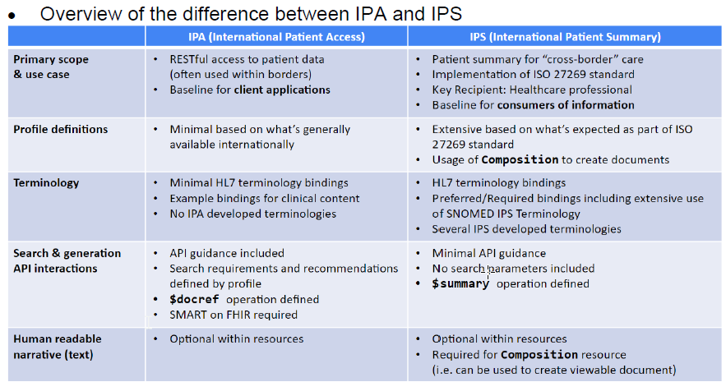
IPS / IPA – WGM Update
Notes:
The logo can be changed in the master slides. Please use the following instructions
Select view > slide master.
Right click on the logo and select change picture.
Select the image you want to use you may need to scale the image accordingly
When you're done, select close master view.

Slide 9
IPA – What’s in it for me?
What’s in it for patients?
Greater access to health data empowers patients to standardly and computably access and retain their health data
What’s in it for App Developers?
Guidelines for developers new to health IT, or FHIR.
Lowest common denominator, globally.
Base layer of interoperability.
What’s in it for regulators & nations?
IPA provides a starting place for governments to jumpstart a national health API ecosystem, with an emphasis on patient access.
To define, profile, and further constrain for unique regional differences or domains, with code systems, required elements, and FHIR’s MustSupport.
What’s In It for FHIR servers?
Enables reusable technology that conforms with regional requirements.
Enables reusable technology that works with existing apps.
Discourages regional, regulated incompatibilities.
Notes:
The logo can be changed in the master slides. Please use the following instructions
Select view > slide master.
Right click on the logo and select change picture.
Select the image you want to use you may need to scale the image accordingly
When you're done, select close master view.

Slide 10
IPS / IPA – Status
IPS project status
Current version - https://build.fhir.org/ig/HL7/fhir-ips/
Published version - https://hl7.org/fhir/uv/ips
Published in November 2022
Newly added resources
Added $summary operation
Evaluated MustSupport
Terminology updates - even if not a SNOMED affiliate
Canada hosting Projectathons for their national adaption of IPS (PS-CA)
IPA project status
Current version - https://build.fhir.org/ig/HL7/fhir-ipa/
Published version - imminent
IPA is about to publish STU1
Has been approved by PCWG
IG QA completed
Notes:
The logo can be changed in the master slides. Please use the following instructions
Select view > slide master.
Right click on the logo and select change picture.
Select the image you want to use you may need to scale the image accordingly
When you're done, select close master view.

Slide 11
Thank you!
Contact Information

