Slide 1

CA-Baseline
July 2024 Profiling Call

Slide 2
Agenda
Housekeeping:
  YouTube Playlist changed to Public: https://www.youtube.com/playlist?list=PLm8ff1Z6HoFTzBvcjJg9iRHTrvucbqEEQ
  https://infocentral.infoway-inforoute.ca/en/resources/docs/fhir/ca-baseline-materials
  Simplifier URL Facelift: https://simplifier.net/cabaseline
Fixes for 1.2
  Discussing errors/changes to AllergyIntolerance, Observation, and Smoking Status Profiles to prep for 1.2

Slide 3
Recap Release Sequencing
1.1.8 – Stub Value Set (PR approved, package created!)
  https://simplifier.net/packages/hl7.fhir.ca.baseline/1.1.8
1.2 – Breaking Change Fix to Allergy, Observation, Device Invariants
2.0 – update to new canonical url & overall QA clean up

Slide 4
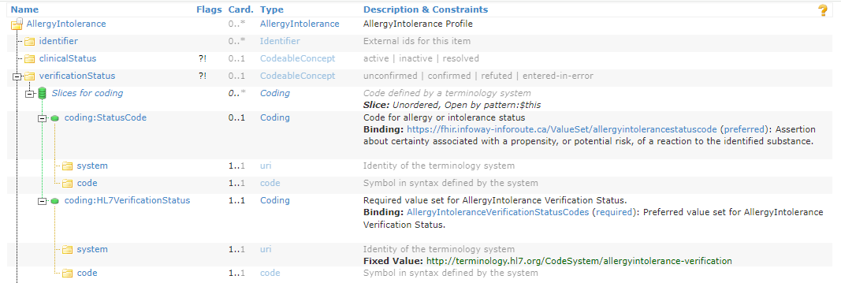
AllergyIntolerance Inv Fix – Cont’
AllergyIntolerance has slicing on verificationStatus.coding to indicate that if a verification status is provided, at least one coding shall be from the HL7 required valueSet (codeableConcept so multiple codings can be provided)
IGP now interprets slices with min of 1 to apply to parent element as well (expecting verificationStatus min of 1 even though this isn’t the original intent of our slicing).
Should we: show the sliced valueSets as mappings or conceptMaps instead, or decide to forgo the call out of the v3 status coding (showing what was historically used) now that the pCHDCF and Core are moving towards the standard FHIR valueSet as well?
Outcome: Motion to remove the slicing from the verificationstatus element and leave the constraints on the VS same as the base standard - Carried (11-0-0)

Slide 5
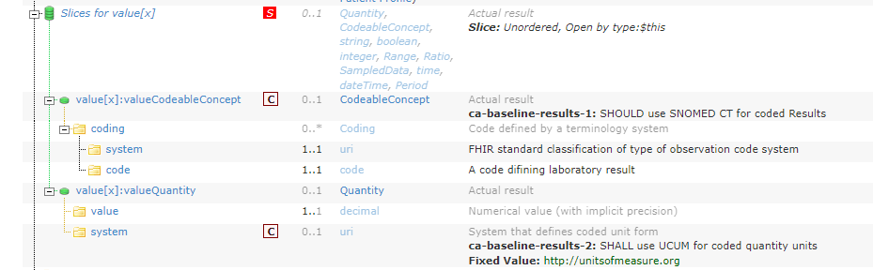
Observation Inv Fix
Observation Results Profile has both an invariant and a fixed value for the valueQuantity slice that enforces the use of UCUM.
Do we really need both (duplicative mechanical rule)?

Slide 6
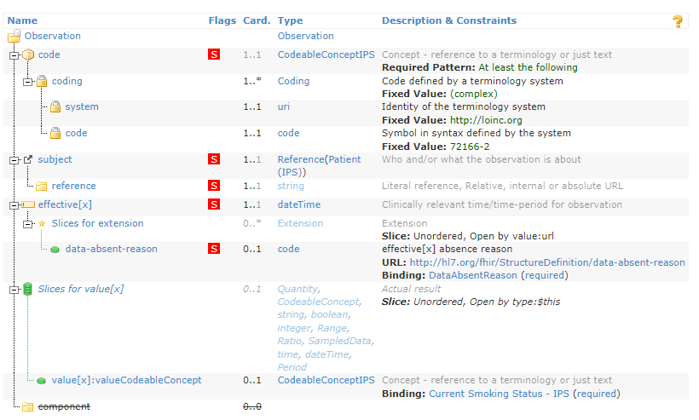
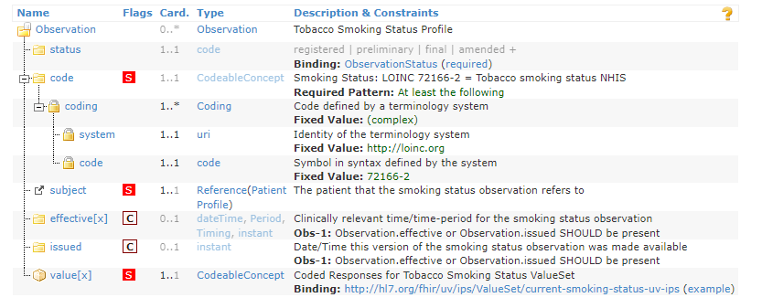
Smoking Status Inv Fix
IPS Profile has evolved in the few years since CA Baseline made a smoking profile. The only major mechanical difference is the baseline in promoting effective OR issued instead of effective
  Should the Baseline even have a smoking status profile (given intent of baseline for localized base)?
  If yes, is there value to having the exact same base profile except for a minor relaxation that brings us out of alignment with PS-CA/IPS?
IPS/PS-CA Tobacco Use Profile
CA Baseline Smoking Status Profile

Slide 7
AllergyIntolerance Inv Fix
Working through conflicting/breaking invariants on AllergyIntolerance status
  Using FHIRPath lab to help fix our invariants
    Fixed location and syntax for the ca-baseline-allergy (changed to .exists() implies)
    Fixed location and syntax for the ca-baseline-allergy-notasked (also removed verification status because it contradicted inv above)
Ca-baseline-noallergy remains
Also these are all errors / overmodeled hard constraints – may not be appropriate for baseline
  Originally pulled from US Core 4 years ago but US Core has since changed approach – provides as guidance section rather than Inv (AU core does something similar)
    Better to raise as warnings or shift to guidance like other core?
    Better to raise in 2.0 ballot or as part of 1.2?
    Fix syntax error now – come back to questions on guidance vs warning vs error in later releases
Allergy VerificationStatus slicing (min of 1 issue now that IGP is flagging things we previously modeled as conditional if slice is met)
  Better to show mapping or do concept map than continue fighting with the slicing when FHIR has made it clear we should be switching to different valueSet?

Slide 8
Device Inv Fix
UDI invariants flagging errors
Originally pulled from US Core 4 years ago but US Core has since changed approach – provides as guidance section rather than Inv (AU core does something similar)
  Do we have any reason to continue modelling the invariants in the Baseline (that is Baseline specific)?
Can we also remove the text div that was applied as a whole that is creating noise in errors (holdover from when we had to publish entire generated resource w/ snapshot)?
  If we can see that removing the “previously generated text table” from prior builds, once removed resolves the underlying issue (i.e., the v2 value set that IGP now generates text for is resolvable)
Hyperlink 'http://terminology.hl7.org/3.1.0/CodeSystem-v2-0074.html' at 'div/table/tr/td/a' for 'http://terminology.hl7.org/CodeSystem/v2-0074' does not resolve

Slide 9
Observation Inv Fix
Observation Results –
  Results-1 collection issue – discuss select
  Results-2 – UCUM (is it needed if we have system fixed?)
Also have similar errors for observation smoking status and result invariants
  Obs smoking status inv targets two elements on the wrong location
  Also text = SHOULD but strength = Error
  Out of alignment w/ current IPS/PS-CA – are we applying anything Canadian in Base that would have us profiling this anymore now that IPS/PS-CA has a smoking status?

Slide 10
Discussion – Extension Registry
FHIR Projects using extensions based on existing specs but that aren’t used in all domains (e.g., registry contexts, prescriber contexts) – assessing if makes sense at Core level if not extensively reusable across domains
Determining if helpful to have as part of national extension registry
Benefits
  different publication/packaging cycles,
  Ease of finding extensions from each others content
    Reducing duplication of folks making different extensions to accomplish the same thing
  Easy to know which extensions should be considered for maturation up into national level
Considerations
  Content that is owned by others (e.g., jurisdictional extensions) – consider experience from CA URI Registry re: maintenance and governance
    Regional extensions may have challenges if not maintained properly
    Understanding impact if there are major changes to artefacts (like OID definitions) – extension changes naturally more inclined to be more significant (changing structure, changing requirements, terminology)
      though does packaging allow us more control over this?
    Sometimes extensions published by owning guides have philosophy towards avoiding breaking change, but clinical concepts may continue to be meaningful and systems may evolve towards future state – having these in a national reg/core allows us to examine these for improvements, examine areas for harmonization
  Balloting to refine and assess national use? Assert authority & maturity?
Is there a risk to starting to do this with a subset of existing national-oriented extensions that we feel good about while some of these details get hashed out (e.g., do we accept regional/jurisdictional)? Is there a risk to not doing this?
  Risk to not doing it – continued spread, duplication, challenges like we exp in baseline w/ pointing to external content (if external content points to us)
  May be a subset initially– things we know are shareable to start
Standing item on future governance calls – discussing findings/updates/considerations and needs

Slide 11
Recap Canonical Url
Submitted ticket to CA Core indicating that canonical url changing soon (because of imposeProfile and page pointers) – others who are publishing summer releases will want to know of canonical ahead of time
HL7 Canada has hl7canada.ca domain, that we can use in our canonical base
Comms plan:
  Publishing statement to forums after this call regarding canonical url timeline (in 2.0 after 1.2 release to correct breaking changes) and details on how to defer incorporation using packaging
  Reminder on FHIR Implementers Quarterly
  Countdown clock reminders leading up to change
Need to confirm full canonical base before putting out the initial announcement:
  http://hl7canada.ca/fhir/baseline/ImplementationGuide/hl7.fhir.ca.baseline (Canonical url for the implementation guide file)
  http://hl7canada.ca/fhir/baseline (<- canonical url in the package itself)
  http://hl7canada.ca/fhir/baseline/StructureDefinition/profile-allergyintolerance (Canonical url for a profile)
  <-this is the canonical we’ll move forward)
  -----------------------
  Indicate that website is to follow but this will be at a later date (site for baseline url anticipated to be http://hl7canada.ca/fhir/baseline/index.html (acknowledging redirections/sub-domains possible)
  http://hl7canada.ca/ig/baseline OR http://hl7canada.ca/fhir/ig/baseline OR http://hl7canada.ca/fhir/baseline/ig/baseline
  OR
  http://hl7canada.ca/fhir/base/ImplementationGuide/hl7.fhir.ca.baseline / http://hl7canada.ca/fhir/base/StructureDefinition/profile-allergyintolerance

Slide 12
Discussion for 2.0 Publishing
Sticking with current Guide in IGP build and profiles / package in Simplifier?
Anything that HL7 Canada needs to do w/ HL7 international to get sign off on formal build process that will produce guide at nominated url?
  Any volunteers to help investigate this? Maybe asking another jurisdiction like AU or IT or Germany or some other country?
    Elliot has prev experience w/ publishing mechanism in IGP (Elliot & Jean could help talk us through the process to inform assessment) – follow-up governance call – Target for July 5 Governance Call (Mike will open up call)
    Ron bringing forward broader conversation re: quality, stability, maintenance, support (re: HL7 IG Publisher) – to board retreat to help inform the discussion
-------------------topics for future call--------------------------------------------
Contributors page
  Any volunteers to make the md page and start adding names?
How do we ensure that our versioned IGuides point to the equivalent versioned profiles (in context of simplifier vs IGP)?
Discussion of conformance against various baseline versions in instances if received – Elliot previously volunteered some thinking – target for one of our upcoming profiling call / dedicated call

Slide 13
Terminology Server Discussion
Dedalus implementing Terminology servers in Australia, Scotland, UK, Netherlands, etc. and that has supported CSIRO in usage of Ontoserver
Cloud based, hosted on Amazon, FHIR compliant server for hosting & maintaining ntl terminology content
  Q: If cloud based, will it be based in Canada
    Still in early stage conversations re: data (not expecting PHI)
Accessible through APIs & web tools like SHRIMP to browse terminology artefacts
  Starting with SCT CA, PCLOCD, CCDD, PrescribeIT, and a lot subsets
    When considering from CA Baseline – know that coordination w/ respective content owners – will likely be iterative (so some subsets might be staggered) – TG isn’t going to be shut down in interim or right away – gradual batches – timeline details forthcoming (internal reviews in early summer/June before externals like baseline can review for swaps) - Are there ways CA Baseline community can help?
  Q: Is it also intended to host regional ValueSet? IE a province that would want to put their value sets there
    A: Expected to host national and international terminologies – still to confirm re other terminologies
      A: Discussions w/ provinces (know there are some existing subsets – some may be current, others may not be up to date – asking jurisdictions to review & update if applicable)
        They are trying to understand who is actively using what subsets on TG – will be posting questions on HL7 forums to determine if there are issues with porting or retiring subsets that aren’t sure folks are using
        Q: Is this the time to evaluate updates for certain practices before the port (i.e., unit value set that mixes code systems) –
          A: Anil & Janice working on plan for tidying subsets that have a mix of code systems, as well as bucket of external owned (e.g., Telus owned) and with _ (underscore)
          Considering cases where union of code systems (lab v3 have pclocd and intl loinc, Substitute Decision Maker have HL7 and ON specific codes) in a value set – may not be considered bad practice in that bucket
      A:Discussions w/ other implementers about this type of use in their terminology solutions
        Versioning of value sets often creates complexity in the space of hosting regional content
  Q: Existing IG bound to VS in TG (some actively updating, others active but not updating/changing) – want to understand process (same url) and timing for porting over the pointers in our guides
Syndication to allow systems to be connected to each other – roadmap item
  Q: Does syndication only work with other Ontoserver instances?
    A: Don’t need to have another Ontoserver in order to connect through API/syndication
  Q: Is there a possibility to leverage licensing options for jurisdictions to be able to have management of their own content (rather than spinning up totally independent instance)
    A: Tarek looking into this
Q: Who is contact if there are further questions? Tarek Kadoura (tkadoura@infoway-inforoute.ca)
Further announcements and FAQs on forums coming as well as discussions with implementers to apply lessons learned/feedback/need considerations

Slide 14
Discuss points re: CA Core Review from
4-26 Call
4/26: Group discussed community review of Core profiles as worthwhile and need to consider if review (or review of change log) is something that should be done w/ each release (dependent on scope)
4/26: Group mentioned wanting to understand what reconciliation process moving forward might look like
Core v0.2 (Condition, Immunization, Medication, MedicationRequest) already available for review
  Focused on mappings w/ some terminology put forward
  Recent feedback that the interim approach to apply obligations on everything identified in the Data Content Standard goes beyond intent
    e.g., may want to expose concept and terminology for something even if it’s not considered core data for interoperability
  Does this shift focus/approach of CA Baseline community review (is it about orientation to the core & mappings to framework or about understanding what needs to change within the baseline)?
As a Community, think about the challenge of a community reconciliation on content that is intended to be a translation of an upstream artefact – how do other communities engage in cross org specs (how is this done w/ recent HL7 & IHE spec?) How does it influence interactions with other wgs (like building blocks) now that there is a space for foundational specs?

Slide 15
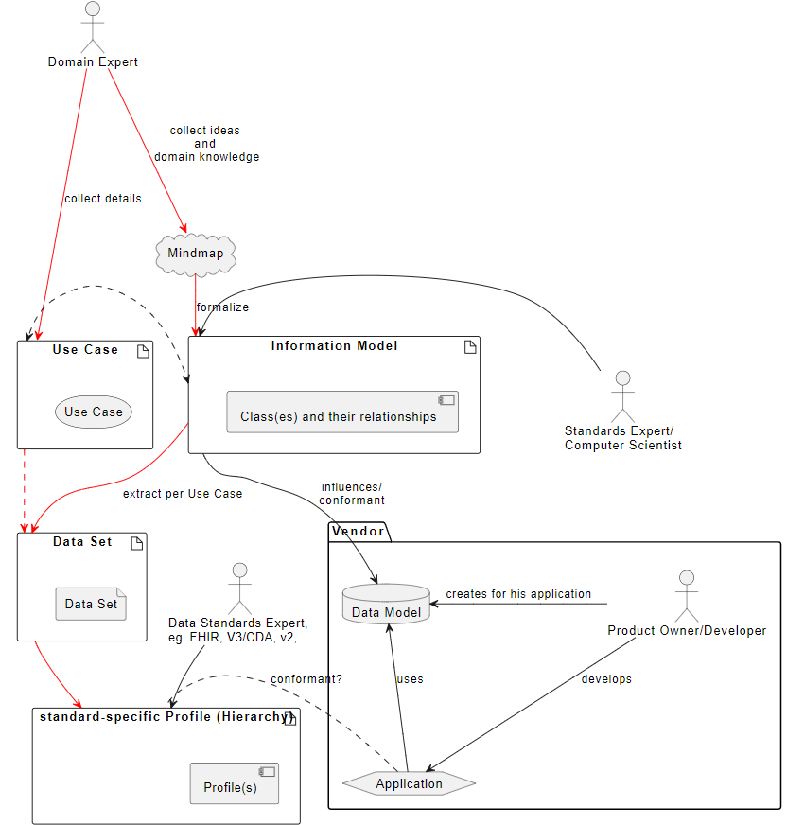
Discuss points re: CA Core Review from
4-26 Call
As a Community, think about the challenge of a community reconciliation on content that is intended to be a translation of an upstream artefact – how do other communities engage in cross org specs (how is this done w/ recent HL7 & IHE spec?)

Slide 16
Lessons learned that we could apply towards balloting CA FHIR Baseline?
Span of profiles? Timing?
  Timing when there are other ballots (HL7 Int, pan-Canadian specs, etc.) might make it difficult to get feedback on baseline (same reviewers across all)
  Interdependencies/impact to other guides (e.g., if baseline version X imposed by Core Y, if dependent on value sets)
    Would like to have highest dependency changes in ← if this accomplished with packaging, does this change how ballot would be approached by baseline
      Depends on what packaging is being used for (e.g., getting patches in vs formal published versions that infer additional meaning or that introduce breaking changes)
  Because goal is to broaden exposure beyond folks who have been actively engaged in the baseline – the timing it takes for them to get up to speed with the specification should be considered (because many of those engaged in baseline to date may already have been shaping it through calls & community issues)
Community Review? Facilitation? Disposition cycle?
  Would need some capacity to track down folks for disposition calls if we hosted them as a CA Baseline (e.g., equiv to discuss in person)
    posting a schedule might be a way of dealing with that with our current capacity challenge w/ volunteers
    Could have our friday calls ahead of time to triage what goes into the schedule (starting this way anticipating it scales)
Ballot sheets & technology? What else?
  Initially (if low feedback) the spreadsheets may help streamline the process in the beginning for triage-rs (but hybridization may be more helpful once feedback grows high in volume) – targeted audience should be considered for who we want to provide feedback to the baseline

Slide 17
Owncloud
New public link:https://storage.infoway-inforoute.ca/index.php/s/PgsnnhYm6iaabLk
  Challenge over last few weeks as ownclouder folder intended for point in time collaboration / offload rather than persistent storage
  Automatic Refresh/Time-out will could happen again in future
Now that we’re hosting recordings on our youtube channel, owncloud has largely been used (every few months) for special topic presentation uploads
Should we port everything over to Infocentral for storage and just load any special topic presentations to the Infocentral FHIR Implementers -> CA Baseline Profiling Folder?
  Natural behavior (folks look for other documents that place)
https://infocentral.infoway-inforoute.ca/en/resources/docs/fhir/ca-baseline-materials Sheridan will begin porting information, we’ll have the folder link on future call housekeeping, and forum post, following that we can have the owncloud link dismissed

Slide 18
Simplifier URL & Canonical URL
https://simplifier.net/canadianfhirbaselineprofilesca-core
  Previously scrubbed all notion of Core from guide & pages, project url remains
  People still confused about baseline and core, however folks used to finding our project through the old hyperlink
  Have a chance to improve project page name to provide clarity: https://simplifier.net/CABaseline
  Not closing down the old url entirely but putting a note indicating the project has moved – archiving “old project”
    Options to avoid confusion in future readers who find
      Setting “retired” on our profiles
      Removing the artefacts from the https://simplifier.net/canadianfhirbaselineprofilesca-core after they are moved to
  Will need to get beta status fields feature added to new project
  Need to ask firely if we can port the profile history and package history and maintain the same packaging id
  Will help tie things when we host a ballot version in the directory of published versions in the future (that includes the package for that version)
  https://simplifier.net/canadianfhirbaselineprofilesca-core/$manage/editkey?projectId=2614 – can change url of project
Still need to change our canonical url (discussions in Dec to resume)
  We have hl7canada.ca domain, began discussions of hl7.ca
    Decision on which one put to HL7 Canada in next few weeks, will also discuss redirection/landing page w/ Infoway
  Predictability will be important
  Some code change (pointers in profiles, impose users in profiles) will need to coordinate with other releases* (profiles/guides/software)
    *Packaging will allow folks to shift when they are available
    Decision about what the new canonicals will need to be made before the May WGM and before any ballot of CA Baseline

Slide 19
Potential Topics for Resumed Series
  Lessons Learned from recent ballot that we could apply to future CA FHIR Baseline Ballot(s)
  Identification of how we'd like to address potential changes that came out of review of CA Core (e.g., harmonizing around name invariant)
  Simplifier Project URL & Canonical URL Changes?
  Stub value set approach
  Community Issue items (new item added in Feb)
  Reconnecting to current state w/ roadmap diagram and prior questions (agenda item over next few months)
  Language translations & incorporation in the ValueSets/CodeSystems (may be a good hybrid topics with terminology WG) with lens of valueSets from the baseline (what it looks like/how it’s used in profile & users)
  Return to discussion around MS/Obligations as a baseline specification – check back in with other bases & cores on structured expectations & guidance
  What is CA Baseline group scope in relationship to CA Core
  Explore whether our guide for ballot of CA Baseline should be made in simplifier (guide version publishing) or through the IGP process
  Formalizing governance (what decisions need votes, where does voting occur, etc.)

