Slide 1
Public Health Surveillance Community (PHSC)
Working Group Meeting
October 5, 2023
2:00 – 3:00 ET

Slide 2
PHS Community Agenda:
Welcome and introductions
Review draft Terms of Reference
RFCs update
4. CVC update
5. Questions?

Slide 3
Public Health Surveillance Community (PHSC) meetings:
Monthly calls:
Infoway provides secretariat support for these meetings – transition back to Infoway from CVC working group
Membership: P/Ts, CIRC, NACI, VVWG, Health Canada, etc.
Agenda, minutes, supporting materials via Infoway's InfoCentral Public Health Surveillance Community Forum.
Attendees must register to attend each call.

Slide 4
2. Review draft ToR
Objective
Scope
PHSC rep for RFCs
Confirm final version at November PHSC call

Slide 5



Title text here
3. Requests for Changes (RFCs)
Status update:
SNOMED CT CA release due September 30, 2023
33 vaccine related updates: includes new concepts for 2023 influenza and COVID 19 vaccines
InfoRMS COVID dashboard: plan to create Vaccine Dashboard for viewing progress on submitted RFCs
Subtitle text here
Notes:
Would someone from PHSC be interested in the responsibility for RFC submissions?

Slide 6
3. Completed RFCs – COVID-19
RFC | Type | Status | Link
SPIKEVAX XBB.1.5 0.10 mg/mL mRNA MBCC | New concept (tradename) | Complete & added to the CVC | Link to RFC
COMIRNATY Omicron XBB.1.5 30 mcg/0.3mL mRNA PB | New concept (tradename) | Complete & added to the CVC | Link to RFC
COMIRNATY Omicron XBB.1.5 pediatric 10 mcg/0.3 mL mRNA PB | New concept (tradename) | Complete & added to the CVC | Link to RFC
COVID-19 COMIRNATY Omicron XBB.1.5 pediatric 10 mcg/0.2 mL mRNA PB | New concept (tradename) | Complete & to be added to the CVC | Link to RFC
COMIRNATY Omicron XBB.1.5 pediatric 3 mcg/0.2 mL mRNA PB | New concept (tradename) | Complete & added to the CVC | Link to RFC
NUVAXOVID Omicron XBB.1.5 NOV | New concept (tradename) | Complete & added to the CVC | Link to RFC

Slide 7
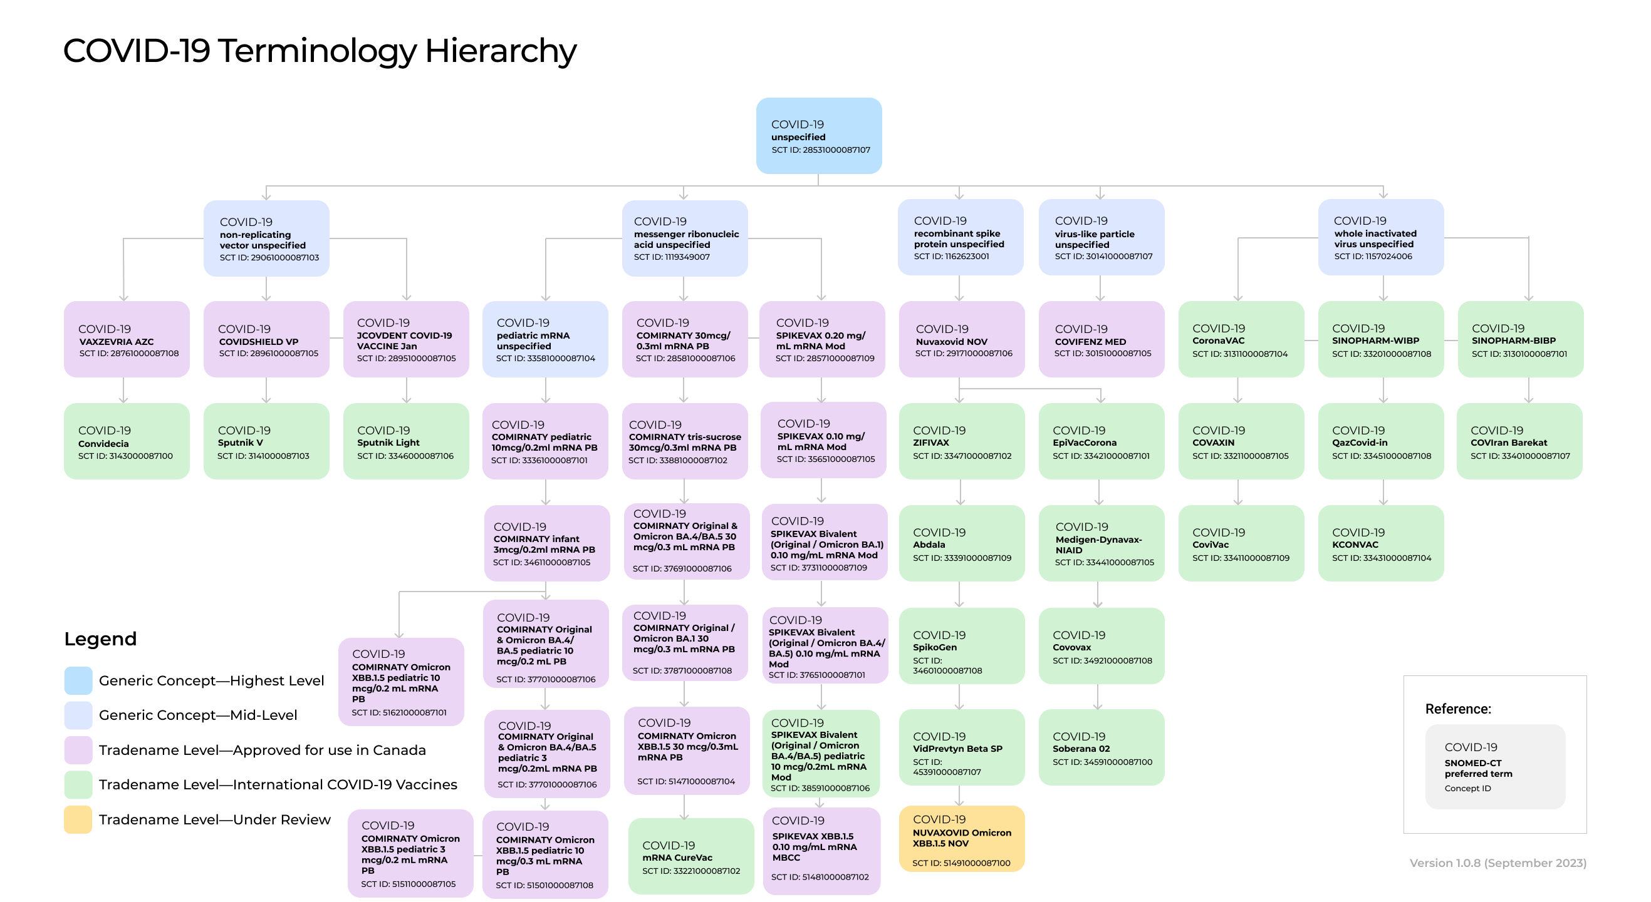
3. RFCs in Progress
Notes:
TO BE UPDATED

Slide 8
3. COVID-19 - CVC Picklist Terms
ConceptID | Display Term (SNOMED-CT PT) | CVC Public Picklist Term (proposed) | CVC Clinician Picklist Term (proposed)
51481000087102 | SPIKEVAX XBB.1.5 0.10 mg/mL mRNA MBCC | Moderna Spikevax XBB.1.5 0.10 mg/mL COVID-19 mRNA | Moderna Spikevax XBB.1.5 0.10 mg/mL (COVID-19)
51471000087104 | COMIRNATY Omicron XBB.1.5 30 mcg/0.3mL mRNA PB | Pfizer-BioNTech Comirnaty Omicron XBB.1.5 COVID-19 mRNA | Pfizer-BioNTech Comirnaty Omicron XBB.1.5 (COVID-19)
51501000087108 | COMIRNATY Omicron XBB.1.5 pediatric 10 mcg/0.3 mL mRNA PB | Pfizer-BioNTech Comirnaty Omicron XBB.1.5 COVID-19 mRNA pediatric | Pfizer-BioNTech Comirnaty Omicron XBB.1.5 pediatric (COVID-19)
51621000087101 | COVID-19 COMIRNATY Omicron XBB.1.5 pediatric 10 mcg/0.2 mL mRNA PB | Pfizer-BioNTech Comirnaty Omicron XBB.1.5 10 mcg/0.2 mL COVID-19 mRNA pediatric | Pfizer-BioNTech Comirnaty Omicron XBB.1.5 10 mcg/0.2 mL (COVID-19)
51511000087105 | COMIRNATY Omicron XBB.1.5 pediatric 3 mcg/0.2 mL mRNA PB | Pfizer-BioNTech Comirnaty Omicron XBB.1.5 COVID-19 mRNA infant | Pfizer-BioNTech Comirnaty Omicron XBB.1.5 infant (COVID-19)
51491000087100 | NUVAXOVID Omicron XBB.1.5 NOV | Novavax NUVAXOVID Omicron XBB.1.5 COVID-19 | Novavax NUVAXOVID Omicron XBB.1.5 (COVID-19)
Notes:
Pfizer-BioNTech Comirnaty Omicron XBB.1.5 infant (COVID-19)

Slide 9
3. Questions for stakeholders – COVID-19 CVC Picklist Terms
How to best differentiate between the two pediatric COMIRNATY Omicron XBB.1.5 products?
IE: should we also include the strength in the CVC public & clinician picklist terms for both COMIRNATY Omicron XBB.1.5 pediatric products? Or include the strength in the picklist term for all COMIRNATY Omicron XBB.1.5 products?

Slide 10
3. Completed RFCs – Other vaccines
RFC | Type | Status | Link
HyperHEP B 110 IU/0.5 mL Grif | New concept (tradename) | Complete & to be added to the CVC | Link to RFC
HyperHEP B 220 IU/mL Grif | New concept (tradename) | Complete & to be added to the CVC | Link to RFC
HBIg HyperHEP B S/D 220 IU/mL Grif | Updated description (tradename) | Complete & to be added to the CVC | Link to RFC
Live attenuated Human alphaherpesvirus 3 antigen (Zos live) | Antigen (FR description) | Complete & to be added to the CVC | Link to RFC
Non-live Human alphaherpesvirus 3 antigen (Zos) | Antigen (EN and FR description) | Complete & to be added to the CVC | Link to RFC (EN) Link to RFC (FR)
Notes:
Is there a need to create a new mapping with the antigens for Zos live & Zos to agents/tradenames?

Slide 11
3. Other Vaccines - CVC Picklist Terms
ConceptID | Display Term (SNOMED-CT PT) | CVC Public Picklist Term (proposed) | CVC Clinician Picklist Term (proposed)
45881000087100 | HBIg HyperHEP B 110 IU/0.5 mL Grif | HyperHEP B 110 IU/0.5 mL | HyperHEP B 110 IU/0.5 mL (HBIg)
45871000087102 | HBIg HyperHEP B 220 IU/mL Grif | HyperHEP B 220 IU/mL | HyperHEP B 220 IU/mL (HBIg)
28411000087101 | HBIg HyperHEP B S/D 220 IU/mL Grif | HyperHEP B S/D | HyperHEP B S/D (HBIg)
Question for stakeholders: is it acceptable to include the strength in HyperHEP B to differentiate between the two products? Should HyperHEP S/D also include the strength?

Slide 12
3. Completed RFCs – Other vaccines
RFC | Type | Status | Link
Human enterovirus 71 vaccine | New concept (agent) New description (agent – FR) | Complete & to be added to the CVC | Link to RFC (concept) Link to RFC (agent - FR)
Human enterovirus 71 antigen | New concept (antigen) New description (antigen – FR) | Complete & to be added to the CVC | Link to RFC (concept) Link to RFC (description - FR)
Enterovirus A71 infection | New description (disease – EN) New description (disease – FR) | Complete & to be added to the CVC | Link to RFC (agent - EN) Link to RFC (agent - FR)
RSV AREXVY GSK | New concept (tradename) | Complete & to be added to the CVC | Link to RFC
RSV respiratory syncytial virus unspecified | New concept (agent) | Complete & to be added to the CVC | Link to RFC

Slide 13
3. Completed RFCs – Other vaccines
RFC | Type | Status | Link
RSV glycoprotein F antigen | New concept (antigen) | Complete & to be added to the CVC | Link to RFC
Question for stakeholders: are there other RFCs we should submit related to RSV, IE Beyfortus (AstraZeneca), a monoclonal antibody? Other more granular agent concepts that might be needed?

Slide 14
4. CVC Update – Current Scope
The CVC has been funded by PHAC until March 31st, 2024. This funding includes:
Bi-weekly releases
Stakeholder engagement activities to inform a long-term solution for vaccine standards in Canada

Slide 15
4. CVC Update – Future Direction
PHAC has announced they are building a federal vaccine catalogue, with more details to follow.
Currently, CANImmunize has not made a decision on whether the CVC will exist beyond March 2024.

Slide 16
CVC Release Update – v 1.1.32, v 1.1.33 & v 1.1.34
Updates in v 1.1.32, released on Sept 8, 2023
Addition of lot and expiry date data for all vaccines (including COVID-19 vaccines) for the months of April, May, June, July and August 2023
Extension of expiry dates for select COVID-19 vaccines
Updated mapping of tradename – DIN – lot number for 21691000087104 |MENJUGATE® Liquid (Men-C-C)|

Slide 17
CVC Release Update – v 1.1.32, v 1.1.33 & v 1.1.34 (cont’d)
Updates in v 1.1.33, released on Sept 15, 2023 (ad hoc)
Addition of 6 tradename concepts: SPIKEVAX XBB.1.5, COMIRNATY Omicron XBB.1.5 (infant), COMIRNATY Omicron XBB.1.5 (pediatric), COMIRNATY Omicron XBB.1.5 (regular), NUVAXOVID Omicron XBB.1.5, CORBEVAX
Addition of lot and expiry data for SPIKEVAX XBB.1.5
Updates in v 1.1.34, released on Sept 28, 2023
Addition of lot and expiry date data for COVID-19 vaccines

Slide 18
CVC Release Update – 1.1.35
Target Prerelease: Oct 6, 2023
Target release: Oct 12, 2023
Addition of tradename – agent – antigen – disease tab in excel workbook (request from Ontario)
Update Public & Clinician Picklist terms, DIN and shelf status for newly approved COMIRNATY Omicron XBB.1.5 products
Addition of RSV agent, antigen & AREXVY tradename
Addition of Enterovirus A71 to agent, antigen & disease subset (request from BC)
Addition of Non-live Human alphaherpesvirus 3 antigen & Live attenuated Human alphaherpesvirus 3 antigen to antigen subset (request from Ontario)

Slide 19
CVC Release Update – 1.1.35 (con’t)
Target Prerelease: Oct 6, 2023
Target release: Oct 12, 2023
Addition of Plasmodium falciparum to agent subset (anti-malaria – request from Ontario)
Addition of HBIg HyperHEP B 220 IU/mL Grif & HBIg HyperHEP B 110 IU/0.5 mL Grif to tradename subset; update PT for HBIg HyperHEP B S/D 220 IU/mL Grif (request from BC)
Addition of vaccine lot/expiry data for month of Sept & COVID-19 lot/expiry data since last release
Correct disease & antigen mapping for 33381000087107 |Inf influenza quadrivalent high-dose unspecified|
Addition of generic concept 6991000087105 |Inf influenza A monovalent H1N1 unadjuvanted unspecified| to agent-antigen-disease subset

Slide 20
Wrap up / Questions? Next meeting date: Thursday, November 2, 2:00-3:00 ET

Slide 21
Thank you!
Contact Information:
tmawhinney@infoway-inforoute.ca

