Slide 1
Social Determinants of Health Working Group
Monthly SDOH Working Group Zoom Meeting
March 12, 2025 - 10 am PT; 11 am MT 1 pm ET
Facilitated by Jennifer Lawson and Brooke Carroll
Notes:
The logo can be changed in the master slides. Please use the following instructions
Select view > slide master.
Right click on the logo and select change image.
Select the image you want to use you may need to scale the image accordingly.
When you're done, select close master view.

Slide 2

Land Acknowledgement
Land acknowledgement​
We would like to acknowledge the lands that we occupy, whether treaty or unceded. We recognize that these lands are home to many diverse First Nations, Inuit and Métis Peoples.
Seed gatherers by Duncan Nagonigwane Pheasant from the M’Chigeeng First Nation of Manitoulin Island

Slide 3
Recording is starting
REC

Slide 4

Agenda
Welcome and introductions to new Members – 5 min
Initial review of Housing Stability (20 min)
Initial review of Education Level (20 min)
Next Steps (5 min)

Slide 5

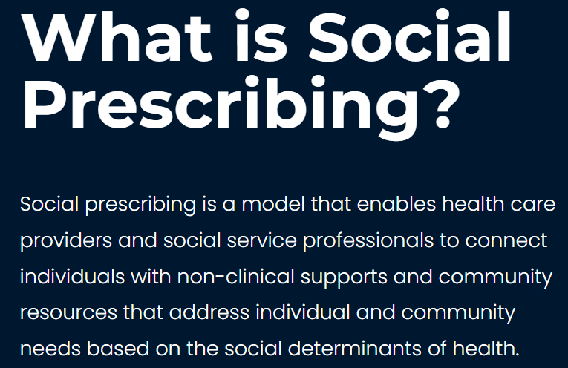
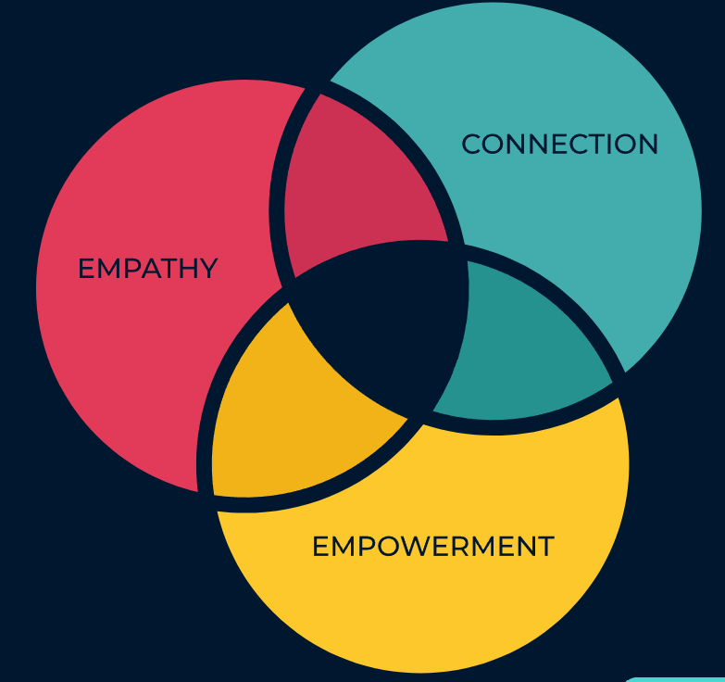

Slide 6

Social Prescribing Day 2025: March 19
CISP Virtual Events:
Date: Monday March 17
Time: 1 PM - 2 PM EST
Date: Tuesday March 19
Time: 1 PM - 2 PM EST
Date: Friday March 21
Time: 1 PM - 2 PM EST

Slide 7
Social Determinants of Health Assessment
Definition: A detailed assessment of a person’s needs related to the social determinants of health, including social and demographic information.
Data elements
Service language
Gender Identity
Employment Status
Access to Food
Education Level
Sexual orientation
Financial Stability
Access to Medication
Relationship Status
Sex at Birth
Housing Stability
Access to Internet
PS-CA v1.0
SPARK Tool
BC GSSO Standard
USCDI V5
Racialized Group
Gender Used
Household Composition
Access to a Phone
Ethnicity
Recorded sex or gender
Housing Condition
Access to Transportation
Indigenous Identity
Sex Parameter for Clinical Use
Household Income
Access to Utilities
Religious or spiritual affiliations
Name used*
Access to Childcare
Today’s review
Born in Canada Status
Personal Pronouns*
Social Supports
Time since arrival in Canada
Person No Fixed Address Flag*
Legal History
Priority data elements for development
Experience with Interpersonal Violence
* Denotes data elements that under Person Information data category
Notes:
Other standards/tools compared – Telus Health Equity Questionnaire, Ontario Guidance for Collection and Use of Sociodemographic Data, and Gravity as well.
Priority data elements were found across multiple standards -

Slide 8
Methods
Goal: Identify if there are matches in SNOMED CT or LOINC for the responses to the questions in the SDOH questionnaire.
Approach:
Look for any existing curated value sets to adopt or adapt.
Searched SNOMED CT CA, LOINC to identify
  Any lexical matches to responses
  Similar matches
  Need for new synonym proposal
  Need for new concept proposal
Consult with SDOH WG, Terminology team, Subject matter experts,
Clinicians, Community
We are here
Notes:
Goal: Identify if there are matches in SNOMED CT for the responses to the questions in the SDOH questionnaire.
Approach: Three C&T specialists and the Program Lead reviewed the responses and searched the
SNOMED CT CA to identify any lexical matches. When there was no lexical match further review was undertaken to determine if there were "similar" matches in SNOMED CT where the response could be considered a synonym to the SNOMED CT concept. The specialist identified this in the synonym column for consideration.
The team utilized the Finding hierarchy in SNOMED CT.
When there was no lexical match and no similar concept, the specialist provided a suggestion for a new SNOMED CT concept and the associated parent for consideration as a submission to Canada Health Infoway.
In the instances where the response was "yes" or "no" , "Not applicable" etc.., the suggestion was to consider using an HL7 value for these responses.
Additional comments were provided for consideration of whether or not a "yes", "No" value is enough where the response has specific information, such as "included in rent".

Slide 9
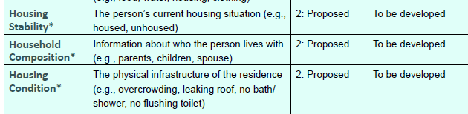
Housing Related Data Elements

Slide 10
Social Determinants of Health
Housing Stability and Education concept review
Preliminary review of possible concepts that we are seeking feedback on.
Granularity
Is the level of detail sufficient? More or less?
Missing concepts
Are there any concepts that have not been captured here that would be key for screening SDOH?

Slide 11
SDOH: Housing Stability- Value set exploration

Slide 12
Leading SDOH Screening Tool: Housing
Question: What is your current housing situation?
SPARK | OH | Alliance Telus
A place you or your family owns | A place you or your family owns | A place you or your family owns
A place you or your family rents | A place you or your family rents | A place you or your family rents
Social housing, Subsidized housing or Rent-geared-to income | Social housing, Subsidized housing or Rent-geared-to income | Social housing, Subsidized housing or Rent-geared-to income
Supportive housing or Group Home | Supportive housing or Group Home | Supportive housing or Group Home
Long-term care facility | Long-term care facility | Long-term care facility
Correctional facility | Correctional facility | Correctional facility
Staying in someone else’s place because you have no alternative | Staying in someone else’s place because you have no alternative | Staying in someone else’s place because you have no alternative
Experiencing homelessness (e.g., shelter, living in a public place or vehicle) | Experiencing homelessness (e.g., shelter, living in a public place or vehicle) | Experiencing homelessness (e.g., shelter, living in a public place or vehicle)
Other housing situation (if not included above). Please specify: ________________ | Other. Please specify: ________________
Do not know | Do not know | Do not know
Prefer not to answer | Prefer not to answer | Prefer not to answer

Slide 13
Unpacking Concepts
Feedback:
Are there other housing status concepts to consider?
Students post-secondary residence
Military housing
temporarily displaced e.g. due to evacuation
Unstable/stable
Safe/unsafe
Home ownership and rental can still present housing instability
What is your housing situation? is vague – “How are you currently housed?” perhaps matches actual response set. However, phrasing of question not likely to change so best option may be to put in a clarifying statement in the Data Content Standard
Sheltered vs unsheltered is relevant but nuanced – those living in encampments might consider themselves to be sheltered
Without granularity – erroneous assumptions made – but better than nothing?
Question: What is your current housing situation?
Responses | Concepts
A place you or your family owns | Owns home Lives in home owned by family member
A place you or your family rents | Lives in home that is rented Lives in home rented by a family member
Social housing, Subsidized housing or Rent-geared-to income | Lives in Social housing Lives in Subsidized housing Lives in Rent-geared-to income
Supportive housing or Group Home | Lives in Supportive housing Lives in Group Home
Long-term care facility | Lives in Long-term care facility
Correctional facility | Incarcerated at correctional facility
Staying in someone else’s place because you have no alternative | Unhoused, staying with friends
Experiencing homelessness (e.g., shelter, living in a public place or vehicle) | Experiencing homelessness Living in a shelter Living in a public place Living in a vehicle

Slide 14
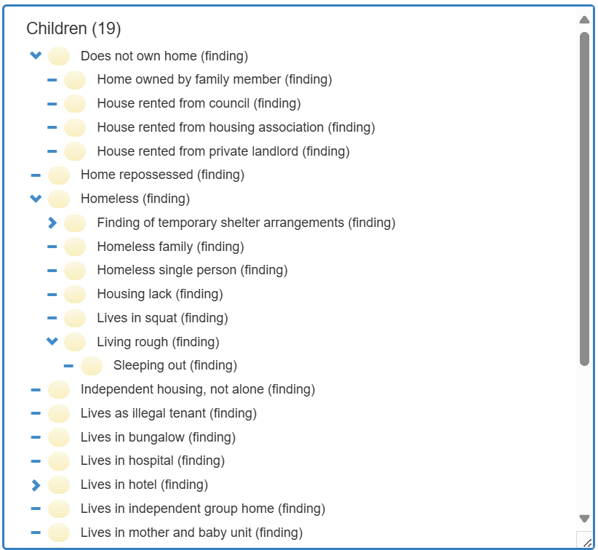
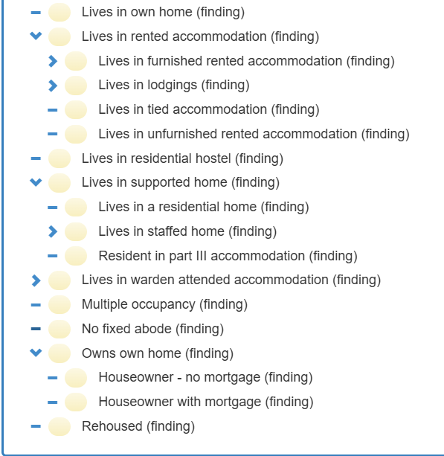
SNOMED CT CA: Finding of housing ownership and tenure (finding)

Slide 15
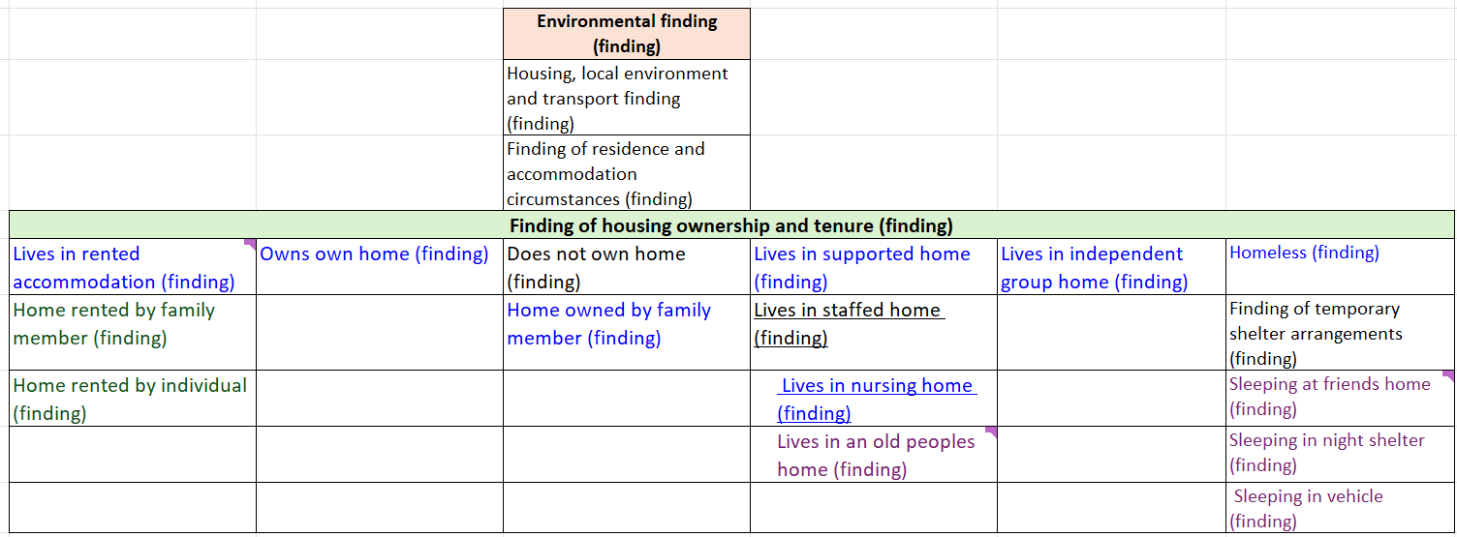
Value Set Options: Housing - Finding Branch

Slide 16
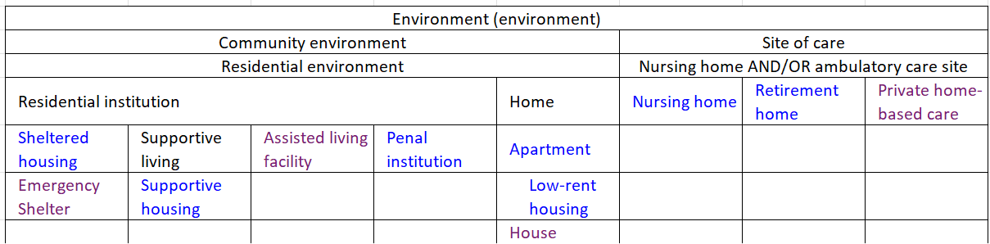
Value Set Options: Housing - Environment Branch

Slide 17
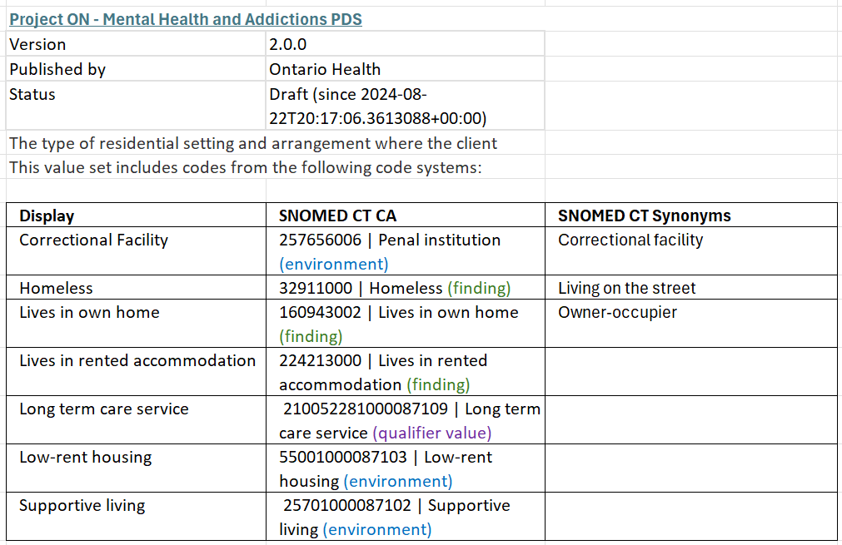
Ontario Health Mental Health and Addictions PDS

Slide 18
Move to spreadsheet for Housing Status concept mapping details

Slide 19
SDOH: Education - Value set exploration

Slide 20
Leading SDOH Screening Tool: Education
Question: What is your current level of education?
SPARK | OH | Alliance Telus
No formal schooling | No formal schooling
Grade school (grade 1-8) | Grade school (grade 1-8) | Grade school (grade 1-8)
Some high school, but did not graduate | Some high school, but did not graduate | Some high school, but did not graduate
High school or high school equivalency certificate (grade 9-12) | High school or high school equivalency certificate (grade 9-12) | High school or high school equivalency certificate (grade 9-12)
Completed Registered Apprenticeship or other trades certificate or diploma (or ongoing) | Completed Registered Apprenticeship or other trades certificate or diploma (or ongoing) | Completed Registered Apprenticeship or other trades certificate or diploma (or ongoing)
College, CEGEP or other non-university certificate or diploma (or ongoing) | College, CEGEP or other non-university certificate or diploma (or ongoing) | College, CEGEP or other non-university certificate or diploma (or ongoing)
Undergraduate degree or some university | Undergraduate degree or some university | Undergraduate degree or some university
Postgraduate degree or professional designation (e.g., Master’s, PhD, MD) | Postgraduate degree or professional designation (e.g., Master’s, PhD, MD) | Postgraduate degree or professional designation (e.g., Master’s, PhD, MD)
 |  | Not Applicable
Do not know | Do not know | Do not know
Prefer not to answer | Prefer not to answer | Prefer not to answer
 |  | Null

Slide 21
Unpacking Concepts
Question: What is your current level of education?
Responses | Concepts
No formal schooling | Kindergarten or preschool only? Not intended to me home-schooled.
Grade school (grade 1-8) | Elementary
Some high school, but did not graduate | Achieved an amount of high school experience, pursuing courses from grade 9,10, 11, 12 curriculum but not achieving enough course credits to achieve high school diploma.
High school or high school equivalency certificate (grade 9-12) | High school diploma achieved General Education Development (GED), also called the Ontario High School Equivalency Certificate, now known as the Canadian Adult Education Credential (CAEC) replaces GED in Canada
Completed Registered Apprenticeship or other trades certificate or diploma (or ongoing) | Training in the trades occurs via college programs often (but is next category) Vocational training may be synonymous CEGEP is equivalent of grade 12 in Quebec and
College, CEGEP or other non-university certificate or diploma (or ongoing) | College begins after grade 12 and required high school diploma in many jurisdictions In Quebec CEGEP begins after grade 11 and is a 6 mon -3 year program
Undergraduate degree or some university | Considerable difference in taking some university courses and earning a BSc or BA
Postgraduate degree or professional designation (e.g., Master’s, PhD, MD) | Consider relevance for clinical or social risks MSc, PhD, Post-doc may all indicate a similar social risk in one sense, but can come with financial hardships
Feedback
What is the clinical significance of capturing these data?
What education levels are related social risk/social risk protection. How do they intersect with health literacy?
Are there other education attainment concepts to consider?
How to consider differences in Prov/Ter?

Slide 22
SDOH: Education - SNOMED CT CA Value set exploration
Education and/or schooling finding (finding)
Finding of education received in the past
  Received elementary school education
  Educated to high school level
  Educated to secondary school level
    Received senior high school education
  Received education at a technical college
  Received vocational training
  Received undergraduate education
Finding of Educational Achievement
  Secondary school diploma achieved
  Received less than secondary school graduate school education [?]
  College diploma received
        Synonym CEGEP
  Bachelor’s degree achieved
  Masters degree achieved
  Doctorate degree achieved

Slide 23
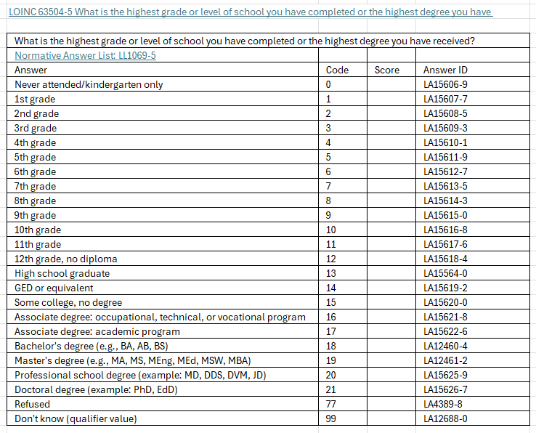
SDOH: Education – LOINC Value set exploration
Source: https://loinc.org/63504-5

Slide 24
Social Determinants of Health – Education
LOINC Description | SNOMED CT Fully Specified Name
Never attended/kindergarten only | No formal education (finding)
1st grade … up to 8th grade (all separate concepts) | Received elementary school education (finding)
9th to 12th grade, no diploma | Received less than secondary school graduate education (finding)
Less than high school degree | Received less than secondary school graduate education (finding)
More than high school
GED or equivalent | Secondary school diploma achieved (finding)
High school diploma or GED | Secondary school diploma achieved (finding)
High school graduate | Secondary school diploma achieved (finding)
Associate degree: occupational, technical, or vocational program | Vocational training diploma achieved (finding)
Some college, no degree | College diploma achieved (finding)
Bachelor's degree (e.g., BA, AB, BS) | Received undergraduate education (finding)
Associate degree: academic program | Post-secondary diploma above bachelor's degree achieved (finding)
Master's degree (e.g., MA, MS, MEng, MEd, MSW, MBA) | Master's degree achieved (finding)
Professional school degree (example: MD, DDS, DVM, JD)
Doctoral degree (example: PhD, EdD) | Received doctorate degree (finding)

Slide 25
SDOH: Education - SNOMED CT CA Value set exploration
What else is clinically relevant for social risk assessment?
  Completed adult learning center program (finding)
  Completed basic skills training program (finding)
  Completed English as a second language program (finding)
  Completed vocational education program (finding)
What level of granularity?
Grade 6
Grade 8
Grade 10
Grade 11
Grade 12
High school diploma
High school equivalency certificate

Slide 26
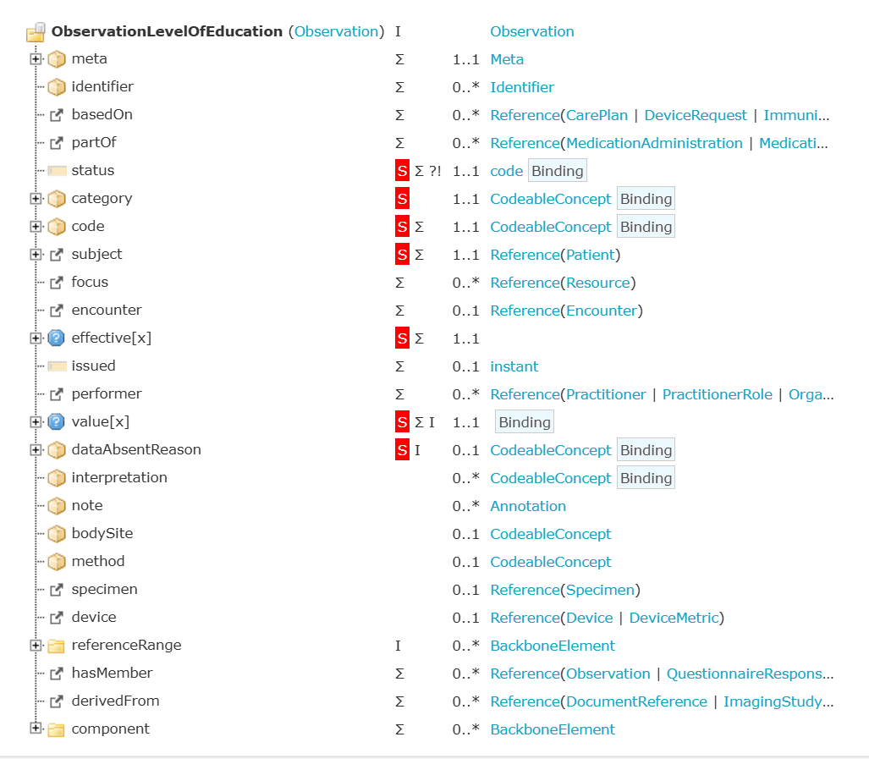
Mental Health and Addictions – FHIR Observation Profiles
Detail: Highest Level of Education and Housing Status
Category: Social History (Fixed Code)
Social History Observations define the patient's occupational, personal (e.g., lifestyle), social, familial, and environmental history and health risk factors that may impact the patient's health.
Code: 'SDOH-ObservationCode’:
Highest Level of Education (LOINC 82589-3)
Code: 'SDOH-ObservationCode’:
Housing status (LOINC 71802-3)
Value Set: EducationalAttainment (required): The highest level of education attained by the client.
Value Set: HousingStatus (required): The type of residential setting and arrangement where the client normally lives.
Source:
ON - Mental Health and Addictions PDS | MHA Observation-LevelOfEducation Profile - SIMPLIFIER.NET
ON - Mental Health and Addictions PDS | MHA Observation-LevelOfEducation Profile - SIMPLIFIER.NET

Slide 27
Additional Slides

Slide 28
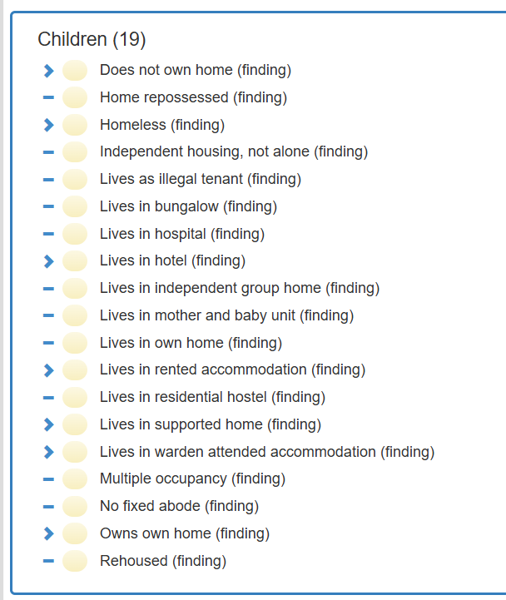
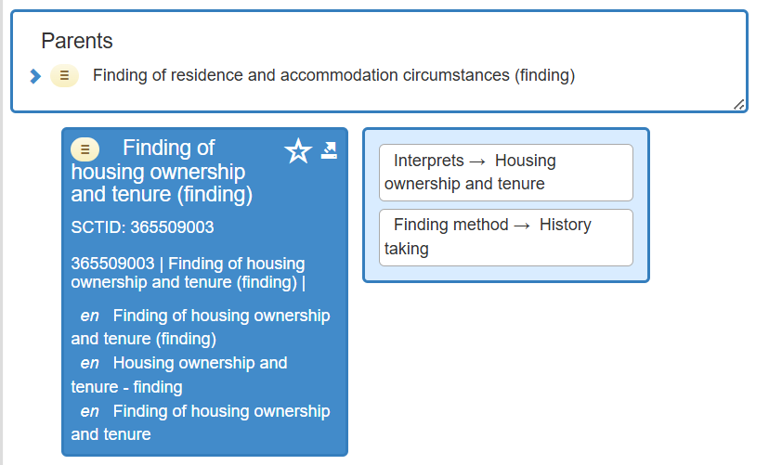
Finding of Housing ownership and tenure (finding)

Slide 29
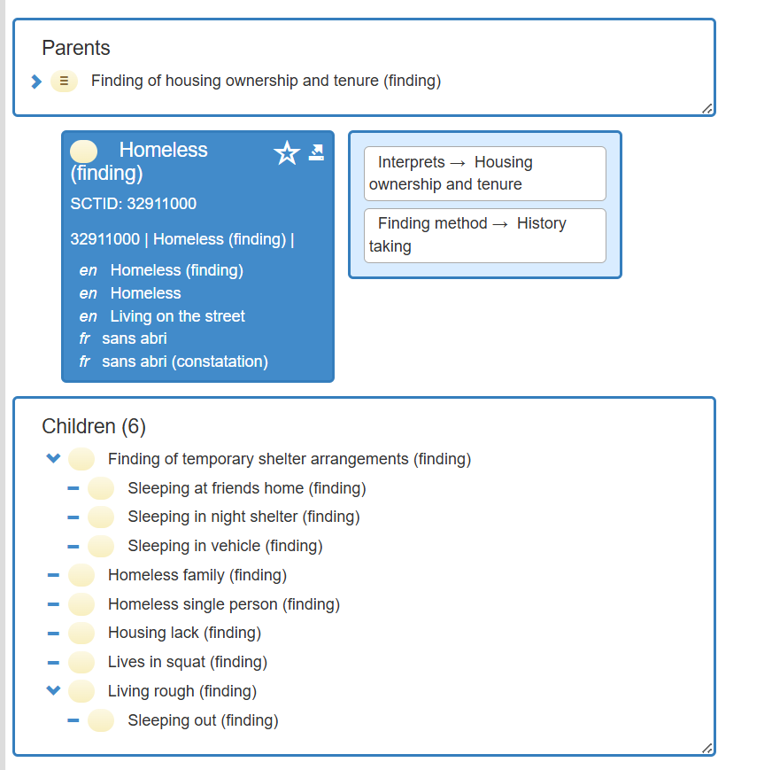
Homeless

Slide 30
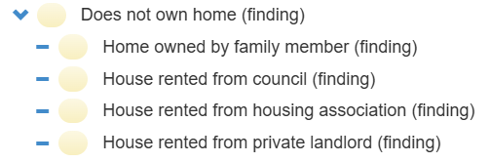
Does not own home (finding)
Live with family or family provide housing
Most Apartment rentals

Slide 31
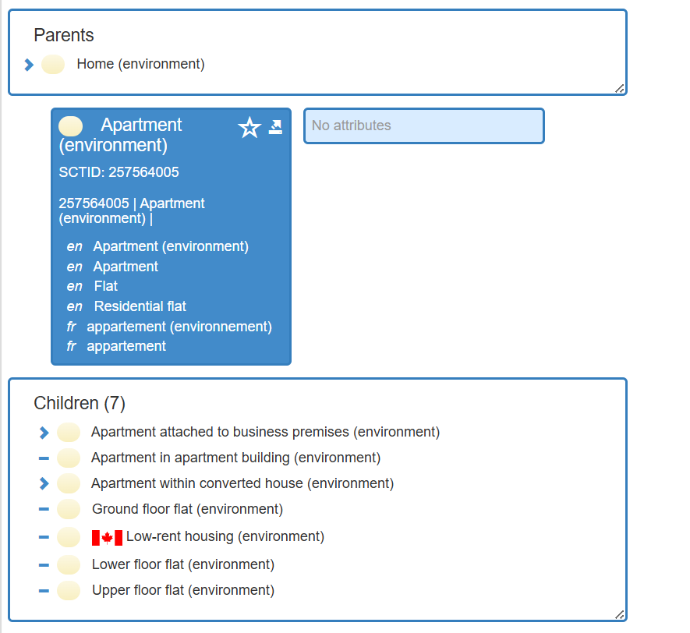
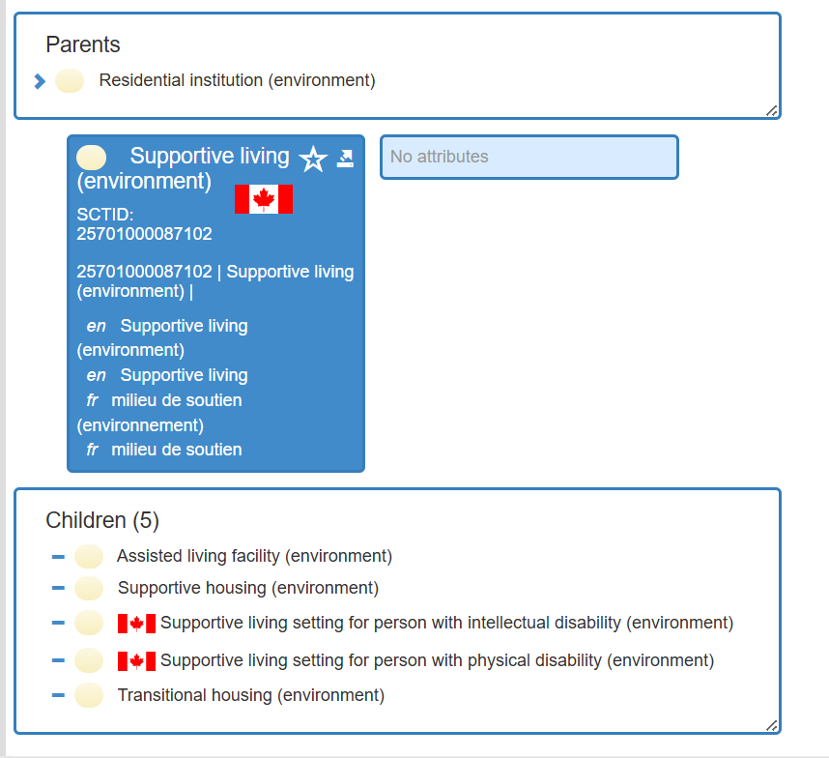
Environment Branches

Slide 32
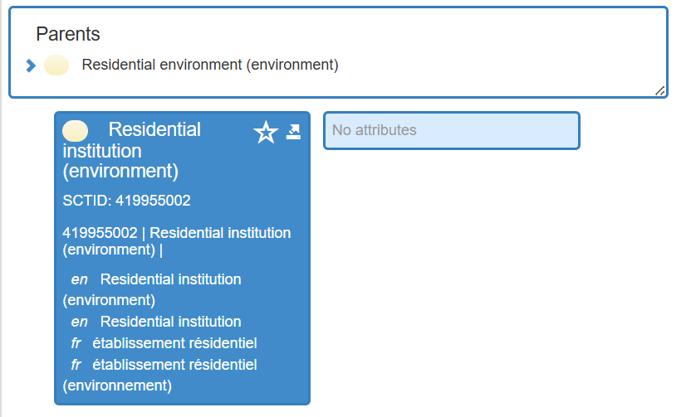
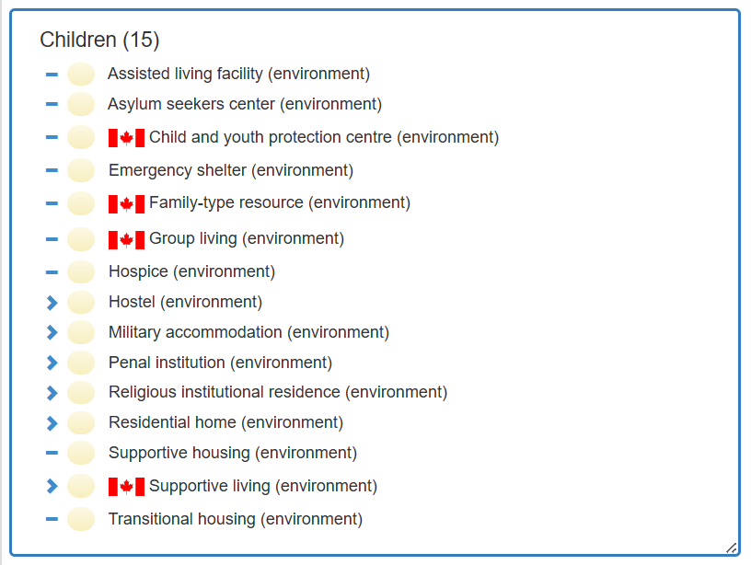
Environment Branches

Slide 33
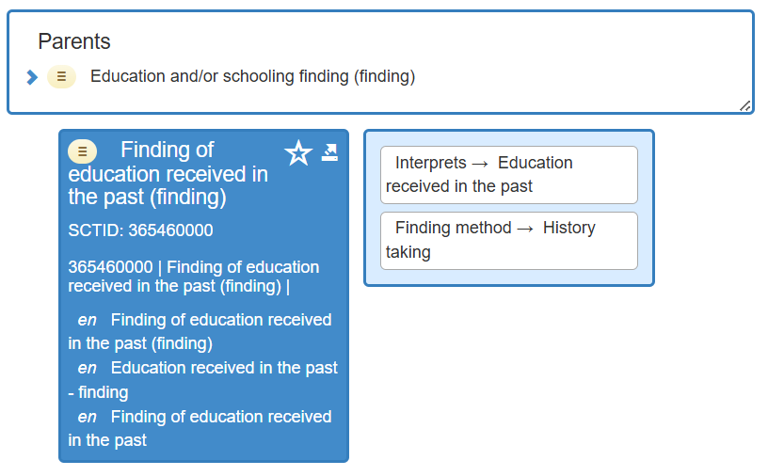
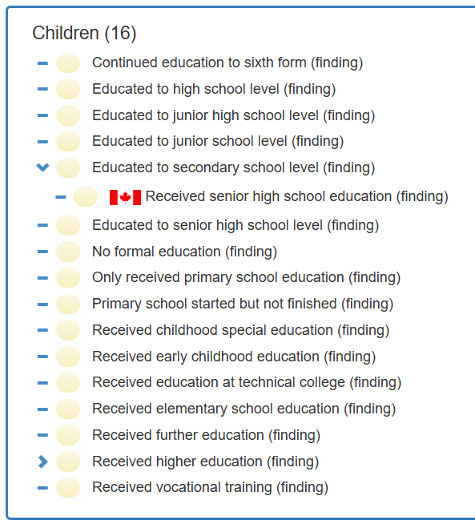
SNOMED CT CA: Finding of education received in past

Slide 34
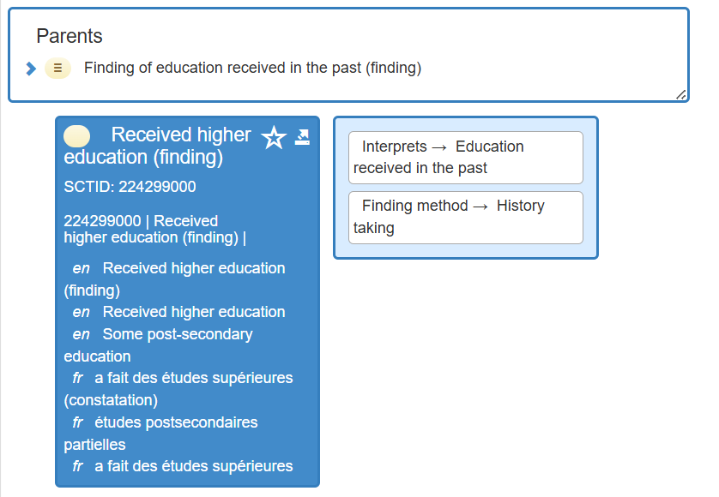
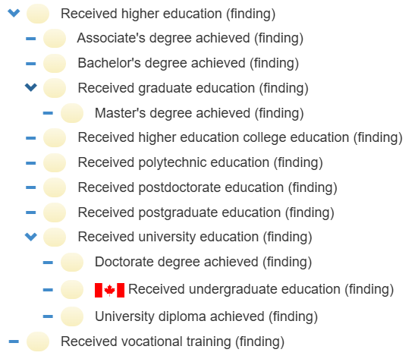
SNOMED CT CA: Received higher education

Slide 35
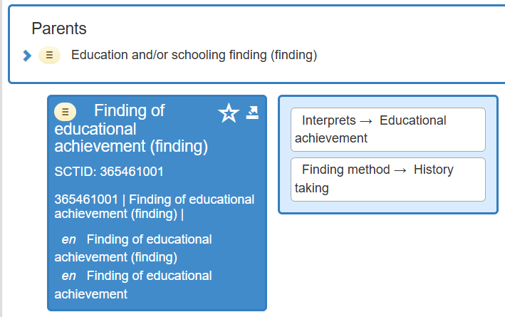
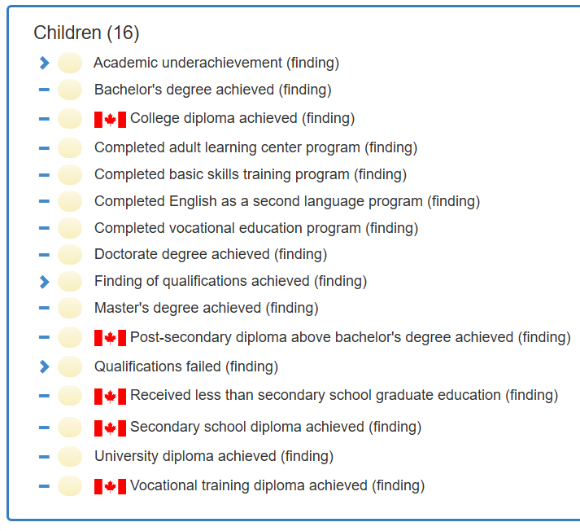
SNOMED CT CA: Finding of educational achievement

Slide 36
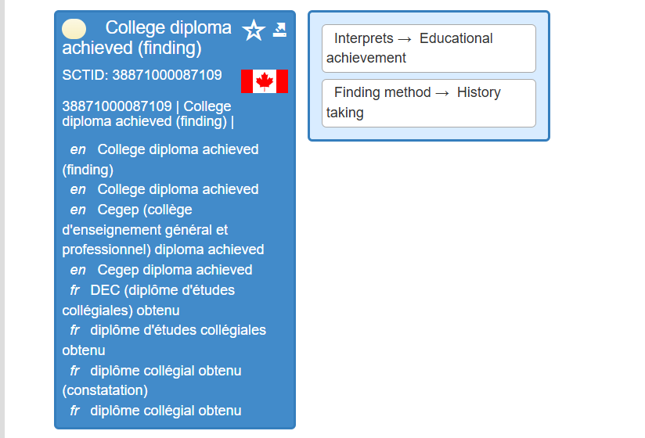
SNOMED CT CA : College diploma & CEGEP

Slide 37
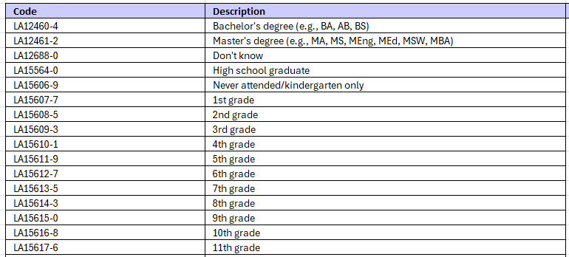
SDOH: Education – LOINC Value set exploration
Value Set: Less Than High School Education Screening Assessments Answers
Code System: LOINC; Extensional
Version 2023; Gravity

Slide 38
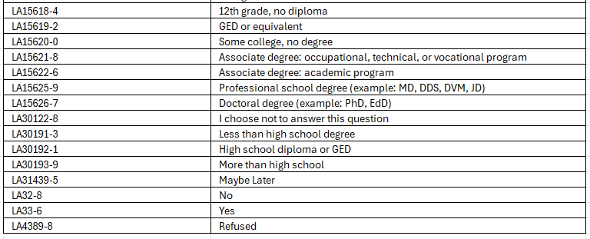
SDOH: Education – LOINC Value set exploration

