Slide 1

CA-Baseline June Profiling Call – Special Session – Must Support Modeling Change Discussion

Slide 2
Agenda
Housekeeping:
OwnCloud: https://storage.infoway-inforoute.ca/index.php/s/r2fgjIKoaNMXpVT
Recording and outcomes of today
Initially looking to come to a decision on the 6/2 call but heavy discussion led to decision to discuss 6/09 & 6/16 to land on a refined proposal
Goal is to agree on refined proposal and close feedback loop by EOD if we feel confident this is the way forward

Slide 3
Recap of what is driving a re-consideration of modeling practices for the CA FHIR Baseline profiles
When we started CA FHIR Baseline profiling – only had US Core and a nascent AU Base to use as reference points for process
Defined our intent, scope, development principles and processes
Began profiling work to develop initial set of profiles for community reaction
Documented our approach (e.g., what does MustSupport mean in context of Baseline)
Iteratively refined the profiles and our processes as we identified how we wanted the profiles to be used
Long-standing discussions about our processes for executing against a use case agnostic approach – how that would fit into change & maintenance
Created Due Diligence Review Process ~ 2 years ago as organic way of targeting use case agnosticism – tied it to artefact maturity process
The more DDRs conducted – the smaller the changes became – but we were left with some items that kept some prescriptive constraints
More national bases and cores were developed – in Jan 2023 we started talking about our differences (particularly towards MS)
Pan-Canadian Initiatives that will drive the development of a CA Core+ began – prompting discussions on how the Baseline could be best leveraged and our processes for making those changes

Slide 4
Review of Process to Define/Set MS Date
Defined our intent, scope, development principles and processes
Profiles developed through the three profiling streams (entities, medication, clinical)
Starting with reviewing constraints applied in US Core constraints and assessed against context of Canadian healthcare & existing implementations
Collected feedback from community – landed at a starting point for the profiles
Defined what Must Support meant in context
Client/Server and Query/Create Scenario
Assessed for impact against our technical mechanisms for use/alignment
Maintained & Changed using DDR and community feedback

Slide 5
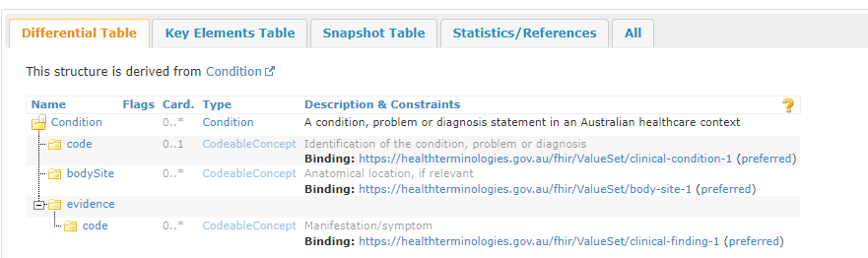
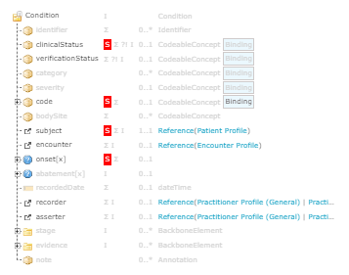
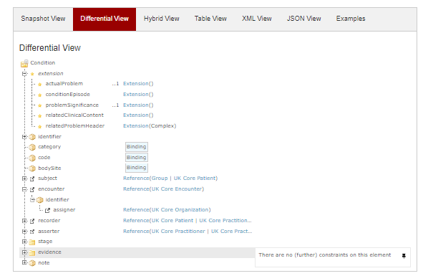
Comparison with other Base Practices
AU Base Condition
UK Core Condition
CA Baseline Patient

Slide 6
Proposal
Thread on Infocentral FHIR Implementers Forum
Change our modeling approach to be more aggressive about Use Case Agnosticism (additional steps beyond DDR to consider removal of Must Supports
Re-evaluate where MustSupports are supposed to be removed
“Spring Cleaning” – removing any that are not use case agnostic
If we decide that an element meets this bar – then it should be computable/not just referenced in the narrative
How do we access the bar:
Would element occur in every care setting (e.g., outside of hospital encounter, in context of registration system or lab systems)
If one care setting (starting with a list of common care settings that could be refined)
If we identify guides in jurisdictional assets or use cases (not just name – has to be “claim” by the jurisdiction) that don’t share the MS –
Treating where MS would show up as an exception
Considering impact on expectation on receivers
Question: Does impending change to use more sophisticated methods (e.g., Obligation) make a difference?
Not right now – but may have to let readers know about impending change in the FHIR Spec (and differences from how MS is being used – noting scenario of impact to end users – and if there are challenges to come forward)
Continue to ask people to identify areas that need to be relaxed through our community issue process
As things are removed Document the removed MustSupport constraints in the following ways:
In the Guide – identify them in the individual profile pages of the guide as “Considerations for Harmonized Use in Canadian Guides” (validate)
In the Profile – ensure they are marked in the differential with a comment indicating the element is a “Consideration for Harmonized Use in Canadian Guides (validate)
Document the list of current state of MustSupport and discuss how they might align to obligations in the future
Update the development process and general guidance (mustSupport section) pages on new approach
Additional Spring Cleaning process
Considering modifying mustSupport page in guide to describe the definition in CA Baseline as starting point and awareness of mustSupport replacement/deprecation
Further explore the ability to express usage and convey to readers

Slide 7
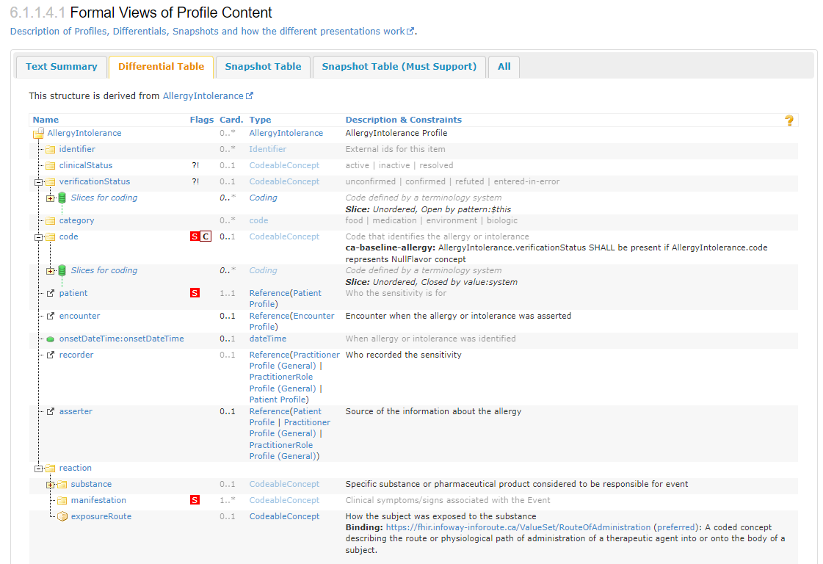
Proposal – Re-evaluation Example
Re-evaluate where MustSupports are supposed to be removed
“Spring Cleaning” – removing any that are not use case agnostic
Would element occur in every care setting (e.g., outside of hospital encounter, in context of registration system or lab systems)
If one care setting (starting with a list of common care settings that could be refined)
Lack of presence in jurisdictionally claimed guides
Treating it as an exception –
Considering impact on expectation on receivers -
Continue to ask people to identify areas that need to be relaxed through our community issue process

Slide 8
Feedback from 6/2
There is some value in the education the MustSupport definition in the guide currently provides
Impacts of conformance / testing activities – either for derived profiles or target profiles
Particularly automated testing / assertions to indicate that they are compliant to the CA Baseline
What are the concerns around how the change could be (mis)interpreted – impacts to our community

Slide 9
Forum Feed
Lloyd Mckenzie on Infocentral topic: “There's been a fair bit of effort that's gone into trying to land on the MS assertions, so it'd be a shame to throw all of that away. However, the new "obligation" framework that allows more specific SHALL/SHOULD/MAY assertions specific to particular types of apps (and that can be maintained separately from the base profiles) is definitely where we should go with this. Perhaps, for now, move the MS notion into a parallel spreadsheet pre profile with rows for each element that we can eventually migrate into Obligations?”

Slide 10
Refining for more Use Case Agnosticism
From a past governance call:
True use case agnosticism might not be where we are at with the baseline if we have constraints - Other National Bases have much less constraints”
If we continue as a set of artifacts that is useful to Core/Mores we need to continue actively vetting whether we’re maintaining use case agnosticism – needs to be a foundational process to ensure that requests for changes are handled in a transparent manner
Review what other more agnostic approaches look like in other bases
http://build.fhir.org/ig/hl7au/au-fhir-base/StructureDefinition-au-condition.html
https://build.fhir.org/ig/HL7NZ/nzbase/StructureDefinition-NzCondition.html
https://simplifier.net/guide/uk-core-implementation-guide-stu3-sequence/Home/ProfilesandExtensions/Profile-UKCore-Condition?version=1.6.0
https://hl7.dk/fhir/core/StructureDefinition-dk-core-condition.html
http://build.fhir.org/ig/HL7-Canada/ca-baseline/branches/master/StructureDefinition-profile-condition.html

Slide 11
Refining for more Use Case Agnosticism
Where we may be missing the mark for use case agnosticism?
Prior to use cases the IGuide provides consistent representation of concepts
Are there things that we can comfortably apply cardinality or MustSupport rules that will never be challenged by use cases (paramedical services, consumer apps, emergency treatment) (what about CDS hooks?)
Are CA Baseline requirements different from the FHIR Base? When do we need to be different due to our locale…and whether it is necessary to represent in the StructureDefinition?
If we really mean for something to be applied consistently– computable constraints are necessary
MustSupport?
Practitioner and PractitionerRole examples where MS was too strong raised by BC
Considerations for mustSupport as a section in guide (without applying the MS flags themselves?)
Do we want to change or delay change because of what is coming forward in the replacement of MustSupport and the work occurring with pan-Canadian data models?
Process for how we make this decision: Send note to the forums on the decision (remove or not remove MustSupport flags w/ addition of noting any in a section), decision will be made by community by date X, will be discussed on X call, feedback provided before date X via forums and/or calls, posting the decision that was made on forum and reiterated on call
Two weeks notice ahead of last feedback call - Feedback before the 9th, discussion on the 2nd, discussion on how to handle on the 9th, decision after the 9th communicated as above
Right level for a major change like position on mustSupport
Following similar process for other types of decisions (with potential for grouping)
Cardinality?
Terminology?
Clinical terminology: can cause creep of use cases (e.g., different billing codes vs clinical codes)
Data Types?
Reference Targets?
Extensions?
Do we set a target? And if so how do we get there? Is it different from our current DDR process?

Slide 12
Refining for more Use Case Agnosticism
Will there be impact to users that is different if we preempt these revisions vs wait for them to come up organically in the community?
Does it erode some of the value for our users to remove some of these items? How do we prioritize our users?
Does this concern only exist for some types of revisions (e.g., Must Support) what about data type rules)?
What is and isn’t working about our current DDR and community issue process to determine if anything needs to change with those to drive the work?

