Slide 1
FHIR Must-Support Alternative

Slide 2
Background
September 2022 Baltimore Meeting
  FHIR-I and Conformance agreed to replace must-support with a mechanism that allows specifiers to select from a set of pre-defined “must-support” requirements.
  One goal is to provide a standardized code set of support levels that can be bound to elements—these codes are “off-the-shelf” terms to select from
  The codes will have detailed definitions with interpretation explanations
  The codes provide consistency in definitions of “must-support” levels
  Associated descriptions will be provided of how and to what degree implementations can be tested that specify the “must-support” levels
  The mechanism allows for “more” automated testing
  The codes will get us further “down-the-road” but not all the way
    Refined and improved over time
  The code set and their definitions will be the key to success
    much work needs to be done
  Grahame had action item to incorporate into R5

Slide 3
Current State
Grahame has incorporated an initial (draft) mechanism into R5
The primitive “must-support” flag is replaced with a complex object called “obligations”
  Actually “must-support” remains but its use is discouraged
Obligations are part of the element definition
  https://build.fhir.org/elementdefinition.html#ElementDefinition
Obligations are to be linked to the Actor resource (New Resource)
  Actor resource is referenced from the ElementDefinition obligation
  https://build.fhir.org/actordefinition.html
Obligations Code Set
  https://build.fhir.org/codesystem-obligation.html

Slide 4
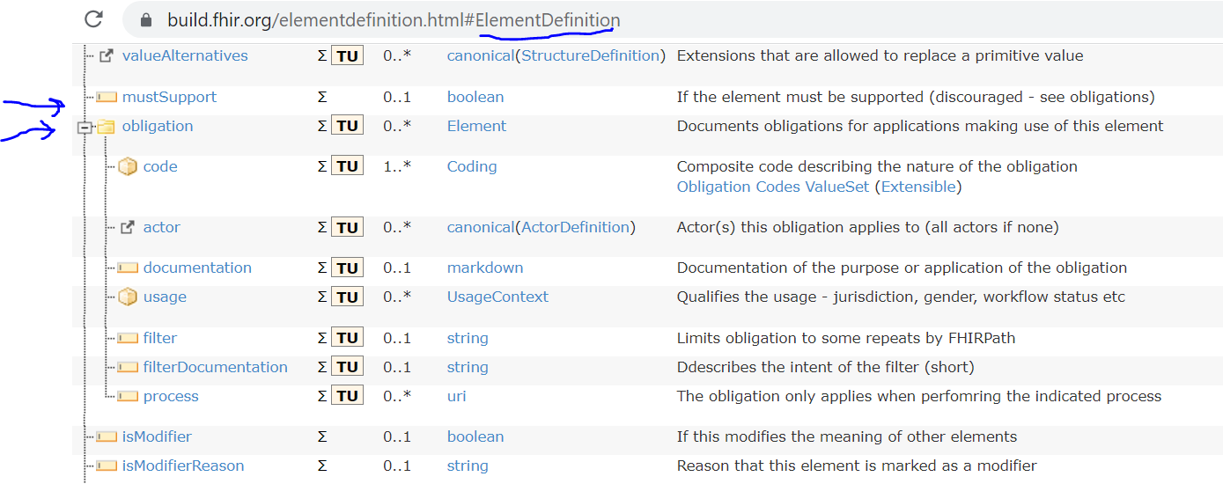
Current Definition - Obligations

Slide 5
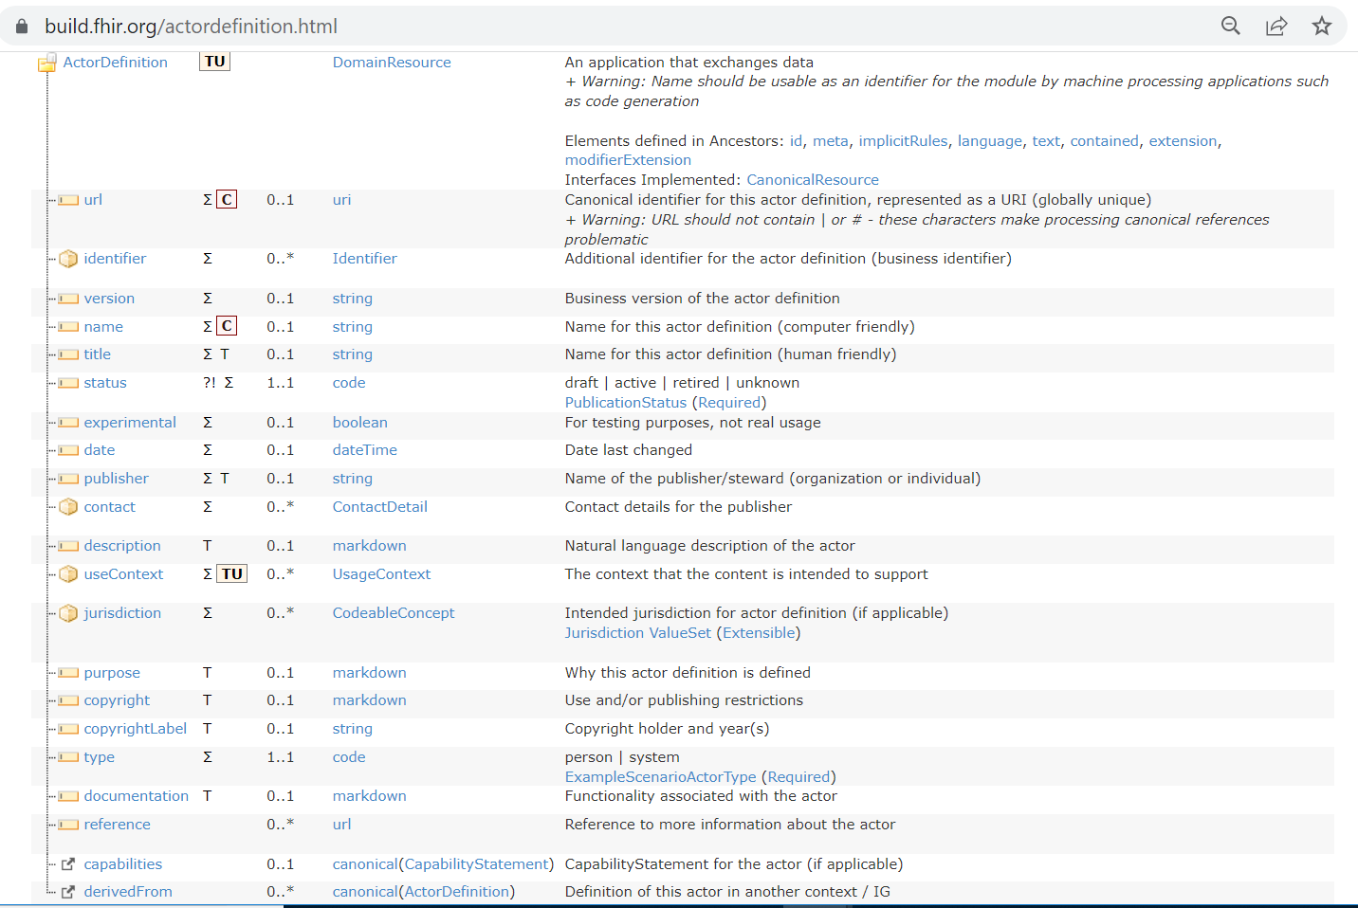
Current Definition – Actor Resource

Slide 6
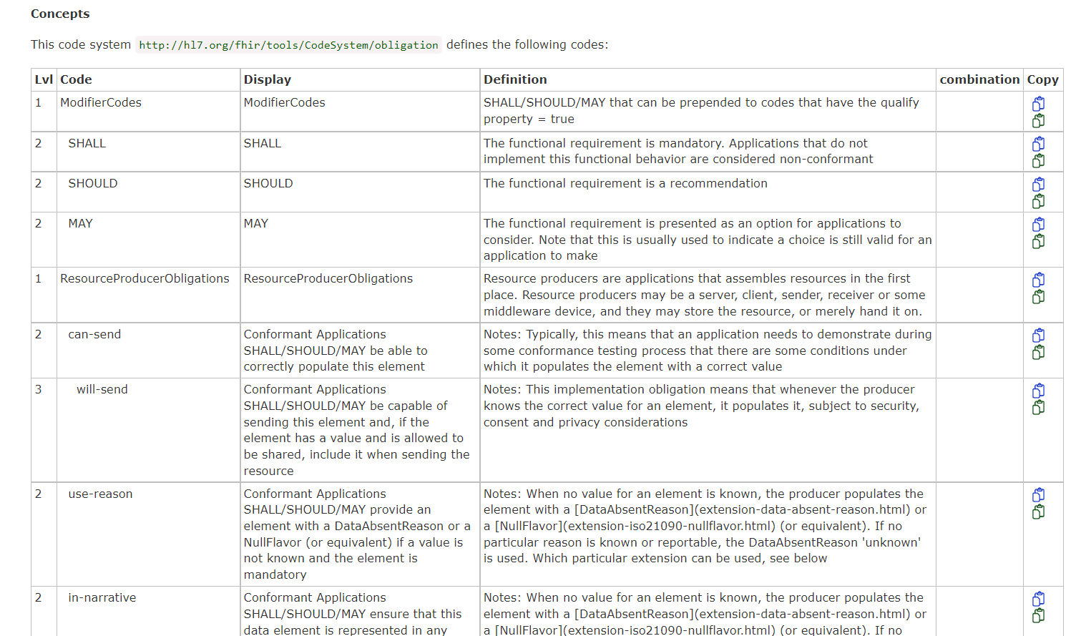
Current Definition – Obligations Code Set Samples
…

Slide 7
Conformance WG Feedback - 1
Actor should be independent resource and separated from static (data) profiles.
We envision an implementation guide to have a set of actors and a set of static (data) profiles.
Obligations should be a resource (and not an embedded object)
Obligations should be referenced by actors, and not be part of a data element.
Obligations “overlay” the data profiles to describe a dynamic profile.
Separation of the obligations and data element definition allows for broader use of the data structures and obligation sets
Promotes reusable component design (“think” a set of pre-defined obligations)
Actors are the higher-level objects, that refer to data profiles and a set of obligations on that data (this models real world – Actor and Use Cases)
Actors define functional requirements that NEED to be divorced from (but linked to) an interface specification. Functional requirements should be defined independent of a protocol standard (e.g., v2, FHIR)

Slide 8
Big Picture
Implementation Guide
Actor
Resource(s)
References
Profile(s)
References
Obligations
Resource(s)
Applies to
Obligations “overlay” (via path) and impose support levels on data elements.

Slide 9
Conformance WG Feedback - 2
Obligation Code Set – Design and Definitions
  Critical task
Current set is flat list but contains “mishmash multimodal concepts” (i.e., apples, oranges, carrots, tree limbs, etc.)
Need structured approach to code set – may be Complex Structure
Initial Proposal – Triplet to “build” an Obligation
  Requirement Level - Conformance Verbs or Pre-coordinated Usage Indicators (M, R, etc).
  Activity (send, receive, process, store, ...)
  Data Expectation (exactly, missing, translated, ...)
Delineate via (Sender/Producer/Client) and (Receiver/Consumer/Server)
Introduce formal profile hierarchy and derivation rules
See: https://confluence.hl7.org/display/CONF/Support-Handling

Slide 10
Summary
Current direction is very encouraging
Devil is in the details
Resources in an implementation guide need to model the real-world use case development. Actors are at the higher level in an implementation guide and must be independent resources that reference data profiles and obligations. Modularity promotes reuse and more “flexible” approach to IG development. Reduces proliferation of profiles if process adopted correctly.
Development of well structured and understandable code set will be the key success metric
Code set must have unambiguous definitions and conformance (testable) interpretations
Consensus is not established yet…
NOT EASY task ahead…

