Slide 1

HL7 CA Membership Modelling Discussions
2024

Slide 2
FY 2024 Membership Approach Refresh
FY2023 began identifying how we would enhance our current membership approach – given the increase in momentum towards pan-Canadian standards and the opportunity for HL7 Canada to be clear in its role in the CA & Intl Community
  Agreed to compartmentalize approach; tackling membership costs, membership benefits, activities to increase membership, and role with balloting separately (so we could action each one)
Membership costs: Dec 19th 2023 voted to increase individual membership rate from $50->100 for coming year, kept organization membership rate at $500
Membership benefits: Next step is to confirm membership benefits domestically and internationally

Slide 3
Membership Benefits: Domestic & Intl
The following benefits apply to individual members and anyone within an organization that is an organizational member (regardless of whether they are named members)
International:
  Voting: Previously confirmed that our “named members” determined by 1/10th of votes that we report to HL7 international (based on our voting structure we provide to them)
  Certification/Training: Discount ~30% on HL7 Intl hosted training/certification (has not been limited to “named voters” from an organization members to take advantage of the discount code)
  Discounts on any HL7 hosted events (e.g., WGM, Connectathon): ~30% on HL7 Intl hosted events
    Includes participation in Tutorials in-person during WGMs
  Other HL7 events (DevDays, HIMSS): ~20% based on package
  HelpDesk: Access to the HL7 Helpdesk for questions & FAQs on HL7 Products (live but not active)
Domestic:
  HL7 CA Sponsored Courseware from HL7 Intl: ~30% discount
  Space for us to include additional domestic offerings however they aren’t in place today

Slide 4
Relationships between Membership and Council Membership
No computational requirements from HL7 International
  Our Jan 2020 TOR currently includes 2 private, 2 public (all w/ staggered terms) & a chair, and an Infoway rep
  We have latitude on how we allocate CA Council positions – action item for TOR Refresh

Slide 5
Membership Modelling Framing
Previously discussed updating membership modelling and circulated HL7 CA Membership Considerations Excel shows projected membership and budgeting based on shifts to tie membership towards a change in domestic voting structures
  We wanted to be sure a change in modelling would unintentionally create a challenge to our financial solvency
  But excel converged too many variables in making decision
Membership costs: Held Dec 19th 2023 discussion to increase individual membership rate from $50->100 for coming year, kept organization membership rate at $500
  But didn’t record exact vote counts, so asking a motion today to formally ratify the vote
Named Member Structure: Will need a formal vote to make the change official (with framing for new members) to shift to asking orgs to provide additional named members
  Any decisions will be updated in the renewal communications (i.e., Infocentral page and announcements)
  As well as evaluated for how to represent these changes in the TOR

Slide 6
Voting
Motion: The HL7 Canada Council resolves that the HL7 Canada personal membership fee increase to $100 CAD annually.
  All privileges remain the same
2/27: Motion carried (SC/SO 4:0:0)

Slide 7
Current Membership Modelling
Currently, we count any membership (individual or organizations) as a single “named member” in our Affiliate reporting to HL7 International
  We aren’t beholden to count named members this way – Ron confirmed it is under our discretion to put forward our domestic membership structure for named votes
  Regardless of domestic approach, each named member counts towards 1/10th of an HL7 International Vote (e.g., towards ballots) – see 6.2 in Affiliate Agreement
Membership Type | Individual Memberships | Organization Memberships | Sponsored Memberships
FY 23 Total Members | 23 | 12 | 15
50 / 10 = 5 HL7 International Votes

Slide 8
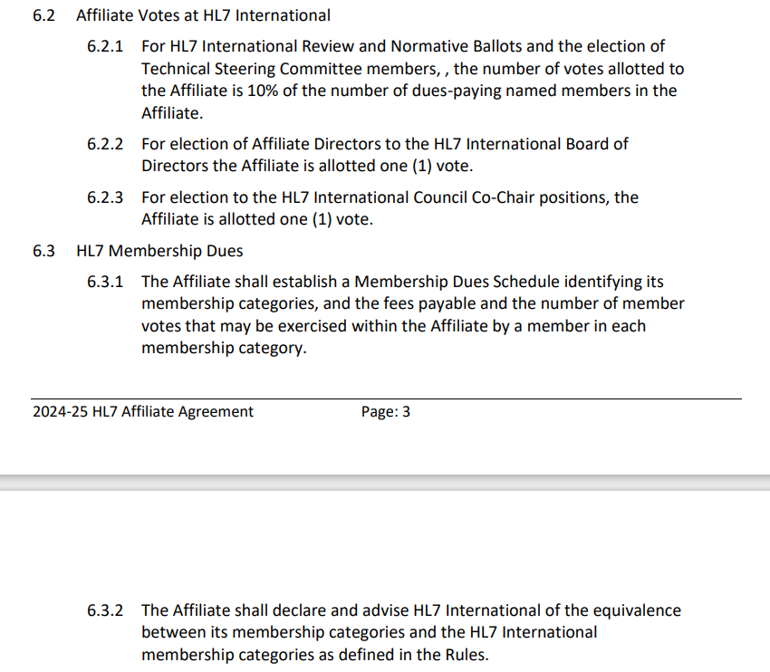
2023-2024 Affiliate Agreement – 6.2 Section

Slide 9
FY24 Membership Modelling - Proposal
Proposal: Shift to Organizational Memberships (up to 5 named members), Individual Memberships (1 named member)
  Increases our voting influence in HL7 International
  Easier logic for International and Domestic administrative purposes if individuals count as
    a single “named member”,
    a single vote (instead of a %) in any domestic activities (e.g., future balloting)
  Greater parity between membership costs in established categories ($500:$100)
  This shift on its own is not expected to negatively impact our financial sustainability (HL7 Intl dues are 20% of total membership revenue which would be the same)
Note: The proposal above counts for both Domestic ballot activities and International ballot calculations (by default)– further modifications to domestic activity structure could be accomplished through a separate vote

Slide 10
Voting
Motion: The HL7 Canada Council resolves to adjust HL7 Canada organizational membership to increase the number of HL7 Canada members for that organization from “1 named member” to “up to 5 named members of the organization”.
  The additional members are included in the calculation for HL7 Canada voting on HL7 International Ballots
  If an organization nominates or put forwards does not fill the maximum of 5 named members, whatever named members they provides (e.g., 3) will be reported to HL7 International for the 1/10th calculation
  The definition of organization (in relation to organizational members) will be formally defined in the Terms of Reference
2/27: Motion carried (SC/JF 5:0:0)

Slide 11
FY24 Membership Sign-Up / Renewal Communications
HL7 allows for us to update the membership count at any point in the year (meaning the named members don’t have to be captured only at the point of membership sign-up/renewal)
Infocentral membership renewal page updated to indicate the change in maximum of named members for organizations (up to 5)
Tarek to follow-up with Linda Monico to identify if there are existing mechanisms (e.g., from Infoway) that organizations & sponsored organizations used for naming members in the past
  Designated primary member logs in and manage the list
Depending on what we find, we’ll discuss the
  Separate templated email follow-up using the email of the person who registered the organization to ask for named members
  Email process for organizational members to reach out to change named members throughout the year

Slide 12
Terms of Reference
What aspects (and degree of granularity) of membership costs, benefits, council membership, proxies, and voting goes into the Terms of Reference?

