Slide 1
Infoway Q&A Webinar
Summarizing Recommendations from Coordinating Table Meeting
September 23, 2021

Slide 2

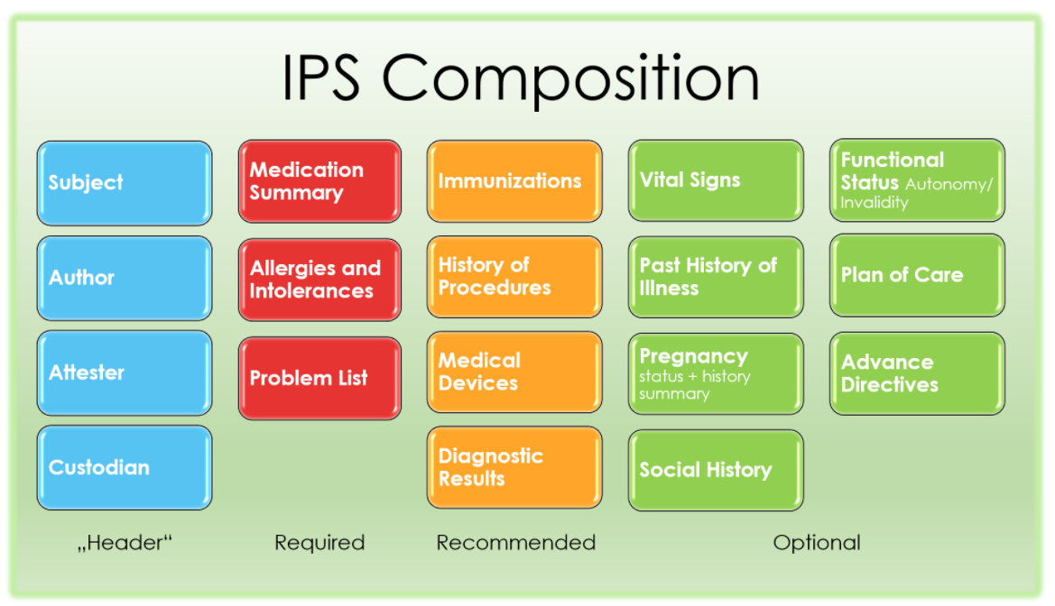
Recommendation #1 - Level of alignment to HL7 International’s IPS specification and development strategy for the IPS-CA FHIR baseline
International Patient Summary
Canada’s G7 Commitment to the IPS
The IPS-CA FHIR profile set will be as closely aligned to the HL7 IPS specification as possible in order to allow vendors in Canada to implement patient summaries aligned with local needs. This means that every effort will be made to adopt the international specification and analyze its constraints with practical implementations in mind.
Patient summaries are used in an increasingly complex clinical and technological ecosystem, driving the need for a standardized Patient Summary (the International Patient Summary standard, ISO 27269:2021) for widespread use to facilitate cross-border, cross-jurisdictional and local care use cases.

Slide 3
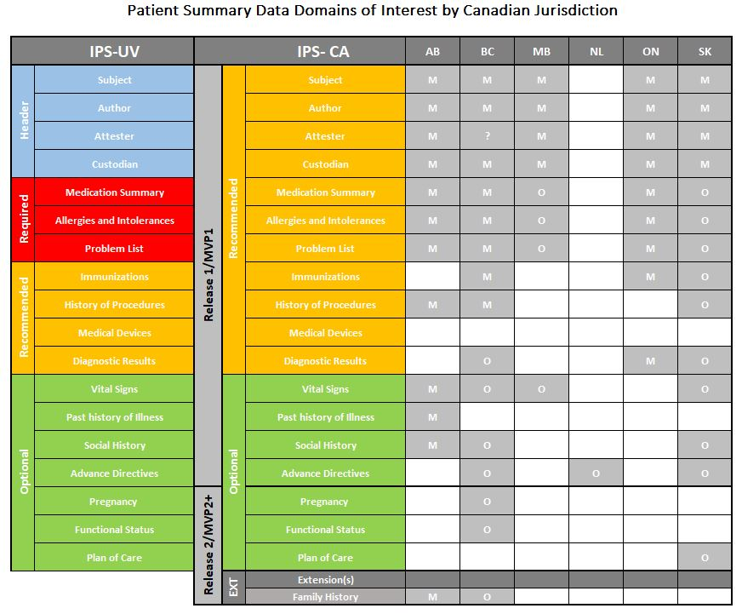
Recommendation #2 - Implementation strategy regarding inclusion of the IPS data domains in the summary
PS-CA/PT Matrix
The HL7 IPS specification lists a number of data domains as mandatory; however, there is also an expectation that jurisdictional policy variations may mandate some or other data domains being required in those locales.
Taking all these into consideration and the desire to offer vendor solutions the ability to configure rather than customize PS solutions across the country, the recommendation was made to relax the cardinality of the data domains from Required to Recommended. This will allow for a single national standard where jurisdictions can still express a desire to require certain domains through implementation guidance, without a need for changing the national standard.

Slide 4


Recommendation #3 - Strategy and approach to semantic interoperability and data mapping
Level of adoption and alignment for terminologies varies across Canada for very practical reasons.
As a result, the Coordinating Table approved a recommendation to relax semantic bindings of the FHIR profiles to at most Preferred, including allowing free form text for cases where clinical systems struggle to do automatic or assisted mapping to published ValueSets.
There is a need for a roadmap of progressively tightening the specification with clearly listed milestones such that the industry has the runway to change and adapt.
Free form text
Code sets

Slide 5
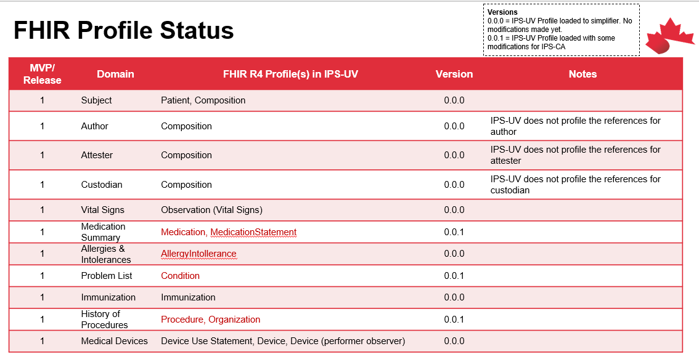
Recommendation #4 - Scope of coverage for Release 1 of the PS-CA FHIR specifications
Given the aggressive timelines of the first phase of the Patient Summary project and input from detailed consultation with participating jurisdictions, it was recommended a national FHIR profile set that covers all Phase 1 data domain implementations will be created for Release 1.
The remainder of the IPS data domains and updates to Phase 1 profiles will be followed shortly and will be based on implementation experience.
These profiles will be developed over the next few weeks with a reasonable draft available for vendors to review by end the of September.
The FHIR profiles and Implementation Guide will be available through the Canadian FHIR Registry on Simplifier
National FHIR Profiles Will be Developed

