Slide 1

CA-Baseline
June Profiling Call –
Special Session – Must Support Modeling Change Discussion

Slide 2
Agenda
Housekeeping:
  OwnCloud: https://storage.infoway-inforoute.ca/index.php/s/r2fgjIKoaNMXpVT
  Recording and outcomes of today
Recap of how we got here
Review of process used to apply / address Must Supports to date
Review and Discuss Proposal – Collect Feedback in Refining Proposal

Slide 3
Recap of what is driving a re-consideration of modeling practices for the CA FHIR Baseline profiles
When we started CA FHIR Baseline profiling – only had US Core and a nascent AU Base to use as reference points for process
Defined our intent, scope, development principles and processes
  Began profiling work to develop initial set of profiles for community reaction
  Documented our approach (e.g., what does MustSupport mean in context of Baseline)
  Iteratively refined the profiles and our processes as we identified how we wanted the profiles to be used
Long-standing discussions about our processes for executing against a use case agnostic approach – how that would fit into change & maintenance
  Created Due Diligence Review Process ~ 2 years ago as organic way of targeting use case agnosticism – tied it to artefact maturity process
  The more DDRs conducted – the smaller the changes became – but we were left with some items that kept some prescriptive constraints
More national bases and cores were developed – in Jan 2023 we started talking about our differences (particularly towards MS)
Pan-Canadian Initiatives that will drive the development of a CA Core+ began – prompting discussions on how the Baseline could be best leveraged and our processes for making those changes

Slide 4
Review of Process to Define/Set MS Date
Defined our intent, scope, development principles and processes
    Profiles developed through the three profiling streams (entities, medication, clinical)
    Starting with reviewing constraints applied in US Core constraints and assessed against context of Canadian healthcare & existing implementations
    Collected feedback from community – landed at a starting point for the profiles
Defined what Must Support meant in context
  Client/Server and Query/Create Scenario
  Assessed for impact against our technical mechanisms for use/alignment
Maintained & Changed using DDR and community feedback

Slide 5
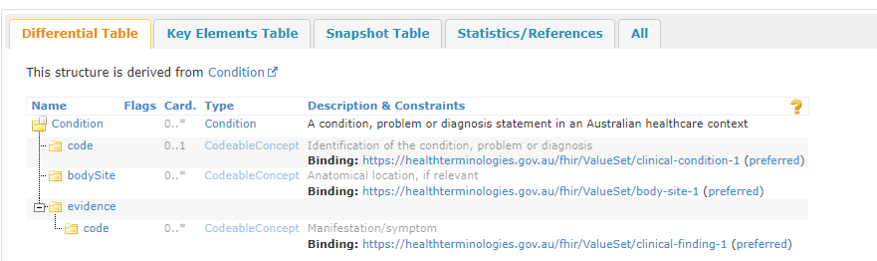
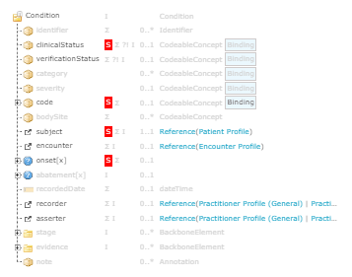
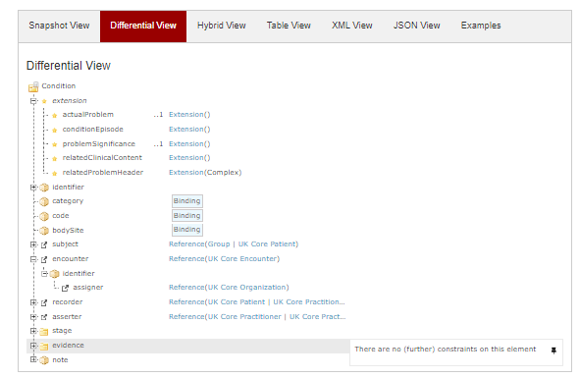
Comparison with other Base Practices
AU Base Condition
UK Core Condition
CA Baseline Patient

Slide 6
Proposal
Thread on Infocentral FHIR Implementers Forum
Change our modeling approach to remove use of MustSupport in CA FHIR Baseline
  Document the current MustSupport constraints to identify in text section of the guide
    Call them out as should supports
  Update the development process and general guidance (mustSupport section) pages on new approach
  Share the list of
  Identify approach
Feedback to date:

Slide 7
Feedback from 6/2
There is some value in the education the MustSupport definition in the guide currently provides
Impacts of conformance / testing activities – either for derived profiles or target profiles
  Particularly automated testing / assertions to indicate that they are compliant to the CA Baseline
What are the concerns around how the change could be (mis)interpreted – impacts to our community

Slide 8
Forum Feed
Lloyd Mckenzie on Infocentral topic: “There's been a fair bit of effort that's gone into trying to land on the MS assertions, so it'd be a shame to throw all of that away. However, the new "obligation" framework that allows more specific SHALL/SHOULD/MAY assertions specific to particular types of apps (and that can be maintained separately from the base profiles) is definitely where we should go with this. Perhaps, for now, move the MS notion into a parallel spreadsheet pre profile with rows for each element that we can eventually migrate into Obligations?”

Slide 9
Refining for more Use Case Agnosticism
From a past governance call:
True use case agnosticism might not be where we are at with the baseline if we have constraints - Other National Bases have much less constraints”
If we continue as a set of artifacts that is useful to Core/Mores we need to continue actively vetting whether we’re maintaining use case agnosticism – needs to be a foundational process to ensure that requests for changes are handled in a transparent manner
Review what other more agnostic approaches look like in other bases
http://build.fhir.org/ig/hl7au/au-fhir-base/StructureDefinition-au-condition.html
https://build.fhir.org/ig/HL7NZ/nzbase/StructureDefinition-NzCondition.html
https://simplifier.net/guide/uk-core-implementation-guide-stu3-sequence/Home/ProfilesandExtensions/Profile-UKCore-Condition?version=1.6.0
https://hl7.dk/fhir/core/StructureDefinition-dk-core-condition.html
http://build.fhir.org/ig/HL7-Canada/ca-baseline/branches/master/StructureDefinition-profile-condition.html

Slide 10
Refining for more Use Case Agnosticism
Where we may be missing the mark for use case agnosticism?
  Prior to use cases the IGuide provides consistent representation of concepts
  Are there things that we can comfortably apply cardinality or MustSupport rules that will never be challenged by use cases (paramedical services, consumer apps, emergency treatment) (what about CDS hooks?)
  Are CA Baseline requirements different from the FHIR Base? When do we need to be different due to our locale…and whether it is necessary to represent in the StructureDefinition?
    If we really mean for something to be applied consistently– computable constraints are necessary
    MustSupport?
      Practitioner and PractitionerRole examples where MS was too strong raised by BC
      Considerations for mustSupport as a section in guide (without applying the MS flags themselves?)
      Do we want to change or delay change because of what is coming forward in the replacement of MustSupport and the work occurring with pan-Canadian data models?
        Process for how we make this decision: Send note to the forums on the decision (remove or not remove MustSupport flags w/ addition of noting any in a section), decision will be made by community by date X, will be discussed on X call, feedback provided before date X via forums and/or calls, posting the decision that was made on forum and reiterated on call
          Two weeks notice ahead of last feedback call - Feedback before the 9th, discussion on the 2nd, discussion on how to handle on the 9th, decision after the 9th communicated as above
          Right level for a major change like position on mustSupport
        Following similar process for other types of decisions (with potential for grouping)
    Cardinality?
    Terminology?
      Clinical terminology: can cause creep of use cases (e.g., different billing codes vs clinical codes)
    Data Types?
    Reference Targets?
    Extensions?
  Do we set a target? And if so how do we get there? Is it different from our current DDR process?

Slide 11
Refining for more Use Case Agnosticism
Will there be impact to users that is different if we preempt these revisions vs wait for them to come up organically in the community?
  Does it erode some of the value for our users to remove some of these items? How do we prioritize our users?
  Does this concern only exist for some types of revisions (e.g., Must Support) what about data type rules)?
What is and isn’t working about our current DDR and community issue process to determine if anything needs to change with those to drive the work?

