Slide 1
Social Determinants of Health Working Group
Monthly SDOH Working Group Zoom Meeting
July 9, 2025 - 10 am PT; 11 am MT 1 pm ET
Facilitated by Jennifer Lawson and Brooke Carroll
Notes:
The logo can be changed in the master slides. Please use the following instructions
Select view > slide master.
Right click on the logo and select change image.
Select the image you want to use you may need to scale the image accordingly.
When you're done, select close master view.

Slide 2

Land Acknowledgement
Land acknowledgement​
We would like to acknowledge that the lands that we occupy, whether treaty or unceded are home to many diverse First Nations, Inuit and Métis Peoples.
Seed gatherers by Duncan Nagonigwane Pheasant from the M’Chigeeng First Nation of Manitoulin Island

Slide 3
Recording is starting
REC

Slide 4

Agenda
1. Welcome and introductions to new members
2. Summary of SDOH initiatives in Canada
        Deep End Canada and SPARK
        MHA PDS 2.0
            Canadian Institute for Social Prescribing (CISP)
3. SDOH within the Data Content Standard of the PCHDCF

Slide 5
SDOH Initiatives in Canada

Slide 6
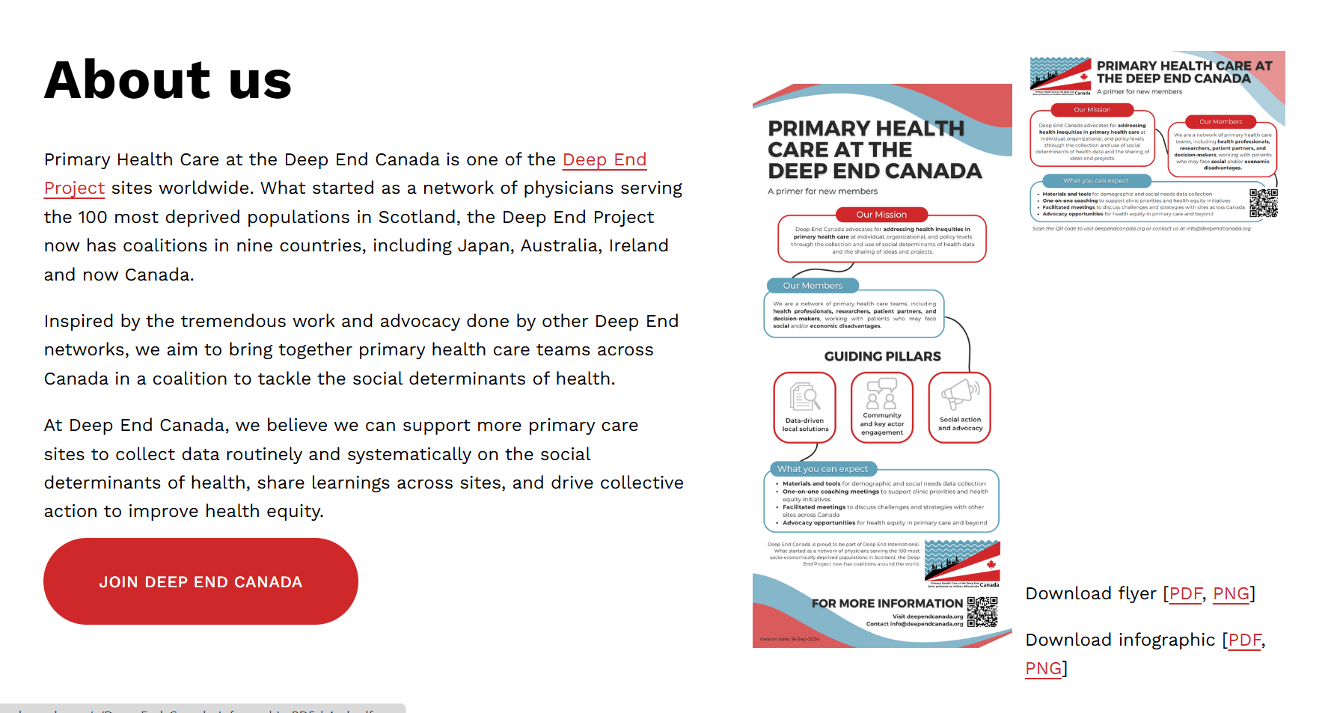
Deep End Canada
From: Who we are — Deep End Canada
Notes:
Deep End Canada currently has 10 organizations from 7 provinces, representing around 25 clinics. Organizations are represented by health care providers, clinic administrators, policy and evaluation staff, researchers, and patient partners.

Slide 7
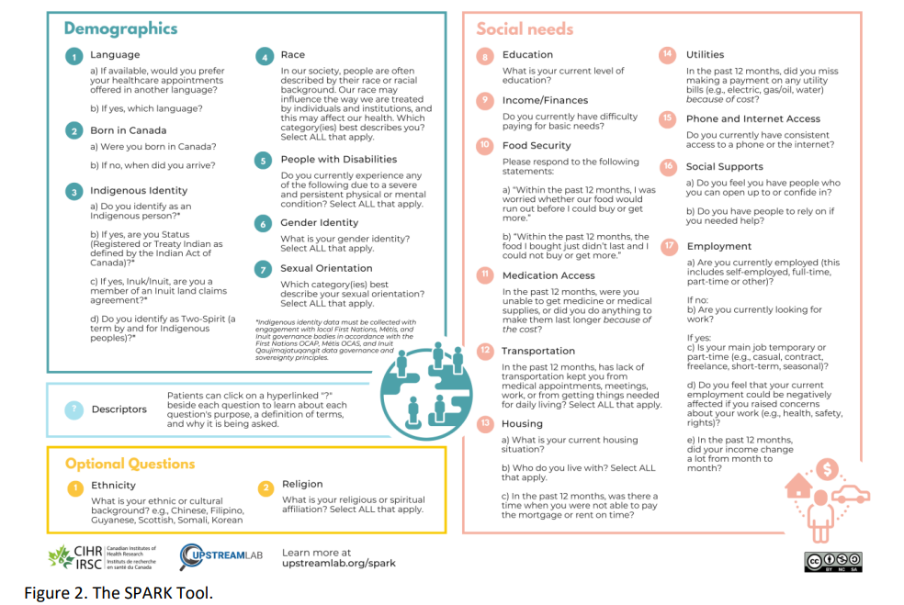
SPARK Tool Materials and Resources — Deep End Canada
From: Implementing the SPARK Tool A Change Package for Primary Care Clinics. Figure 2
Notes:
Goal: Identify if there are matches in SNOMED CT for the responses to the questions in the SDOH questionnaire.
Approach: Three C&T specialists and the Program Lead reviewed the responses and searched the
SNOMED CT CA to identify any lexical matches. When there was no lexical match further review was undertaken to determine if there were "similar" matches in SNOMED CT where the response could be considered a synonym to the SNOMED CT concept. The specialist identified this in the synonym column for consideration.
The team utilized the Finding hierarchy in SNOMED CT.
When there was no lexical match and no similar concept, the specialist provided a suggestion for a new SNOMED CT concept and the associated parent for consideration as a submission to Canada Health Infoway.
In the instances where the response was "yes" or "no" , "Not applicable" etc.., the suggestion was to consider using an HL7 value for these responses.
Additional comments were provided for consideration of whether or not a "yes", "No" value is enough where the response has specific information, such as "included in rent".

Slide 8
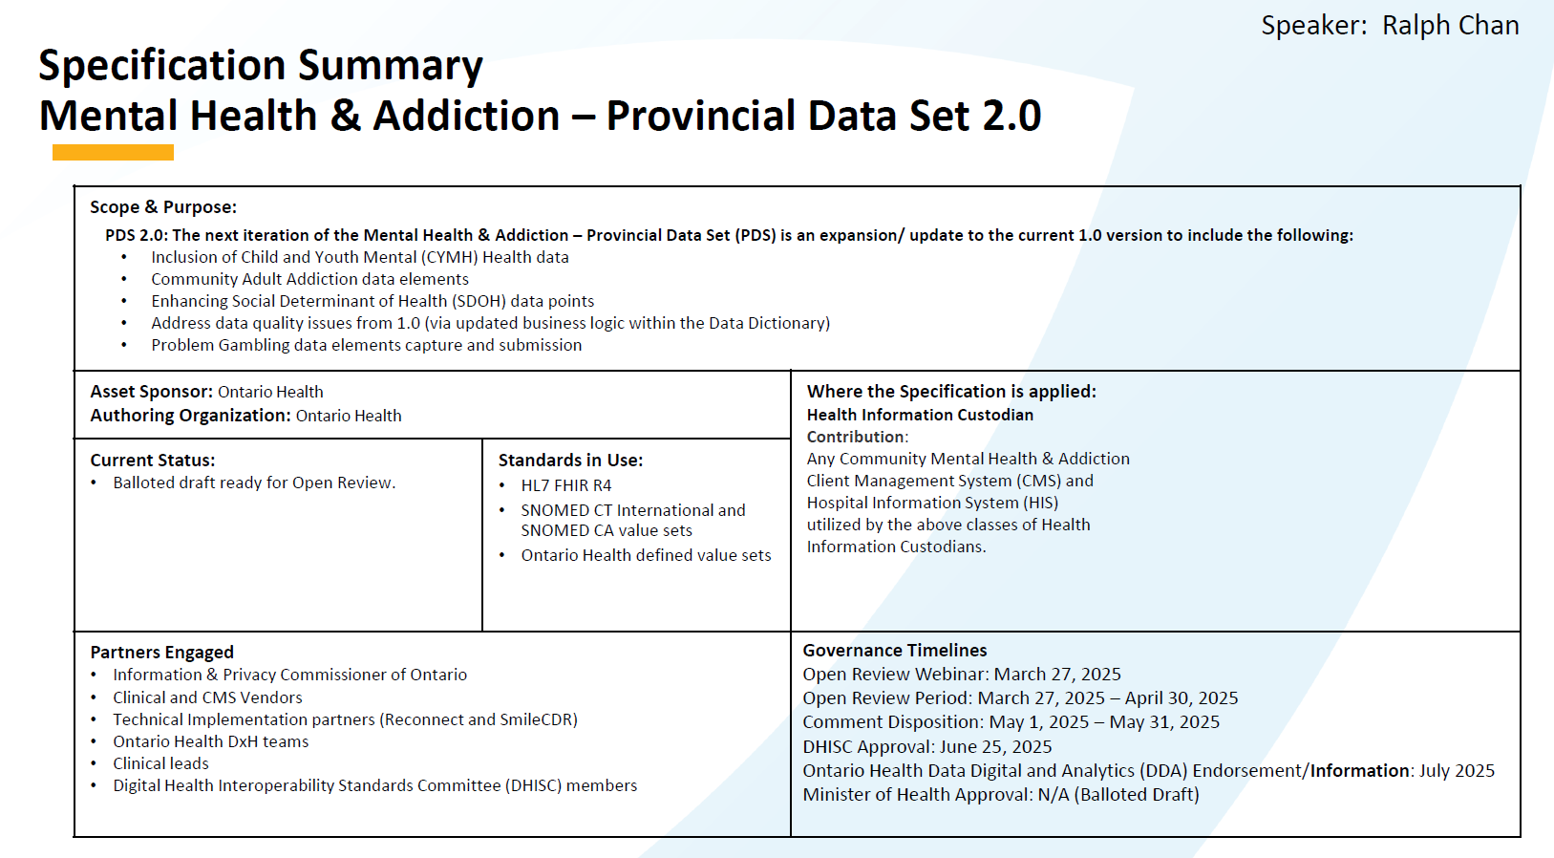
ON MHA PDS v 2.0

Slide 9
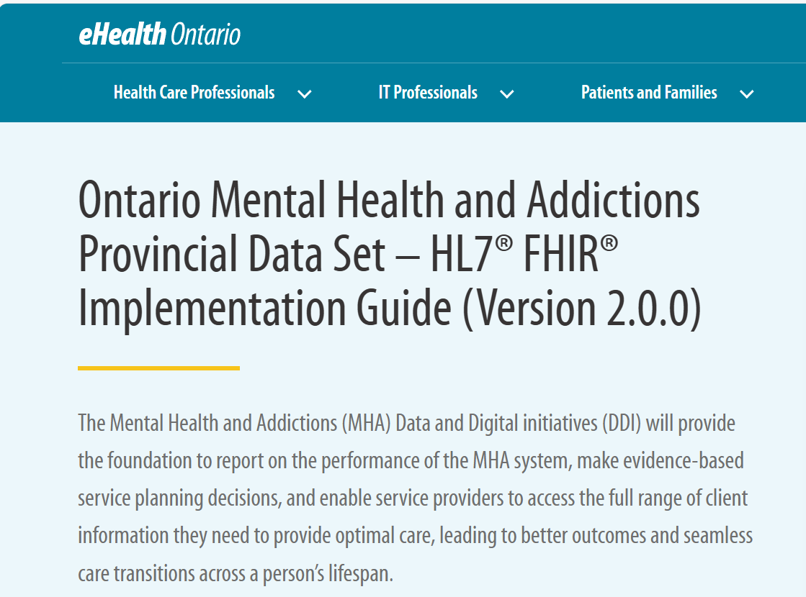
ON MHA PDS v 2.0
Ontario Mental Health and Addictions Provincial Data Set – HL7® FHIR® Implementation Guide (Version 2.0.0) | eHealth Ontario | It's Working For You

Slide 10

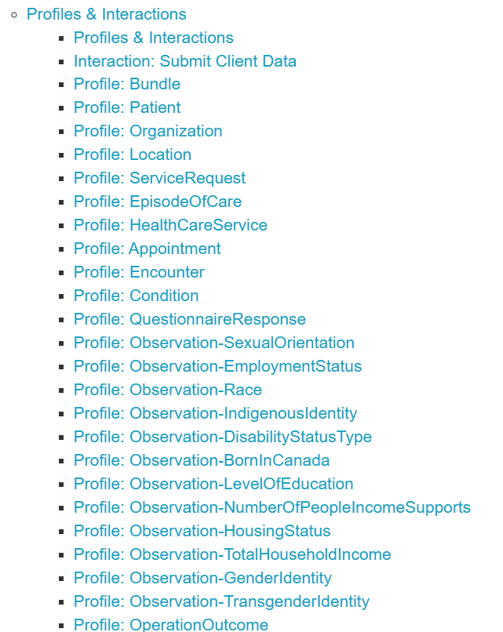
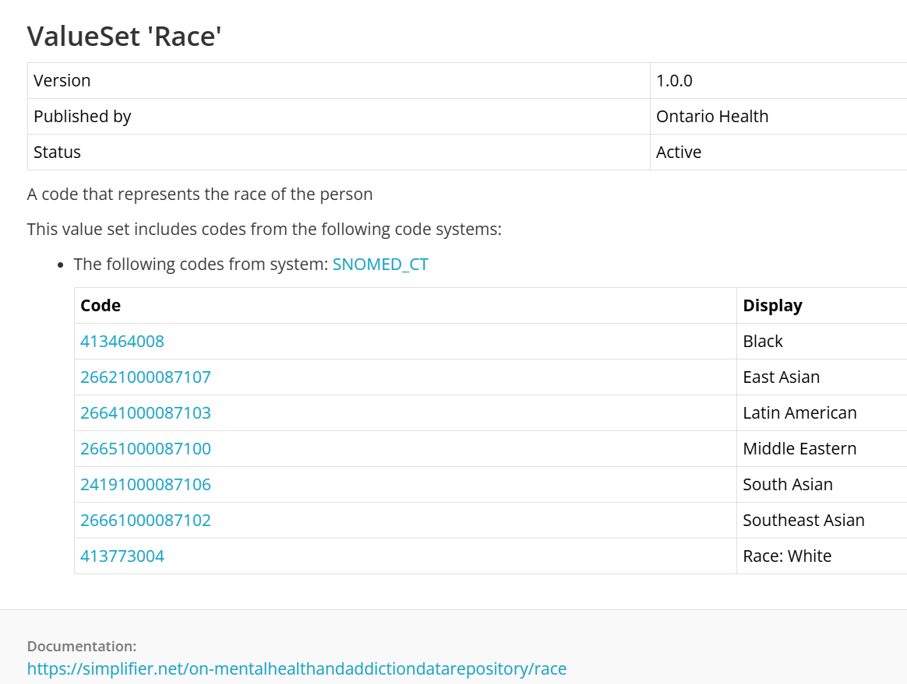
MHA PDS FHIR Implementation Guide
Terminology Tab
https://simplifier.net/guide/ca-on-mha-r4-iguide-v2.0.0?version=current
Notes:
Deep End Canada currently has 10 organizations from 7 provinces, representing around 25 clinics. Organizations are represented by health care providers, clinic administrators, policy and evaluation staff, researchers, and patient partners.

Slide 11

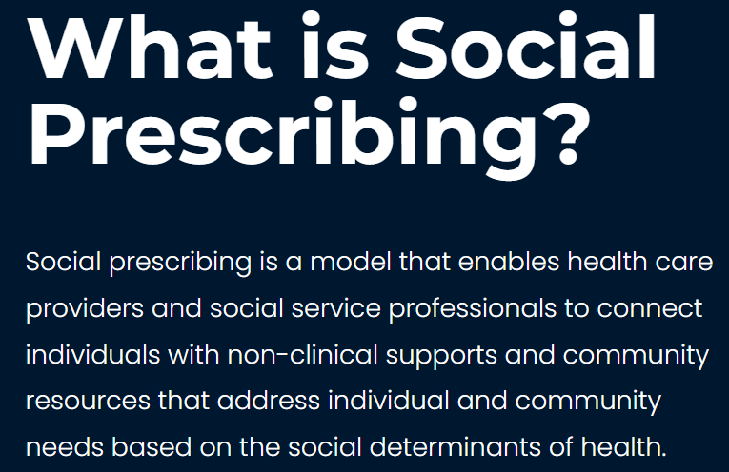
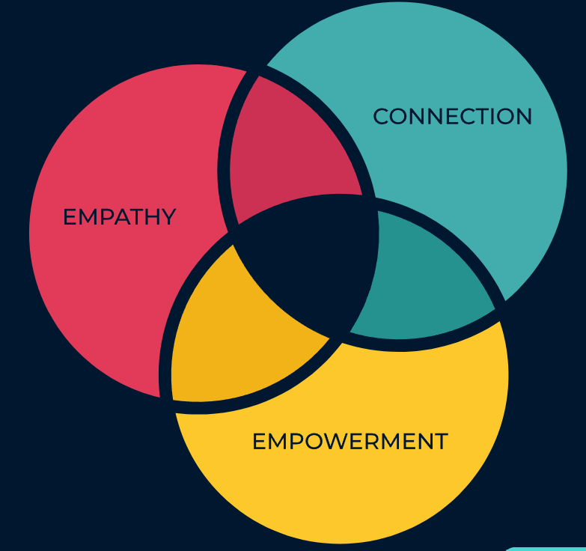

Slide 12

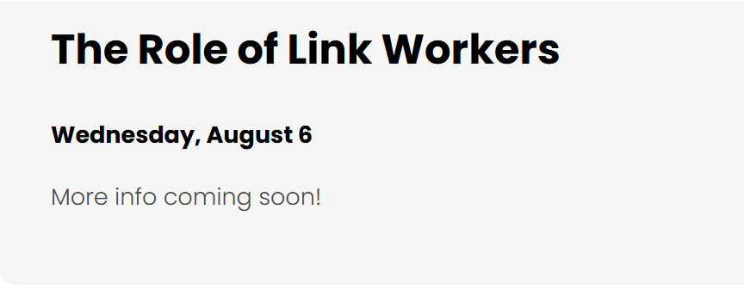
Learning Opportunities

Slide 13

Marcy Antonio’s Work
administrative burden of medication affordability resources: an environmental scan with implications for health informatics to advance health equity | Journal of the American Medical Informatics Association | Oxford Academic

Slide 14
SDOH Presentation with the Data Content Standard

Slide 15
Proposal for reorganizing SDOH in Data Content Standard and CACDI
Person Information
Sociodemographic/ Identity
Sociodemographic
Social Risk, Social Needs
Social Determinants of Health (SDOH)
SDOH Screening Assessment
SDOH Patient Goals
Gravity and USCDI framing
SDOH Problems/ Health Concerns
SDOH Interventions

Slide 16
Social Care Arc Housing Example
Screening/Assessment
Problem/Health Concern
Patient Goals
Intervention
How are you currently housed?
Owns home 
Lives in home that is rented 
Lives in Subsidized housing
Lives in Supportive housing
Lives in Long-term care facility
Incarcerated at correctional facility
Has living arrangement 
Experiencing homelessness: 
        Sheltered 
        Unsheltered 
Housing Instability
1156191002 | Housing instability (finding) |
Housing Inadequate
161036002 | Housing adequate (finding) |
105531004 | Housing unsatisfactory (finding) |
Homeless
32911000 | Homeless (finding) |
Further granularity: SNOMED CT USA
611131000124100 | Sheltered homelessness (finding)
611141000124105 | Unsheltered homelessness (finding)
611181000124104 | Unsheltered homelessness, sleeping in safe environment (finding)
611551000124102 | Homelessness, living in a shared accommodation (finding)
Example:
Have secure housing
Reduce affordability stress
Example:
1148817001 | Assessment of barriers in housing insecurity care plan (procedure) |
Example:
Have safer housing
Have bedrooms for kids
Example:
1148816005 | Assessment for inadequate housing (procedure) |
Example:
Have shelter upon hospital discharge
Example:
306697004 | Discharge to sheltered housing (procedure) |
SNOMED CT CA Finding Concept 
SNOMED CT US 

Slide 17
Review and feedback
SDOH WG rev 9Jul2025.docx

Slide 18
Updates or Announcements from Members

Slide 19
Archive

Slide 20
Social Determinants of Health Assessment
Definition: A detailed assessment of a person’s needs related to the social determinants of health, including social and demographic information.
Data elements
Service language
Gender Identity
Employment Status
Access to Food
Education Level
Sexual orientation
Financial Stability
Access to Medication
Relationship Status
Sex at Birth
Housing Stability
Access to Internet
PS-CA v1.0
SPARK Tool
BC GSSO Standard
USCDI V5
Racialized Group
Gender Used
Household Composition
Access to a Phone
Ethnicity
Recorded sex or gender
Housing Condition
Access to Transportation
Indigenous Identity
Sex Parameter for Clinical Use
Household Income
Access to Utilities
Religious or spiritual affiliations
Name used*
Access to Childcare
Today’s review
Born in Canada Status
Personal Pronouns*
Social Supports
Time since arrival in Canada
Person No Fixed Address Flag*
Legal History
* Denotes data elements that under Person Information data category
Experience with Interpersonal Violence
Notes:
Other standards/tools compared – Telus Health Equity Questionnaire, Ontario Guidance for Collection and Use of Sociodemographic Data, and Gravity as well.
Priority data elements were found across multiple standards -

Slide 21
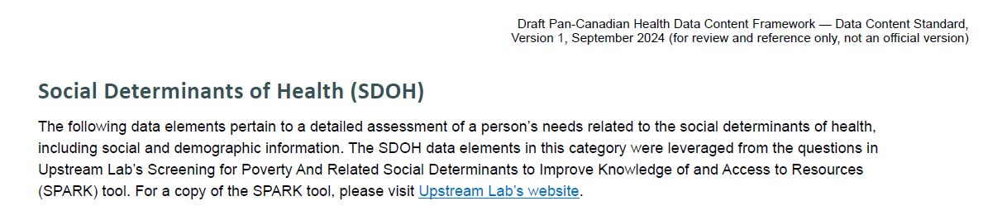
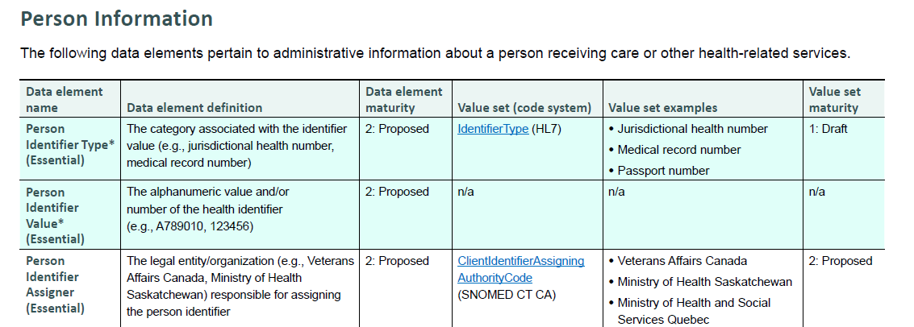
PCHDCF Data Content Standard v 1

Slide 22
2 SDOH Categories
Sociodemographic/ Identity
Social Risk, Social Needs

Slide 23
Proposal for reorganizing SDOH in Data Content Standard and CACDI
Person Information
Sociodemographic/ Identity
Sociodemographic
Social Risk, Social Needs
Social Determinants of Health (SDOH)
SDOH Screening Assessment
SDOH Patient Goals
Gravity and USCDI framing
SDOH Problems/ Health Concerns
SDOH Interventions

Slide 24
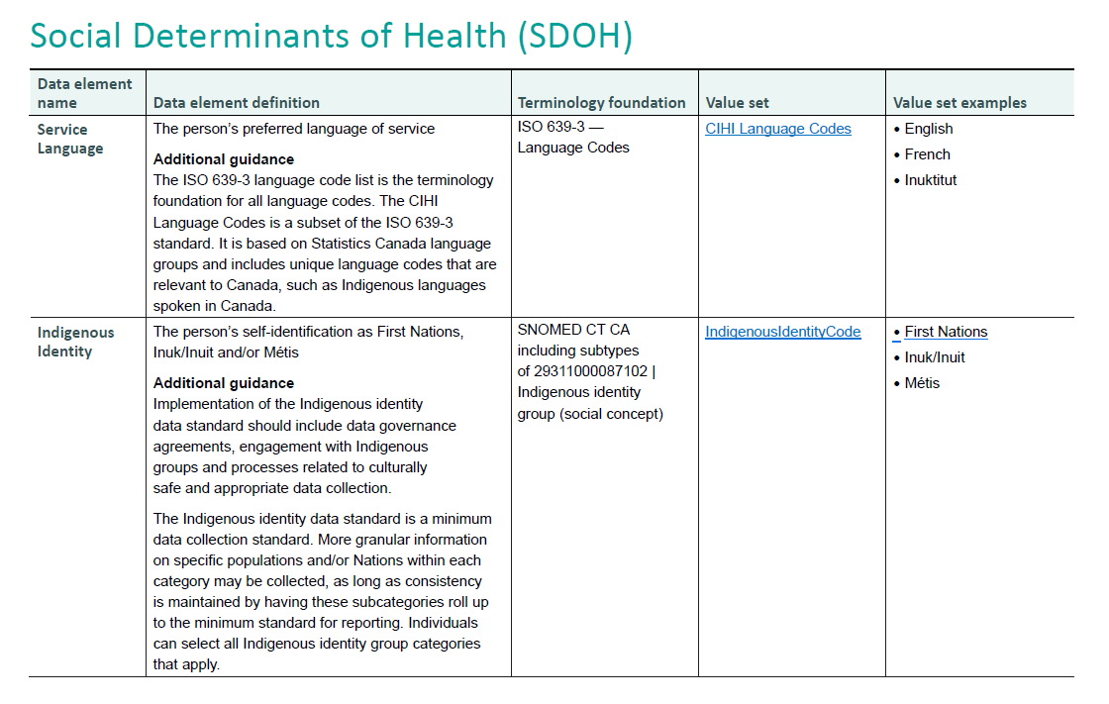
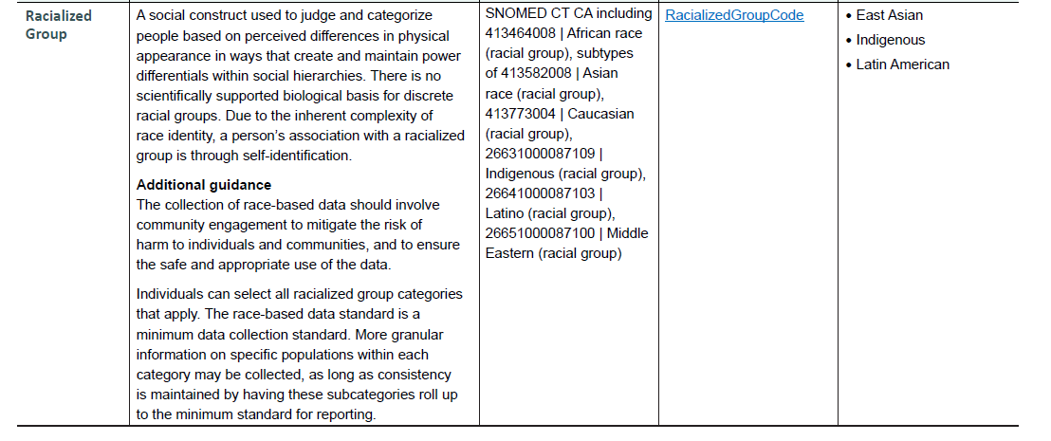
CACDI SDOH Data Elements

Slide 25
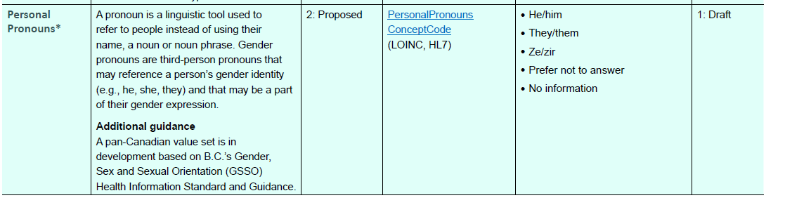
Person Information
The following data elements pertain to administrative information about a person receiving care or other health-related services.

Slide 26
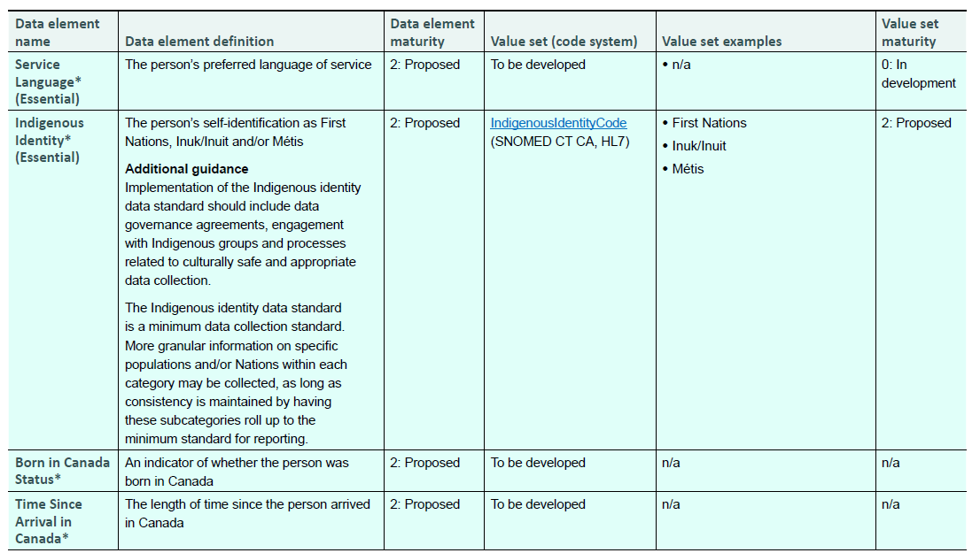
Proposed Data Elements to Move to Person or named as Sociodemographic Section of Social Determinants of Health

Slide 27
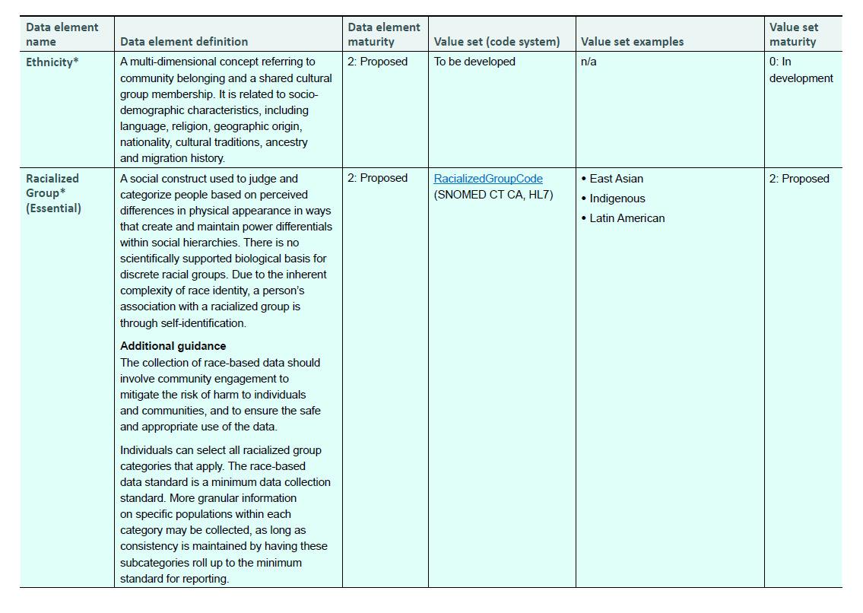

Slide 28
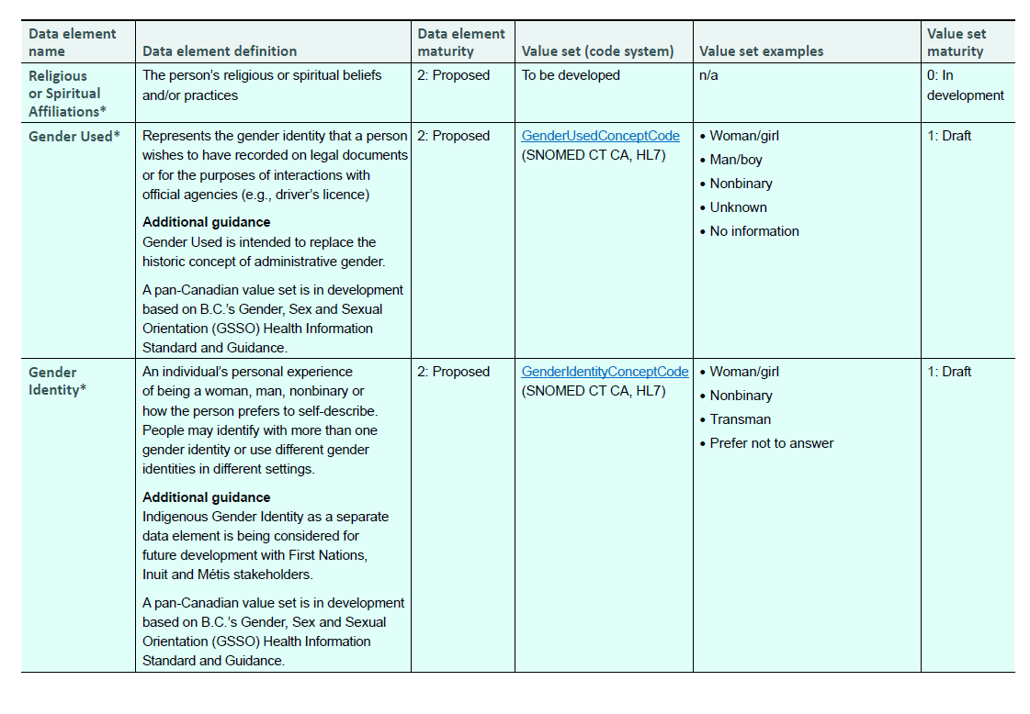

Slide 29
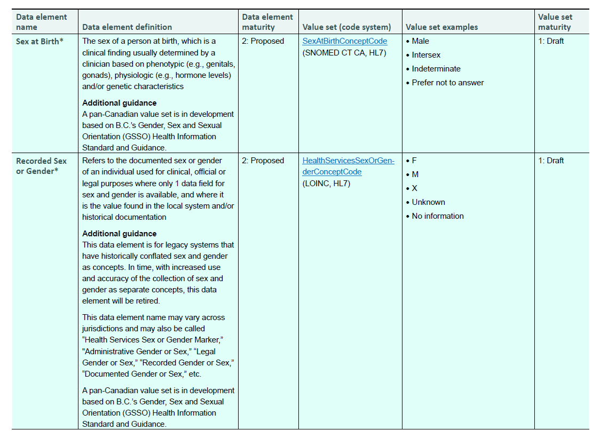

Slide 30
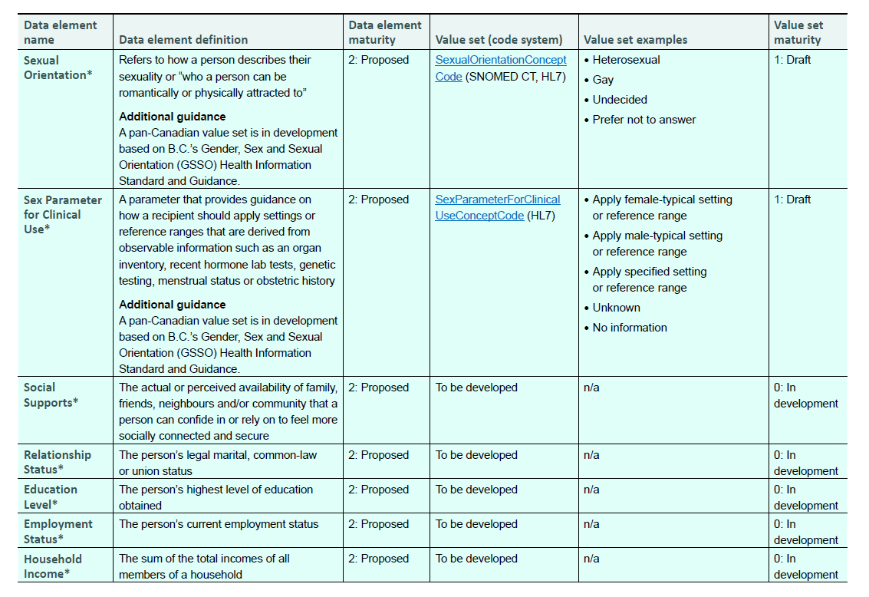

Slide 31
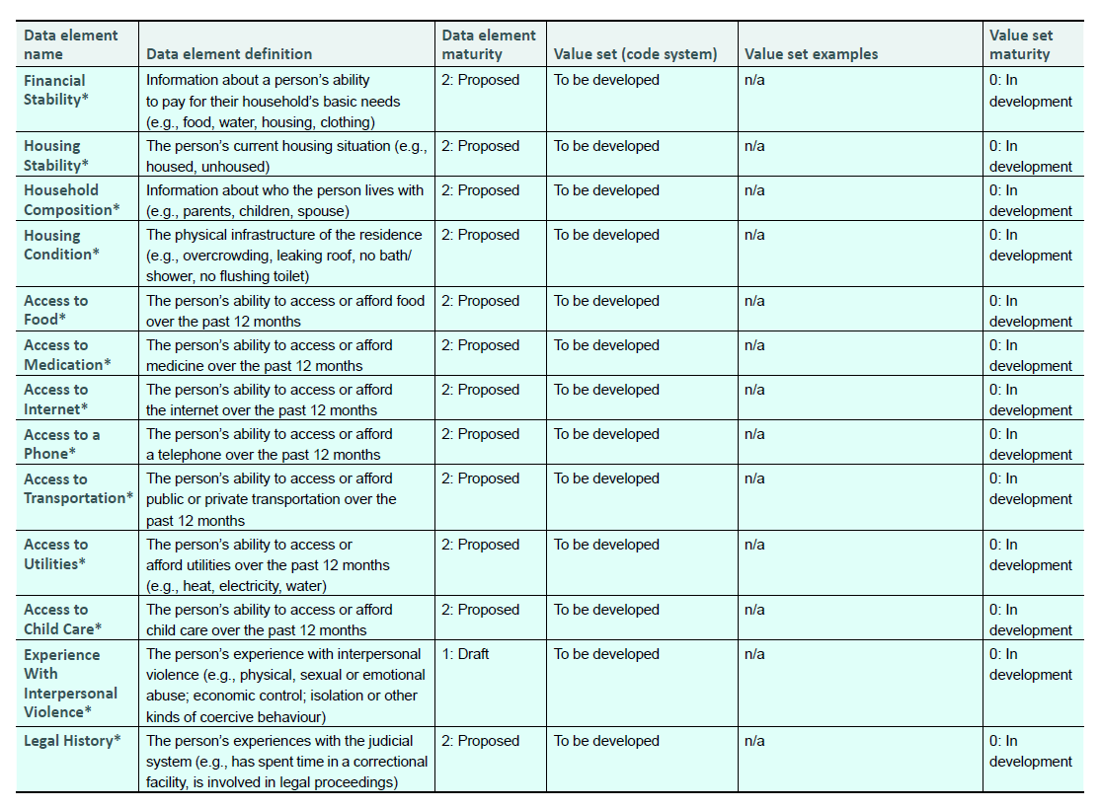

Slide 32
Social Care Arc Housing Example
Screening/Assessment
Problem/Health Concern
Patient Goals
Intervention
How are you currently housed?
Owns home 
Lives in home that is rented 
Lives in Subsidized housing
Lives in Supportive housing
Lives in Long-term care facility
Incarcerated at correctional facility
Has living arrangement 
Experiencing homelessness: 
        Sheltered 
        Unsheltered 
Housing Instability
1156191002 | Housing instability (finding) |
Housing Inadequate
161036002 | Housing adequate (finding) |
105531004 | Housing unsatisfactory (finding) |
Homeless
32911000 | Homeless (finding) |
Further granularity: SNOMED CT USA
611131000124100 | Sheltered homelessness (finding)
611141000124105 | Unsheltered homelessness (finding)
611181000124104 | Unsheltered homelessness, sleeping in safe environment (finding)
611551000124102 | Homelessness, living in a shared accommodation (finding)
Example:
Have secure housing
Reduce affordability stress
Example:
1148817001 | Assessment of barriers in housing insecurity care plan (procedure) |
Example:
Have safer housing
Have bedrooms for kids
Example:
1148816005 | Assessment for inadequate housing (procedure) |
Example:
Have shelter upon hospital discharge
Example:
306697004 | Discharge to sheltered housing (procedure) |
SNOMED CT CA Finding Concept 
SNOMED CT US 

Slide 33
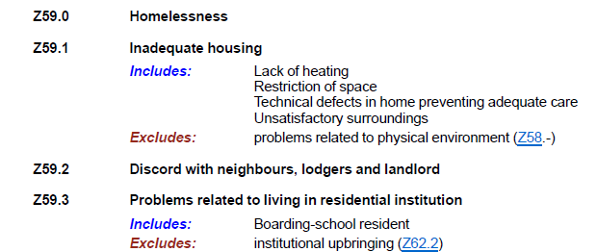
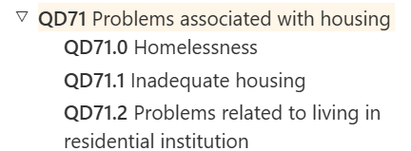
Homelessness in Classifications ICD10 and ICD11
ICD10 CA
ICD11
ICD10 CM (US)
Z59.00 | Homelessness unspecified
Z59.01 | Sheltered homelessness
Z59.02 | Unsheltered homelessness
Z59.1 | Inadequate housing
Z59.3 | Problems related to living in residential institution

Slide 34
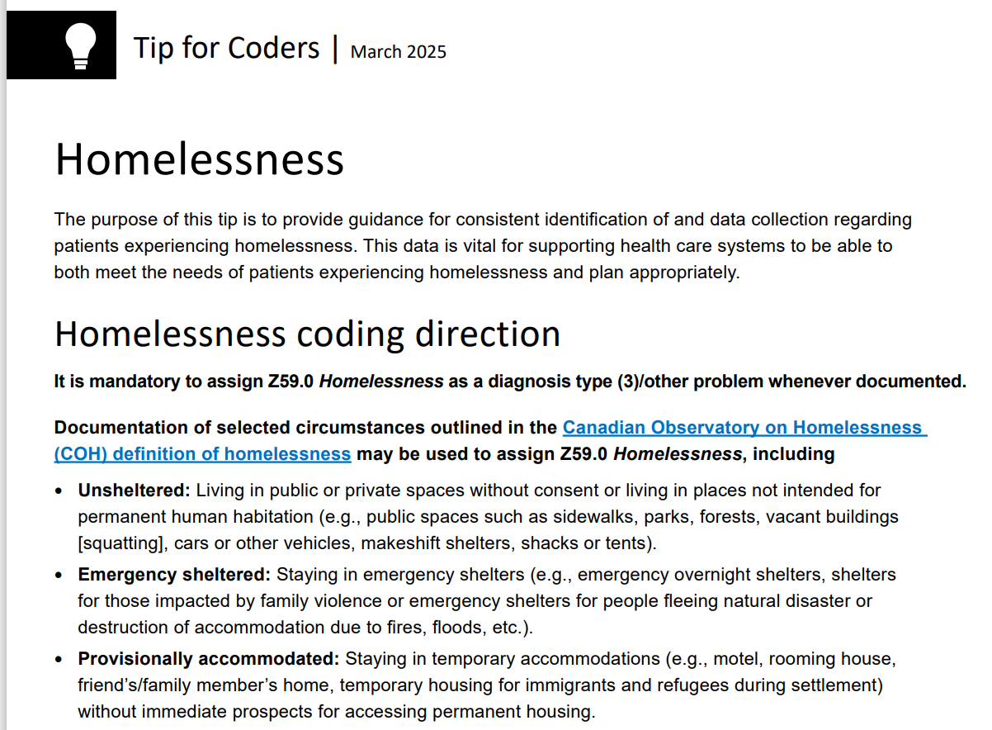

Slide 35
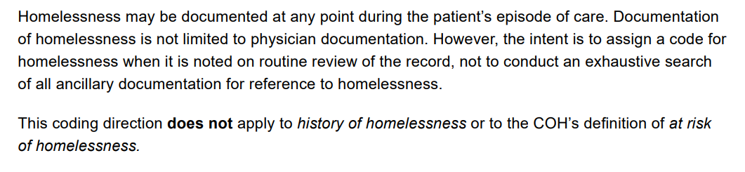
TIPS for Coders continued

Slide 36
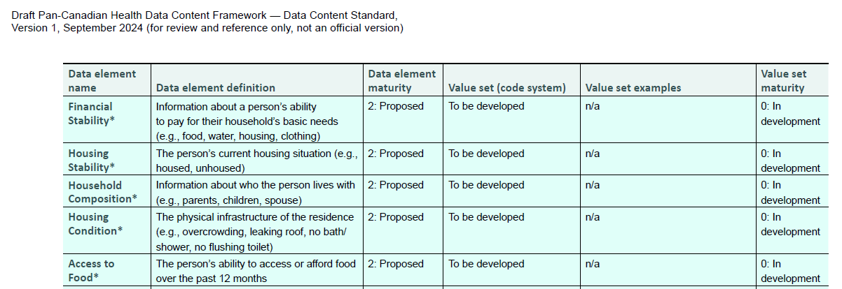
Priority Data Elements progress for next draft

Slide 37
Housing Stability

Slide 38
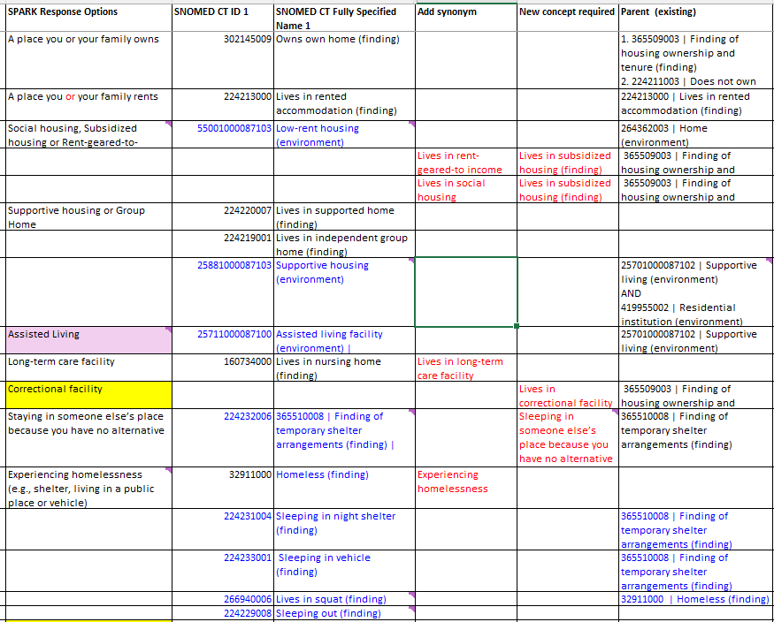
Housing stability The person's current housing situation (e.g., housed or unhoused)

Slide 39
Household Composition

Slide 40
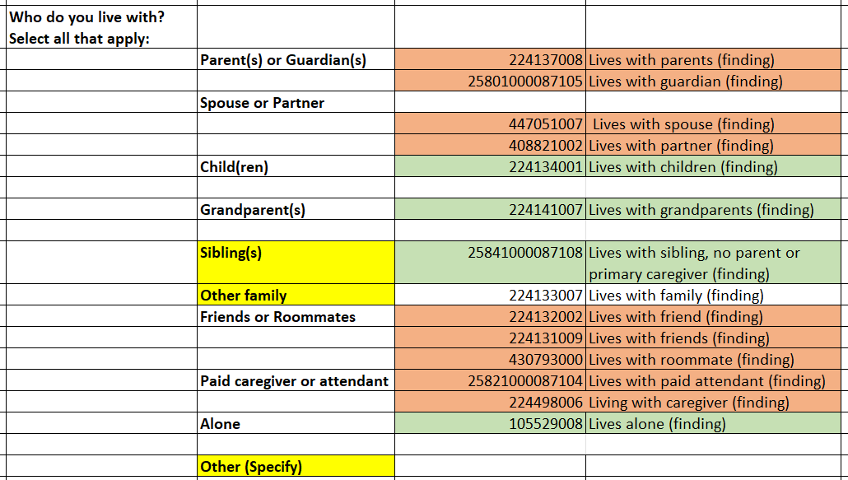
Household Composition: Information about who the person lives with (e.g., parents, children, spouse)
SPARK Question | Responses | SNOMED CT CA Code | SNOMED CT CA Concept name

Slide 41
Housing Condition

Slide 42
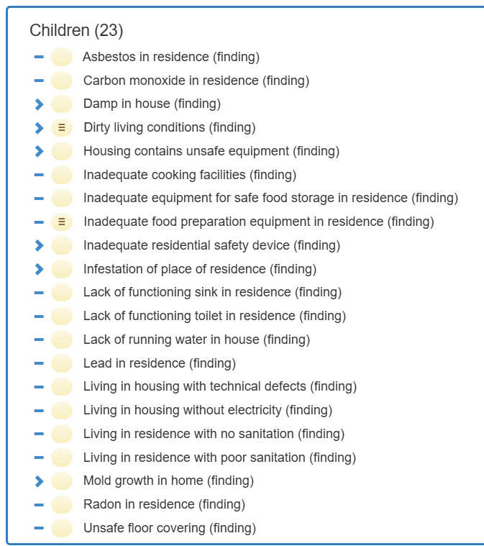
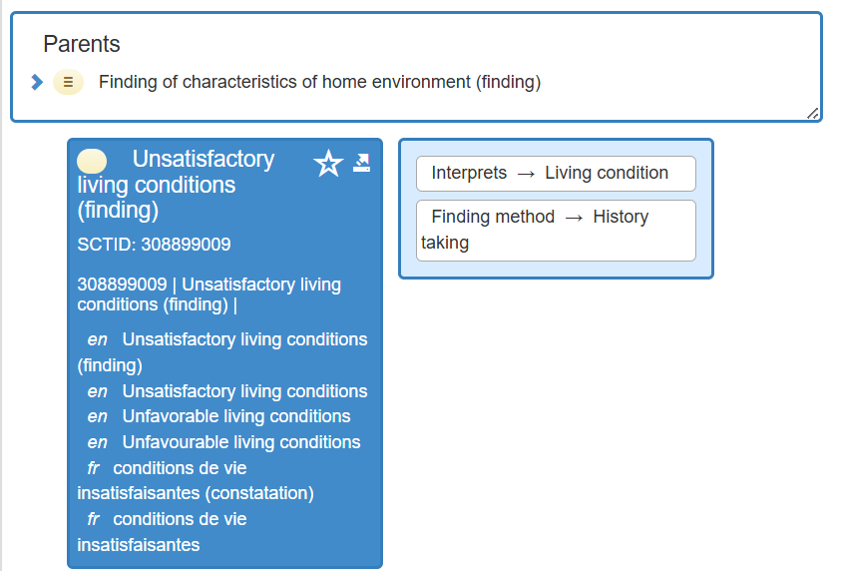
Housing Condition: The physical infrastructure of the residence (e.g., overcrowding, a leaking roof, no bath/shower and no flushing toilet)
Inadequate Housing - Gravity Project – Confluence
An occupied housing unit that has moderate or severe physical problems (e.g., deficiencies in plumbing, heating, electricity, hallways, and upkeep).
SNOMED CT CA

