Slide 1

CA-Baseline
2023 Community Governance Discussions – Where Does the CA Baseline Fit?

Slide 2
Process
Announcement in January/February about the pan-Canadian Data Model and CA Core+
February Presentation followed by FAQ published a few weeks later
Concerns raised in FAQ about the CA Baseline being retired
  Asks for clarity and feedback on FAQ
Started our Community Governance Discussions with a Set of Structured Questions to Evaluate Concerns and Identify Path Forward
  Examine whether maintaining the CA Baseline is necessary if its rules are subsumed (duplicate with less power for change) – looking at technical and communal aspects
  Identify how scope of each guide impacts our recommendation on relationship between CA Baseline & Core+
  Examine the established options for conveying relationships
    Focusing on impacts of derivative relationship given discussions at HL7 International to set these expectations within the definitions
    Technical and Governance Risks/Benefits to pursuing a derivative relationship
    Whether internal or external variables change these risks/benefits
Summarize what has been discussed and outline recommendations for next steps with CA Baseline
Validate these with the group, refine, then share them with impacted parties

Slide 3
Is Mutual Exclusivity Necessary – and how can we avoid the conditions in which it is?
Is there a future where a Base or Baseline no longer is needed to achieve our goal of “exposing the implementation guide and vendor community to what concepts can be expected to be supported across jurisdictions today.” and the outcome of “concepts that were common across existing implementations become ubiquitous in future implementations.”
Does our ability to fulfill our goals and achieve outcomes change based on the presence of other national/domain guides in our community?
  Will depend on positioning and scope of other guides (and ensuring Baseline use case agnostic scope)
  Redundancy/duplication of profiles should be avoided
  Not being use case agnostic poses a challenge for asking Core or other national domain guides to derive or align to us
    True use case agnosticism might not be where we are at with the baseline if we have constraints - Other National Bases have much less constraints
  If we continue as a set of artifacts that is useful to Core/Mores we need to continue actively vetting whether we’re maintaining use case agnosticism – needs to be a foundational process to ensure that requests for changes are handled in a transparent manner
  There are some benefits beyond profile consistency that the CA Baseline provides (e.g., business & technical information sharing and coordination amongst peers, community building, learning FHIR) – these need to be considered

Slide 4
How do the scopes of Baseline & Core impact decision on whether to continue the Baseline?
  If the Core subsumed constraints in the CA Baseline (X) and was use case agnostic (X) then….
    If consumed and a mechanism for community input & trusted processes – no concerns with the Baseline retiring (other than losing some of our passive benefits being on calls together)
    Would have to feel confident in the process and that input of community authors concerns are considered and addressed.
  If the Core subsumed constraints in the CA Baseline (X) and was use case agnostic plus additional desired constraints (X+) then….
    If consumed and a mechanism for community input & trusted processes – no concerns with the Baseline retiring (other than losing some of our passive benefits being on calls together)
    Would have to feel confident in the process and that input of community authors concerns are considered and addressed.
  If the Core subsumed constraints in the CA Baseline (X) and wasn’t use case agnostic (X, Y) then…
    Most likely initial scenario for CA Core+ – though it may become use case agnostic as more domains are tackled
    If consumed and a mechanism for community input & trusted processes – the CA Baseline should remain but would need modify its approach and will need a way to push applicable implementors to the Core (to be validated)
      Would need a mechanism for the pushing implementers to the applicable guide
  If the Core subsumed constraints in the CA Baseline (X) and wasn’t use case agnostic (A, Z) then…

Slide 5
Established Options for Conveying Relationship
Informal Alignment Approach
What is it: Reviewing the StructureDefinition of the CA Baseline CI Build profile, inputting its constraints manually into your profile, and surfacing any constraints that need to be relaxed to CA Baseline issue log
Flexible
Informal Alignment
IGuide Dependencies
Instance Validation
Re-profiling
Instance Validation Approach
What is it: Adding CA Baseline Profile to meta.profile element in example messages, running through validator (e.g., FHIR Validator, Simplifier validation button, etc.)
Dynamic
Stable
Implementation Guide Dependencies
What is it: Adding CA Baseline Guide into ImplementationGuide.dependsOn to allow your guide to point to CA Baseline profiles, terminology, extensions, etc.
Re-Profiling
What is it: Adding CA Baseline profile into StructureDefinition.basedOn to allow your profile to inherit constraints directly from CA Baseline w/o needing to include in differential
Rigid
Notes:
(1:15) Thanks Mike, one of the most important things to understand about the Canadian Baseline is that it operates in a uniquely challenging space- it’s been developed through grassroots volunteer efforts which means were not starting from a place of a formal policy or program stating that the baseline will be adopted these ways – which means we also don’t have formal incentives or disincentives tied to adoption.
So we’ve done considerable work in our governance stream to identify a path forward to connect with federal and jurisdictional working groups in asking them to be part of a collaborative enforcement body that will enforce the use of the CA Baseline in their jurisdictions for any prospective guides. We know jurisdictions like BC have already started to include the Baseline in their standards catalogue but we’ve also heard that they are looking for some assurance to the maturity and stability in the content before enforcing that their implementation guide authors start using the CA Baseline.
So in the meantime we’ve outlined a number of mechanisms that implementors can use to adopt and test the profiles for the improvement of their content as well as the improvement and further maturity of ours.
So I’m Going to talk about four of these mechanisms today and the conditions in which theyre most helpful to implementors.

Slide 6
Do a Base or a Baseline have to be a formal derivation point for Cores & Mores – benefits vs risks?
Need to explore the formal derived relationship given discussions happening at HL7 International about a formal definition including derived relationship expectations
Benefits of a Core formal deriving from a Base:
  Ensures consistency to make it easier for vendors to implement against our collective guides
  Sets the fundamental common concepts we need without a specific use case – allows implementations who are not covered by the use cases (temporarily or in the future) in other guides to have common starting point
  Use case agnosticism helps to reduce risks that occur when implementers review each others use case driven guides (that aren’t scoped exactly the same)
  Allows for faster comparison between guides by removing need to assess functionally claimed commonalities
Risks of a Core formal deriving from a Base:
  If using the most current – any issues around instability / bugs are inherited downstream, and necessitates continued review to determine if changes bring your implementation out of conformance (e.g., required concept that a child guide does not require)
    If using stable versions: still requires continued review
    As layers are added: software dependency management risks are incurred– particularly if the various layers have different governing bodies/processes that the most downstream guide doesn’t have control over
  If the artefact that necessitates inheritance doesn’t have the input from the various guides (that would have to inherit its rules) creates issues that organically result in variances

Slide 7
Are there specific risks that are modified by internal or external variables?
Example Baseline-driven modifiers are 1) approach to applying constraints that are common but not Canadian (application of MS, conditional constraints), 2) low maturity (1.0.0 Trial Use), and grassroots process.
Primarily the highest risks identified for implementers are associated with the layers (Base, Core, etc) having different governing bodies/processes
There may not be commonality in ideas and approach if baseline and national guides are not governed under same groups and principles
Some equivalents that have addressed these types of concerns through process and transparency
Credibility issues that are bidirectional – if we aren’t aligned and working together trust in both guides will be eroded
Example of an external-driven modifier is the Number of IGuide layers expected in the ecosystem (e.g., Universal Realm-Use Case/Domain, National Base, National Core, National Use Case, Regional Use Case, Direct Implementations)
  The more distributed the layers of guides are in terms of governance and process – the more burden is compounded for implementers as new layers are introduced
  May depend on the process or “safety valve” that is supported for deviations and documentations of deviations (e.g., what is done in the US Core)

Slide 8
Assessment & Recommendations Based on Discussion to Date
Passive benefits and lack of certainty given stage in process makes the community resistant to retiring the CA Baseline (even if it was 1-for-1 what is proposed in CA Core+)
CA Core+ will likely have some additional scope (e.g., starting with primary care) beyond the CA Baseline though it may grow to offer guidance that is use case agnostic, this will take time…
  In the interim there may still be some value in upholding soft standardization for guides not covered by the published domains yet
  But it will be important not to confuse/distract implementers who should be going to the respective CA Core+ guidance
We need to plan for a future where the CA Baseline conformance artifacts are needed less and less, and incorporate steps in the meantime that embody our intent to be collaborators not competitors
Proposal: Immediate Next Steps
Keep improving, refining (use case agnosticism), gathering details about our implementation in the meantime to make it more leverageable, acknowledging that we will re-evaluate/stay-tuned on further steps re: relationship with CA Core+ when there is an initial draft/engagement started on CA Core+
  Examples include: Revisions in the issue log, Discussing best practices/ current practices we’re experiencing in our implementations
Discuss if there are governance processes that address how a use case agnostic guide addresses changes that come in from community
Review any CA Core+ materials that are released in our community - provide questions/asks for clarity
Proposal: Future – Evaluate whether the steps below hold up after the CA Core+ efforts begin in our community
Maintain the CA Baseline as a community until a reasonable set of domains has been covered by the CA Core+ and enough trust has been built up in the process that folks are comfortable fully retiring it (coverage & trust) - then we will discuss as a group readiness to retire
  Doesn’t mean that we can’t still have passive benefits as a group that meets and shares best practices through FHIR Implementers
Use CA Core+ as an input into CA Baseline DDR process (e.g., relax what CA Core+ has not identified as a constraints)
  Will mean the Baseline and Core+ will need to have channel of communication/will surveil when changes occur to Core+
  Versioning in CA Baseline will allow for us to be nimble/communicative in incorporating changes from CA Core+
Request that CA Baseline be considered an input in CA Core+ , for example:
  Identifying any elements or constraints previously raised by community
  Providing context from past discussions on elements
  Requesting involvement in the process of review/feedback as an established standards community
The CA Baseline guide will recommend that implementers engaging in domains that CA Core+ covers - go directly to the linked CA Core+
Do not pursue direct derivation between Baseline and Core+ unless the difference in Governance is resolved
  Consider asking implementing guides not to pursue direct derivation from the CA Baseline (To be decided)
  Communicate to existing derived implementers on how to move forward (To be decided)
    May need to wait for official announcement that we can point to / make determination
Modify our ask for endorsement to include claims for the CA Core+ as an alignment option

Slide 9
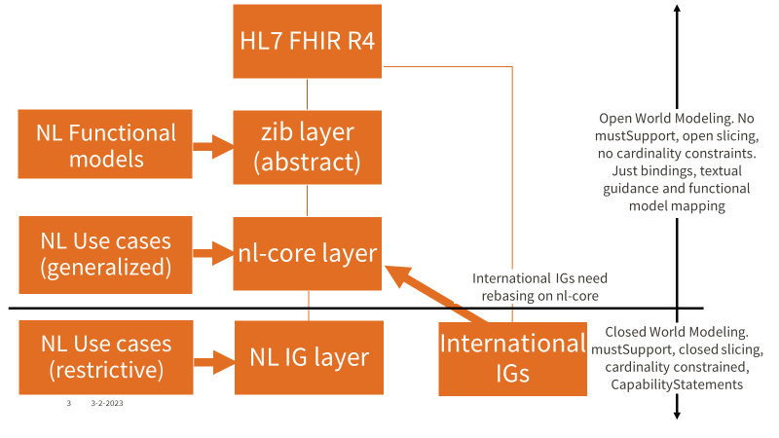
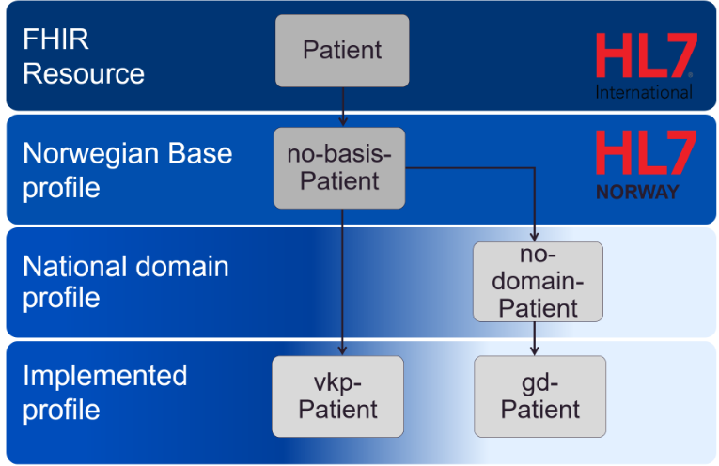
National Examples of Relationships between FHIR Profiles
Norway Relationships Between Profiles
Netherlands Relationships Between Profiles

Slide 10
Emerging Framework
(using concepts from NL and NO)
Base FHIR Resource
Open World Modeling
National Abstract Profile (Use Case Agnostic)
No mustSupport, No cardinality constraints.
Bindings, open slicing, textual guidance and functional model mapping
National Domain/Use Case Profile (Generalized)
Best practice guidance (terminology, approach, recommendations for re-use by other IGuides)
National Use Case Profile (Restrictive)
mustSupport, cardinality constraints
use case related guidance,
closed slicing
Where do UV Profiles fit in this framework….and this hierarchy?
International Use Case Profile (Restrictive)
CapabilityStatements
Implementation Profile (Most Restrictive)
How does the place in the hierarchy impact how National FHIR Authors “use” UV profiles?
Closed World Modeling

Slide 11
US Example
Resource
Patient
The political context of how and why the Base or Core was created has created an underlying muddying of the models
National Abstract Profile (Use Case Agnostic)
National Domain/Use Case Profile (Generalized)
National Use Case Profile (Restrictive)
US Core Patient
Implementation Profile (Most Restrictive)
International Use Case Profile (Restrictive)
IPA Patient

Slide 12
United Kingdom Example
Resource
Patient
National Abstract Profile (Use Case Agnostic)
UK Core Patient
National Domain/Use Case Profile (Generalized)
National Use Case Profile (Restrictive)
UK Core Patient Access Patient
Where do UV Use Case profiles fit in the hierarchy?
How do profiles meet both International Use Case Profiles and their National Profiles that are more abstracted?
Implementation Profile (Most Restrictive)
International Use Case Profile (Restrictive)
IPA Patient

Slide 13
Finland Example
Resource
Patient
National Abstract Profile (Use Case Agnostic)
National Domain/Use Case Profile (Generalized)
FI Base Patient
HL7 Finland is attempting to derive its base profiles off of IPA wherever possible
FI Base Patient
National Use Case Profile (Restrictive)
How do we ensure that the constraints that are introduced or are relaxed due to this relationship are appropriate for the given use case (particularly when national use case scopes differ from the use case scope in the UV profile?)
Implementation Profile (Most Restrictive)
Finnish PHR Patient
International Use Case Profile (Restrictive)
IPA Patient

Slide 14
Switzerland Example
Resource
Patient
National Abstract Profile (Use Case Agnostic)
CH Core Patient
National Domain/Use Case Profile (Generalized)
National Use Case Profile (Restrictive)
CH Core Patient - EPR
Implementation Profile (Most Restrictive)

Slide 15
Canada Example
Resource
Patient
National Abstract Profile (Use Case Agnostic)
CA Baseline constraints may need to be relaxed further to be considered truly use case agnostic
CA Baseline Patient
National Domain/Use Case Profile (Generalized)
CA Core Patient
Where do these fit in? Which layers do we need?
CA Core Patient – Primary Care
National Use Case Profile (Restrictive)
CA Core Patient – Patient Access
Implementation Profile (Most Restrictive)
International Use Case Profile (Restrictive)
IPA Patient

