Slide 1
Past, present, and potential future California adoption methodologies for renewable energy resources
IEEE SF PES Chapter Technical Presentation
Chase Sun, PE, IEEE Life Member
March 4, 2021

Slide 2
Disclaimer:
The information presented are based on the presenter’s 40+ years of professional experience in the power system areas. They are not intended to represent the official position of any company or agency.

Slide 3
Background:
National and state policy focused on energy efficiency and alternative energy resource adoption due to strong desire for energy independence after the 1973 Arab Oil Embargo.
Global warming and the desire to minimize human caused GHG emission going forward.
Existing power system was designed to work with large utility scale power plants powered by fossil fuels, and controlled to meet real time load demand.
The meshed transmission system was designed to provide multiple/redundant paths for the large power plants and provided high supply reliability.
Existing distribution system, was designed for low cost distribution of electric power over a wide geographic area in a radial/tree fashion. Typically, there are no/minimal redundancy to minimize the costs. All of the distribution control and protection devices, except for limited network systems, were designed for radial flow, single path, from central locations. Vast majority of the US distribution system used radial overhead line construction which are the easiest/cheapest to build and easily repairable. But they are vulnerable to foreign object contact and fires.

Slide 4
Brief regulatory history
CA Rule 21 governs the interconnection, operation, and metering requirements for CPUC-jurisdictional generating facilities (NEM, non-export, and PURPA)
  Rule 21 allows for interconnection of both export and non-export generators to utility grid
Energy crisis
1935
1945
Deregulation
1975
1980
1985
1990
1995
2000
2005
2010
2015
FPA*
Creates FERC for Wholesale sales
PURPA*
Open access
FERC
Order 888
Standardizes IC
R.99-10-025
D.00-12-037
Current OIR
R. 17-07-007
creates R21 for QFs
D.82-01-103 - orders R21
D.82-04-071 - QFs
AL-886-E
CAISO
created
Railroad Commission becomes CPUC
CHP / QF
A.08-11-001
01
R21 Settlement
For timely,
predictable &
transparent
distribution
interconnection
R. 11-09-011
D.2-09-018
AL 4110-E
*FPA=-Federal Powers Act PURPA = Public Utility Regulatory Policy Act

Slide 5
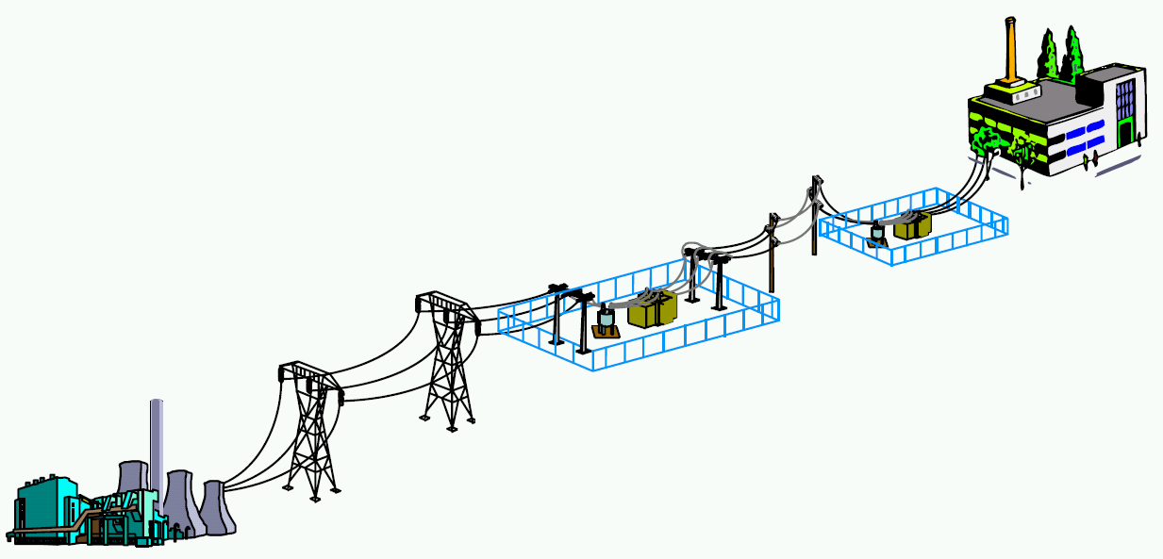
Traditional Electrical Power
System
Electric power system overview
LOAD
120 Volts
240 Volts
480 Volts
4160 Volts
12000 Volts
18000Volts
34500 Volts
DISTRIBUTION
SUBSTATION
115-12 KV
115-21 KV
230-34.5 kV
60-18 KV
115-21 KV
230-21 KV
TRANSMISSION
SUBSTATION
500-230 KV
230-115 KV
115-60 KV
230-60 KV
TRANSMISSION
500 KV
230 KV
115 KV
60KV
GENERATION

Slide 6
Existing electric power system was designed and operated to provide electricity to load customers with:
  Safety
  Reliability
    High electric power availability by providing redundant generation resources to cover different contingencies
    Service voltage within +/-5% of nominal voltage by employing automatic voltage regulators and capacitors (fixed and switched) on the distribution system
    High power quality by minimizing the harmonic content from the loads and inverters
  Affordability
    Minimize the capital and M&O costs to run the power system

Slide 7
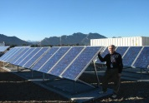


Electric power system overview
Traditional
Electric Grid…
Modern Electricity Choices …
Utility Scale
PV
Power park
Hydrogen Storage
Wind Farms
Remote Loads
Industrial DG
Fuel Cells
Rooftop Photovoltaics
Smart Substation
EV’s
Load as a resource
Combined Heat and Power

Slide 8
Power system fundamentals
  Any AC power grid, include microgrids, needs to have a dynamic power balance between generation and load for stable operation.
    More generation (real power) relative to load - overfrequency
    More load relative to generation - underfrequency
    Excessive UF and OF conditions may lead to improper equipment operation and/or equipment damage
    Due to the criticality of system frequency, WECC has an Underfrequency Load Shedding Program (UFLS) set up to shed load automatically during significant underfrequency events to maintain system stability. This UFLS program is separate from the manual Rolling Blackout load shedding option that CAISO deployed last August.
https://www.wecc.org/Reliability/WECC%20ONF%20Report%20July%202005.pdf#:~:text=This%20Final%20Report%20of%20the%20%E2%80%9CWSCC%20Coordinated%20Off-Nominal,WSCC%20Board%20of%20Trustees%20approved%20the%20Coordinated%20Plan.

Slide 9
Past generation procurement/interconnection methodology-before 1990
  Requirements were similar for all generation resources
    Generation resources were procured based on local/regional load and reliability needs.
    Generators were typically connected to the transmission system that was designed for bi-directional flow and high reliability with multiple paths.
    Each proposed project was studied for compatibility with existing grid, such as fault duty, grid equipment ampacity, voltage, harmonics, etc, and mitigated prior to actual operation
    Generation resources were controlled based on load demand in real time and economic dispatch. FYI, the system load fluctuates throughout the day and the aggregate generator output was controlled either directly or indirectly by the system operator to follow aggregate system load in real time.
  Results
    The grid operated properly after each generator interconnection
    The interconnection studies were laborious and time consuming. Mitigations may be extensive and time consuming. Sometimes, the mitigations may take years to complete. Communication and control of the generators by the grid operator were also required. Sometimes, the required protection and control costs exceed the cost of the smaller generators themselves. Hence, only large units with economy of scale were typically put into operation.
    Minimal intermittent renewable energy project interconnections.

Slide 10
DER challenges for electric utilities/operators:
How to use the existing distribution system to collect renewable energy and streamline the interconnection of large numbers of small generators to the existing distribution system safely with minimal studies/time/costs at low penetration levels?
Evolving:
How to avoid/minimize system-wide issues at higher levels of uncontrolled intermittent renewable energy resources?
How to transition from large central station power plants to a large number of distributed renewable resources at minimal costs to the ratepayers/taxpayers ?

Slide 11
Issues with connecting DERs to the existing distribution system
Each DER output may influence the local current flow and the associated voltage on the feeder to some extent. Big units tend to have larger impact than smaller units. Also, a lot depends on how well matched are the DERs relative to the local facility load. DERs serving local loads exclusively, i.e., no reverse flow, and no/small fault contribution, usually have minimal impact.
Depending on DER output relative to the load, the power flow may or may not be reversed from the original design. Utilities need to account for all conditions.
In the presence of DERs, instead of the normal voltage drop towards load, it may be voltage rise going towards load/DER depending on the amount of DER output relative to local load. The existing voltage drop tolerance may no longer be appropriate when the DER operates. Overvoltage may be an issue.
DER will also contribute fault duty. So, the available fault duty may be higher/lower when the DER is operating, depending on the DER location relative to the fault location and the point of measurement.

Slide 12
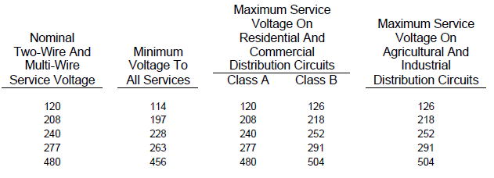
DER’s impact on the grid and its mitigation
Voltage Drop (and Voltage Rise)
Electric
Rule 2
126 V
With DG (PV)
Acceptable Service Voltage Band
114 V
Without DG (PV)
Feeder

Slide 13
The challenges of distribution system that led to the current low penetration interconnection methodology
Existing distribution feeders were designed to serve load radially, in a tree configuration, with progressively smaller conductors. For example, a 12 kV feeder may be capable of 600A at the feeder outlet (tree trunk), but may only have much lower current rating at the end taps (small tree branches). They were not designed nor studied for potential reverse flow due to generator interconnections
The distribution secondary service voltage need to be within +/-5% of nominal voltage per CA Rule 2. The distribution feeder voltage regulators, along with fixed and switched capacitors, were designed to automatically provide proper voltage, from zero load to full load in the radial direction, for the entire feeder.
Some long feeders may have multiple +/-10% regulators in series. The radial voltage regulator controls were designed for radial flow and may misoperate under reverse current flow conditions.
The distribution protection is also based on radial feed to isolate the distribution fault with minimum customer interruptions.
The existing protection and control systems were not designed to protect and control in the reverse direction.

Slide 14
Current low penetration renewable energy adoption methodology (Evolving) -1990-2020
  Due to the need to accommodate state and national energy policies, new national and local standards were developed to enable easier renewable interconnection and operation on the distribution system by using the operating margin of the existing distribution system.
  For example, there is usually 10% design/operating margin for equipment capacity. So, if the DER is small and the penetration level low, the distribution system may still operate within the original design margins after DER interconnection, then the DERs may be interconnected without any significant issues.
  The simplified interconnection process allowed fast interconnection and still addressed the safety and power quality concerns.

Slide 15
Evolving methodology, continued
    IEEE-929 (inverters<10 kW) and subsequently IEEE-1547, 2003 (for distribution projects less than 10 MW), developed anti-islanding and certification concepts to address utility safety and PQ concerns
    UL-1741 provided national lab certification procedures for anti-islanding and harmonic limits
    These simplified requirements were incorporated into CA Rule 21 for distribution interconnections
    This simplified approach captured the maximum amount of available renewable energy at the lowest cost by relying on existing grid equipment capability and operating margin, to maintain proper electric load service and public safety. At low penetration levels, the intermittent renewable energy resources were not needed nor used for dynamic system support since they may or may not be available when needed.
    Evolving:
    IEEE-1547 was revised in 2018 to address transmission system reliability concerns due to excessive tripping of large PV plants interconnected and operated largely based on the IEEE-1547, 2003, requirements.
    In addition, IEEE-p2800 WG was formed to provide large inverter based transmission interconnection requirements to address grid-wide issues, such as supply adequacy and system reliability.

Slide 16
CA Rule 21 requirements
Rule 21 requirements were focused on simplified requirements and functions to facilitate small DER interconnection. The primary focus was on safety and to get the units off line quickly during abnormal grid conditions and to allow the existing distribution system to operate as they were designed. So, the current approach is to use the existing grid design and operating margin to enable quick interconnection of the smaller DERs at low penetration levels. Any necessary incremental grid upgrades are picked up during the annual utility assessment so as not to impede the small individual interconnection.
The Rule 21 initial review was automated about 10 years ago, by incorporating the local feeder operating parameters such as section load, fault duty, and local device interrupting rating, into the automated review process. This enabled the vast majority of the PV projects to be reviewed/approved in less than 5 days (PG&E) now. To minimize interconnection costs, there were no monitoring/ control requirements for the small PV units
After 2017, and the appearance of grid impacts due to the earlier simplified interconnection requirements, the requirements started to phase in smart inverter functions (SIWG Phase 1, 2 & 3 functions), for new installations to enable grid support functions at higher renewable penetrations to minimize potential grid impact. These functions emulate the conventional generator functions, such as voltage and frequency control, and load following, that are needed to support the grid. They are more complicated and may require direct communication/control with the utility for effective implementation. These additional capabilities are possible and may be necessary in the future but they may increase the cost of the DER projects.
At this time, once a given distribution location reached some limits, such as Aggregate Short Circuit Current Ratio > 10%, or device fault duty exceeding 87.5%, Rule 21 required more detailed studies to ensure that the distribution feeder can still operate properly, and ensure that voltage/load current/fault current/harmonics are still within limits, after DER interconnection. So, larger units typically require more studies/modifications
For more details on Rule 21, see https://www.pge.com/tariffs/assets/pdf/tariffbook/ELEC_RULES_21.pdf

Slide 17
From CA Rule 21

Slide 18
Rationale behind some key R21 screens
Short circuit contribution ratio less than 10% of existing fault duty
  Existing system usually has a tolerance of 10% for future growth. This screen allow the small units to be interconnected quickly if the fault duty contribution is less than 10% or within the original design margin. The system will be reviewed annually by the utility and any deficiencies can be identified and upgrade implemented as needed.
  Larger projects with SCCR >10% will fail this screen and go through a supplemental/detailed review and any deficiencies will be flagged and mitigated prior to interconnection
Will power be exported across the PCC?
  If the power will not be exported across the PCC, the distribution load flow is still radial and within the original radial distribution design parameters and hence should have minimal impact.

Slide 19
Rationale-continued
Aggregate generation less than 15% of line section peak load
  If the generation is less than 15% of line section peak load, there is not likely to be any reverse flow on the line since the minimal load on the line section is typically more than 15% of peak load. So, for generation less than 15% of the line section load, the existing section load is likely to absorb all of the generation on the line section and there would be no reverse flow on the primary line and the system may operate within original design parameters.
Certified equipment
  If the inverter is certified, it would not island and cause a safety issue, it would also not produce excessive harmonics and cause power quality problems with other customers. Inverters are electronic switching equipment and may be capable of producing a lot of harmonics if not designed and built properly.

Slide 20
Economic incentives
    Federal and state tax credits
    Distribution System- Net Energy Metering Program allowed the renewable projects to export excess power to the grid and get credit for the excess renewable energy for an entire year. As a result, many of the NEM customers are capturing the benefits of being connected to the grid but not paying for the full costs of those grid services. They do pay a minimum service charge. Hence, most of the grid support costs were shifted to non-NEM customers in the form of higher rates. The higher rates incentivize more customers to adopt NEM. See https://www.cpuc.ca.gov/General.aspx?id=3800 for more details on NEM.
    Bulk System- CPUC Loading Order ensured that renewable energy has higher priority than fossil fuel based conventional units for loading purposes. This maximized the return for the renewable projects and encouraged wider adoption of bulk system renewable projects. But the reduction in usage and the increased cycling requirements made many fossil units uneconomic. See https://pucresearchguide.weebly.com/california.html#:~:text=Purpose%20California%E2%80%99s%20energy%20agencies%E2%80%94the%20California%20Public%20Utilities%20Commission,resource%20%22loading%20order%22%20to%20guide%20their%20energy%20decisions
.

Slide 21
CA Energy/Environmental Policy Results
    Many if not most new generation resources were installed primarily to displace fossil fuel usage.
    Dramatic increase in PV adoption in the last 10 years
    The renewable resources were allowed to produce maximum as available energy and not controlled to meet the load/grid needs. The controllable conventional units and existing grid equipment are used to serve load/grid needs and to make up for the renewable variable outputs.
    This resulted in the CAISO Duck Curve. In addition to the load variability, now we have intermittent renewable variability and the variability of market based programs, and imports, they made balancing load and generation and maintaining system stability much more challenging.
    “Flexible Generation” were procured to mitigate the duck curve ramping issue.
    Negative pricing used to pay adjoining utilities for accepting excess power
    Retirement of fossil power plants due to reduction in usage and other market forces
    Scheduled shut down of large Once Thru Fossil Units to minimize impact on marine life.
    Rotating outages due to vastly increased system complexity and resulting supply shortages

Slide 22
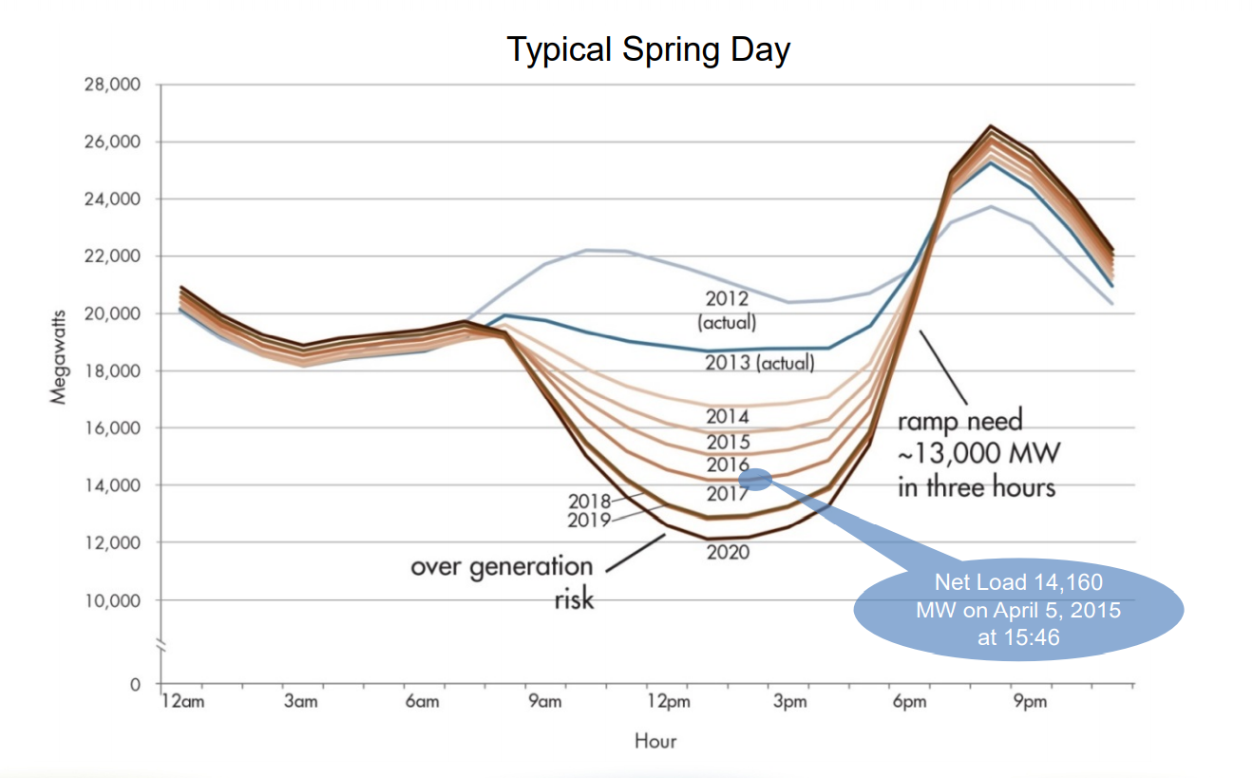
https://www.caiso.com/Documents/FlexibleResourcesHelpRenewables_FastFacts.pdf

Slide 23
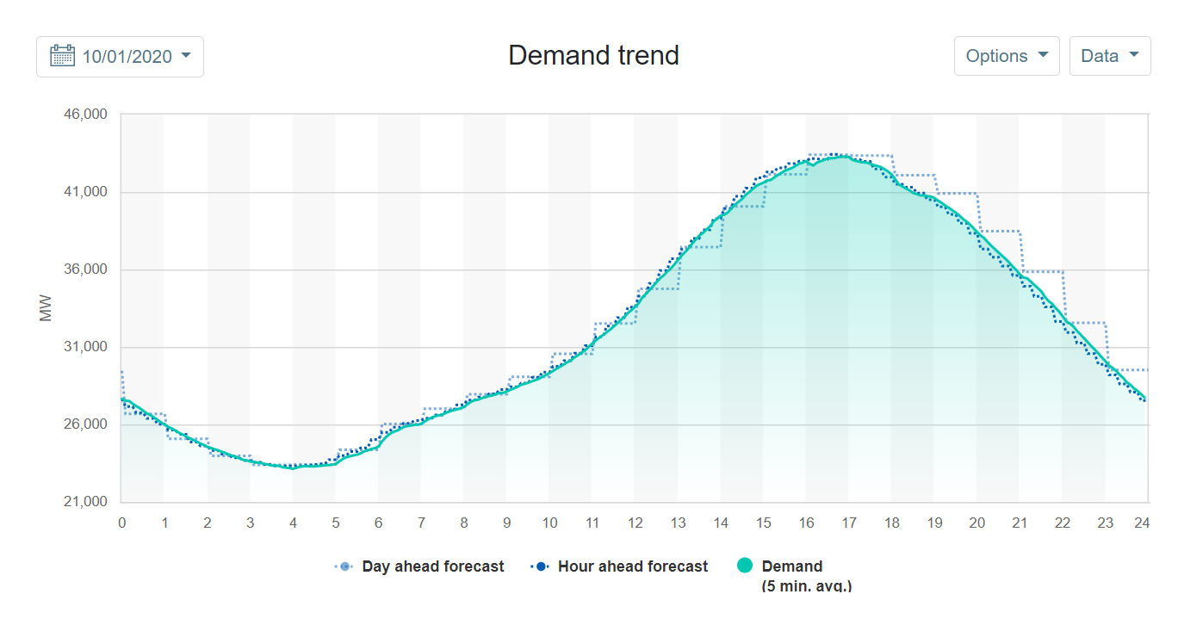
From CAISO website

Slide 24
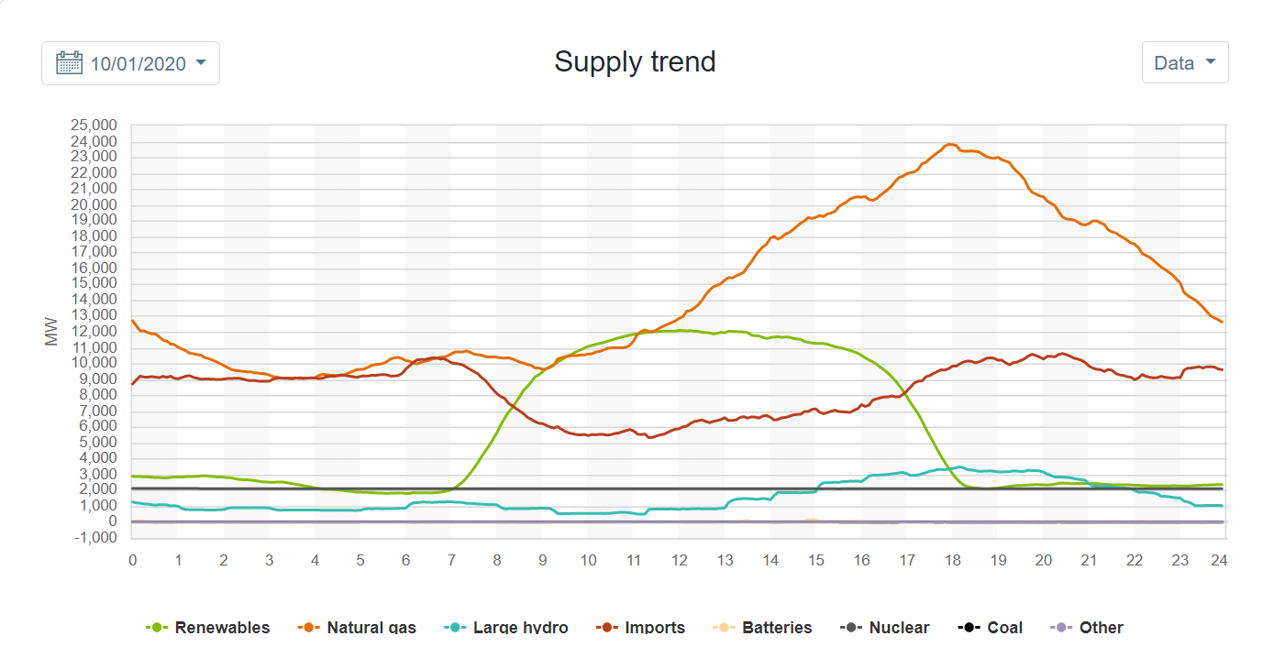
From CAISO website

Slide 25
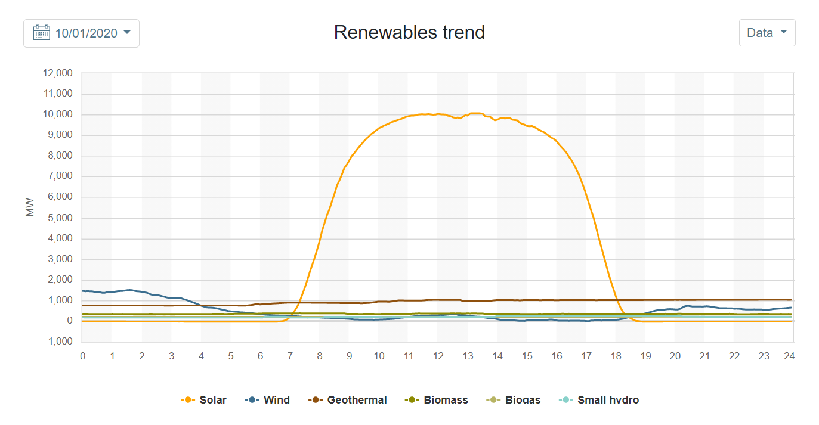

Slide 26
Potential future methodologies (s1)
  Modify the government sponsored economic incentives to cover grid reliability needs in addition to GHG needs. Reliable and affordable electric service is critical to the state’s economy
  Develop more accurate and dependable forecasting tools for those renewable resources with no remote control/monitoring capability to allow the grid operator to use these resources with confidence
  Convert some of the fossil fuel unit to be powered by renewable biofuel, or hydrogen assuming that these fuels can be made competitive in the future.
  Develop more Demand Response programs to absorb excess renewable power and/or reduce demand when needed
  Continue with Negative Pricing and pay adjoining utilities to take the excess power or Install load banks to absorb excess uncontrolled power if needed or economical
  Use energy market to lower energy costs but recognizing that generation and transmission capacity may be long lead time investments and that the market may not be able to provide additional capacity in the near term regardless of the price when the supply elasticity is exhausted.
  In light of what happened in Texas recently, plan for and ensure sufficient capacity is available for contingencies such as earth quakes, wild fire, and severe weather events. This is needed with/without renewable energy issues.

Slide 27
Potential future methodologies (s2)
  Until sufficient cost effective controllable non-GHG generation are available, keep adequate amount of existing conventional units around on standby duty to maintain grid stability/reliability,.
  Adequately compensate the controllable conventional units to keep them available on standby for the grid support services. Forcing them to retire may drive the need to adopt higher cost alternative resources, such as battery storage.
  Develop lower cost non-GHG stored energy controllable technology capable of longer term support than the conventional battery technology. Storage batteries are typically sized for 4 hour support at this time. But lower cost, multi-day controllable storage technology may be needed for infrequent conditions. Fossil fuel is cheap stored energy but it does have GHG emissions. Other possible stored energy alternatives may be Biofuel, Pumped hydro, Hydrogen Fuel Cell, Advanced nuclear, others, etc.
  Expand the use of distributed generation, such as plug-in hubs for community resiliency during wildfires and microgrids, when cost effective.

Slide 28
Potential future methodologies (s3)
  Deploy smart inverter functionalities along with stored energy projects to enable renewable energy resource facilities to follow load and/or provide necessary dynamic real and reactive power support
  Require communication/control capabilities between the larger renewable DERs and the grid control centers.
  Upgrade the existing grid operating system to provide real time DER visibility and enable the grid operators to actually use DERs for grid support at higher DER penetration levels.
  Recognize that the electronic inverter characteristics, such as limited fault duty and fast response/lack of inertia are very different from the conventional synchronous generators. FYI, synchronous generators may have 10X rated current during fault conditions and high rotational inertia. But inverters may only have 1.2X rated current during fault conditions and have practically no inertia. So, a grid supported predominantly by inverters may have vastly different characteristic.
  If needed, and if cost effective, redesign/rebuild existing power system to work with the new power system characteristics at the expected high renewable penetration levels. The design criteria for future system with low inertia and low fault duty associated with inverter based generation may be very different from the current design

Slide 29
Potential methodology for transitioning towards very high penetration non-GHG
    Since the existing power system is working prior to the adoption of renewables, we may be able to use a similar approach as what we are using now for the low/medium penetration level by using existing grid capacity (generation, transmission and distribution) to support intermittent non-GHG renewable energy adoption even at very high penetration levels.
    Recognizing that the renewable outputs are weather dependent and may not be available to serve load when needed and that storage batteries are expensive at this time.
    Keep a sufficient amount of the existing conventional units available for grid support, but tapering off the normal output of the conventional units, when the renewables are available, to minimize GHG emissions, and keep sufficient amount of rotating units on line for grid support. This way, we may be able to achieve very high non-GHG level by 2045 without impacting grid safety and reliability.
    If most of the existing fossil fueled power plants are normally kept in spinning reserve/back-up mode, the amount of GHG emission from these units may be minimal. Also, since most of the conventional units are still on-line, the system inertia and fault duty may be near the original system design level and hence there may not be any need for significant grid modifications.
    By using the controllable conventional units to back-up the intermittent renewable energy resources in real time, we may be able to minimize the need for expensive storage systems even at very high renewable energy penetration levels and minimize the rate impact. But some 4 hour battery storage may be needed to reduce the cycling duty of the conventional units.
    Capacity compensation schemes may be required to keep the controllable conventional units operational and maintain existing stability/reliability even at high renewable penetration levels.

Slide 30
Conclusions:
Power system needs to operate based on the laws of physics
Any engineered system needs to operate within the design parameters until the system has been redesigned/rebuilt.
New concepts, such as distributed grid, or novel market design, may need to be piloted/proven for the intended mode of operation before widespread adoption
Current low penetration methodology that relied on redundant existing grid capacity to enable low penetration of renewable units may be adapted to operate at high penetration levels.
By keeping a sufficient amount of existing conventional units on standby mode to support the renewable resources, we may be able to capture the benefit of non-GHG renewable energy without affecting the existing system reliability and safety.

Slide 31
Conclusions-cont:
GHGs such as CO2 and methane are part of nature’s biological process and will be present with or without human presence/influence.
Capacity compensation program may be needed to keep the controllable conventional units available for system support
Cost effective and controllable non-GHG generation units capable of multi-day grid support may need to be developed.
If necessary, new grid upgrade designs for inverter based grid may need to be developed and the grid rebuilt accordingly.
  At high PV inverter adoption levels, and the forecasted retirement of the existing conventional units, the system inertia and fault duty may decrease drastically and the existing system that was engineered based on previous conditions, may not operate as expected. Hence, system re-design/rebuild may be needed if and when we do go in that direction.

Slide 32
Acknowledgement
The presenter wants to thank Chuck Whitaker, may God bless his soul, for challenging him and other utility engineers to think outside the box and enable the smaller renewables to be interconnected more quickly while maintaining the existing distribution system safety and reliability, despite the fact that the existing system was not designed for the distributed renewables. Before he passed away, Chuck was the coordinator of the Rule 21 working group. He was a dedicated and highly respected renewable industry leader.
Chuck asked probing questions such as if the distribution conductors can take 400A in the load direction, why can’t they take 400A in the reverse direction? Answering Chuck’s questions made the presenter think much deeper and increased his own understanding of the power systems. Much of what is being shared today germinated from Chuck’s questions.

Slide 33
Q&A

