Slide 1

How Not to Accelerate Electrification: A Case Study of California
January 29, 2024
Ahmad faruqui, ph. D.
Economist-at-large

Slide 2
Electrification is a high priority for California
California, home to nearly 40 million people, is the largest state in the US. If it were a country, its economy would be the fifth largest in the world.
Managing climate change is one of the top priorities of the Golden State, which is a major producer and consumer of fossil fuels. Electrification has emerged as one of the best ways to reduce harmful carbon emissions that come from burning fossil fuels. Two technologies hold the keys to electrifying homes: heat pumps for maintaining a comfortable temperature at home and electric vehicles (EVs) for transportation. Other technologies include heat pumps for water heating, induction stoves, clothes dryers and electric spas.
To accelerate electrification, the state needs to make electricity competitive with natural gas for domestic use and with gasoline for transportation. That means lowering the capital cost of electric equipment and lowering the cost of electricity to the consumer.
The state, along with the federal government, is providing various financial incentives that would lower the purchase and installation cost of electric technologies and EVs. But it is also doing something that makes electrification unaffordable: repeatedly raising electric rates and pushing up electric bills to the breaking point. To make matters worse, it has come up with two solutions that are going to make matters worse.

Slide 3
Let’s consider the case of Pacific Gas & Electric (PG&E)
PG&E serves 5.5 million electric customers and 4.5 million gas customers in northern California. With the consent of the California Public Utilities Commission (CPUC), PG&E has doubled its electric rates over the past decade. The off-peak rate in the EV2-A rate that many people use to charge their EVs has now risen to 34 cents/kWh, double what it was just five years ago.
When I shared the news with friends, one said with that rate, an EV that gets 4 miles/kWh (which is the best that a Tesla Model 3 can provide) was not going to save much in driving costs compared to an ICEV that gets 45 mpg.
Another asked me to compare PG&E’s rates with those of neighboring utilities. Sacramento Municipal Utilities District (SMUD), a municipal utility that serves the state capital, came to mind. On their website, I found this startling comparison. PG&E bills are 2.25 times higher than SMUD’s bill for a residential customer who uses 750 kWh a month.

Slide 4
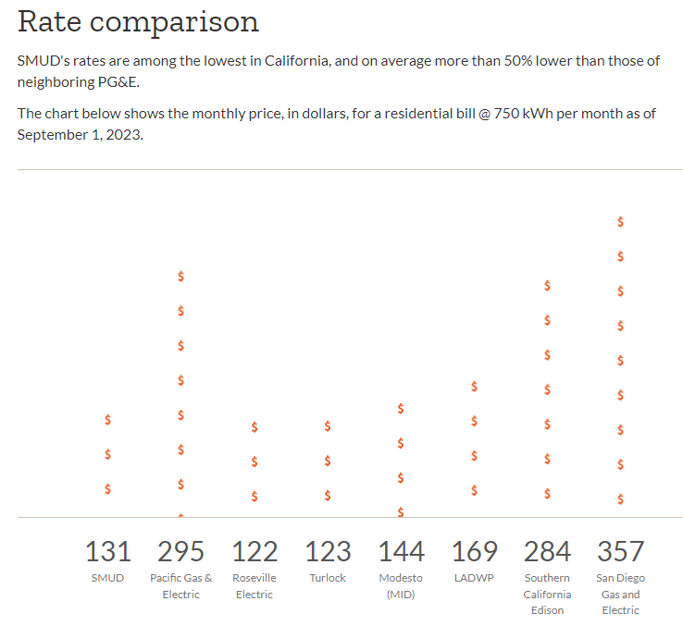
How much would a household using 750 kWh a month pay at PG&E versus other utilities in California?

Slide 5
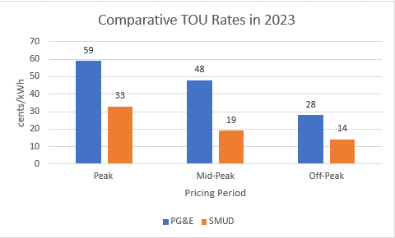
I compared SMUD’s three-period TOU rates with PG&E’s and was stunned

Slide 6
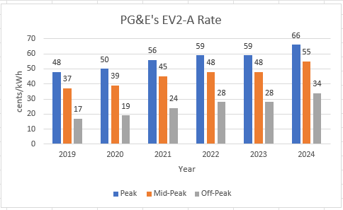
PG&E’s rates have been accelerating rapidly during the past five years, as seen below for the EV2-A rate – they constitute a Manhattan skyline

Slide 7
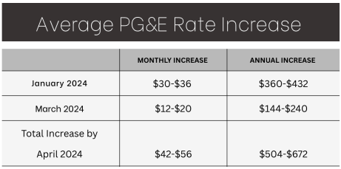
Monthly PG&E bills may rise by $56 by the end of April and $100 by year-end. Average electric rates may reach 45 cents/kWh, almost 3 times the US average of 16 cents/kWh

Slide 8
PG&E, along with the other two investor-owned utilities in the state, blamed its skyrocketing electric rates on the surge in rooftop solar installations
This was disingenuous, since California’s high rates predate the arrival of solar panels by more than two decades
Californians install solar panels to cope with skyrocketing rates, not the other way around
Furthermore, solar customers are more likely to install electric technologies such as heat pumps and electric vehicles (EVs)

Slide 9
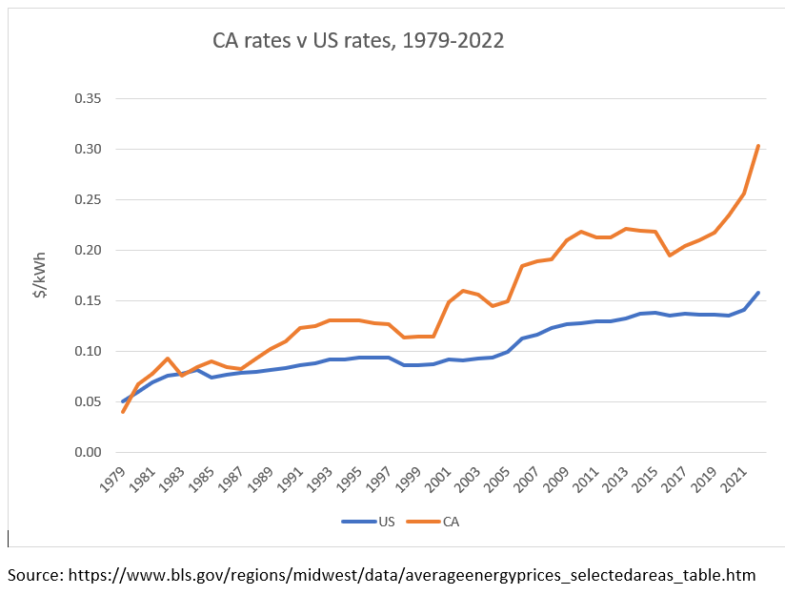
In the late 1980’s, California’s rates began their inexorable rise above the US average – the climb was accelerated after the energy crisis of 2000-01

Slide 10
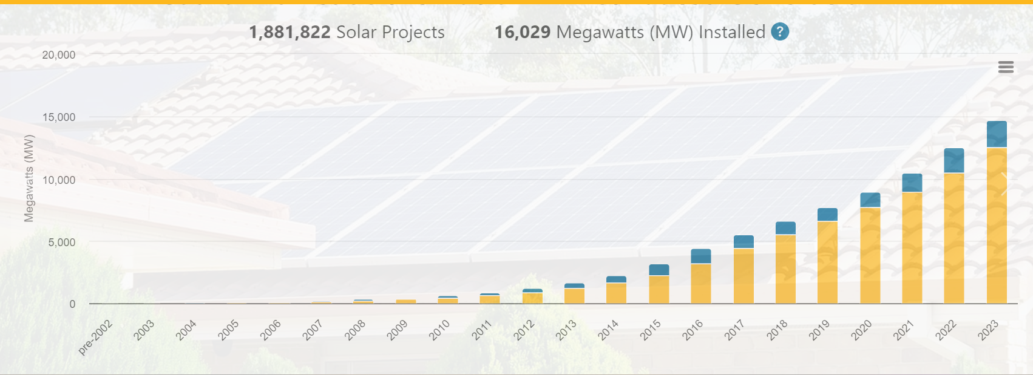
Rooftop solar panels did not begin to make their presence felt until more than 20 years later

Slide 11
The customer’s incentive to install rooftop solar panels was crippled when NEM 3.0 was activated
Compensation for exports was dropped by 75%, ostensibly to offset the cost-shift from solar to non-solar customers
The argument was specious since there are so many cost shifts in rate design between small and large customers, between apartments and single-family homes, between peaky and less peaky customers, and between rural and urban customers
Solar installations dropped by 80% in the following six months since roughly half of the savings come from exports and the payback period nearly doubled
Battery installations as a percent of solar installations rose but that did not make much of a difference
In one fell swoop, the best option to lower electric bills was taken away from customers
Instead of making solar+storage affordable to everyone, the CPUC made it unaffordable to all but the wealthy

Slide 12
Not content with implementing one bad solution, the state proposed a second bad solution, which is even worse since it applies to all customers, not just to new solar customers
PG&E, along with a few other parties, is proposing to change the structure of rates by lowering the energy charge and recovering the lost revenue through a fixed charge
Today, two of the three utilities have a zero dollar fixed charge while the third one has a fixed charge of just under a dollar --- the median is zero dollars
PG&E is proposing to levy a fixed charge of $53 a month, which is 5X the national median of $11 a month
To soften the impact on low income customers, it’s proposing to levy a lower charge on them, even though they already get a discount of 35% on their electric bill through the CARE program

Slide 13
Across 173 investor-owned utilities, the US median for fixed charges is under $11/month

Slide 14
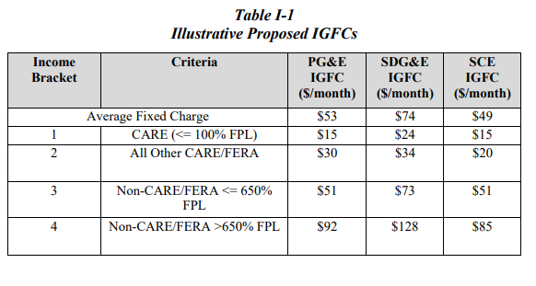
PG&E has proposed levying a fixed charge of $15/month for low income customers and $92/month for upper middle income customers, with an average of $53/month

Slide 15
PG&E’s proposal is totally out of line with fixed charges in the US and all their proposed fixed charges are dramatically higher than their current fixed charge of $0/month

Slide 16
There is no evidence IGFC will promote “affordable electrification”
Discounting energy charges and moving the “lost revenue” into fixed charges is just a shell game
Low-income customers who save money under IGFC will prioritize food, clothing and shelter over buying heat pumps or electric vehicles
Their bill savings won’t make for affordable electrification
Many of them are renters
Many don’t own cars

Slide 17
Ironically, IGFC will penalize efficiency and reward gluttony
Middle income customers whose bills are in the $50-150 range a month range will see their bills go up dramatically
Single individuals
Couples living in apartments
Families living in energy efficient homes
Homes with solar panels
Those who use a lot of energy will see their bills go down
The proposal will encourage the wasting of energy
This proposal is contrary to the state’s long-standing tradition of promoting energy efficiency

Slide 18
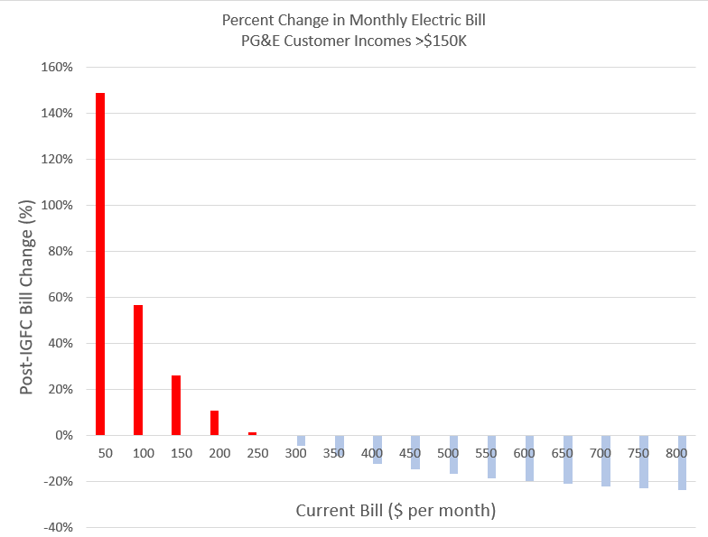
Frugal, efficient and green users with income > $150K will be hit really hard

Slide 19
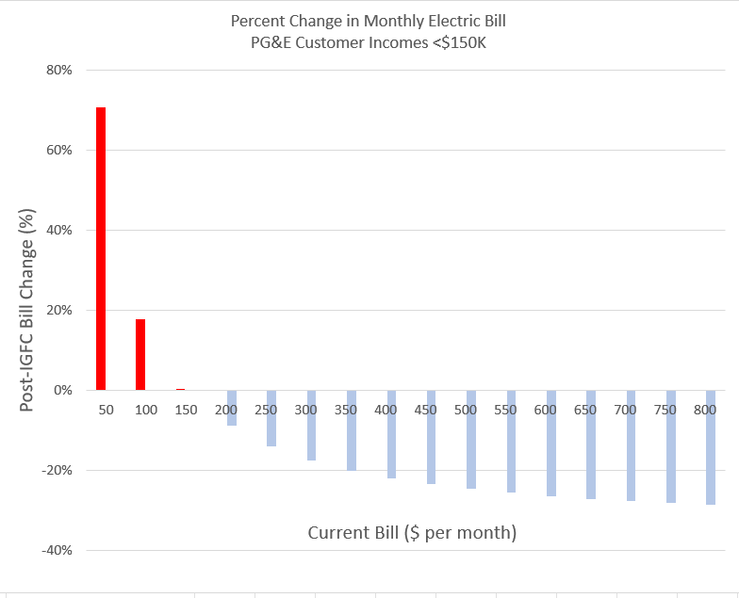
Frugal, efficient and green users with income < $150K but not low income customers will be hit hard

Slide 20
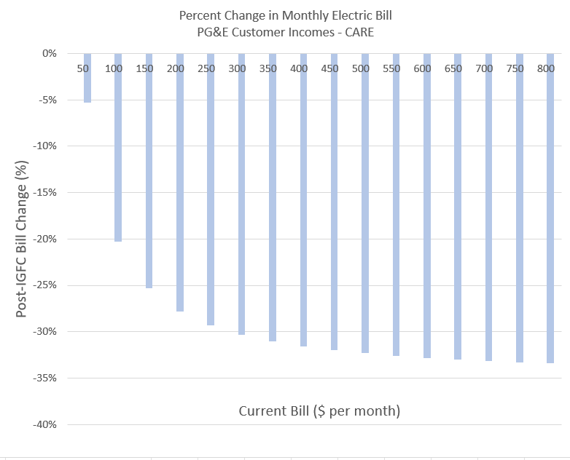
All low income (CARE) customers will see lower bills but larger users will see the greatest percent savings

Slide 21
Faced with unprecedented public opposition, the utilities have backtracked in the “first version” of IGFC
PG&E dropped the average fixed charge from $53 to $42, still 4X the US average
It dropped the upper tier fixed charge from $92 to $51, which is 5X the US average
The fixed charges in the “final version” have not been changed
The “first version” is meant to get the IGFC legitimized, and to open the door for implementing the original numbers in the “final version”
This is just a ruse and should be ignored

Slide 22
There is a better way to make electrification affordable
Cap the growth in electric rates to the rate of inflation
Find ways to lower cost and thus the rate level – as noted earlier, PG&E’s rates are almost three times the national average and more than two times SMUD’s rates
Offer low income customers additional rebates to offset the capital and installation costs of electrification technologies
Replace the IGFC with a better rate design, such as that outlined in the next slide

Slide 23
Here is a more efficient and equitable rate design for promoting electrification
First, include a modest fixed charge (~$10-15) and set the energy price equal to marginal cost. Let it vary by time of use. This rate design will help promote demand flexibility, which is the title of the proceedings in which the CPUC is discussing IGFC.
Second, only apply the new rate design to customers who are (a) in the market for replacing their HVAC system, water heater, stove, clothes dryer or gasoline car or (b) building a new house.
Third, even for customers who are in the market for new electric technologies, only apply the new rate design to the incremental use of electricity which will occur via electrification. In other words, don’t incentivize wasteful use of energy from existing technologies.

Slide 24
Conclusions
California has set some very strong goals for reducing carbon emissions and electrification has is a top priority
The biggest barrier to electrification is high electric rates
Merely shifting energy costs into fixed charges will not stimulate electrification and will end up raising bills for efficient customers who happen to be middle income
To make electrification affordable, the state needs more rooftop solar panels, not less; it should reconsider NEM 3.0
The state needs to abandon IGFC and focus instead on providing an opt-in rate that prices incremental uses of electricity associated with electrification at marginal energy cost

Slide 25
My articles on NEM 3.0
https://ahmadfaruqui.blogspot.com/2022/01/my-comments-on-cpucs-proposed-decision.html
https://ahmadfaruqui.blogspot.com/2022/01/letter-from-ten-energy-experts-to-cpuc.html
https://ahmadfaruqui.blogspot.com/2022/01/my-conversation-with-professor-severin.html
https://energycentral.com/c/cp/how-should-california-price-electricity-customers-rooftop-solar-panels
https://energycentral.com/c/cp/let%E2%80%99s-make-rooftop-solar-panels-paired-storage-affordable-all
https://pv-magazine-usa.com/2022/09/27/why-did-i-reform-my-views-on-net-energy-metering-nem/
https://www.pv-magazine.com/2022/12/08/regulator-could-prove-solars-nemesis/

Slide 26
My articles on IGFC
https://energyregulationquarterly.ca/articles/new-electricity-rate-reform-in-california-a-rejoinder-to-meredith-fowlie#sthash.PNMgM89u.dpbs
https://www.sandiegouniontribune.com/opinion/commentary/story/2023-06-21/opinion-cpuc-sdge-income-based-flat-energy-rates-california-conservation
https://www.ocregister.com/2023/12/18/whats-wrong-with-basing-electricity-fees-on-household-incomes/
https://pv-magazine-usa.com/2023/08/10/promoting-electrification-without-penalizing-efficiency-an-alternative-to-the-income-graduated-fixed-charge-proposal/
https://pv-magazine-usa.com/2023/05/08/the-income-graduated-fixed-charges-in-california-will-harm-customers-with-low-electric-bills/
https://energycentral.com/c/um/how-will-income-graduated-fixed-charges-igfc-proposed-california%E2%80%99s-investor-owned
https://www.latimes.com/opinion/letters-to-the-editor/story/2023-05-02/make-power-companies-test-their-fixed-rate-plan

Slide 27
References
https://www.sandiegouniontribune.com/business/story/2023-12-24/fixed-charges-on-utility-bills-based-on-your-income-an-update-on-what-the-fees-could-look-like
https://www.rstreet.org/commentary/income-based-utilities-plan-is-the-most-california-plan-ever/
https://www.siliconvalley.com/2023/04/22/pge-san-jose-oakland-bill-electric-customer-ratepayer-economy-utility/
https://www.sandiegouniontribune.com/business/story/2023-04-15/what-would-fixed-charges-on-electricity-bills-mean-for-rooftop-solar-customers
https://www.kpbs.org/news/economy/2023/04/10/sdg-e-proposes-adding-flat-fee-to-utility-bills
https://www.kpcc.org/podcast/airtalk/reflecting-on-former-los-angeles-mayor-richard-riordan-and-what-he-did-for-the-city
https://www.kpcc.org/podcast/airtalk/reflecting-on-former-los-angeles-mayor-richard-riordan-and-what-he-did-for-the-city
https://energycentral.com/c/um/public-speaks-income-graduated-fixed-charge-proposal-utilities

Slide 28

Presented By
Since 1978, I have assisted nearly 150 clients across the globe on energy issues involving the customer and testified or appeared before commissions in Alberta, Arizona, Arkansas, Australia, California, Colorado, Connecticut, Delaware, District of Columbia, FERC, Illinois, Indiana, Kansas, Maryland, Minnesota, Nevada, Ohio, Oklahoma, Ontario, Pennsylvania, New Brunswick, Nova Scotia, and Texas. I have also presented to governments in Australia, Egypt, Ireland, New Zealand Philippines, Thailand, Saudi Arabia, and United Kingdom.
I have worked at the California Energy Commission, Electric Power Research Institute, and five consulting firms. I am the recipient of a lifetime excellence award for my work on rate design by ESIG and have been recognized by AESP as one of seven game changers during the past three decades.
My work has been cited in Business Week, The Economist, Forbes, National Geographic, The New York Times, San Francisco Chronicle, San Jose Mercury News, Wall Street Journal and USA Today. I have appeared on Fox Business News, National Public Radio and Voice of America.
I have authored, co-authored or edited 4 books and more than 150 articles on energy matters and taught economics at the University of Karachi, UC Davis and San Jose State University and given guest lecturers at several other universities including Harvard, Northwestern, MIT, Stanford and UC Berkeley. I hold BA and MA degrees from the University of Karachi and an MA in agricultural economics and a PhD in economics from the University of California at Davis.
Ahmad Faruqui
Economist-at-Large
Ahmadfaruqui@gmail.com
+1.925.408.0149

