Slide 1

CA-Baseline
Pan Canadian Baseline Governance Group Discussion

Slide 2
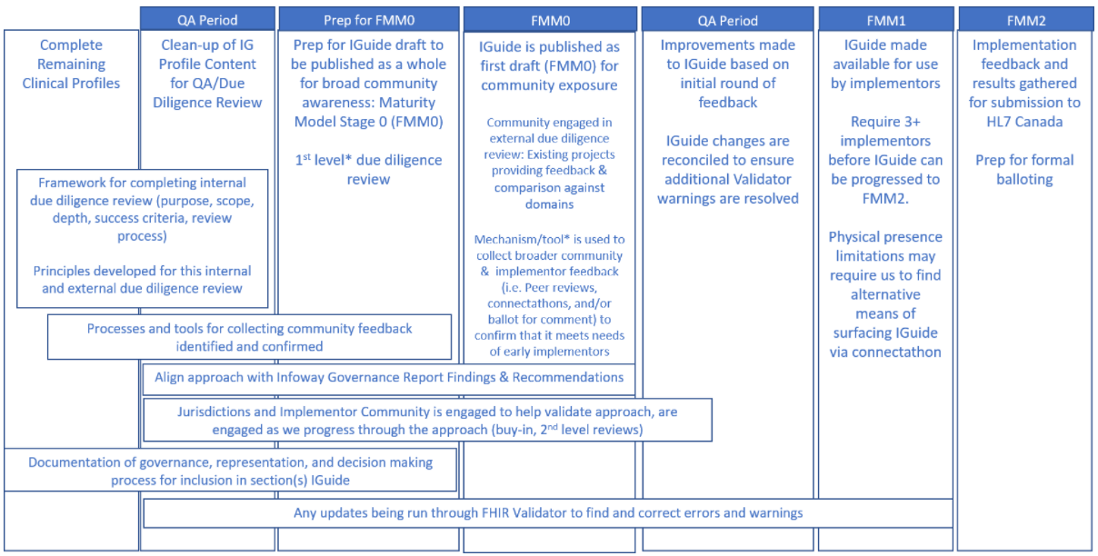
Where are we in our Baseline Maturity Roadmap?
We’re Here
Pan-Canadian Baseline Governance Group Created
to Drive Adoption of Baseline

Slide 3
Workstream Efforts to Help Establish Governance Group
Endorsements Collected
Jurisdictional and regional operational working groups
Federal Strategic Level Organizations agree to support: “secretariat roles”
Governance Group Terms of Reference & Adoption Milestones Established
Previously engaged Solution Vendors
Previously engaged Standards Organizations
Governance Group Commitment Confirmed
Endorsers collectively form partnership as co-owners
Governance Group Drives Adoption
Governance Group Maintains & Evolves Baseline
Efforts Identified by CA Baseline Workstream
Ways we might support:
Things like lessons learned, example terms of reference (CA Baseline terms of reference, HL7 v2/v3 ToR – if we can find them)
Governance group making decisions but will need the operational & technical support
SME community to answer questions/provide recommendations
Sketch in profile and guidance versioning policy recommendation (ex: “a change to value sets could be done as a future non-breaking change, guides that use previous value sets are still valid”)
Endorsement Activities Underway:
Alberta HISCA – HL7 Sub Committee
Ontario Health - Strategic Committee (SC) & Business & Technical Committee (BTC)
British Columbia HISWG & HISIG – BC FHIR Working Group

Slide 4
Boundaries with CA Baseline Governance Group
What is the CA Baseline Workstream Responsible for? Where do our boundaries begin and end with the governance group?
Are any of these CA Baseline Workstream Activities?
Responsibilities for the Governance Group
  Workstream might suggest options to consider
  Higher level responsibilities may already be defined
How will the group make decisions, how will it resolve conflicting opinions across jurisdictions
  Workstream might provide template example of terms of reference and point to supportive materials
Time/resource commitment
  Workstream could provide examples of what previous types of engagements have for engagement, but the terms of ref would be where commitment decided
Timelines for having prospective guides derive
  Timeline for when a Baseline of resource might be this level which means XYZ
  When governance says “ready” that infers the timeline for adoption
Decision about whether/how having previously published guides will be harmonized (unlikely to be in scope in terms of references)
  Governance group has to decide whether or not this happens at all or if it’s all going prospective
  Workstream may provide language in guide around encouraging harmonization
Tooling that should be used
  Workstream likely only recommending tools -
Decisions about Maintaining the Baseline: profiling versions, feedback process
  Handling of cases where the guide deriving reasonably needs to break a conformance rule - how do we handle?
Effort and interest to constrain further - is the Pan-Canadian group the group that wants to tackle the governance of the CA Core
How/does the CA Baseline workstream support the Pan Canadian Baseline Governance Group after the group is up and running?

Slide 5
CA-Baseline
A Starting Point for Canadian FHIR Implementation Guides

Slide 6
Who Are We?
FHIR Implementers Community
eReferral
InfoCentral Community
Community Streams
Canadian FHIR Baseline Profiles
~250 members to date
~100 distinct organizations from across the country
Representation across primarily Ontario, Alberta, Saskatchewan, British Columbia, Quebec, New Brunswick, Newfoundland, as well as Pan-Canadian groups
Notes:
We represent the Canadian FHIR Implementers Community, a grass-roots group of FHIR implementers and enthusiasts from across Canada
The FHIR Implementers Community has maintained several sub-working groups during its existence. Currently, the two prominent groups in operation are the eReferral Working Group and the Canadian FHIR Baseline Profiles Working Group

Slide 7











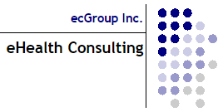

Who Participates?

Slide 8
What are the Limitations of the FHIR Base Specification?
FHIR Base Specification = “building blocks”, whose defined data elements are expected to be encountered in 80% of systems around the world
FHIR Base Specification intentionally avoids region-specific code systems & business rules (based on policy)
Expects implementations to constrain and extend the building blocks to meet their specific needs
Each implementor builds an Implementation Guides (IG) that uses those blocks to meet their needs
Starting from base specification is like starting from scratch each time
Lack of alignment between IGs operating in same countries and domains
We all need customization, but we aren’t leveraging each other’s efforts
FHIR Base Specification
IG
IG
IG
IG
IG
IG
IG
IG
IG
IG
IG
Notes:
The Canadian FHIR Baseline Profiles (CA Baseline for short) group is working on building and socializing its namesake: a set of FHIR Profiles which will serve as the starting point for all Canadian FHIR Implementation Guides going forward.
These FHIR Profiles possess constraints which are deemed to be common across the majority of Canadian FHIR-based workflows, and across jurisdictional boundaries.
The data elements which are included in a 'base' FHIR Resource are those which are considered relevant / useful to at least 80% of implementing systems; the 80-20 rule is the 'rule of thumb' for deciding 'what's in & what's out' of a FHIR Resource base list of elements (those that aren't relevant to at least 80% of systems are what have to be defined at the specific implementation level as 'extensions’
Reuse and Composability – FHIR resources are designed with the 80/20 rule in mind – focus on the 20% of requirements that satisfy 80% of the interoperability needs. To this end, resources are designed to meet the general or common data requirements of many use cases to avoid the proliferation of numerous, overlapping and redundant resources. Extension and customizations exist (see FHIR Profiles) to allow common, somewhat generic resources to be adopted and adapted as needed for specific use case requirements. In addition, FHIR resources are highly composable in that resources commonly refer to other resources. This further promotes reuse and allows for complex structures to be built from more atomic resources.
data elements are in the 80%: i.e. something that 80% of implementers will encounter and/or need - not 80% of the cases that occur to all implementers (this is about preventing work flow variations from complicating the model) -https://wiki.hl7.org/Authoring_FHIR_Resources#DesignConsiderations

Slide 9
What Are We Doing And Why?
Realm-specific guidance (i.e. Canadian Baseline)
Completed effort upfront to identify the basic constraints and extensions that any FHIR implementation operating in Canada can expect to include
Intended as a common starting point, not an out-of-the-box implementation
Convened Canadian implementers and Implementation Guide authors to develop initial draft over the last 18 months
Due diligence reviews against existing Canadian FHIR Implementation Guides to ensure alignment and appropriate scope maintained
Ready for the larger community to review it (which helps us refine the content to support the breadth of use cases in the Canadian realm)
FHIR Base Specification
Canadian Realm
IG
IG
IG
IG
IG
IG
US
Realm
IG
IG
IG
Notes:
The Canadian FHIR Baseline Profiles (CA Baseline for short) group is working on building and socializing its namesake: a set of FHIR Profiles which will serve as the starting point for all Canadian FHIR Implementation Guides going forward.
These FHIR Profiles possess constraints which are deemed to be common across the majority of Canadian FHIR-based workflows, and across jurisdictional boundaries.

Slide 10
What Are We Doing And Why?
HL7 FHIR
Canadian FHIR Baseline Profiles
Canadian FHIR Implementation Guide 1
Canadian FHIR Implementation Guide 2
Canadian FHIR Implementation Guide 3
Etc.
Canadian Baseline:
27 Profiles
(resources from the base specification constrained/extended for Canadian use)
Start Here
First step in reducing burdens on IGuide authors and unnecessary system customization across jurisdictions and healthcare domains
Notes:
The Canadian FHIR Baseline Profiles (CA Baseline for short) group is working on building and socializing its namesake: a set of FHIR Profiles which will serve as the starting point for all Canadian FHIR Implementation Guides going forward.
These FHIR Profiles possess constraints which are deemed to be common across the majority of Canadian FHIR-based workflows, and across jurisdictional boundaries.

Slide 11
Who are we Targeting and Why?
Federal, Provincial, Territorial (Strategic Level)
Broadly incorporate published standards in the tools/solutions
Standards Organization
Define policy and fund initiatives to improve data quality, reporting, and interoperable exchange
Clinical Organizations
FHIR Community Affiliates
Support health systems in meeting requirements
Contribute expertise to the refinement of standard
Use and extend standards to write IGuides
Enforce and support (fund) the implementation of programs/tools that meet requirements
Jurisdictional and Regional (Operational Level)
Health Systems
Solution Vendors
Implement tools/changes that meet requirements for program
Utilize IGuides to inform specific changes/development of tools
FHIR iGuide Authors/SMEs
Define requirements that are operationalized through implementation guides
Canadian Health Information Standards Ecosystem
Notes:
You are part of the diverse Pan-Canadian community that informs, drives, and enforces FHIR implementations in Canada
Complex levers/motivation, each member of the ecosystem contributes something that drives the adoption of FHIR
Community affiliates largely made up of organizations in this ecosystem contributing members to the community

Slide 12
What’s Our Ask Of You?
Solution Vendors
Federal, Provincial, Territorial (Strategic Level)
Jurisdictional and Regional (Operational Level)
Health Systems
Clinical Organizations
FHIR Community Affiliates
FHIR iGuide Authors / SMEs
Standards Organization
We are asking [Insert group name] to endorse the CA Baseline.
Statement of Endorsement:
We agree with the vision and benefits of the CA Baseline
You are part of the diverse Pan-Canadian community that informs, drives, and enforces FHIR implementations in Canada
We require iGuide authors under our purview to use the CA Baseline as a starting point for their profiles
We promote awareness of & participate in the refinement of the CA Baseline
We will contribute to the creation of a shared governance model for this work, that is co-owned across jurisdictions and chaired by a Pan-Canadian body
Notes:
Fundamentally, we are asking for you to declare that you agree with the vision and benefits of establishing a set of Canadian FHIR Baseline Profiles
As a Jurisdictional and Regional Group, our ask of you is as follows:

Slide 13
What’s In It For You?
Solution Vendors
Federal, Provincial, Territorial (Strategic Level)
Jurisdictional and Regional (Operational Level)
Health Systems
Clinical Organizations
FHIR Community Affiliates
FHIR iGuide Authors / SMEs
Standards Organization
Incorporation of the Baseline into our Canadian Ecosystem results in the following benefits for jurisdictional stakeholders:
Business Lens
Technical Lens
Increased reliability / quality of data & patient safety
Achieving front end & backend interoperability across vendors & jurisdictions more feasible
Canadian
Health Information
Standards
Ecosystem
Reduced effort/time for jurisdictional resources to generate Implementation Guides
Decreased need to customize vendor products for jurisdictional needs
Increased power & choice in procurement of vendors that support Canadian concepts
Helps alleviate discrepancies between jurisdictional data exchange workflows
Increased business opportunities and partnerships
Creation of conformance tools to support testing and compliance
Notes:
As a Jurisdictional and Regional Group, beyond the stakeholder-agnostic benefits of the CA Baseline here is what we feel you stand to gain by declaring yourself as an advocate of our work with the CA Baseline:
Publishing iGuides with a minimum set of common constraints reduces time taken to author net-new Guides & also primes participating iGuide Implementers for future Jurisdictional initiatives

Slide 14
What’s Next?
Immediate Next Steps:
Walkthrough of the CA Baseline materials with subcommittee/ technical team
Gain confirmation that [insert name here] endorses the CA Baseline and will support the asks identified in this proposal.
CA Baseline workstream will collect additional endorsements from the other stakeholders identified in the presentation
After Endorsements Collected:
Jurisdictional operational working group endorsements input into proposal for Federal Strategic Level organizations (e.g., Canada Institute for Health Information, Canada Health Infoway, etc.) to ask for:
  Support in the establishment of a formal governance model that is co-owned by jurisdictions and chaired by a Pan-Canadian body, to ensure the CA Baseline is adopted and maintained unilaterally
  Harmonization between the CA Baseline and strategic initiatives
  Acceptance of the CA Baseline as a foundation for a future more prescriptive / constraining specification (Core)
  Tooling to support conformance testing and adherence to the CA Baseline Profiles (profile validators, sandbox environment, etc.)
Notes:
We are hoping the prospect of a pan-Canadian set of FHIR Baseline Profiles resonates with you. As we continue to seek pan-Canadian sponsorship, we would like to be able to include your organization name and logo in our growing list of CA Baseline advocates.

