Slide 1
Sex and Gender Working Group
Monthly Tuesday Zoom Meeting
September 28, 2021 at 9am PT / 12pm ET
Kelly Davison RN, CTSS, Canada Health Infoway
Karen Courtney RN, PhD, University of Victoria
Francis Lau PhD, CTSS University of Victoria

Slide 2
Agenda
Welcome and Acknowledgement
Purpose of Infoway Sex and Gender Working Group
Margaret Robinson, Dalhousie University – Two-Spirit Identity in a Time of Gender Fluidity
Group Discussion and/or Questions
Update – Karen Courtney – UVIC – MSFHR REACH Grant, Policy & Practice Meeting
Update – Karen Courtney – UVIC – MSFHR REACH Grant, Meeting Plan
Schedule and Topics Review
SNOMED CT – Francis Lau – Proposed Changes Update
Adjournment

Slide 3
Welcome and Acknowledgement
We respectfully acknowledge that the land on which we are hosting this meeting – the land that sustains us – includes the ancestral territories of many First Peoples. Canada Health Infoway recognizes the colonial injustices experienced by Indigenous Peoples, many of which continue today and continue to affect their health and well-being. I invite all attendees to reflect on the privilege they have of living, working and playing in the territory from which you are joining this call, and invite you to commit yourself with me to having an open heart and an open mind; to forging culturally safe spaces for and relationships with Indigenous People including Two-Spirit people in Canadian health care; and in making a meaningful contribution to reconciliation through our shared work.

Slide 4
Purpose
Sex and Gender Working Group meeting every fourth Tuesday of month. Our next meeting is October 26th, 2021 at 9am PT/12pm ET.
Bring your knowledge and experience to this working group to develop an implementation strategy to modernize sex and gender information practices in EHR systems in Canada. In this WG we will:
Examine expanded definition, collection, use and sharing of sex-gender info in EHRs
Discuss current research, practices, gaps and challenges
Work to operationalize the Action Plan
Notes:
The logo can be changed in the master slides. Please use the following instructions
Select view > slide master.
Right click on the logo and select change picture.
Select the image you want to use you may need to scale the image accordingly
When you're done, select close master view.

Slide 5
Agenda
Welcome and Acknowledgement
Purpose of Infoway Sex and Gender Working Group
Margaret Robinson, Dalhousie University – Two-Spirit Identity in a Time of Gender Fluidity
Group Discussion and/or Questions
Update – Karen Courtney – UVIC – MSFHR REACH Grant, Policy & Practice Meeting
Update – Karen Courtney – UVIC – MSFHR REACH Grant, Meeting Plan
Schedule and Topics Review
SNOMED CT – Francis Lau – Proposed Changes Update
Adjournment

Slide 6
Citation
Robinson M. (2020). Two-Spirit Identity in a Time of Gender Fluidity. Journal of homosexuality, 67(12), 1675–1690. https://doi.org/10.1080/00918369.2019.1613853

Slide 7
Agenda
Welcome and Acknowledgement
Purpose of Infoway Sex and Gender Working Group
Margaret Robinson, Dalhousie University – Two-Spirit Identity in a Time of Gender Fluidity
Group Discussion and/or Questions
Update – Karen Courtney – UVIC – MSFHR REACH Grant, Policy & Practice Meeting
Update – Karen Courtney – UVIC – MSFHR REACH Grant, Meeting Plan
Schedule and Topics Review
SNOMED CT – Francis Lau – Proposed Changes Update
Adjournment

Slide 8
Agenda
Welcome and Acknowledgement
Purpose of Infoway Sex and Gender Working Group
Margaret Robinson, Dalhousie University – Two-Spirit Identity in a Time of Gender Fluidity
Group Discussion and/or Questions
Update – Karen Courtney – UVIC – MSFHR REACH Grant, Policy & Practice Meeting
Update – Karen Courtney – UVIC – MSFHR REACH Grant, Meeting Plan
Schedule and Topics Review
SNOMED CT – Francis Lau – Proposed Changes Update
Adjournment

Slide 9
MSFHR REACH Grant, Policy & Practice Meeting
Sept 14
  Questions posed:
    Why is this information being collected?
    What information should be collected?
    How can information be collected?
    Who should have access to this information?
    How should information be displayed?

Slide 10
What information should be collected across different settings? – In Progress
GSSO Information | Intake | Registration | Clinical Encounter | Prescription | Laboratory | Imaging | Referral | Billing | Research
Gender Identity | Optional | Optional | Yes | Yes | Yes | Yes | PRN |  | Optional
Admin Gender/Sex |  | PRN* | PRN* |  | PRN* |  |  | PRN* | Optional
Admin / Legal Name |  | Yes | Yes | Yes | Yes | Yes | Yes | Yes
Name Used | Yes | Yes | Yes | Yes | Yes | Yes | Yes
Pronouns Used | Optional | Yes | Yes | Yes | Yes | Yes | Yes |  | Optional
Sex Assigned at Birth |  | Optional |  |  |  |  |  |  | Optional
Anatomical Inventory |  |  | PRN |  |  | PRN | PRN |  | Optional
Hormone medication inventory |  |  | PRN |  | Yes |  | PRN |  | Optional
Hormone reference ranges |  |  |  |  | PRN/Yes |  |  |  | Optional
Direct Source: Trans Care BC , 2020c
Notes:
What are your thoughts on what information should be collected across different settings?

Slide 11
MSFHR REACH Grant, Policy & Practice Meeting
Oct 12 – Part 2
  Questions posed:
    Why is this information being collected?
    What information should be collected?
    How can information be collected?
    Who should have access to this information?
    How should information be displayed?

Slide 12
Agenda
Welcome and Acknowledgement
Purpose of Infoway Sex and Gender Working Group
Margaret Robinson, Dalhousie University – Two-Spirit Identity in a Time of Gender Fluidity
Group Discussion and/or Questions
Update – Karen Courtney – UVIC – MSFHR REACH Grant, Policy & Practice Meeting
Update – Karen Courtney – UVIC – MSFHR REACH Grant, Meeting Plan
Schedule and Topics Review
SNOMED CT – Francis Lau – Proposed Changes Update
Adjournment

Slide 13
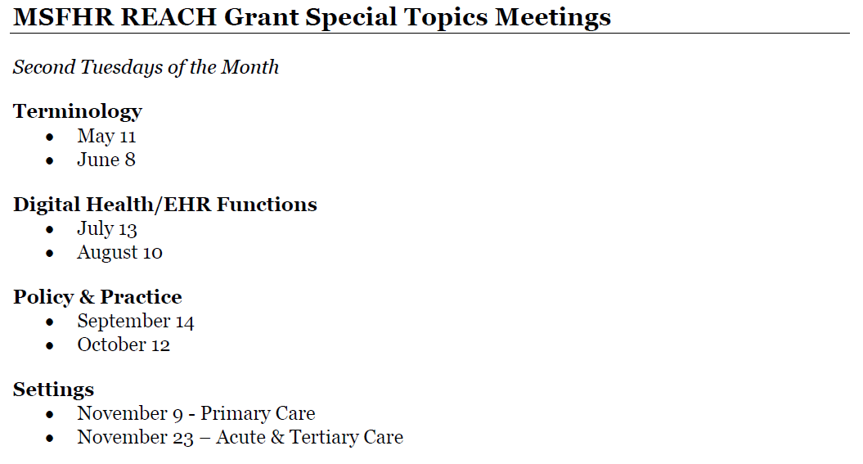
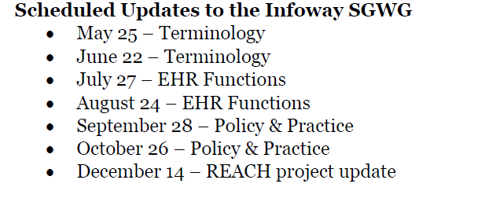
Second Tuesdays of the Month
Fourth Tuesdays of the Month

Slide 14
One-time registration for REACH special topics meetings
You may register for the REACH sessions at: https://uvic.zoom.us/meeting/register/tZ0ud--gqDMrE9z6A80wG8lIuEBBt7omvhVs

Slide 15
Agenda
Welcome and Acknowledgement
Purpose of Infoway Sex and Gender Working Group
Margaret Robinson, Dalhousie University – Two-Spirit Identity in a Time of Gender Fluidity
Group Discussion and/or Questions
Update – Karen Courtney – UVIC – MSFHR REACH Grant, Policy & Practice Meeting
Update – Karen Courtney – UVIC – MSFHR REACH Grant, Meeting Plan
Schedule and Topics Review
SNOMED CT – Francis Lau – Proposed Changes Update
Adjournment

Slide 16
Schedule and Topics Review
Session | Infoway SGWG Meetings 4th Tuesday Each Month
Jan 26 Feb 23 Mar 23 Apr 27 May 25 Jun 22 Jul 27 Aug 24 Sep 28 Oct 26 Nov 23 Dec 14 | Francis Lau, UVic – Recap and Next Steps Fernand Comeau, LGBTQ2 Secretariat – LGBT Action Plan France-Pascale Ménard and Elena Prokopenko – StatCan, Centre for Gender, Diversity and Inclusion Studies Sidsel Pedersen, SAIT – Sex, Identity, Gender, Expression Form- Pilot Project Amédé Gogovor, Université Laval (Laval University) – Sex and Gender Considerations in Knowledge Translation Interventions Alex Abramovich, University of Toronto – Investigating Health Outcomes and Health Service Use Among Transgender Individuals in Ontario Erin Ziegler, Ryerson University – Primary Care for Transgender Individuals: Literature Review, a Canadian Perspective Clair Kronk, University of Cincinnati School of Medicine – Modeling and Operationalizing Gender, Sex, and Sexual Orientation: Recommendations and Future Directions Marian Luctkar-Flude, Queen’s University School of Nursing and Erin Ziegler, Ryerson University – Developing a Sexual Orientation and Gender Identity Nursing Education Toolkit Tehmina Ahmad, University of Toronto – The case for a Canadian standard for 2SLGBTQIA+ medical education Margaret Robinson, Dalhousie University – Two-Spirit Identity in a Time of Gender Fluidity Robert McClure and Robert Horn, HL7 International – Gender Harmony Project Informative Ballot See MSFHR Schedule See MSFHR Schedule

Slide 17
Schedule and Topics Review …cont’d
Session | MSFHR REACH KT Grant Special Topics Meetings 2nd Tuesday Each Month
May 11 Jun 8 Jul 13 Aug 10 Sept 14 Oct 12 Nov 9 Nov 23 Dec 14 | Francis Lau – UVIC – MSFHR REACH Grant, Special Topics Meeting #1 - Terminology Francis Lau – UVIC – MSFHR REACH Grant, Special Topics Meeting #2 - Terminology Francis Lau – UVIC – MSFHR REACH Grant, Special Topics Meeting #3 - Digital Health/EHR Functions Francis Lau – UVIC – MSFHR REACH Grant, Special Topics Meeting #4 - Digital Health/EHR Functions Marcy Antonio & Kelly Davison – UVIC – MSFHR REACH Grant, Special Topics Meeting #5 - Policy & Practice Marcy Antonio & Kelly Davison – UVIC – MSFHR REACH Grant, Special Topics Meeting #6 - Policy & Practice Karen Courtney & Kelly Davison – UVIC – MSFHR REACH Grant, Special Topics Meeting #7 - Settings – Primary Care Kelly Davison – UVIC – MSFHR REACH Grant, Special Topics Meeting #8 - Settings – Acute & Tertiary Care Karen Courtney – UVIC – MSFHR REACH Grant, Special Topics Meeting #9 - REACH Project Update

Slide 18
Agenda
Welcome and Acknowledgement
Purpose of Infoway Sex and Gender Working Group
Margaret Robinson, Dalhousie University – Two-Spirit Identity in a Time of Gender Fluidity
Group Discussion and/or Questions
Update – Karen Courtney – UVIC – MSFHR REACH Grant, Policy & Practice Meeting
Update – Karen Courtney – UVIC – MSFHR REACH Grant, Meeting Plan
Schedule and Topics Review
SNOMED CT – Francis Lau – Proposed Changes Update
Adjournment

Slide 19
Agenda
Welcome and Acknowledgement
Purpose of Infoway Sex and Gender Working Group
Margaret Robinson, Dalhousie University – Two-Spirit Identity in a Time of Gender Fluidity
Group Discussion and/or Questions
Update – Karen Courtney – UVIC – MSFHR REACH Grant, Policy & Practice Meeting
Update – Karen Courtney – UVIC – MSFHR REACH Grant, Meeting Plan
Schedule and Topics Review
SNOMED CT – Francis Lau – Proposed Changes Update
Adjournment

Slide 20
Thank you!
kdavison@infoway-inforoute.ca

