Slide 1

Social Determinants of Health Working Group
Monthly SDOH Working Group Zoom Meeting
Apr 8, 2026- 10 am PT; 11 am MT 1 pm ET
Facilitated by Jennifer Lawson and Brooke Harvey

Slide 2

Land acknowledgement
We would like to acknowledge the lands we occupy, including those that are treaty or unceded. We recognize that these lands are home to many diverse First Nations, Inuit, and Métis Peoples.
Notes:
I am joining this meeting from the lands of the Mississauga, Haudenosaunee, Attawandaron people, which includes the Six Nations of the Grand River and the Mississaugas of the Credit First Nation.

Slide 3
Recording is starting
REC

Slide 4
Agenda
Overview of SDOH Assessment Data elements and value sets
Changes planned for DCS v2 – v3
New Data elements
Shifted, removed Data elements
Social care Arc: Housing
Social care Arc: Food

Slide 5
Food Security Definition
Household Food Security Survey Module (HFSSM)
Questions measuring food insecurity resulting from limited financial resources
SPARK Tool
Food not lasting & worries about food running out before more could be bought
Gravity: Food Insecurity
Uncertain, limited, or unstable access to food that is: adequate in quantity and in nutritional quality; culturally acceptable; safe and acquired in socially acceptable ways
AUCDI & OpenEHR: Food and nutrition summary – Food security status
Assessment of reliable and consistent access to sufficient, affordable, nutritious, culturally suitable, safe food

Slide 6
Housing Stability Definition
Canadian Housing and Mortgage Association (CMHA): Finance, Research, Funding; research and lit review; delivering housing programs for the Government of Canada
SPARK Tool
Food not lasting & worries about food running out before more could be bought
Gravity: Food Insecurity
Uncertain, limited, or unstable access to food that is: adequate in quantity and in nutritional quality; culturally acceptable; safe and acquired in socially acceptable ways
AUCDI & OpenEHR: Food and nutrition summary – Food security status
Assessment of reliable and consistent access to sufficient, affordable, nutritious, culturally suitable, safe food

Slide 7
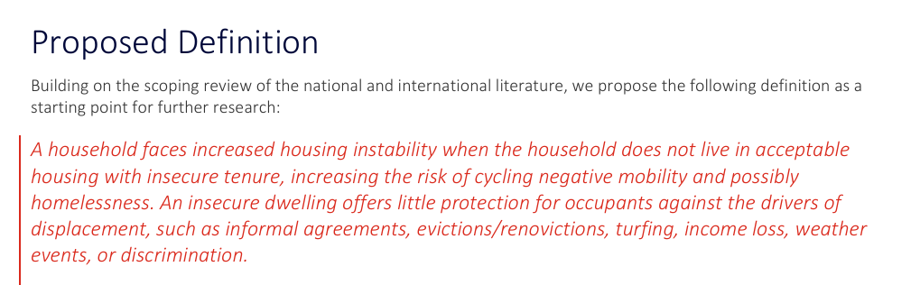
Housing Instability Definition
Lit review to examine housing precariousness and instability
little consensus on a definition of housing in/stability in a Canadian and international context
analysis reveals the complexity of factors involved in housing in/stability
those of low- or fixed-income levels, experience household moves more often
compounding effects of tenure, affordability, and housing adequacy
Ref: Housing instability: Observations in Canada https://assets.cmhc-schl.gc.ca/sf/project/archive/research_6/stability-final.pdf

Slide 8
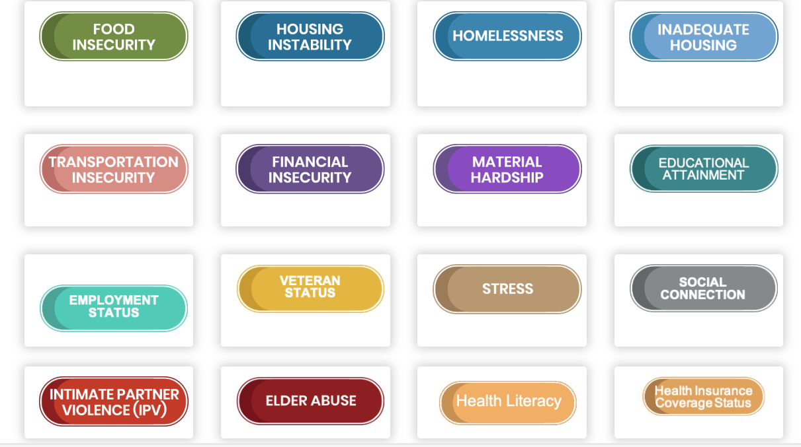
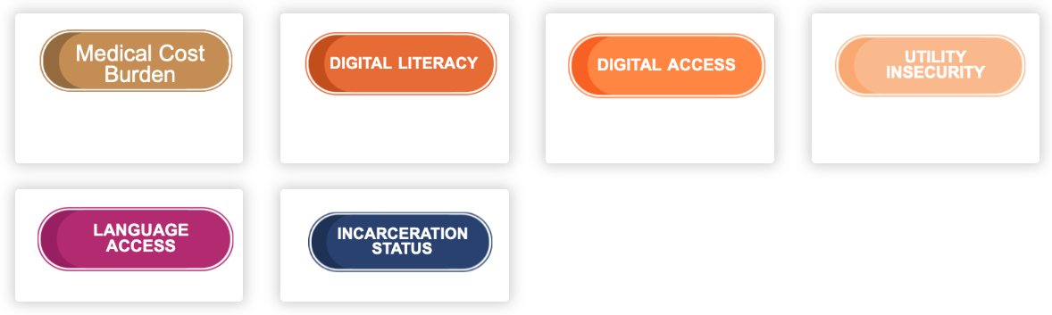
Gravity Domains
Gravity Project:
A collaborative public-private initiative launched in May 2019 with the goal to develop consensus-driven data standards to support the collection, use, and exchange of data to address the social determinants of health (SDOH).
Gravity Goal:
Build and promulgate* consensus driven social determinants of health (SDOH) data standards for health and social care interoperability and use among multi-stakeholders
*to make (an idea, belief, etc.) known to many people by open declaration : proclaim

Slide 9
Housing Instability Definition
Gr
Ref: Housing instability: Observations in Canada https://assets.cmhc-schl.gc.ca/sf/project/archive/research_6/stability-final.pdf

Slide 10
Food Security Definition
Clapp, J., et al., 2022. Viewpoint: the case for a six-dimensional food security framework. Food Policy 106, 102164
Dimension | Definition
Availability | Sufficient quantity and quality of safe, nutritious, culturally acceptable food are available, supplied via domestic production or imports.
Access | Having financial means to acquire food for an adequate diet; and that adequate food is accessible to everyone (economic, social and physical)
Utilization | Having an adequate diet, clean water, sanitation and health care for nutritional well-being where all physiological needs are met.
Stability | Having the ability to ensure food security in the event of sudden shocks (e.g. an economic, health, conflict or climatic crisis) or cyclical events (e.g. seasonal food insecurity).
Agency | Having the capacity to act independently to make choices about what they eat, the foods they produce, how that food is produced, processed, and distributed
Sustainability | Ensuring the food needs of the present generations are met without compromising the food needs of future generations.

Slide 11
Food Security Definition

Slide 12
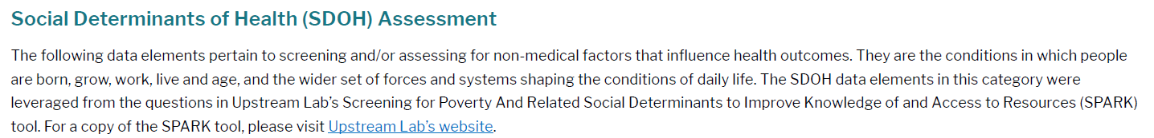
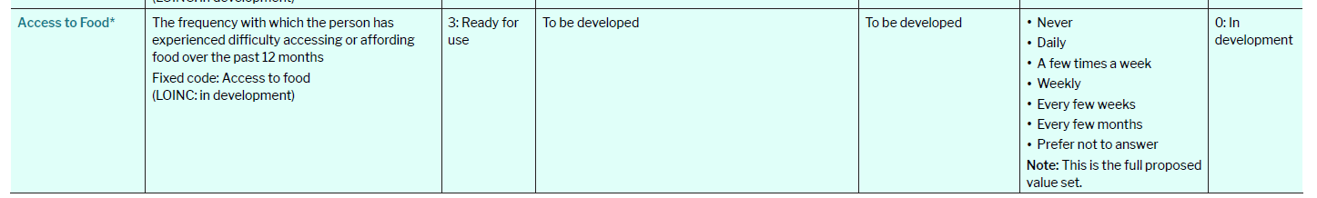
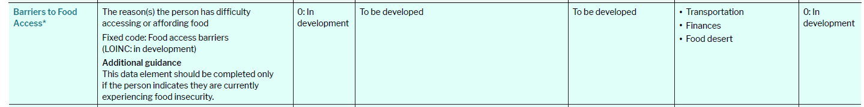
PCHDCF Data Content Standard V2 Food Security
Open Review: Create capacity for embedded links in an EMR re food banks etc. so providers can easily share information via EMR.

Slide 13
Data Standard for Social Care
Person Information
Data Content Standard v2
Sociodemographic attributes
Social Determinants of Health (SDOH)
NEW: Data Content Standard v3 work
SDOH Standardized Screening & Other Assessment
Data Content Standard v2
Gravity and USCDI framing
SDOH Patient Goals
* New: reflects Whole person care: Characteristics or strengths of individuals, families, communities or societies that act to mitigate risks an promote positive well-being and healthy development
SDOH Diagnoses/Assessed Needs & Protective Factors*
SDOH Interventions: Procedures and Programs*
Important to Social Prescribing and Referral to community and social services

Slide 14
Social Arc: Housing and Food

Slide 15
Social Arc Components
Screening and Assessment
Identifed Social Need
Patient Goals
Interventions

Slide 16
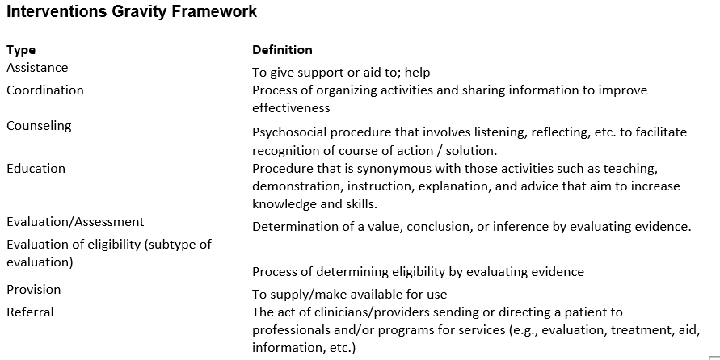
Social Arc: Interventions

Slide 17
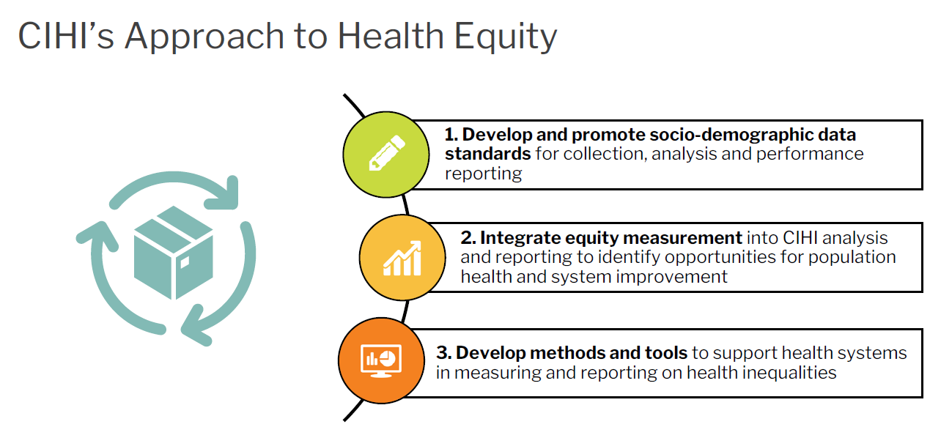

Slide 18
Determining food security status - Canada.ca
Household Food Security Survey Module (HFSSM)
Incorporated into the annual Canadian Income Survey in 2019 (2018 reference year).
Canada’s primary validated measure of food insecurity.
Contains 18 questions designed to measure food insecurity resulting from limited financial resources.
Asks about the household’s experiences of food insecurity during the previous year for both adults and children. These experiences include:
worrying about running out of food before there is money to buy more
cutting the size or skipping meals because there wasn’t enough money for food
going a whole day without eating because there wasn’t enough money for food
Households can be classified into one of the 4 following categories:
food secure
food insecure, marginal
food insecure, moderate
food insecure, severe
Note: The categories of “food insecure, moderate” and “food insecure, severe” have been combined into an overall category of “food insecure” as they reflect disruptions in the food consumed.

Slide 19
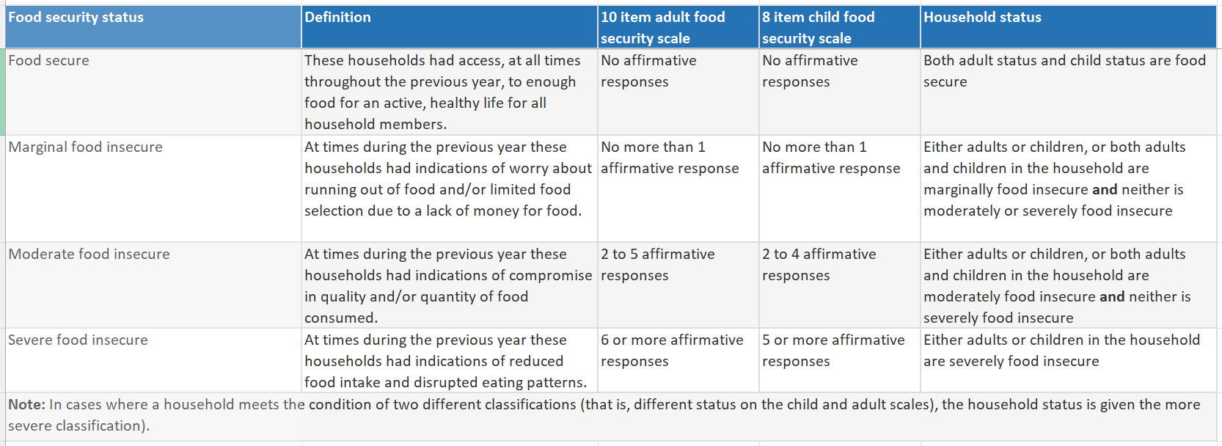
Household Food Security Survey Module (HFSSM)

Slide 20

Main Finding: In 2018, 11.5% of people lived in households that experienced moderate or severe food insecurity. This rate decreased to 10.6% in 2019. In 2019, 7.4% lived in moderately food insecure households, while 3.2% lived in severely food insecure households.
Ref: Canadian Income Survey: Food insecurity and unmet health care needs, 2018 and 2019

Slide 21
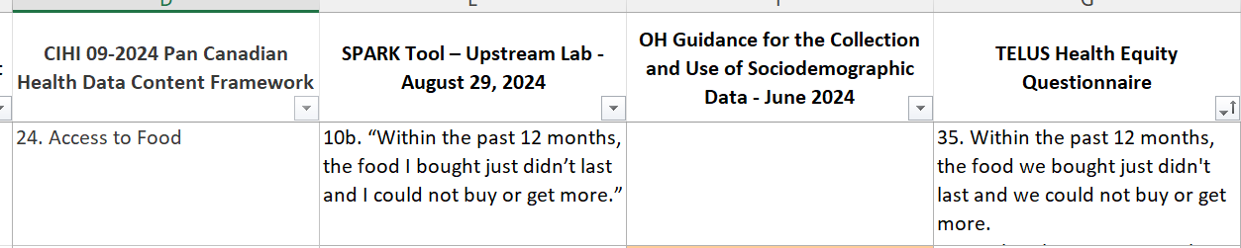
Food Access/Security Screening Questions from published Surveys
Pan-Canadian Health Data Content Framework (PCHDCF): Data Content Standard
Upstream Lab's SPARK Tool August 29, 2024
Ontario Health's Guidance for the Collection and Use of Sociodemographic Data for Equity Analytics June 2024
Alliance for Healthier Communities' TELUS Health Equity Questionnaire
These all largely derive from the Ask Because We Care Survey We-Ask-Because-We-Care-Report.pdf
We Ask Because We Care: Health Equity Data Collection at Sunnybrook - Sunnybrook Health Sciences Centre

Slide 22
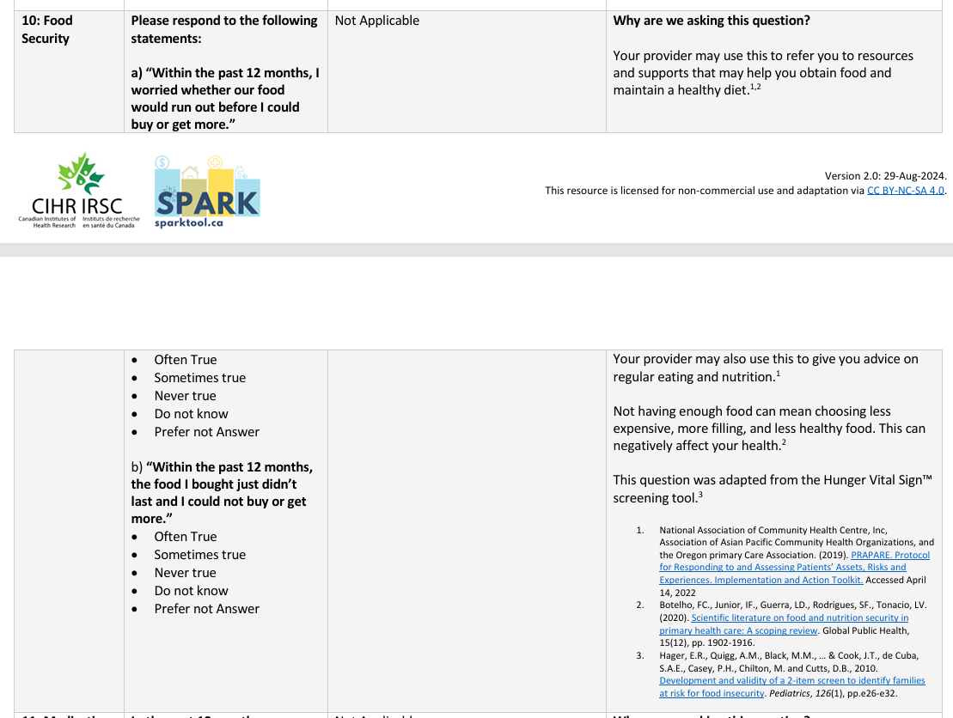
SPARK Tool

Slide 23
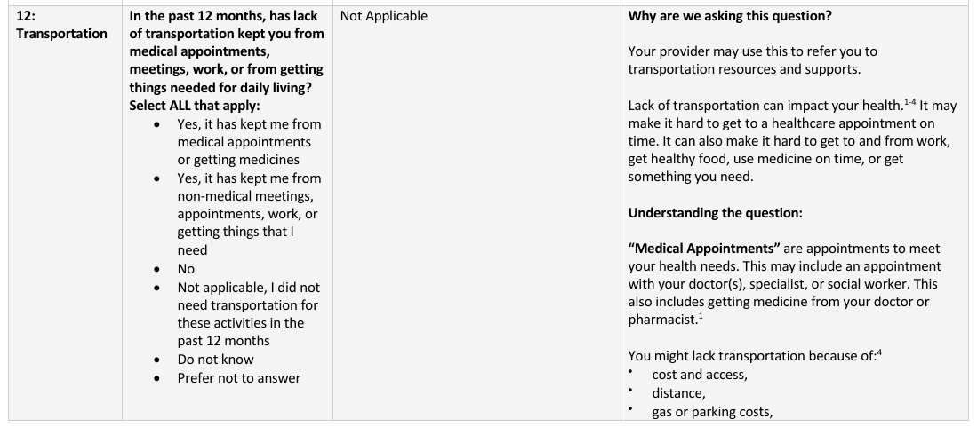
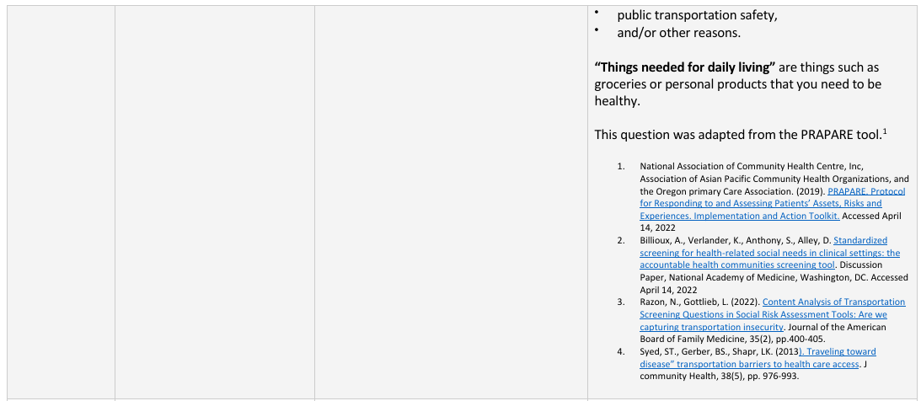
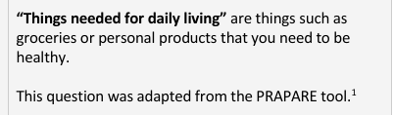
SPARK Tool Transportation

Slide 24
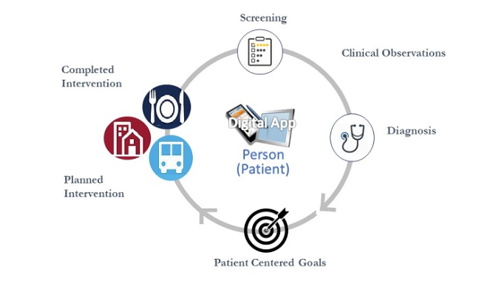
Gravity’s Conceptual Framework

Slide 25
Gravity Domains
Gravity Project:
A collaborative public-private initiative launched in May 2019 with the goal to develop consensus-driven data standards to support the collection, use, and exchange of data to address the social determinants of health (SDOH).
Gravity Goal:
Build and promulgate* consensus driven social determinants of health (SDOH) data standards for health and social care interoperability and use among multi-stakeholders
*to make (an idea, belief, etc.) known to many people by open declaration : proclaim

Slide 26
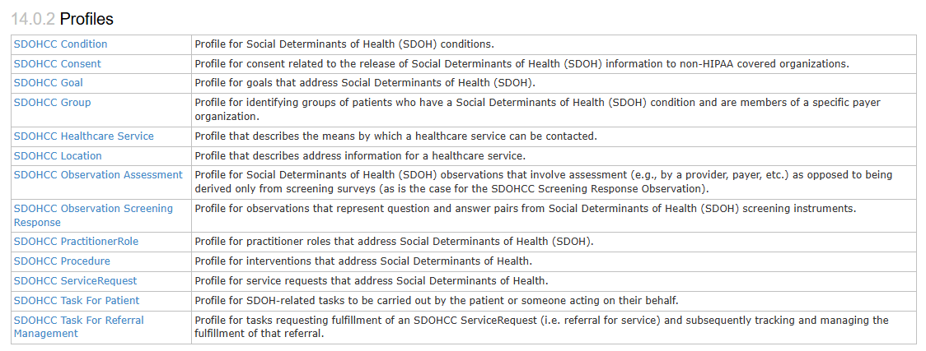
Gravity Technical Stream: SDOH Clinical Care FHIR Implementation Guide
IG Home - SDOH Clinical Care v2.3.0

Slide 27
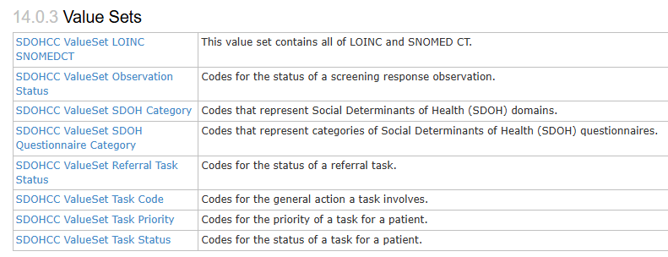
Gravity Technical Stream: SDOH Clinical Care FHIR Implementation Guide
Ref: IG Home - SDOH Clinical Care v2.3.0

Slide 28
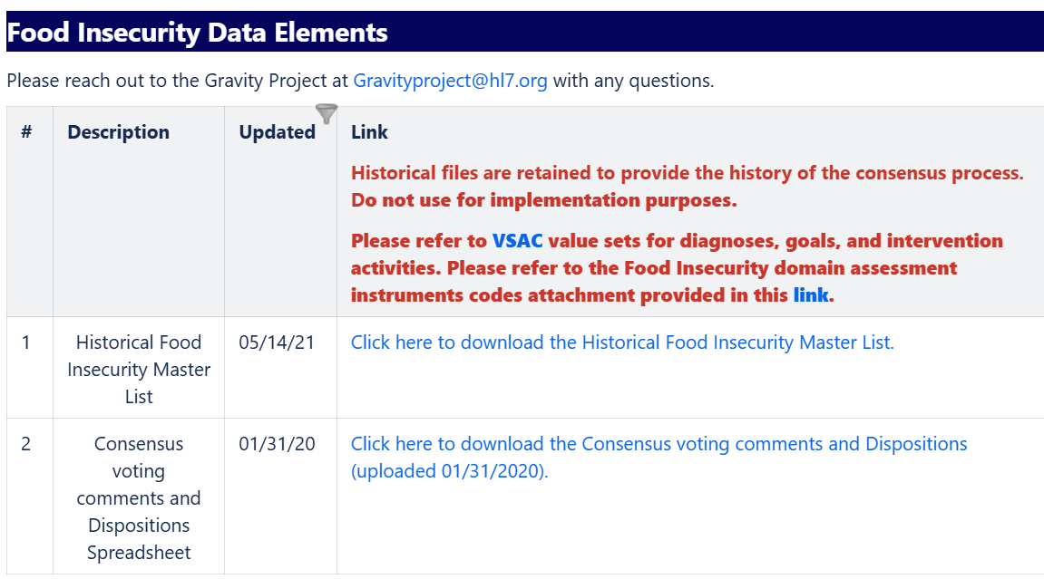
Gravity: Food Insecurity
Definition: Uncertain, limited, or unstable access to food that is: adequate in quantity and in nutritional quality; culturally acceptable; safe and acquired in socially acceptable ways
Confluence Page: Food Insecurity - Gravity Project – Confluence

Slide 29
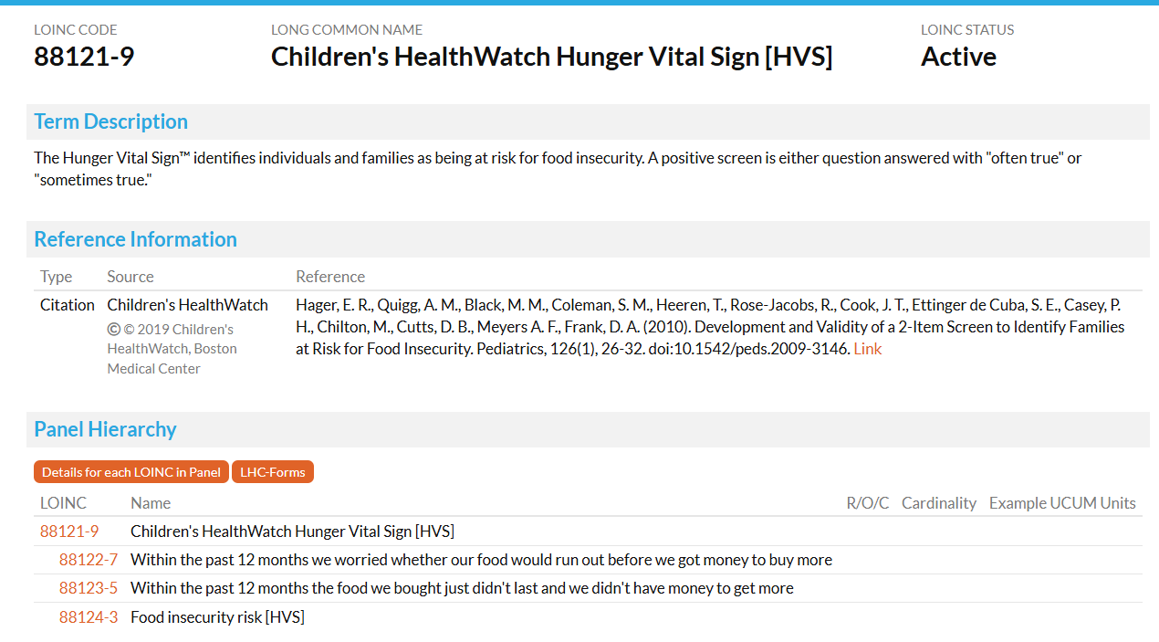
Gravity Food Insecurity: Screening and Assessment

Slide 30
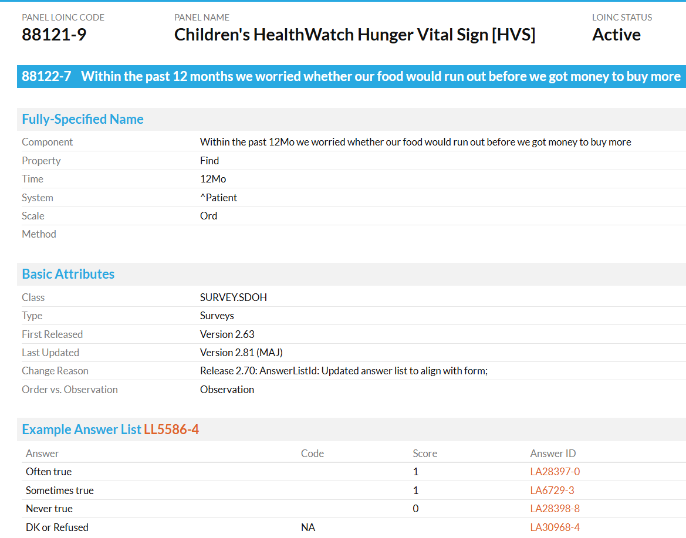
Gravity Food Insecurity: Screening and Assessment

Slide 31
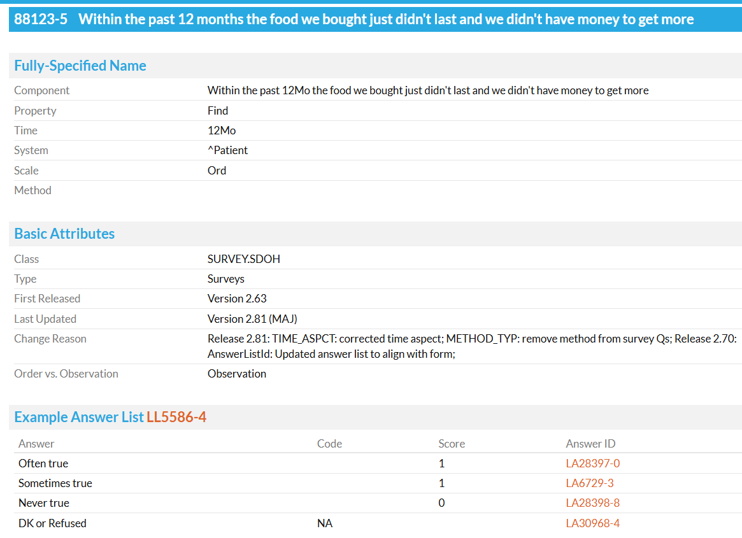
Gravity Food Insecurity: Screening and Assessment

Slide 32
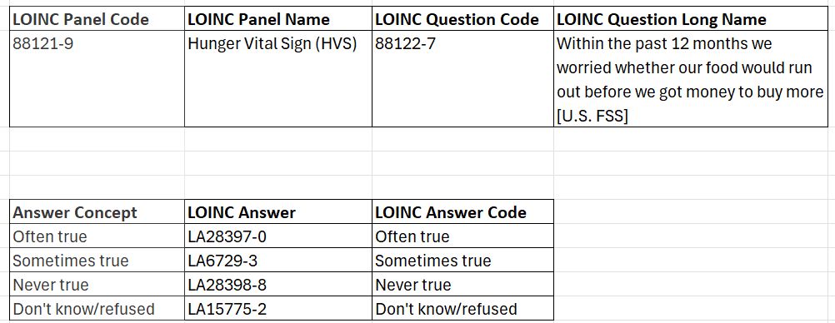
Gravity Food Insecurity: Screening and Assessment
Reference: 05142021 Food Insecurity MASTER
Food Insecurity - Gravity Project - Confluence

Slide 33
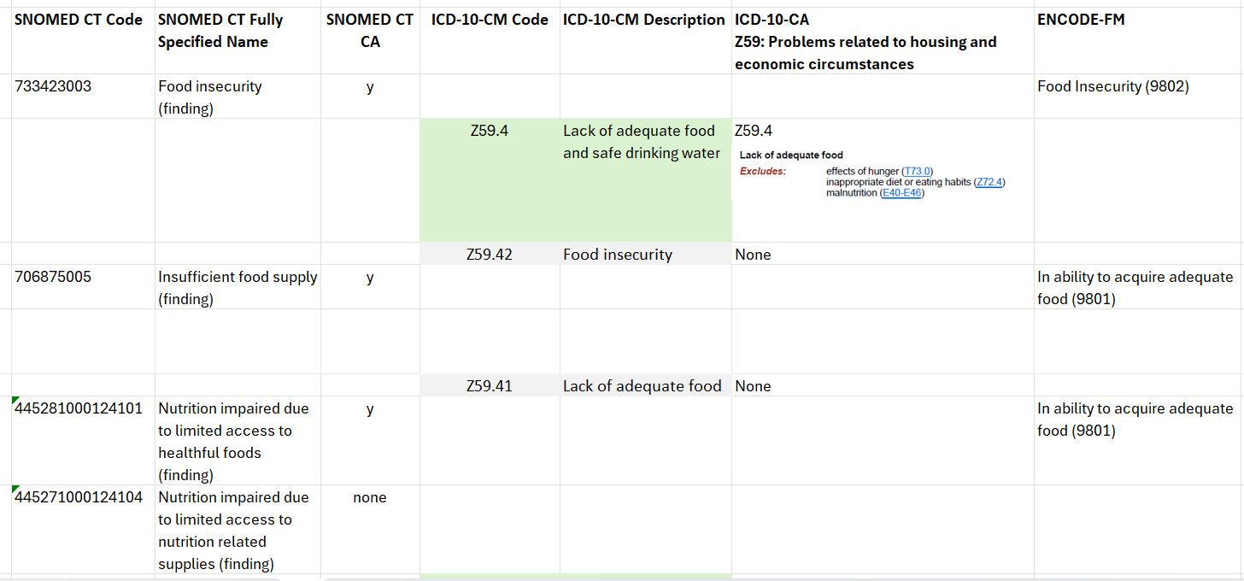
Gravity Food Insecurity: Diagnosis and Assessed Need
Current
Proposed

Slide 34
Gravity: Interventions
Counseling
441271000124102 Counseling about nutrition using goal setting strategy (procedure)
441281000124104 Counseling about nutrition using self-monitoring strategy (procedure)
441291000124101 Counseling about nutrition using problem solving strategy (procedure)
441301000124100 Counseling about nutrition using social support strategy (procedure)
441311000124102 Counseling about nutrition using stress management strategy (procedure)
Education
385767005 Meals on wheels provision education (procedure)
445301000124102 Content-related nutrition education (procedure)
445291000124103 Nutrition-related skills education (procedure)
61310001 Nutrition education (procedure)
445641000124105 Technical nutrition education (procedure)
Provision of Food
710925007 Provision of food (procedure)
Referral to Meal Program
103699006 Patient referral to dietitian (procedure)
713109004 Referral to community meals service (procedure)
308440001 Referral to social worker (procedure)

Slide 35
Gravity: Interventions: Programs
Program Classification - Gravity Project - Confluence
Help receiving food
Garden programs (Community Gardens)
garden program
211 HSIS programs may apply*
Food pantry
Food pantry program
Food Distribution on Indian Reservation Program
211 HSIS programs may apply*
Subsidized food outlets*
Markets and restaurants accepting EBT
Markets to redeem farmers market vouchers
211 HSIS programs may apply*
Specialty food providers*
211 HSIS programs may apply*
Food prescription
food prescription program
Produce prescription
Healthy groceries
211 HSIS programs may apply*
Grocery delivery
Grocery delivery program
211 HSIS programs may apply*
Infant food and formula
Infant formula
Infant food
211 HSIS programs may apply*
Home delivered meals
home-delivered meals program
211 HSIS programs may apply*
Community meals
congregate meal program
community meals program
national school lunch program
school breakfast program
Summer Food Service Program
Child and Adult Care Food Program
Holiday meals
211 HSIS programs may apply*

Slide 36
Gravity: Interventions: Programs
Program Classification - Gravity Project - Confluence
Medically Tailored Meals
medically tailored meal program
211 HSIS programs may apply*
Medically Tailored Groceries
Medically tailored groceries program
211 HSIS programs may apply*
Help paying for food
Supplemental Nutrition Assistance Program (SNAP) Enrollment
Supplemental Nutrition Assistance Program
211 HSIS programs may apply*
Special Supplemental Nutrition Program for Women, Infants and Children (WIC) Enrollment
Special Supplemental Nutrition Program for Women, Infants and Children
211 HSIS programs may apply*
Farmers' Market Nutrition Program
Senior Farmers' Market Nutrition Program
Farmers' Market Nutrition Program for Women, Infants and Children
211 HSIS programs may apply*
Financial assistance for food
food voucher
211 HSIS programs may apply*
Nutrition education
Nutrition education
Community nutrition programs
YMCA Diabetes Prevention Program
Dietician
211 HSIS programs may apply*

Slide 37
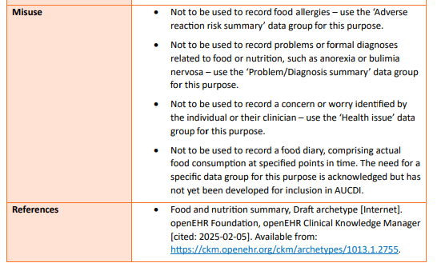
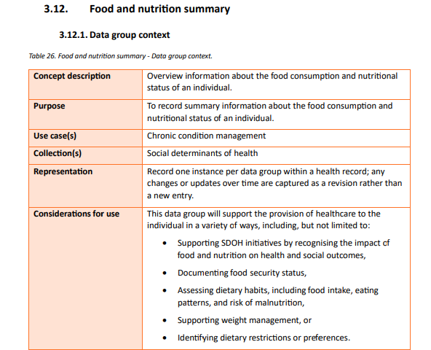
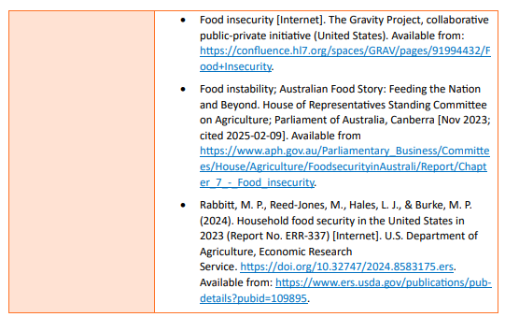
AUCDI: Food
https://sparked.csiro.au/index.php/aucdi-release-2/

Slide 38
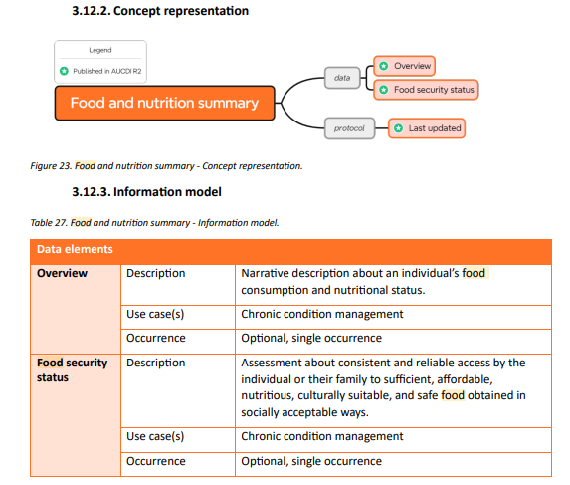
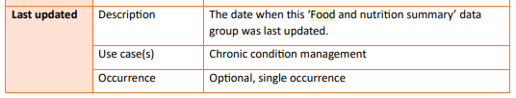
AUCDI: Food

Slide 39
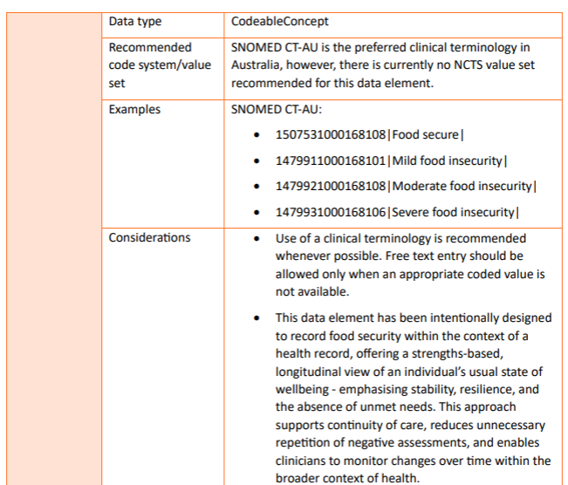
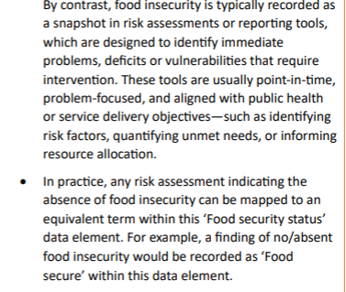
AUCDI: Food

Slide 40
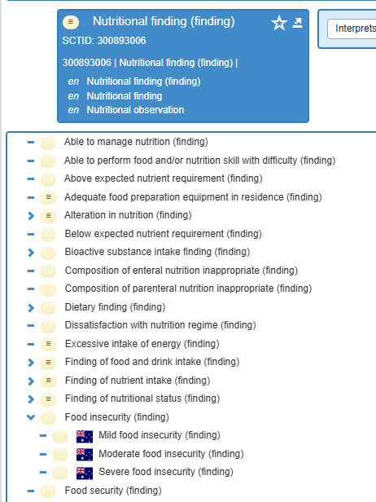
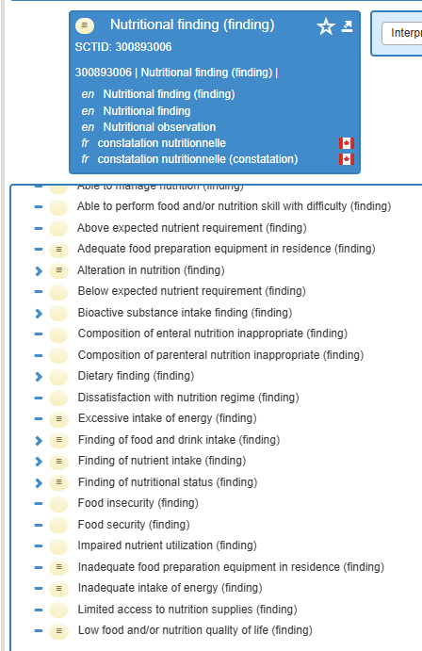
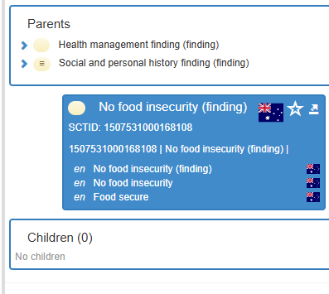
SNOMED CT CA
SNOMED CT AU
Gap

Slide 41
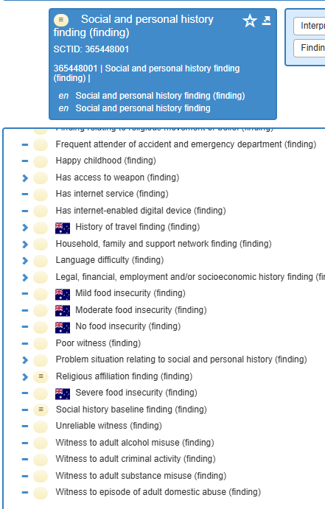
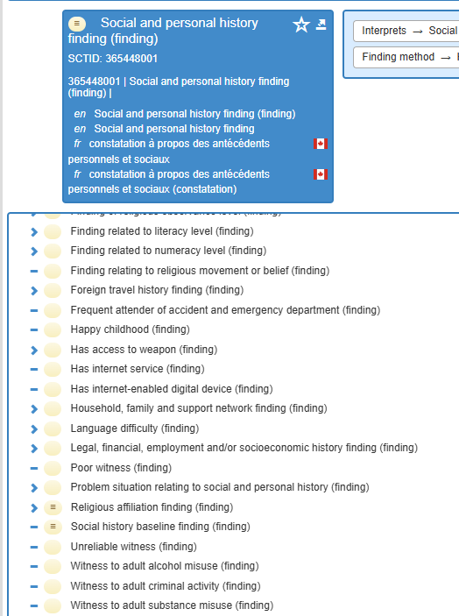
SNOMED CT AU
SNOMED CT CA
Gap
Gap

Slide 42
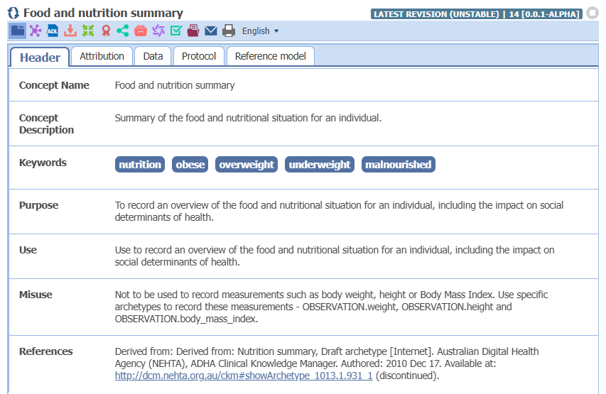
OpenEHR Food

Slide 43
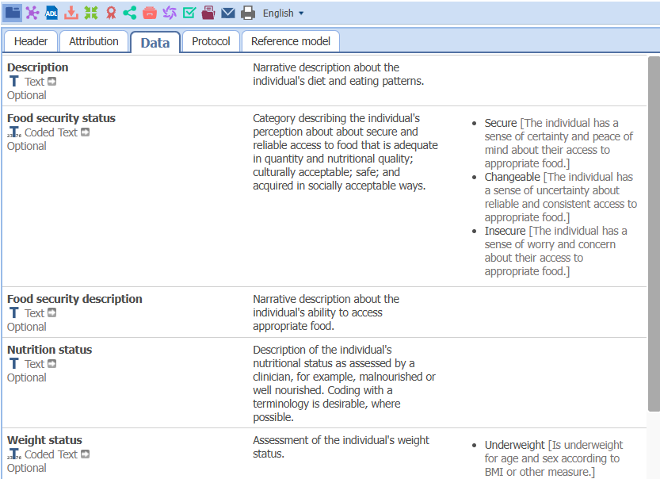
OpenEHR Food

Slide 44
Archive
Notes:
After next slide - pivot here to showing the DCS and doing high level walk through

Slide 45
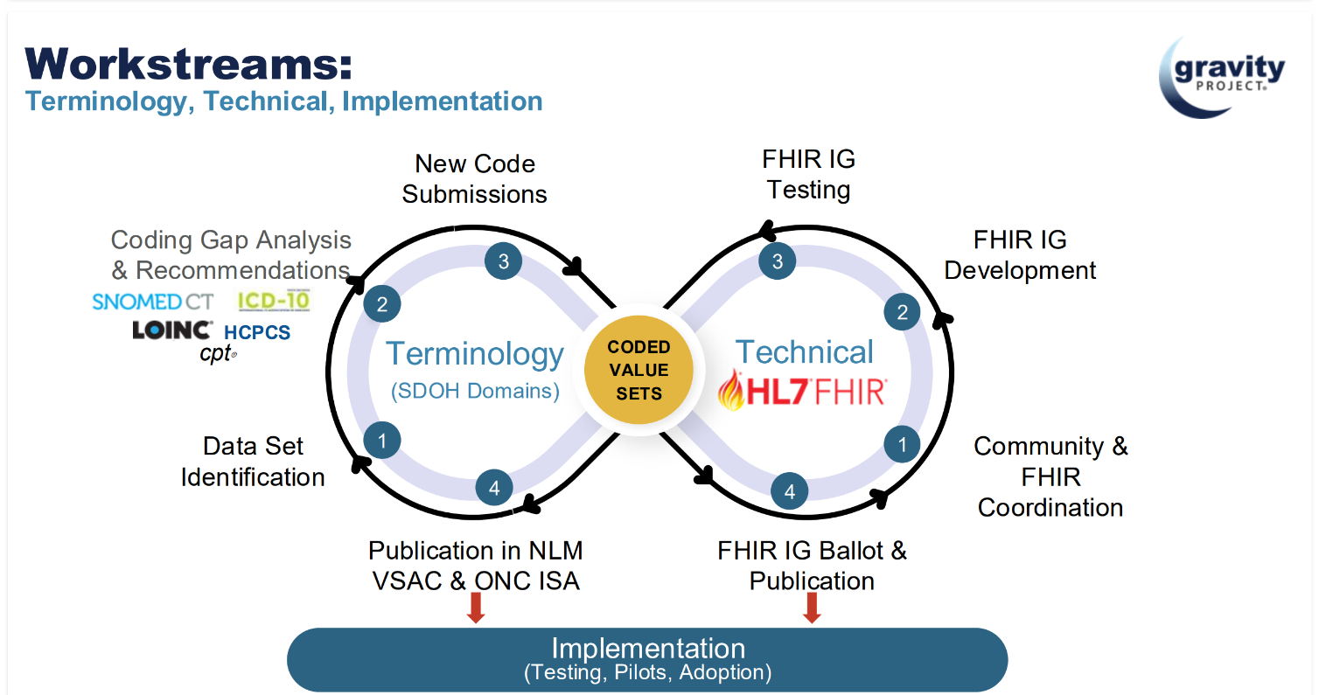
Gravity Workstreams
Notes:
Point here is that Coded Value sets like at the intersection of the Terminology and Technical workstreams in that they undergo rigorous terminology development and form important technical documentation for HL7 FHIR implementation.

Slide 46
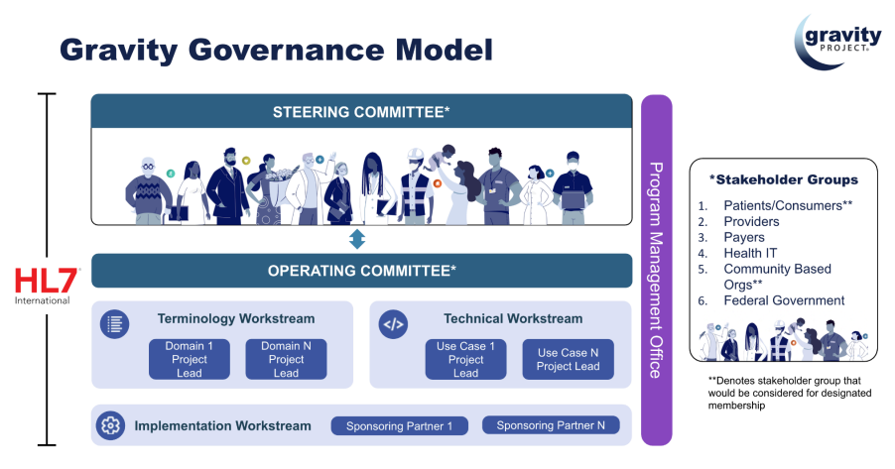
Gravity Project Social Determinants of Health Terminology Lifecycle report
Notes:
This document is a formal response to international requests to understand the “Gravity Terminology Curation Process,” from planning through to value set and content maintenance.
Outlines the evidence-based, public-consensus process employed by the Gravity Project Terminology Workstream and the Gravity community to develop terminology standards and their associated value sets

Slide 47
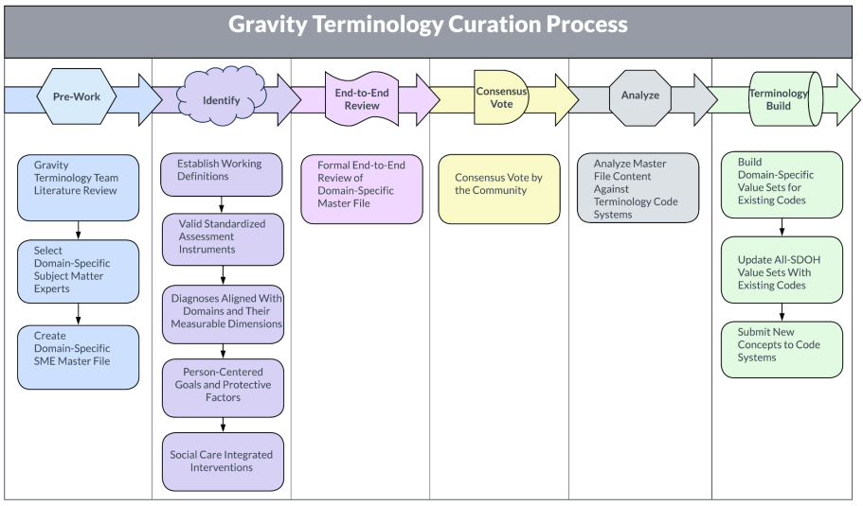
Gravity Project Social Determinants of Health Terminology Lifecycle report
Lifecycle Steps
Domain selection and approval process
Identify potential SDOH domains
Assess domain readiness and importance
Approval and prioritization by Gravity Governance Committee
Terminology Curation
Pre-work
Identify
End-to-end review
Consensus vote
Analyze
Terminology build
Maintenance and Evaluation
Value set updates and maintenance
Terminology evaluation
Notes:
This document is a formal response to international requests to understand the “Gravity Terminology Curation Process,” from planning through to value set and content maintenance.
Outlines the evidence-based, public-consensus process employed by the Gravity Project Terminology Workstream and the Gravity community to develop terminology standards and their associated value sets

Slide 48
V3 SDOH Work plan

Slide 49
Ready for Use – 11 Data elements
Data Element | Definition | Data Element Maturity | Value Set Detail | Value Set Maturity
Gender Used | Represents the gender identity that a person wishes to have recorded on legal documents or for the purposes of interactions with official agencies | 3: Ready for use | Gender Used (GSSO) | 3: Ready for use
Recorded Sex or Gender | Refers to the documented sex or gender of an individual used for clinical, official or legal purposes where only 1 data field for sex and gender is available, and where it is the value found in the local system and/or historical documentation | 3: Ready for use | Recorded Sex or Gender (GSSO) | 3: Ready for use
Gender Identity | An individual’s personal experience of being a woman, man, nonbinary or how the person prefers to self-describe. People may identify with more than one gender identity or use different gender identities in different settings | 3: Ready for use | Gender Identity (GSSO) | 3: Ready for use
Personal Pronouns | Gender pronouns are third-person pronouns that may reference a person’s gender identity and that may be a part of their gender expression | 3: Ready for use | Personal Pronouns (GSSO) | 2: Proposed
Sex at Birth | The sex of a person at birth, which is a clinical finding, usually determined by a clinician based on phenotypic, physiologic, and/or genetic characteristics | 3: Ready for use | Sex at Birth (GSSO) | 3: Ready for use
Sexual Orientation | Refers to how a person describes their sexuality, or who a person is romantically or physically attracted to | 3: Ready for use | Sexual Orientation (GSSO) | 3: Ready for use
Service Language | The person’s preferred language of service | 3: Ready for use | all-languages CIHI Language Codes | 3: Ready for use
Born in Canada | An indicator of whether the person was born in Canada | 3: Ready for use | N/A | N/A
Date of Arrival | The estimated or actual date the newcomer arrived in Canada | 3: Ready for use | N/A | N/A
Racialized Group* | A social construct used to judge and categorize people based on perceived differences in physical appearance in ways that create and maintain power differentials within social hierarchies | 3: Ready for use | RacializedGroupCode | 3: Ready for use
Indigenous Identity | The person’s self-identification as First Nations, Inuk/Inuit and/or Métis | 3: Ready for use | IndigenousIdentityCode | 3: Ready for use

Slide 50
Ready for V3 Value set Development – 9 Data elements
Data Element | Definition | Data Element Maturity | Value Set Detail | Value Set Maturity
Interpreter Needed | Whether the person requires language interpretation services | 0: In development | • Interpreter not needed • Interpreter needed • No understanding/ interpreter not needed | 0: In development
Ethnicity* | A person or group affiliation with those who share social, cultural and ancestral heritage | 3: Ready for use | N/A | N/A
Religious or Spiritual Affiliations* | The person's religious or spiritual denomination or religious community with which a person identifies, regardless of whether they are currently practising or observing that community’s beliefs or practices | 3: Ready for use | To be developed | 0: In development
Relationship Status | The person’s partnership or intimate status with another individual(s), reflecting the range of connections and preferences | 3: Ready for use | • Single • Married | 0: In development
Education level | The person’s highest level of education obtained | 3: Ready for use | • No formal education • Elementary school | 0: In development
Employment Status | The person’s current employment status | 3: Ready for use | • Full-time permanent • Part-time permanent | 0: In development
Financial Stability | The person’s perceived financial stability (i.e., ability to pay for basic needs such as food, water, housing, clothing) as reported by the person or the caregiver | 2: Proposed | • Stable finances • Mild financial instability | 0: In development
Housing Stability | The person’s perceived current housing stability (e.g., stable, mild, moderate) | 2: Proposed | • Stable housing • Mild housing instability | 0: In development
Access to Food | The frequency with which the person has experienced difficulty accessing or affording food over the past 12 months | 3: Ready for use | • Never • Daily | 0: In development
* These data elements are cross cutting CIHI corporate standards and are developed with a process outside of the specific work for the PCHDCF. They will be undergoing CIHI standard’s review and we expect updates or changes in the future
Notes:
.

Slide 51
Future Development: Start July 2026
Data Element | Definition | Data Element maturity | Value Set Detail | Value Set Maturity
Access to Medication | Whether the person has experienced difficulty accessing or affording medicine over the past 12 months Fixed code: Medication access (LOINC: in development) | 2: Proposed | To be developed | 0: In development
Access to Treatment | The person’s ability to access or afford treatment services (e.g., physiotherapy, occupational therapy) over the past 12 months | 2: Proposed | To be developed | 0: In development
Access to Internet | Whether the person has experienced difficulty accessing or affording the internet over the past 12 months | 2: Proposed | To be developed | 0: In development
Access to a Phone | Whether the person has experienced difficulty accessing or affording a telephone over the past 12 months | 2: Proposed | To be developed | 0: In development
Access to Transportation | Whether the person has experienced difficulty accessing or affording public or private transportation over the past 12 months | 2: Proposed | To be developed | 0: In development
Access to Utilities | Whether the person has experienced difficulty accessing or affording utilities over the past 12 months (e.g., heat, electricity, water) | 2: Proposed | To be developed | 0: In development
Access to Child Care | Whether the person has experienced difficulty accessing or affording childcare over the past 12 months | 2: Proposed | To be developed | 0: In development
Social Support | The actual or perceived availability of family, friends, neighbours and/or community that a person can confide in or rely on to feel more socially connected and secure | 3: Ready for use | To be developed | 0: In development
Experience With Interpersonal Violence | The person’s experience with interpersonal violence (e.g., physical, sexual or emotional abuse; economic control; isolation or other kinds of coercive behaviour) | 2: Proposed | To be developed | 0: In development
Legal History | The person’s experiences with the judicial system (e.g., has spent time in a correctional facility, is involved in legal proceedings) | 3: Ready for use | To be developed | 0: In development

