Slide 1
HL7 Canada Community Call
Community Meeting
June 4th, 2024 12:00 PM EDT

Slide 2
2024-06-04 Canada Community Agenda
Welcome
Updates on pan-Canadian FHIR Specifications
Report out from the HL7 May WGM and Connectathon
Update on Canada Council Review of HL7 Canada Terms of Reference
Other business
Next meetings

Slide 3
2024 Pan-Canadian Specifications Update
PS-CA / pan-Canadian Patient Summary
  PS-CA v1.1.0 DFT IG published
  Next PSWG call June 18 (to be confirmed)
  PS-CA v2.0.0 early DFT Oct 2024
CA: FeX / Canadian FHIR Exchange
  CA: FeX 2.0.0 DFT published May 22, 2024
CA Core+
  CA Core+ 0.2.0 DFT Ballot responses closed; 8 comments received
  Disposition sessions forthcoming as part of Building Blocks WG
eReC / eReferral – eConsult
  Ballot feedback extended to June 10, 2024
  Disposition sessions shortly after
Service Directory
  Kicked off weekly Thursday sessions
Building Blocks
  Working group to develop and collaborate on “Building Block” content, e.g. Core+, CA:FeX, Service Directory
To submit requests for change to PS-CA, CA:FeX , Core, etc. for changes between formal ballot periods –follow process here to create a Jira account: https://infocentral.infoway-inforoute.ca/en/forum/301-patient-summaries/5512-guide-to-submitting-feedback-on-ps-ca-v1-1-0-dft

Slide 4
CA FHIR Baseline Updates
Simplifier URL Facelift: https://simplifier.net/cabaseline
Governance Stream:
  A few missed Governance stream calls in May due to holiday & WGM
  Outstanding discussion point to CA Baseline to think through timing for canonical url transition + continuing conversation for how to target meaningful involvement (acknowledging upstream nature) with CA Core moving forward: https://youtu.be/NzaRNQ4MVDs
Profiling Stream:
  Stub value sets added – minor tweaks before 1.1.8 packaging (forthcoming)
  Working through invariant QA – challenge with context around decisioning (given it’s been 4 years since some invariants were written/examined) – anticipate they will have some improvements to breaking changes

Slide 5
Report out from the HL7 May WGM and Connectathon
Invitation for contributions by attendees

Slide 6
HL7 May 2024 WGM - Highlights
Strong Canadian turnout
  Very enjoyable and lively Canadian dinner
Canadian Patient Summary featured at International Council
Brazil Super Secretary of Digital Health provided HL7 General Session address
Canada and Brazil forging an active collaboration
HL7 Foundry is up and running
Trial of Affiliate balloting using HL7 JIRA underway
  May be available by end-of-year for use by interested affiliates
Notes:
Strong Canadian turnout including 5 Infoway Participants and Canadian co-chairs and contributors to HL7 Intl Working Groups
Very enjoyable and lively Canadian dinner
Canadian Patient Summary featured at International Council
Canada and Brazil forging an active collaboration

Slide 7
HL7 International Council

Slide 8
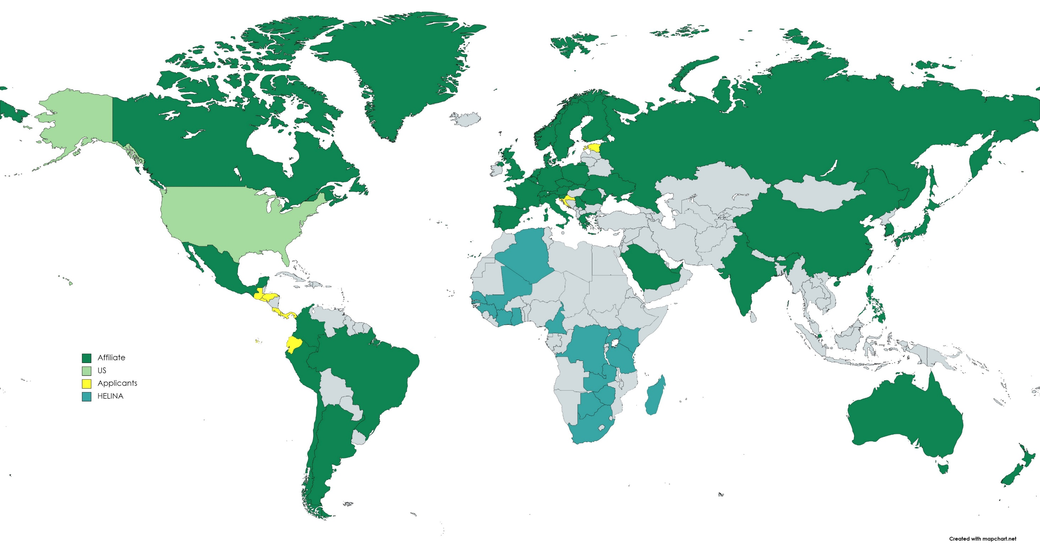


Estonia upcoming Affiliate
HL7 Central America Awaiting final approval
AeHIN is waiting for final approval as regional partner
There are 42 countries represented on the HL7 International Council

Slide 9
Affiliate Updates
41 Affiliates in Good Standing
Bosnia - Herzegovina, and Pakistan lapsed
Saudi Arabia re-engaging
Pending Board Approval
  HL7 Central America (first regional Affilliate)
  HL7 Ecuador
  AeHIN – Asian eHealth Information Network as second regional partner (after HELINA – Health Informatics in Africa)

Slide 10
Recent Affiliate Engagement
Peru is actively and energetically engaged
Slovakia is looking for guidance and support in establishing their affiliate
Brazil is strongly represented at the May WGM and also very engaged with the IC community and HL7 Executive
International Council has an annual budget of $25,000 for support of Affiliate members
  As of the May WGM, 17,000 has already been funded
  8,000 remaining will likely be committed before the Sept WGM

Slide 11
HL7 May 2024 WGM – International Council - 1
Overview of HL7 Brazil
Presentation by Brazil MoH on the Nov 2024 G20 Meeting focus on Digital Health
Presentation of HL7 Canada Patient Summary Approach
Recommendation for IC to sponsor a project to determine where and how Affiliate Language Packs should be stored and distributed
Link to WGM Presentations

Slide 12
HL7 May 2024 WGM – International Council - 2
HL7 Intl Implementation Division – The Foundry Project
Report from HL7 Europe and also on their Gravitate Project
Presentation promoting participation in and use of the HL7 Education Advisory Council
Presentation from HL7 Spain on May 2025 Meeting in Madrid
  HL7 Goes to Madrid or Madrid on FHIR
Presentation from HL7 Peru on their structure and approach
Link to WGM Presentations

Slide 13
HL7 May 2024 WGM – International Council - 3
Reports from HL7 Standards Development and Implementation Divisions
Grahame Grieves gave updates on
  FHIR Community Process
  WHO Project for IG translation
  Resource Maturity Levels
Presentation from John Carter on NZ IPS-athon – excellent video
IC sub-group will assess possibility of a multi-country IPS Demo at G20 Meeting in Brazil
Link to WGM Presentations
Notes:
FHIR Community Process:
Guides following the process will receive a logo for inclusion.
Affiliates are not currently required to follow the process but are encouraged to do so.
Mentioned Australia’s authority validating guides and offered support to affiliates wanting to replicate this model.
HL7 Germany: Asked about the participation process. Grahame referred them to Confluence and mentioned the main coordinators: Grahame, Dan, Diego.
WHO Project:
Aim to generate implementation guides in multiple languages, starting with at least six.
The first step is translating resources in the IG by preparing language packs.
HL7 UAE: Asked how affiliates can contribute. Grahame emphasized testing in French, Arabic, Chinese, and Russian. Diego highlighted the need for domain knowledge in translation.
Resource Maturity Levels:
Concern about how maturity levels reflect HL7 International’s perspective, not affiliates'.
Grahame explained that defining levels per affiliate is not possible, but what each level means can be clarified.

Slide 14


HL7 Intl September - 38th Plenary and WGM+
Sept 19th to Sept 27th
Connectathon + WGM
Omni Atlanta Hotel
190 Marietta St NW, Atlanta, GA 30303
Last day to book: Friday, August 30, 2024
Special group rate at the Omni Atlanta Hotel: $299 USD per night
Book your room for the FHIR Connectathon and WGM+

Slide 15
Update on Review of HL7 Canada Terms of Reference
Anticipating that balloting of pan-Canadian specifications will have significant impact on many aspects of HL7 Canada
The HL7 Canada Council is holding open working sessions to adjust the ToR / Charter

Slide 16
Other Business?

Slide 17
Next Meetings / Events - Adjournment
  June 18th - HL7 Canada Council Regular Monthly Meeting
  July 2nd - HL7 Canada Community Meeting

Slide 18
Thank You
Ron G. Parker
HL7 Canada Affiliate Chair ron@parkerdhc.com

