Slide 1
Public Health Surveillance Community
April 3^{rd, 2025}
Myriam Talantikit,
Specialist, Standards
Notes:
The logo can be changed in the master slides. Please use the following instructions
Select view > slide master.
Right click on the logo and select change picture.
Select the image you want to use. You may need to scale the image accordingly
When you're done, select close master view.

Slide 2
Agenda
Welcome and Introduction
New RFC since last meeting
Picklists Updates
Antigen and Immunoglobulin subsets content modification
Subsets Merging
Questions and wrap up
Notes:
The logo can be changed in the master slides. Please use the following instructions
Select view > slide master.
Right click on the logo and select change picture.
Select the image you want to use you may need to scale the image accordingly
When you're done, select close master view.

Slide 3
2. New RFC since last meeting
No new concepts
Some CD

Slide 4
3. Picklists updates

Slide 5
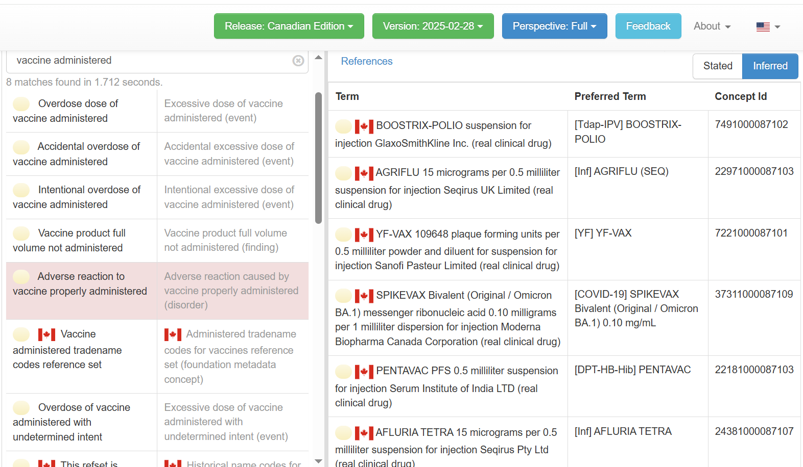
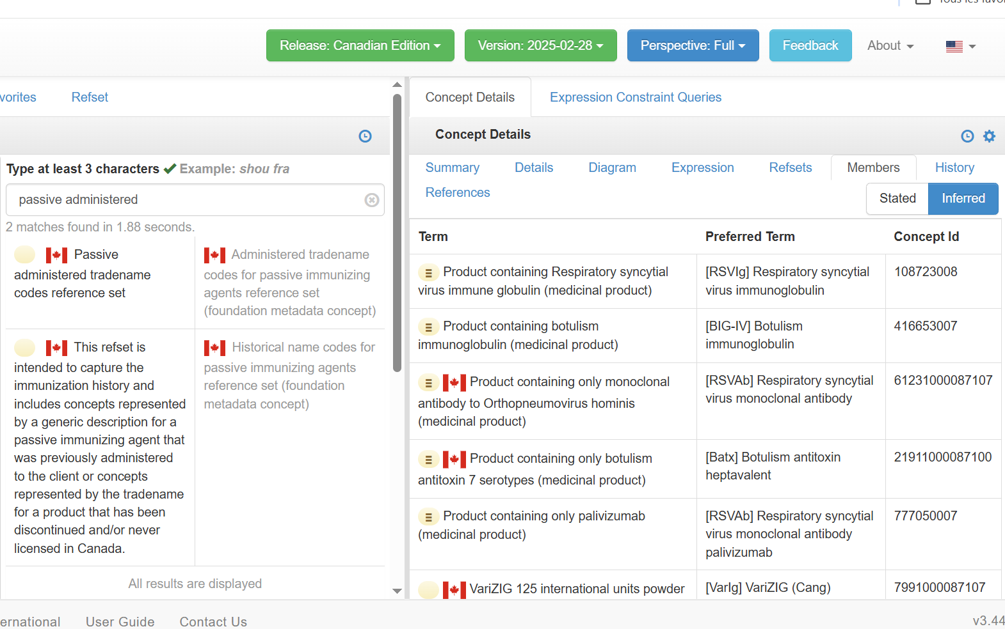
Clinician Picklists
Integrated into the February Edition following the Picklists Editorial guideline
As concepts’ PT

Slide 6
Patients Friendly Picklists
Will be integrated into the May Edition
Publication format

Slide 7
4. Antigen subset and Immunoglobulin subset content modification

Slide 8
AntigenCode susbset Current scope
The scope of this subset is antigens contained within the vaccines (based on VaccineHistoricalNameCode subset) that may be administered to or have been received by a patient. In some cases, more than one antigen per disease or pathogen may be included when the sub-type, serotype or formulation (adjuvant) is relevant (e.g. pneumococcal conjugate and pneumococcal polysaccharide). This is to facilitate population of a comprehensive immunization history, forecasting and inventory management.

Slide 9
NVC requirements
For mapping purposes, NVC required that
All antigens should be included in one same subsets
Not the same scope
Options
Redefine the subsets scope and add all substances
Recommendation
Create a new subset with all antigens to facilitate the mapping
Notes:
The logo can be changed in the master slides. Please use the following instructions
Select view > slide master.
Right click on the logo and select change picture.
Select the image you want to use you may need to scale the image accordingly
When you're done, select close master view.

Slide 10
5. Subsets merge

Slide 11
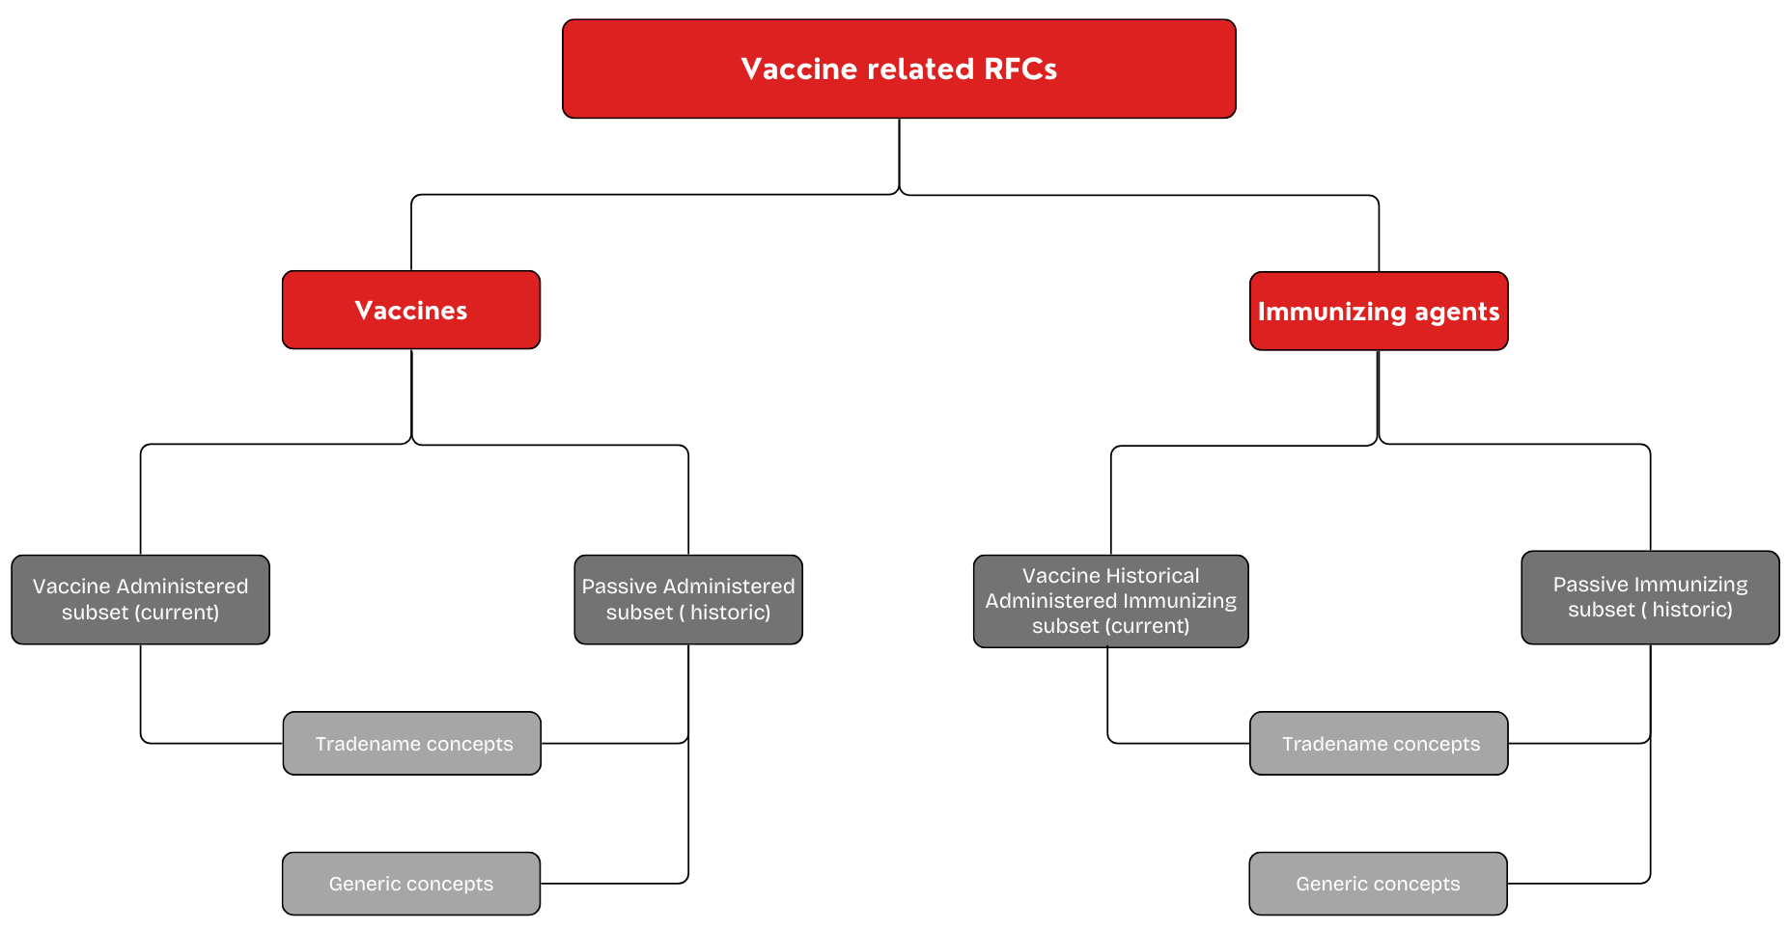
Current subsets representation

Slide 12
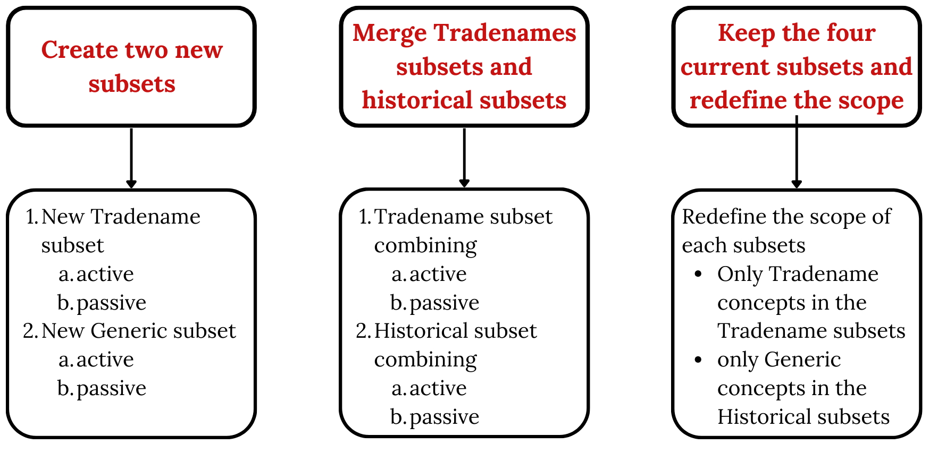
Different options

Slide 13
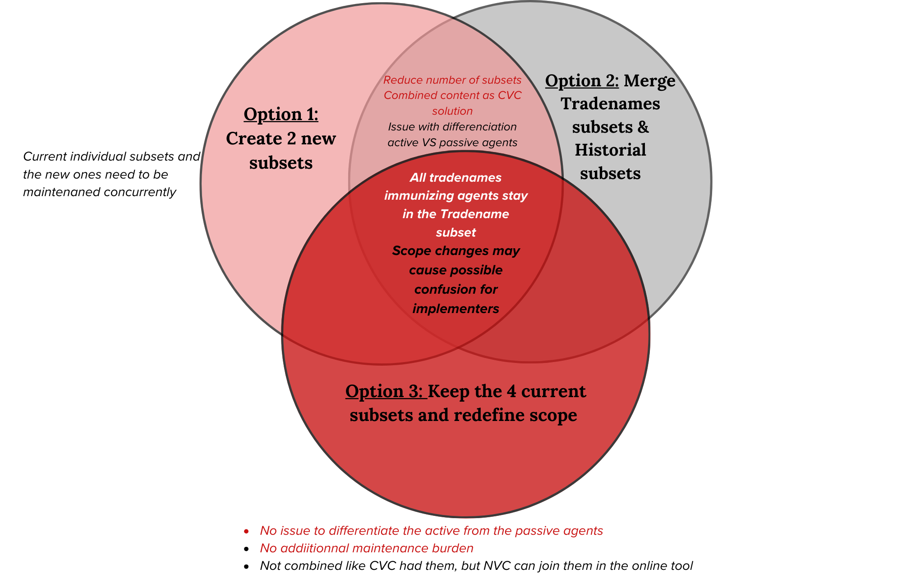
Visual representation of options

Slide 14
Option 3: proposed subsets scopes
VaccineAdministeredCode
The subset includes concepts represented by the trade name (brand name) of the vaccine administered to the client. The scope of this subset is all vaccines that have been are currently licensed for use in Canada, and those obtained through special access programs for use in Canada, and those that were never licensed in Canada (i.e., administered in other countries).
VaccineHistoricalCode
The scope of this subset is generic vaccines that have been are currently licensed for use in Canada (generic description, i.e. no trade name), those obtained through special access programs (generic description), and for vaccines that have been discontinued and/or were never licensed in Canada. (with trade name). This content is intended to be used when populating an immunization history when the client and /or provider does not have the detail of the trade name (brand name) of the vaccine administered or OR the product has been discontinued and/or never been licensed in Canada. This subset will include concepts represented by a generic description for a vaccine that was previously administered to the client as may be expressed by the client or provider for an immunization history and concepts represented by the trade name for products. that have been discontinued and/or never licensed in Canada.
Passive
The subset includes concepts represented by the trade name (brand name) of the passive immunizing agent (immune globulin or antitoxin) that was administered to the client. The scope of this subset is all passive immunizing agents that that have been are currently licensed for use in Canada, and those obtained through special access programs for use in Canada, and those that were never licensed in Canada (i.e., administered in other countries). Passive immunizing agents are used to facilitate protection against vaccine preventable infections, when vaccines are not available or are contraindicated or when vaccines have not been used before exposure to the infective agent.
Passive
The scope of this subset is generic passive immunizing agents used in Canada (generically described, i.e. without trade name), those obtained through special access programs (generically described), and passive agents that have been discontinued and/or were never licensed in Canada. (with trade name). This content is intended to be used when populating an immunization history when the client and/or provider does not have the detail of the trade name of the agent administered or OR the product has been discontinued and/or never been licensed in Canada. Passive immunizing agents are used to facilitate protection against vaccine preventable infections, when vaccines are not available or are countraindicated or when vaccines have not been used before exposure to the infective agent. This subset will include concepts represented by a generic description for an a passive agent that was previously administered to the client as may be expressed by the client or provider for an immunization history and concepts represented by the trade name for products. that have been discontinued and/or never licensed in Canada..

Slide 15
6. Questions/Wrap up
Next meeting Thursday, May 1, 2024, 2:00-3:00 pm ET

Slide 16
Thank you!
Contact Information
standards@infoway-inforoute.ca

