Slide 1

CA-Baseline Pan Canadian Baseline Governance Collaborative Discussion

Slide 2
Where are we in our Baseline Maturity Roadmap?
We’re Here
QA Period
Prep for FMM0
FMM0
QA Period
FMM1
FMM2
Complete Remaining Clinical Profiles
Clean-up of IG Profile Content for QA/Due Diligence Review
Prep for IGuide draft to be published as a whole for broad community awareness: Maturity Model Stage 0 (FMM0)
IGuide is published as first draft (FMM0) for community exposure
Community engaged in external due diligence review: Existing projects providing feedback & comparison against domains
Mechanism/tool* is used to collect broader community & implementor feedback (i.e. Peer reviews, connectathons, and/or ballot for comment) to confirm that it meets needs of early implementors
Improvements made to IGuide based on initial round of feedback
IGuide changes are reconciled to ensure additional Validator warnings are resolved
IGuide made available for use by implementors
Require 3+ implementors before IGuide can be progressed to FMM2.
Physical presence limitations may require us to find alternative means of surfacing IGuide via connectathon
Implementation feedback and results gathered for submission to HL7 Canada
Prep for formal balloting
Framework for completing internal due diligence review (purpose, scope, depth, success criteria, review process)
Principles developed for this internal and external due diligence review
1st level due diligence review against existing CA FHIR IGuides
Reconciliation of changes driven by DDRs
Processes and tools for collecting community feedback identified and confirmed
Align approach with Infoway Governance Report Findings & Recommendations
Jurisdictions and Implementor Community is engaged to help validate approach, are engaged as we progress through the approach.
Identification and call for endorsement & creation of governance collaborative
Pan-Canadian Baseline Governance Collaborative - promotes roll out of the Baseline in jurisdictional FHIR projects– formalizes decision making about a CA Core and requirements related to procurement
Documentation of governance, representation, and decision making process for inclusion in section(s) IGuide
CA Baseline Workstream supports PCBGC with recommendations, maintenance & enhancement of the CA Baseline
Any updates being run through FHIR Validator to find and correct errors and warnings
Notes:
Due Diligence Review:
Handful (2-3) National/International IGuides used as comparison points during Friday Calls
*First level definition needed (what’s the depth we want to get to before building to a 2nd level review with larger community
Need to have some recognition of the step that is required at a national level to align the provinces (not just align the implementors w/in provinces) – gap that needs to be filled and this process will need to align to that.
Identify enablers needed to accomplish these milestones

Slide 3
Due Diligence Review Progress
Profile | Substream Review Status | Due Diligence Review Status
Practitioner Profile (General) | Complete | PPR, DHIR, Ontario eReferral, PrescribeIT
Immunization Profile | Complete | DHIR, IPS, PHI Access
Patient Profile | Complete | PCR, DHIR, Ontario eReferral
Location Profile | Complete | PPR, Ontario eRefferal
Organization Profile | Complete | DHIR, PrescribeIT
AllergyIntolerance Profile | Complete | Ontario eReferral, IPS
Condition Profile | Complete | Ontario eReferral, IPS
Medication Profile | Complete | PrescribeIT, IPS
MedicationDispense Profile | Complete | PrescribeIT, PHI Access
ImmunizationRecommendation Profile | Complete | DHIR
MedicationStatement Profile | Complete | IPS
Procedure Profile | Complete | IPS
Practitioner Profile (Provider Registry) | Complete | PPR
PractitionerRole Profile (General) | Complete | PPR
PractitionerRole Profile (Provider Registry) | Complete | PPR
MedicationRequest Profile | Complete | PrescribeIT
MedicationAdministration Profile | Complete | Not Complete
Encounter Profile | Complete | Not Complete
Goal Profile | Complete | Not Complete
Observation Profile (General) | Complete | IPS (started)
Observation Profile (Laboratory Results) | Complete | Not Complete
DiagnosticReport for Report and Note Profile | Complete | Not Complete
Observation Profile (Laboratory Results) | 2nd Review Round will resume after DDR | Not Complete
DiagnosticReport Profile (Laboratory) | Complete, 2nd Review Round review will resume after DDR | PHI Access
Document Reference Profile | Complete | Not Complete
Device Profile (Medical and Non-medical) | Partial - Paused until SME available | Not Complete
Device Profile (Implantable) | Partial - Paused until SME available | Not Complete
SmokingStatus Profile | Not Complete | Not Complete

Slide 4
Dealing with Profile Maturity Differences
Do we want to apply maturity levels to the profiles, the guide, or both?
Likely both
Maturity levels reflected for both profiles & guides following traditional FMM progression
Want to shoot for IGuide maturity level that is closer to trial use to alert implementors they are stable enough to try out
Until we get out of Draft level for whole guide - marking resources/elements as lower maturity may not be helpful - because the assumption is that entirety of it is low maturity
What do we do with the profiles that are lower level in maturity than the others? Keep them out of the guide, segment them somewhere else?
Don't leave them out of the IGuide, clearly differentiate them at resource level (and maybe even element level - for example observation.focus)
Does it make sense to vary from the FHIR FMM implementation-driven definition given that we’re a baseline?
May have to vary somewhat given baseline scope is different than a traditional implementation guide scope/different than the international spec use of maturity (i.e. used in multiple countries)
Need to define a logic for understanding our maturity level that is communicated in the guide.
# of comparison specifications included as parameters in the definition for maturity (differentiate specs that have been implemented vs those that are also still in draft form)
#of times the baseline/profiles based off the baseline are used as another indicator for later levels of maturity
Does it make sense to ask for a different expectations for less mature profiles?
Not appropriate for the workstream to define the expectations- we can make recommendations but decision on what jurisdictions are expected to do with each comes from the collaborative
Does it make sense for us to ask for different types of support from our governance group for less mature profiles
- i.e. agreeing to use the level X for implementation and to provide support getting community feedback for level Y)

Slide 5
Baseline Profile Maturity Level Definitions
# | Current FHIR Maturity Level Definition | CA Baseline Maturity Level Definition
0 (draft) | FHIR Base Definition: the artifact has been published on the current build. This level is synonymous with Draft. UK Core: The Profile has been published on the current build. This Profile has had no formal review and therefore may have quality issues. It is published only to allow the review process to start | The artifact has been published on the current build. This level is synonymous with Draft.
1 | FHIR Base Definition: FMM0 + the artifact produces no warnings during the build process and the responsible WG has indicated that they consider the artifact substantially complete and ready for implementation. For resources, profiles and implementation guides, the FHIR Management Group has approved the underlying resource/profile/IG proposal. UK Core: The Profile produces no warnings during the build process and has had a formal internal review by the UK Core development team | The artifact produces no warnings during the build process and has had a formal internal review by the CA Baseline Working Stream. The artifact is considered substantially complete and ready for XYZ use.
2 | FHIR Base Definition: FMM1 + the artifact has been tested and successfully supports interoperability among at least three independently developed systems leveraging most of the scope (e.g. at least 80% of the core data elements) using semi-realistic data and scenarios based on at least one of the declared scopes of the artifact (e.g. at a connectathon). These interoperability results must have been reported to and accepted by the FMG UK Core: The Profile has been released for review to the UK FHIR community, any feedback received has been addressed as far as possible | The artifact has been released for review to the CA FHIR community, and is being used and/or demonstrated by at least three implementations (e.g., pan-Canadian, jurisdictional, vendor, etc.) from at least two different jurisdictions. Implementor feedback has been addressed as far as possible.
For the Purposes of the Canadian Baseline Implementation Guide, current build means it is published on the publicly available CI Build(http://build.fhir.org/ig/HL7-Canada/ca-baseline/branches/master/index.html) and Simplifier Project (https://simplifier.net/CanadianFHIRBaselineProfilesCA-Core)
For our purposes, ready for use means ready for Canadian profiles to begin attempting to derive from the Baseline profiles, it is understood that artifacts can be ready for use but are still expected to undergo revisions
*used=direct implementation (using CA Baseline for exchanging data)
*demonstrated could mean 1) profiles formally derive from the baseline using the basedOn.element and show no conformance errors , OR 2) conformant data to can be pointed to meta.profile: {BaslineProfileURL] and is conformance (produces no errors)nd/or conformant profile derivation can be demonstrated
Notes:
https://confluence.hl7.org/display/FHIR/FHIR+Maturity+Model#:~:text=This%20page%20describes%20the%205,it%20has%20been%20subject%20to.
https://simplifier.net/guide/UKCoreDevelopment2/Profiles
# of comparison specifications included as parameters in the definition for maturity (differentiate specs that have been implemented vs those that are also still in draft form)
#of times the baseline/profiles based off the baseline are used as another indicator for later levels of maturity

Slide 6
Baseline Profile Maturity Level Definitions
# | Current FHIR Maturity Level Definition | CA Baseline Maturity Level Definition
3 | FHIR Base Definition: FMM2 + the artifact has been verified by the work group as meeting the Conformance Resource Quality Guidelines; has been subject to a round of formal balloting; has at least 10 distinct implementer comments recorded in the tracker drawn from at least 3 organizations resulting in at least one substantive change UK Core: The Profile has been presented for inclusion in the Technical and Clinical Assurance process
4 | FHIR Base Definition: FMM3 + the artifact has been tested across its scope (see below), published in a formal publication (e.g. STU), and implemented in multiple prototype projects. As well, the responsible work group agrees the artifact is sufficiently stable to require implementer consultation for subsequent non-backward compatible changes. UK Core: The Profile has completed the Technical and Clinical Assurance process and the status has been changed to active
5 | FHIR Base Definition: FMM4 + the artifact has been published in two formal publication release cycles at FMM1+ (i.e. STU level) and has been implemented in at least 5 independent production systems in more than one country UK Core: The Profile has been presented for inclusion in the HL7 UK Ballot Process
6 (normative) | FHIR Base Definition: FMM5 + the responsible work group and the FMG agree the material is ready to lock down and the artifact has passed HL7 normative ballot UK Core: The Profile has completed the HL7 UK Ballot process and is now deemed to be Normative
Notes:
https://confluence.hl7.org/display/FHIR/FHIR+Maturity+Model#:~:text=This%20page%20describes%20the%205,it%20has%20been%20subject%20to.
https://simplifier.net/guide/UKCoreDevelopment2/Profiles
From the HL7 Confluence Site – Footnotes: Any of the criteria can be waived provided the sponsoring WG can convince the FMG that that criteria should not apply in the case of a specific artifact.
Tested across scope means:
- The FMG has signed off on the list of "example contexts" defined for the artifact- For each example context, the artifact has either been: reviewed and approved by a domain expert for that scope area, mapped to an existing implemented scope-area-specific standard or tested in an implementation
In most cases, if an artifact is derived from or otherwise depends on another artifact, the derived artifact cannot be more mature than the artifact referenced. However, FMG may make general or specific exceptions to this rule.
In some cases, an artifact may have components or dependencies that are a lower level than the resource overall. For example, a resource may have been well tested, with the exception of one or two data elements which are "new" or that have limited production use due to the distribution of early adopters. In these cases, a "maturity note" will be provided that highlights areas of the resource that are considered "less mature" than the resource as a whole.
# of comparison specifications included as parameters in the definition for maturity (differentiate specs that have been implemented vs those that are also still in draft form)
#of times the baseline/profiles based off the baseline are used as another indicator for later levels of maturity

Slide 7
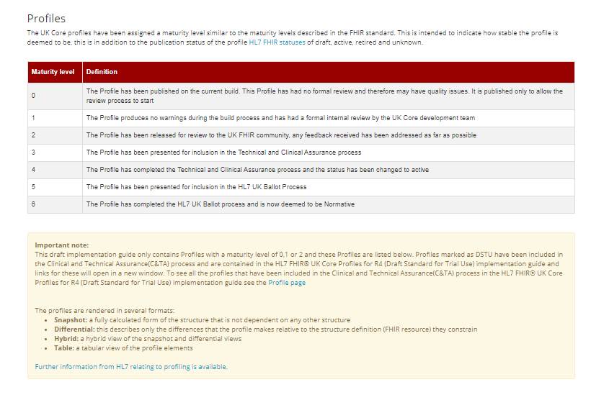
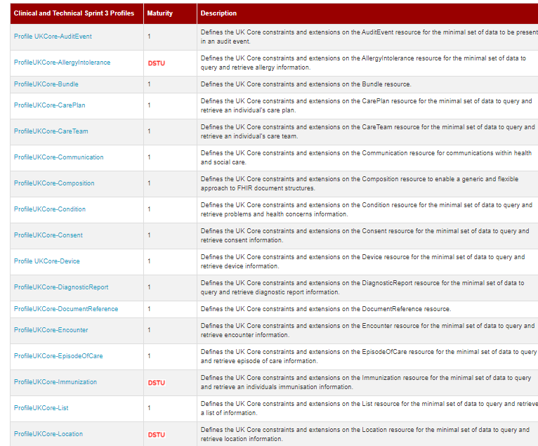
UK Core – Another National Baseline
https://simplifier.net/guide/UKCoreDevelopment2/Profiles

Slide 8
Governance Workstream & Collaborative: Plan & Boundaries
Draft Endorsement Deck
Identify Key Endorsers
Create supportive materials to prep Collaborative for ToR
Endorsement Presentations to Working Groups
Confirm endorsements
Supply SME recommendations for profile reconciliation, tooling, maintenance, & evolution
Re-engage SMEs around CA Core – resurface recommendations for more prescriptive constraints
Confirm commitments to join collaborative
Manage tool/reconciliation for feedback from any implementors
Collaborative initiated
Creation of ToR & Adoption Milestones
Drive Baseline profile adoption (websites, materials for IGuide Authors)
Decisions around tooling/enforcement
Decision on CA Core & Enforcement

Slide 9
Key Endorsers Identifier
Alberta HISCA – HL7 Sub Committee
Workstream members from Alberta attempting to get on agenda
Ontario Health - Strategic Committee (SC) & Business & Technical Committee (BTC)
Preliminary conversation before getting on agenda
Informed of federal requirements in preliminary discussion
British Columbia HISWG & HISIG – BC FHIR Working Group
BC FHIR WG have previously reviewed guide but have outstanding changes they’d like to see
Awaiting to get on agenda given current priorities
CHI & CIHI
Engaging after
What about vendors?
HL7 Canada, IHE Canada?
Should every endorser be a target for the Baseline Collaborative – or just jurisdictional & federal orgs?

Slide 10
Boundaries with CA Baseline Governance Collaborative
What is the CA Baseline Workstream Responsible for? Where do our boundaries begin and end with the governance group?
Governance Collaborative needs to be the group making decisions to be valid, but the workstream can support them in getting the governance collaborative running (operational support) and supporting the collaborative by offering up recommendations and subject matter expertise
Responsibilities for the Governance Group
Workstream might suggest options to consider
Some higher-level responsibilities may already be defined through the work we’re doing now
Governance Collaborative needs to edit and confirm responsibilities and goals of the group as part of the ToR
Process for Decision Making & Resolving Conflicting Opinions across Jurisdictions
Workstream might provide template example of terms of reference and point to supportive materials
Governance Collaborative needs to come to agreement and define process in ToR
Time/resource commitment
Workstream can provide examples of what previous types of engagements have for engagement, but ToR would be where commitment decided
Governance Collaborative needs to decide on time commitment and meeting cadence as part of ToR
Preparing additional supportive materials for implementors
Workstream can provide examples (workflow scenarios?) to assist implementors in using the baseline
Governance Collaborative supports workstream by connecting to realistic data that would assist with this type of modeling of test data and scenarios
Enforcement/Adoption Decisions/Maturity
Governance Collaborative will decide readiness & timelines for having prospective guides derive from the CA Baseline
Workstream can provide insight into level of stability/make recommendations for how reconciliation and versioning is handled
Workstream can provide guidance on maturity levels & interpreting them but the expectations for what each maturity level will
Workstream can provide language in Guide around encouraging harmonization of previous guides and which CA guide/versions were considered harmonized during the DDR
Tooling Decisions
Workstream can provide recommendations for tools for viewing profiles, submitting/reconciling feedback, and other kinds of tools (FHIR servers, conformance tools, etc.) depending on the scope decided by the Collaborative
Governance Collaborative will decide what kinds of tools are required and will determine how tools will be supported if they are not open-source
Maintaining the Baseline: profiling versions, feedback process,
Workstream will be responsible for committing any changes to the Baseline to prepare for the Governance Collaborative
Workstream will provide intermittent support committing any agreed upon changes to the Baseline that result out of Collaborative/Implementor Adoption Feedback
CA Core Decisions
Workstream can provide insight into past recommendations for prescriptive constraints for CA Core
Governance Collaborative will have to decide how and when to pursue CA Core and develop plan to tie to incentives/disincentives (i.e. procurement)
Notes:
Sketch in profile and guidance versioning policy recommendation (ex: “a change to value sets could be done as a future non-breaking change, guides that use previous value sets are still valid”)

Slide 11
CA-Baseline A Starting Point for Canadian FHIR Implementation Guides

Slide 12
Who Are We?
FHIR Implementers Community
eReferral
InfoCentral Community
Community Streams
Canadian FHIR Baseline Profiles
~250 members to date
~100 distinct organizations from across the country
Representation across primarily Ontario, Alberta, Saskatchewan, British Columbia, Quebec, New Brunswick, Newfoundland, as well as Pan-Canadian groups
Notes:
We represent the Canadian FHIR Implementers Community, a grass-roots group of FHIR implementers and enthusiasts from across Canada
The FHIR Implementers Community has maintained several sub-working groups during its existence. Currently, the two prominent groups in operation are the eReferral Working Group and the Canadian FHIR Baseline Profiles Working Group

Slide 13
The Canadian FHIR Baseline Profiles Stream
75 Participants
41 Organizations
Multi-jurisdictional Representation
Profiling Streams
Nova Scotia
Alberta
British Columbia
First Nations
Manitoba
Newfoundland
Ontario
Quebec
Pan-Canadian
International
Due Diligence Review Stream
Governance Stream
Clinical Organizations
Jurisdictional & Regional Organizations (Operational Level)
Strategic Federal Organizations
Solution Vendors
Standards Organizations
Health Systems

Slide 14









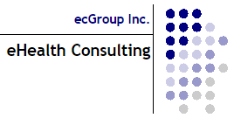

Who Participates?

Slide 15
What are the Limitations of the FHIR Base Specification?
FHIR Base Specification = “building blocks”, whose defined data elements are expected to be encountered in 80% of systems around the world
FHIR Base Specification intentionally avoids region-specific code systems & business rules (based on policy)
Expects implementations to constrain and extend the building blocks to meet their specific needs
Each implementor builds an Implementation Guides (IG) that uses those blocks to meet their needs
Starting from base specification is like starting from scratch each time
Lack of alignment between IGs operating in same countries and domains
We all need customization, but we aren’t leveraging each other’s efforts
FHIR Base Specification
IG
IG
IG
IG
IG
IG
IG
IG
IG
IG
IG
Notes:
The Canadian FHIR Baseline Profiles (CA Baseline for short) group is working on building and socializing its namesake: a set of FHIR Profiles which will serve as the starting point for all Canadian FHIR Implementation Guides going forward.
These FHIR Profiles possess constraints which are deemed to be common across the majority of Canadian FHIR-based workflows, and across jurisdictional boundaries.
The data elements which are included in a 'base' FHIR Resource are those which are considered relevant / useful to at least 80% of implementing systems; the 80-20 rule is the 'rule of thumb' for deciding 'what's in & what's out' of a FHIR Resource base list of elements (those that aren't relevant to at least 80% of systems are what have to be defined at the specific implementation level as 'extensions’
Reuse and Composability – FHIR resources are designed with the 80/20 rule in mind – focus on the 20% of requirements that satisfy 80% of the interoperability needs. To this end, resources are designed to meet the general or common data requirements of many use cases to avoid the proliferation of numerous, overlapping and redundant resources. Extension and customizations exist (see FHIR Profiles) to allow common, somewhat generic resources to be adopted and adapted as needed for specific use case requirements. In addition, FHIR resources are highly composable in that resources commonly refer to other resources. This further promotes reuse and allows for complex structures to be built from more atomic resources.
data elements are in the 80%: i.e. something that 80% of implementers will encounter and/or need - not 80% of the cases that occur to all implementers (this is about preventing work flow variations from complicating the model) -https://wiki.hl7.org/Authoring_FHIR_Resources#DesignConsiderations

Slide 16
What Are We Doing And Why?
Realm-specific guidance (i.e. Canadian Baseline)
Completed effort upfront to identify the basic constraints and extensions that any FHIR implementation operating in Canada can expect to include
Intended as a common starting point, not an out-of-the-box implementation
Convened Canadian implementers and Implementation Guide authors to develop initial draft over the last 18 months
Due diligence reviews against existing Canadian FHIR Implementation Guides to ensure alignment and appropriate scope maintained
Ready for the larger community to review it (which helps us refine the content to support the breadth of use cases in the Canadian realm)
FHIR Base Specification
Canadian Realm
IG
IG
IG
IG
IG
IG
US
Realm
IG
IG
IG
Notes:
The Canadian FHIR Baseline Profiles (CA Baseline for short) group is working on building and socializing its namesake: a set of FHIR Profiles which will serve as the starting point for all Canadian FHIR Implementation Guides going forward.
These FHIR Profiles possess constraints which are deemed to be common across the majority of Canadian FHIR-based workflows, and across jurisdictional boundaries.

Slide 17
What Are We Doing And Why?
HL7 FHIR
Canadian FHIR Baseline Profiles
Canadian FHIR Implementation Guide 1
Canadian FHIR Implementation Guide 2
Canadian FHIR Implementation Guide 3
Etc.
Canadian Baseline:
27 Profiles
(resources from the base specification constrained/extended for Canadian use)
Start Here
First step in reducing burdens on IGuide authors and unnecessary system customization across jurisdictions and healthcare domains
Notes:
The Canadian FHIR Baseline Profiles (CA Baseline for short) group is working on building and socializing its namesake: a set of FHIR Profiles which will serve as the starting point for all Canadian FHIR Implementation Guides going forward.
These FHIR Profiles possess constraints which are deemed to be common across the majority of Canadian FHIR-based workflows, and across jurisdictional boundaries.

Slide 18
Who are we Targeting and Why?
Federal, Provincial, Territorial (Strategic Level)
Broadly incorporate published standards in the tools/solutions
Standards Organization
Define policy and fund initiatives to improve data quality, reporting, and interoperable exchange
Clinical Organizations
FHIR Community Affiliates
Support health systems in meeting requirements
Contribute expertise to the refinement of standard
Use and extend standards to write IGuides
Enforce and support (fund) the implementation of programs/tools that meet requirements
Jurisdictional and Regional (Operational Level)
Health Systems
Solution Vendors
Implement tools/changes that meet requirements for program
Utilize IGuides to inform specific changes/development of tools
FHIR iGuide Authors/SMEs
Define requirements that are operationalized through implementation guides
Canadian Health Information Standards Ecosystem
Notes:
You are part of the diverse Pan-Canadian community that informs, drives, and enforces FHIR implementations in Canada
Complex levers/motivation, each member of the ecosystem contributes something that drives the adoption of FHIR
Community affiliates largely made up of organizations in this ecosystem contributing members to the community

Slide 19
What’s Our Ask Of You?
Solution Vendors
Federal, Provincial, Territorial (Strategic Level)
Jurisdictional and Regional (Operational Level)
Health Systems
Clinical Organizations
FHIR Community Affiliates
FHIR iGuide Authors / SMEs
Standards Organization
We are asking [Insert group name] to endorse the CA Baseline.
Statement of Endorsement:
We agree with the vision and benefits of the CA Baseline
You are part of the diverse Pan-Canadian community that informs, drives, and enforces FHIR implementations in Canada
We require iGuide authors under our purview to use the CA Baseline as a starting point for their profiles
We promote awareness of & participate in the refinement of the CA Baseline
We will contribute to the creation of a shared governance model for this work, that is co-owned across jurisdictions and chaired by a Pan-Canadian body
Notes:
Fundamentally, we are asking for you to declare that you agree with the vision and benefits of establishing a set of Canadian FHIR Baseline Profiles
As a Jurisdictional and Regional Group, our ask of you is as follows:

Slide 20
What’s In It For You?
Solution Vendors
Federal, Provincial, Territorial (Strategic Level)
Jurisdictional and Regional (Operational Level)
Health Systems
Clinical Organizations
FHIR Community Affiliates
FHIR iGuide Authors / SMEs
Standards Organization
Incorporation of the Baseline into our Canadian Ecosystem results in the following benefits for jurisdictional stakeholders:
Business Lens
Technical Lens
Increased reliability / quality of data & patient safety
Achieving front end & backend interoperability across vendors & jurisdictions more feasible
Canadian
Health Information
Standards
Ecosystem
Reduced effort/time for jurisdictional resources to generate Implementation Guides
Decreased need to customize vendor products for jurisdictional needs
Increased power & choice in procurement of vendors that support Canadian concepts
Helps alleviate discrepancies between jurisdictional data exchange workflows
Increased business opportunities and partnerships
Creation of conformance tools to support testing and compliance
Notes:
As a Jurisdictional and Regional Group, beyond the stakeholder-agnostic benefits of the CA Baseline here is what we feel you stand to gain by declaring yourself as an advocate of our work with the CA Baseline:
Publishing iGuides with a minimum set of common constraints reduces time taken to author net-new Guides & also primes participating iGuide Implementers for future Jurisdictional initiatives

Slide 21
What’s Next?
Immediate Next Steps:
Walkthrough of the CA Baseline materials with subcommittee/ technical team
Gain confirmation that [insert name here] endorses the CA Baseline and will support the asks identified in this proposal.
CA Baseline workstream will collect additional endorsements from the other stakeholders identified in the presentation
After Endorsements Collected:
Jurisdictional operational working group endorsements input into proposal for Federal Strategic Level organizations (e.g., Canada Institute for Health Information, Canada Health Infoway, etc.) to ask for:
Support in the establishment of a formal governance model that is co-owned by jurisdictions and chaired by a Pan-Canadian body, to ensure the CA Baseline is adopted and maintained unilaterally
Harmonization between the CA Baseline and strategic initiatives
Acceptance of the CA Baseline as a foundation for a future more prescriptive / constraining specification (Core)
Tooling to support conformance testing and adherence to the CA Baseline Profiles (profile validators, sandbox environment, etc.)
Notes:
We are hoping the prospect of a pan-Canadian set of FHIR Baseline Profiles resonates with you. As we continue to seek pan-Canadian sponsorship, we would like to be able to include your organization name and logo in our growing list of CA Baseline advocates.

Slide 22
For Authors and Implementers
CA Baseline iGuide: http://build.fhir.org/ig/HL7-Canada/ca-baseline/branches/master/index.html
FHIR Implementers Community on InfoCentral: https://infocentral.infoway-inforoute.ca/en/collaboration/wg/fhir-implementations
Contact Info for CA Baseline Co-Leads:
Sheridan Cook: scook@gevityinc.com
Mike Savage: michael.savage@ontariomd.com

