Slide 1
FhirPath?
What is FhirPath?
Navigation
Manipulation
Evaluation
Why FhirPath? (aren’t there other existing options?)
Standards status:
Normative https://hl7.org/fhirpath
Current Build https://build.fhir.org/ig/HL7/FHIRPath
Notes:
FHIR Path is an expression language that can navigate a fhir resource and evaluate a result. It can manipulate the result or perform tests along the way in a fluent style.
Could return a collection of nodes from the resource, a single Boolean value, or even a concatenation of multiple fields.
It’s kindof like XSLT or XPath or JsonPath or .NET’s LinQ
We didn’t use any of these options as we needed an answer that would work for both XML and JSON (or direct object models) without needing to perform translations to another format to operate.
Has a formal grammar

Slide 2
FhirPath uses in FHIR
StructureDefinitions
Invariants (boolean result)
Search Parameters
Value to index (extraction)
Questionnaires
Invariants
Pre-population
Dynamic fields
And many more!
SQL on FHIR
Mapping Language
Logical model
not XML or JSON
Datatype Mappings
FHIR Specific extras
Polymorphism
Patient.deceased[x] (spec)
deceased (fhirpath prop)
deceasedBoolean (xml/json)
Notes:
In FHIR we use it to describe validation expressions (invariants/constraints) in StructureDefintions and Questionnaires, and to define what data is to be indexed in search parameters, and lots of dynamic ways in questionnaires (hope you were able to see my session on Questionnaires or pre-population earlier in the week)
Resource Model: FHIRPath uses a tree model based on the logical views of FHIR resources and data types, rather than the specific JSON or XML formats
Polymorphism: It handles choice elements (e.g., Patient.deceased[x]) by allowing explicit treatment of specific types using the as operation.

Slide 3
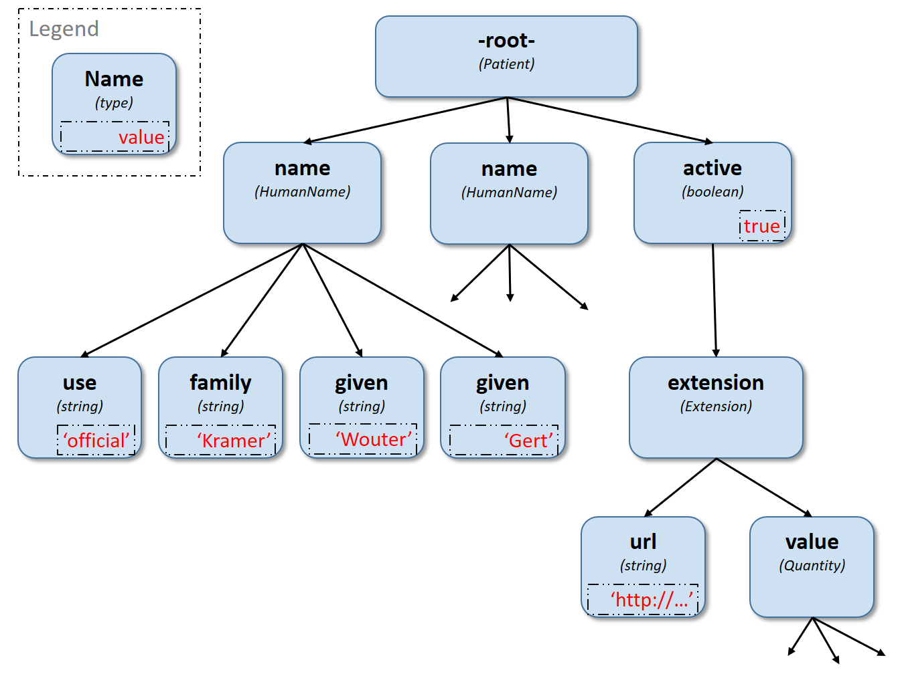
Navigation
Walking the property tree
Selection
Patient.name.given
name.where(family.exists()).given
Patient.deceasedDateTime
Patient.birthDate.extension(‘http://…birthTime’).value
Notes:
Refer to the resource as a property tree, not a specific format. This can apply to multiple formats.
Quickly mention polymorphic types and extension shortcut
Also mention everything is a collection

Slide 4
Operators
Math Operators +, -, /, *, &, (), etc
Logical Operators =, ~, ! =, <, or, and, implies
Casting Operators as, is
Set Operator |
Note: These do not support collections!
Tip: To use in collections, move inside select(…)
Tip: Concatenating strings can be done with + or & (use & if you want to handle either side being empty)

Slide 5
Functions
Projection Functions
Existence Functions
Manipulation Functions
Evaluation Functions
Focus/Context
Parameters/Arguments
Return Value/Result
Types, Polymorphism and casting
Execution behaviour
name.where(family.exists()).given.empty()
Collections – everything is one!
But not all functions work on collections
https://build.fhir.org/ig/HL7/FHIRPath/#functions
Notes:
Highlight the order of operation, i.e. don’t stop navigating just because the collection is empty, as the function at the end might be an exists() call.

Slide 6
Projection Functions (expression arguments)
select(…)
where(…)
first()
last()
skip(2)
combine(…)
repeat(…)
aggregate(…)
$this and $index variables
Tip: where() requires the expression inside to return a Boolean, use existence functions and operators to ensure collections are handled correctly. e.g. .allTrue(), .exists()
https://build.fhir.org/ig/HL7/FHIRPath/#filtering-and-projection

Slide 7
Context Variables
variable | description
%context | The item that the expression is requested to be evaluated from. E.g. For invariants, the context is set to a property, not the resource.
%resource | the resource that contains the original node that is in %context.
%rootResource | the container resource for the resource identified by %resource
Tip: None of these variables change during the execution of an expression
https://hl7.org/fhir/fhirpath.html#variables
Notes:
Before we dive in and explore $this in more detail, it’s important that we understand context variables

Slide 8
Understanding the $this variable
The $this variable is initially set the same as the %context variable
The $this variable (and $index) will be set to each item during the evaluation of a function that has a parameter type of expression,
e.g. where() / select()
NOT for other functions such as toString()
When exiting the function, $this is restored
“the current focus” is NOT $this, though has similarities
Proposed $focus – closer to other languages version of this (FHIR-44601)
Good Examples:
Bundle.entry.resource.all($this is Observation implies status = 'finished')
value.aggregate($this + $total, 0)
Bad Examples:
name.given.where($this > 'ba' and $this < 'bc')
'A/B/C'.substring($this.indexOf('/')+1)
name.given.iif($this = 'Brian ', ' Its Me!', $this)
See FHIR-44601

Slide 9
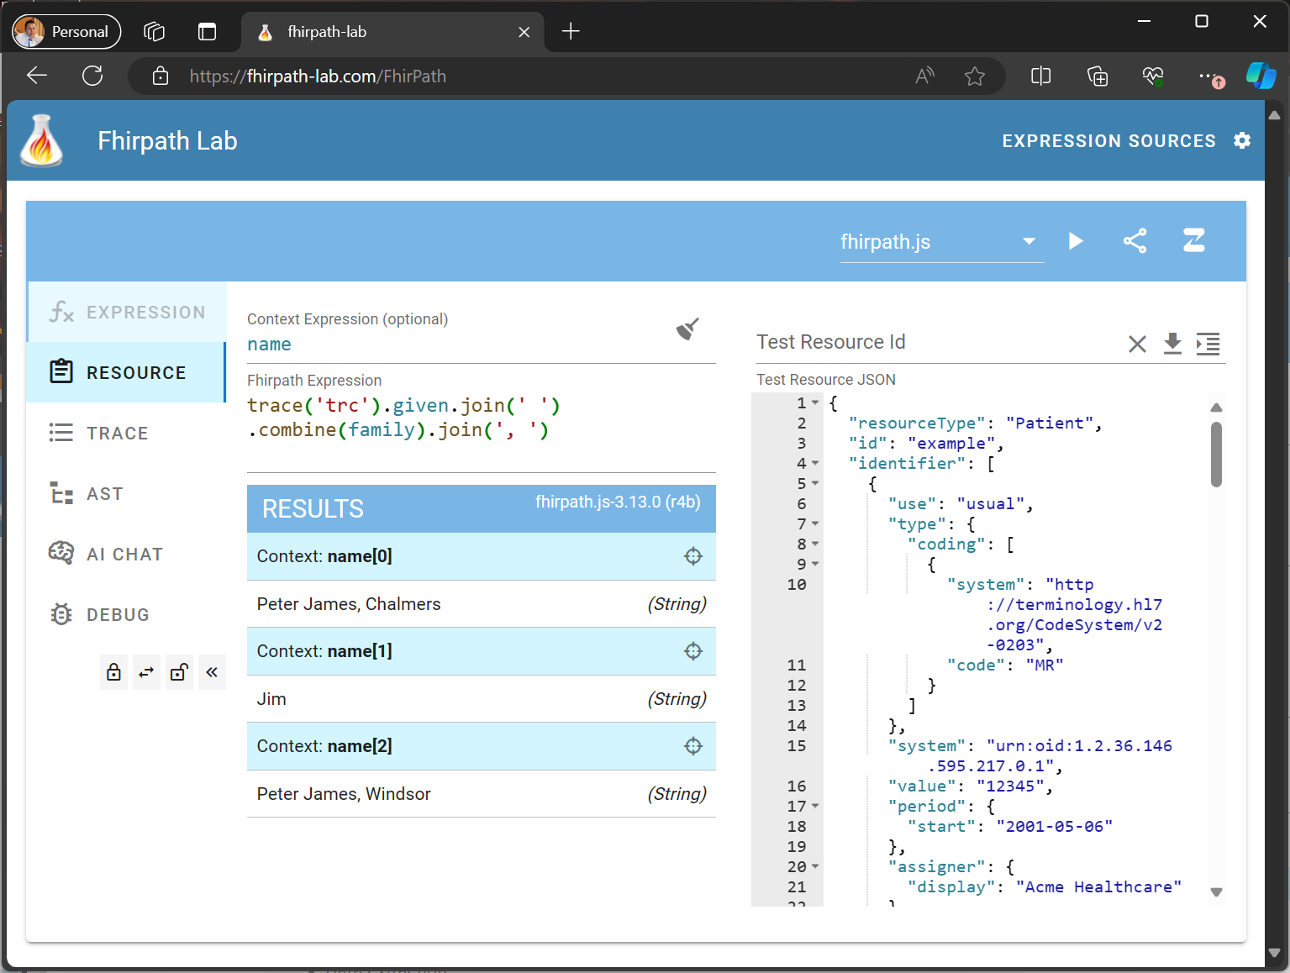
The FhirPath-Lab
https://fhirpath-lab.com
Create
Test
Debug
Share
FhirPath
Questionnaires
FHIR Mapping Language
Notes:
Tracing
Variables
Different Engines – Validation from the .NET engine
Abstract Syntax Tree – function hyperlinks to spec
Save the AI Chat for later

Slide 10
Debugging Expressions
Using Trace effectively
Understanding the Abstract Syntax Tree
Comparing different engines
Improved static validation from .NET
Review collections/context
code.select((coding.where(system='http://snomed.info/sct’).display | coding.where(system!='http://snomed.info/sct’).display.first() | text ).first())
Notes:
Trace is the console.log or printf of the fhirpath world
How can we debug this expression with several cases – This use case for this expression is to select the first of the values if it exists in the code: snomed concept, other concept, or free text.

Slide 11
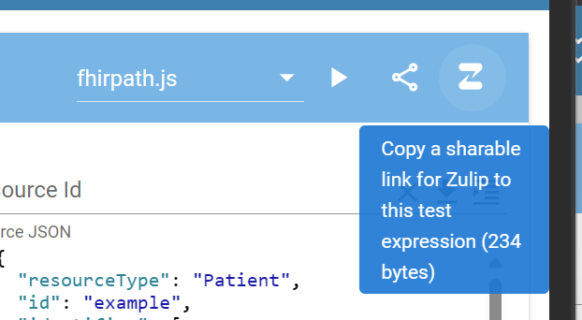
Getting Help with FhirPath
Zulip
https://chat.fhir.org/#narrow/stream/179266-fhirpath
https://chat.fhir.org/#narrow/stream/179298-fhirpath.2Ejs
Test with the FhirPath Lab first, then share issue
Using the “share with Zulip” button
This wraps the expression, context, test resource and engine into a link and markdown block ready to paste into Zulip to let others test too!

Slide 12
FhirPath Tooling/Engines
Project | Company/Contributor | Dev Language | Distribution
FhirPath Lab | Brian Postlethwaite | VueJS | (hosted)
Fhirpath.js | (lots of contributors) | Javascript | Npm
Firely SDK | Firely | .net 8 | NuGet
HAPI | Smile Digital Health | JAVA | Maven
FhirPath Validator | Brian Postlethwaite | .net 8 | NuGet
Aidbox | Health Samurai | Closure
Fhirepath.py (new) | Beda Software | Python

Slide 13
FHIRPath in FHIR
https://hl7.org/fhir/fhirpath.html
Additional variables: %resource, %rootResource
Additional functions:
extension(url)
hasValue()
getValue()
resolve()
ofType()
elementDefinition()
slice(structure, name)
checkModifiers()
conformsTo(structure)
memberOf(valueset)

Slide 14
FHIRPath in SDC
https://build.fhir.org/ig/HL7/sdc/expressions.html#fhirpath-supplements
Additional variables: %questionnaire, %qitem
Additional functions:
sum(), min(), max(), count(), avg()
answers()
ordinal() weight()

Slide 15
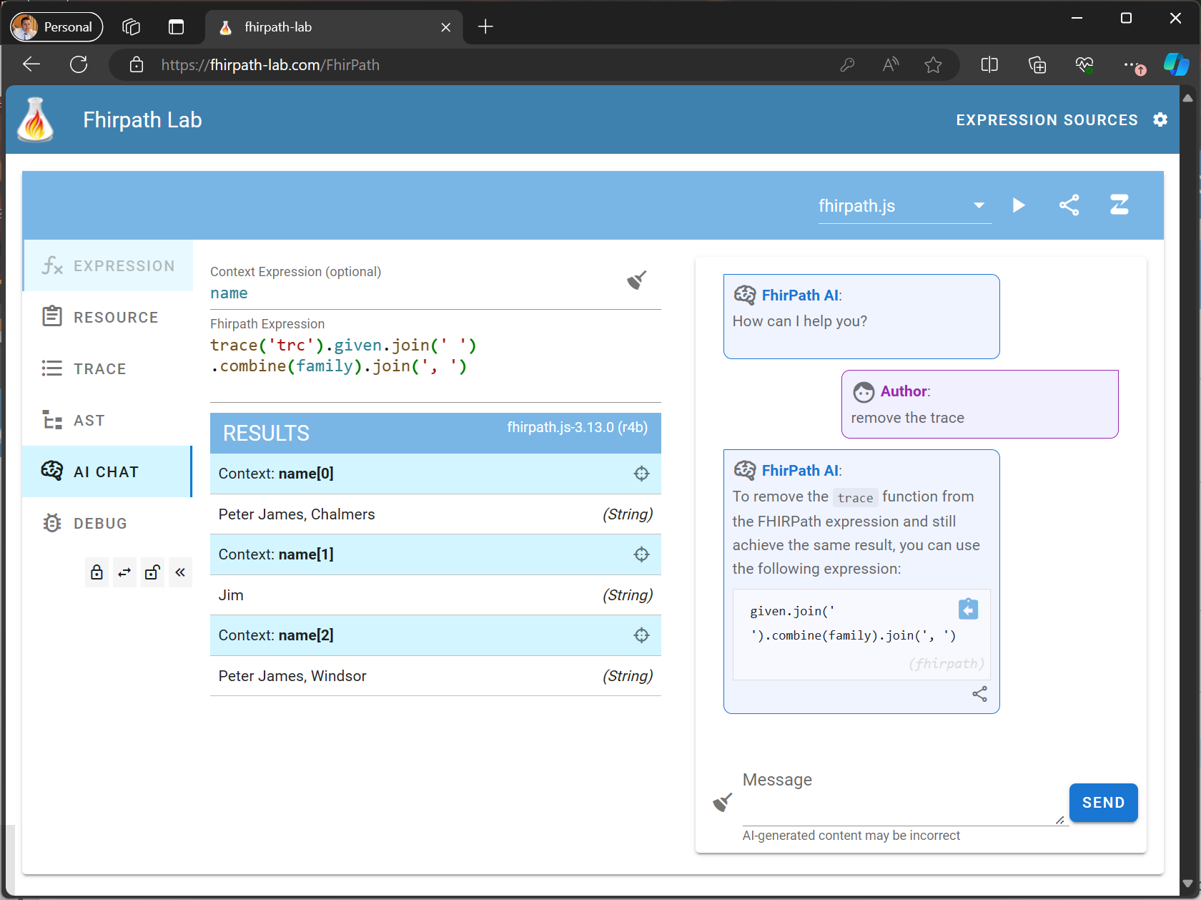
Demonstration
https://fhirpath-lab.com/FhirPath

