Slide 1
Social Determinants of Health Working Group
Monthly SDOH Working Group Zoom Meeting
Dec 11th - 10 am PT; 11 am MT 1 pm ET
Facilitated by Jennifer Lawson and Brooke Carroll
Notes:
The logo can be changed in the master slides. Please use the following instructions
Select view > slide master.
Right click on the logo and select change image.
Select the image you want to use you may need to scale the image accordingly.
When you're done, select close master view.

Slide 2

Land Acknowledgement
Land acknowledgement​
We would like to acknowledge the lands that we occupy, whether treaty or unceded. We recognize that these lands are home to many diverse First Nations, Inuit and Métis Peoples.
Seed gatherers by Duncan Nagonigwane Pheasant from the M’Chigeeng First Nation of Manitoulin Island

Slide 3
Recording is starting
REC

Slide 4

Agenda
Welcome and introductions – 5 min
Update on SPARK Tool and Deep End Canada (Joe and Leanne) – 15 min
Overview of the PCHDCF (Framework) and CACDI, review data standards development process (Brooke) – 5 min
Review SDOH category (Brooke and Jen) – 20 min
a) Review and member discussion/feedback
b) Discuss priority of data elements for development
Workplan and schedule for data element discussion for 2025 meetings (Jen) – 5 min

Slide 5
Pan-Canadian Health Data Content Framework;
Data Content Standard;
and
the Draft Canadian Core Data for Interoperability (CACDI) Version 1
Notes:
As mentioned earlier, CIHI is working towards defining what data needs to be transmitted between systems. A product that stems from this work is the Pan Canadian Health Data Content Framework

Slide 6




Definition | The Pan-Canadian Health Data Content Framework
One common data content standard, data architecture and business glossary for all health-related data in Canada
Purpose: to improve data quality and consistency of health data, leading to more trust and use of the data for patient safety
What it does: it defines and standardizes data to ensure meaningful exchange and interpretation across the health care system to achieve semantic interoperability (same meaning from sender to recipient).
Use: It will be the “source of truth” that will define foundational data for health care delivery and management across all health sectors.
Notes:
The purpose of the pan Canadian health data content framework is to improve data quality and consistency of health data, leading to more trust and use of the data for patient safety through defining and standardizing data to ensure meaningful exchange and interpretation. This will be the“source of truth” that will define foundational data for health care delivery and management across all health sectors.

Slide 7




Scope | Pan-Canadian Health Data Content Framework
Provides one data content standard and architecture for all health-related data for primary and secondary uses
Person health
Care organization operations
Health system
management
People and communities
Clinicians, care team, clients, families
Administrators, directors,
managers
Provinces,
territories
and regions
Population
and public
health
Clinical care planning and management
Quality improvement,
Program planning,
Resource allocation
Health system use,
Pan-Canadian comparability
Chronic disease management,
Health outcomes
CIHI’s typical area of standards development for health system use
Notes:
Scope of the framework is for both primary and secondary use of the data. CIHI traditionally developed standards for secondary use (which is health system management) (#3) but scope of framework is broader than that. Content of framework is to help inform clinical care and operational planning, quality improvement, health system use and population/public health initiatives.

Slide 8
Data Content Standard - Overview
Data required for Connected Care in contexts of primary use and secondary use
Specifies the Data Elements and Value Sets to ensure semantic value across the health care system
Strong relation to the Pan-Canadian Health Data Content Framework Data Models
Data
Models
Value
Sets
Data
Elements

Slide 9
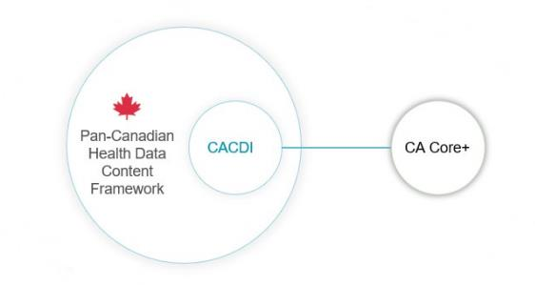
Relationship between the Pan-Canadian Health Data Content Framework, CACDI and CA Core+
Pan-Canadian Health Data Content Framework (the “what”): A comprehensive set of health information that should be collected and shared in a standardized way across health systems to satisfy a variety of health information needs.
Canadian Core Data for Interoperability (the “essential”): The minimum data required to support standardized information capture and enable meaningful exchange of health information.
CA Core+ (the “how”): The technical specification that outline how the CACDI will be exchanged between systems.
Together, the CACDI and CA Core+ work in tandem to facilitate interoperability and data exchange.
Notes:
Next, I want to introduce the Draft Canadian Core Data for Interoperability or the CACDI in context of other standards products
The pan-Canadian Health Data Content Framework is considered the comprehensive set of health information that has been identified for standardized collection and sharing
the CACDI is the “essential” portion of the Framework’s content
It composes the minimum data required to support standardized information capture and enable its meaningful exchange.
The CACDI informs the CA Core+ which is the draft Canadian HL7 FHIR specification led by Canada Health Infoway and which describes the rules for packaging the CACDI data for transfer from one system to another, or in other words the “how”:
The CACDI represents a first for Canada demonstrating our commitment to forming and publishing products that will help enable pan-Canadian, interoperable health data exchange

Slide 10
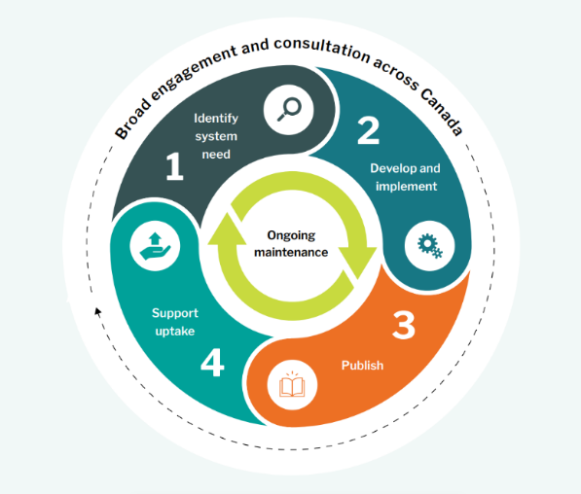
What is the development methodology lifecycle of health data standards?
Notes:
At CIHI, we follow 4 steps to developing data standards - Through all of this, important to ensure broad engagement and consultation.
Step 1 is identify system needs and periodically evaluate standards for relevance and to support emerging priority areas such as equity and COVID-19.
Step 2 is develop and implement. Once needs have been identified, then we collaborate with key partners to develop and implement the standard, which includes defined data elements and value sets.
Step 3 is publish. The new or modified standard is published with supporting documentation. This may include user manuals, data dictionaries and coding resources such as training guides, specific coding directions, FAQs, infographics/data visualizations and job aids.
Step 4 is support uptake. So closely working with provinces, territories, and other health organizations and vendors to ensure that the standards are adopted properly and implemented.
Step 1: Continuous scanning of needs, some areas that are continuously evolving such as equity
Identify system need / Periodic evaluation: Determine new standards or modifications to existing standards that are needed to support emerging priority health system areas. Examples: equity, COVID-19. Periodically evaluate standards for relevance.
Step 2: once we have identified needs, we will collaborate with key partners to develop and implement standard, with defined core data elements, value sets and code systems
Develop and implement In collaboration with key partners and based on the input gathered through the consultations, a standard is developed and implemented with defined core data elements, value sets and code systems, which may vary based on care setting.
Step 3: Once developed, publish….
Publish The new or modified standard is published with supporting documentation. This may include user manuals, data dictionaries and coding resources such as training guides, specific coding directions, FAQs, infographics/data visualizations and job aids.
Step 4: Lastly, supporting intake: we work closely with P/Ts and other health orgs and vendors to make sure that the standards are adopted properly and implemented. Importance of ongoing support and training (e.g. support for data submission or conformance testing)
Support uptake Provincial/territorial jurisdictions, other health-related organizations, and vendors receive ongoing support for the implementation of the standard in their systems and vendor solutions. This includes the tools to build capacity through training, including on data literacy, to troubleshoot data submissions and the support for conformance testing.
There is also a need for ongoing maintenance – for example, if there are changes to the standard, these need to be conveyed as well.
Broad engagement and consultation through each of these steps is important to ensure that the interest-holders are involved.
Consult at pan-Canadian level: Pan-Canadian level consultations with federal organizations, provinces and territories, clinicians, researchers, health delivery organizations, expert working groups, professional associations, patients, indigenous representatives, communities and international groups to understand information needs that inform the development of new standards or modifications to existing standards.

Slide 11
Social Determinants of Health Assessment
Definition: A detailed assessment of a person’s needs related to the social determinants of health, including social and demographic information.
Data elements
Service language
Gender Identity
Employment Status
Access to Food
Education Level
Sexual orientation
Financial Stability
Access to Medication
Relationship Status
Sex at Birth
Housing Stability
Access to Internet
PS-CA v1.0
SPARK Tool
BC GSSO Standard
USCDI V5
Racialized Group
Gender Used
Household Composition
Access to a Phone
Ethnicity
Recorded sex or gender
Housing Condition
Access to Transportation
Indigenous Identity
Sex Parameter for Clinical Use
Household Income
Access to Utilities
Religious or spiritual affiliations
Name used*
Access to Childcare
Born in Canada Status
Personal Pronouns*
Social Supports
Time since arrival in Canada
Person No Fixed Address Flag*
Legal History
Priority data elements for development
Experience with Interpersonal Violence
* Denotes data elements that under Person Information data category
Notes:
Other standards/tools compared – Telus Health Equity Questionnaire, Ontario Guidance for Collection and Use of Sociodemographic Data, and Gravity as well.
Priority data elements were found across multiple standards -

Slide 12
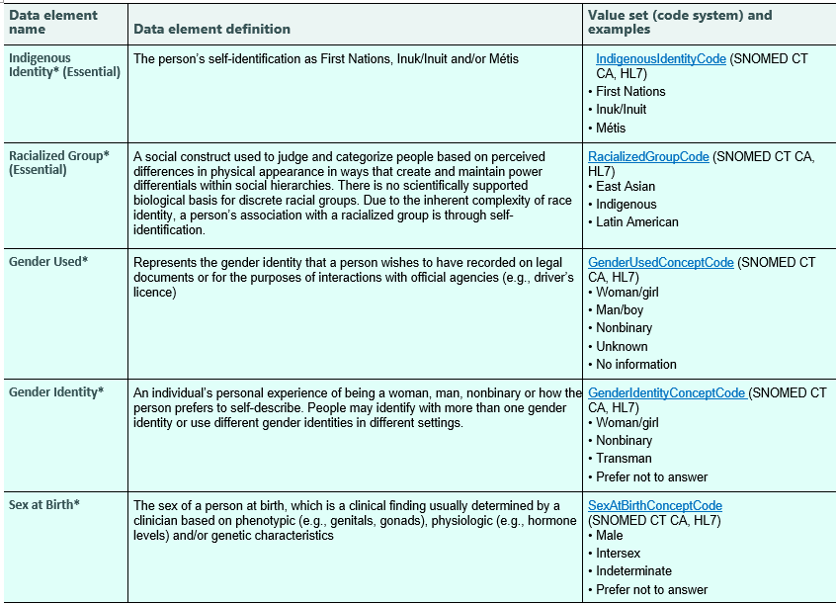
SDOH Assessment Data Category – draft Version 1
Notes:
Blue fill with asterisk = Frontend
White fill = Backend (none for SDOH)
Essential = CACDI element

Slide 13
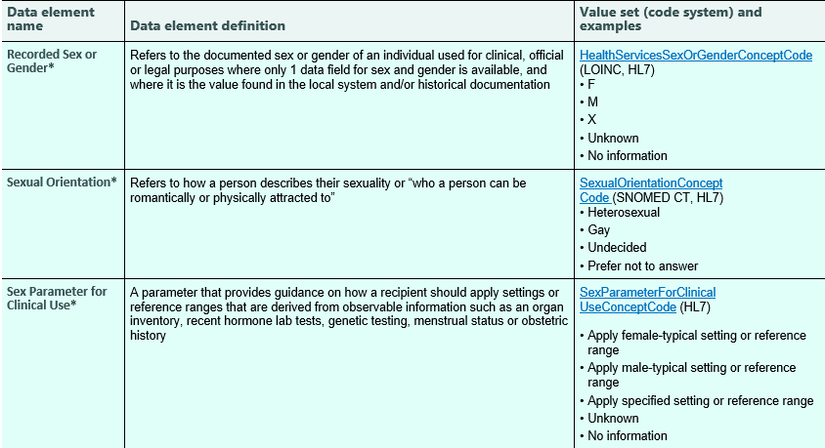
SDOH Assessment Data Category – draft Version 1 continued
Notes:
Not shown here, but Service Language – no value sets in draft V1, but is stable and has appropriate recommended value set for review with value sets working group. Ready for draft V2 Sept 2025

Slide 14
Proposed work plan and prioritization
Month of Meeting | Data Elements
January 2025 | Housing Stability Education Level
February 2025 | Employment Status Financial Stability
March 2025 | Ethnicity TBD
April 2025 | TBD
May 2025 | TBD
June 2025 | TBD
For prioritization discussion:
Born in Canada Status
Religious or Spiritual Affiliations
Social Supports
Household Composition
Access to Food
Access to Transportation
Others?
Notes:
Examples of others missing or key that are in Framework currently
Access to medication
Access to internet
Access to a phone
Access to utilities
Access to child care
Experience with interpersonal violence
Legal history
Housing condition
Household income
Time since arrival in Canada

Slide 15
Other Business
Members Updates?
Conferences
Readings
Next Meeting: January 8th, 2024, 1 pm EST.

Slide 16
Breast Cancer and Ethnicity
In consideration of use cases that spur better collection of SDOH data in health care systems, I will direct you to this recent short feature story on CBC radio, Nov 5 - listen at 19 min mark here: Breast Cancer and race and ethnicity study .
A summary of Dr. Wilkinson recent paper is linked here.
Breast cancer characteristics and outcomes in Canada related to race and ethnicity are not currently documented. This new study has found that Canadian women who did not identify as White had an earlier peak age of breast cancer diagnosis and higher proportions of cases diagnosed under age 50. They also have an earlier peak age of death, dying on average seven years earlier. Posted to WG documents section. You can navigate there on our WG's top menu or they are linked below. Breast cancer incidence and mortality, by age, stage and molecular subtypes, by race/ethnicity in Canada and Dr. Carr's research The experiences of Indigenous people with cancer in Saskatchewan: a patient-oriented qualitative study using a sharing circle

