Slide 1
Patient Summary
Working Group (PSWG)
January 7, 2025
Allana Cameron, Senior Product Manager, PS-CA
Sonia Balgah, Senior Business Analyst, PS-CA
Ken Sinn, Senior Standards Specialist

Slide 2




Welcome to 2025!
Together, we embark on a new year filled with opportunities to innovate, collaborate, and make a meaningful impact on patient care. Let's harness our collective expertise and passion to drive forward our mission and achieve new milestones.
Here's to a year of growth, success, and positive change!
2
©2025 Canada Health Infoway

Slide 3


What is your favorite memory or team achievement from 2024 ?
ⓘ Start presenting to display the poll results on this slide.
3
©2025 Canada Health Infoway

Slide 4
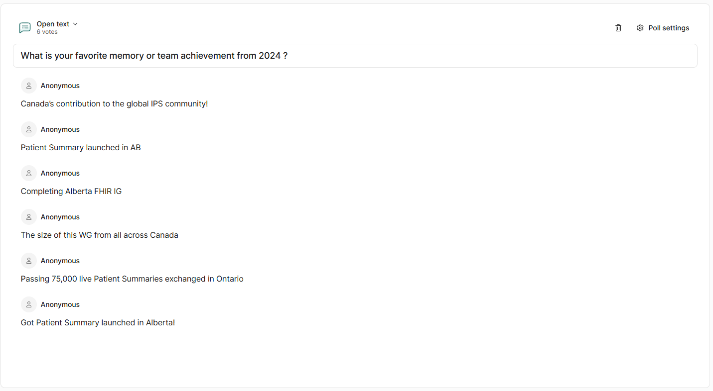

Slide 5
Name something fun and/or adventurous you plan to do in 2025.
ⓘ Start presenting to display the poll results on this slide.
5
©2025 Canada Health Infoway

Slide 6
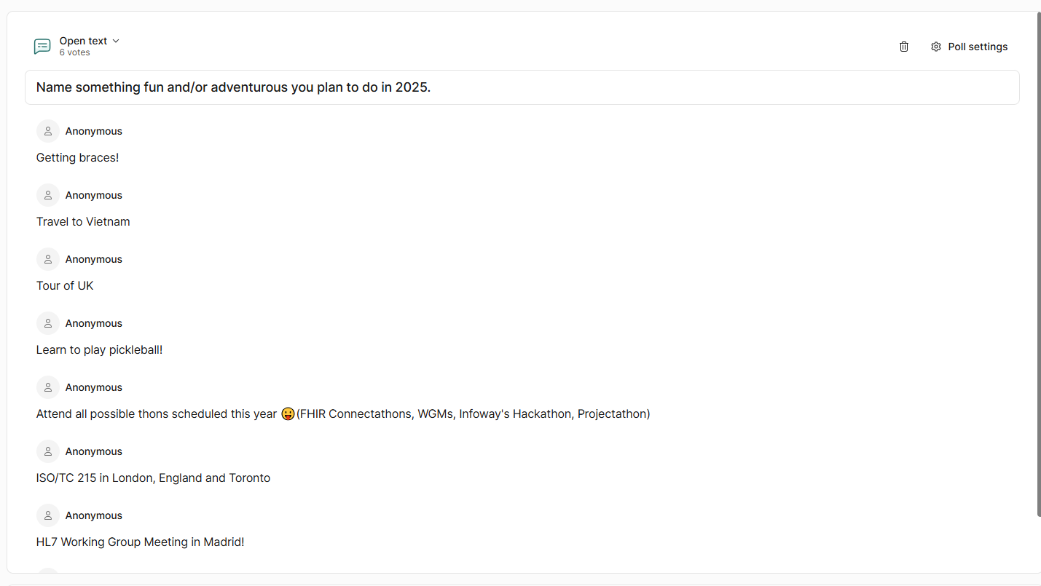

Slide 7
Agenda
1
IHE North America Connectathon
2
PS-CA Release Timing and Scope
3
IPS Updates
4
Patient Summary Implementation Progress
5
Next Steps
7
©2025 Canada Health Infoway

Slide 8
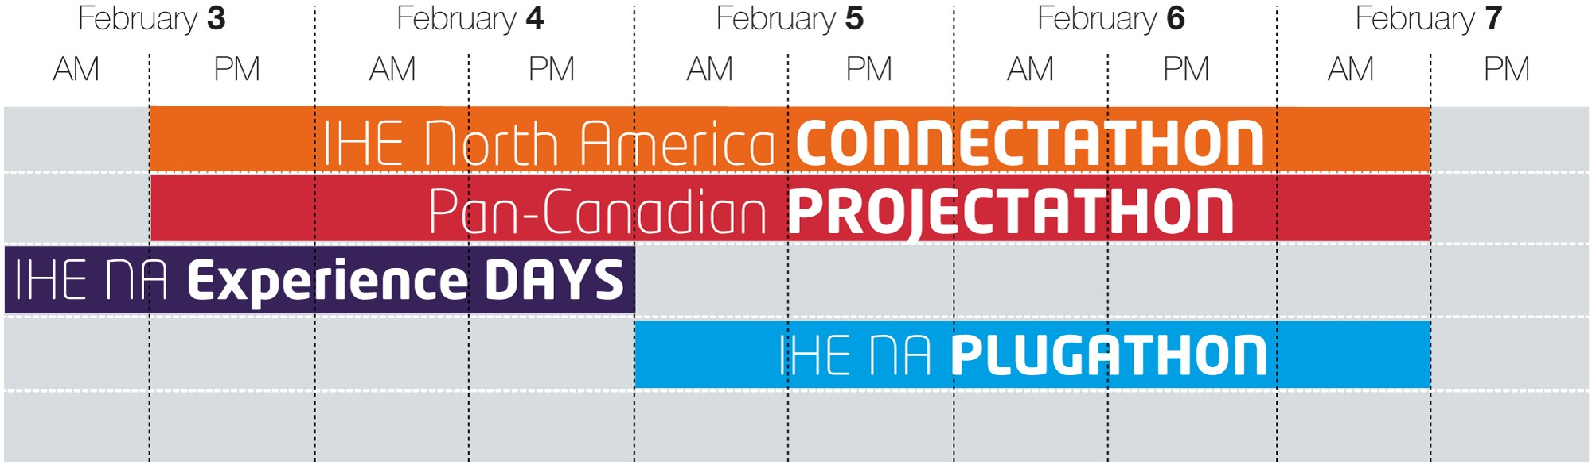
Pan-Canadian Projectathon
26 Systems are registered to test the PS-CA and CA:FeX specs at the Projectathon 2025!
Testing will include test cases for the PS-CA, CA:FeX and harmonized provincial Patient Summary specifications for British Columbia, Alberta, Ontario and New Brunswick!
Projectathon Support: Weekly office hours, Tuesdays 2-4pm ET. Dedicated space for questions, clarifications, and support on Projectathon topics.
8
Projectathon registration is closed. Please reach out to us directly if you have questions about Projectathon attendance: interoperability@infoway-inforoute.ca
©2025 Canada Health Infoway
Notes:
Highlight the importance of registering for both the Projectathon and Plugathon with different people to ensure they take advantage of testing current specifications and the opportunity to participate in the future of the IPS/PS-CA.

Slide 9
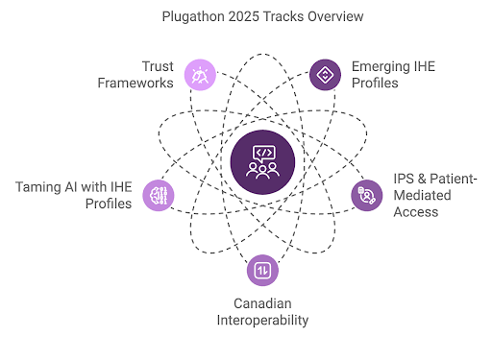
Plugathon
Open exploration of emerging technologies and IHE profiles through dedicated tracks. Facilitates dynamic exchange of ideas, bridging user needs, vendor solutions, standards, and industry innovations.
Track 3: Highlights the pan-Canadian Shareable Health Link specification (CA:SHL) which supports the patient-mediated access use case in PS-CA.
Track 2: Highlights IPS testing tools, IPS global implementations and patient-mediated access using VHL.
Global Collaboration Opportunity! We encourage everyone to join together for collaboration on IPS shared topics.
9
View the Plugathon schedule and register here.
©2025 Canada Health Infoway

Slide 10

PS-CA Upcoming Release: Timing and Scope Considerations
Projectathon Learnings: Show-stopper/critical results of vendor testing
IPS v2.0.0 Updates: New section “Patient Story” and additional status options for labs
PS-CA
Scope
Considerations
PS-CA Implementations: Early learnings from PT PS-CA production MVP/LPRs
CA Core+: Continued alignment
Backlog: Items from previous ballot cycles
10
©2025 Canada Health Infoway
Notes:
Can we get Ken to create a slide on obligations and explain what obligations are?

Slide 11
IPS Updates

Slide 12
Observation.status to allow for “pending” lab results
The request to relax Observation.status to allow for pending lab results has been approved.
The ValueSet has been changed from https://hl7.org/fhir/uv/ips/2024Sep/ValueSet-results-status-uv-ips.html to https://build.fhir.org/ig/HL7/fhir-ips/ValueSet-results-status-uv-ips.html
{ final | amended | corrected } to { registered | preliminary | final | amended | corrected | cancelled | unknown }
This ValueSet applies to profiles “Observation Results - Laboratory/Pathology (IPS)” and “Observation Results - Radiology (IPS)”
Similary, new ValueSets have been created for ImagingStudy.status and DiagnosticResult.status
ImagingStudy Status: https://build.fhir.org/ig/HL7/fhir-ips/ValueSet-imaging-study-status-uv-ips.html (previously https://hl7.org/fhir/R4/valueset-imagingstudy-status.html) (basically excludes “entered-in-error”)
DiagnosticReport Status: https://build.fhir.org/ig/HL7/fhir-ips/ValueSet-diagnostics-report-status-uv-ips.html (previously fixed to “final” from https://hl7.org/fhir/R4/valueset-diagnostic-report-status.html) – vastly larger ValueSet
Update planned post-Projectathon

Slide 13
IPS WG Calls Update
https://confluence.hl7.org/display/PC/IPS+2024-11-27
Versioning – which version of IPS does an IPS document conform to?
Appropriate to use composition.meta.profile, but not forced to
Obligations, once available, will be used with composition.meta.profile as a MAY
Update $summary to support Profile input parameter, mirroring $docref
https://confluence.hl7.org/display/PC/IPS+2024-12-04
Rob McClure joined to discuss Gender Harmony extension requests

Slide 14
IPS WG Calls Update
https://confluence.hl7.org/display/PC/IPS+2024-12-11
Discussion on alignment on IPS Patient and IPA Patient (diff card on Patient.identifier)
Discussion on rendering of Condition profile, and
https://confluence.hl7.org/display/PC/IPS+2024-12-18
Continued discussion on alignment on IPS Patient and IPA Patient (diff card on Patient.identifier)
https://chat.fhir.org/#narrow/channel/207835-IPS/topic/IPS.202024.20Year.20End.20Summary
John D’Amore wrote up a 2024 year-end summary of IPS successes/announcements (NB!), along with upcoming 2025 events (incl IHE Connectathon in Toronto in Feb 2025)

Slide 15
Block Vote 7
https://chat.fhir.org/#narrow/channel/207835-IPS/topic/IPS.20Block-Vote-7
Block Vote 7 on Patient Care FHIR Call Jan 9th, 2025, 5pm ET
https://jira.hl7.org/browse/FHIR-39889 - Patient.identifier IPS/IPA diff, new narrative section
https://jira.hl7.org/browse/FHIR-43721 - req to relax Patient card for research; future use
https://jira.hl7.org/browse/FHIR-44765 - Med Ingr Stren Ratio binding loosened to allow UCUM + SCT (prev UCUM only)
https://jira.hl7.org/browse/FHIR-47521 - IPS version guidance
https://jira.hl7.org/browse/FHIR-47779 - GenderIdentity extension to be added to Patient profile
https://jira.hl7.org/browse/FHIR-47780 - personalPronoun extension to be added (similar to US Core)
https://jira.hl7.org/browse/FHIR-47782 - Sex Param Clinc Use – guidance added

Slide 16
Slicing Rule fix
PS-CA will also be changing slicing rules from FixedCodeableConcept to PatternCodeableConcept (e.g. Patient.identifier:JHN and Patient.identifier:MRN), due to unintended behaviours.
FixedCodeableConcept is applied very strictly when matching for slicing, PatternCodeableConcept is more permissive
Expect this in PS-CA post-Projectathon

Slide 17

Infoway Partnerships: IPS and PS-CA
Working together to evolve the IPS through formal processes,
introducing changes based on implementation experience,
for the benefit of all IPS implementers!
Canadian
Patient Summary Implementers
Jurisdictions
& Vendors
GDHP-IPS Stream
PCHOs
GDHCN
IPSCC
Other
Nations
International SDOs
Legend:
GDHP: Global Digital Health Partnership
GDHCN: Global Digital Health Certification Network
SDOs: Standards Development Organizations
IPSCC: International Patient Summary Coordination Committee
Canada
Health
Infoway
17
©2025 Canada Health Infoway

Slide 18
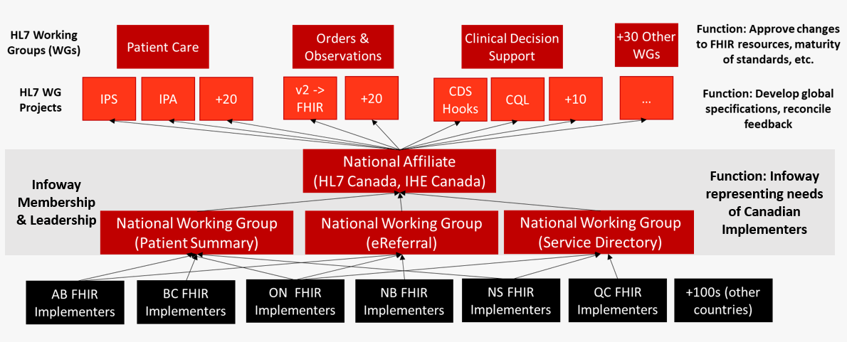
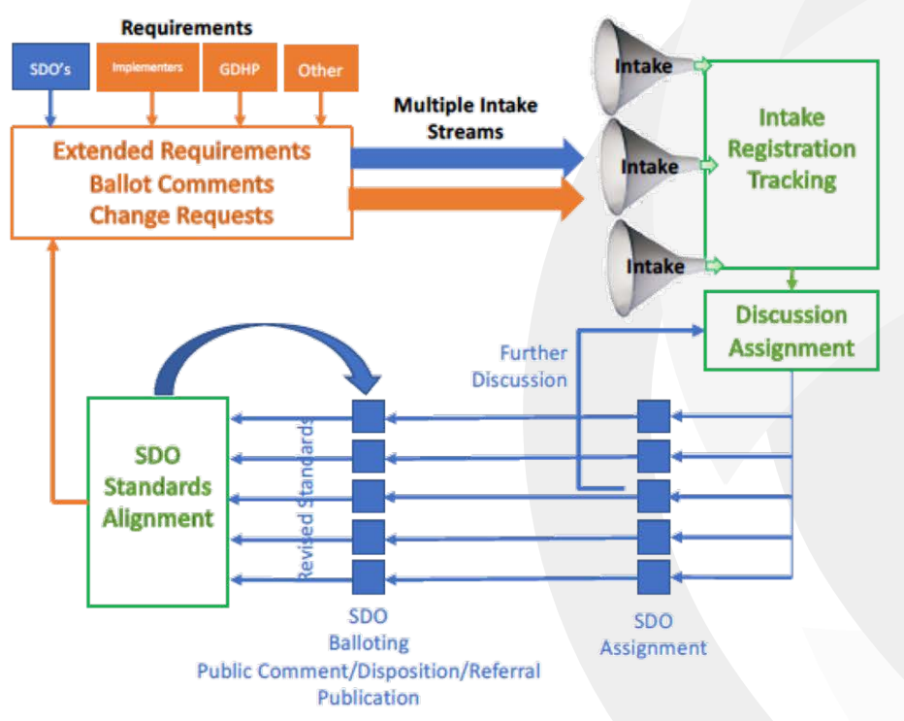
How Canadian Requirements Enter the Global Landscape
Canada Health Infoway represents the Canadian implementers’ needs into the IPS and applies IPS updates to the PS-CA
IPS Coordination Committee
Process Model
HL7 Consensus Structures
IPSCC is introducing a new process model for inputs into the IPS. Infoway is participating in a pilot of the new process
Meetings bi-weekly with participation from the 5 SDOs: HL7, ISO, SNOMED, IHE and CEN. (+ Infoway)
18
©2025 Canada Health Infoway

Slide 19
Patient Summary
Canadian Implementation Guides (IG):
BC IG
AB IG
ON IG
NB: Adopted PS-CA as is. IG under consideration

Slide 20

Current PS-CA Initiatives
The pan-Canadian Patient Summary aligns with the IPS and includes adaptations for the Canadian health context
Clinical engagement throughout to inform content, workflow approaches, and identify opportunities for adoption
PS-CA
BC
AB
ON
NB
Go-Live Date: Nov 5, 2024
Go-Live Date: July 15, 2024
PS-CA implementations live or in progress
20
PS-CA implementation planning underway
©2025 Canada Health Infoway
“PS-like” implementation w/ plans to migrate to PS-CA

Slide 21
PS-CA:PT LPR Clinical Use Cases
PT | Clinical Use Cases
BC | Direct sharing from community physicians to hospital clinicians in support of: Support patient hospital admissions, either proactive or on request between the Primary Care Provider and Hospital Health Care Provider
AB | Physician shares to central repository for access by authorized physicians in support of: Coordination and collaboration around a patient’s care, particularly for those with chronic conditions, who often require care from a broad care team beyond their medical home / family clinic Transition of care across care team members
ON | Physician shares to central repository for access by authorized physicians in support of: Safe provision of care in unexpected or unscheduled medical situations Transitions and transfers of patients across the continuum of care Coordination and collaboration around a patient’s care in Ontario Health Teams
NB | Patient-mediated sharing at any point of care in support of: Patient needs a snapshot of their health information while travelling within Canada or abroad
21
©2025 Canada Health Infoway

Slide 22
Next Steps
Confirm PS-CA release dates
Projectathon Support: Weekly office hours start today and will run every Tuesday from 2-4pm ET up until the Projectathon.
Plugathon – There’s still time to register! Please consider registering, here, before January 13th
Still a little unsure about the value of attending? Check out this article:
Shaping the Future of Patient Summaries at the 2025 IHE NA Connectathon Week!
22
©2025 Canada Health Infoway

Slide 23
Helpful Links
Published specifications (available on InfoScribe):
PS-CA v2.0.0 DFT-Ballot
PS-CA v2.0.0 DFT-PreBallot
PS-CA v1.1.0 DFT-Ballot
CA:FeX v2.0.0 DFT-Ballot
CA Core+ v0.1.0 DFT-Ballot
Working Groups (hosted on InfoCentral):
Patient Summary
eReferral
Projectathon Information (available on InfoScribe):
IHE North America Connectathon Week 2025
2023 Final Report
23

Slide 24
Thank you!
Contact Information
interoperability@infoway-inforoute.ca

