Slide 1
Main theme logo
Pan-Canadian Service Directory
Implementation Guide
June 13th, 2024

Slide 2
Agenda
Select Co-Chair
Review Use Cases: Confirm the cases have been correctly articulated
Define Actors/Transactions: Confirm the roles, actors and responsibilities for the first release
MustSupport Definition: Socializing the MS definition we have found across relevant guides
FHIR Resources: Review the resources for the first draft of the iGuide
Product Name: The product name is needed so that product pages, etc. can start to be created

Slide 3
Code of Conduct
Members to share their opinions on the content presented
Co-chairs to actively listen and consolidate the opinions and ideas shared during the WG sessions and shared through notes post meeting
All ideas are welcome; however, priority will be given to content related to the current version of the guide
Coming to a consensus that everyone “can live with”
If all avenues are exhausted through discussion and consensus has not been reached, an online poll (during the WG call and on forums) will be used to reach majority consensus

Slide 4
Service Directory – Summary
Definition
The service directory specification harmonizes how data regarding healthcare services and providers is structured and provides standardized interactions with that information (e.g., Querying service/provider information). This directory would also store relationships between the service, service providers and their roles, organizations, and associated locations, as well as details on how to contact them. This standardization will enable users (regardless of jurisdiction) to search for, locate, and communicate with healthcare providers, and help them search, plan, and choose the right health services for their patient(s) needs.
Out-of-Scope
The initial version of the implementation guide will not cover:
• A directory of instances and its subsequent such use,
• Federated services/functionality,
• Inclusion of actors outside the scope defined within this implementation guide. This is done to avoid complex processes that are outside of the current defined processes of a service directory.
• Security and access considerations

Slide 5
Co-Chair Selection

Slide 6
Use Cases
Search for Service Location
Service Consumer looks up specialist within the patient’s city that speaks the same language
Query: Search for location that has a specific city and an associated specialist service and the specified language and return the location and associated practitioners that provide that service
Alternative: Health region queries all locations within the region to update its central repositories information
Query: Search for all locations within a specific organization that have been updated since the last update, and include in the results all practitioners associated with each location
2. Search for Service Provider
Patient asks their general practitioner additional information on their diagnosis which only the specialist they saw can provide additional information on
Query: Search for a practitioner based on their name and specific specialty and include locations and contact information in the response

Slide 7
Types of Actors – Roles and Definition (Pan-Canadian)
Actors | Description
Services Consumer | Requests a list of resources from the SD Services Supplier based on the query parameters selected. Some examples of this actor are: Registered Care Providers (Physician, Nurse, etc.), Front Desk Staff, Health Region, Community Clinic
Services Supplier | Is an actor that accepts the query request and produces a list of matching resources that it sends as a response. Some examples of this actor are: Jurisdiction, Health Region, Hospital, Community Clinic

Slide 8
Exercise – MustSupport in Service Directory
PS-CA MS Definition
IHE mCSD MS Definition
Implementers conforming to the PS-CA Implementation Guide, when creating patient summary content:
To be considered a conformant vendor you SHALL show that your system is capable of producing a value for that element
To produce a conformant instance you SHALL show that your system can send/relay the data if available and appropriate
Implementers conforming to the PS-CA Implementation Guide, when receiving patient summary content:
SHALL be capable of processing resource instances containing Must Support data elements without generating an error or causing the application to fail
SHOULD be capable of displaying Must Support data elements for human use, or processing (e.g., storing) them for other purposes
SHALL be able to process resource instances containing Must Support data elements asserting missing information
IHE defines the following as its mustSupport definition:
Required if known.
If the sending application:
Has data for the element, it is required to populate the element with a non-empty value
If the value is not known, the element MAY be omitted
A receiving application:
MAY ignore the information conveyed by the element
A receiving application SHALL not raise an error solely due to the presence or absence of the element
Notes:
IHE ITI TF Vol2

Slide 9
Exercise – MustSupport in Service Directory
Implementers conforming to the Service Directory Implementation Guide, when acting as the supplier service(s) directory:
To be considered a conformant vendor you SHALL show that your system is capable of producing a value for that element
To produce a conformant instance you SHALL be able to populate the element with a non-empty value
Implementers conforming to the Service Directory Implementation Guide, when acting as the consuming service(s) directory:
SHALL be capable of processing resource instances containing Must Support data elements without generating an error or causing the application to fail
SHALL be able to process resource instances containing Must Support data elements asserting incomplete or missing information

Slide 10
Initial Resources
Resource | Represents
HealthcareService | Service offered
Location | Location of service
Practitioner | Person providing the service
PractitionerRole | Relationship between person and location or organization
Organization | Department, health region, jurisdiction etc.
OrganizationAffiliation | How two organizations relate to each other or to a location

Slide 11
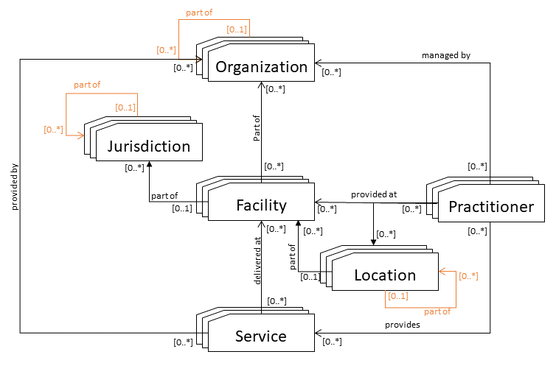
mCSD Resource Relationship
Business Name | FHIR Resource
Organization | Organization
Jurisdiction | Pairing of Location and Organization
Facility | Pairing of Location and Organization
Location | Location
Practitioner | Practitioner
Service | HealthcareService
*Adjoining lines | OrganizationAffiliation

Slide 12
Product Name
Pan-Canadian Care Service Directory (CA: CSD)
Covers resources and content that spans more than Healthcare services
Structure aligns with the previous guide names created for similar projects

Slide 13
Next Steps
Discussions on use case workflow and how transactions related to service directory fit into workflow:
How the various levels within a jurisdiction relate to the defined actors
Examples and how they fit within the framework
Demo from Ontario

Slide 14
Selected Use Cases
Search for Service
Filter by:
Service
Service Type
Location (city, postal code, health region etc.)
Organization
Provider Availability
Possible Elements to return
Service(s)*
Practitioner
Location(s)
Organization(s)
Availability
Search for Service Provider
Filter by:
Provider details (name, qualifications)
Service(s) offered
Service Type
Location (city, postal code, health region etc.)
Organization
Provider Availability
Possible Elements to return
Practitioner
Qualifications
Services Provided
Associated Location(s)
Associated Organization(s)
Availability
* mandatory

