Slide 1




Michael Smith Foundation for Health Research (MSFHR)
REACH Grant Knowledge Translation Topics: Review of Gender, Sex and Sexual Orientation (GSSO)
In Digital Health Systems – Part 1
Jul 13, 2021
Karen Courtney, Francis Lau, Aaron Devor, Marcy Antonio, Kelly Davison, Roz Queen
University of Victoria
Jody Jollimore, Michael Kwag, Anu Radha Verma
Community-Based Research Centre
Canada Health Infoway, Canadian Institute for Health Information, Canadian Health Information Management Association

Slide 2
… acknowledge with respect the Lekwungen-speaking peoples on whose traditional territories the University of Victoria stands; the Songhees, Esquimalt and the W_SÁNEC (“w’Saanich”) peoples, whose historical relationship with the land continues to this day
… each of you will join me and acknowledge the privilege we have of coming together in the spirit of respectful dialogue from the traditional territories of indigenous peoples from across this land known as Canada

Slide 3
Agenda
Meeting Schedule
GSSO Action Plan
Digital Health Systems
Implications
Next Steps

Slide 4
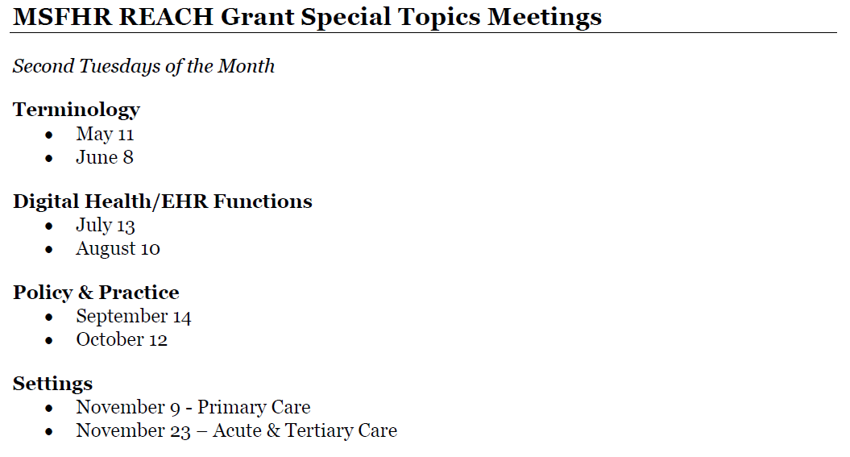
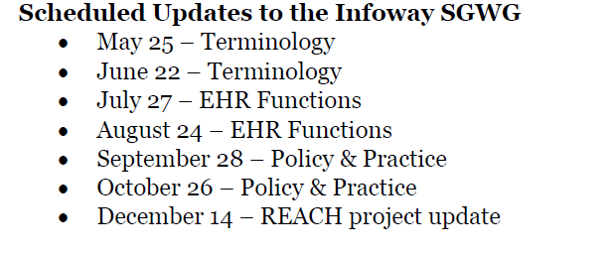
1. Meeting Schedule
Second Tuesdays of the Month
Fourth Tuesdays of the Month

Slide 5
2. GSSO Action Plan
Envisage an equity- and SGM-oriented health system vision and goal
Engage and partner with organizations and communities to modernize GSSO information practices to meet SGM needs
Establish GSSO terminology for patient care, health system use and research
Enable EHRs +digital health to collect, use, exchange and reuse standardized GSSO data
Integrate and tailor GSSO data collection with organizational structures, policies, use cases and workflow processes
Educate & train staff to provide culturally competent and safe care, and educate patients to understand need
Establish a central hub to coordinate this action plan over time and continue national conversation as next step
This plan focuses on what actions are needed, with details on who, how and when to be discussed and established later

Slide 6
3. Digital Health Systems
Action-4: Enable EHRs +digital health to collect, use, exchange and reuse standardized GSSO data
Databases
Interfaces
Outputs
Security/Privacy
Decision support
Analytics
IT support
What are the specific implementation issues for YOUR organization to incorporate GSSO into your digital health systems?

Slide 7
3. Digital Health Systems
Databases – data dictionary, codes, mapping, quality, usage
How to incorporate GSSO into an organization’s data dictionaries and databases?
How to handle GSSO mapping, e.g. detailed <=> aggregated options?
What data quality assurance and monitoring should be in place?
What other implementation issues should be considered?
Notes:
How to ensure consistency between local/regional and national data holdings?
How to incorporate GSSO coded values into an organization’s databases?
What data usage monitoring should be in place?

Slide 8
3. Digital Health Systems
Databases – dictionary, codes, mapping, quality, access, usage
Interfaces – input forms, displays, searches, help
When/where/how to display pronouns, names, gender identity, sex at birth?
How to design search functions – names, gender identity, sex at birth?
What help features and when/where/how to use them?
What other implementation issues should be considered?
Notes:
What forms to review, e.g. intake, registration, requisitions, others?

Slide 9
3. Digital Health Systems
Databases – dictionary, codes, mapping, quality, access, usage
Interfaces – input forms, searches, displays, help
Outputs – lists, reports, letters, labels, wrist bands
What key data to show on outputs, e.g. names, pronouns, gender, sex?
When/where/how to display pronouns, names, gender identity, sex at birth?
What data usage monitoring should be in place?
What other implementation issues should be considered?

Slide 10
3. Digital Health Systems
Databases – dictionary, codes, mapping, quality, access, usage
Interfaces – input forms, searches, displays, help
Outputs – lists, reports, letters, labels, wrist bands
Security/Privacy – access, masking, help, exchange, audit
How to decide who can access what data when, where and how?
What data should be masked, and when, where and how to mask the data?
What safeguards are needed when exchanging GSSO data between systems?
What other implementation issues should be considered?
Notes:
What help features and documentation are needed to explain security/privacy?
What audits are needed to ensure the security/privacy of patient’s GSSO data?

Slide 11
4. Implications
Databases – dictionary, codes, mapping, quality, access, usage
Interfaces – input forms, searches, displays, help
Outputs – lists, reports, letters, labels, wrist bands
Security/Privacy – access, masking, help, audit
Decision support
Analytics
IT support
What are the implications for YOUR organization wishing to implement GSSO in your digital health systems?

Slide 12
Agenda
Meeting Schedule
GSSO Action Plan
Digital Health Systems
Implications
Next Steps

Slide 13
4. Next Steps
Second Tuesdays of the Month
Fourth Tuesdays of the Month
√
GSSO Practice/Research Presentations
July 27 - Marian Luctkar-Flude, Queen’s University School of Nursing and Erin Ziegler, Ryerson University: Developing a Sexual Orientation and Gender Identity Nursing Education Toolkit

Slide 14


