Slide 1
Public Health Surveillance (PHS) Community
November 9, 2023
2:00 – 3:00 ET

Slide 2
PHS Community Agenda:
Welcome and introductions
Overview of National Vaccine Catalogue
Finalize Terms of Reference
RFCs update – Imms Dashboard
5. CVC update
6. Wrap up

Slide 3
2. Developing a New PHAC-Led National Vaccine Catalogue Public Health Surveillance Community Nov 9, 2023

Slide 4




Team Introductions
Technical Project Management Team Lead
Etran Bouchouar, DrPH
A/Manager
Vaccine Coverage and Monitoring Initiatives (VCMI)
Center for Immunization Surveillance (CIS)
Public Health Agency of Canada
Ogesanmola, Omitayo
Senior Advisor, Program Development
Vaccine Logistics and Operations (VLO)
Centre for Vaccine and Therapeutic Readiness (CVTR)
Public Health Agency of Canada
Development Team Lead
Serge Léger
Prototype Developer
Digital Technologies Research Center
National Research Council Canada (NRC)

Slide 5
Project Overview
The Canadian Vaccine Catalogue (CVC) was developed and maintained by CANImmunize from 2016 to 2022 with funding from the Government of Canada to support the provision of comprehensive information on all vaccine products licenced for use in Canada.
As part of longer-term commitments to provide timely access to F/P/T stakeholders, PHAC will develop, maintain and internally manage a national vaccine catalogue for the Government of Canada.
The NVC will be a PHAC-led public-facing platform offering a comprehensive data repository of vaccine products licenced for use in Canada, along with information about these products (e.g., lot#, DINs, expiry dates) and standardized terminology to promote interoperability. It is expected that:
The platform’s effectiveness will be increased by better aligning with users’ business processes
Processes will be streamlined to better align with users' business requirements
Updates to the vaccine catalogue will be more prompt, to reflect the rapid changes in products, lot releases and shelf-life extensions observed during the COVID-19 pandemic
It will adhere to accessibility and official languages commitments
PHAC has engaged the National Research Council of Canada (NRC) to develop the new National Vaccine Catalogue (NVC) which will be maintained by PHAC starting in March 2024.
PHAC and CANImmunize will continue to collaborate to maintain the existing CVC platform, and support knowledge transfer activities between August 2023 – March 31, 2024.

Slide 6

Project Overview
An Expert User and Data Provider Team (EUDP) was established (kick-off Oct 30,2023) comprised of F/P/T reps in immunization clinical, registry, inventory capacities; HC-BRDD and CHI.
The objectives of the EUDP team are to:
Facilitate developer’s understanding of requirements and context of use
Seamless integration of stakeholder input into the development process
Ensure effectiveness of development through user acceptance testing and timely feedback
Enable quick adaption to evolving needs.

Slide 7
High-Level Timeline
This roadmap shows the phased process used to develop the National Vaccine Catalogue which will be maintained and managed internally within the Government of Canada.
Feb to Dec 2023
Jan to mid-Mar 2024
Mar 2024
Apr 2024 +
Plan & Develop
Deliver
Action
Stabilize & Optimize
Configure/Prototype & Operational Plan
Test
Deploy
Support & Enhance
PHASE 1 Begins Feb Define business requirements, config dev env, database schema, rudimentary API, UI and browsing, storage capacity
PHASE 2 Begins Jul
Integration of one data source (Health Canada), admin accounts, subscription services, notification system
F/P/T engagement planning and begin consultations with federal partners
PHASE 3 Begins Oct
Integration of data sources, features development, and adherence to government online guidelines
User acceptance testing
Establish PHAC & NRC working group
Mar 31
End of CANImmunize funding for CVC maintenance/PHAC business operations phase begins
Updates and new releases
Explore feasibility of incorporating standardized data on vaccines not yet licensed or available in Canada
International bodies such as Gavi (the Vaccine Alliance), the International Vaccine Access Center (IVAC), the American Immunization Registry Association.
End-to-end testing
Feb 19
PHAC begins to transition operations in-house
Mar 31
Prototype 1
Optimize and streamline data sources
Sep 31
Prototype 2
Establish F/P/T Expert User and Data Provider Team to integrated end-user input
Dec 31, 2023
Prototype 3
Feb 24
NRC IFA signed
Engage in QA with CHI to optimize SNOMED CT mapping
Commencement of PHAC/CANImmunize knowledge transfer activities
Post-launch support
Collaborate with DTB for hosting and IT support
MVP
National Vaccine Catalogue goes live
Mar 18, 2024
Feature enhancements (e.g., reports, notifications)
PHAC & CANImmunize continue to collaborate to maintain CVC operations
Develop post launch operational plan

Slide 8
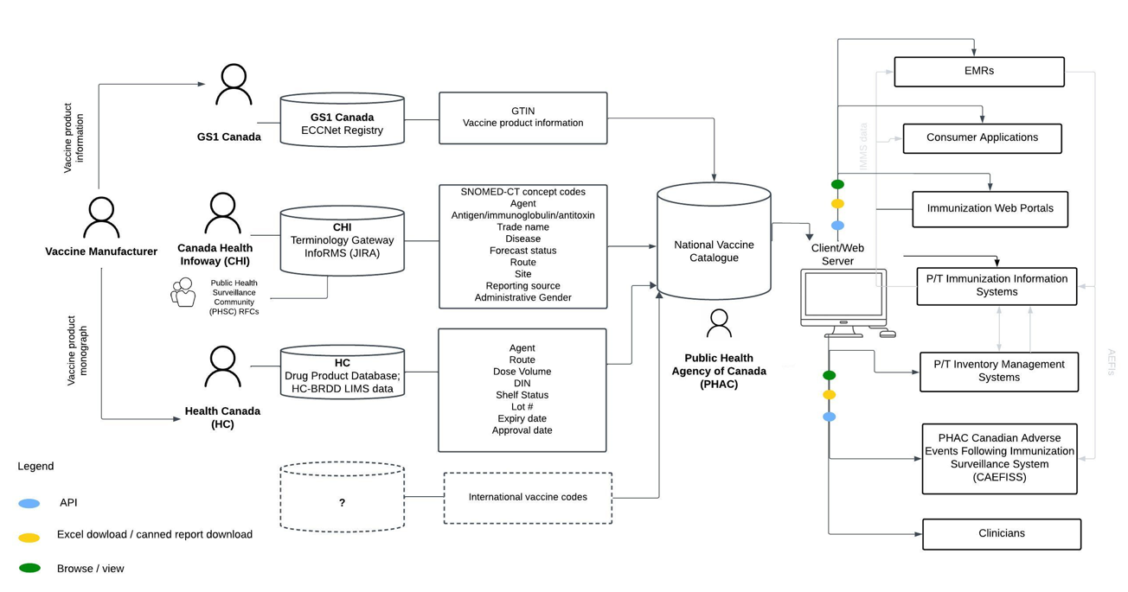
National Vaccine Catalogue Updates - Data Flow
The figure illustrates the journey of information within the national vaccine catalogue, with a core emphasis on the integration of three primary data sources and the exploration of international vaccine data. The new catalogue will be hosted by PHAC and accessible via a public-facing client web server. Information can be readily retrieved through a well-maintained Fast Healthcare Interoperability Resources(FHIR) API, downloadable in Excel format, accessed through canned reports, or viewed directly on the client web server, ensuring a versatile user-friendly experience that serves a wide range of use cases.

Slide 9
Contact
Etran Bouchouar, DrPH
A/Manager
Vaccine Coverage Monitoring and Initiatives
Etran.Bouchouar@phac-aspc.gc.ca
Ogesanmola, Omitayo
Senior Advisor, Program Development
Vaccine Logistics and Operations
Ogesanmola.Omitayo@phac-aspc.gc.ca

Slide 10
3. Finalize ToR:
“The scope for the PHSC, with regard to immunization data, includes new and revised SNOMED CT CA encoded immunization related content and subsets, as required for provincial / territorial / jurisdictional immunization registries and digital health projects. To support this work, the scope also includes consideration of other standards-based content included in vaccine catalogues.”
Notes:
Summarize postings on Forum / meeting input – reflected in ToR – include mention of Vaccine Catalogue, other content in the Vaccine Catalogue, support imms registries and digital health projects; highlight that our focus excludes CD, for now focus is just imms and VPDs
Included in ToR: PHSC rep for RFCs – anyone interested in volunteering?

Slide 11



Title text here
4. Requests for Changes (RFCs)
Status update:
SNOMED CT CA
New release schedule: increased to 4x per year ☺ February, May, August, November
Vaccine Dashboard: for viewing progress / status on submitted RFCs
Dashboard Preview - any suggested additions?
Subtitle text here

Slide 12
RFCs in Progress
RFC | Type | Status | Link
Men-C-A meningococcal conjugate A unspecified | New generic (agent) concept | Processing | Link to RFC
Request from Ontario to assist with forecasting. Use case: Add Men-C-A as a separate agent that can be recorded. This is for children who have received Men-C-A, allowing accurate recording of meningococcal vaccine and prevents affecting the Men-C-C series if recorded as Men-unspecified. If Men-C-AC is used, it affects the Men-C-C forecast and relates to ISPA regulations.

Slide 13
Update on naming conventions
Based on our conversations and needs of those who use the public picklist fields in the CVC, the CVC team has made a decision to distinguish the two Pfizer Comirnaty XBB.1.5 pediatric vaccines by whether or not it should be diluted.
For HyperHEP B products, we have proceeded with distinguishing by strength, where applicable:
HyperHEP B 110 IU/0.5 mL
HyperHEP B 220 IU/mL
HyperHEP B S/D

Slide 14
5. CVC Release Update – 1.1.35
Addition of tradename – agent – antigen – disease tab in excel workbook (request from Ontario)
Tradename subset
Addition of AREXVY
Update to the following concepts:
DIN & Shelf Status for Pfizer-BioNTech Comirnaty Omicron XBB.1.5 infant and adult formulations
DIN, Shelf Status, Public & Clinician Tradename Picklist Terms for Pfizer-BioNTech Comirnaty Omicron XBB.1.5 DO NOT DILUTE COVID-19 mRNA pediatric (10 mcg/0.3 mL formulation)
Generic subset
Addition of 3 new concepts: Enterovirus A71, RSV, Plasmodium falciparum (anti-malarial)

Slide 15
CVC Release Update – 1.1.35 (con’t)
Antigen subset
Addition of Non-live Human alphaherpesvirus 3 antigen & Live attenuated Human alphaherpesvirus 3 antigen; RSV antigen; Enterovirus A71 antigen
Disease subset
Addition of Enterovirus A71 disease
Agent– Antigen – Disease Mapping
Addition of generic concept 6991000087105 |Inf influenza A monovalent H1N1 unadjuvanted unspecified| to agent-antigen-disease subset
Correct disease & antigen mapping for 33381000087107 |Inf influenza quadrivalent high-dose unspecified|
Lot / Expiry
Addition of data for month of Sept & COVID-19 data up to October 5, 2023

Slide 16
CVC Release Update – 1.1.36
Prerelease shared on November 3rd
Target release: November 9th
Tradename subset
Addition of HBIg HyperHEP B 220 IU/mL Grif & HBIg HyperHEP B 110 IU/0.5 mL Grif; update PT for HBIg HyperHEP B S/D 220 IU/mL Grif
Addition of Pfizer-BioNTech Comirnaty Omicron XBB.1.5 DILUTE PRIOR TO USE COVID-19 mRNA pediatric (10 mcg/0.2 mL)
Lot / Expiry
Addition of data for month of Oct & COVID-19 data up to November 2, 2023

Slide 17
CVC Release Update – 1.1.37
Prerelease target: November 17th
Target release: November 24th
Generic subset
Addition of Men-C-A agent
Lot / Expiry
Addition of COVID-19 data up to November 15th

Slide 18
Wrap up / Questions? Next meeting date: Thursday, December 7, 2:00-3:00 ET

Slide 19
Thank you!
Contact Information:
tmawhinney@infoway-inforoute.ca

