Slide 1

Social Determinants of Health Working Group
Monthly SDOH Working Group Zoom Meeting
Oct 15, 2025 - 10 am PT; 11 am MT 1 pm ET
Facilitated by Jennifer Lawson and Brooke Harvey
Notes:
The logo can be changed in the master slides. Please use the following instructions
Select view > slide master.
Right click on the logo and select change image.
Select the image you want to use you may need to scale the image accordingly.
When you're done, select close master view.

Slide 2

Land acknowledgement
We would like to acknowledge the lands that we occupy, whether treaty or unceded. We recognize that these lands are home to many diverse First Nations, Inuit, and Métis Peoples.

Slide 3
Recording is starting
REC

Slide 4
Agenda
Welcome
PCHDCF new release
Person & SDOH Assessment within the Data Content Standard
SPARK Survey vs. AUCDI representation
LOINC coding for SDOH Screening Tools and Surveys
SDOH Groups and Families in LOINC
LOINC fixed terms
Development of 4 pillars and framework/modeling: including new Data Elements

Slide 5
Data Content Standard: SDOH focus
Notes:
After next slide - pivot here to showing the DCS and doing high level walk through

Slide 6
Two SDOH Categories
Sociodemographic/ Identity
→ Person Information
Social Risk, Social Needs → SDOH Assessment

Slide 7
Gravity Project FHIR Implementation Guide: SDOH for Clinical Care (SDOHCC)

Slide 8
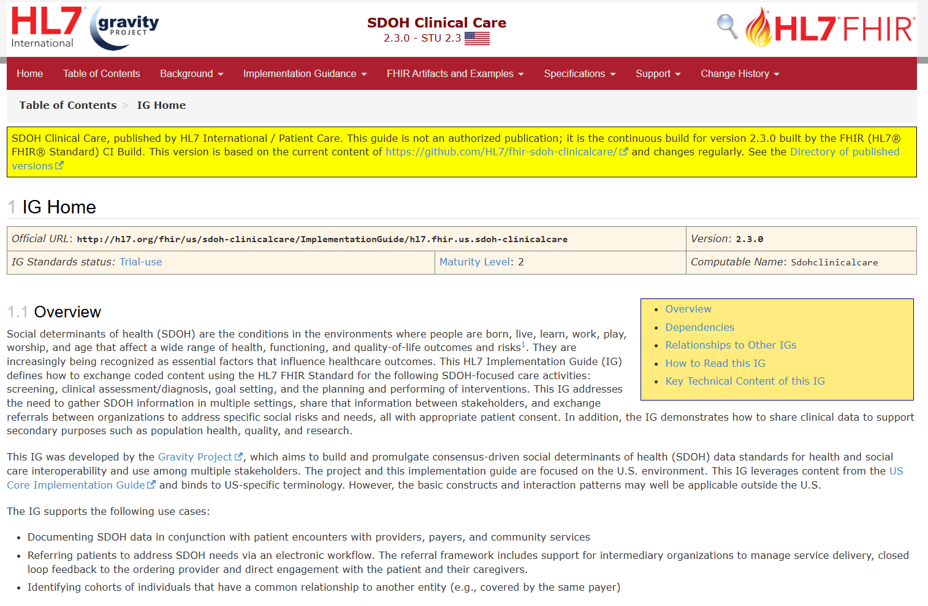
Link: IG Home - SDOH Clinical Care v2.3.0

Slide 9
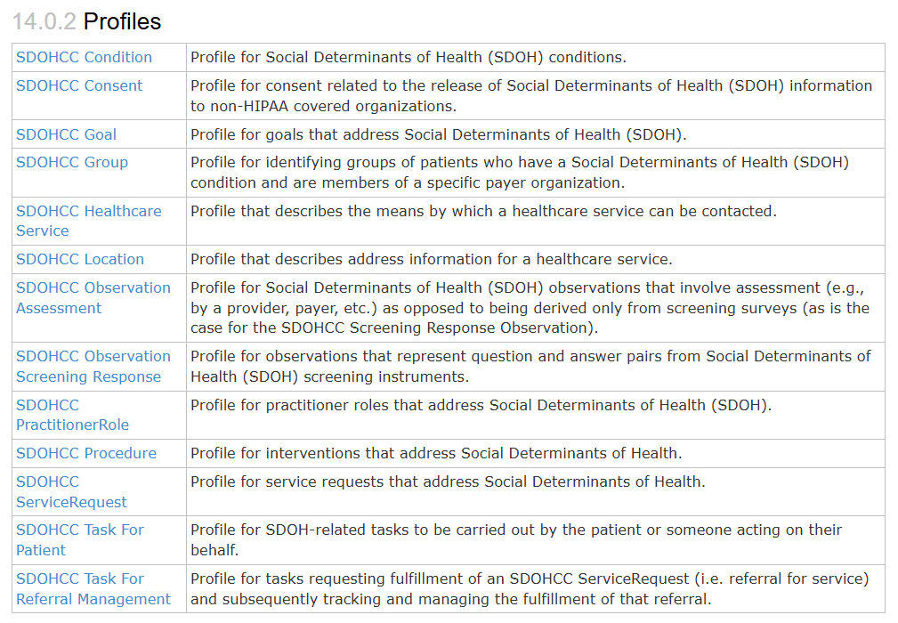
SDOHCC Profiles
LINK: Artifacts Index - SDOH Clinical Care v2.3.0

Slide 10
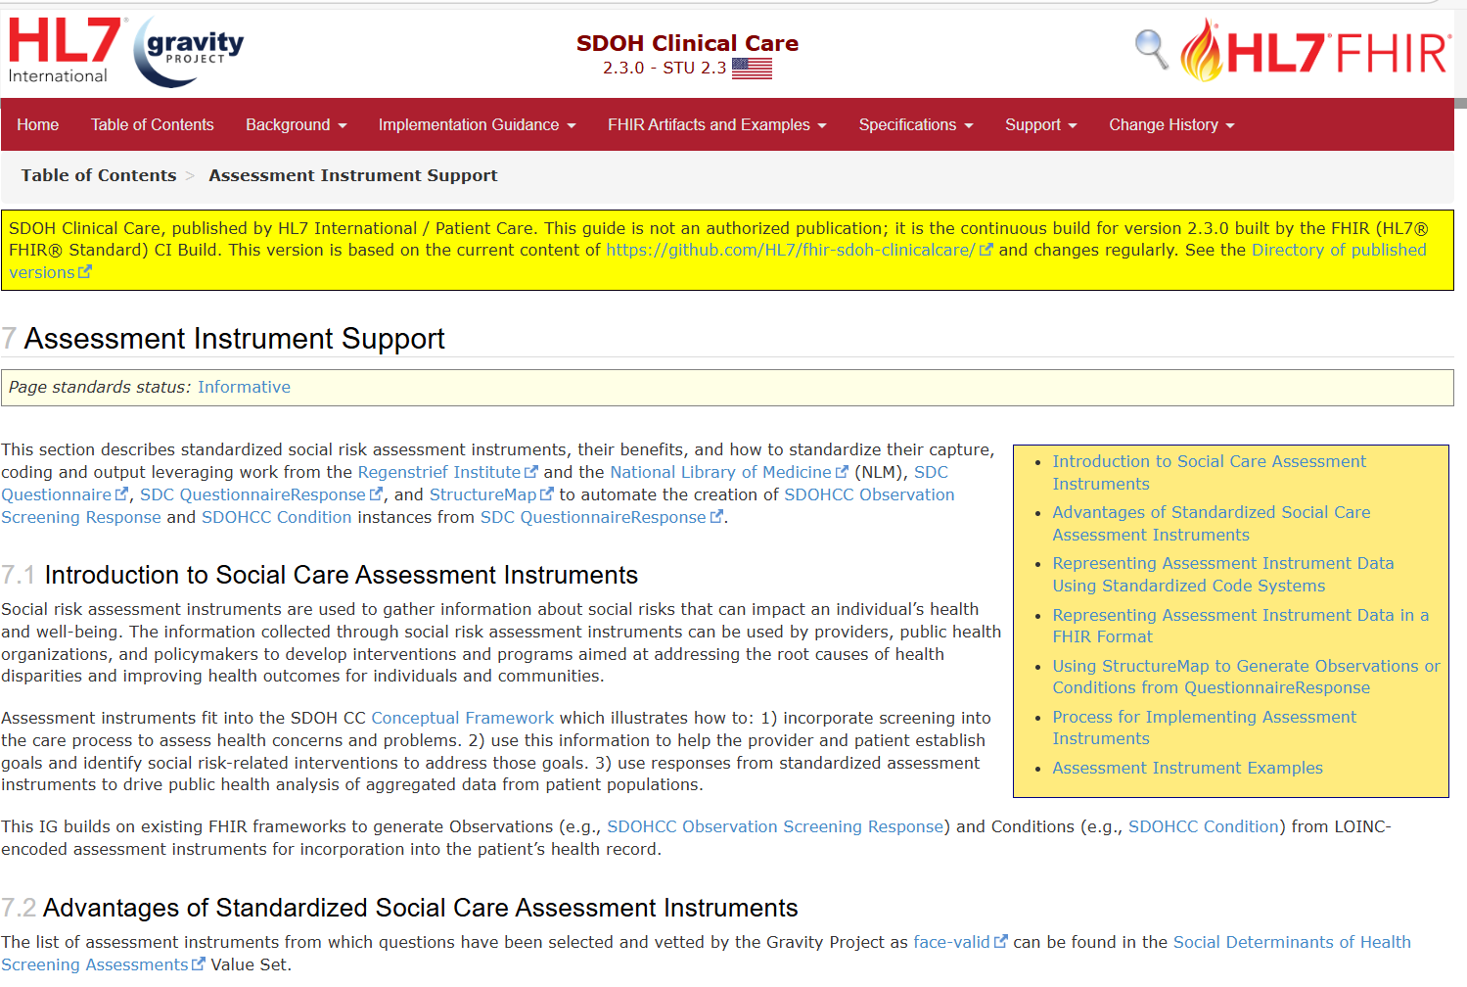
SDOHCC Observation Screening Response - SDOH Clinical Care v2.3.0
LINK: Assessment Instrument Support - SDOH Clinical Care v2.3.0

Slide 11
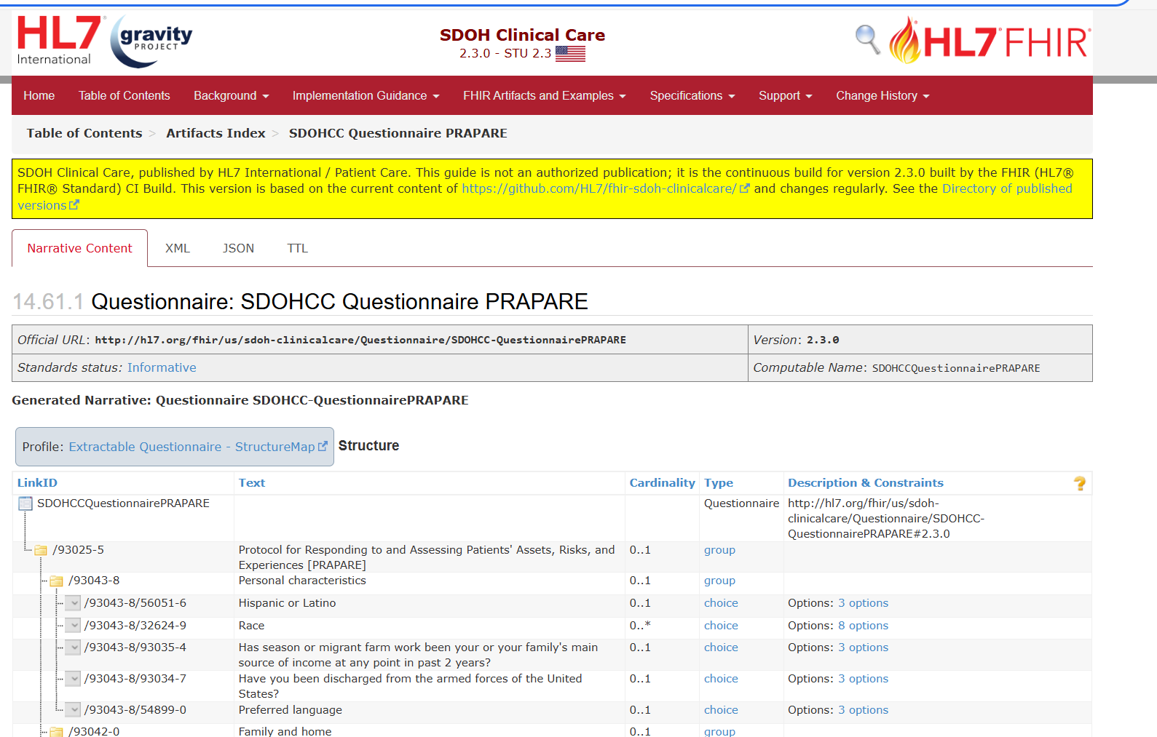
SDOHCC Questionnaire PRAPARE - SDOH Clinical Care v2.3.0

Slide 12
LOINC coding for SDOH Screening Tools and Surveys

Slide 13
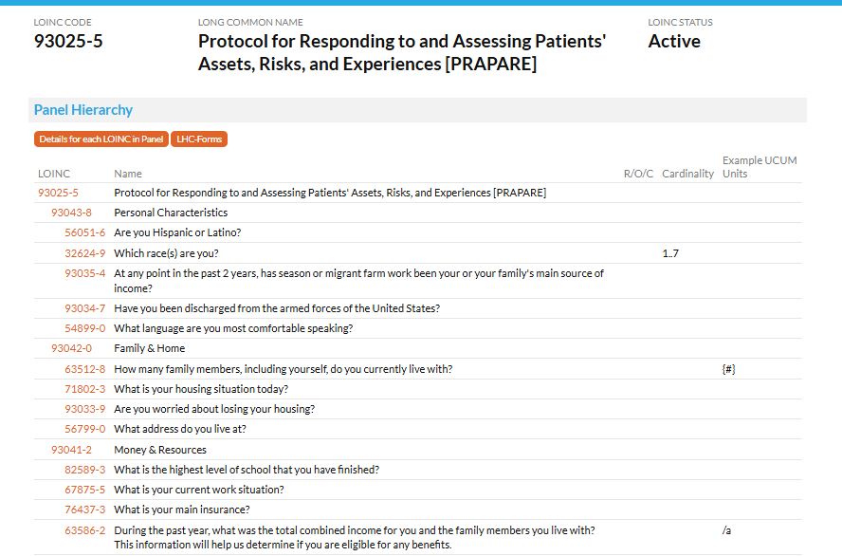
LOINC Panels for Survey Coding
Panel Code

Slide 14
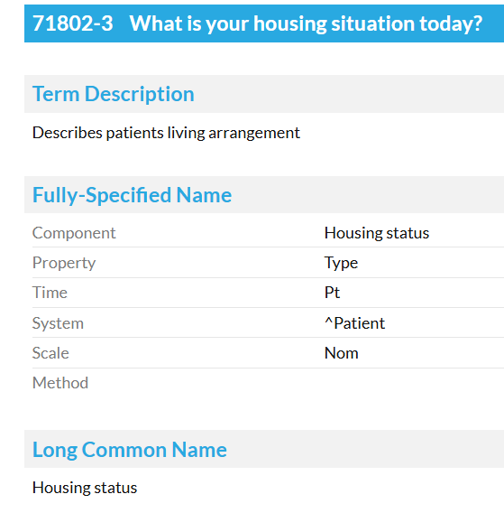
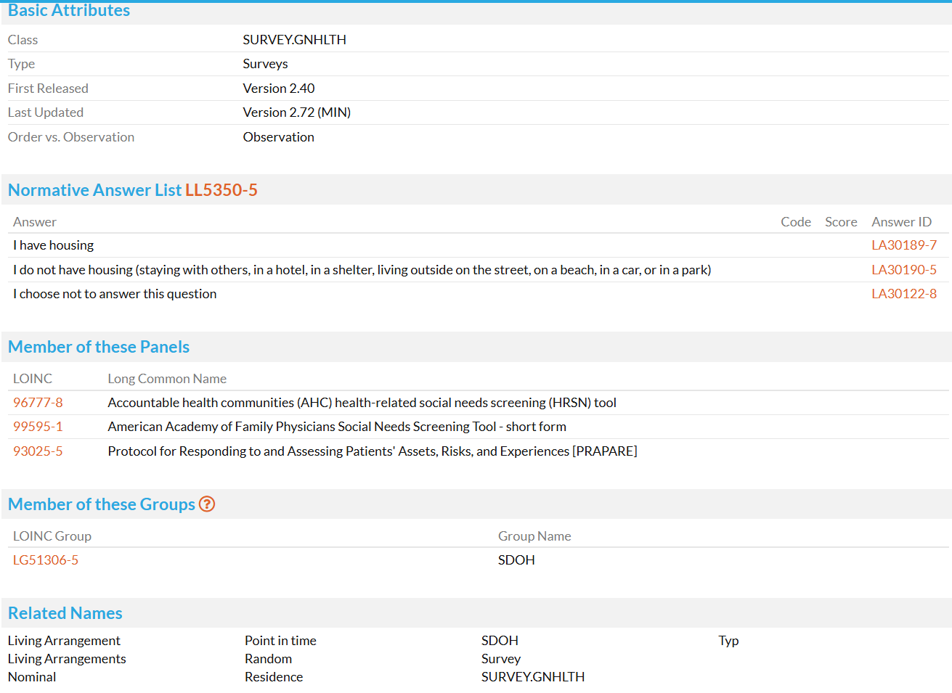
Question Code
Answer List Code
Answer Codes

Slide 15

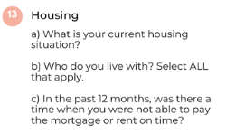
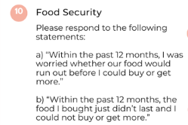

Codifying the SPARK Survey as LOINC Panel

Slide 16
Data Content Standard: SDOH presented within Social Medicine Arc
Notes:
After next slide - pivot here to showing the DCS and doing high level walk through

Slide 17
Proposal for reorganizing SDOH in Data Content Standard and CACDI
Person Information
Sociodemographic/ Identity
Sociodemographic attributes
Social Risk, Social Needs
Social Determinants of Health (SDOH)
SDOH Standardized Screening & Other Assessment
Gravity and USCDI framing
SDOH Patient Goals
SDOH Problems/ Health Concerns/Protective Factors*
* New: reflects Whole person care: Characteristics or strengths of individuals, families, communities or societies that act to mitigate risks an promote positive well-being and healthy development
SDOH Interventions: Procedures and Programs*

Slide 18
Social Care Arc Housing Example
Screening/Assessment
Social Risk or Social Need
Patient Goals
Intervention
How are you currently housed?
Owns home 
Lives in home that is rented 
Lives in Subsidized housing
Lives in Supportive housing
Lives in Long-term care facility
Incarcerated at correctional facility
Has living arrangement 
Experiencing homelessness: 
Sheltered 
Unsheltered 
Housing Instability
1156191002 | Housing instability (finding) |
Housing Inadequate
161036002 | Housing adequate (finding) |
105531004 | Housing unsatisfactory (finding) |
Homeless
32911000 | Homeless (finding) |
Further granularity: SNOMED CT USA
611131000124100 | Sheltered homelessness (finding)
611141000124105 | Unsheltered homelessness (finding)
611181000124104 | Unsheltered homelessness, sleeping in safe environment (finding)
611551000124102 | Homelessness, living in a shared accommodation (finding)
SNOMED CT AU
• Stable housing
• Mild housing instability
• Moderate housing instability
• Severe housing instability
Example:
Have secure housing
Reduce affordability stress
Example:
1148817001 | Assessment of barriers in housing insecurity care plan (procedure) |
Example:
Have safer housing
Have bedrooms for kids
Example:
1148816005 | Assessment for inadequate housing (procedure) |
SNOMED CT CA Finding Concept 
SNOMED CT US 
Example:
Have shelter upon hospital discharge
Example:
306697004 | Discharge to sheltered housing (procedure) |

Slide 19
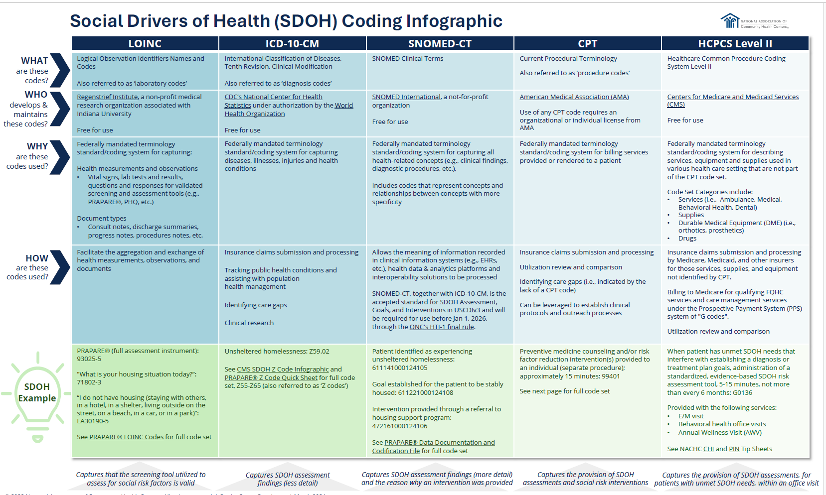
pCLOCD
ICD-10-CA
SNOMED CT-CA
CCI & SNOMED CT-CA
Ref: https://www.nachc.org/wp-content/uploads/2024/03/SDOH-Coding-Infographic.pdf

Slide 20


Slide 21
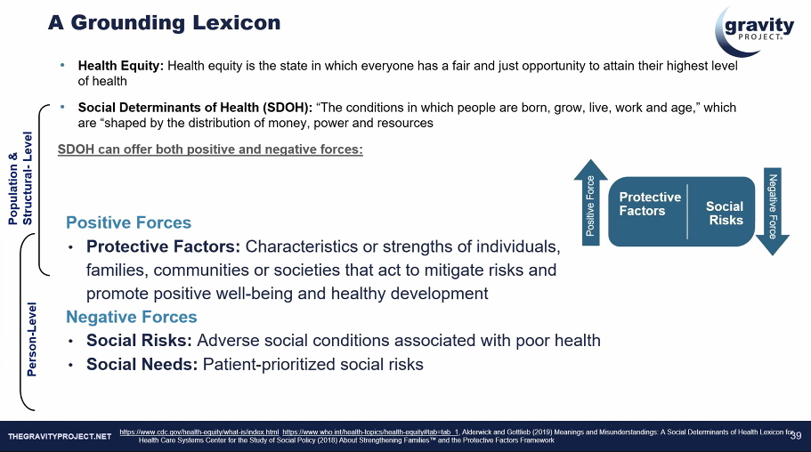

Slide 22
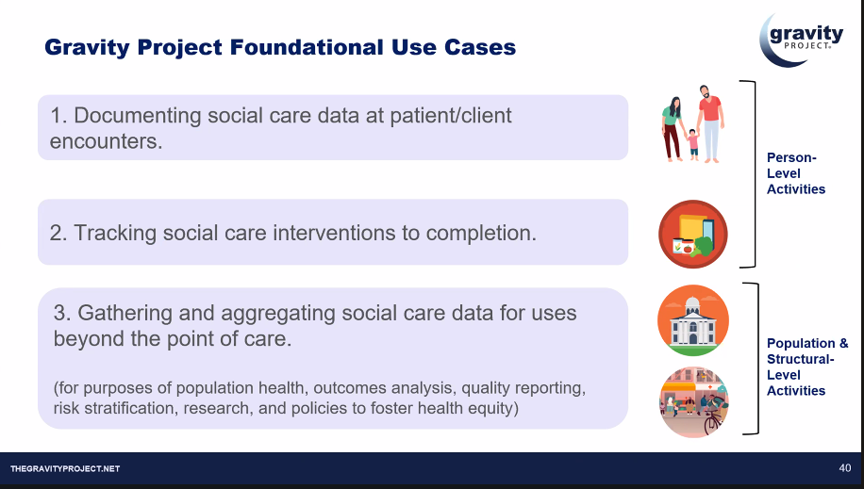

Slide 23
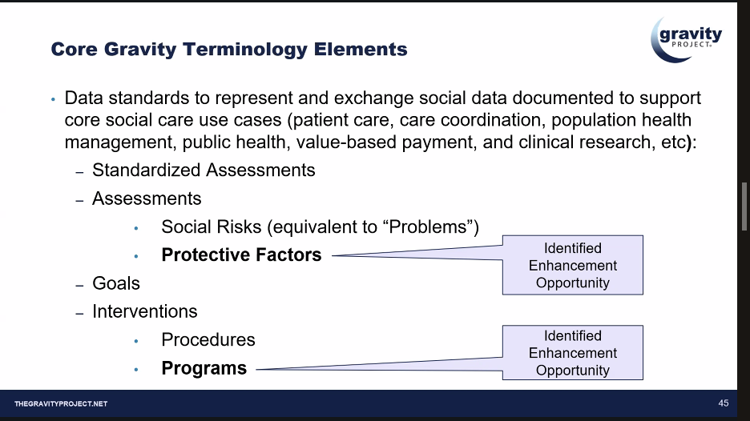

Slide 24
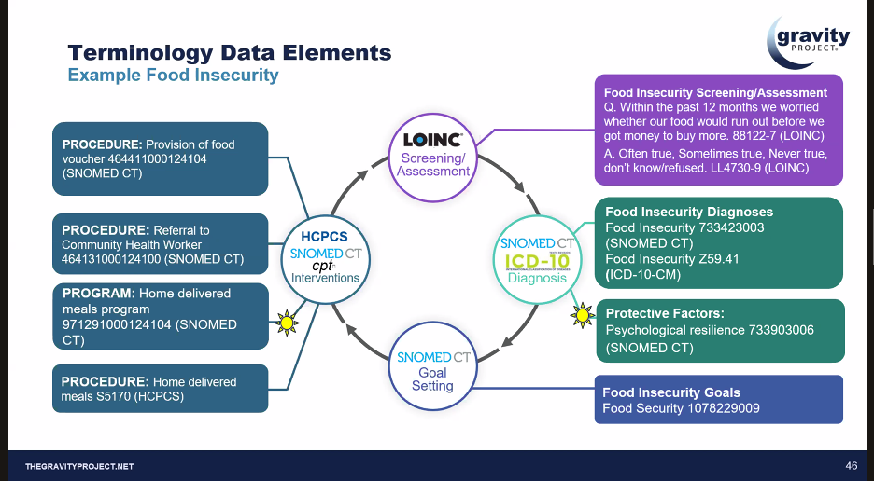

Slide 25
Updates or Announcements from Members

Slide 26
