Slide 1

Social Determinants of Health Working Group
Monthly SDOH Working Group Zoom Meeting
February 11, 2026- 10 am PT; 11 am MT 1 pm ET
Facilitated by Jennifer Lawson and Brooke Harvey
Notes:
The logo can be changed in the master slides. Please use the following instructions
Select view > slide master.
Right click on the logo and select change image.
Select the image you want to use you may need to scale the image accordingly.
When you're done, select close master view.

Slide 2

Land acknowledgement
We would like to acknowledge the lands that we occupy, including those that are treaty or unceded. We recognize that these lands are home to many diverse First Nations, Inuit, and Métis Peoples.
Notes:
I am joining this meeting from the lands of the Mississauga, Haudenosaunee, Attawandaron people, which includes the Six Nations of the Grand River and the Mississaugas of the Credit First Nation.

Slide 3
Recording is starting
REC

Slide 4
Agenda
Update on the recent in-person meeting for the First Nations, Inuit, and Métis Determinants of Health Data Standard project
Brief overview of the Gravity Project Social Determinants of Health Terminology Lifecycle report
Workplan for v3 Data Content Standard
Revisit Housing Security and other Housing related Data Elements for v3 development

Slide 5

Meeting Objectives:
Purpose: Build a health data content standard that supports First Nation, Inuit and Métis Peoples health and wellness
Who? A community of people with lived experience and expertise to guide us on our journey towards the development of First Nation, Inuit and Métis determinants of health data standard
How? Co-design a collaborative standard development process to guide the work – how decisions are made, how feedback is gathered, and how the work moves forward
What? Identify and prioritize the key themes, data elements and value sets for determinants of health data to support First Nation, Inuit and Métis Peoples health and wellness

Slide 6
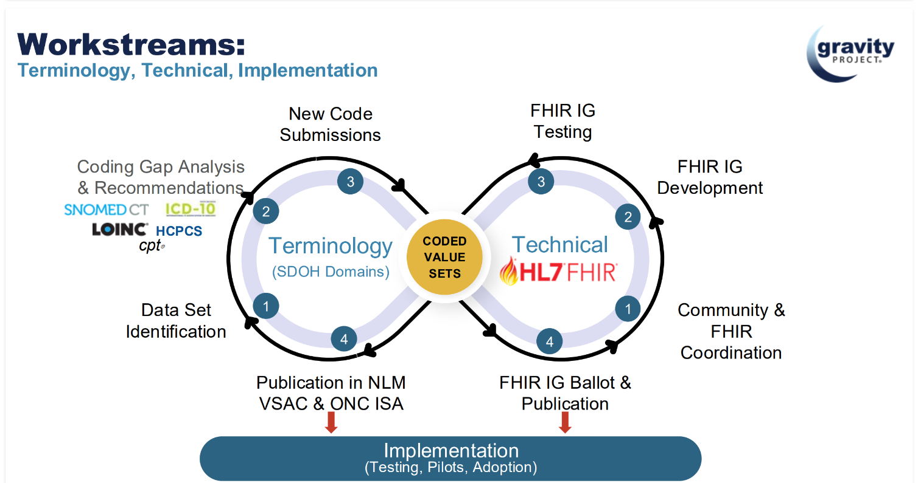
Gravity Workstreams
Notes:
Point here is that Coded Value sets like at the intersection of the Terminology and Technical workstreams in that they undergo rigorous terminology development and form important technical documentation for HL7 FHIR implementation.

Slide 7
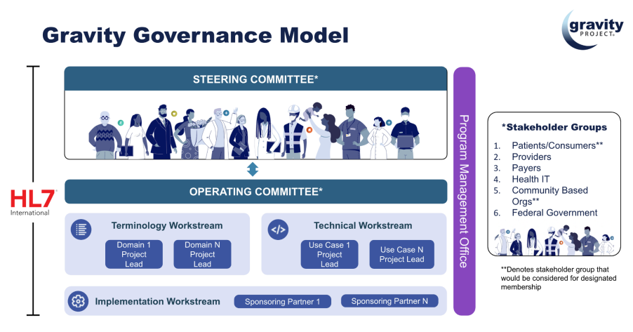
Gravity Project Social Determinants of Health Terminology Lifecycle report
Notes:
This document is a formal response to international requests to understand the “Gravity Terminology Curation Process,” from planning through to value set and content maintenance.
Outlines the evidence-based, public-consensus process employed by the Gravity Project Terminology Workstream and the Gravity community to develop terminology standards and their associated value sets

Slide 8
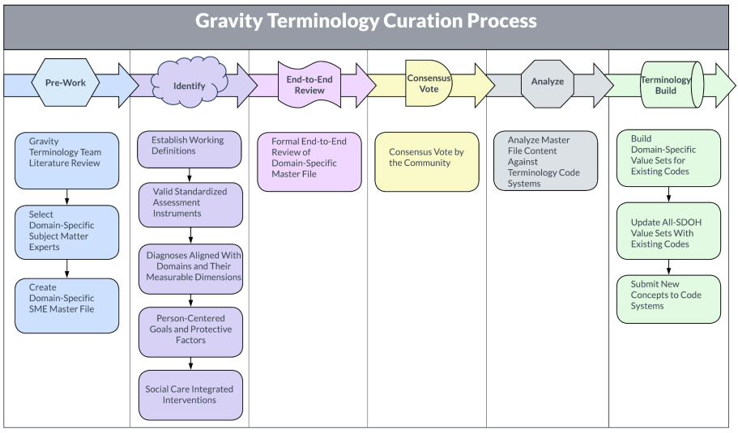
Gravity Project Social Determinants of Health Terminology Lifecycle report
Lifecycle Steps
Domain selection and approval process
Identify potential SDOH domains
Assess domain readiness and importance
Approval and prioritization by Gravity Governance Committee
Terminology Curation
Pre-work
Identify
End-to-end review
Consensus vote
Analyze
Terminology build
Maintenance and Evaluation
Value set updates and maintenance
Terminology evaluation
Notes:
This document is a formal response to international requests to understand the “Gravity Terminology Curation Process,” from planning through to value set and content maintenance.
Outlines the evidence-based, public-consensus process employed by the Gravity Project Terminology Workstream and the Gravity community to develop terminology standards and their associated value sets

Slide 9
V3 SDOH Work plan

Slide 10
Ready for Use – 11 Data elements
Data Element | Definition | Data Element Maturity | Value Set Detail | Value Set Maturity
Gender Used | Represents the gender identity that a person wishes to have recorded on legal documents or for the purposes of interactions with official agencies | 3: Ready for use | Gender Used (GSSO) | 3: Ready for use
Recorded Sex or Gender | Refers to the documented sex or gender of an individual used for clinical, official or legal purposes where only 1 data field for sex and gender is available, and where it is the value found in the local system and/or historical documentation | 3: Ready for use | Recorded Sex or Gender (GSSO) | 3: Ready for use
Gender Identity | An individual’s personal experience of being a woman, man, nonbinary or how the person prefers to self-describe. People may identify with more than one gender identity or use different gender identities in different settings | 3: Ready for use | Gender Identity (GSSO) | 3: Ready for use
Personal Pronouns | Gender pronouns are third-person pronouns that may reference a person’s gender identity and that may be a part of their gender expression | 3: Ready for use | Personal Pronouns (GSSO) | 2: Proposed
Sex at Birth | The sex of a person at birth, which is a clinical finding, usually determined by a clinician based on phenotypic, physiologic, and/or genetic characteristics | 3: Ready for use | Sex at Birth (GSSO) | 3: Ready for use
Sexual Orientation | Refers to how a person describes their sexuality, or who a person is romantically or physically attracted to | 3: Ready for use | Sexual Orientation (GSSO) | 3: Ready for use
Service Language | The person’s preferred language of service | 3: Ready for use | all-languages CIHI Language Codes | 3: Ready for use
Born in Canada | An indicator of whether the person was born in Canada | 3: Ready for use | N/A | N/A
Date of Arrival | The estimated or actual date the newcomer arrived in Canada | 3: Ready for use | N/A | N/A
Racialized Group* | A social construct used to judge and categorize people based on perceived differences in physical appearance in ways that create and maintain power differentials within social hierarchies | 3: Ready for use | RacializedGroupCode | 3: Ready for use
Indigenous Identity | The person’s self-identification as First Nations, Inuk/Inuit and/or Métis | 3: Ready for use | IndigenousIdentityCode | 3: Ready for use

Slide 11
Ready for V3 Value set Development – 9 Data elements
Data Element | Definition | Data Element Maturity | Value Set Detail | Value Set Maturity
Interpreter Needed | Whether the person requires language interpretation services | 0: In development | • Interpreter not needed • Interpreter needed • No understanding/ interpreter not needed | 0: In development
Ethnicity* | A person or group affiliation with those who share social, cultural and ancestral heritage | 3: Ready for use | N/A | N/A
Religious or Spiritual Affiliations* | The person's religious or spiritual denomination or religious community with which a person identifies, regardless of whether they are currently practising or observing that community’s beliefs or practices | 3: Ready for use | To be developed | 0: In development
Relationship Status | The person’s partnership or intimate status with another individual(s), reflecting the range of connections and preferences | 3: Ready for use | • Single • Married | 0: In development
Education level | The person’s highest level of education obtained | 3: Ready for use | • No formal education • Elementary school | 0: In development
Employment Status | The person’s current employment status | 3: Ready for use | • Full-time permanent • Part-time permanent | 0: In development
Financial Stability | The person’s perceived financial stability (i.e., ability to pay for basic needs such as food, water, housing, clothing) as reported by the person or the caregiver | 2: Proposed | • Stable finances • Mild financial instability | 0: In development
Housing Stability | The person’s perceived current housing stability (e.g., stable, mild, moderate) | 2: Proposed | • Stable housing • Mild housing instability | 0: In development
Access to Food | The frequency with which the person has experienced difficulty accessing or affording food over the past 12 months | 3: Ready for use | • Never • Daily | 0: In development
* These data elements are cross cutting CIHI corporate standards and are developed with a process outside of the specific work for the PCHDCF. They will be undergoing CIHI standard’s review and we expect updates or changes in the future
Notes:
.

Slide 12
Future Development: Start July 2026
Data Element | Definition | Data Element maturity | Value Set Detail | Value Set Maturity
Access to Medication | Whether the person has experienced difficulty accessing or affording medicine over the past 12 months Fixed code: Medication access (LOINC: in development) | 2: Proposed | To be developed | 0: In development
Access to Treatment | The person’s ability to access or afford treatment services (e.g., physiotherapy, occupational therapy) over the past 12 months | 2: Proposed | To be developed | 0: In development
Access to Internet | Whether the person has experienced difficulty accessing or affording the internet over the past 12 months | 2: Proposed | To be developed | 0: In development
Access to a Phone | Whether the person has experienced difficulty accessing or affording a telephone over the past 12 months | 2: Proposed | To be developed | 0: In development
Access to Transportation | Whether the person has experienced difficulty accessing or affording public or private transportation over the past 12 months | 2: Proposed | To be developed | 0: In development
Access to Utilities | Whether the person has experienced difficulty accessing or affording utilities over the past 12 months (e.g., heat, electricity, water) | 2: Proposed | To be developed | 0: In development
Access to Child Care | Whether the person has experienced difficulty accessing or affording childcare over the past 12 months | 2: Proposed | To be developed | 0: In development
Social Support | The actual or perceived availability of family, friends, neighbours and/or community that a person can confide in or rely on to feel more socially connected and secure | 3: Ready for use | To be developed | 0: In development
Experience With Interpersonal Violence | The person’s experience with interpersonal violence (e.g., physical, sexual or emotional abuse; economic control; isolation or other kinds of coercive behaviour) | 2: Proposed | To be developed | 0: In development
Legal History | The person’s experiences with the judicial system (e.g., has spent time in a correctional facility, is involved in legal proceedings) | 3: Ready for use | To be developed | 0: In development

Slide 13
Housing : Work to Date
Notes:
After next slide - pivot here to showing the DCS and doing high level walk through

Slide 14
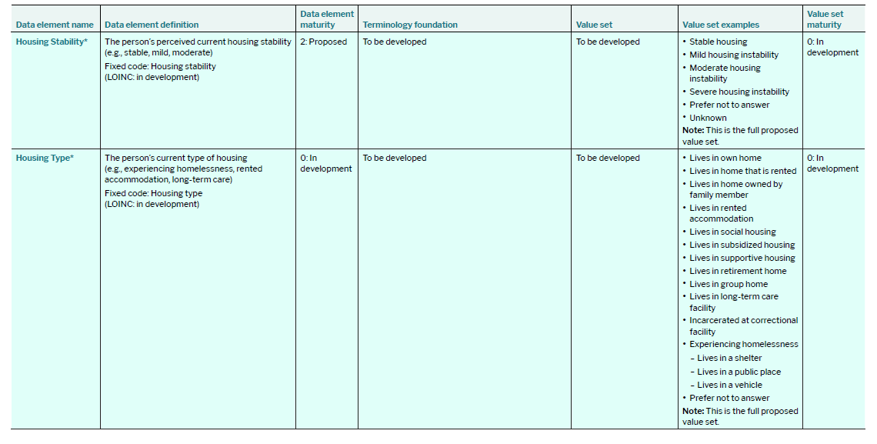
Housing Related Content
Comment:
could add unhoused
Stable means unchanging and not necessarily secure
Comment:
Suggest adding someone people who "may be living in transitional housing; couch-surfing or living in overcrowded/’doubled up’ conditions in someone else’s home; living day-today or week-to-week in motels or hostels; or living in another type of provisional accommodation".

Slide 15
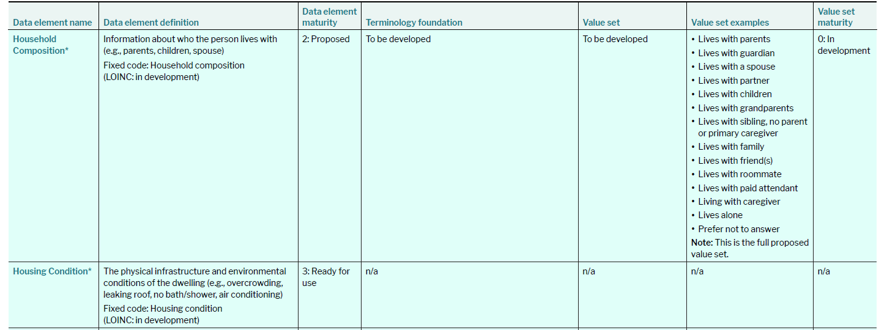
Housing Related Content
Comments:
Business rule to enable multiple selections
Include living with someone with whom them feel unsafe

Slide 16
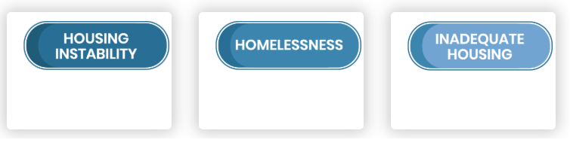
Gravity Housing-related Domains
Currently consistently housed but experiencing any of the following circumstances in the last 12 months: behind on rent or mortgage, 3 or more relocations, housing cost burden, homelessness, or risk of eviction. | Sheltered Homelessness Definition: Because of economic difficulties, currently living in a shelter, motel, temporary or transitional living situation, scattered-site housing, or not having a consistent place to sleep at night. Unsheltered Homelessness Definition: Residing in a place not meant for human habitation, such as cars, parks, sidewalks, abandoned buildings, on the street. | Housing does not meet habitability standards.

Slide 17

AUCDI version 2
Data element | Definition | SNOMED CT-AU Term | SNOMED CT-AU Code
Housing stability status | An assessment of the extent of consistency and continuity of housing over time | Stable housing | 1472091000168100
 |  | Mild housing instability | 933483581000036000
 |  | Moderate housing instability | 933483591000036000
 |  | Severe housing instability | 933483601000036000
Living arrangement | Summary information about the social and interpersonal circumstances of an individual, with a focus on the people they live with, those they care for, and those who may provide care or support to them. | Narrative description about the social and interpersonal aspects within an individual's usual residential setting. Identifies who they live with and the structure of their household, including family members, non-family members, and animals, presence of caregivers Use context social connectedness, carers, caring responsibilities and social –cultural dynamics

Slide 18
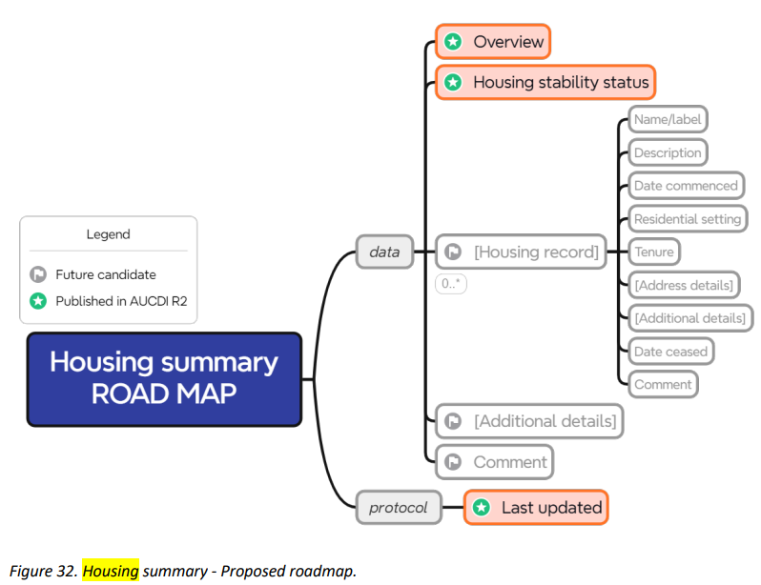
AUCDI V2 – Housing summary ROADMAP
Akin: OpenEHR “Dwelling”

Slide 19
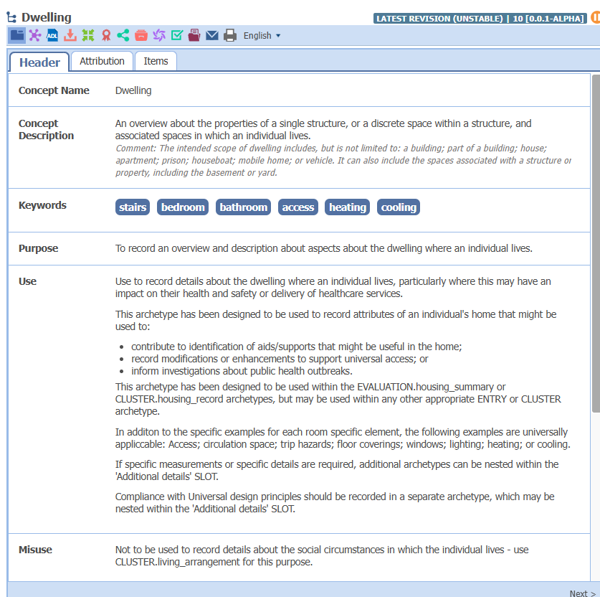
https://ckm.openehr.org/ckm/archetypes/1013.1.3285
…record details about the dwelling where an individual lives…impact on their health, safety, delivery of healthcare services.
Not to be used to record details about the social circumstances in which the individual lives, use Living Arrangement for this purpose.

Slide 20
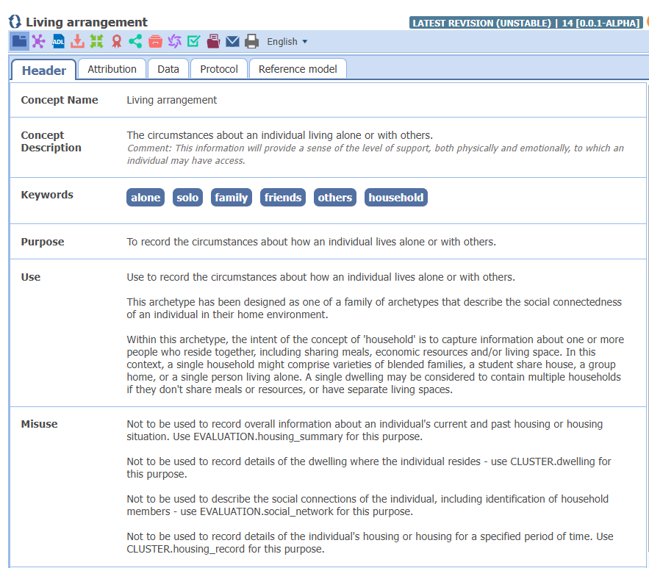
https://ckm.openehr.org/ckm/archetypes/1013.1.3280

Slide 21
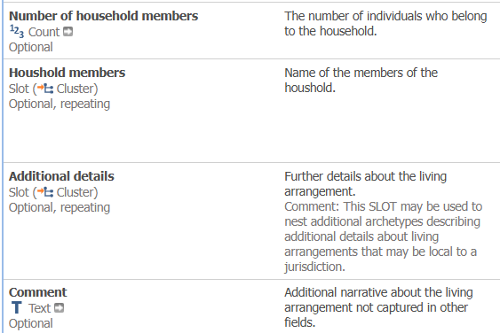
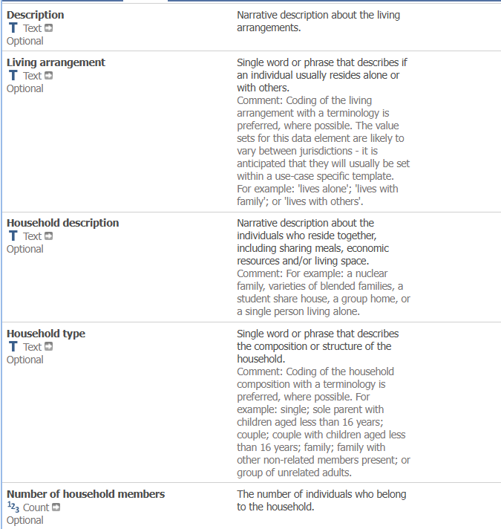
Living Arrangement: Data Elements
https://ckm.openehr.org/ckm/archetypes/1013.1.3280

Slide 22
Distillation
PCHDCF Data Elements | Mapped comparison
Housing Stability : The person’s perceived current housing stability (e.g., stable, mild, moderate) | AUCDI: Housing Stability Status Gravity: Housing Instability – currently housed but marking risk to continued our worsening instability
Housing Type: The person’s current type of housing (e.g., experiencing homelessness, rented accommodation, long-term care) | AUCDI (future) & OpenEHR: Dwelling SPARK: What is your current housing situation?
Household Composition: information about who the person lives with (e.g., parents, children, spouse) | AUDCDI: Living Arrangement SPARK: Who do you live with?
Housing Condition: The physical infrastructure and environmental conditions of the dwelling (e.g., overcrowding, leaking roof, no bath/shower, air conditioning) | AUCDI: Gravity: Inadequate Housing
 | Gravity: Homelessness

