Slide 1
Main theme logo
Social Determinants of Health Working Group
Monthly SDOH Working Group Zoom Meeting
Dec 20th 9am PT / 12pm ET
Facilitated by Jennifer Lawson
Notes:
The logo can be changed in the master slides. Please use the following instructions
Select view > slide master.
Right click on the logo and select change image.
Select the image you want to use you may need to scale the image accordingly.
When you're done, select close master view.

Slide 2

Acknowledgement
We respectfully acknowledge that the land on which we are hosting this meeting – the land that sustains us – includes the ancestral territories of many First Peoples. Canada Health Infoway recognizes the colonial injustices, many of which continue today and continue to affect the health and well-being of Indigenous people. With the working group dedicated to addressing the social determinants of health it brings to light the importance of engaging in anti-colonial actions to address the historical and ongoing inequities experienced by Indigenous communities.We invite all attendees to reflect on the privilege they have of living, working and playing in the territory from which you are joining this call, and to come with an open heart and an open mind in forging culturally safe spaces and relationships.

Slide 3
Agenda
1. Land Acknowledgement 2. Gravity Project and value sets 3. Ontario Mental Health and Addictions Provincial Data Set HL7 FHIR Implementation Guide 4. Group members' involvement in SDoH local, and regional projects - share and tell 5. CIHI updates 6. Other business
Notes:
Summary of our review of the measures on racism and discrimination
Discuss how the measures intersect with racism and discrimination / healthcare access/ material hardship

Slide 4
AMA Meeting
Communicating Social Determinants of Health: A Role for Coding – Dec 8
Presentation by Sarah DeSilvey of The Gravity Project
^{Review slides}
How can this help a Gravity North approach?

Slide 5
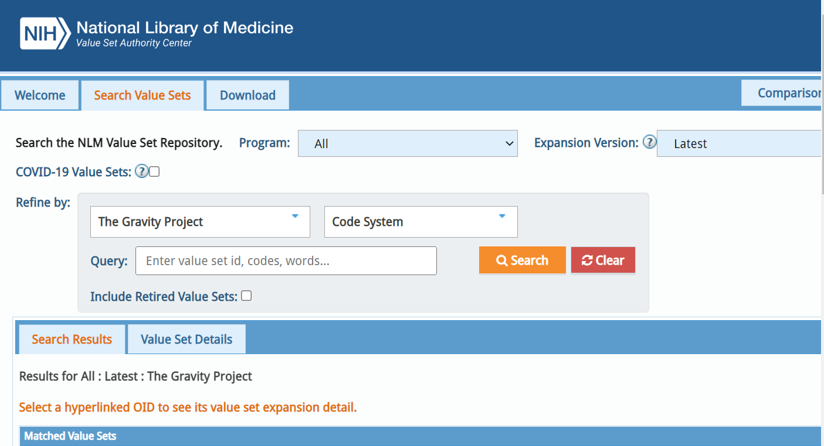
Gravity Project Value Set

Slide 6
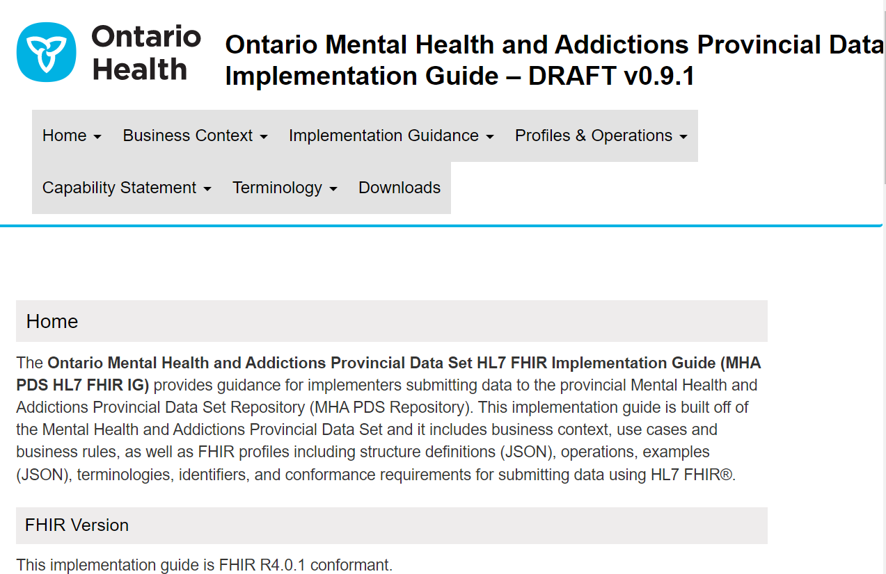
Standards in Action

Slide 7

CISP

Slide 8
Members SDoH Updates
Please share your knowledge, experiences, plans

