Slide 1
Demonstrating the Value of a Patient Summary to Inform Care Delivery and Enable a Better Patient Experience
Partnership Conference 2023, November 15, 2023
Presenter: Dr. Payal Agarwal, MD, CMIO Grand River & St. Mary’s General Hospital
Moderator: Dr. Rashaad Bhyat, Senior Clinical Leader, Canada Health Infoway
Notes:
The logo can be changed in the master slides. Please use the following instructions
Select view > slide master.
Right click on the logo and select change image.
Select the image you want to use you may need to scale the image accordingly.
When you're done, select close master view.

Slide 2


Over the last two decades, Canada has experienced a digital health transformation
Building infrastructure through Electronic Health Records (EHR) in the early 2000’s
Digitization of Health Records via Electronic Medical Records (EMR) in early 2010’s
National shift to prioritizing Virtual Care through the emergence of COVID in 2020
WHERE WE ARE NOW:
Interoperability is laying the foundation for connected care
But a lot more work is needed…

Slide 3






The Shared pan-Canadian Interoperability Roadmap will deliver…
Four Strategic Goals over five years
1
Reducing Data Blocking and Easing Portability
2
Improving Provider Access to Patient Data at Point-of-Care
3
Enabling Patient Access to their Health Record
4
Improving Care Coordination and Collaboration
Supported in the near term through targeted initiatives
Patient Access to Electronic Health Data
e-Referral &
e-Consult
Primary Care Data Portability
Patient Summary

Slide 4






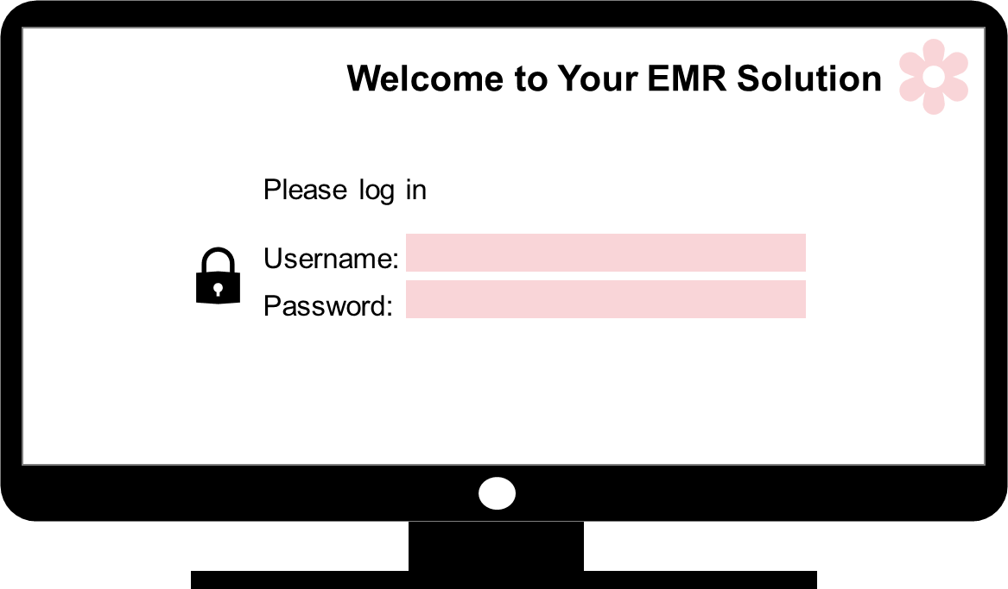
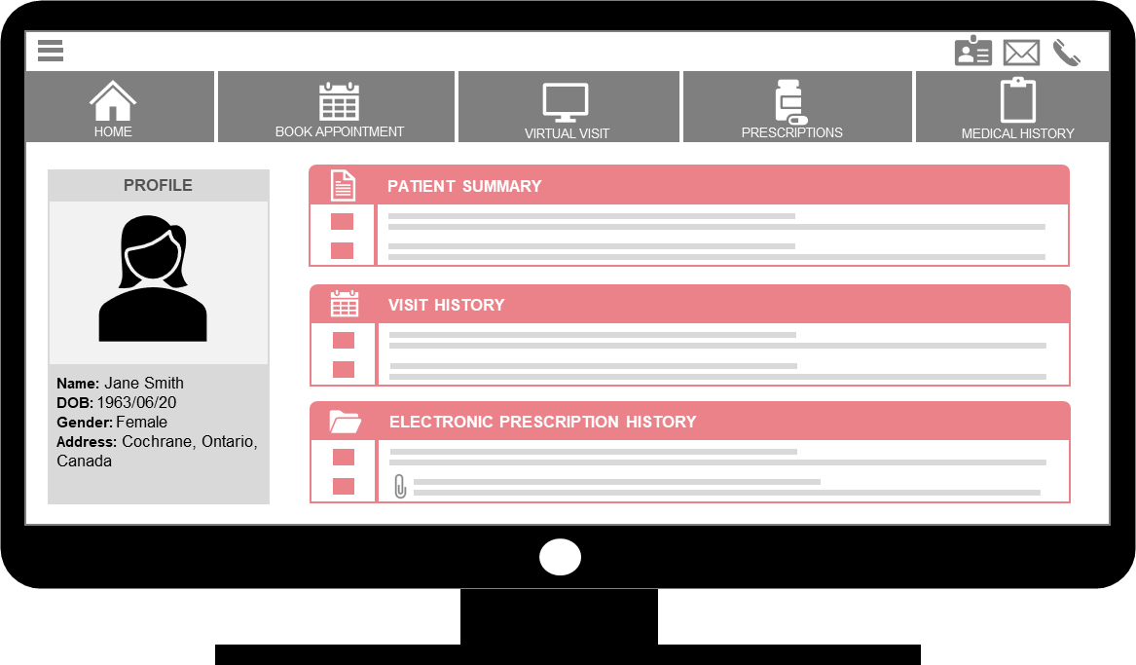
Patient Summary
The pan-Canadian Patient Summary Specification (PS-CA), aligned to the International Patient Summary (IPS), will allow care solutions to contribute pertinent patient health information into clinical repositories (e.g., provincial/regional EHR, CDR, PHR, etc.) to improve health outcomes, and reduce administrative burden for clinicians.
HIS
4

Slide 5
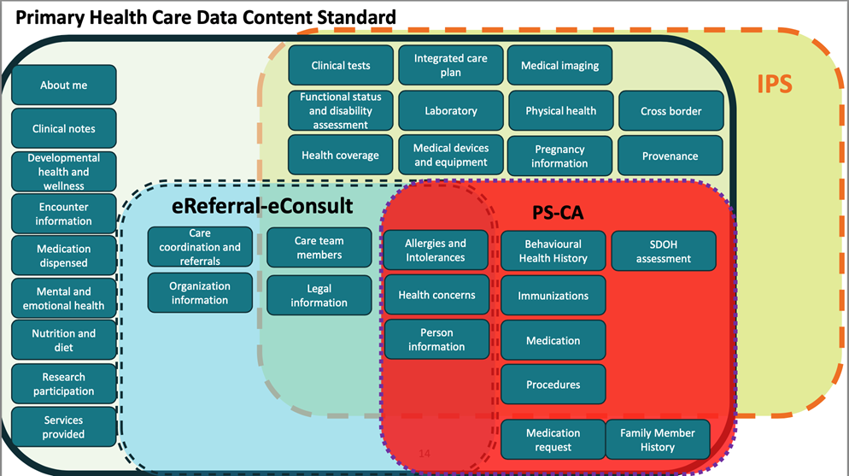

Slide 6
Patient Summary in Practice
Patient summary data is typically collected in primary care settings
  Physicians usually don’t refer to it as the ‘Patient Summary’ (e.g. CPP, Patient History)
  Intended to provide core clinical information about a patient
Data collection / hygiene varies across settings and providers
  This can affect how easily data can be exchanged between systems
The Challenge:
How to standardize data across different EMRs, and enable sharing without interrupting clinical workflows or adding significant work

Slide 7

Physician Burnout and the Administrative Burden
OMA - 72.9 % of physicians experienced some level of burnout in 2021¹
  Solutions included “Making digital health tools a seamless part of physicians’ workflow, including by ensuring different systems can speak to each other” ¹
CFPC - May 2021 survey – increased burnout levels over May 2020
Renewed advocacy from multiple organizations in 2023
  CMA – “Improving Accountability in Health care for Canadians” report
  CFPC, P/T Colleges of Family Medicine - Letter to the Council of the Federation, urging
    “we recommend governments across Canada seek to standardize or reduce forms, update outdated digital health record and referral systems…increase financial support for innovative AI-based solutions that will improve the efficiency of patient visits“²
¹ https://www.oma.org/newsroom/news/2021/aug/ontarios-doctors-report-increased-burnout-propose-five-solutions/
² https://www.cfpc.ca/CFPC/media/Resources/Research/COVID-19-Summary-May2021-ENG.pdf
Notes:
The OMA report includes five solutions to address burnout, starting with reducing and streamlining documentation. Studies have shown that physicians spend two hours on electronic documentation for every one hour of direct patient interaction. Primary care physicians spend about six hours a day recording patient information electronically, both during and after clinic hours.
The other top solutions are:
More work-life balance through flexible work arrangements
Making digital health tools a seamless part of physicians’ workflow, including by ensuring different systems can speak to each other
Support for physician wellness at their workplaces
Fair and equitable compensation for all work, including administrative work that cannot be reduced

Slide 8








How do we support physicians in a time of digital transformation ?
More intuitive digital health and virtual care tools
Support for Education and Training
Invest in change for the long term
      As outlined in…
      “Digital health value realization through active change efforts”¹
¹Bhyat, Hagens, Bryski, and Kohlmaier. Frontiers in Public Health. https://www.frontiersin.org/articles/10.3389/fpubh.2021.741424/abstract

Slide 9
And now…
The Innovation

Slide 10
Art of the of the Possible
Leading edge developments in technology have enabled exciting opportunities to leverage the PS-CA in healthcare
Today we are showing the art of the possible by showing how we can empower a patient care journey using 3 components:
  Interoperable EMR
  Transcription/scribe tool
  Automated Patient Summary PS-CA Tool, powered by AI

Slide 11


The power of a PS-CA tool
A simple tool can automatically generate the PS-CA for clinicians with minimal clicks
  Integrated with EMR for workflow efficiency
  Does not require additional sign-ons
The PS-CA can update the Cumulative Patient Profile
Patient can have immediate access to the PS-CA through integrations with consumer health platforms
Standardized data can be shared with regional data repositories to improve care continuity
HIS

Slide 12

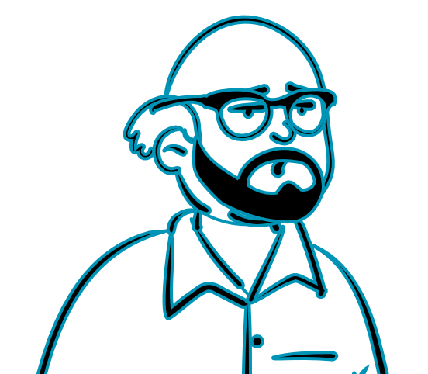



Demonstration: Patient Case
John, 61, has coronary artery disease and dyslipidemia
Currently taking Lipitor (40 mg OD) and Ramipril (2mg OD)
Quit smoking 5 years ago
10 pack-year history
A few years ago he moved to a rural area for work, he recently returned but hasn’t seen his current provider in all that time

Slide 13




Demonstration: Patient Case
3 months ago, before moving back, he experienced a myocardial infarction
Successfully underwent cardiac catheterization
Started on Aspirin (81mg OD) and Metformin (500 mg OD)
* MI = Myocardial Infarction or ‘Heart Attack’

Slide 14
Product Demonstration

Slide 15

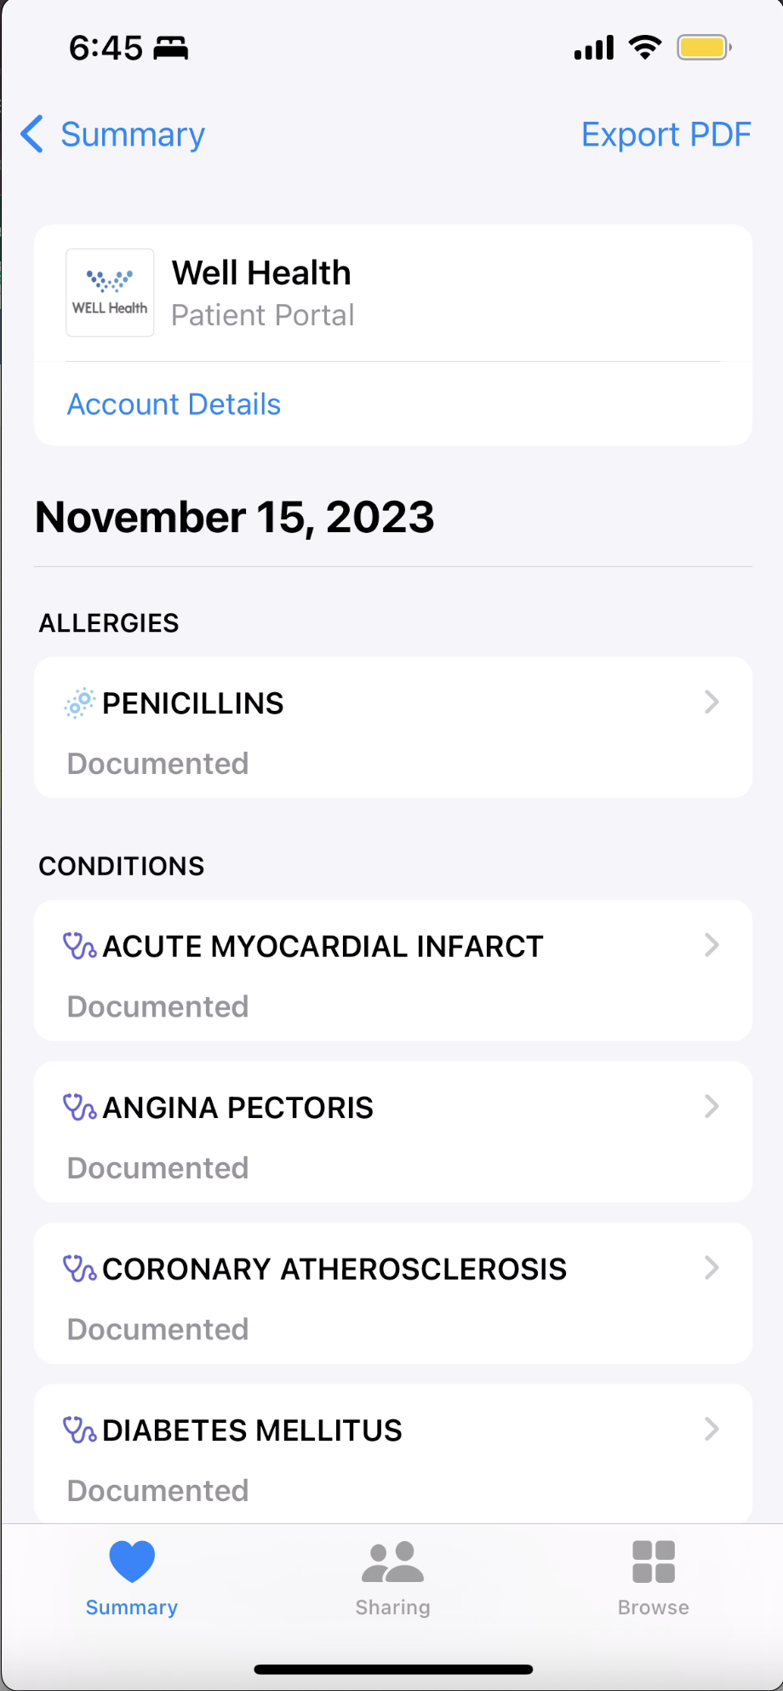



Use Case: Patient Summary in emergency care
He is taken to the nearest hospital via ambulance
John starts to experience severe chest pain and altered status while at a restaurant with his family
John can’t communicate with ER staff; his wife must step in
She is able to pull up John’s patient summary on his cell phone and share his medical history and medication list with ER staff

Slide 16

















The power of the PS-CA
Leverage technology to enable clinicians to quickly generate the data required for the PS-CA
Support empowered patient and care continuity
Standardized data can support improved workflow efficiencies and reduce administrative burden

Slide 17






Questions and Discussion

