Slide 1
Social Determinants of Health Working Group
Monthly SDOH Working Group Zoom Meeting
Apr 9, 2025 - 10 am PT; 11 am MT 1 pm ET
Facilitated by Jennifer Lawson and Brooke Carroll
Notes:
The logo can be changed in the master slides. Please use the following instructions
Select view > slide master.
Right click on the logo and select change image.
Select the image you want to use you may need to scale the image accordingly.
When you're done, select close master view.

Slide 2

Land Acknowledgement
Land acknowledgement​
We would like to acknowledge the lands that we occupy, whether treaty or unceded. We recognize that these lands are home to many diverse First Nations, Inuit and Métis Peoples.
Seed gatherers by Duncan Nagonigwane Pheasant from the M’Chigeeng First Nation of Manitoulin Island

Slide 3
Recording is starting
REC

Slide 4

Agenda
Welcome and introductions to new Members – 10 min
CACDI Tour (10 min)
Review of ON MHA PDS 2.0 (20 min)
SDOH Related Reads
Members inputs on guest speakers (5 min)

Slide 5
Social Determinants of Health Assessment
Definition: A detailed assessment of a person’s needs related to the social determinants of health, including social and demographic information.
Data elements
Service language
Gender Identity
Employment Status
Access to Food
Education Level
Sexual orientation
Financial Stability
Access to Medication
Relationship Status
Sex at Birth
Housing Stability
Access to Internet
PS-CA v1.0
SPARK Tool
BC GSSO Standard
USCDI V5
Racialized Group
Gender Used
Household Composition
Access to a Phone
Ethnicity
Recorded sex or gender
Housing Condition
Access to Transportation
Indigenous Identity
Sex Parameter for Clinical Use
Household Income
Access to Utilities
Religious or spiritual affiliations
Name used*
Access to Childcare
Born in Canada Status
Personal Pronouns*
Social Supports
Time since arrival in Canada
Person No Fixed Address Flag*
Legal History
Experience with Interpersonal Violence
* Denotes data elements that under Person Information data category
Notes:
Other standards/tools compared – Telus Health Equity Questionnaire, Ontario Guidance for Collection and Use of Sociodemographic Data, and Gravity as well.
Priority data elements were found across multiple standards -

Slide 6
Methods
Goal: Identify if there are matches in SNOMED CT or LOINC for the responses to the questions in the SDOH questionnaire.
Approach:
Look for any existing curated value sets to adopt or adapt.
Searched SNOMED CT CA, LOINC to identify
Any lexical matches to responses
Similar matches
Need for new synonym proposal
Need for new concept proposal
Consult with SDOH WG, Terminology team, Subject matter experts,
Clinicians, Community
We are here
Notes:
Goal: Identify if there are matches in SNOMED CT for the responses to the questions in the SDOH questionnaire.
Approach: Three C&T specialists and the Program Lead reviewed the responses and searched the
SNOMED CT CA to identify any lexical matches. When there was no lexical match further review was undertaken to determine if there were "similar" matches in SNOMED CT where the response could be considered a synonym to the SNOMED CT concept. The specialist identified this in the synonym column for consideration. The team utilized the Finding hierarchy in SNOMED CT. When there was no lexical match and no similar concept, the specialist provided a suggestion for a new SNOMED CT concept and the associated parent for consideration as a submission to Canada Health Infoway. In the instances where the response was "yes" or "no" , "Not applicable" etc.., the suggestion was to consider using an HL7 value for these responses. Additional comments were provided for consideration of whether or not a "yes", "No" value is enough where the response has specific information, such as "included in rent".

Slide 7
Canadian Core Data for Interoperability (CACDI) Version 1 was published March 27th
Foundation for seamless exchange of high-quality health data across the country, ensuring a more connected and efficient healthcare system for all Canadians
Ready for implementation
Scope
23 patient-centric data elements (e.g., patient information, allergies, immunizations, medications, health concerns, and SDOH)
Download CACDI Version 1 (PDF)
Download the CACDI Logical Data Model (PDF)
HTML version of the CACDI Logical Data Model
Products of the Pan-Canadian Health Data Content Framework

Slide 8
ON MHA
PDS 2.0
Broad overview of the standard
Comparisons on Data Elements with the PCHDCF
Comparisons on value sets with PCHDCF

Slide 9
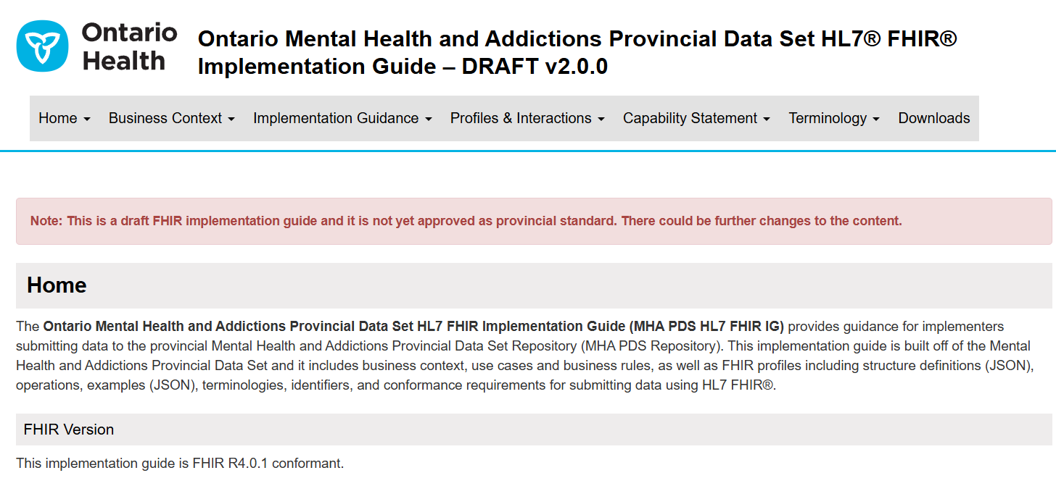
ON MHA PDS Draft v 2.0.0
Link: Ontario Mental Health and Addictions Provincial Data Set HL7® FHIR® Implementation Guide – DRAFT v2.0.0

Slide 10
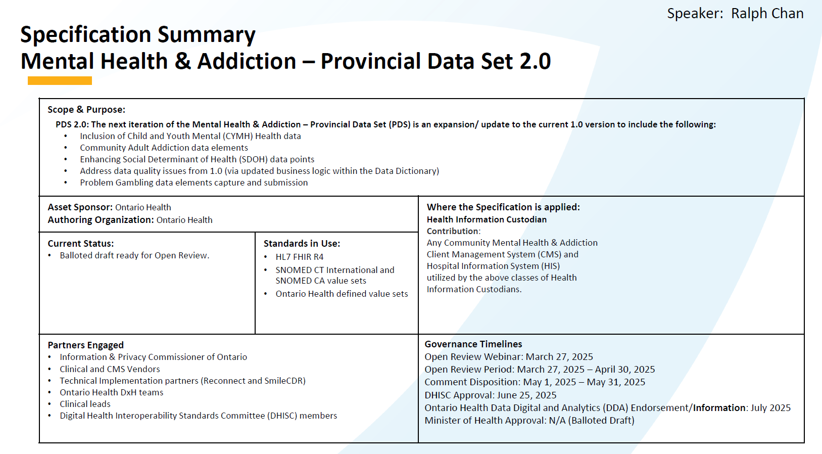
ON MHA PDS v 2.0

Slide 11
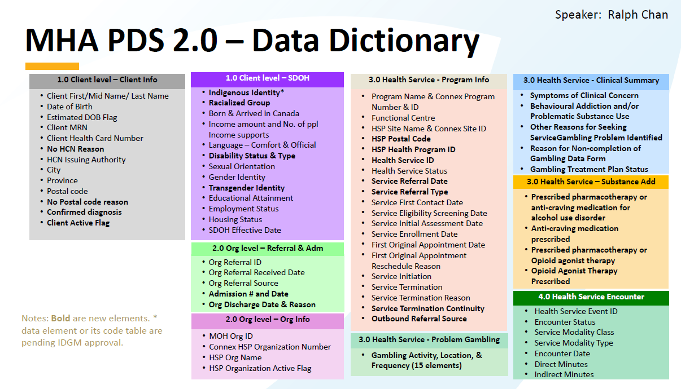
ON MHA PDS v 2.0

Slide 12
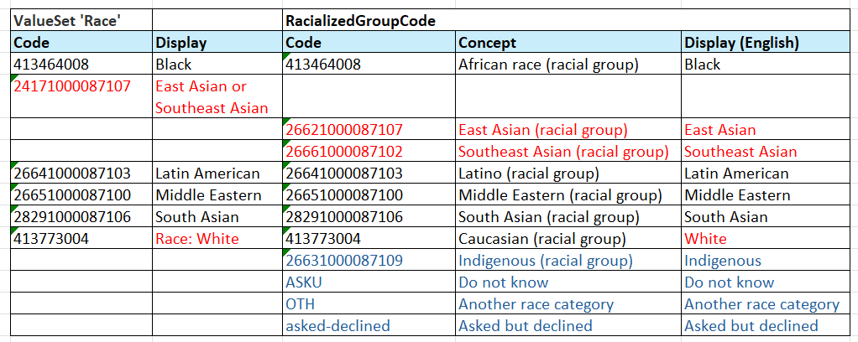
ON MHA PDS v 2.0 : PCHDCF Data Content Standard Racialized Group
Data Element: Racialized Group
Data Element: Racialized Group* (CACDI)

Slide 13
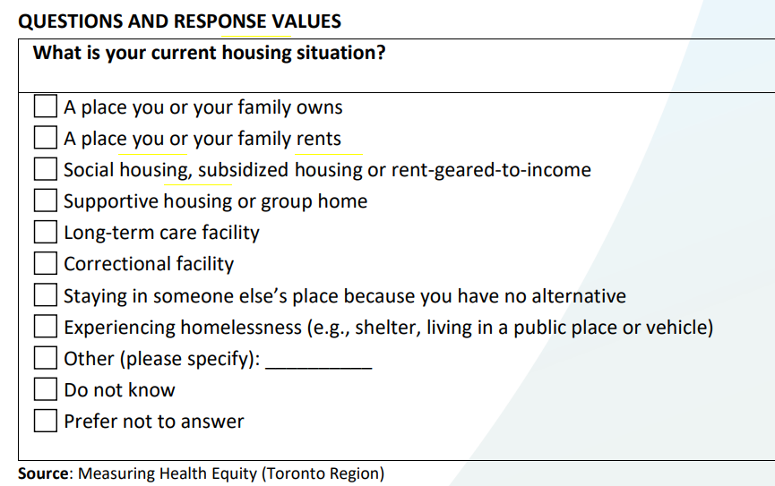
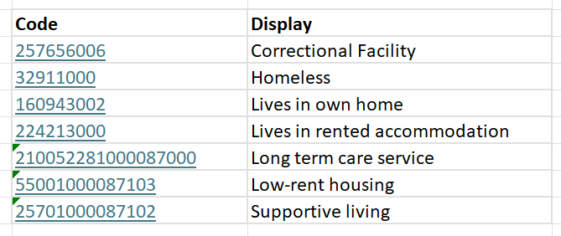
ON MHA PDS draft v 2.0.0 : PCHDCF Data Content Housing Status
PCHDCF:
Housing Status: Identifies what the client's current housing status is. Housing status refers to whether an individual owns or rents their residence, lives in social or subsidized housing, or in a facility, or is underhoused or experiencing homelessness
ON MHA PDS draft v 2.0.0
Housing Status: Identifies what the client's current housing status is. Housing status refers to whether an individual owns or rents their residence, lives in social or subsidized housing, or in a facility, or is underhoused or experiencing homelessness

Slide 14
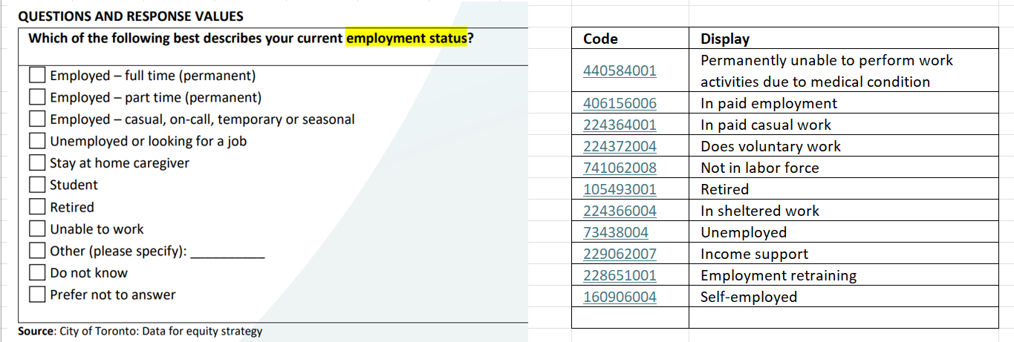
ON MHA PDS draft v 2.0.0 : PCHDCF Data Content Standard Employment Status
PCHDCF:
Employment Status: Identifies the employment status that best describes the client's current situation. Employment status refers to an individual’s current participation in the labour force.
ON MHA PDS draft v 2.0.0
Employment Status: Identifies the employment status that best describes the client's current situation. Employment status refers to an individual’s current participation in the labour force.

Slide 15
SDOH and Standards Relevant Reads
The Gravity Project Overview - Confluence
Gravity Brief: an overview of how employing a standardized approach to screening for, documenting and coding social risk factors and needs will enable healthcare providers and organizations to track the social needs that impact their patients, allowing for personalized care that addresses patients' medical and non-medical needs; aggregate data across patients to determine how to focus a social determinants strategy; and identify population health trends and guide community partnerships.
Gottlieb LM, Hessler D, Wing H, Gonzalez-Rocha A, Cartier Y, Fichtenberg C. Revising the Logic Model Behind Health Care's Social Care Investments. Milbank Q. 2024 Jun;102(2):325-335.
Discusses how increased awareness of patients’ social conditions in the health care sector may influence health and health care utilization outcomes.
Proposed a more expansive logic model to explain the impacts of social care programs and inform future social care program investments and evaluations.

